Slide 1
IRE … Turkish Foreign Policy
Assist. Prof. Saffet Akkaya
Course hours: ???
saffetakkaya@cag.edu.tr
Week 11: Turkish Foreign Policy During Cold War (1945-1960)

Slide 2
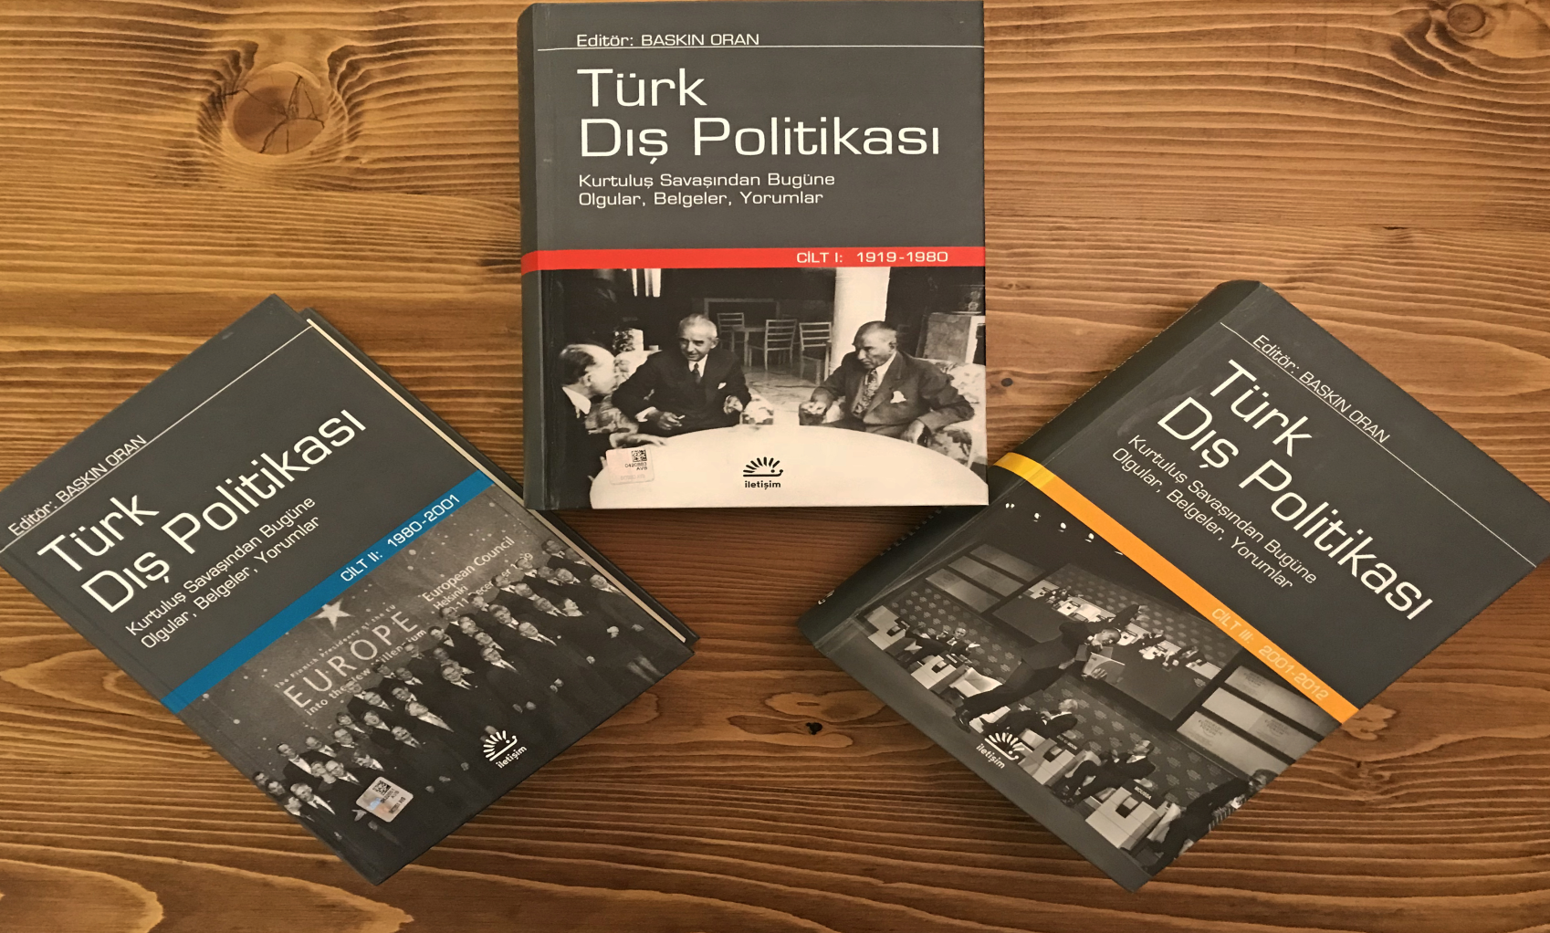
Main Source for the Course
Türk Dış Politikası Vol 1, 2, 3
Ed. Baskın Oran
Türk Dış Politikası Vol 1: Pages 479-612

Slide 3
Bi-polar System (Cold War)
When World War II ended, the multipolar world system ended, and a bipolar system began.
The foundations of a new international environment were being laid not only for Europe but for the entire world.
Europe was no longer the dominant force in world politics, but was effectively divided by its new rivals, the USSR and the USA.
Europe had become a subsystem within the world system. The new system was called a bipolar world system, and it was built on three principles:

Slide 4
Bi-polar System (Cold War)
Political Leg:
  The United Nations, the most universal and comprehensive organization ever established, had been established.
  The year was 1945, and it had no universality beyond the General Assembly.
  Because political power was in the hands of the Security Council, composed of the victorious states.

Slide 5
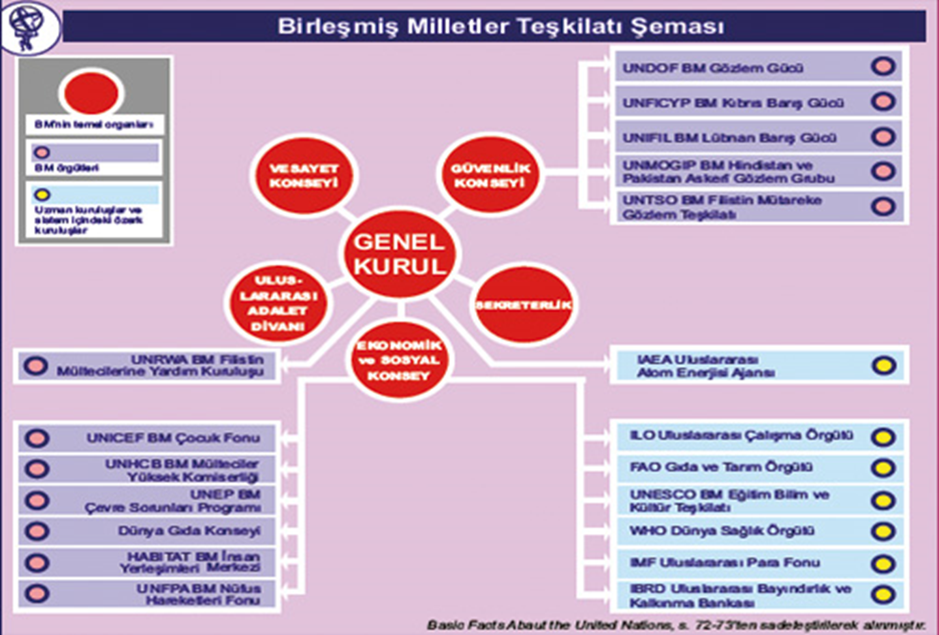
United Nations

Slide 6
Bi-polar System (Cold War)
Military Leg:
  Because the victors of the war in Europe were the USSR and the US, military polarization emerged around these two states.
  The two military blocs of the Cold War, NATO and the WARSAW Pact, were established during these years.
  The most challenging years of the Cold War were between 1945 and 1965.
  Founding members of NATO: USA, Canada, United Kingdom, France, Italy, Portugal, Denmark, Iceland, Norway, Belgium, Netherland, Luxembourg.

Slide 7
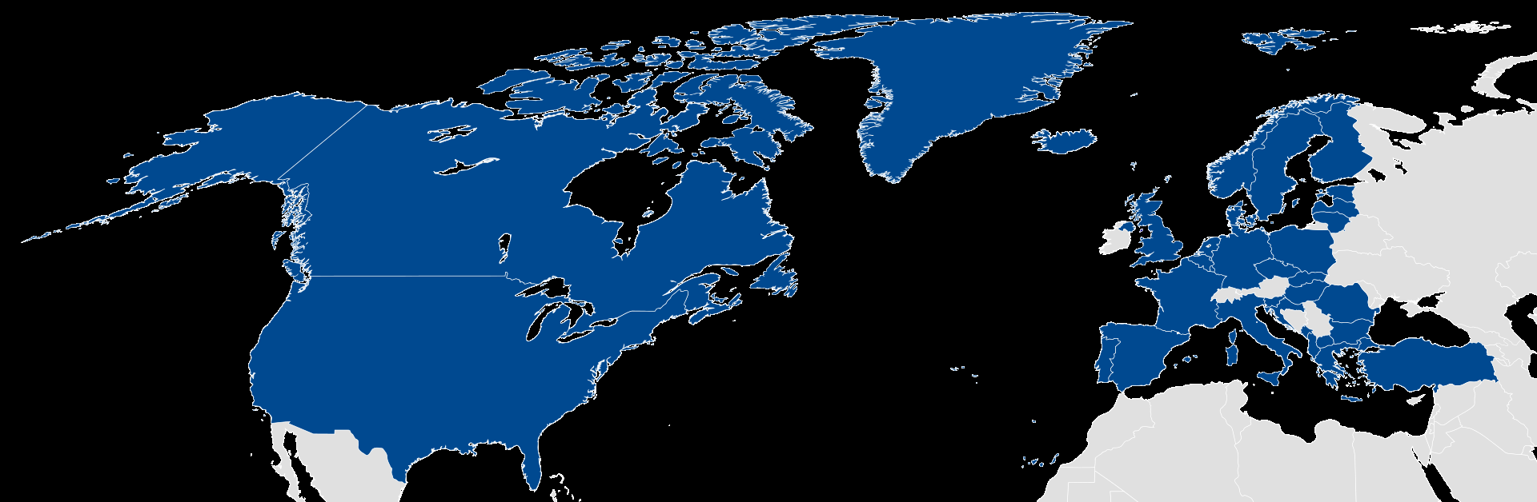
NATO
(1949) 12 Member States
(2025) 31 Member States

Slide 8
Bi-polar System (Cold War)
Economic leg:
  The communist economic cycle would begin to turn under the leadership of the USSR, and the capitalist economic cycle would begin to turn under the leadership of the US.
  In 1947, in response to the US's Truman Doctrine and Marshall Plan, the USSR established the Cominform and COMECON.
  The capitalist economic cycle began to be driven by the US through three different institutions.
  The International Monetary Fund (IMF) ensured international monetary discipline, the World Bank ensured international credit discipline, and the Customs and Trade Agreement (GATT) ensured global free trade discipline.

Slide 9
Internal Environment and Dynamics in Turkey
By the end of World War II, Turkey had fallen into economic, political, and social turmoil and destitution.
While the war had not begun, and the country's already weak economy and infrastructure had not been destroyed, its weak economy had deteriorated further, and the social fabric had been distorted to the detriment of farmers, workers, and civil servants.

Slide 10
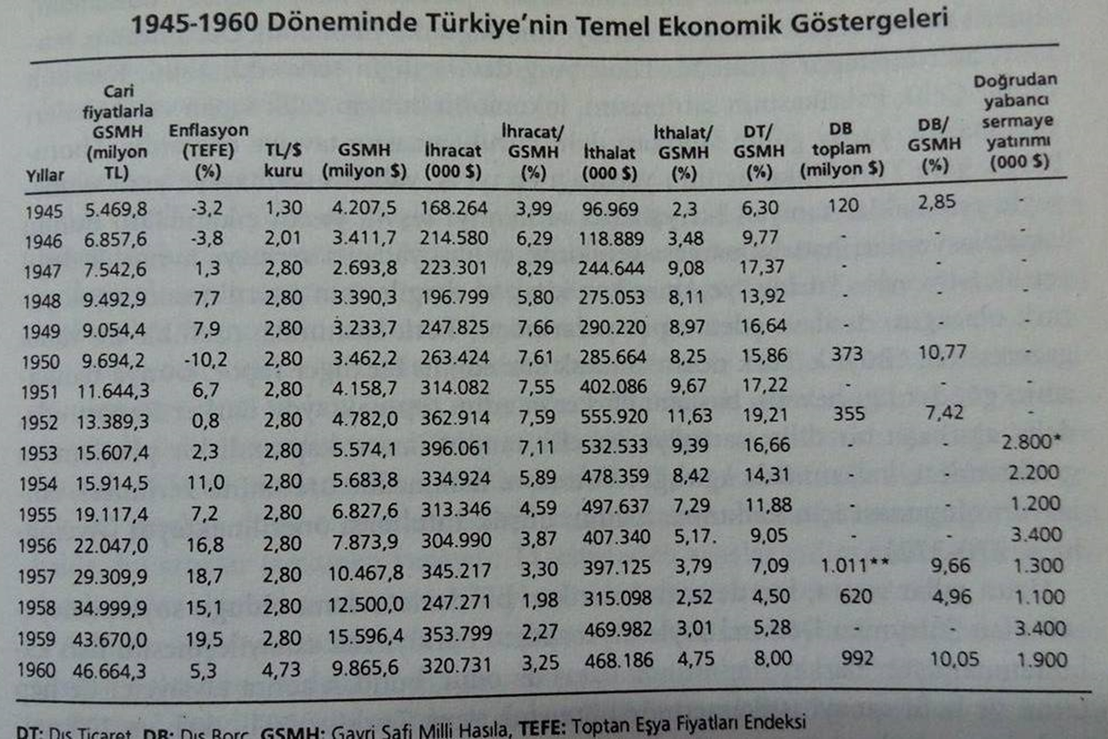
Internal Environment and Dynamics in Turkey

Slide 11
Internal Environment and Dynamics in Turkey
The economic picture between 1948 and 1958 can be summarized as follows.
As can be seen from the table, trade was revitalized thanks to Marshall Aid, and Turkey became a food and raw material supplier to Western Europe.
In accordance with US policies and reports, the statist policy based on import substitution industrialization, which began in the 1930s, would be abandoned.
As a result, imports and exports would increase, just as they did between 1923 and 1930, but the foreign trade deficit would be detrimental to our country.

Slide 12
Internal Environment and Dynamics in Turkey
Agricultural production had increased. Thanks to foreign loans, the number of agricultural implements and tractors had increased.
For example, the number of tractors, which was 1,000 in 1945, rose to 40,000 in 1954.
Money was flowing into the villagers' pockets. National income increased by around 30% between 1950 and 1953.
Turkey had become the fruit, vegetable, and grain warehouse of Western Europe.
Continuous loans were received from the IMF, and the central bank's own resources were used for this purpose.

Slide 13
Internal Environment and Dynamics in Turkey
However, this was a reckless expansion. It was a policy of a state lacking an industrial infrastructure, targeting only the agricultural sector with foreign loans.
As a result of this policy, inflation rose, as can be seen in the table. The imbalance between imports and exports created a need for foreign currency, and foreign borrowing began to be used to defer IMF debt and meet the agricultural sector's spare parts needs.
The Turkish economy was now governed by IMF prescriptions.
In 1958, the exchange rate of one dollar rose from 3 TL to 9 TL, $250 million in new debt was borrowed, and $600 million in IMF debt was deferred.

Slide 14
Internal Environment and Dynamics in Turkey
This agreement between the Turkish government and the IMF was identical to the terms offered to the Ottoman Empire when it sought a loan from England in 1854.
(Reductions in public spending, the cessation of printing unissued currency, a reduction in the number of civil servants, and judicial reform to combat corruption).
From 1958 onwards, Turkey would resume import-substitution industrialization due to a lack of foreign goods.
However, this industrialization effort would not be sufficient to keep the wheels of the economy turning. Turkey was now forced to seek new loans to repay its debts.
The social impact of this economic situation would be a migration from rural areas to urban areas.

Slide 15
Foreign Relations
The USSR's three demands on Turkey at the trilateral conference held in Crimea/Yalta in 1945 created a security problem for Turkey.
Parallel to this, a deteriorating economic structure and US aid and security policies also led to Türkiye's alignment with the Western camp.
First the Korean War (1950) and then its accession to NATO (1952) were significant milestones for Türkiye.

Slide 16
Foreign Relations
Turkey's entry into NATO also proved problematic.
Turkey applied to NATO twice in 1949 and 1950, but this request was rejected by the United Kingdom and the Scandinavian countries.
Turkey saw the Korean War as an opportunity to join NATO, and 721 of the soldiers it sent to the first brigade suffered martyrdom.
From this date on, Turkey's national economy and objective, balanced, and independent foreign policy goals would be eliminated.

Slide 17
Foreign Relations
Some examples of Turkish foreign policy during this period can be summarized as follows:
  - A pro-Israel foreign policy and the disappointment of the Arab world
  - Supporting Britain in the Cyprus issue since 1950
  - Striving to avoid bringing the Algerian issue to the UN agenda since 1954
  - Taking part in the Baghdad Pact in 1955 and opposing the Arabs
  - Pro-US stance at the 1955 Bandung Non-Aligned Conference
  - Siding with Britain and France during the Suez Crisis of 1956
  - Allowing the US to use bases in Türkiye while landing troops in Beirut in 1958
  - Being exposed to the threat of a nuclear attack during the U-2 incident in 1960 and the Cuban Missile Crisis of 1962

Slide 18
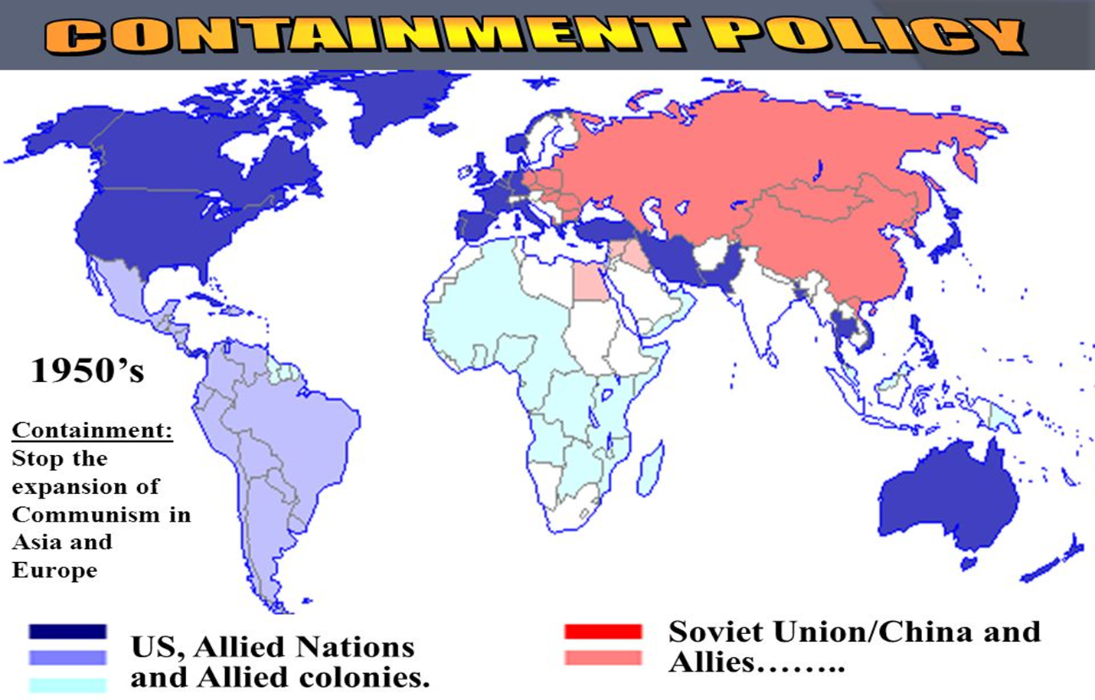
American Containment Policy

Slide 19
Relations with USSR
The Soviet Union emerged from the war victorious, but essentially a devastated country.
Economic indicators had recovered. After the war, it began to restructure with a new ideology.
It began to exert political pressure on Turkey, along with Eastern European countries.
After the war, it informed the Turkish side that it would no longer extend the 1925 Soviet-Turkish Cooperation Agreement and presented three conditions for the new agreement:
  The transfer of Kars and Ardahan to the Soviets,
  The granting of a base in the Straits,
  The relocation of Montreux.

Slide 20
Relations with USSR
Turkey rejected these demands.
Turkey realized that conditions were no longer as they had been in 1939, and now faced a powerful state.
The publication of articles by two Georgian professors demanding territory from Türkiye in Pravda and Izvestiya further escalated tensions.
  Ardahan,
  Artvin,
  Tortum,
  Ispir,
  Bayburt,
  Gümüşhane,
  Trabzon,
  Giresun

Slide 21
Relations with USSR
The USSR's pressure on two Mediterranean countries, Greece and Turkey, led the US to include them in the NATO security and Marshall Aid umbrella.
This period also marked a time when Turkey attempted to distance itself from communist ideology.
Joining NATO was perceived as a national issue.

Slide 22
Relations with USSR
There was a thaw in relations between the USSR and Turkey after Stalin.
The main reason for this was the death of Stalin, who had pursued an uncompromising and confrontational foreign policy, and the replacement of the more moderate Khrushchev.
After Stalin, the USSR leaders adopted three new principles in domestic and foreign policy:
  A thaw in international relations,
  Restructuring the economy,
  Development of the peasantry.

Slide 23
Relations with USSR
As part of this policy, the USSR issued a diplomatic note to Türkiye in 1953, officially renouncing its 1945 demands.
This marked the beginning of a new era between the two countries.
However, problems still arose from time to time during this period.
The US's foreign policy practices, in line with its "Containment" policy, also affected Turkey, and therefore Turkish-Soviet relations.
Türkiye took some steps to counter the Soviets' policies of increasing influence in the Middle East.

Slide 24
Relations with USSR
During the Syrian and Iraq crises, the USSR personally warned Turkey, through Khrushchev, against being too much under US control.
The U-2 spy plane and Cuban crises between the US and USSR in the late 1960s, which brought the two countries to the brink of war, also soured Turkish-Soviet relations, making Turkey a target in the event of a nuclear war.
Adnan Menderes' planned visit to Moscow in 1960 was also thwarted due to the May 27 military coup.

Slide 25
Relations with Greece
Turkish-Greek relations reached a positive level in the 1930s and developed in an atmosphere of cooperation and security under the leadership of Atatürk and Venizelos.
The Balkan Pact and bilateral economic initiatives were positive approaches that continued until World War II.
Despite both the 1934 Balkan Pact and the bilateral agreements signed between the two countries, Turkey did not assist Greece when it was invaded by either Italy or Germany.
It remained neutral towards Greece during the war but did not support it.
The wealth tax imposed on the Greek minority and the compulsory military service were also criticized.

Slide 26
Relations with Greece
However, during the Cold War, there was a rapprochement between the two countries.
This was because the national interests of both countries began to align with Western interests.
One of the issues between the two countries was the transfer of the Dodecanese islands, which had been held by Italy since 1911, to Greece.
Because Britain also sided with Greece, the islands were transferred to Greece in 1947, on the condition that they be demilitarized.

Slide 27
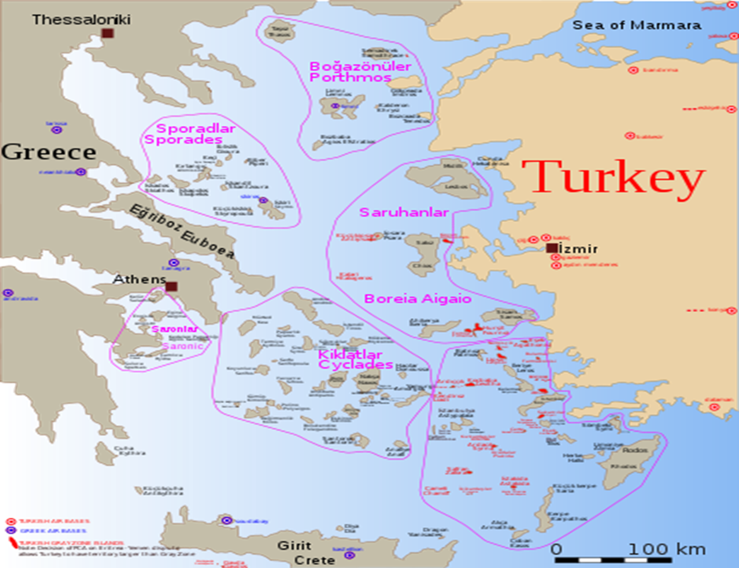
Relations with Greece

Slide 28
Relations with Greece
The 1950s and 1960s marked a period of friendship between the two countries.
In 1954, the Balkan Alliance was established between Turkey, Greece, and Yugoslavia, with the encouragement of the United States.
The independence-neutrality policy pursued by Marshal Tito influenced the formation of this alliance.
It was a requirement of the US policy of containment. The Balkan Alliance was a defense mechanism formed by three Balkan countries, which perceived a threat from the USSR but had no conflict with each other, with support from the West.

Slide 29
Relations with Greece
From the 1960s onward, Turkish-Greek relations would continue under the shadow of the Cyprus issue.
The island of Cyprus held strategic importance for Britain, which assumed a sovereign-leadership role in the Middle East.
Greek Cypriots also had a goal of Enosis and constantly fostered this goal.
When the terrorist organization EOKA, aiming to unite Cyprus with Greece, began its intimidation and killings on the island, the events of September 6-7 occurred in Türkiye.
Greek Cypriot businesses and homes were burned in Istanbul. Two elderly Greek Cypriots lost their lives and 35 people were injured.

Slide 30
Relations with Greece
Negotiations between the two countries and the United Kingdom to find a solution to the problem continued until 1960.
The aim was to resolve the issue as a Republic of Cyprus.
The atmosphere created by the Zurich and London conferences culminated in the London Treaty.
Accordingly, Cyprus would be a republic governed by a presidential system, with a Greek Cypriot President and a Turkish Vice President, official languages ​​would be Greek and Turkish, and the 50-member parliament would be 70% Greek Cypriot and 30% Turkish.

Slide 31
Relations with the Middle East
The cornerstones of Türkiye's relations with the Middle East during this period were the 1955 Baghdad Pact, the 1956 Suez Canal Crisis, the 1957 Syrian Crisis, and the 1958 Iraqi Coup.
In fact, Turkey's pro-Western stance within the bipolar world order offended Middle Eastern countries.
Türkiye's Middle East policy developed in line with this resentment, the USSR's Middle East policies, and the US's containment policies.

Slide 32
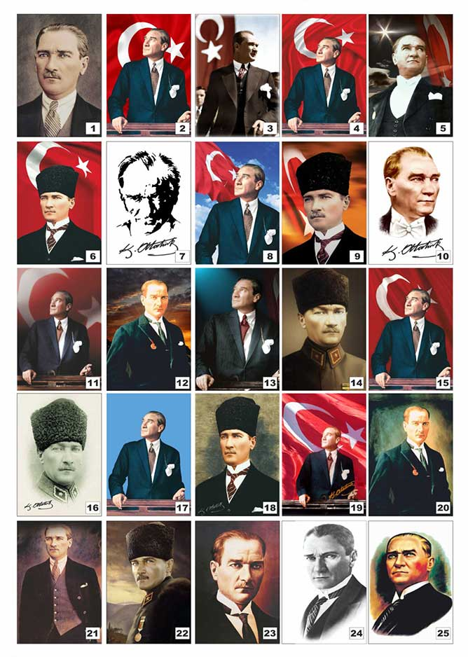
Questions?

