Slide 1
CHAPTER1 : AN OVERVİEW OF HEALTHCARE MANAGEMENT
Jon M. Thompson, Sharon Buchbinder, and Nancy Shanks

Slide 2
Mid term exam
% 30
Essays& multiple choices
Seminers
attending invited speakers sessions & Dr. Koral Çepni’s lecture.
% 20
projects
% 30 Detailed in the lecture
%20 Detailed in the lecture

Slide 3
hospitals
Which is better?

Slide 4
Hospitals

Slide 5
http://www.medlineadana.com.tr

Slide 6
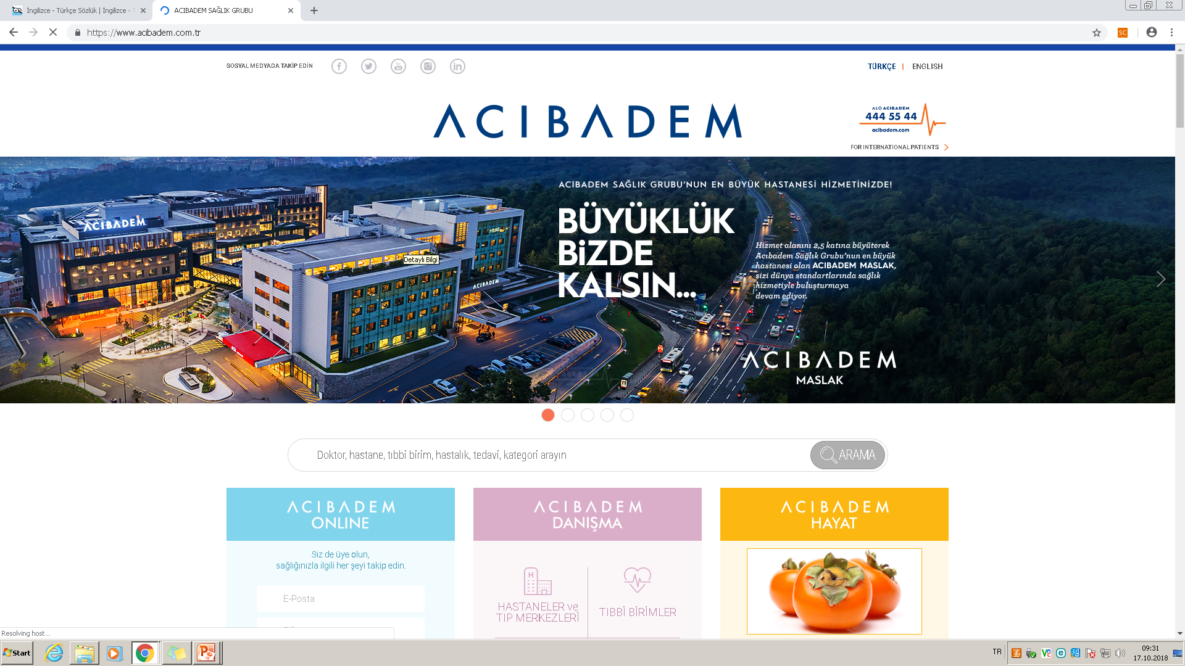

Slide 7
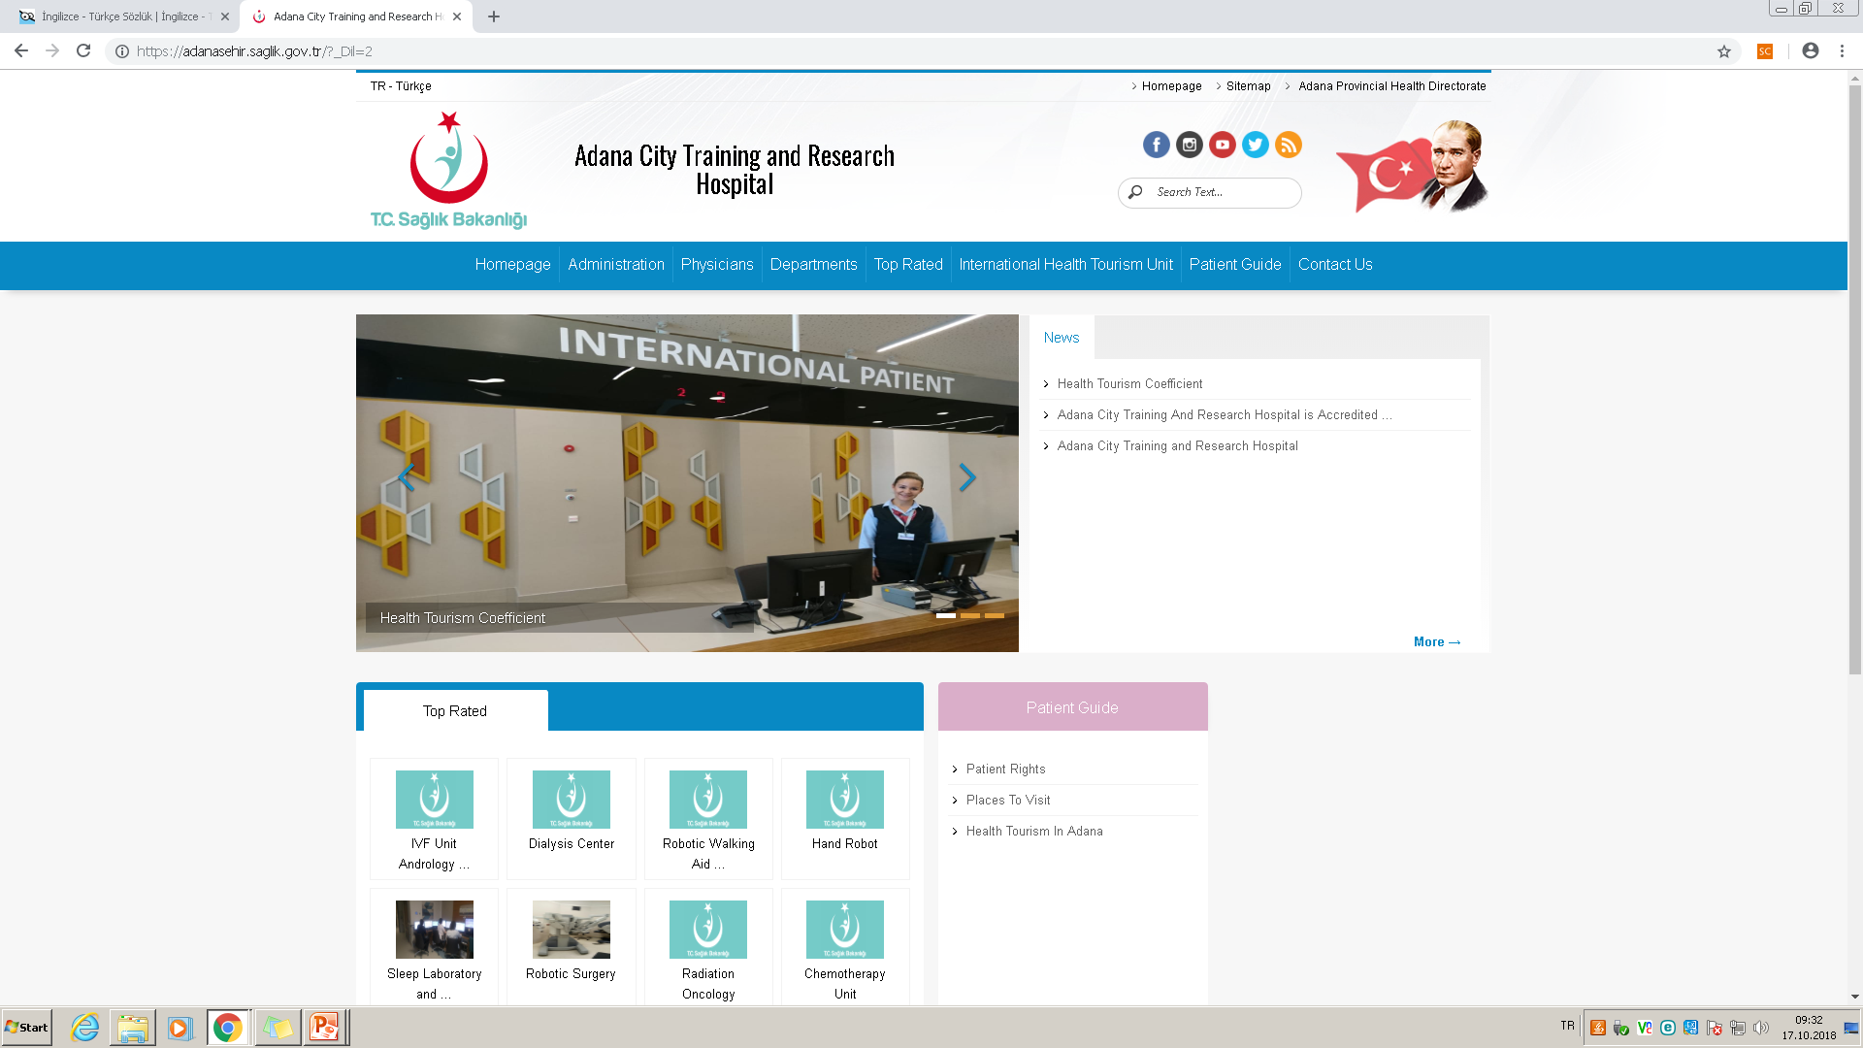

Slide 8
Learning objectives
Define healthcare management and the role of the healthcare managers.
Differentiate among the functions, roles and responsibilities of healthcare managers.
Compare and contrast the key competencies of healthcare managers
Identify current areas if research in healthcare management.

Slide 9
Care setting | explanation
Direct : | those organizations that provide care directly to a patient, client, residence who seeks services from the organization.
Non-direct: | are not directly involved in providing care to persons needing health services, but rather support the care of individuals through products and services made available to direct care settings.

Slide 10
Healthcare Management;
HCM provides significant rewards and personal satisfaction for those
-who want to make a difference in the lives of others.
is the profession that provides leadership and direction to organizations that deliver personal health services to divisions, departments units or services within those organization.

Slide 11
Healthcare organizations (HCO)
Are complex and dynamic
The scope and complexity of tasks carried out in provision of services are so great that individual staff operating on their own
The necessary task in producing services, in HCO requires the coordination of many highly specialized disciplines

Slide 12
The rule: Decisions made by an individual manager impact the organization’s overall performance. ;
Healthcare managers
are appointed to positions of authority, where they shape the organization by making important decisions
recruitment and development of the staff,
Acquisition of the technology,
Service additions and reductions
Allocation and spending of financial resources

Slide 13
Domains of Healthcare Services

Slide 14
is anyone in the organization who supports and is responsible for the work performance of one or more other persons.
the process, comprised of social and technical functions and activities, occurring within organizations for the purpose of accomplishing predetermined objectives through human and other resources.
Management | Manager

Slide 15
Managerial positions in healthcare

Slide 16
Management functions

Slide 17
Functions | Explanation
Planning: | requires the manager to set a direction and determine what needs to be accomplished. İt means setting priorities and determining performance targets.
Organizing: | refers the overall design of the organization or the specific division, unit
Staffing: | refers to acquiring and retaining human resources.
Controlling: | refers to monitoring staff activities and performance , making the appropriate actions for corrective action to increase performance
Directing: | the focus is on initiating action in the organization through effective leadership and motivation of, and communication with, subordinates.
Decision making: | is critical to all of the aforementioned management functions and means making effective decisions based on consideration of benefits and the drawbacks of alternatives.

