Slide 1
Social CRM

Slide 2
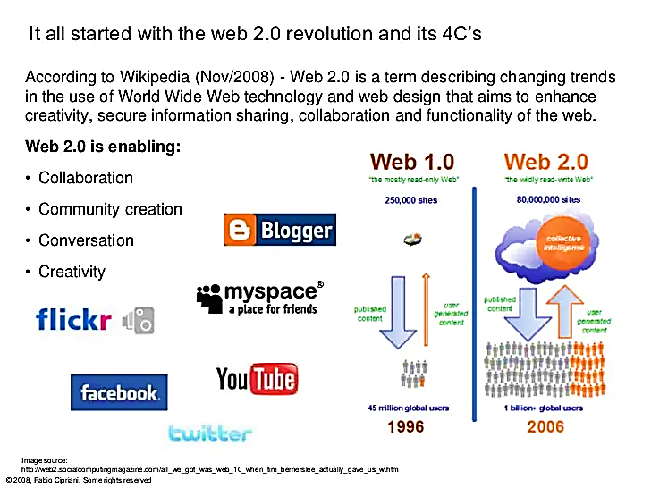

Slide 3
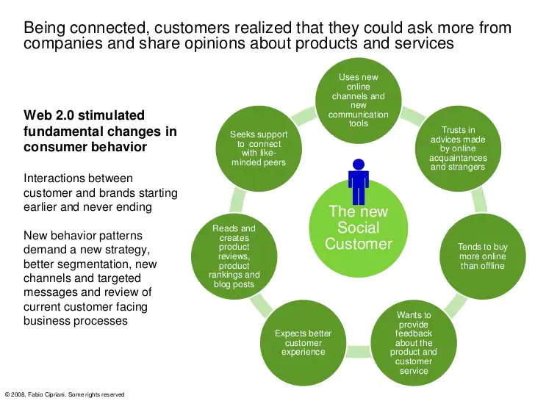

Slide 4
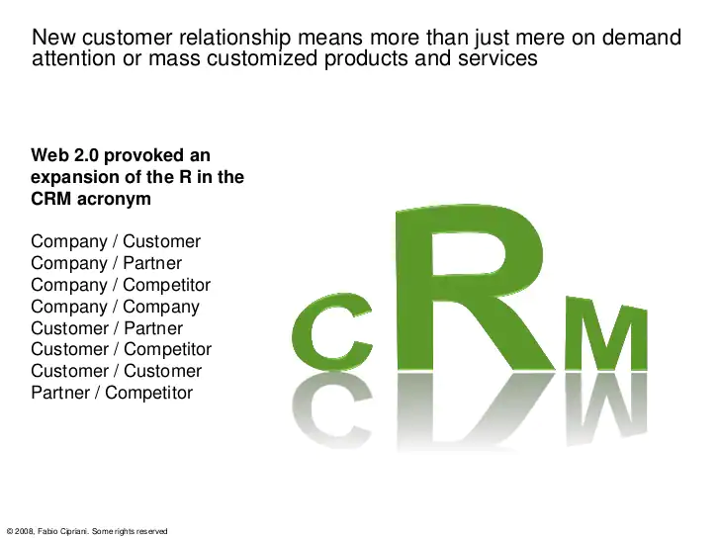

Slide 5
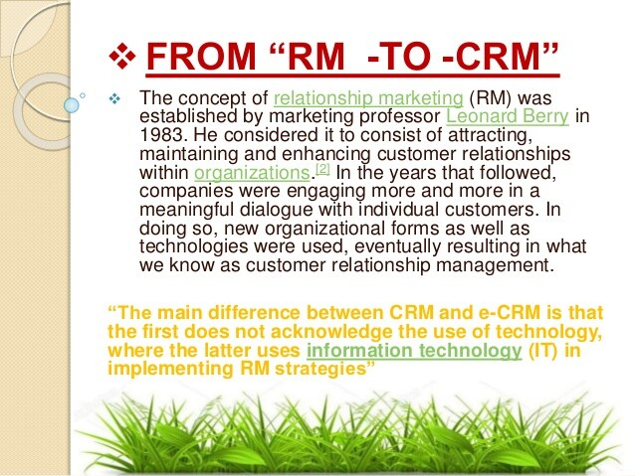
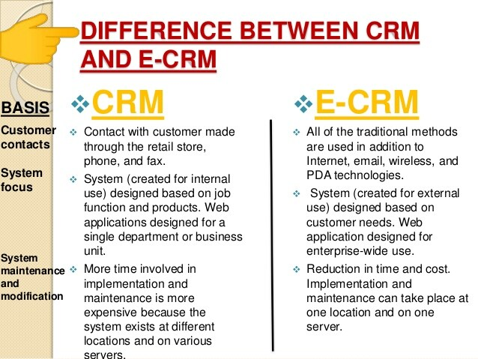
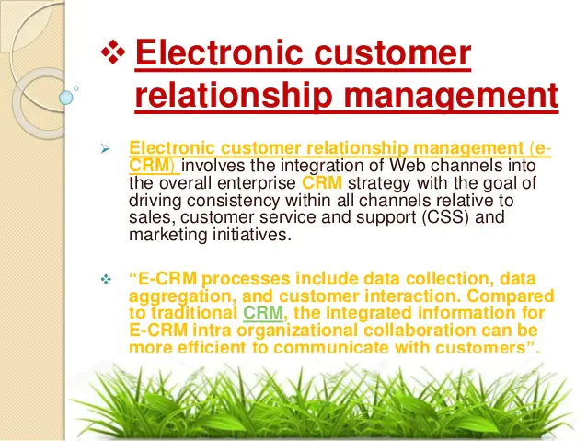

Slide 6
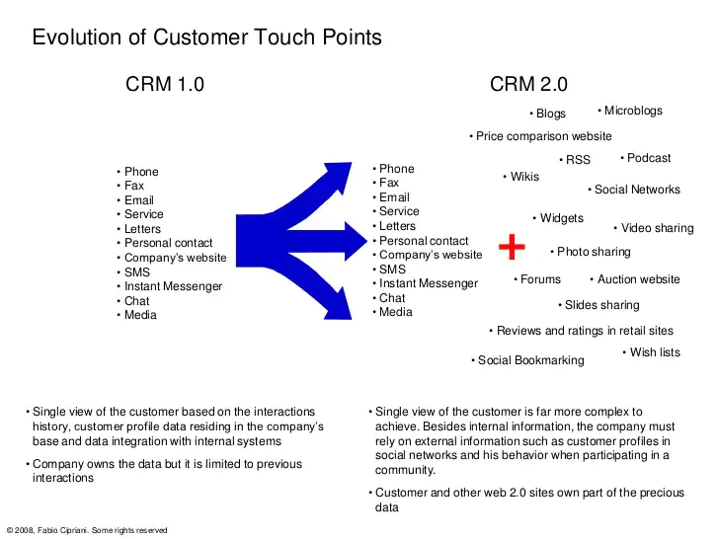

Slide 7
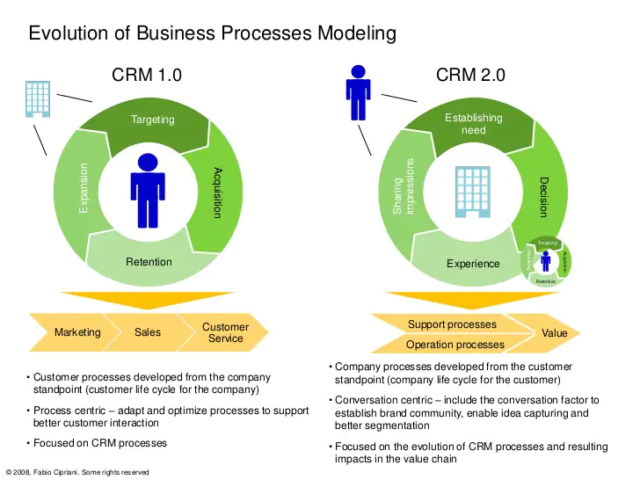

Slide 8
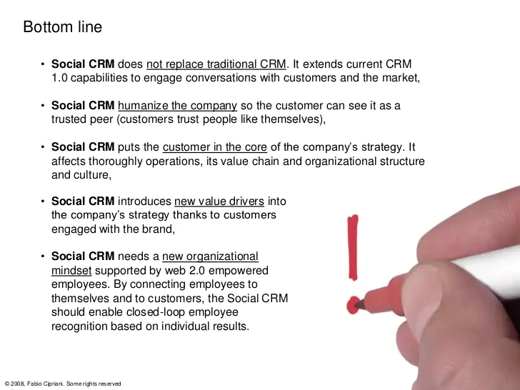

Slide 9
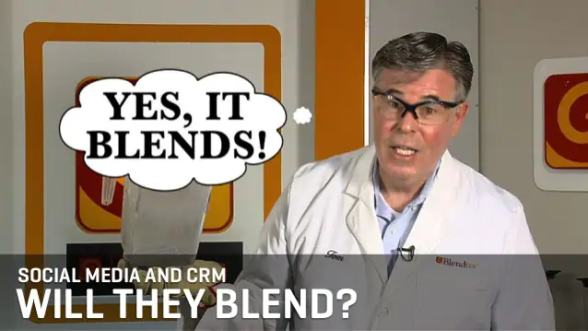

Slide 10
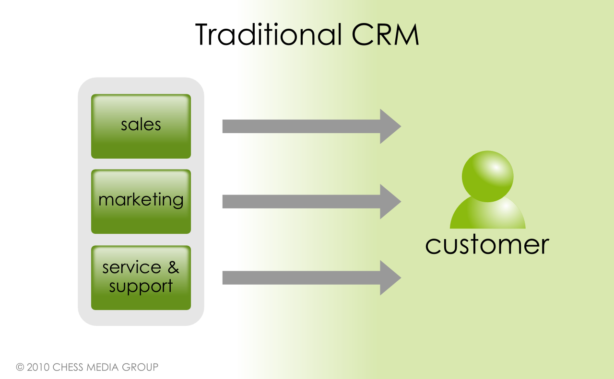
Traditional CRM

Slide 11
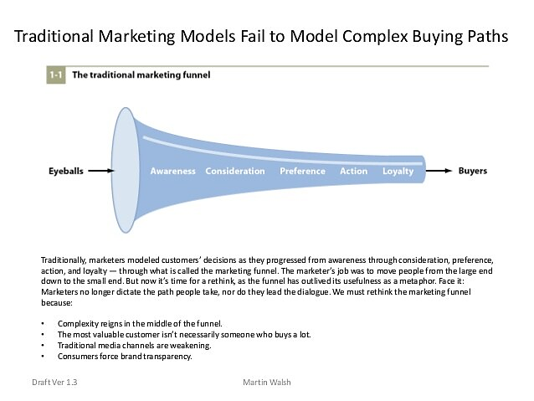

Slide 12
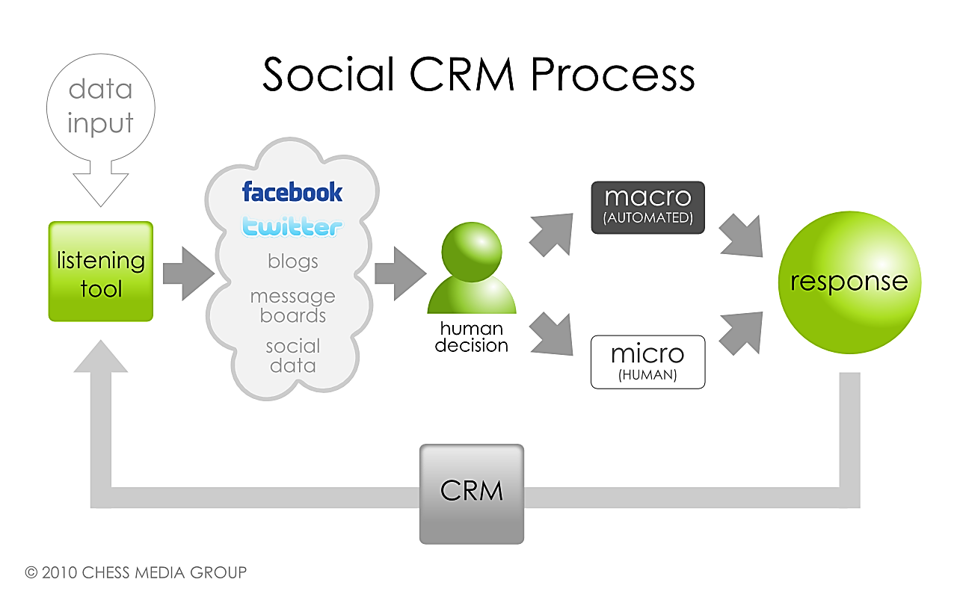
Social CRM

Slide 13
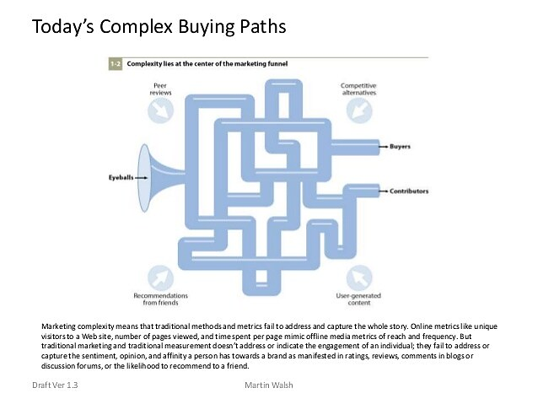

Slide 14
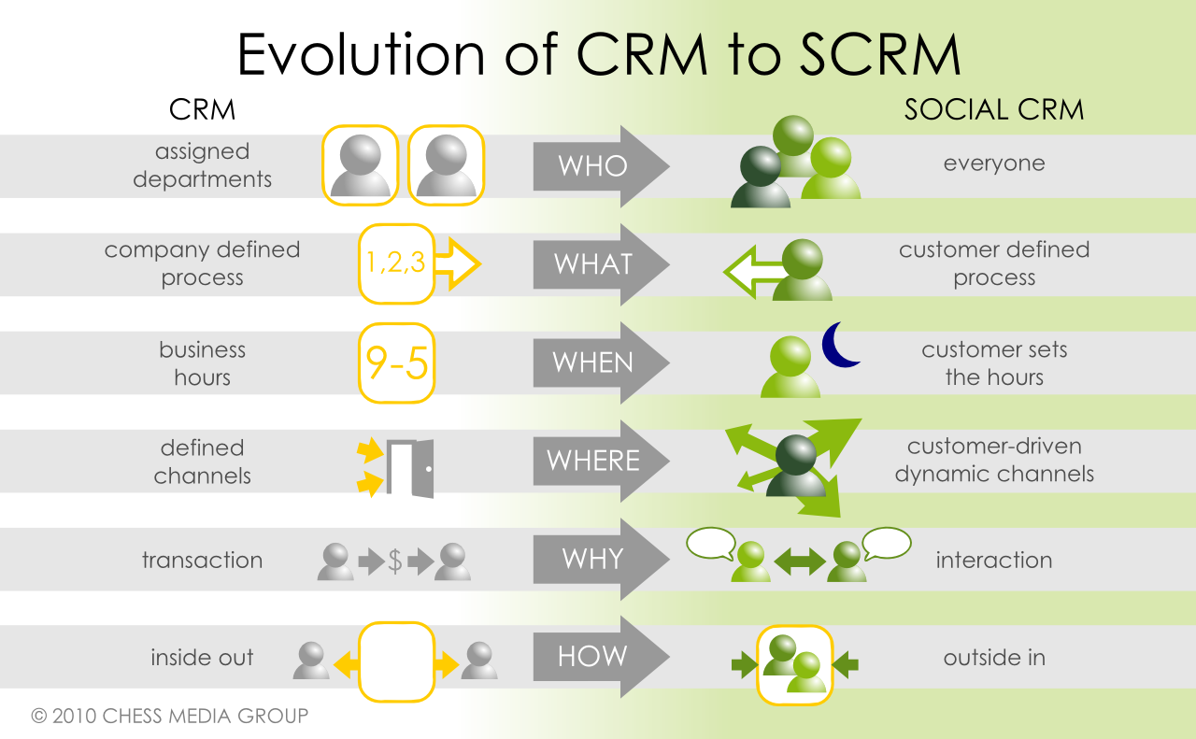
Evaluation of CRM to SCRM

Slide 15
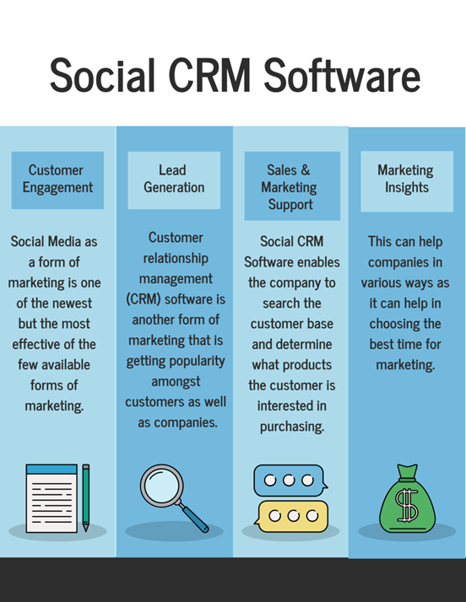

Slide 16
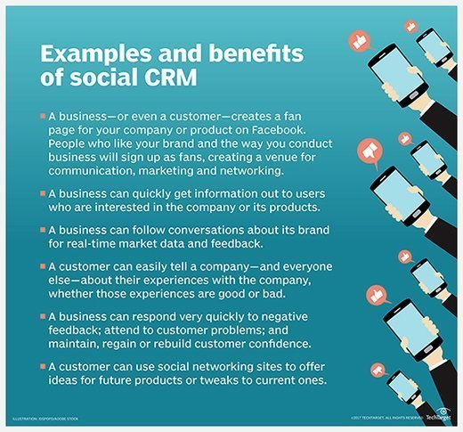

Slide 17
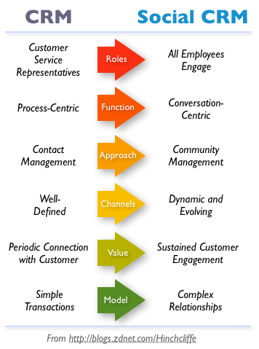

Slide 18
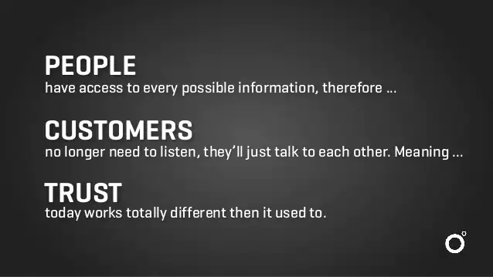

Slide 19
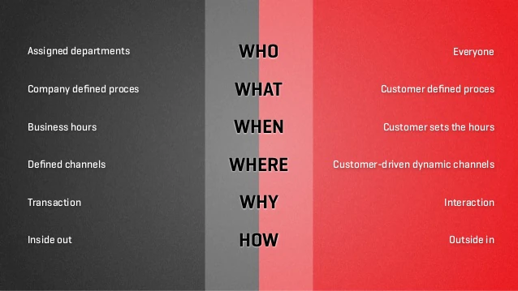

Slide 20
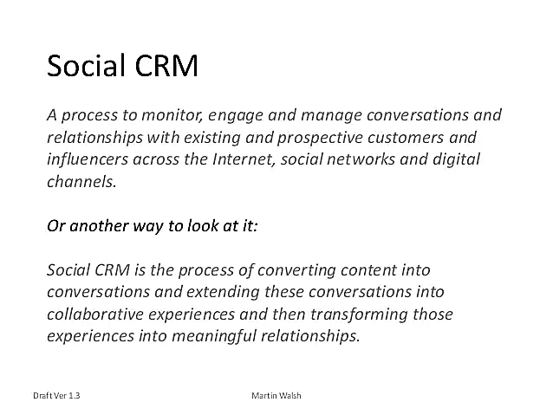

Slide 21
What is customer journey?
The customer journey encompasses all the experiences that customers go through when interacting with your company and brand. Instead of looking at just one part of a transaction or experience, the customer journey considers the full experience of being a customer.

Slide 22
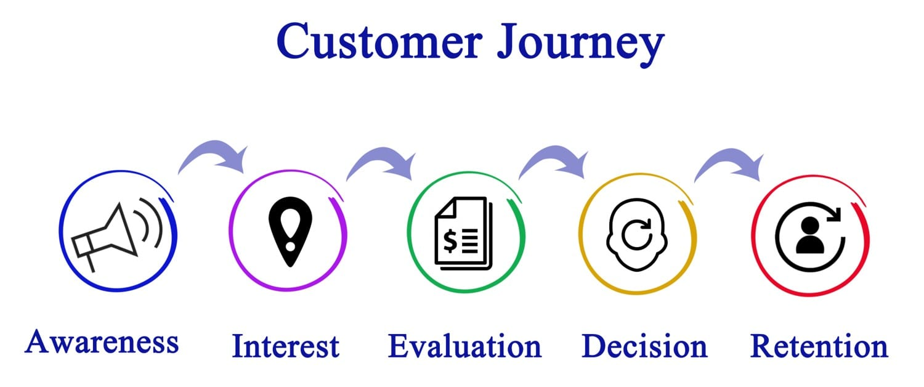

Slide 23
Steps…
Awareness: Awareness involves spreading general information about your products and services to your target audience(s).
Consideration: Brands focus on promotion during the consideration stage of the journey. This is where customers begin to look for alternatives to past purchases. During this phase, your business strives to convince potential buyers to include you on the list of available options. Market research reports help you identify how to communicate with potential customers effectively.
Conversion: This stage prompts visitors to take a particular action. Using a dedicated call-to-action, you encourage customers to make a purchase, subscribe to a mailing list, or sign up for services. You should use this phase to sell your product as the best fit to solve a visitor’s problem.
Retention and Advocacy: These stages were optional in previous business models. The increase in online purchases, however, makes these stages as significant as the others.
Retention: A loyal customer brings an organization consistent business and costs less than the effort to bring in new customers. Retention includes keeping customers happy with a relationship management team.
Advocacy: Most organizations acknowledge the benefits of word-of-mouth marketing. However, few companies commit to a plan for bolstering customer advocacy. Encouraging each customer to share reviews or opinions can take time and money. Reaching out to influencers or guest bloggers is an effective alternative to traditional word-of-mouth marketing.

Slide 24
What is a Net Promoter Score (NPS) survey?
A Net Promoter Score (NPS) survey consists of a single question that measures the likelihood of your customers referring your business to their others. It is an indicator of customer experience, customer satisfaction, and brand loyalty. The responses of the NPS survey are used to generate a score ranging from -100 to 100. The NPS score is used to classify customers and help businesses improve their experience.
Net Promoter Score NPS survey question
Typical NPS surveys consist of just one question.
Considering your complete experience with our company, how likely would you be to recommend us to your friend or colleague?
The answer options are arranged horizontally on a scale of 0-10.

Slide 25
Based on the score, the customers fall into one of the 3 categories
Promoters: Customers who rate 9 or 10 and are happy with your services. They are loyal enthusiasts and might prove to be evangelists for your business. They are extremely likely to recommend your company to people in their social or professional circles.
Passives: Customers who rate 7 or 8 and have average experience with your company. They are satisfied with your services but might switch your competitors if given an opportunity. They have a neutral stand - won't spread negative word-of-mouth but won't promote your brand either.
Detractor: Customers who rate below 6 and are not happy with your products or services. They share their bad experiences with others and damage company's reputation. They would not like to repurchase your products or services and would discourage others too.

Slide 26
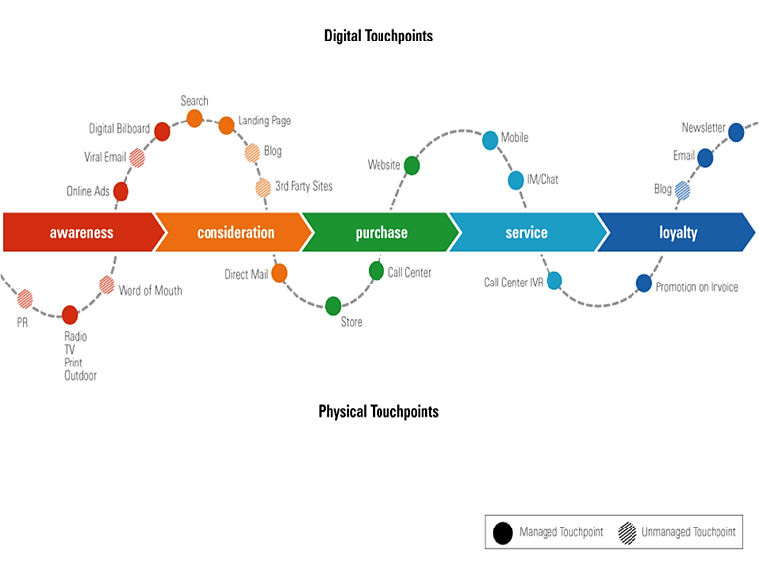
Customer journey map

Slide 27
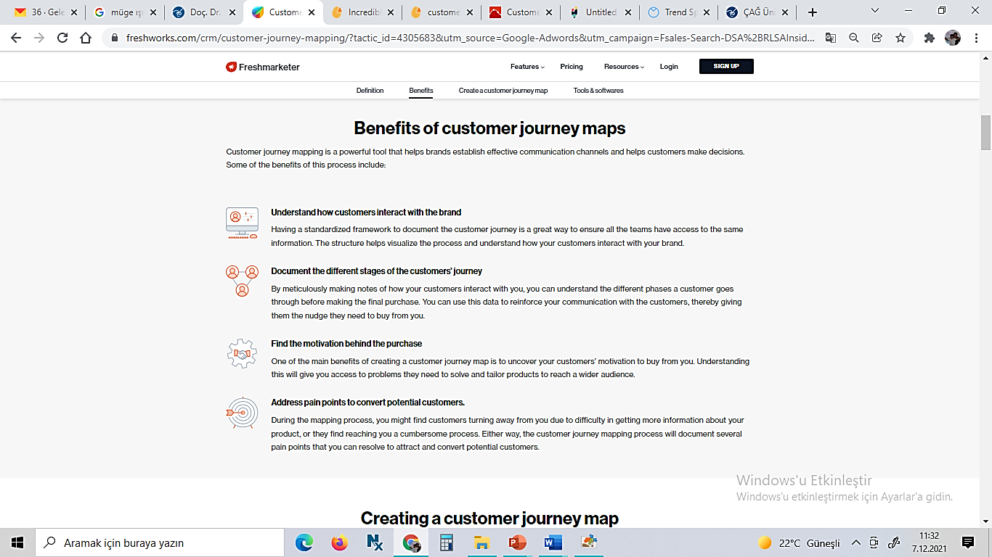

Slide 28
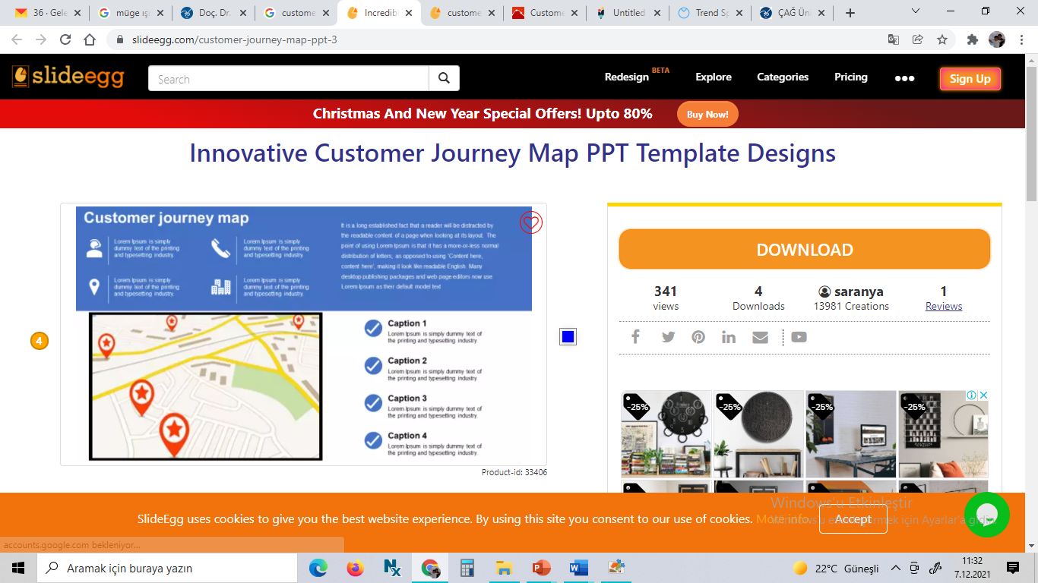
Example site to create a map….

Slide 29
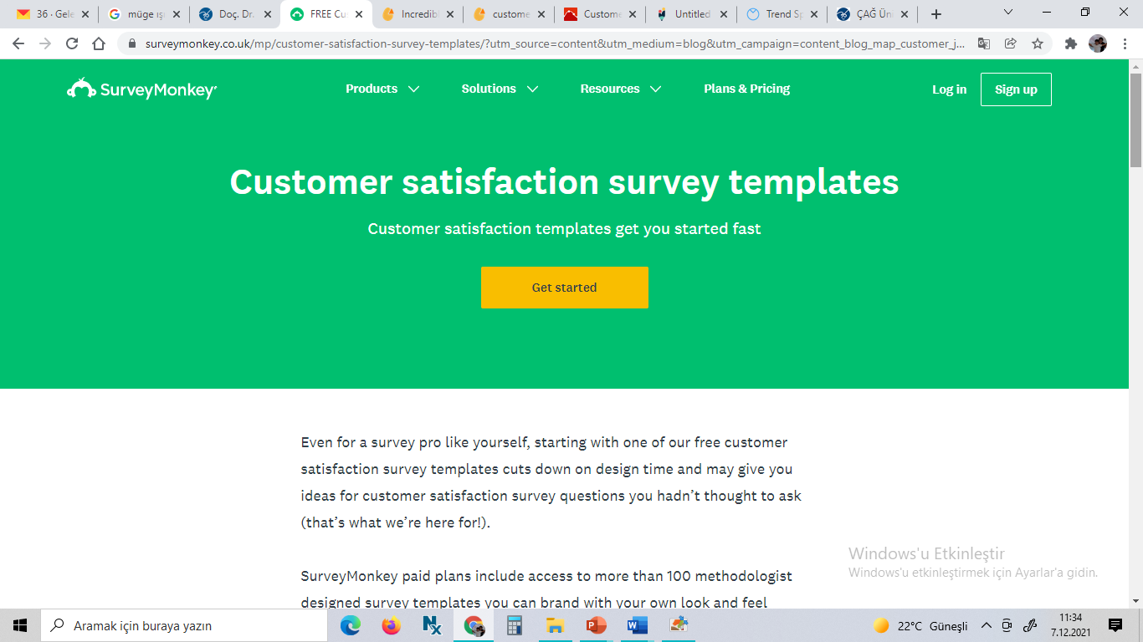
Feedbacks..

Slide 30
360 degree customer feedback survey :
1.) Micro or macro: The first step is to decide what type of surveys you want to run. If your customer base is young and busy, you will find it much easier to get responses from them if you break down your survey into micro surveys. However, if your survey is logic dependent, that is, some questions are dependent on the answer of the previous questions, then it will be easier to get the entire survey answer at once, even if your customers might require some reminders to complete the feedback.
2.) General questions or logic and branching: Often surveys require complex logic and branching to be effective. In other word, instead of using general questions for all your customers, you might want to customize their later questions based on what they answer in previous ones.
If your feedback is just to get some basic ideas on customer experience, you may not require much complex surveys. However, if you expect deep insights, you will have to spend some time using advanced logic and branching options.
3.) Close or open ended questions: In most cases you would find yourself using a mix of both. It is true that when it comes to analytics, it is easier to get concrete insights from close questions where customers can only choose from a set of given options while responding. The only risk in pursuing that is that the list of options may stretch too long. In which case 4-5 options with an option to type in their other response may be the best way to go. You may even chose to keep the entire answer open-ended in cases of “qualitative responses”.

Slide 31
4.) Mode of distribution: Your entire approach to surveys might change depending upon how you want to collect the responses.
If you are a B2C company and have a significant customer base across social media platforms, then quick poll type questions might get you much more responses than embedded links would. If you use SMS or email survey integration, then you have the liberty or going for longer and complex surveys.
5.) Multiple or single surveys: Some organizations, especially ones in the business of consumer goods and services, might have customers belonging to distinctive demographics and questions will have to be customized based on certain aspects such as age, gender, geographic location and so on.
While survey logic and branching mechanisms can greatly help, another option is that of creating different surveys for different groups. While this is feasible when you have all the required customer data with you to identify them properly, a particular advantage of doing so is that the language and tone can be set to best attract responses without make the survey logic too complex.

Slide 32
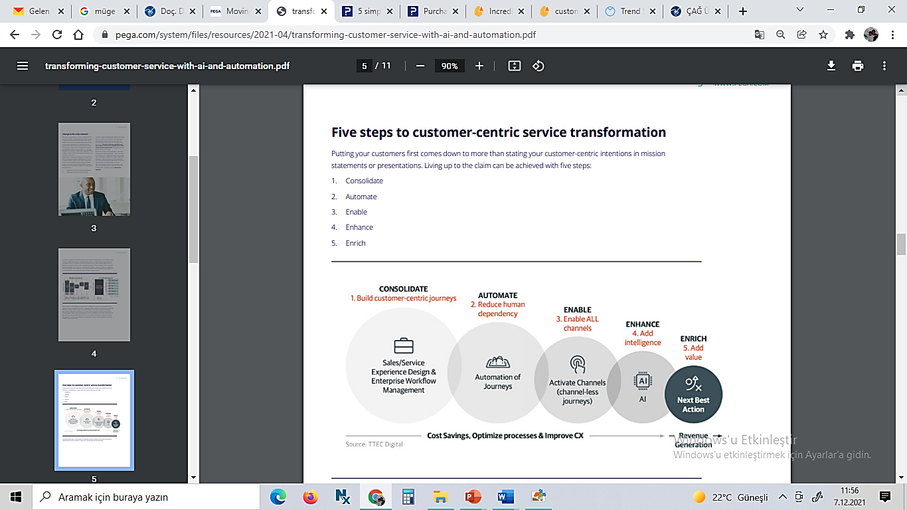

Slide 33
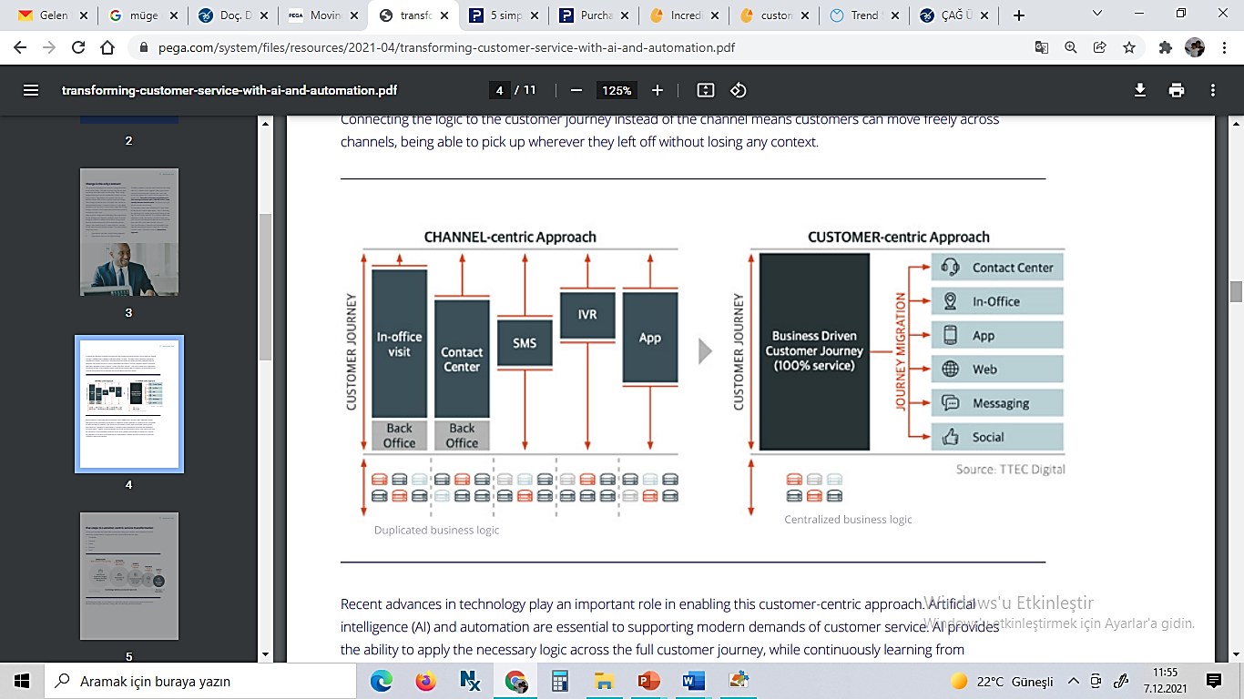
Channel /Customer centric

Slide 34
Put your customers at the center.
Regardless of time or money, focus on creating customer value by putting your customers first.
When you put your customers first and understand what your customers value, you begin to collect a wealth of data. It can be used to define your own strategy pertaining to your business and enhance the customer experience.
You cannot pull off ‘customer’ success by being customer-centric alone. It can be achieved only by the coexistence of Customer Value, Customer Experience, and Customer Journey.

Slide 35
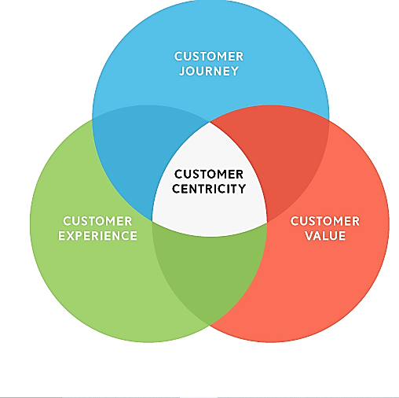

Slide 36
Start by seeing the world through your customer’s eyes.
Understand what customers want and use that data. Capture customer insights and share this across your organization.
Commit your organization to focus on what the customer wants. Develop products or services revolving around their needs.
Build relationships that are designed to maximize the customer’s product and service experience.
Analyze, plan and implement a formulated customer-centric operation that focuses on reducing churn.
Design your customer-centric approach by providing a great customer experience.

Slide 37
Customer Empathy
Customer Empathy is a powerful human resource for positively impacting customer experience excellence.
Customer empathy helps leaders and employees to see the customer’s world differently. Doubling down on CX practices by switching on customer empathy to create deeper understanding, more meaningful connection, align and unite teams and enrich decision making to benefit customers, employees and the business

Slide 38
Empathy map
An empathy map is a collaborative tool teams can use to gain a deeper insight into their customers.
Much like a user persona, an empathy map can represent a group of users, such as a customer segment.
The empathy map was originally created by Dave Gray and has gained much popularity within the agile community.

Slide 39
There are some key steps to keep in mind while creating an empathy map.
Define the key question.
Note down what you want to ask/test/know.
Conduct the test as per the above mentioned six quadrant theory.
Use data to get insights that will be helpful.
Observe how customers think.
Help solve customer problems with this map.

Slide 40
To ensure that customers are at the center always, you need to create a strong strategy. Customer empathy maps are methods that company teams such as engineers, customer success, product, and design can use to improve their understanding of customer needs. It is an effective and easy way to place various aspects of the customer’s mindset while using the product.

Slide 41
The map has six quadrants that cover what a customer says, thinks, does, feels, hears, and goals in mind.
Quadrant 1: Who are we empathizing with and what are their goals?
In this case, we want to identify who the customer is and what their situation is. What is the remedy or solution they seek? We also need to understand what decisions they might be making and how we can trigger them to be successful.
Quadrant 2: What do they see?
What are the shifts in the market? Is there any similar product; any blog or article that talks about the product or similar? With empathy, you need to proactively talk to customers offer them with solutions and improve trust.
Quadrant 3: What do they say?
Customer opinions are important. What are they saying about the product? how much have their surroundings impacted them? Making sure customers are educated to know the product and its benefits is important.

Slide 42
Quadrant 4: What do they do?
What is the actual customer behaviour? Are there any inclinations? You must understand why they do what they do and map it out clearly. Exchange of value between customers will help create trust and improve performance.
Quadrant 5: What do they hear?
Recommendations are awesomely helpful. Guess what clicks the most- word of mouth. So what are your potential customers hearing from friends or colleagues? It is a compelling and powerful way of ensuring customers choose your product.
Quadrant 6: What do they feel?
Identify and understand customer pain points. What makes them anxious, worried, happy, or scared? Through needs and fears analysis, you can determine which product they would prefer and why.

Slide 43
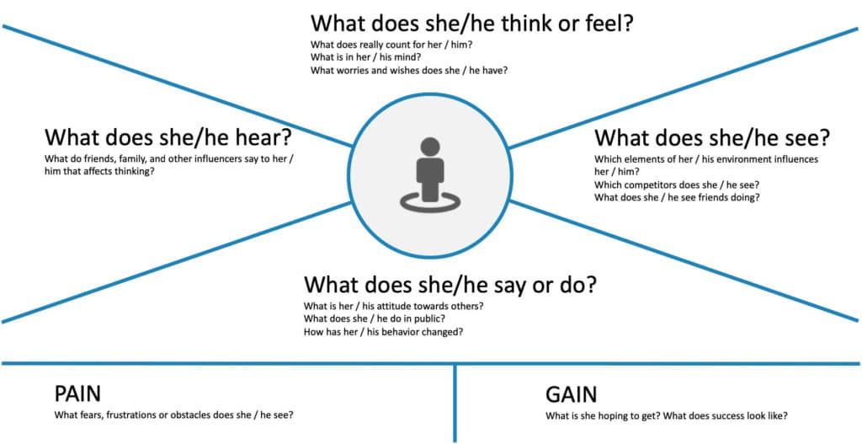
Customer empathy map

Slide 44
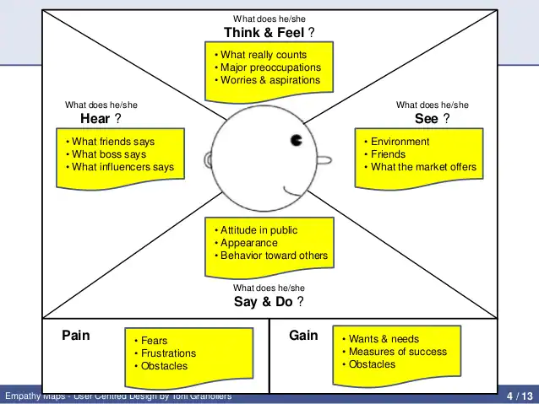

Slide 45
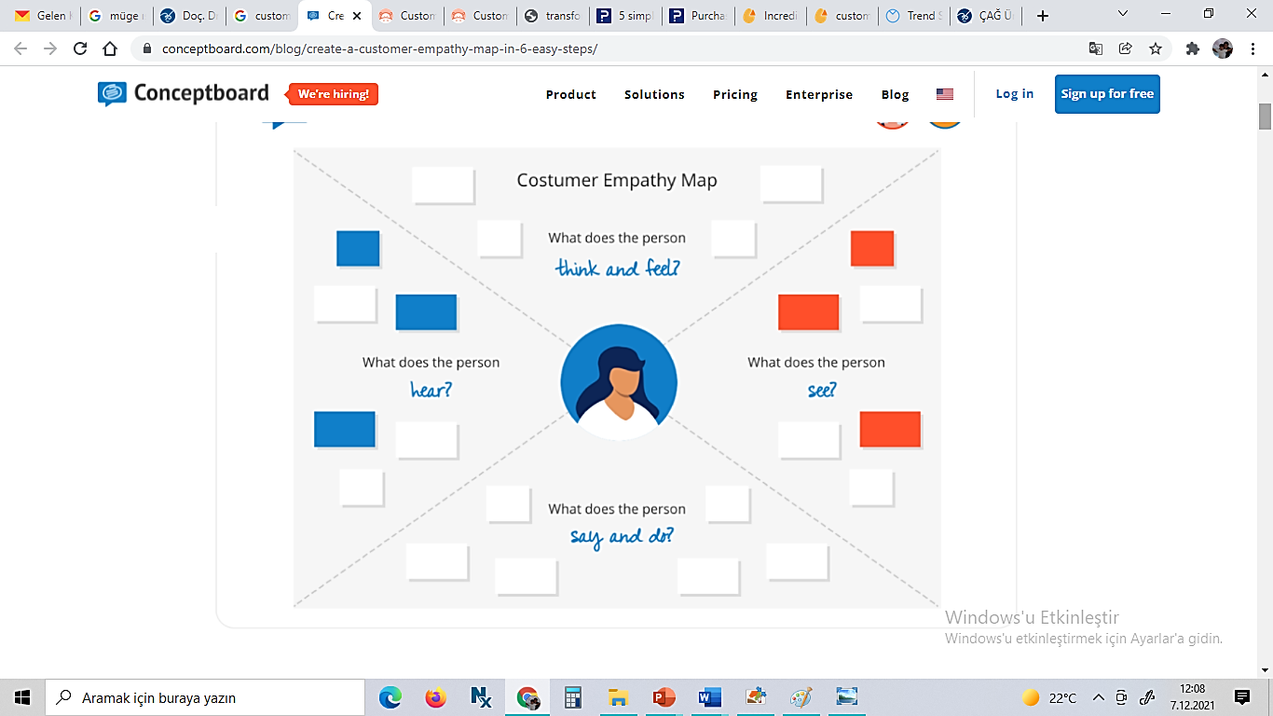
Map creating with…

Slide 46
