Slide 1
Chapter Eighteen
Pension Funds
©McGraw Hill LLC. All rights reserved. No reproduction or distribution without the prior written consent of McGraw Hill.

Slide 2
Pension Funds
Pension funds (PFs) offer savings plans through which fund participants accumulate tax-deferred savings during their working years before withdrawing them in retirement years
  Funds originally invested in and accumulated in a pension plan are exempt from current taxation
  Tax payments are not made until funds are withdrawn by the participant (i.e., during retirement)
PFs were first established in the U.S. in 1759 to benefit the widows and children of church ministers
First corporate PF established by American Express Company in 1875
Mutual funds and insurance companies are the main providers of PFs

Slide 3
Pension Funds (Continued)
By 1940, only 400 PFs existed
  Most of these were for employees in the railroad, banking, and public utilities industries
Currently, over 740,000 PFs exist
  In 2021, U.S. households had 20% of their financial assets invested in pension funds, compared to just over 5% in 1950
Financial crisis of 2008-2009 produced significant losses to PFs, decreasing the value of worldwide pension assets from $25 trillion to $20 trillion
  U.S. retirement account values fell by over $2 trillion, causing many to postpone retirement, take second jobs, and/or downsize the lifestyles they had enjoyed for decades

Slide 4
Private versus Public Pension Funds
PF industry comprises two distinct sectors:
  Private PFs are those funds administered by private corporations (e.g., insurance companies or mutual funds)
  Public PFs are those funds administered by a federal, state, or local government (e.g., Social Security)
In 2021, total financial assets invested in PFs were $31,879.1 billion:
  $17,359.1 billion in private funds (including life insurance companies);
  $9,956.1 billion in state and local government funds; and
  $4,563.9 billion in federal government funds

Slide 5
Defined Benefit PFs
A pension plan governs the operations of a pension fund
In a defined benefit PF, the employer agrees to provide the employee with a specific cash benefit upon retirement, based on a formula that considers such factors as years of employment and salary during employment
  Flat benefit formula pays a flat amount for every year of employment
  Career average formula pays benefits based on the employee’s average salary over the entire period of employment
  Final pay formula pays benefits based on a percentage of the average salary during a specified number of years at the end of the employee’s career times the number of years of service
Notes:
Pension funds can be distinguished by the way contributions are made and benefits are paid. A pension fund is either a defined benefit fund or a defined contribution fund.

Slide 6
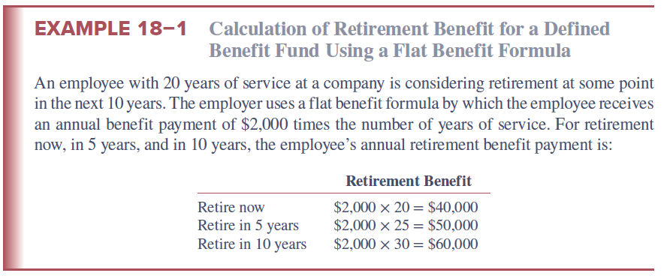
Calculation of Retirement Benefit for a Defined Benefit Fund Using a Flat Benefit Formula

Slide 7
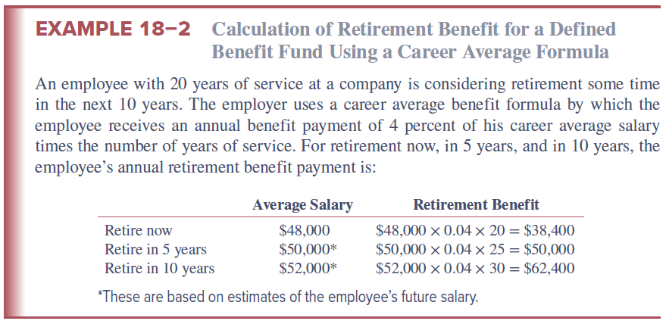
Calculation of Retirement Benefit for a Defined Benefit Fund Using a Career Average Formula
Notes:
Two variations of career average formulas exist; both base retirement benefits on the average salary over the entire period of employment. Under one formula, retirees earn benefits based on a percentage of their average salary during the entire period they belonged to the pension fund. Under the alternative formula, the retirement benefit is equal to a percentage of the average salary times the number of years employed.

Slide 8
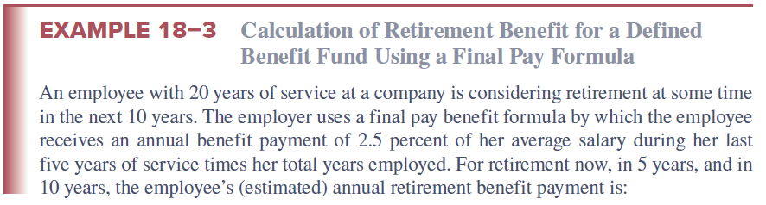
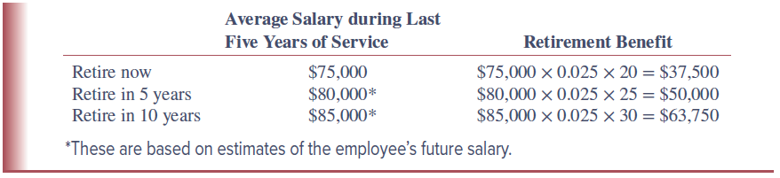
Calculation of Retirement Benefit for a Defined Benefit Fund Using a Final Pay Formula
Notes:
Notice that of the three benefit formulas, the final pay formula usually produces the biggest retirement benefit increases as years of service increase. This formula generally provides better protection against erosion of pension income by inflation. Benefit payments are based on the employee’s career-end salary, which is generally the highest and often reflects current levels of price and wage inflation. This type of plan is also generally more costly to the employer.

Slide 9
Defined Benefit PFs (Continued)
Under defined benefit plans, the employer should set aside sufficient funds to ensure that it can meet the promised payments
  Fully funded pension plans have sufficient funds available to meet all future payment obligations
  Underfunded pension funds do not have sufficient funds available to meet all future promised payments
  Occasionally, pension funds are overfunded, meaning they have more than enough funds available to meet the required future payouts

Slide 10
Defined Contribution PFs
A defined contribution pension fund is a fund in which the employer agrees to make a specified contribution to the pension fund during the employee’s working years
  Employer does not commit to providing a specified retirement income; rather, employer contributes a specified amount
  Provide benefits to employees in the form of higher potential returns relative to defined benefit funds, but employees also must accept increased risk of uncertain payouts
Fixed-income funds typically offer a guaranteed minimum rate of return, with the possibility of higher returns if fund assets earn above minimum rates of return
With variable-income funds, all investment profits and losses are passed through to fund participants

Slide 11
Insured versus Noninsured Pension Funds
An insured pension fund is administered by a life insurance company
  Pension plan funds are pooled and invested in the general assets of the insurance company
  In 2019, life insurers managed a total of $3,656.0 billion in pension fund assets, representing 42.6% of the industry’s total liabilities and equity
A noninsured pension fund is administered by a financial institution other than a life insurance company
  Assets managed are owned by the sponsor and are thus segregated and listed as separate pools of assets on the trustees’ balance sheet
  Sponsor normally specified guidelines trustee should follow, but day-to-day investment decisions are controlled by trustee
Notes:
Premiums paid into insured pension funds, and the assets purchased with these premiums, become the legal property of the insurance company managing the pension funds. In contrast, premiums paid into noninsured pension funds, and the assets purchased with these premiums, are the legal property of the sponsoring corporation.

Slide 12
Private Pension Funds
Private pension funds are created by private entities (e.g., manufacturing, mining, or transportation firms) and are administered by private corporations (FIs)
  Defined contribution funds are increasingly dominating the private pension fund market
  Number of defined benefit pension plans decreased from more than 100,000 in 1990 to fewer than 50,000 in 2020
    Over the same period, the number of defined contribution pension plans increased from approximately 600,000 to over 700,000
  As of 2020, more than 90% of private pension plans are defined contribution plans

Slide 13
Private Pension Fund Assets, 1990 - 2019
Notes:
Figure 18–1 shows private pension fund assets from 1990 to 2021. From Figure 18–1 note that as equity market values fell in 2001 and in 2008 (during the financial crisis), pension fund asset values, particularly for defined contribution funds, fell as well.

Slide 14
401(k) and 403(b) Plans
401(k) and 403(b) plans are employer-sponsored plans that supplement a firm’s basic retirement plan
  Allow for both employer and employee contributions
  401(k) plans are offered to employees of taxable firms, while 403(b) plans are offered to employees of certain tax-exempt employers
  Contributions are made on a pretax basis and thus reduce the employee’s taxable salary
  Most plans are transferable if the employee changes jobs
  Participants generally make their own choice of the allocation of assets from both employee and employer contributions
    Younger participants generally invest more in equities, while older participants invest more in fixed-income securities

Slide 15
Defined Contribution Plan Assets by Type of Plan, 1994 - 2019
Notes:
Private defined benefit and defined contribution pension funds come in various types. Employees may participate in 401(k) and 403(b) plans, individual retirement accounts (IRAs), and Keogh accounts (see Figure 18–2).

Slide 16
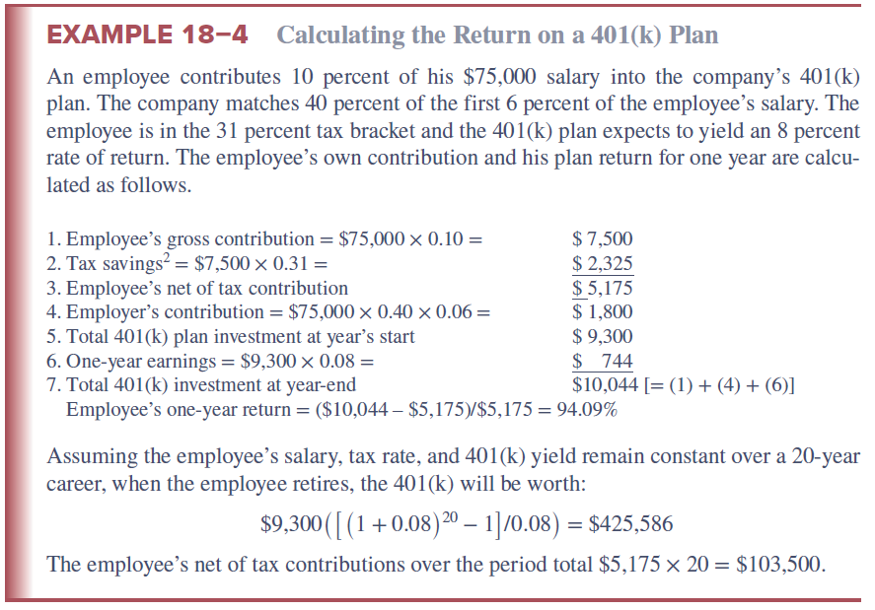
Calculating the Return on a 401(k) Plan

Slide 17
Individual Retirement Accounts
Individual retirement accounts (IRAs) are self-directed retirement accounts set up by employees who may also be covered by employer-sponsored pension plans as well as self-employed individuals
  Contributions are made strictly by the employee
  First allowed in 1981 as a method of creating a tax-deferred retirement account to supplement an employer-sponsored plan
  As of 2023, maximum contributions were $6,500 per year
Roth IRAs were introduced in 1998
  In 2023, they allowed a maximum of $6,500 after-tax contribution per individual ($13,000 per household)
  Contributions are taxed in the year of contribution, and withdrawals are tax-free (provided the funds have been invested for at least five years and the account holder is at least 59 ½ years old)
  Only available to individuals or households with an adjusted gross income of less than $153,000 or less than $228,000, respectively
Notes:
Table 18–3 summarizes the main differences between a Roth IRA and a traditional IRA.

Slide 18
Keogh Accounts
A Keogh account is a retirement account, available to self-employed individuals, in which contributions by the individual may be deposited in a tax-deferred account administered by a life insurance company, a bank, or other financial institution
  Profit-sharing plan contributions can vary by year
    Contributions can vary from 0 to 25 percent of the individual’s income, up to $66,000
  Money-purchase plans require a mandatory contribution (at a constant percentage of the employee’s income) each year whether the individual has profits or not
    Contributions can be as high as the lesser of $66,000 or 25 percent of the individual’s self-employment income

Slide 19
Public Pension Funds
Pension funds sponsored by the federal or state and local governments are referred to as public pension funds
Employees of state or local governments may contribute to pension funds sponsored by these employers
  Most funded on a “pay as you go” basis
  Due to an increasing number of retirees relative to workers, some pension funds are underfunded
Federal government sponsors two types of pension funds:
  Funds for federal government employees, including civil service employees, military personnel, and railroad employees
  Social Security, which provides retirement benefits to almost all employees and self-employed individuals in the U.S.

Slide 20
Financial Asset Investments and Recent Trends:
Private Pension Funds
Financial assets (pension fund reserves) held by private pension funds in 1975 totaled $244.3 billion, compared to $13,314.5 billion in 2021
  In 2021, 72.05% of pension fund assets were in corporate equities or equity mutual fund shares, compared to 44.61% in 1975
In 2021, defined benefit funds had 30.95% of their funds invested in U.S. government securities and corporate and foreign bonds, compared to 5.23% for defined contribution funds
  Defined benefit funds had 41.93% of their assets invested in corporate equities, compared to 26.49% by defined contribution funds
Notes:
Employer and employee contributions made to pension funds are invested in financial assets. These investments are tracked by the Federal Reserve because of the increasing importance of pension funds as participants in national and international security markets.

Slide 21
Financial Assets Held by Private Pension Funds, 1975 and 2021
Notes:
Financial assets (pension fund reserves) held by private pension funds in 1975 and 2021 are reported in Table 18–4.

Slide 22
Financial Asset Investments and Recent Trends:
Public Pension Funds
Like private pension funds, state and local pension funds held most of their assets in corporate equities or equity mutual fund shares (38.27% in 2021)
  In 1975, 23.32% of pension fund assets were in equities
Second in importance were U.S. government securities and bonds (12.08% in 2021)
  In 1975, 66.03% of pension fund assets were in U.S. government securities and bonds
At the federal level, Social Security contributions are invested in relatively low-risk, low-return Treasury securities

Slide 23
Financial Assets Held by State and Local Government Pension Funds, 1975 and 2021
Notes:
Financial assets held by state and local government pension funds in 1975 and 2021 are reported in Table 18–5.

Slide 24
Social Security 2100 Act:
Proposals
Increase the combined payroll tax rate by 2.4 percentage points, from 12.4 to 14.8%, phased in by 0.1% per year over 24 years;
Apply the entire payroll tax to earnings above $400,000 and, ultimately, to all income as the current wage-indexed maximum of $132,900 caught up;
Offer some benefit credit for new taxes paid by increasing benefits by 2% of all wage income above $400,000;
Increase the income threshold for taxation of 85% of Social Security benefits to $50,000 for single filers and $100,000 for joint filers, up from $34,000 and $44,000;
Increase the lowest Primary Insurance Account (PIA) factor in the benefit formula from 90 to 93%, increasing benefits across the board;
Use the faster-growing, experimental Consumer Price Index for the elderly (CPI-E) for cost-of-living adjustments (COLAs); and
Create a minimum benefit of 125% of the poverty line for people who have worked 30 years or more
Notes:
In 2017, Congressman John B. Larson, the Ranking Member of the Ways & Means Subcommittee on Social Security, introduced the “Social Security 2100 Act.” The bill represented a comprehensive plan to rescue Social Security from its pending trust fund insolvency in 2035, making the program sustainably solvent for the next 75 years and beyond while also increasing benefits.
Despite these calls for reform, no major reform of Social Security has been realized.

Slide 25
Pension Fund Regulation
Major piece of regulation governing private pension funds is the Employee Retirement Income Security Act (ERISA) of 1974
While ERISA does not mandate employers establish pension funds for their employees, it requires them to meet certain standard if a fund is to be eligible for tax-deferred status
Principal features of ERISA focus on the following:
  Pension plan funding
  Vesting of benefits
  Fiduciary responsibility
  Pension fund transferability
  Pension fund insurance

Slide 26
Pension Fund Regulation:
Funding
Prior to ERISA, there were no statutory requirements forcing defined benefit fund administrators to adequately fund their pension funds
ERISA established guidelines for funding and set penalties for fund deficiencies
  Contributions to pension funds must be sufficient to meet all annual costs and expenses and to fund any unfunded historical liabilities over a 30-year period
  Any new underfunding arising from low investment returns or other losses must be funded over a 15-year period
Provisions in ERISA led many companies to switch from defined benefit plans to defined contribution plans
Notes:
For some companies, the required obligations resulting from ERISA were significant. For example, after ERISA was enacted, General Motors had to put $7.3 billion into its underfunded pension funds, while Ford Motor Company had to add $3.3 billion.

Slide 27
Pension Fund Regulation:
Vesting and Fiduciary Responsibilities
A vested employee is eligible to receive pension benefits because he or she has worked for a stated period of time
  Prior to ERISA, some plans required their employees to work 15 and even 25 years before they were eligible to receive pension benefits
  ERISA requires that a plan must have a minimum vesting requirement and sets a maximum vesting period of 10 years
A pension plan fiduciary is a trustee or investment advisor charged with management of the pension fund
  ERISA required that PF contributions be invested with the same diligence, skill, and care as a “prudent person” in like circumstances (i.e., the prudent-person rule)
  Fund assets are required to be managed with the sole objective of providing the promised benefits to participants

Slide 28
Pension Fund Regulation:
Transferability and Insurance
ERISA allows employees to transfer pension credits from one employer to another when switching jobs
ERISA established the Pension Benefit Guarantee Corporation (PBGC), an insurance fund for pension fund participants similar to the FDIC
  PBGC insures participants of defined benefit funds if the proceeds from the fund are unable to meet its promised pension obligations
    As of 2022, nearly 1 million participants receive benefit payments of over $6.5 billion per year from PBGC
    Despite premium increases over the years, the PBGC has generally operated at a deficit since its inception
    Pension Protection Act of 2006 called for increasing the annual premiums paid by companies to $30 per worker from $19 and the imposition of automatic increases in premiums each year
Notes:
As of 2022, annual premiums paid by companies are $88 per participant for single-employer plans and $32 per participant for multi-employer plans.

Slide 29
Total Underfunding of Insured Single-Employer Plans
Notes:
Underfunded pension liabilities for single-employer plans surged to $823 billion in 2012 and $759 billion in 2013, the largest values ever (see Figure 18–5).

Slide 30
Global Issues
Pension systems vary widely in Europe
  The U.K., the Netherlands, Ireland, Denmark, and Switzerland all have a tradition of state- (or public-) funded pension schemes
  Spain, Portugal, and Italy have less developed systems
  France uses a pay-as-you-go system
One method of distinguishing systems across countries is by the extent to which a person’s contributions are linked to the benefits he/she receives in retirement
  The link between contributions and benefits is weak in France and Germany, but strong in Sweden, Italy, the U.K., and Chile
Reform around the globe has included benefit reduction, measures to encourage later retirement, and expansions of private funding for government pensions

