Slide 1
Fundamentals of
Corporate Finance
Tenth Edition
Chapter 1
Goals and Governance of the Corporation
©2020 McGraw-Hill Education. All rights reserved. Authorized only for instructor use in the classroom. No reproduction or further distribution permitted without the prior written consent of McGraw-Hill Education.

Slide 2
Topics Covered
1.1 Investment and Financing Decisions
1.2 What is a Corporation?
1.3 Who Is the Financial Manager?
1.4 Goals of the Corporation
1.5 Agency Problems, Executive Compensation, and Corporate Governance
1.6 The Ethics of Maximizing Value
1.7 Careers in Finance
1.8 Preview of Coming Attractions
1.9 Snippets of Financial History

Slide 3
Investment and Financing Decisions 1
Capital Budgeting Decision
  Decision to invest in tangible or intangible assets.
…also called
  Investment Decision.
  Capital Expenditure (CAPEX) decision.

Slide 4
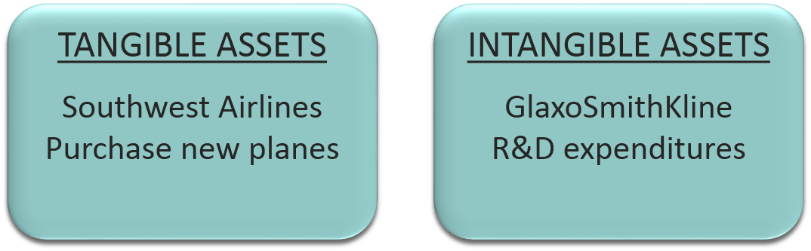
Investment and Financing Decisions 2
  “Capital Budgeting”

Slide 5
Investment and Financing Decisions 3
Financing Decision
  Decision on the sources and amounts of financing.
Capital Structure
  The mix of long-term debt and equity financing.

Slide 6
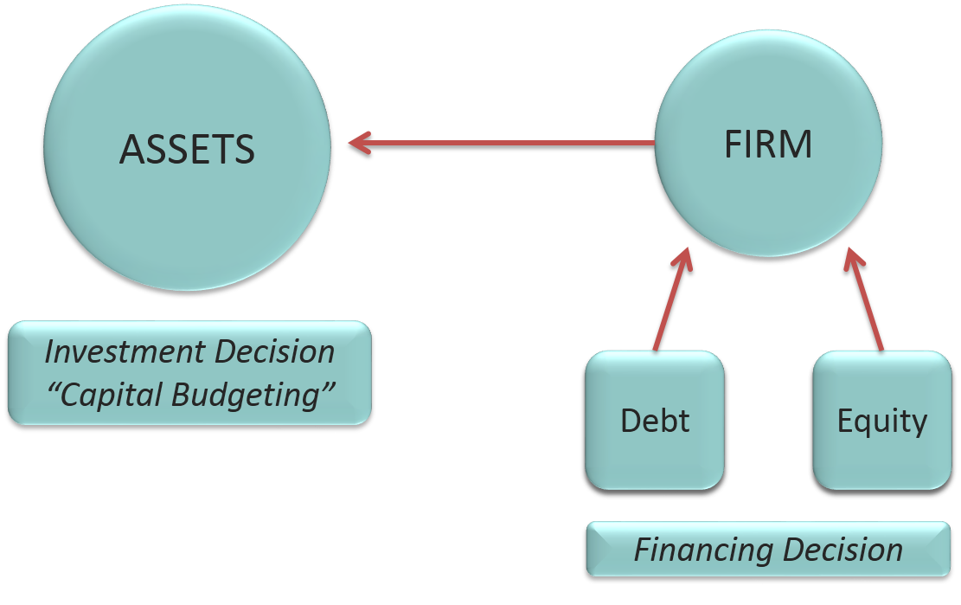
Investment and Financing Decisions 4
Access the text alternative for these images

Slide 7
Investment and Financing Decisions 5
Real Assets
  Assets used to produce goods and services.
Financial Assets
  Financial claims to the income generated by the firm’s real assets.

Slide 8
Investment and Financing Decisions 6
Are the following capital budgeting or financing decisions?
  Intel decides to spend $7 billion to develop a new microprocessor.
  BMW borrows 350 million euros (€350 million) from Deutsche Bank.
  Royal Dutch Shell constructs a pipeline to bring natural gas onshore from a production platform in Australia.
  Avon spends €200 million to launch a new range of cosmetics in European markets.
  Pfizer issues new shares to buy a small biotech company.

Slide 9
What Is a Corporation? 1
Corporation
  A business organized as a separate legal entity owned by stockholders.
Types of Corporation
  Public Companies.
  Private Corporations.
  Limited Liability Corporations (LLC).

Slide 10
What Is a Corporation? 2
Types of Business Organizations
  Sole Proprietorships.
  Partnerships.
  Corporations.
  Limited Liability Options.
    Limited Liability Partnerships.
    Limited Liability Corporations.
    Professional Corporations.
Limited Liability
  The owners of a corporation are not personally liable for its obligations.

Slide 11
What Is a Corporation? 3
 | Sole Proprietorship | Partnership | Corporation
Who owns the business? | The manager | Partners | Stockholders
Are managers and owners separate? | No | No | Usually
What is the owner’s liability? | Unlimited | Unlimited | Limited
Are the owner and business taxed separately? | No | No | Yes

Slide 12
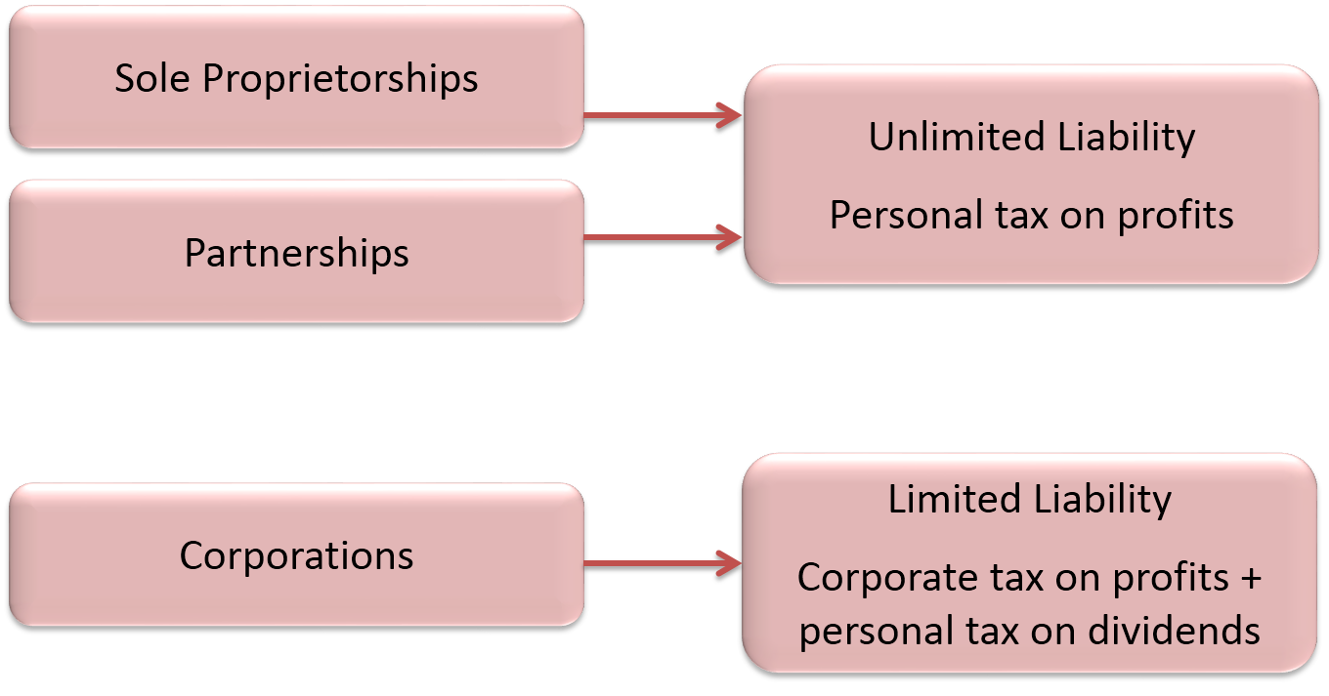
What Is a Corporation? 4
Access the text alternative for these images

Slide 13
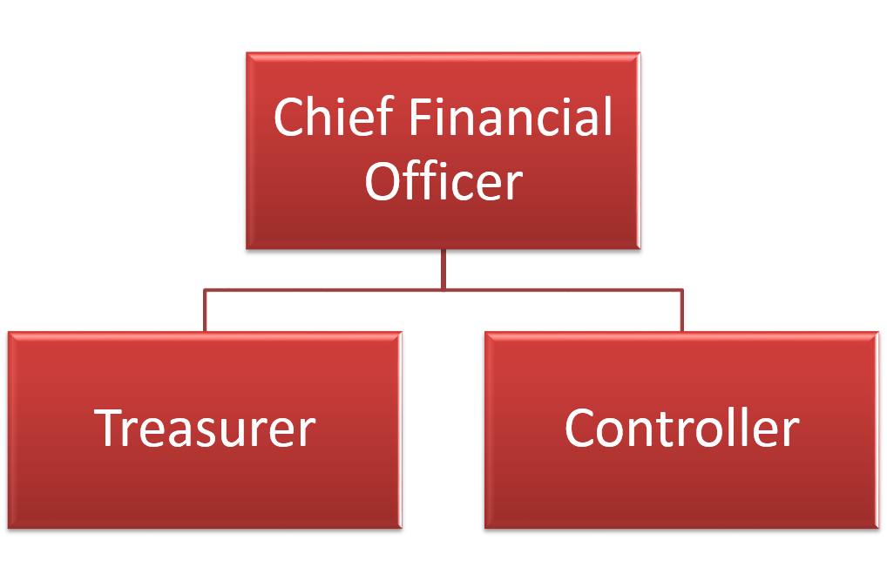
Who Is the Financial Manager? 1

Slide 14
Who Is the Financial Manager? 2
Chief Financial Officer (CFO)
  Responsible for financial policy and corporate planning.
Treasurer
  Responsible for cash management, raising of capital and banking relationships.
Controller
  Responsible for preparation of financial statements, accounting and taxes.

Slide 15
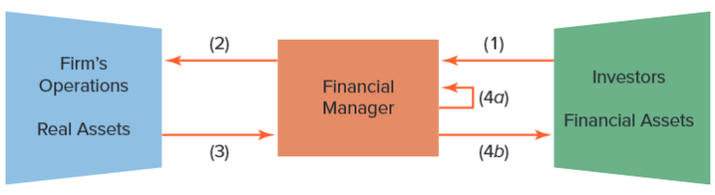
Who Is the Financial Manager? 3
(1) Cash raised from investors.
(2) Cash invested in firm.
(3) Cash generated by operations.
(4a) Cash reinvested.
(4b) Cash returned to investors.
Access the text alternative for these images

Slide 16
Goals of the Corporation 1
Shareholders desire wealth maximization
Profit maximization
  Maximize profits? Which year’s profits?
  Earning manipulation.
Opportunity cost of capital
  The minimum acceptable rate of return on capital investment is set by the investment opportunities available to shareholders in financial markets.

Slide 17
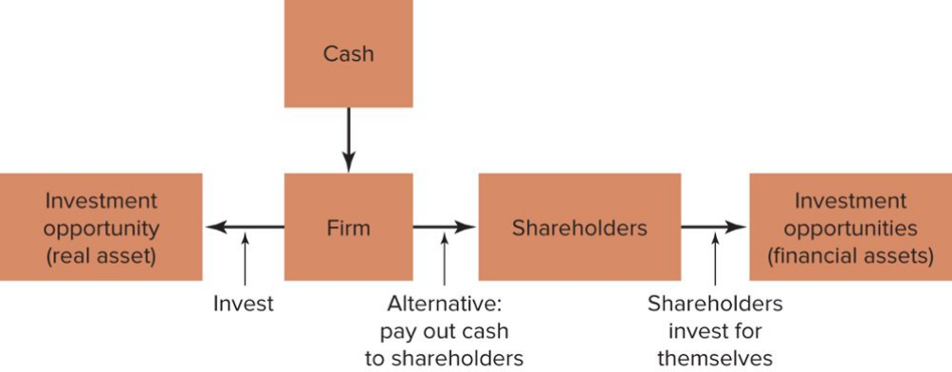
Goals of the Corporation 2
The Investment Trade-Off
Access the text alternative for these images

Slide 18
Agency Problem 1
Do managers maximize shareholder wealth or manager wealth?
Mangers have many constituencies called “stakeholders.”
Stakeholder.
  Anyone with a financial interest in the corporation.

Slide 19
Agency Problem 2
Agency problem
  Managers are agents for stockholders and are tempted to act in their own interests rather than maximizing value.
Agency cost
  Value lost from agency problems or from the cost of mitigating agency problems.

Slide 20
Agency Problem 3
Ownership vs. Management
Difference in Information
Stock prices versus returns.
Dilution of ownership.
Dividend policy.
Financing decisions.
Different Objectives
Managers versus stockholders.
Top managers versus lower managers.
Stockholders versus banks and lenders.

Slide 21
Agency Problem 4
Corporate governance
  The laws, regulations, institutions, and corporate practices that protect shareholders and other investors.

Slide 22
Agency Problem 5
Elements of good corporate governance
  Legal requirements.
  Board of directors.
  Activist shareholders.
  Takeovers.
  Information for investors.

Slide 23
Ethics of Maximizing Value
“It is not from the benevolence of the butcher, the brewer, or the baker, that we expect our dinner, but from their regard to their own interest. We address ourselves, not to their humanity but to their self-love, and never talk to them of our own necessities but of their advantages.” –Adam Smith, 1776.
Does value maximization justify unethical behavior?
  Volkswagen.
  Charles Ponzi.
  Bernard Madoff.
Is it ethical?
  Short selling.
  Corporate raiders.
  Tax avoidance.

Slide 24
Preview of Coming Attractions
How do I calculate the value of a stream of future cash flows?
How do I measure risk?
Where does financing come from?
How do I ensure that the firm’s financial decisions add up to a sensible whole?
What about some of those other responsibilities of the financial manager that you mentioned earlier?

Slide 25
Snippets of Financial History
Date | Activity
Unknown | Compound growth
1800 b.c. | Interest rates
1000 b.c. | Options
15th C | International banking
1650 | Futures
17th C | Joint stock corporations
17th C | Money
1720 | New issue speculation
1792 | Formation of the NYSE
1929 | Stock market crashes
1960s | Eurodollar market
1971 | Corporate bankruptcies
1972 | Financial futures
1986 | Capital investment decisions
1988 | Mergers
1993 | Inflation
1780 & 1997 | Inflation-indexed debt
1993 | Controlling risk
1999 | The Euro
2002 | Financial scandals
2007-09 | Subprime mortgages
2011 | Defaults on soveriegn debt
2016 | Brexit

Slide 26
Accessibility Content:
Text Alternatives for Images

Slide 27
Investment and Financing Decisions 4 Text Alternative
"Assets" is on the left with a caption that reads: Investment decision "capital budgeting." On the right "debt" and "equity" point to "firm," which points to "assets" with a caption that reads: financing decision.
Return to slide containing original image

Slide 28
What Is a Corporation? 4 Text Alternative
Sole Proprietorships and partnerships include unlimited liability and personal tax on profits. Corporations includes limited liability; corporate tax on profits plus personal tax on dividends.
Return to slide containing original image

Slide 29
Who Is the Financial Manager? 3 Text Alternative
The figure shows three boxes arranged horizontally to show the flow of cash between investors and the firm's operations. The three boxes, left to right, are labeled Firm's Operations/Real Assets, Financial Manager, and Investors/Financial Assets. Arrow 1 flows from Investors/Financial Assets to Financial Manager. Arrow 2 flows from the Financial Manager to Firm's Operations/Real Assets. Arrow 3 flows from Firm's Assets to Financial Manager. Arrow 4a flows from Financial Manager and back onto itself. Arrow 4b leads from the Financial Manager to Investors/Financial Assets.
Return to slide containing original image

Slide 30
Goals of the Corporation 2 Text Alternative
The figure shows five boxes arranged so that one sits above the second box in the row containing the remaining four. The flow initiates from the top box labeled, Cash, to the box below it labeled, Firm. An arrow leading from the unboxed word Invest leads to another arrow, which leads from the Firm box to the box to the left, Investment opportunity (real asset). An arrow labeled Alternative: pay out cash to shareholders, leads to the arrow leading from the Firm box to the Shareholders box. An arrow labeled Shareholders invest for themselves leads to the arrow leading from the Shareholders box to the Investment opportunities (financial assets) box.
Return to slide containing original image

