Slide 1
IRE … Turkish Foreign Policy
Assist. Prof. Saffet Akkaya
Course hours: ???
saffetakkaya@cag.edu.tr
Week 9: Turkish Foreign Policy During World War II (1939-1945)

Slide 2
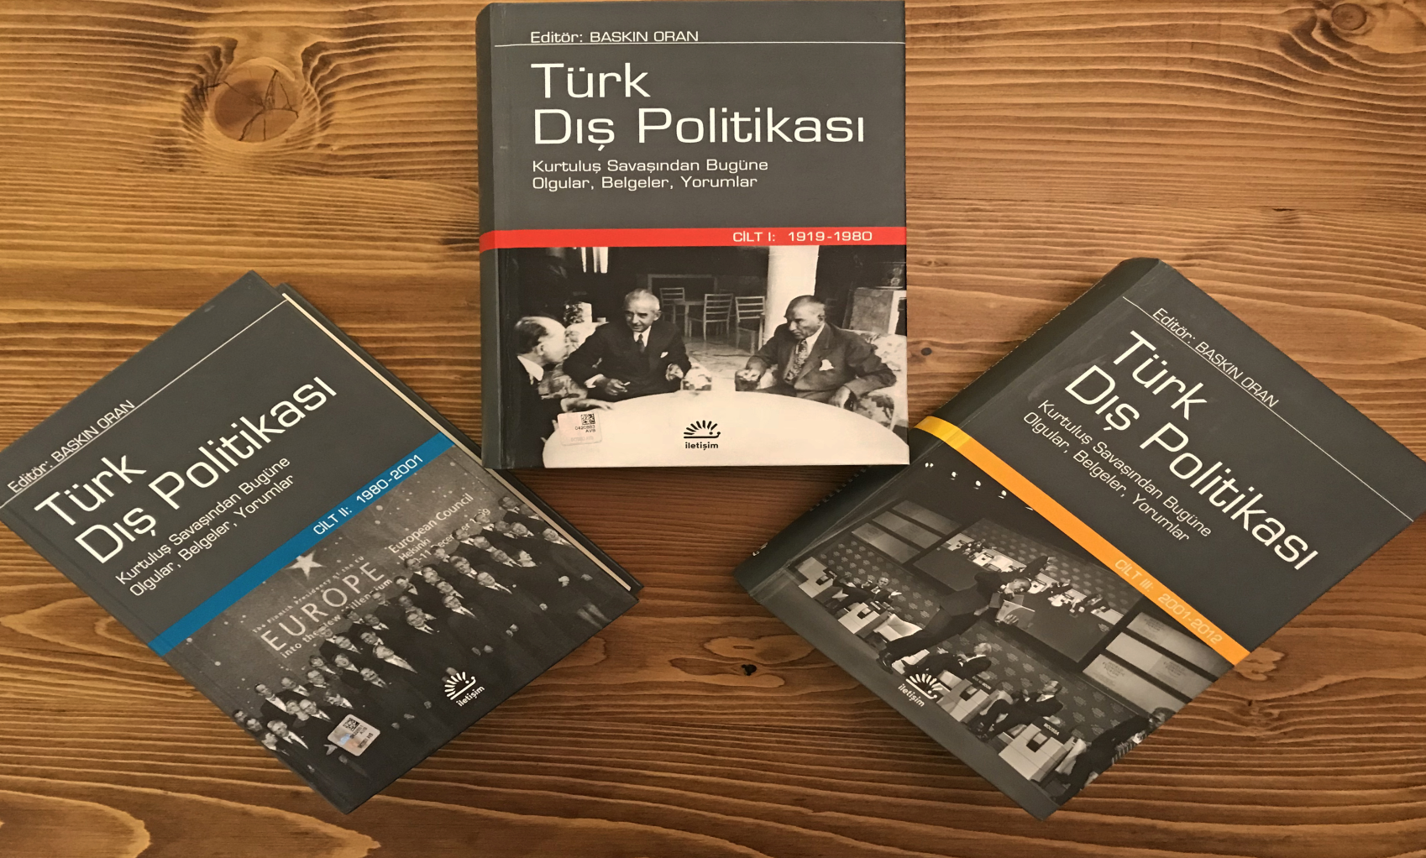
Main Source for the Course Türk Dış Politikası Vol 1, 2, 3 Ed. Baskın Oran
Türk Dış Politikası Vol 1: Pages 387-409

Slide 3
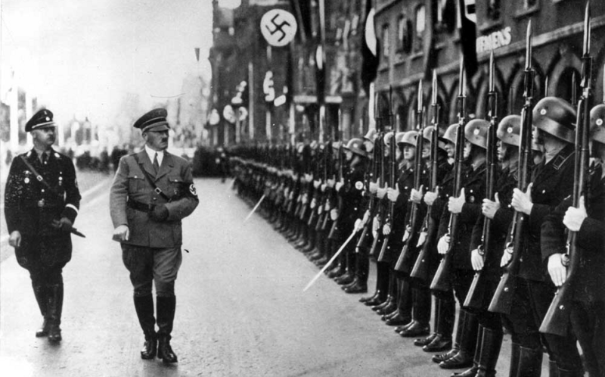
World War II

Slide 4
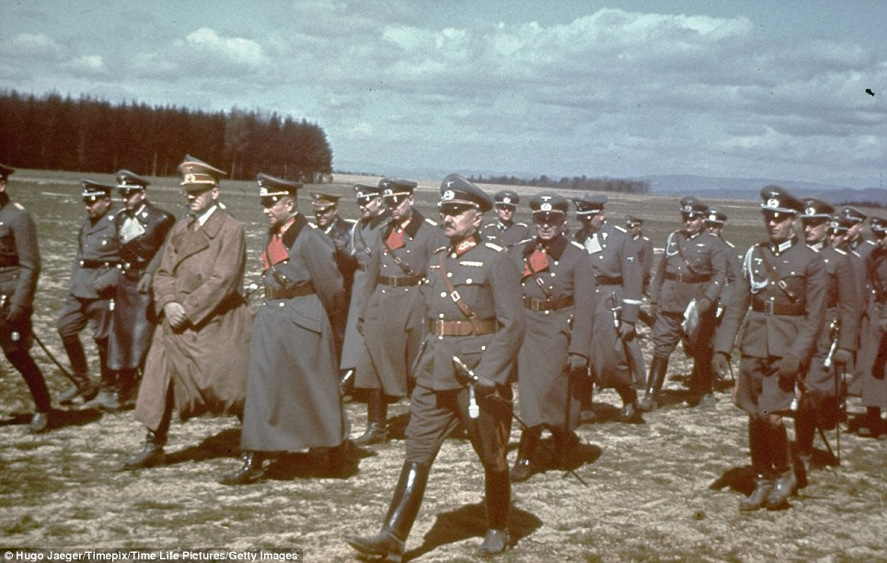
World War II

Slide 5
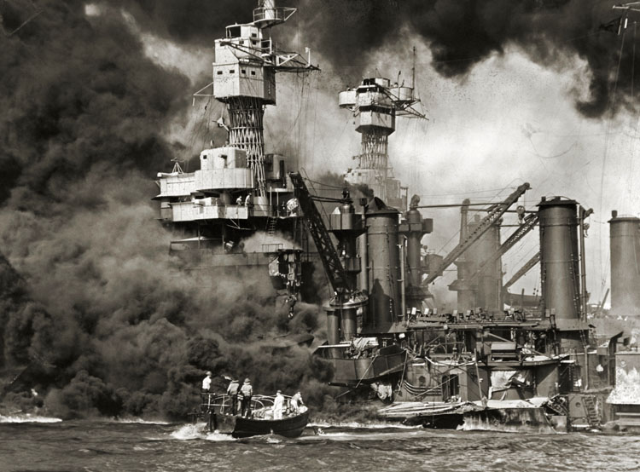
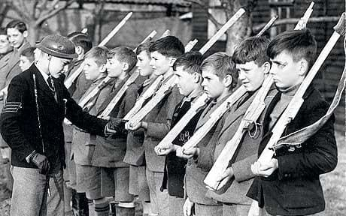
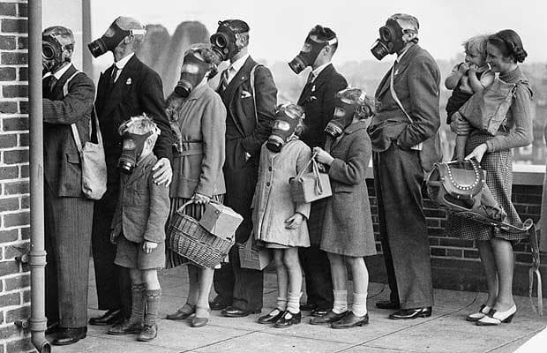
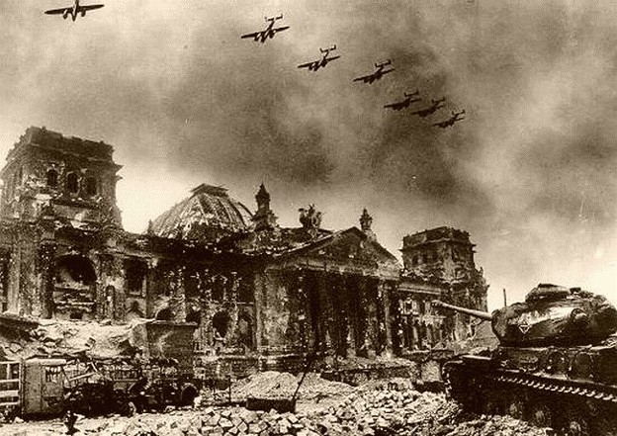
World War II

Slide 6
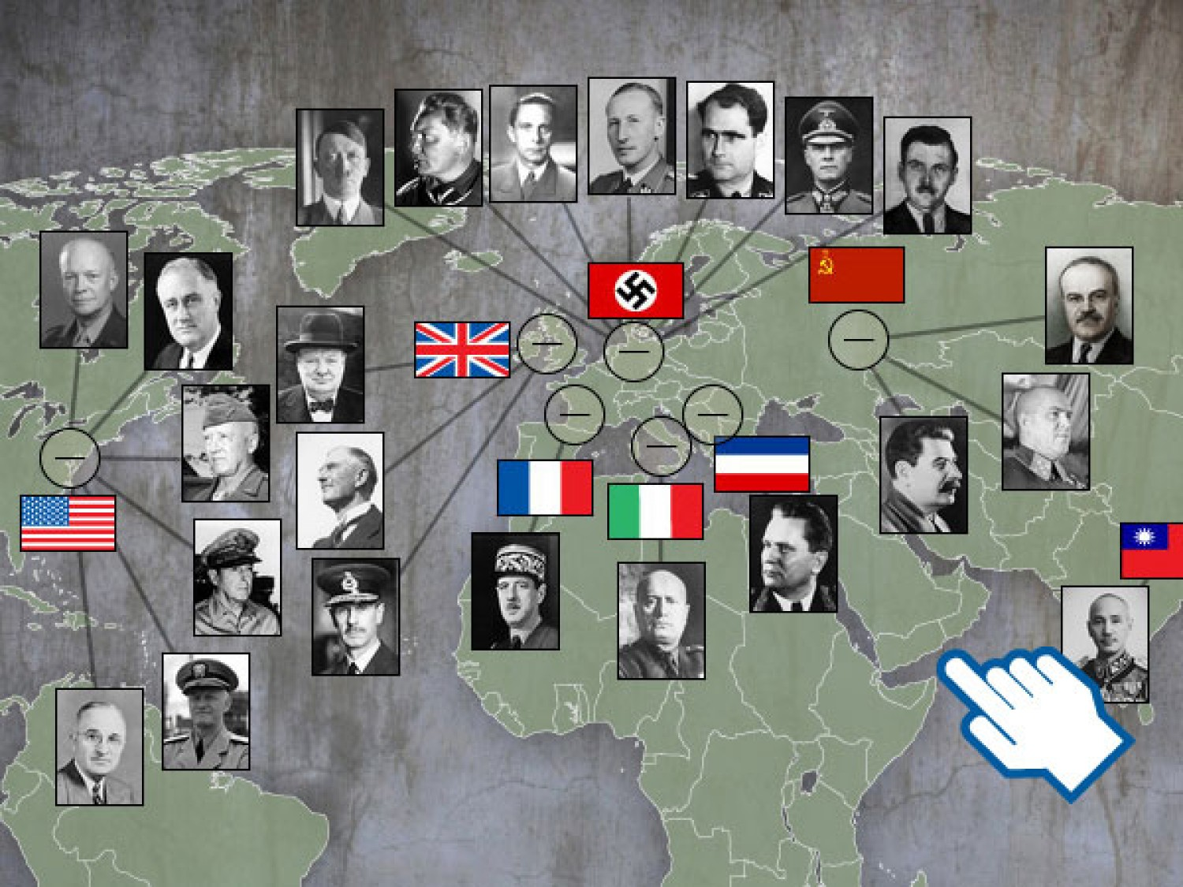
World War II (Important Figures)

Slide 7
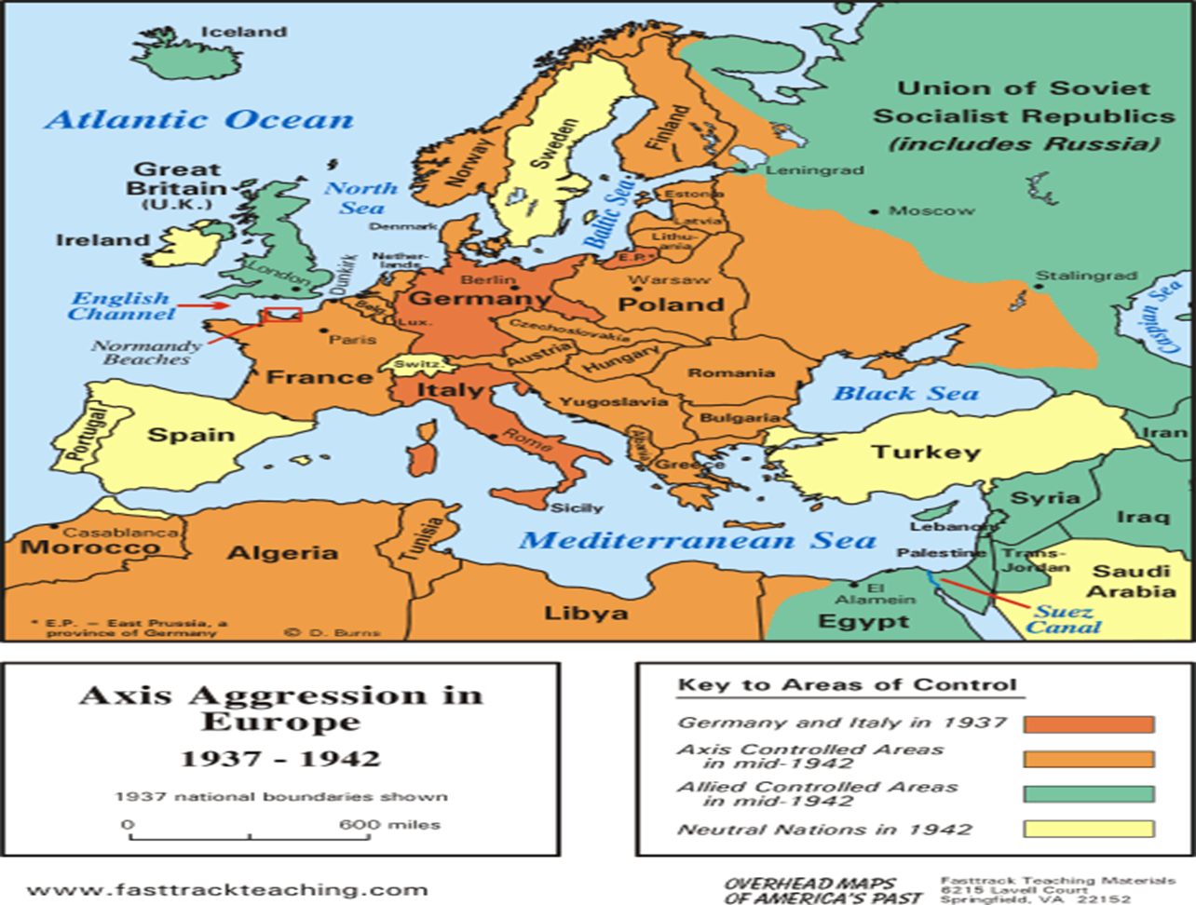
Map of Europe in 1942

Slide 8
Internal Environment and Dynamics
When World War II began, Turkey, in keeping with its status quo stance, planned to avoid war.
However, this monumental event, which affected the entire world, especially Europe, could not have failed to affect a medium-sized country like Turkey.
To stay out of the war, Turkish politicians needed to pursue flawless policies.

Slide 9
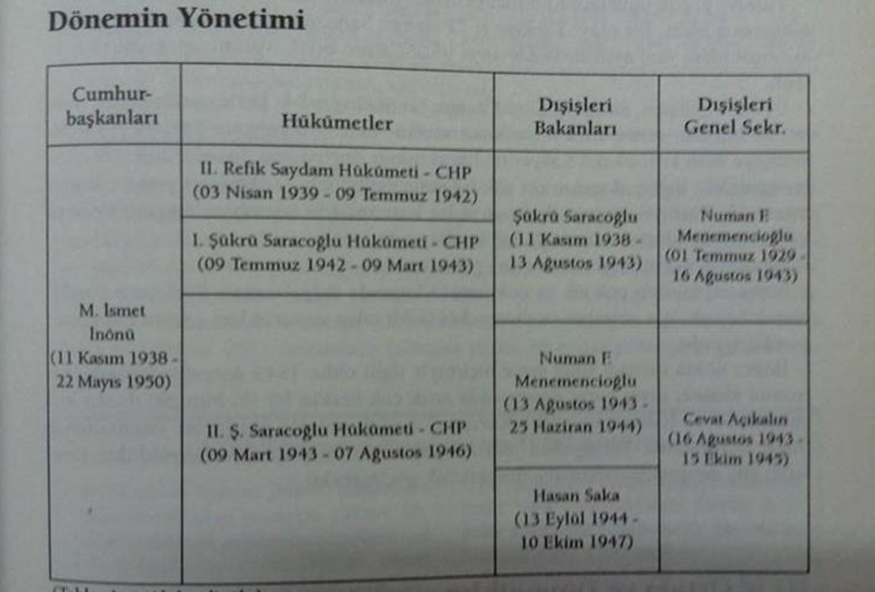
Internal Environment

Slide 10
Internal Environment and Dynamics
Türkiye's initial goal was to avoid war and occupation.
However, France's immediate defeat and surrender to the German armies put Türkiye's expectations of the Triple Alliance into jeopardy.
The German armies turned east, and with Italy's entry into the war, the war shifted to the Mediterranean.
Both the French navy and army quickly gave up.
Italy entered the war in June 1940, and by March 1941, German armies had reached the Thracian border.

Slide 11
International dynamics and Türkiye's situation were as follows;
The three-month period between March 1941 and June 1941 was the most critical for Turkish politicians.
However, Germany's attack on Russia in June ruled out a possible Poland Syndrome—that is, an invasion of our country by German armies from the west and Russian armies from the east.
The German Army's prolonged engagement in the Russian steppes, in other words, the prolongation of the war, benefited Türkiye.
Turkey knew that if either side achieved an early victory, it would return to Türkiye.
With the war's end, a bipolar world order was being established from 1946 onward, and the possibility of Türkiye pursuing a policy of regional balance within this new order was eliminated.

Slide 12
In order to stay away from the upcoming war, Türkiye signed the following agreements and pacts between 1923 and 1939;
Treaty of Friendship and Neutrality signed with the USSR, 1925
Briand-Kellogg Pact, which outlawed war, 1928
Treaty of Friendship and Cooperation signed with Afghanistan, 1928
Treaty of Neutrality and Accommodation signed with Italy, 1928
Treaty of Friendship and Neutrality signed with the USSR, 1929
Treaty of Friendship, Neutrality, and Economic Cooperation signed with Iran, 1932
Balkan Pact, 1934 (Turkey, Greece, Romania, Yugoslavia)
Sadabad Pact, 1937 (Turkey, Iraq, Iran, Afghanistan)
Cooperation and Assistance Pact signed with France and the United Kingdom, 1939

Slide 13
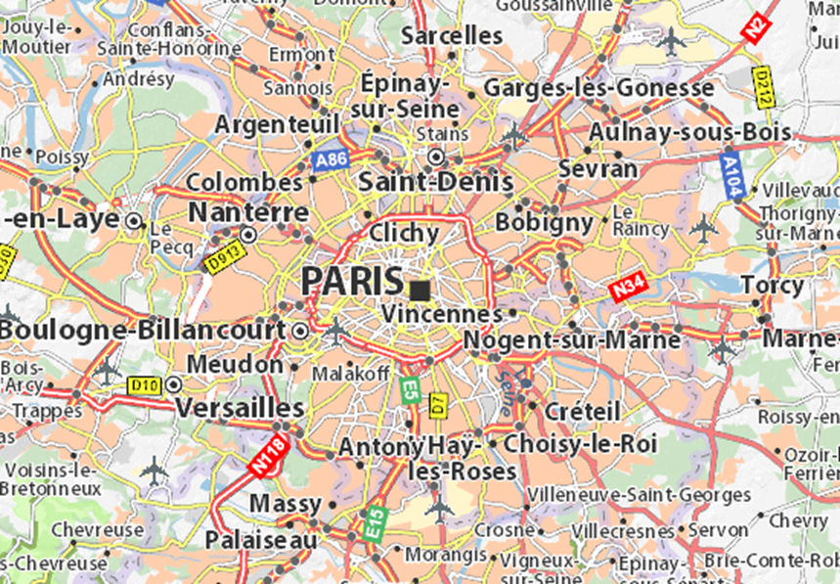
Causes of World War II
The state of discontent and rejection created by the agreements signed in the districts of Paris at the end of World War I (Versailles with Germany, Sevres with the Ottoman Empire, Saint Germain with Austria, Trianon with Hungary, Neuilly with Bulgaria)

Slide 14
Causes of World War II
The Ineffectiveness of the League of Nations
The MC outlawed war and envisioned resolving problems through collective cooperation, but it could not prevent Japan's invasion of China, Italy's invasion of Abyssinia, or Germany's invasion of Poland.
The MC, a universal organization, was merely a document of goodwill, remaining on paper.

Slide 15
Causes of World War II
The US's Return to a Policy of Isolation
The US, the only power capable of stopping Germany, retreated to its own continent, effectively playing into the hands of revisionist powers.
Japan's Expansionist Policy
As a result of Japan's invasion of China to address its raw material shortage, the status quo European powers (Britain, France, and the Netherlands) with colonies in the region sent troops to the region, which benefited Germany.

Slide 16
Causes of World War II
Hitler's Aggressive Policy
Introducing compulsory military service,
Unifying with Austria,
Occupying neighboring countries to gain a living space
The occupation began with Czechoslovakia in March 1939 and continued with the invasion of Poland on October 30, 1939.
In the summer of 1940, France, the Netherlands, Belgium, the Baltic states, and the Scandinavian countries were occupied.
If the island of England had been occupied, England would have been eliminated after France.
The invasion of Russia began in June 1941. It lost four weeks in the Balkans before attacking Russia.
These four weeks served as winter aid to the Russians. If England had been occupied instead of Russia, the course of the war could have been different.

Slide 17
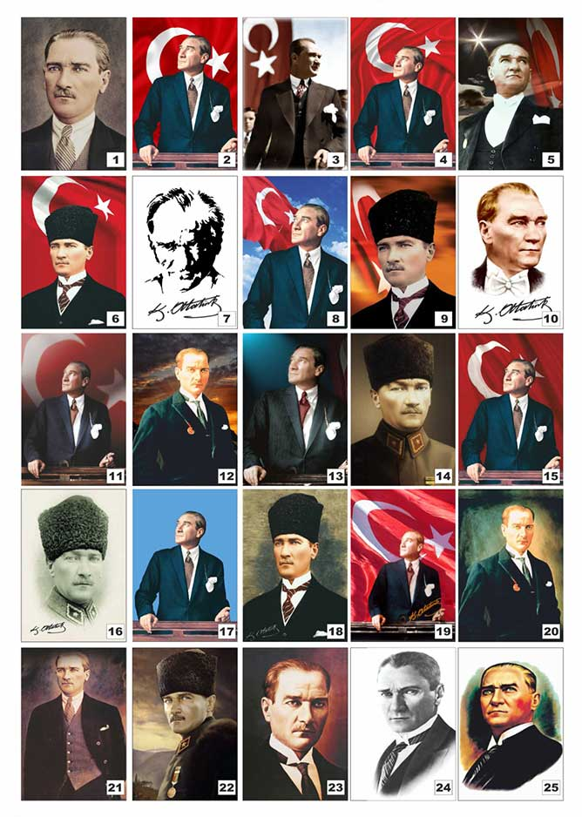
Questions?

