Slide 1


Slide 2
Topics Covered
4.1 How Financial Ratios Relate to Shareholder Value
4.2 Measuring Market Value and Market Value Added
4.3 Economic Value Added and Accounting Rates of Return
4.4 Measuring Efficiency
4.5 The Du Pont System
4.6 Measuring Financial Leverage
4.7 Measuring Liquidity
4.8 Interpreting Financial Ratios
4.9 The Role of Financial Ratios
Notes:
3
2
2
2
2
2

Slide 3
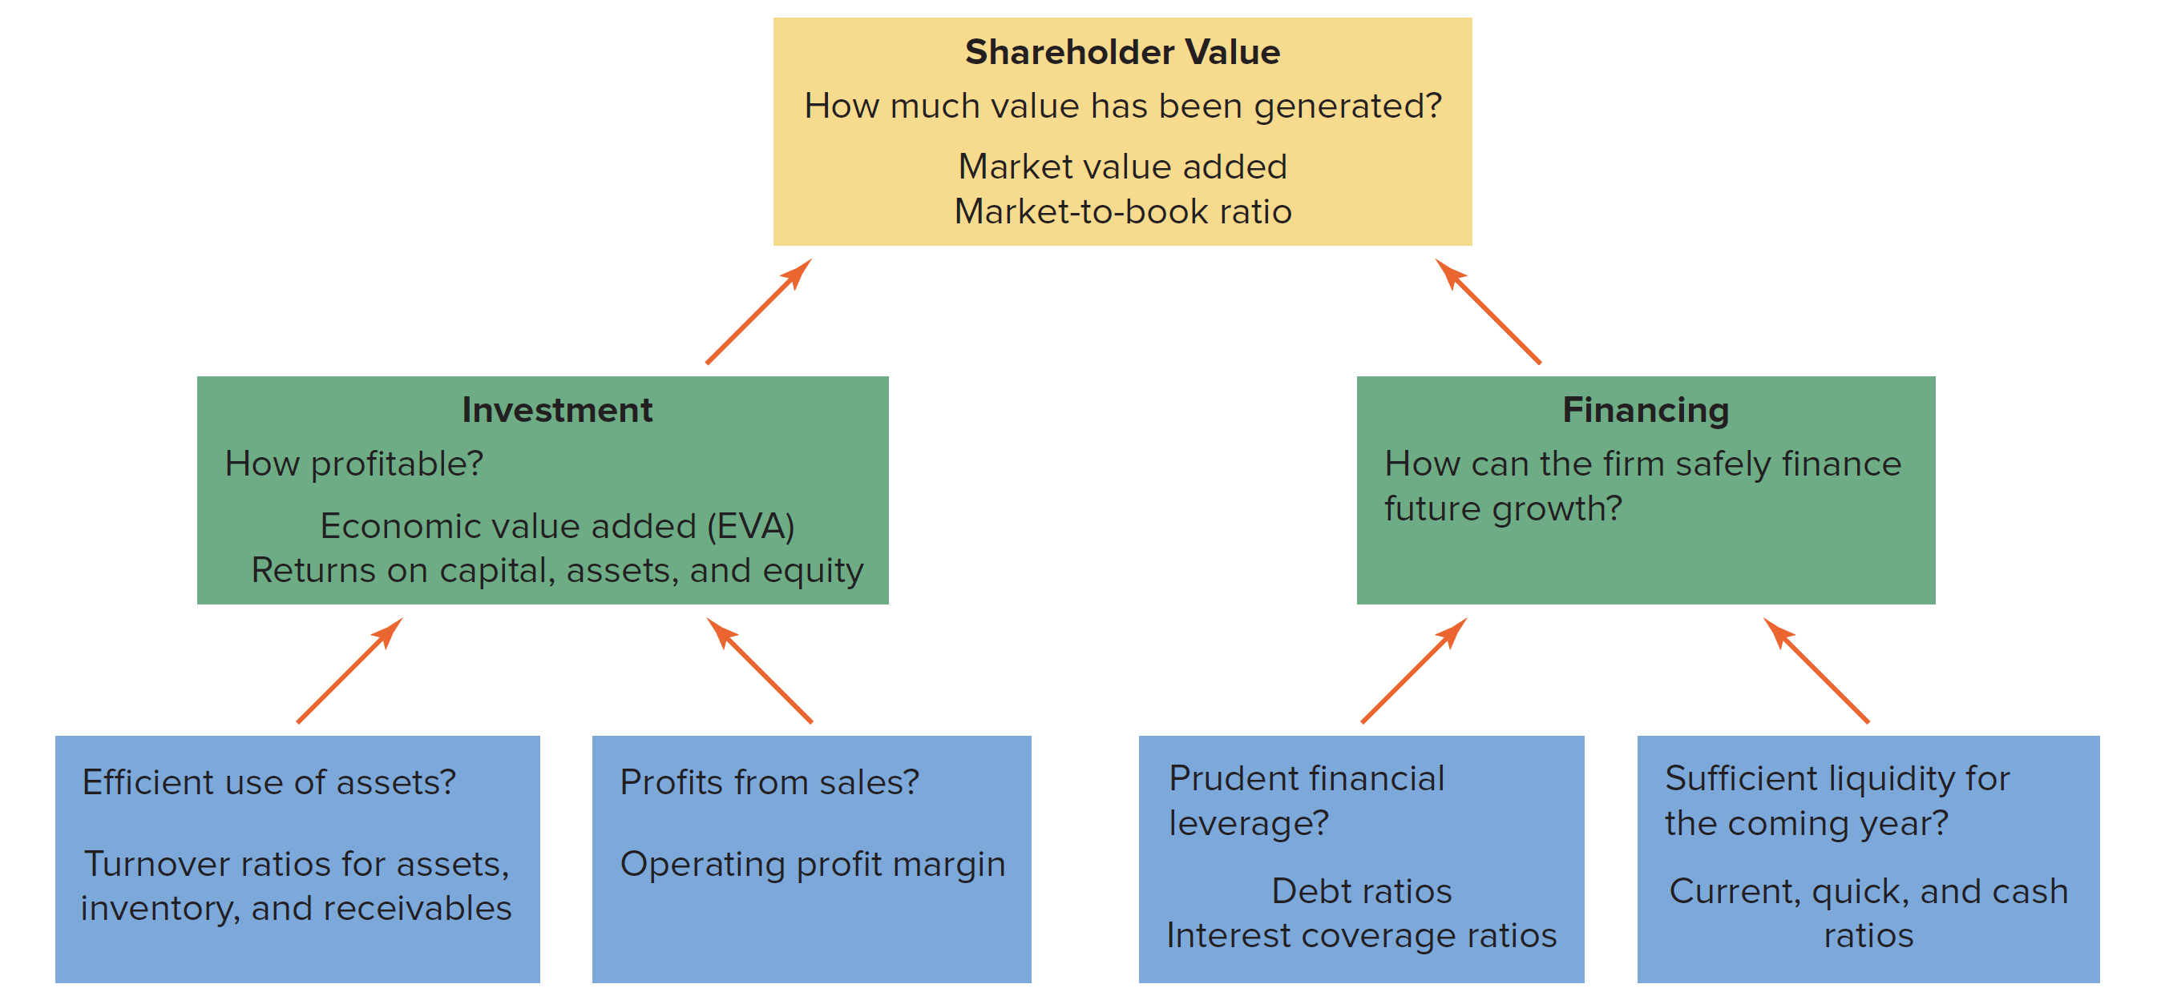
Value and Value Added

Slide 4
Market Value and Market Value Added (1 of 6)
Market Capitalization
  Total market value of equity, equal to share price times number of shares outstanding
    Market capitalization = (#shares) × (price per share)
Market Value Added
  Market capitalization minus book value of equity
    MVA = market capitalization - equity _{book value}

Slide 5
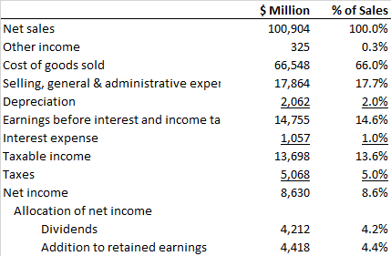
Market Value and Market Value Added (2 of 6)
Home Depot Income Statement (December 31, 2017)
Notes:
13

Slide 6
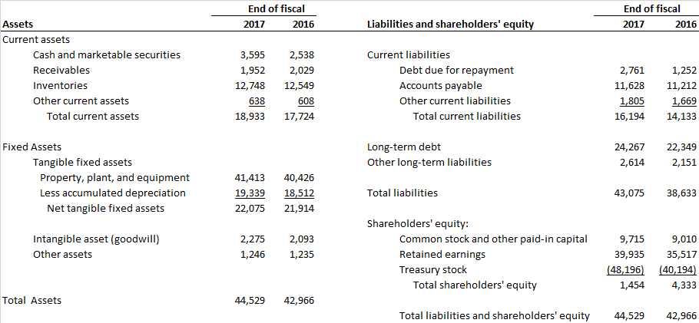
Market Value and Market Value Added (3 of 6)
Home Depot Balance Sheet (December 31, 2017) $Millions

Slide 7
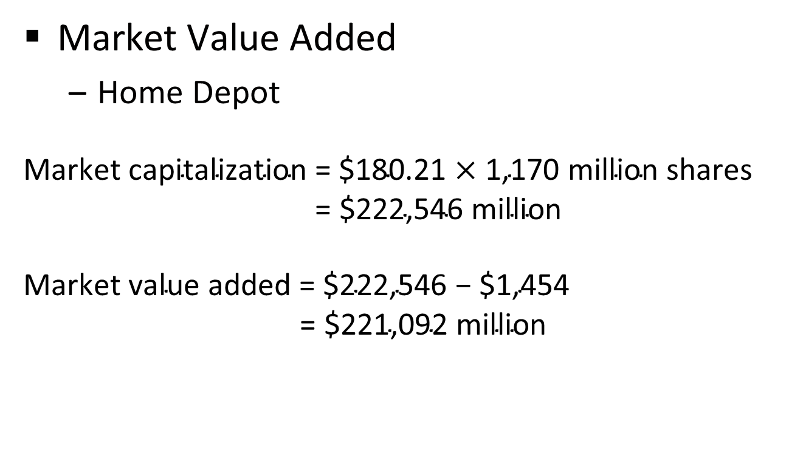
Market Value and Market Value Added (4 of 6)
Market Value Added
  Home Depot
$$\text{Market} \text{capitalization}\text{ = \$180.21 }\text{×}\text{ 1,}\text{170} \text{million} \text{shares}$$
$\text{= \$}\text{222,546} \text{million}$
$$\text{Market} \text{value} \text{added}\text{ = \$222,546 − \$1,454 }$$
$\text{= \$}\text{221}\text{,}\text{092} \text{million}$

Slide 8

Market Value and Market Value Added (5 of 6)
Market-to-Book Ratio
  Ratio of market value of equity to book value of equity
Market-to-book ratio $\text{=} \frac{\text{market} \text{value} \text{of} \text{equity}}{\text{book} \text{value} \text{of} \text{equity}}$
$$\text{=} \frac{\text{\$222,546}}{\text{\$1,454}}$$
$\text{=}$ 148.3

Slide 9
Market Value and Market Value Added (6 of 6)
Stock market measures of company performance, 2017. Companies are ranked by market value added (dollar values in millions)
Consider Walmart and Coca Cola
  Similar MVA, Different Market-to-Book Ratio; Why?

Slide 10
EVA and Accounting ROR (1 of 6)
Economic Value Added (EVA)
  Net income minus a charge for the cost of capital employed; also called residual income
Residual Income
  Net dollar return after deducting the cost of capital

Slide 11
EVA and Accounting ROR (2 of 6)
EVA =
  after tax operating income -
  (cost of capital × total capitalization)
After tax operating income =
  (1 - tax rate) × interest expense + net income
Total capitalization =
  long-term debt + shareholder’s equity

Slide 12
EVA and Accounting ROR (3 of 6)
Home Depot EVA
Total capitalization = $22,349 + $4,333 = $26,682
EVA = [(1-.35) × 1,057] + 2,188 - (.082 × 26,682)
= $7,129 million

Slide 13
EVA and Accounting ROR (4 of 6)
EVA and ROC,2017. Companies are ranked by EVA (dollar values in millions)

Slide 14
EVA and Accounting ROR (5 of 6)
Return on Capital (ROC)
  Net income plus after-tax interest as a percentage of long-term capital
Return on Assets (ROA)
  Net income plus after-tax interest as a percentage of total assets
Return on Equity (ROE)
  Net income as a percentage of shareholders’ equity

Slide 15
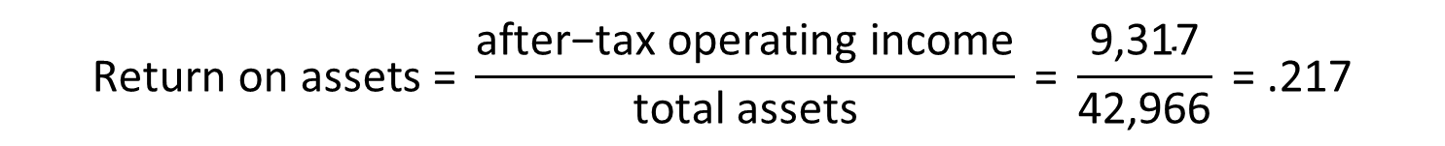
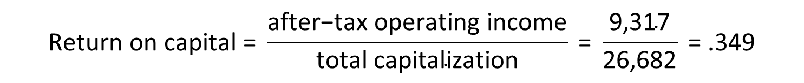

EVA and Accounting ROR (6 of 6)
Home Depot Profitability Measurements
$$\text{Return} \text{on} \text{capital}\text{ = }\frac{\text{after}\text{−}\text{tax} \text{operating} \text{income}}{\text{total} \text{capitalization}} \text{=} \frac{\text{9,317}}{\text{26,682}} \text{=}\text{ .349}$$
$$\text{Return} \text{on} \text{assets}\text{ = }\frac{\text{after}\text{−}\text{tax} \text{operating} \text{income}}{\text{total} \text{assets}} \text{=} \frac{\text{9,317}}{\text{42,966}} \text{=}\text{ .217}$$
$$\text{Return} \text{on} \text{equity}\text{ = }\frac{\text{net} \text{income}}{\text{equity}} \text{=} \frac{\text{8,630}}{\text{4,333}} \text{=}\text{ 1.992 }\text{or}\text{ 199.2\%}$$

Slide 16
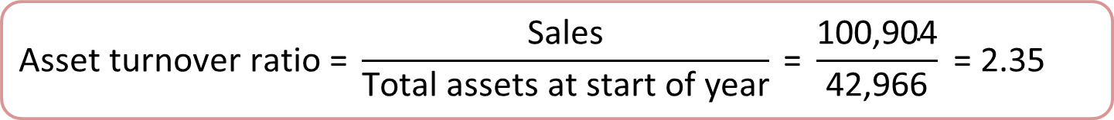
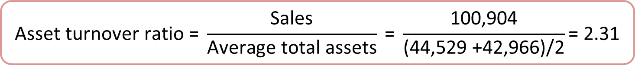
Measuring Efficiency – Asset Turnover Ratio
$$\text{Asset} \text{turnover} \text{ratio}\text{ = }\frac{\text{Sales}}{\text{Total} \text{assets} \text{at} \text{start} \text{of} \text{year}}$$
-or-
$$\text{Asset} \text{turnover} \text{ratio}\text{ = }\frac{\text{Sales}}{\text{Average} \text{total} \text{assets}}$$
For Home Depot
$$\text{Asset} \text{turnover} \text{ratio}\text{ = }\frac{\text{Sales}}{\text{Total} \text{assets} \text{at} \text{start} \text{of} \text{year}} \text{=} \frac{\text{100,904}}{\text{42,966}} \text{=}\text{ 2.35}$$
-or-
$$\text{Asset} \text{turnover} \text{ratio}\text{ = }\frac{\text{Sales}}{\text{Average} \text{total} \text{assets}} \text{=} \frac{\text{100,904}}{\text{(44,529 +}\text{42,966}\text{)/2}}\text{=}\text{ 2.31}$$
Notes:
7

Slide 17
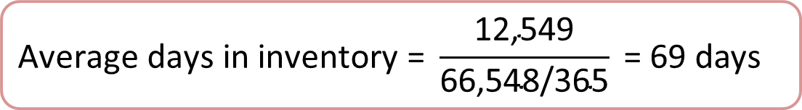
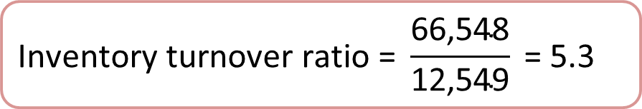
Measuring Efficiency – Inventory Turnover
$$\text{Inventory} \text{turnover} \text{ratio}\text{ = }\frac{\text{cost} \text{of} \text{goods} \text{sold}}{\text{inventory} \text{at} \text{start} \text{of} \text{year}}$$
$$\text{Inventory} \text{turnover} \text{ratio}\text{ = }\frac{\text{66,548}}{\text{12,549}} \text{=}\text{ 5.3}$$
$$\text{Average} \text{days} \text{in} \text{inventory}\text{ = }\frac{\text{inventory} \text{at} \text{start} \text{of} \text{year}}{\text{cost} \text{of} \text{goods} \text{sold}\text{/365}}$$
$$\text{Average} \text{days} \text{in} \text{inventory}\text{ = }\frac{\text{12,549}}{\text{66,548/365}} \text{=}\text{ 69 }\text{days}$$
Notes:
8

Slide 18
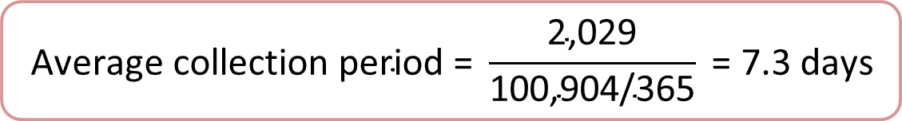
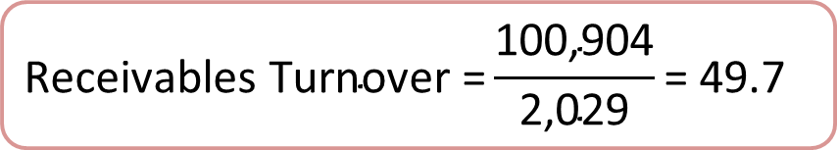
Measuring Efficiency – Receivables Turnover
$$\text{Receivables} \text{Turnover}\text{ = }\frac{\text{sales}}{\text{receivables} \text{at} \text{start} \text{of} \text{year}}$$
$$\text{Receivables} \text{Turnover}\text{ =}\frac{\text{100,904}}{\text{2,029}}\text{=}\text{ 49.7}$$
$$\text{Average} \text{collection} \text{period}\text{ = }\frac{\text{receivables} \text{at} \text{start} \text{of} \text{year}}{\text{average} \text{daily} \text{sales}}$$
$$\text{Average} \text{collection} \text{period}\text{ = }\frac{\text{2,029}}{\text{100,904/365}} \text{=}\text{ 7.3 }\text{days}$$
Notes:
8

Slide 19
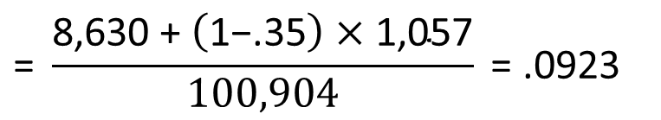
The DuPont System (1 of 4)
A breakdown of ROE and ROA into component ratios
$$\text{Profit} \text{margin}\text{ = }\frac{\text{net} \text{income}}{\text{sales}} \text{=} \frac{\text{8,630}}{\text{100,904}} \text{=}\text{ .086}$$
$$\text{Operating} \text{profit} \text{margin}\text{ = }\frac{\text{after}\text{−}\text{tax} \text{operating} \text{income}}{\text{sales}}$$
$$\text{= }\frac{\text{8,630 + }\left(\text{1−.35}\right) \text{×}\text{ 1,057}}{\text{100,904}} \text{= }\text{.0923}$$
Notes:
13

Slide 20
The DuPont System (2 of 4)
$$\text{ROA}\text{ = }\frac{\text{after}\text{−}\text{tax} \text{operating} \text{income}}{\text{assets}}$$
$$\text{ROA}\text{ =}\frac{\text{sales}}{\text{assets}} \text{×} \frac{\text{after}\text{−}\text{tax} \text{operating} \text{income}}{\text{sales}}$$
$$\text{Operating}$$
$$\text{profit}$$
$$\text{margin}$$
$$\text{Asset}$$
$$\text{turnover}$$
Notes:
15

Slide 21
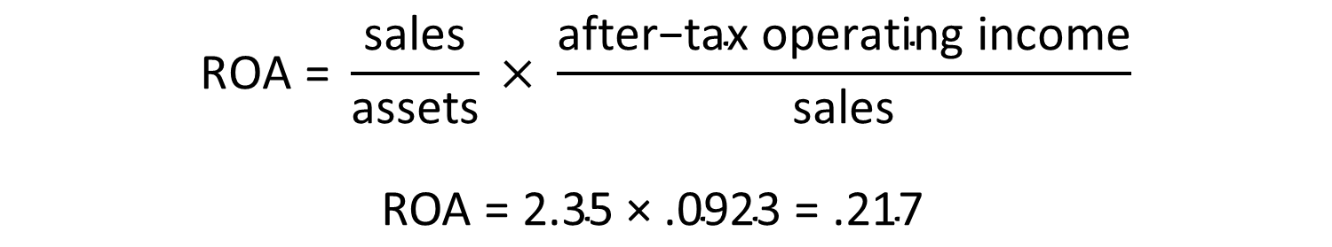
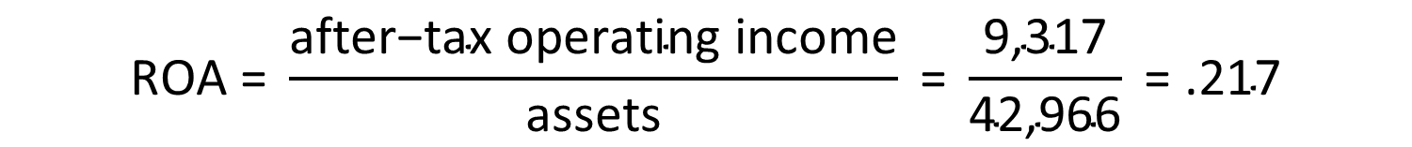
The DuPont System (3 of 4)
$$\text{ROA}\text{ = }\frac{\text{after}\text{−}\text{tax} \text{operating} \text{income}}{\text{assets}} \text{=} \frac{\text{9,317}}{\text{4}\text{2,966}} \text{=}\text{ .217}$$
$$\text{ROA} \text{=} \frac{\text{sales}}{\text{a}\text{ssets}} \text{×} \frac{\text{after}\text{−}\text{tax} \text{operating} \text{income}}{\text{sales}}$$
$$\text{ROA} \text{=}\text{ 2.35 }\text{×} \text{.0}\text{923 }\text{=} \text{.}\text{217}$$
Notes:
15

Slide 22
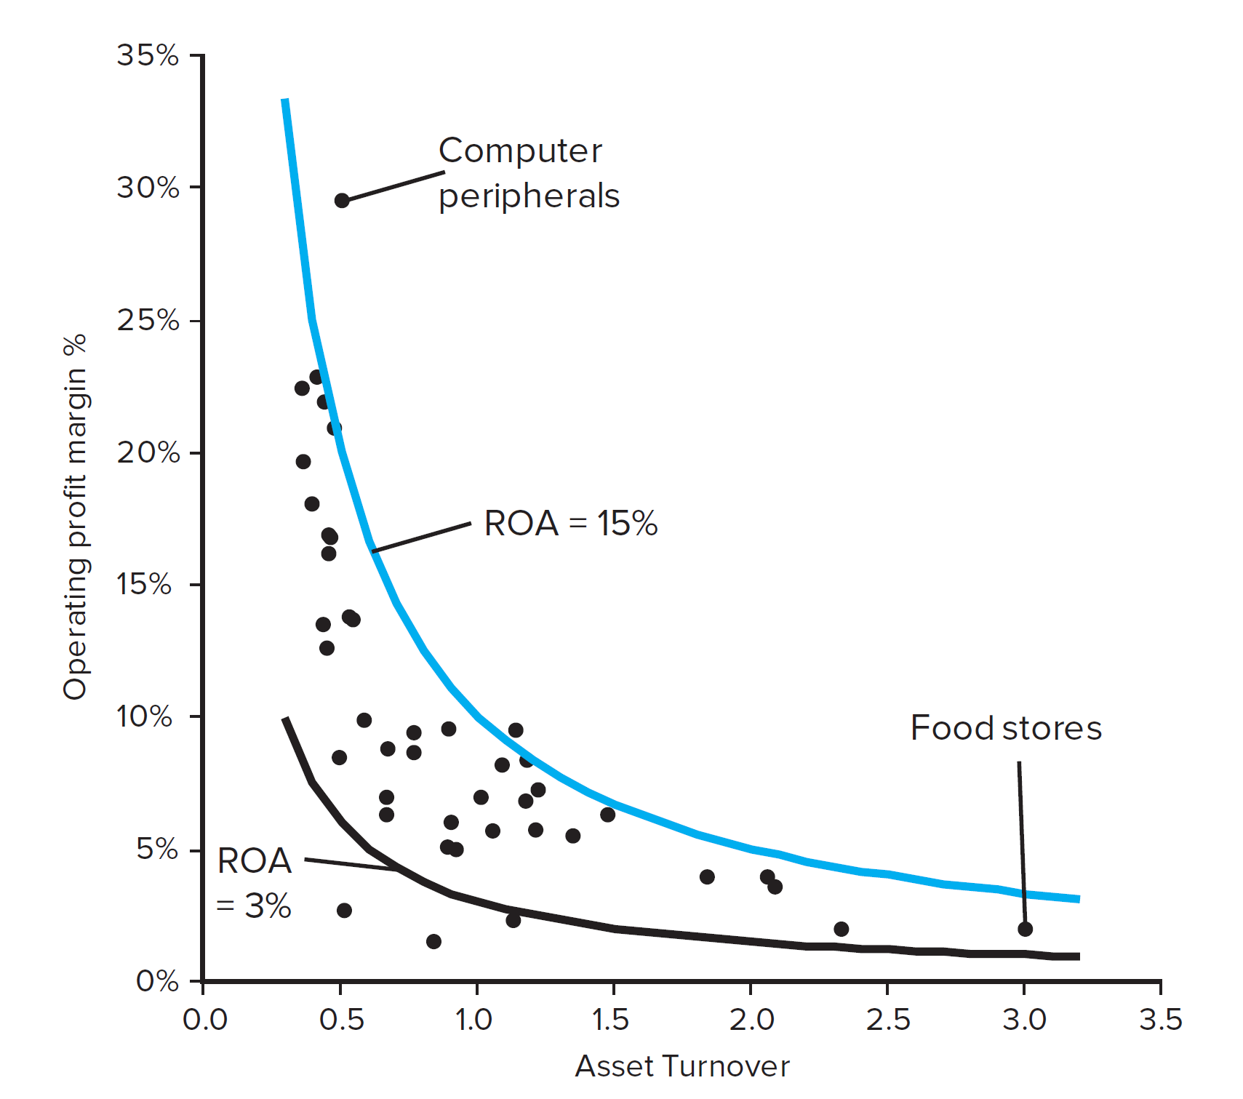
The DuPont System (4 of 4)
Median ROA, profit margin and asset turnover for 45 industries for year ending June 2015
Notes:
15

Slide 23
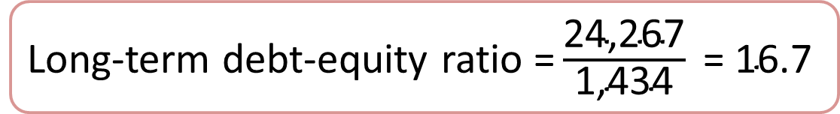
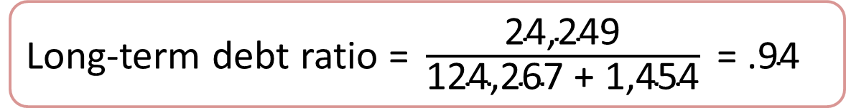
Measuring Financial Leverage (1 of 3)
Long-term debt ratio $\text{=} \frac{\text{long}\text{−}\text{term} \text{debt}}{\text{long}\text{−}\text{term} \text{debt}\text{ + }\text{equity}}$
Long-term debt ratio $\text{=} \frac{\text{24,249}}{\text{124,267 + 1,454}} \text{=}\text{ .94}$
Long-term debt-equity ratio $\text{=} \frac{\text{long}\text{−}\text{term} \text{debt}}{\text{equity}}$
Long-term debt-equity ratio $\text{=}\frac{\text{24,267}}{\text{1,434}} \text{=}\text{ 16.7}$
Notes:
3

Slide 24
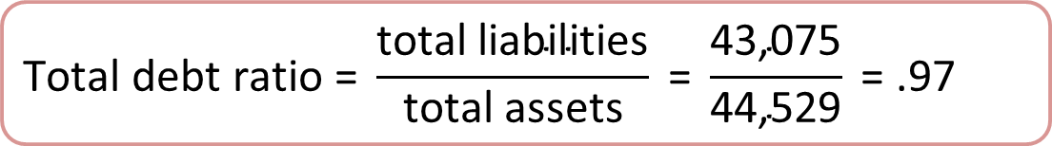
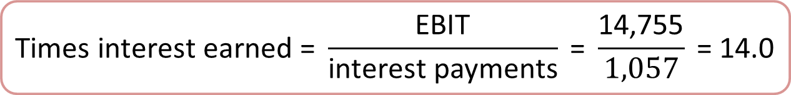
Measuring Financial Leverage (2 of 3)
$$\text{Total} \text{debt} \text{ratio}\text{ =} \frac{\text{total} \text{liabilities}}{\text{total} \text{assets}} \text{=} \frac{\text{43,075}}{\text{44,529}} \text{=}\text{ .97}$$
$$\text{Times} \text{interest} \text{earned}\text{ = }\frac{\text{EBIT}}{\text{interest} \text{payments}} \text{=} \frac{\text{14,755}}{\text{1,057}} \text{=}\text{ 14.0}$$
$\text{Cash} \text{coverage} \text{ratio}\text{ = }\frac{\text{EBIT}\text{ + }\text{depreciation}}{\text{interest} \text{payments}} \text{=} \frac{\text{14,755 + 2,062}}{1,057} \text{=}\text{ 15.}$9
Notes:
4

Slide 25
Measuring Financial Leverage (3 of 3)
Asset
Turnover
Debt
Burden
$$\text{ROE}\text{ = }\frac{\text{assets}}{\text{equity}} \text{×} \frac{\text{sales}}{\text{assets}} \text{×} \frac{\text{after}\text{−}\text{tax} \text{operating} \text{income}}{\text{sales}} × \frac{\text{net} \text{income}}{\text{after}\text{−}\text{tax} \text{operating} \text{income}}$$
Leverage
Ratio
Operating Profit
Margin
Notes:
17

Slide 26
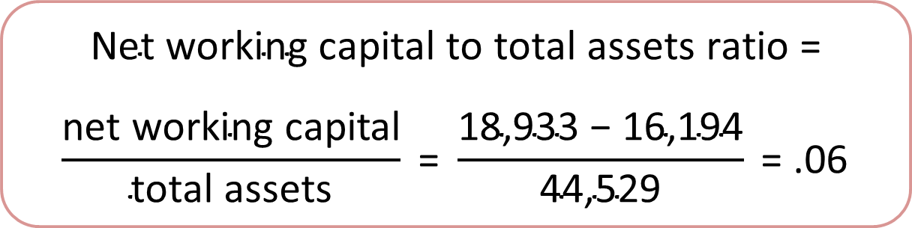
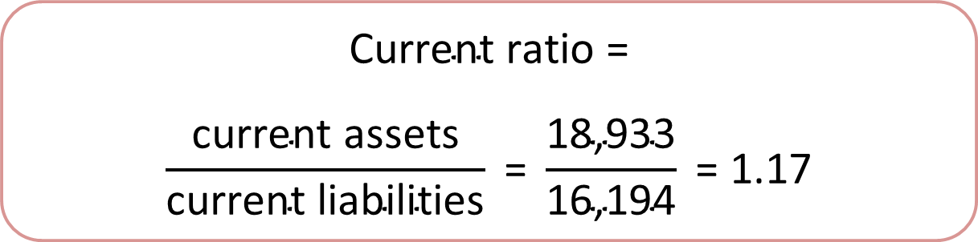
Measuring Liquidity (1 of 2)
$$\text{Net} \text{working} \text{capital} \text{to} \text{total} \text{assets} \text{ratio}\text{ =}$$
$$\frac{\text{net} \text{working} \text{capital}}{\text{total} \text{assets}} \text{=} \frac{\text{18,933 − 16,194}}{\text{44,529}} \text{=}\text{ .06}$$
$$\text{Current} \text{ratio}\text{ =}$$
$$\frac{\text{current} \text{assets}}{\text{current} \text{liabilities}} \text{=} \frac{\text{18,933}}{\text{16,194}} \text{=}\text{ 1.17}$$
Notes:
5

Slide 27
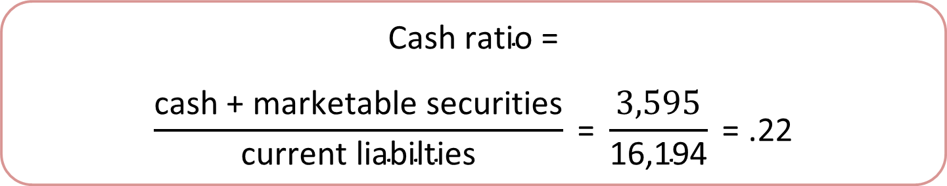
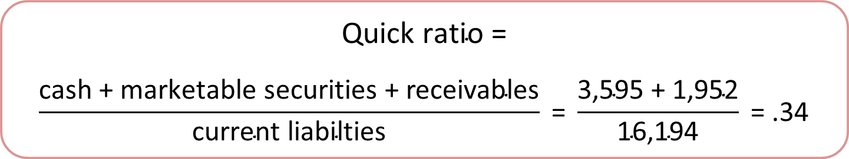
Measuring Liquidity (2 of 2)
$$\text{Quick} \text{ratio}\text{ =}$$
$$\frac{\text{cash}\text{ + }\text{marketable} \text{securities}\text{ + }\text{receivables}}{\text{current} \text{liabilties}} \text{=} \frac{\text{3,595 + 1,952}}{\text{16,194}} \text{=}\text{ .34}$$
$$\text{Cash} \text{ratio}\text{ =}$$
$$\frac{\text{cash}\text{ + }\text{marketable} \text{securities}}{\text{current} \text{liabilties}} \text{=} \frac{\text{3,595}}{\text{16,194}} \text{=}\text{ .22}$$
Notes:
6

Slide 28
Interpreting Financial Ratios (1 of 3)

Slide 29
Interpreting Financial Ratios (2 of 3)
Ratios for comparison

Slide 30
Interpreting Financial Ratios (3 of 3)
Selected March 2017 financial ratios for industry groups

Slide 31
The Role of Financial Ratios
TRANSPARENCY

