Slide 1
John Milton and his time
‘Reason is but choosing’: freedom of thought and John Milton

Slide 2
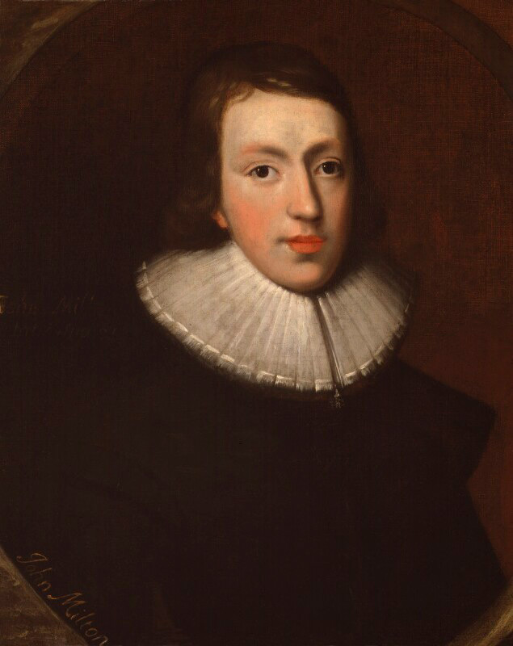

Slide 3
Freedom of the press (1644)
In a time of enormous social and ideological upheaval, with heavy censorship from the state, Milton advocated for freedom of the press, suggesting that it should be left up to the individual, rather than some authority-approved censor, to decide if their reading material was a corrupting influence or not.

Slide 4
In Areopagitica, published in 1644, Milton connected this capacity for choice with man’s original sin, Adam and Eve’s decision to eat the fruit from the forbidden Tree of Knowledge in Eden; this, of course, would become the subject for Milton’s epic poem Paradise Lost (first published in 1667).

Slide 5
He writes:
Many there be that complain of divine Providence for suffering Adam to transgress, foolish tongues! when God gave him reason, he gave him freedom to choose, for reason is but choosing; he had been else a mere artificial Adam, such an Adam as he is in the motions.

Slide 6
Milton’s point is that without freedom to choose, the decisions we make are meaningless – nothing to do with intelligence or virtue, and born only of compulsion. He calls ‘foolish’ those people who complain that God ‘suffered’ – that is, allowed – Adam (and Eve) to eat the fruit of the Tree of Knowledge, reminding his reader that without that freedom, God’s human creations would not have been fully rational beings..

Slide 7
For Milton, if God had not granted mankind ‘reason’ – which means the ability to make their own decisions, even bad ones – then these human creatures would have been little more than puppets, going through the ‘motions’ of autonomy but in reality not free. This is the animating idea behind every one of Milton’s works.

