Slide 1
Chapter 2 Mechanics of Futures Markets

Slide 2
Futures Contracts
specification
operation of margin accounts
organization of exchanges
regulation of markets
quote making
accounting

Slide 3
Futures Contract (e.g cotton futures)
Source:
https://www.danielstrading.com/education/markets/tropicals-softs/cotton-futures

Slide 4
Futures Contracts
Closing Out positions
Available on a wide range of assets
Contract size
Exchange traded
Specifications need to be defined:
What can be delivered,
Where it can be delivered, &
When it can be delivered
Settled daily

Slide 5
Convergence of Futures to Spot (Figure 2.1, page 29)
Futures
Price
Spot Price
Spot Price
Futures
Price
Time
Time
(a)
(b)

Slide 6
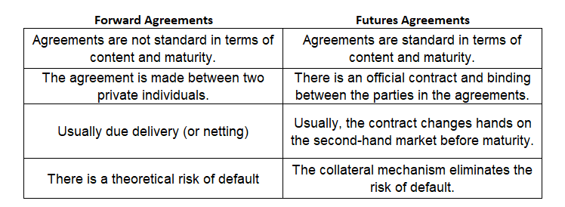
Differences between futures and forwards

Slide 7
Margins
A margin is cash or marketable securities deposited by an investor with his or her broker
The balance in the margin account is adjusted to reflect daily settlement
Margins minimize the possibility of a loss through a default on a contract

Slide 8
Margin Cash Flows
A trader has to bring the balance in the margin account up to the initial margin when it falls below the maintenance margin level
A member of the exchange clearing house only has an initial margin and is required to bring the balance in its account up to that level every day.
These daily margin cash flows are referred to as variation margin
A member is also required to contribute to a default fund
Margin Call

Slide 9
Initial Margin
Investors who will take both long and short positions in futures agreements have to give a certain percentage of their contracts to intermediary institutions in cash.
As a result of this guarantee, any investor holding a long or short position will not face any problems while realizing their profits at the end of the maturity date.
Generally it is stated by the organized exchange but
If it is not stated IM is σ (Variance) x 3
For example is σ = % 2 then IM is % 6

Slide 10
Example 1
Contract value : 2 TL
Underlying asset: SAHOL stock
Buys 50.000 unit
Variance ( σ )of the SAHOL is 2,5%
How much is the Initial Margin?

Slide 11
Contract value : 2 TL
Underlying asset: GARAN stock
Buys 50.000 unit
Variance ( σ )of the GARAN is 2%
How much is the Initial Margin?

Slide 12
Initial Margin
The very high initial margin received reduces the demand for these markets.
Calculation of the margin rate too low may also cause a risk of default in the futures transaction.
Initial margin can be increased during periods when the underlying asset and futures markets are very volatile.

Slide 13
Maintenance Margin
For example, the unit futures agreement value of 2 TL can reach 2.2 TL at the end of the day, or it can reach values such as 1.8 TL. In practice in the futures market, the price of the futures product is subject to a continuous daily evaluation. The process of continuously evaluating the collateral value with the forward product price is called "mark-to-market".

Slide 14
Example 3
Contract value : 2 TL
Underlying asset: SAHOL stock
Long 50.000 unit
1 day later value drops to 1,9 TL
Profit or Loss how much?

Slide 15
Example 4
Contract value : 100 $
Underlying asset: Nasdaq Index
Short 2.000 unit
1 day later value drops to 90 $
Profit or Loss how much?

Slide 16
Maintenance Margin
Such market movements may render collateral in the futures markets insufficient. Therefore, a second collateral structure is required. Usually 75% of the value of the initial margin is called the maintenance margin.
A mechanism has been developed to prevent the value of the investor's initial collateral from depreciating by more than 25%.

Slide 17
Example 5
If the initial margin of a futures contract is 9.000 TL, what is the maintenance margin?

Slide 18
Margin Call
In a futures contract, a margin call is made when the portfolio value falls below the maintenance margin.
In the valuation made at the end of the day, if the value of the collateral falls below the maintenance collateral, the intermediary institution calls the customer and asks for a certain amount of cash to be added to the collateral account.
This cash margin completion process requested from the customer is called “margin call".

Slide 19
Margin Call
The customer is obliged to deposit the amount between the current value of the collateral and the initial collateral into the collateral account in cash.
If the investor does not perform this transaction, the brokerage house may sell the investor's account to another customer.

Slide 20
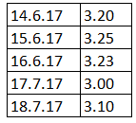
Example 7
At 14.06.2017, an investor is long at a 100.000 unit futures contract with a value of 3,2$. Initial Margin is 10%
Following occur per the dates:
What is the profit / loss per day?
What is the collateral account per day?

Slide 21
Margin Cash Flows When Futures Price Increases
Clearing House
Clearing House
Member
Clearing House
Member
Broker
Broker
Long Trader
Short Trader

Slide 22
Margin Cash Flows When Futures Price Decreases
Clearing House
Clearing House
Member
Clearing House
Member
Broker
Broker
Long Trader
Short Trader

Slide 23
Some Terminology
Open interest: the total number of contracts outstanding
equal to number of long positions or number of short positions
Settlement price: the price just before the final bell each day
used for the daily settlement process
Volume of trading: the number of trades in one day

Slide 24
Key Points About Futures
They are settled daily
Closing out a futures position involves entering into an offsetting trade
Most contracts are closed out before maturity

Slide 25
Clearing Houses and OTC Markets
Traditionally most transactions have been cleared bilaterally in OTC markets
Following the 2007-2009 crisis, the has been a requirement for most standardized OTC derivatives transactions between dealers to be cleared through central counterparties (CCPs)
CCPs require initial margin, variation margin, and default fund contributions from members similarly to exchange clearing houses

Slide 26
Collateralization in OTC Markets
It is becoming increasingly common for transactions to be collateralized in OTC markets
Bilateral Clearing
Consider transactions between companies A and B
These might be governed by an ISDA Master agreement with a credit support annex (CSA)

Slide 27
Collateralization in OTC Markets continued
If A defaults, B is entitled to take possession of the collateral
See Business Snapshot 2.2 for how collateralization affected Long Term Capital Management when there was a “flight to quality” in 1998.

Slide 28
A-----------------------------------B
CONTRACT (BILATERAL)
Value of the contract increases by X$ for A
Value of the contract decreases by X$ for B
In this case B has to provide collateral to A

Slide 29
Bilateral Clearing vs Central Clearing House

Slide 30
New Regulations
New regulations for trades between dealers that are not cleared centrally require dealers to post both initial margin and daily variation margin
The initial margin is posted with a third party

Slide 31
Delivery
If a futures contract is not closed out before maturity, it is usually settled by delivering the assets underlying the contract. When there are alternatives about what is delivered, where it is delivered, and when it is delivered, the party with the short position chooses.
“Notice of intention to deliver”
A few contracts (for example, those on stock indices and Eurodollars) are settled in cash

Slide 32
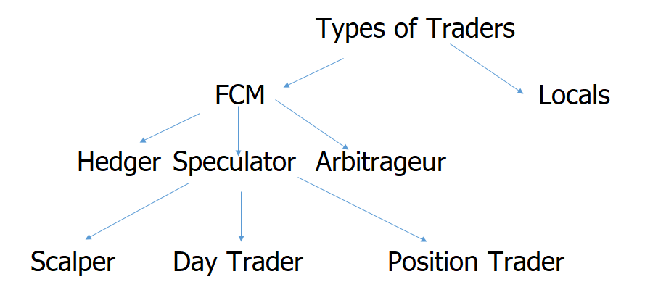
Types of Traders

Slide 33
Forward Contracts vs Futures Contracts (Table 2.3, page 43)
FORWARDS
FUTURES
Private contract between 2 parties
Exchange traded
Non-standard contract
Standard contract
Usually 1 specified delivery date
Range of delivery dates
Settled at end of contract
Settled daily
Delivery or final cash
Contract usually closed out
settlement usually occurs
prior to maturity
Some credit risk
Virtually no credit risk
Notes:
16

Slide 34
Foreign Exchange Quotes
Futures exchange rates are quoted as the number of USD per unit of the foreign currency
Forward exchange rates are quoted in the same way as spot exchange rates. This means that GBP, EUR, AUD, and NZD are quoted as USD per unit of foreign currency. Other currencies (e.g., CAD and JPY) are quoted as units of the foreign currency per USD.
Notes:
17

