Slide 1
Chapter Five
Money Markets
©McGraw-Hill LLC. All rights reserved. No reproduction or distribution without the prior written consent of McGraw-Hill.

Slide 2
Money Markets
Money markets trade debt securities or instruments with maturities of less than one year
  Once issued, money market instruments trade in active secondary markets
  Need for money markets arises because the immediate cash needs of individuals, corporations, and governments do not necessarily coincide with their receipts of cash
Money market instruments share basic characteristics:
  Generally sold in large denominations ($1m to $10m units)
  Low default risk, the risk of late or nonpayment of principal and/or interest
  Must have an original maturity of one year or less

Slide 3

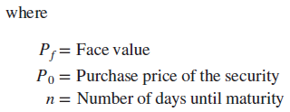

Yields on Money Market Securities
The bond equivalent yield is the quoted nominal, or stated, yield on a security
Bond equivalent yield on money market securities with a maturity of less than one year can be converted to an effective annual interest return (EAR):
Notes:
The bond equivalent yield does not consider the effects of compounding of interest during a less than one year investment horizon. If interest is paid or compounded more than once per year, the true annual rate earned is the effective annual return on an investment.

Slide 4

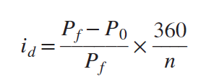
Yields on Money Market Securities: Discount Yields
Some money market instruments (e.g., T-bills and commercial paper) are bought and sold on a discount basis
  Yields on these securities use a 360-day year
  Return on these securities results from the purchase of the security at a discount from its face value (P₀) and the receipt of face value (P_{f}) at maturity
Interest rates on discount securities, or discount yields, are quoted on a discount basis using the following equation:

Slide 5
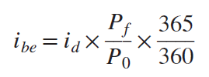
Yields on Money Market Securities: Discount Yields (Continued)
Several features of a discount yield make it difficult to compare with bond equivalent yields on other (nondiscount) securities
  Discount yields use the terminal price, or the security’s face value, as the base price in calculating an annualized interest rate, whereas bond equivalent yields are based on the purchase price of a security
  Discount yields use a 360-day year rather than a 365-day year to compute interest returns
Discount yield can be converted into a bond equivalent yield in the following manner:

Slide 6



Yields on Money Market Securities: Single-Payment Yields
Some money market securities (e.g., negotiable CDs and fed funds) pay interest only once during their lives: at maturity
  Quoted nominal interest rates on single-payment securities normally assume a 360-year.
  To compare interest rates against securities that pay interest based on a 365-day year, the nominal interest rate must be converted to a bond equivalent yield in the following manner:
The EAR for single-payment securities must utilize the bond equivalent yield as follows:
or

Slide 7
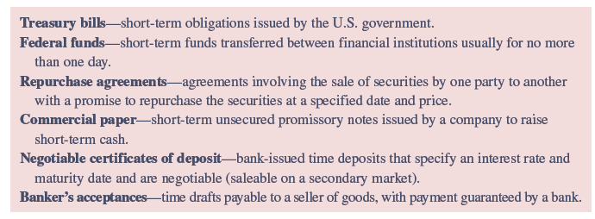
Money Market Instruments
Notes:
A variety of money market securities are issued by corporations and government units to obtain short-term funds. These securities include Treasury bills, federal funds, repurchase agreements, commercial paper, negotiable certificates of deposit, and banker’s acceptances.

Slide 8
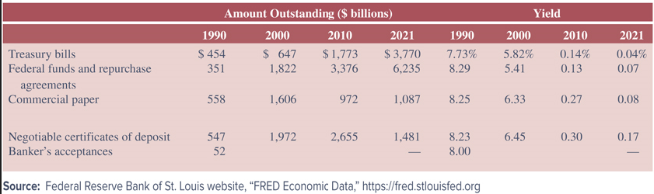
Money Market Instruments Outstanding
Notes:
Table 5–3 lists the amounts outstanding and the interest rate on each type of money market instrument from 1990 to 2021.

Slide 9
Treasury Bills (T-Bills)
T-Bills are short-term debt obligations issued by the U.S. government to cover government budget deficits and to refinance maturing government debt
  Main tool used by the Federal Reserve to implement monetary policy
  Original maturities are 4, 13, 26, and 52 weeks
  Issued in denominations of multiples of $100
  Existing T-bills can be bought and sold in an active secondary market through government securities dealers who purchase T-bills from the U.S. government and resell them to investors
  Virtually default risk free, with little interest rate or liquidity risk

Slide 10
The New Issue and Secondary Market Trading Process for T-Bills
A treasury bill auction is the formal process by which the U.S. Treasury sells news issues of T-bills
  Bids are submitted by government securities dealers, financial and nonfinancial corporations, and individuals
  Bids may be competitive or noncompetitive
  Competitive bids specify the amount of par value of bills desired and the discount yield, rather than the price
    Generally used by large investors and government securities dealers and make up most of the auction market
  Noncompetitive bids are limited to $5m for a single bidder; they specify only the desired amount of the face value of the bills
    Usually represent a small portion of total T-bills auctioned, but allow small investors to participate in the T-bill auction market

Slide 11
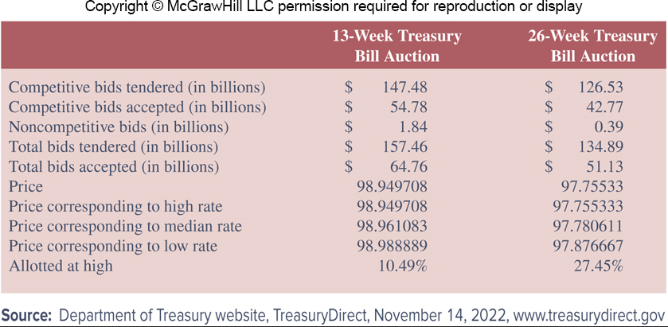
Treasury Auction Results,
November 14, 2022
Notes:
Table 5–4 shows the results of the Treasury auction of 13- and 26-week Treasury bills on November 14,2022. At this auction, 41.13 percent and 37.90 percent of the total submitted bids were accepted for the 13- and 26-week T-bills, respectively.
The highest accepted bid price on the 26-week T-bills was 97.876667 percent of the face value of the T-bills. Bids were filled at prices below the high. The lowest accepted bid price was 97.755333 percent. The median accepted bid price was 97.780611 percent.

Slide 12
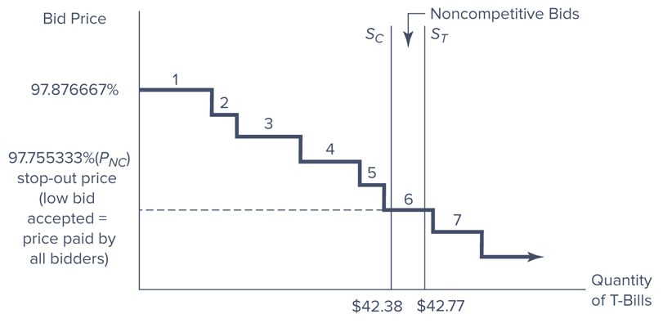
Treasury Auction Results
Notes:
Figure 5–1 illustrates the T-bill auction for the 26-week T-bills.
All bidders who submitted prices above 97.755333 percent (categories 1 through 5 in Figure 5–1) were awarded in full (winning bids) at a price of 97.755333 percent. Thus, those who submitted a bid at a price greater than 97.755333 percent paid less than their bid price yet received their full allocation of T-bills requested. Bidders who submitted a price below 97.755333 percent (categories 7 and beyond in Figure 5–1) received no allocation of the auctioned T-bills. Finally, of the bidders whose yield turned out to be the stop-out yield (i.e., the price submitted was exactly 97.755333 percent, category 6 in Figure 5–1), 27.45 percent received their desired allocations (the “allotted at high”).

Slide 13
Secondary Market for T-Bills
Secondary market for T-bills is the largest of any U.S. money market security
24 FIs are designated as ‘primary government securities dealers’ and purchase most of the T-bills sold competitively at auction, creating an active secondary market
  Around 500 smaller dealers directly trade in this secondary market
  Primary dealers “make a market” for T-bills by buying and selling securities for their own account and by trading for their customers
  Secondary market T-bill transactions between primary government securities dealers are conducted over the Federal Reserve’s wire transfer service — Fedwire

Slide 14
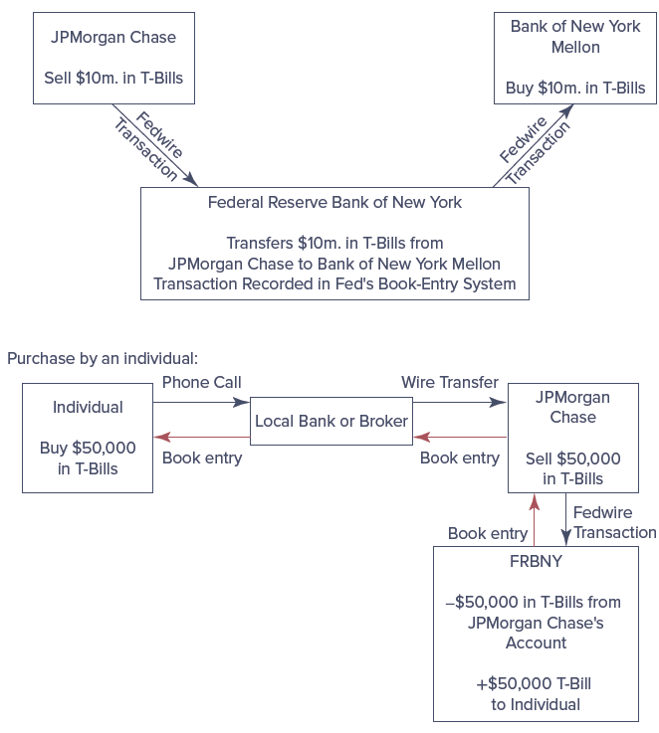
Secondary Market T-Bill Transaction

Slide 15


T-Bill Yields
Discount yield on a T-bill is calculated as follows:
The formula for a bond equivalent yield on a T-bill is:

Slide 16
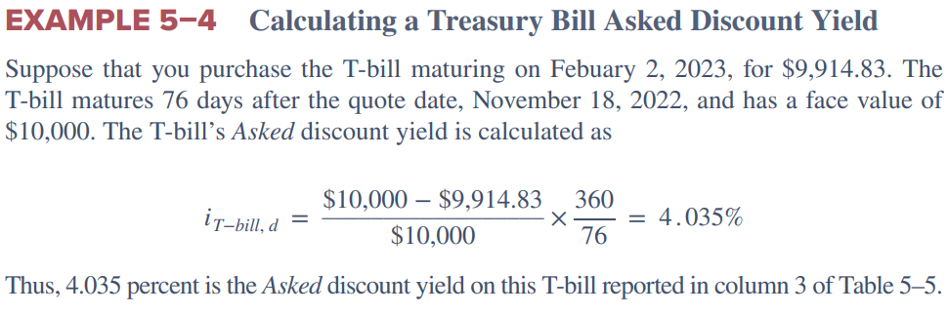
T-Bill Yield: Example 5-4

Slide 17
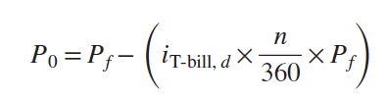
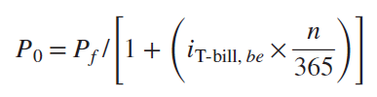
T-Bill Yields (Continued)
For the asked discount yield, the required market ask price would be:
For the bond equivalent yield, the required market ask price would be:

Slide 18
Federal Funds
Federal funds (fed funds) are short-term funds transferred between financial institutions, usually for a period of one day
  Commercial banks trade fed funds in the form of excess reserves held at their local Federal Reserve Bank
Fed funds rate is the interest rate for borrowing fed funds
  Function of the supply and demand for federal funds among financial institutions and the effects of the Federal Reserve’s trading through the FOMC
Primary risk of interbank lending system is that the borrowing bank does not have to pledge collateral for the funds it receives, which are usually in the millions
Notes:
Federal funds (fed funds) are single-payment loans—they pay interest only once, at maturity.

Slide 19
Trading in the Federal Funds Market
Fed funds market is a highly liquid and flexible source of funding for commercial banks and savings banks
  Commercial banks, especially the largest commercial banks, conduct most transactions in the fed funds market
Correspondent banks are those with reciprocal accounts and agreements
  Banks with excess reserves call correspondent banks to see if they need overnight reserves, selling the excess reserves to the correspondent banks that offer the highest rates for the fed funds
  Overnight fed funds loans will likely be based on an oral agreement between the two parties and are generally unsecured loans

Slide 20
Repurchase Agreements
A repurchase agreement (repo or RP) is an agreement involving the sale of securities by one party to another with a promise to repurchase the securities at a specified price and on a specified date
  Most repos are collateralized, with the seller holding securities to back the transaction
  Collateral has a “haircut” applied, meaning the loan is slightly smaller than the market value of securities pledged
  One-day maturity repos are called overnight repos, while repos with longer maturities are called term repos
A reverse repurchase agreement (reverse repo) involves the purchase of securities by one party from another with the promise to sell them back

Slide 21

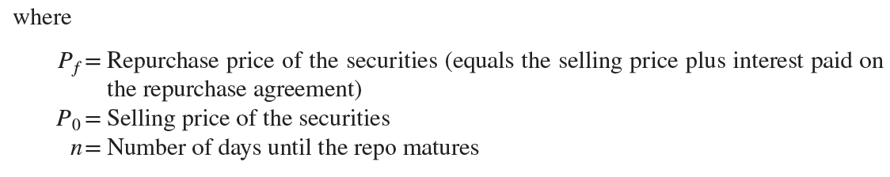
Repurchase Agreements (Continued)
Repurchase agreements are arranged directly between two parties or with the help of brokers and dealers
The yield on repos is calculated as the annualized percentage difference between the initial selling price of the securities and the contracted (re)purchase price, using a 360-day year
Notes:
Because Treasury securities back most repurchase agreements, they are low credit risk investments and have lower interest rates than uncollateralized fed funds.

Slide 22
Commercial Paper
Commercial paper is an unsecured short-term promissory note issued by a company to raise short-term cash, often to finance working capital requirements
  Total value of commercial paper outstanding is almost $1.1 trillion outstanding as of December 2021
  Generally sold in denominations of $100,000, $250,000, $500,000, and $1 million
  Maturities generally range from 1 to 270 days—the most common maturities are between 20 and 45 days
  Generally held by investors from the time of issue until maturity
  No active secondary market for commercial paper

Slide 23
Asset-Backed Commercial Paper (ABCP)
Mid-2000s saw a huge rise in the use of ABCP
  In July 2007, $1.19 trillion of the total $2.16 trillion commercial paper outstanding was ABCP
ABCP is collateralized by other financial assets of issuer
  The financial assets are typically a mix of many different assets that are jointly judged to have a low risk of bankruptcy by a ratings agency
  In the mid-2000s, the collateralized assets were mainly mortgage-backed securities
  Billions of dollars of asset-backed commercial paper were tainted because some of the proceeds were used to buy investments tied to U.S. subprime mortgages
Even as markets stabilized after the financial crisis, outstanding values of commercial paper continued to fall
Notes:
Reasons for this continued fall of commercial paper include a combination of related factors:
Negative and low positive economic growth experienced for years after the financial crisis produced lower demand for funds and thus less of a need to issue commercial paper.
Financial and nonfinancial firms held record amounts of cash reserves after the financial crisis and thus did not need to borrow as much in the short-term commercial paper markets.
Long-term debt rates were at historical lows after the financial crisis.

Slide 24


Commercial Paper (Continued)
Commercial paper is sold to investors either directly using the issuer’s own sales force or indirectly through brokers and dealers
  Commercial paper underwritten and issued through brokers and dealers is more expensive to the issuer
Like Treasury bills, yields on commercial paper are quoted on a discount basis
To convert to a bond equivalent yield, the following applies:

Slide 25
Negotiable Certificates of Deposit
A negotiable certificate of deposit (CD) is a bank-issued, fixed maturity, interest-bearing time deposit that specifies an interest rate and maturity date and is negotiable
Bearer instruments, meaning whoever holds the CD when it matures receives the principal and interest
May be traded any number of times in the secondary market
Denominations range from $100,000 to $10 million; $1 million being the most common
Often purchased by money market mutual funds with pools of funds from individual investors

Slide 26
Negotiable Certificates of Deposit (Continued)
Trading process
  Banks issuing negotiable CDs post a daily set of rates for the most popular maturities of their negotiable CDs, normally 1, 2, 3, 6, and 12 months
  Subject to its funding needs, the bank then tries to sell as many CDs to investors who are likely to hold them as investments rather than sell them to the secondary market
Negotiable CD rates are negotiated between the bank and the CD buyer
  Large, well-known banks can offer CDs at slightly lower rates than smaller, less well-known banks
  Negotiable CDs are single-payment securities
  Interest rates are generally quoted using a 360-day year

Slide 27
Banker’s Acceptances
A banker’s acceptance (BA) is a time draft payable to a seller of goods, with payment guaranteed by a bank
  Make up an increasingly small part of the money markets
  Beginning in June 2002, banker's acceptance levels are included in the commercial paper levels and no longer differentiated from commercial paper
Many BAs arise from international trade transactions
Payable to the bearer at maturity
Traded in secondary markets
Denominations determined by the size of the original transaction, but often trade in secondary markets in round lots of $100,000 and $500,000
Notes:
Like T-bills and commercial paper, banker’s acceptances are sold on a discounted basis.

Slide 28
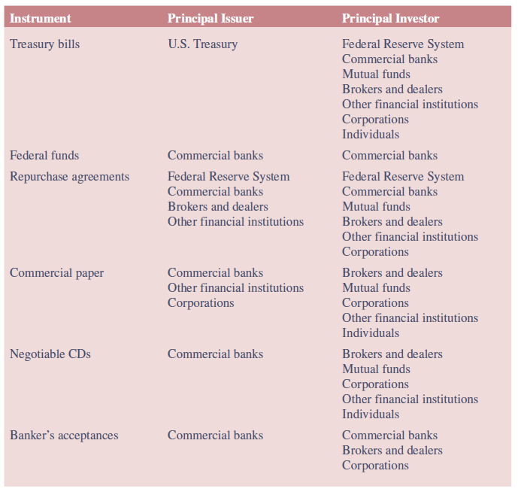
Money Market Participants
Notes:
The major money market participants are the U.S. Treasury, the Federal Reserve, commercial banks, money market mutual funds, brokers and dealers, corporations, other financial institutions such as insurance companies, and individuals.

Slide 29
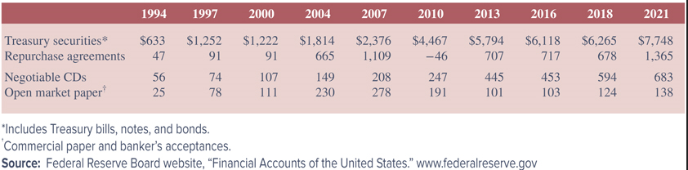
International Aspects of Money Markets
U.S. money markets are the largest and most active in the world, but money markets across the world have been growing in size and importance
Two forms of growth include the following:
  U.S. money market securities bought and sold by foreign investors
  Foreign money market securities
Notes:
Table 5–7 lists the total amounts of various U.S. money market securities held by foreign investors from 1994 through 2021.

Slide 30
Euro Money Markets
Eurodollar market is the market in which Eurodollars trade
  Foreign governments and businesses have historically held a store of funds (deposits) denominated in dollars outside of the U.S., and these deposits are called Eurodollar deposits
  Eurodollars may be held by governments, corporations, and individuals from anywhere in the world and are not directly subject to U.S. bank regulations
  Rate paid on Eurodollar CDs is generally higher than that paid on U.S.– domiciled CDs
As an alternative to the Eurodollar market, companies can also obtain short-term funding by issuing Eurocommercial paper
Notes:
Eurocommercial paper is issued in Europe but can be held by investors inside or outside of Europe.

Slide 31
Eurodollar Market
Eurodollar market is used by banks around the world as a source of overnight funding
Rate offered for sale on Eurodollar funds is known as the London Interbank Offered Rate (LIBOR)
  Funds traded in the Eurodollar market are often used as an alternative to fed funds as a source of overnight funding for banks
  During the financial crisis, the LIBOR rate spiked significantly, while the fed funds rate did not
  Banks manipulated the LIBOR rate for profit
In 2017, Secured Overnight Financing Rate (SOFR) was selected as a successor to USD LIBOR

Slide 32
Eurodollar Certificates of Deposit
Eurodollar certificates of deposits (CDs) are U.S. dollar-denominated CDs in foreign banks
Maturities are less than one year, and most have a maturity of one week to six months
Because these securities are deposited in non-U.S. banks, they are not subject to reserve requirements in the same manner as U.S. deposits

Slide 33
Eurocommercial Paper
Eurocommercial paper (Euro-CP) is an unsecured, short-term loan issued by a bank or corporation in the international money market, denominated in a currency that differs from the domestic currency of the market where the paper is issued
  Example: Eurodollar commercial paper denominated in U.S. dollars but issued in the Japanese debt market with a short time remaining until maturity
  $523.2 billion Eurocommercial paper outstanding and $435.9 billion Eurodollar CDs outstanding as of December 31, 2019
Eurocommercial paper rate is generally benchmarked to the Euro Overnight Index Average (EONIA)

