Slide 1
PUT PRICES
Q13: Today is 15 Nov 2020 Spot: 405,00 Short (write) one put contract from 550 maturity: Mar’21 ; (1 contract is 100 share)
What is the payoff and profit as of Mar 21? Mar’21 Price of ZM is 580. Draw the Graph

Slide 2
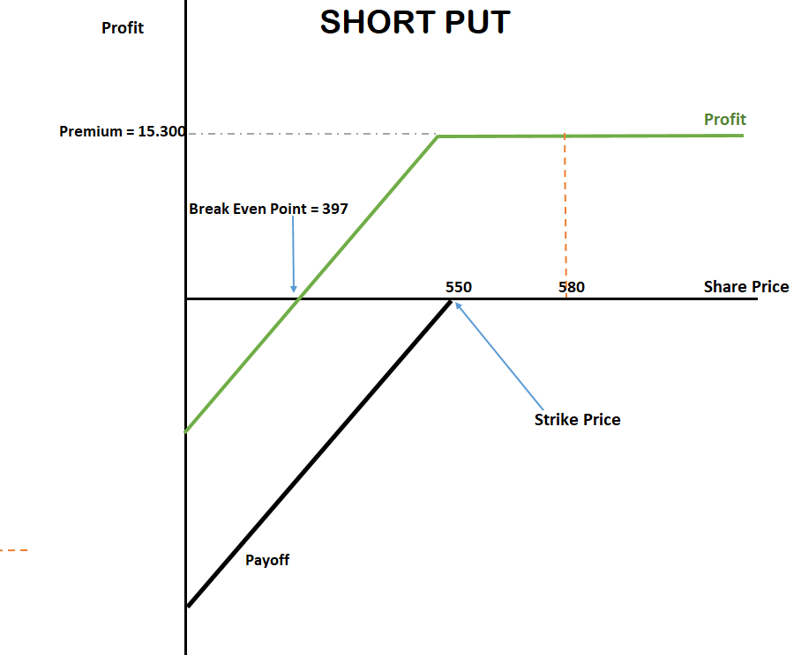
Answer q13:
Bid Cost (550) : 153,00
1 option contract :100 share
Total cost (Premium) = 153 x 100 = 15.300$
Breakeven= 550-153 = 397 $
*** Constant profit occurs above 550
Is the price above 550?
Yes the price is 580.
So constant profit : 15.300 $

Slide 3
PUT PRICES
Q14: Today is 15 Nov 2020 Spot: 405,00 Short (write) two put contracts from 430 maturity: Jun’21 (1 contract is 100 share)
What is the payoff and profit as of Jun 21? Jun’21 Price of ZM is 460. Draw the Graph

Slide 4
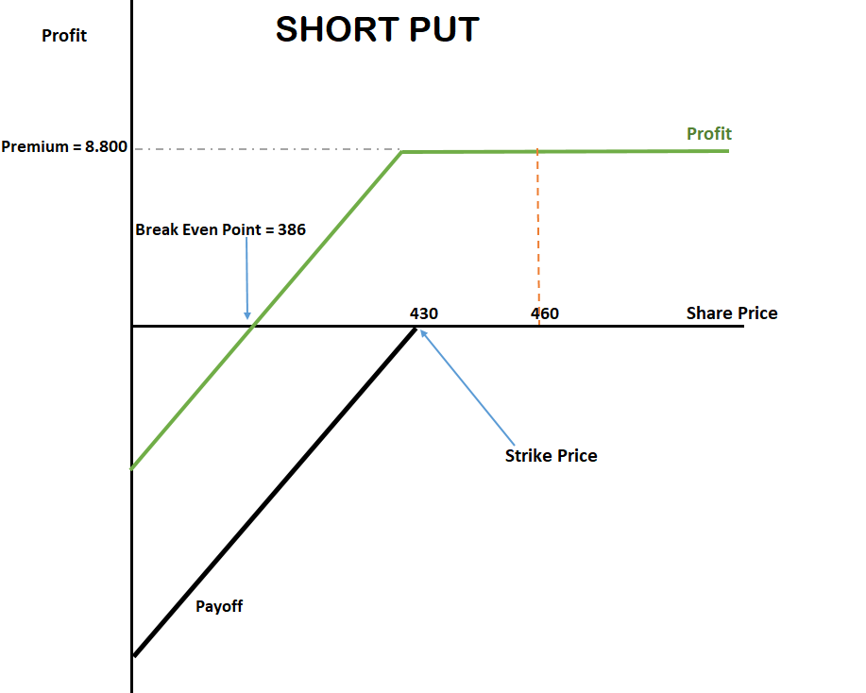
Answer q14:
Bid Cost (430) = 44,00
2 option contracts : 200 shares
Total Cost (Premium) = 200 x 44 = 8.800 $
Breakeven = 430-44= 386 $
*** Constant Profit occurs above 430
Is the price above 430?
Yes the price is 460.
So constant profit is 8.800$

Slide 5
PUT PRICES
Q15: Today is 15 Nov 2020 Spot: 405,00 Short (write) three put contracts from 407 maturity: Dec’20 ; (1 contract is 100 share)
What is the payoff and profit as of Dec 20? Dec’20 Price of ZM is 399. Draw the Graph

Slide 6
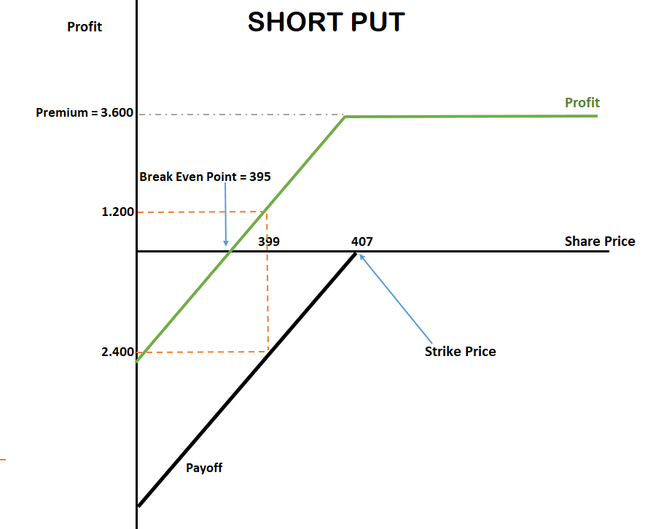
Answer q15:
Bid Cost (407) = 12,00
3 option contract: 300 shares
Total cost (Premium) = 300 x 12 = 3.600 $
Breakeven= 407 – 12 = 395 $
*** Constant profit occurs above 407
Is the price above 407?
No the price is 399.
So: 407-399 = 8$ (loss)
Payoff= 8 x 300 = 2.400$
Profit = 3.600 – 2.400 = 1.200 $

Slide 7
PUT PRICES
Q16: Today is 15 Nov 2020 Spot: 405,00 Short (write) ten put contracts from 680 maturity: Jun’21 ; (1 contract is 100 share)
What is the payoff and profit as of Jun 21? Jun’21 Price of ZM is 660,00. Draw the Graph

Slide 8
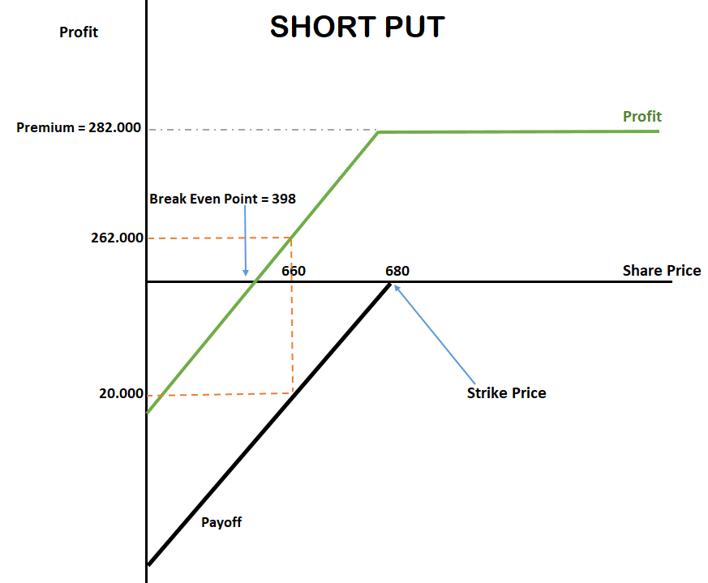
Answer q16:
Bid Cost (680) = 282
10 option contract = 1.000 shares
Total Cost (Premium) = 1.000 x 282 = 282.000 $
Breakeven= 680-282 = 398$
*** Constant profit occurs above 680
Is the price above 680?
No the price is 660.
So : 680 – 660 = 20$ (loss)
Payoff= 20 x 1.000 = 20.000 $
Profit = 282.000 – 20.000 = 262.000 $

Slide 9
PUT PRICES
Q16: Today is 15 Nov 2020 Spot: 405,00 Short (write) ten put contracts from 680 maturity: Jun’21 ; (1 contract is 100 share)
What is the payoff and profit as of Jun 21? Jun’21 Price of ZM is 360,00. Draw the Graph

Slide 10
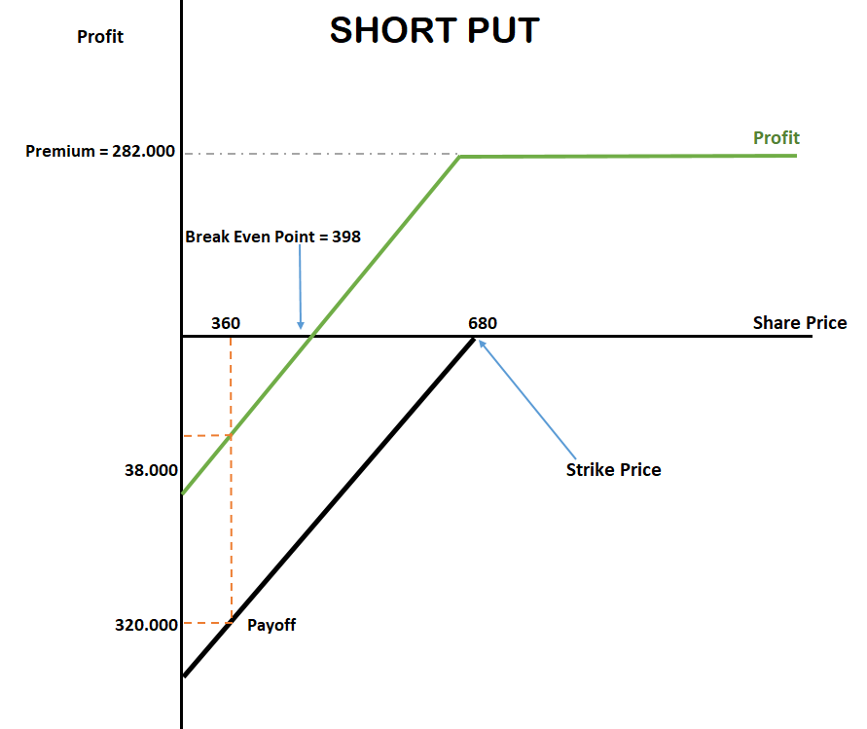
Answer q17:
Bid Cost (680) = 282
10 option contract = 1.000 shares
Total Cost (Premium) = 1.000 x 282 = 282.000 $
Breakeven= 680-282 = 398$
*** Constant profit occurs above 680
Is the price above 680?
No the price is 360.
So : 680 – 360 = 320$ (loss)
Payoff= 320 x 1.000 = 320.000 $
Loss = 282.000 – 320.000 = -38.000 $

Slide 11
Payoffs from Options What is the Option Position in Each Case?
CALL
In the money
ST > K
At the money
ST = K
Out-of-the money
ST < K
K = Strike price, S_{T} = Price of asset at maturity
Payoff
Payoff
A
B
K
PUT
In the money
ST < K
At the money
ST = K
Out-of-the money
ST > K
K
S_{T}
S_{T}
Payoff
Payoff
K
K
S_{T}
S_{T}
C
D

Slide 12
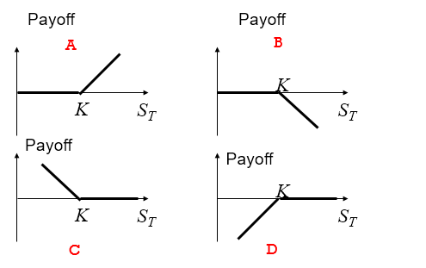
A: Long Call
B: Short Call
C: Long Put
D: Short Put

Slide 13
Profıt/loss : Limıted/unlımıted?

