Slide 1
IRE … Turkish Foreign Policy
Assist. Prof. Saffet Akkaya
Course hours: ???
saffetakkaya@cag.edu.tr
Week 13: Turkish Foreign Policy During Cold War (1980-1990)

Slide 2
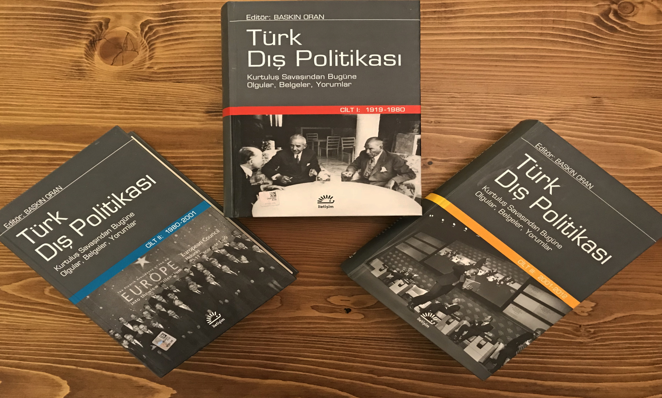
Main Source for the Course Türk Dış Politikası Vol 1, 2, 3 Ed. Baskın Oran
Türk Dış Politikası Vol 2: Pages 9-188

Slide 3
International Environment and Dynamics in the 1980s
Globalization
Globalization has occurred in three waves since the 1500s.
The first wave was mercantilism, that is, exploration, the collection and transportation of virgin raw materials, and the enrichment of the West.
The second wave was colonialism-imperialism, which began in the 1850s.
The third wave is modern globalization, which began in the 1980s and accelerated with the defeat of the USSR and the triumph of capitalism.

Slide 4
International Environment and Dynamics in the 1980s
The first industrial revolution emerged in England in the 18th century, and the second in the United States in the 1900s, creating an industrial society.
The third industrial revolution emerged in the Western world and aimed to create an information society.
The economic pillar of the third wave consists of multinational corporations that emerged from the 1970s onward, while the technological pillar consists of optical cables and computers.
As humanity evolves through agricultural society, industrial society, and information society, it is argued that the fourth will be a space society.

Slide 5
International Environment and Dynamics in the 1980s
The Rise of the West and the US
Oil-producing countries, overly enriched by the oil crisis, spent their money on luxury goods and deposited it in Western banks.
Europe quickly recovered from this energy shock, and the capital structures of its companies became even stronger.

Slide 6
International Environment and Dynamics in the 1980s
US President Carter's (1976-80) Green Belt Theory,
The launch of the human rights campaign against the USSR by implementing the third basket of the Helsinki Final Act,
The anti-communist policies launched worldwide by Reagan, President from 1980 to 1988, and the massively over-budget project Star Wars
Among the global events that marked the era were among the most significant.

Slide 7
International Environment and Dynamics in the 1980s
The Fall of the USSR
While the West and the US were riding the wave of globalization in the 1980s, the USSR had to grapple with internal and external challenges.

Slide 8
International Environment and Dynamics in the 1980s
To briefly summarize these:
Increased space and military spending,
a cumbersome economic structure,
elderly status-quo leaders,
the withdrawal of USSR troops from Eastern Europe,
the withdrawal of the USSR from Afghanistan in 1988,
the demobilization of 500,000 soldiers,
nationalist movements in other Soviet republics, nationalist movements and conflicts in the Caucasus,
efforts to unify East and West Germany,
and ultimately, the OSCE's third basket, effectively taking over the vast USSR empire, ultimately leading to the collapse of a 74-year-old state..

Slide 9
Internal Environment and Dynamics in Turkey
As can be seen from the table, the Turkish economy underwent a structural transformation starting in the 1980s.
The fundamental pillars of this were the reduction of domestic demand, the promotion of exports, the liberalization of the economy, excessive foreign borrowing, and the creation of an economic model working hand in hand with the IMF.
The construction of highways and the privatization of state-owned enterprises (SOEs) also took place during this period.
However, this model of capitalism was an unregulated program, effectively called wild capitalism.
This program was a bitter pill for low-income groups and the civil servant-worker-retired population.

Slide 10
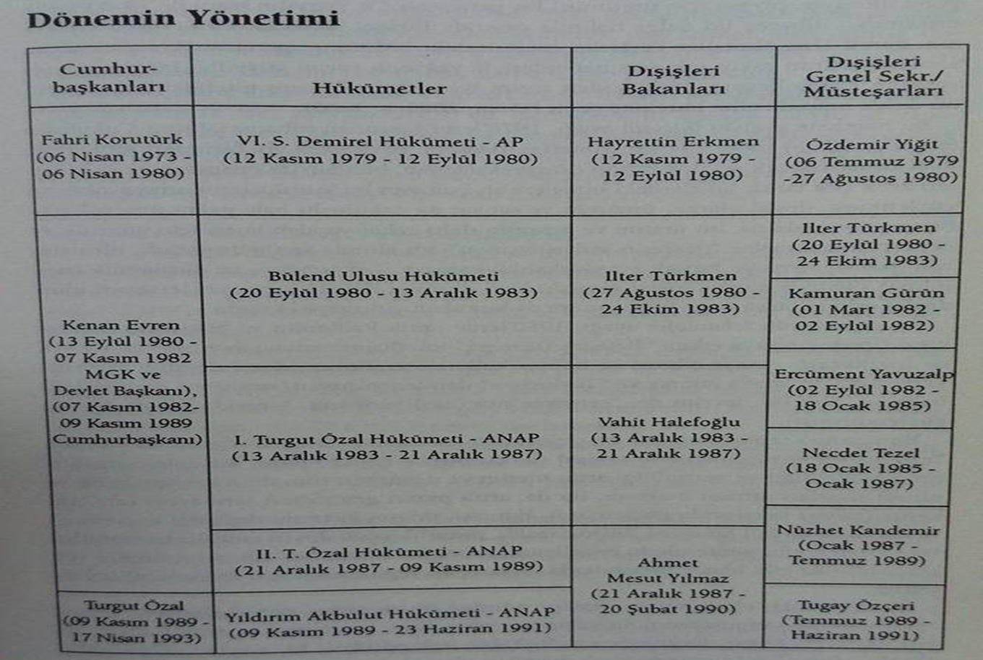
Internal Environment and Dynamics in Turkey

Slide 11
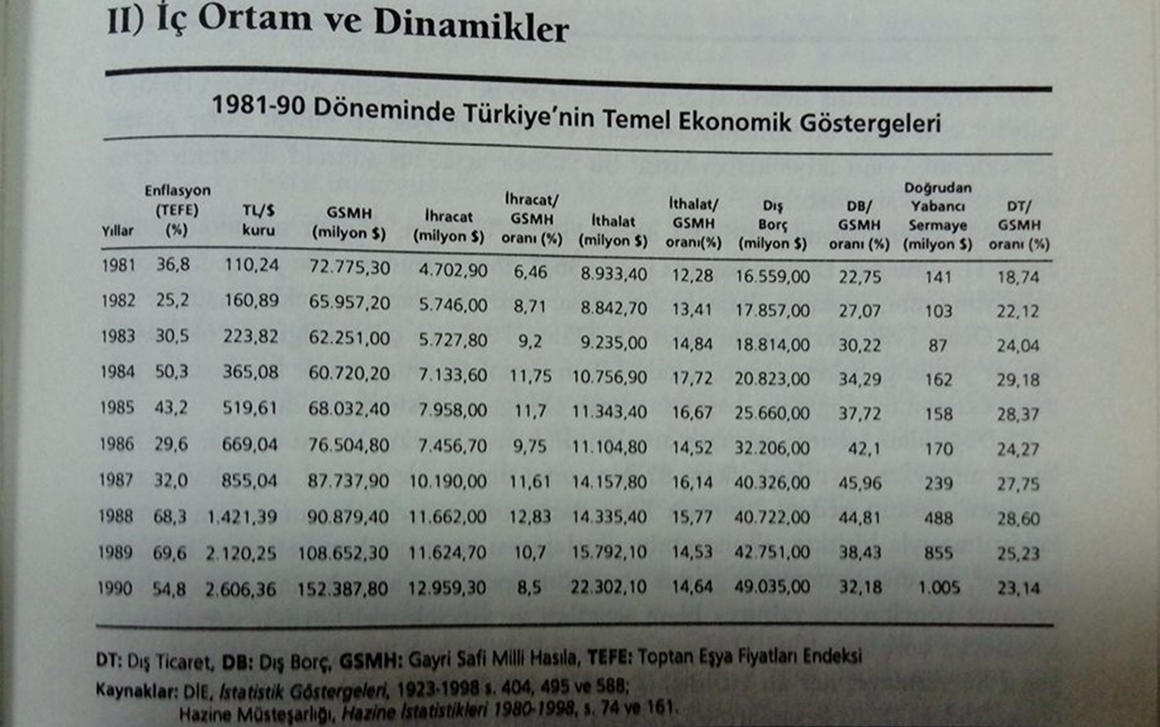
Internal Environment and Dynamics in Turkey

Slide 12
Internal Environment and Dynamics in Turkey
Between 1980 and 1990, domestic politics was shaped by the September 12 military intervention.
Human rights violations, restrictions on personal freedoms, restrictions on union activities, and state policies against left-wing ideology were also consistent with the green belt doctrine implemented by the US against the USSR.

Slide 13
Internal Environment and Dynamics in Turkey
During this period, Turkish foreign policy was influenced by three fundamental factors:
The international environment,
The September 12 coup,
Turgut Özal's economic and political policies.

Slide 14
Turkish Foreign Politics in 1980s
It can be said that the international environment was the primary factor shaping Turkish foreign policy during this period.
The weakening of the USSR, the rise of the US, and the Green Belt project were important dynamics during this period.
However, Turkey pursued a soft foreign policy by increasing its trade with the USSR without entering into a crisis or conflict.
While relations with the USSR improved, problematic relations arose with Greece in the Aegean Sea and with Bulgaria due to racist policies against the Turkish community, including forced name changes.
Armenian terrorism and PKK terrorism were also two significant problems that emerged during this period.

Slide 15
Turkish Foreign Politics in 1980s
The impact of the September 12 coup on Turkish foreign policy was inherently problematic with Europe due to the suspension of human rights, freedoms, and democracy, but positive with the United States, which implemented realpolitik.
While the liberal environment brought about by the 1960 constitution allowed Türkiye to pursue an autonomous policy abroad, the 1982 constitution, which included more limited freedoms than the previous one, led to a foreign policy guided by the West and the United States.

Slide 16
Turkish Foreign Politics in 1980s
The Özal factor weakened the Turkish Democratic Society Party (TDP) for three reasons.
First, by opening the economy to the outside world uncontrollably and without taking any precautions, it left it vulnerable and led to a policy of unbridled capitalism under the leadership of the IMF.
Second, according to Özal, economic relations would also solve the problems between the two countries. However, this philosophy did not work in his policies regarding Greece, Cyprus, and the Middle East.
Third, Özal exhibited reckless and uncontrolled behavior and practices in traditional statecraft. For example, by assigning certain activities that fell under the purview of the Religious Affairs Directorate to other ministries, he caused coordination problems.

Slide 17
Turkish Foreign Politics in 1980s
He occasionally bypassed the state's collective wisdom, causing a fiasco. This was the case with the Bulgarian immigration crisis.
We were forced to close the border gate when hundreds of thousands of our compatriots arrived at our door due to impulsive, undiplomatic statements.
During the 1990 Gulf crisis, he defended the occupation of Mosul and Kirkuk, dealing a blow to the status quo, two of the TDP's core principles.
For the first time, a Chief of the General Staff (Torumtay) was forced to resign.
His policy between the 1980s and 1990s can be compared to Menderes's policy between the 1950s and 1960s.
In other words, taking risky and overly dependent steps on the US put the classical TDP, both pro-status quo and balanced, in a deadlock.

Slide 18
Turkish Foreign Politics in 1980s
Turkey-US relations: If we were to summarize the relations between the two countries between 1980 and 1990, the following stand out:
The rising US and the declining USSR during the Reagan era, the approaching end of the Cold War,
The US's green belt theory, or the green antidote formula against the red menace,
Greece's return to NATO,
The Kurdish issue,
The modernization of the Turkish Armed Forces; the F-16 project.

Slide 19
Turkish Foreign Politics in 1980s
Relations with the EEC focused primarily on democracy, human rights, and Turkey's membership application.
Relations with Greece focused on the declaration of the TRNC in 1983, Aegean issues, and the rights of the Turkish minority in Western Thrace.

Slide 20
Turkish Foreign Politics in 1980s
Its relations with its southern neighbors and Arab countries, however, generally focused on the PKK and the water issue within the context of security. The construction of the Southeastern Anatolia Project (GAP) and Syria's support for terrorism were prominent agenda items.
Relations with the USSR developed within the context of that state's steadily declining power, accompanied by economic cooperation and relative ease. No significant problems arose.

Slide 21
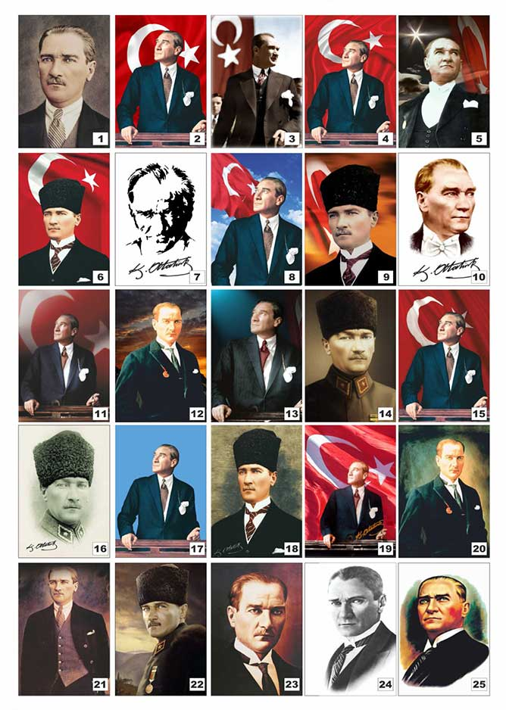
Questions?

Slide 22
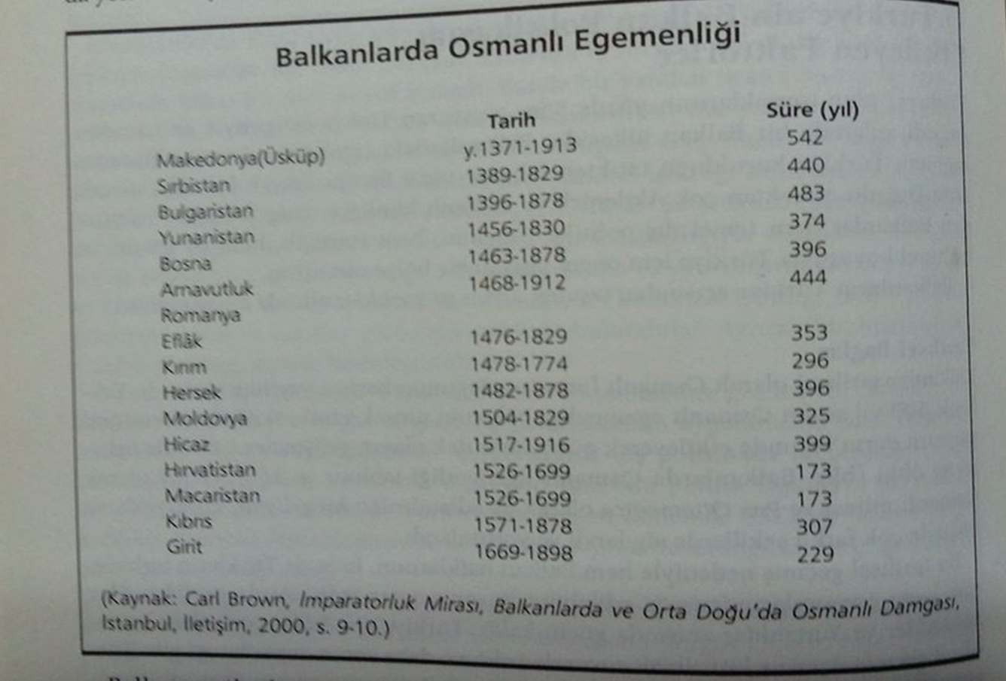
Turkish Foreign Politics in 1980s

