Slide 1





Slide 2
TRUE? FALSE?
The term precis is derived from Spanish word which means “Expressed subjectivity”, in other words, it means expressing “opposing” views or «criticising» a writer.

Slide 3

The term precis is derived from French word which means “Precis” or “Expressed Accurately”.
It also means an “Abstract” or a
“Gist” of a longer passage.

Slide 4
TRUE? FALSE?
It’s about comparing and contrasting the views of a writer with the others in the field.

Slide 5


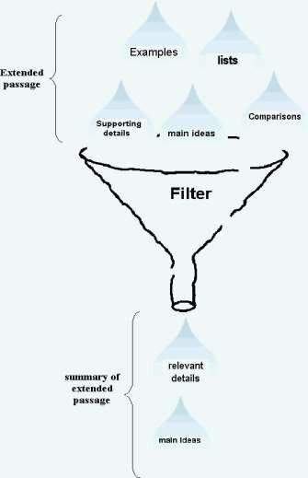
The precis is a clear, compact and logical summary of a passage. It only preserves the essential points or ideas of the original.

Slide 6
Why precis?? What for??
Comments, please....???

Slide 7


The life today has become over busy. Speed is now the essence of time.
Therefore well-connected , narrative paragraph or a precis is needed.
Shortcut has become a way of life. Every one prefers shortcut to complete one’s task.

Slide 8




QUALITIES OF A GOOD PRECIS

Slide 9
There are five qualities of a good precis
Clarity Correctness
Objectivity
Coherence
Conciseness

Slide 10



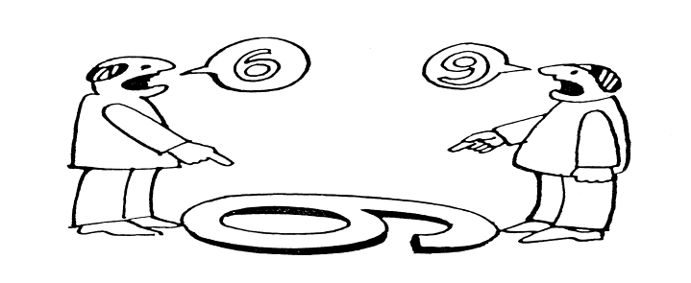
Clarity means “getting your message so that reader can understand easily what the writer is trying to convey.”

Slide 11

Sentence ought to be proper grammatical , punctuation and well spell or free from any sort of error.
Correct idea should be conveyed.

Slide 12

Mistakes which may occur are:
Misspelled words
Mistakes in facts and figures
Mistakes in punctuation
Mistakes of grammar and structure

Slide 13
Objectivity means the ability to present opinions and personal preference.
The writer should adopt an objective approach.
Not add personal opinion and ideas

Slide 14
Coherence means logical inter connection.
Ideas should be well joined.
Sentences should be inter related.

Slide 15


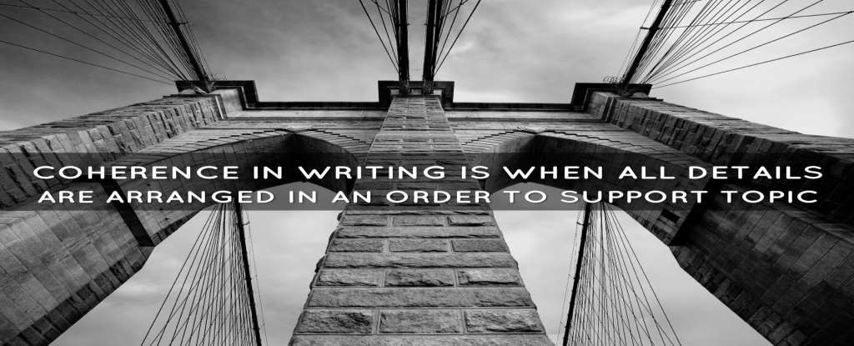
…
A good precis is always coherent
By coherence reader easily understand the main points.

Slide 16
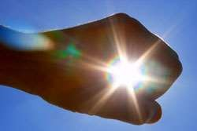
Conciseness means brief and direct.
Conciseness is a desirable quality of a good precis.
Use concise expression.
Avoid unnecessary repetition.
Convey information clear and efficiently.

Slide 17



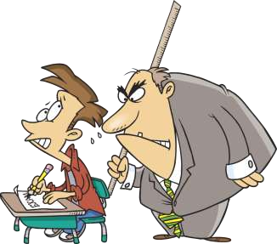
RULES FOR WRITING
A PRECIS

Slide 18



There are 16 rules for precis writing
Careful Reading
Under Lining
Outline
Understanding
Indirect Speech
Omission
Don’t Omit
Length
Avoid giving Opinions
Paragraph form
Tenses & person
Own wording
No change in meaning
Art of compression
Rereading
Conclusion

Slide 19
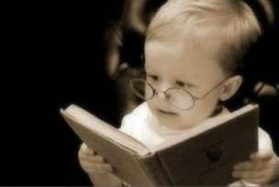
First read the passage again and again until you understand the meaning of the passage.
The more you read it , the more familiar it will become to you.
  Try to read it thrice to make its subject clear.

Slide 20
Usually one is asked to supply a outline for a precis.
While reading the original passage , think of some words , phrases or short sentences that will sum up the main subject of the passage.
Find the key sentences

Slide 21


Read the passage attentively and try to understand the main theme of the passage.
Try to get the idea what the writer trying to convey.

Slide 22
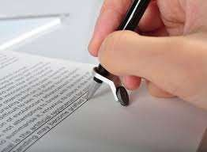
Underline is “mark the important ideas and essential points from the original text.”

Slide 23




Omit all the unnecessary information or long phrases which could be replaced by one word.
All the objectives and adverbs can be omitted in order to make a good precis.

Slide 24

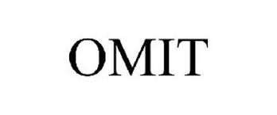

While writing a precis the writer should not omit the important points and ideas which are essential to be described.

Slide 25
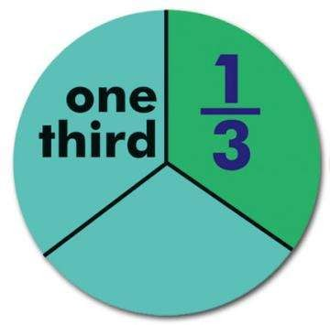
Keep the fact in your mind that the length of the precis be one third of the original passage.
Count the words if you find that it is too long.

Slide 26
Precis should be written in indirect speech. If there is direct speech in the passage , it should be into change in indirect speech.

Slide 27

A precis should be written in your own words and should abstain from borrowing words from original passage

Slide 28
You are not supposed to give any comments , appreciative, critical on the ideas expressed in the passage.

Slide 29
Precis should be in paragraph form.
There may be one or more paragraphs in original passage but your precis should be in only one paragraph.

Slide 30
A precis should be written in past tense but in case of ‘Universal Truth’ present tense should be used.
Always use third person.

Slide 31
While writing a precis:
Don’t change the meaning of precis but it should be written in your own words.
Try to abstain from borrowing words from original passage.

Slide 32
Compress and clarify a lengthy passage , article or book retaining important concepts , keywords and important data.
Cross out unneeded description.

Slide 33
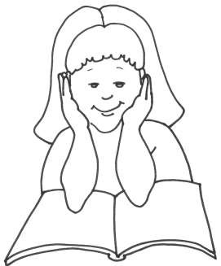
Reread the passage several times if necessary for clear understanding of ideas.
Observe the emphasis or approach used by author.

Slide 34

The conclusion should restate the main idea of the text and reiterate the main support.
do not provide any new information.
Remember to avoid any personal statements about the passage.

Slide 35
Summarising Exercise:
One of the most important aspects of listening for academic study is listening in order to make use of the ideas of other people. This is important as you need to show that you have understood the materials you have heard and that you can use their ideas and findings in your own way. In fact, this is an essential skill for every student.
Spack (1988, p. 42) has pointed out that the most important skill a student can engage in is "the complex activity to write from other texts", which is "a major part of their academic experience." It is very important when you do this to make sure you use your own words, unless you are quoting. You must make it clear when the words or ideas that you are using are your own and when they are taken from another writer. You must not use another person's words or ideas as if they were your own: this is Plagiarism and plagiarism is regarded as a very serious offence.

Slide 36
Summarising
A summary is a shortened version of a text. It contains the main points in the text and is written in your own words. It is a mixture of reducing a long text to a short text and selecting relevant information. A good summary shows that you have understood the text.
Look at this example:
Source
The amphibia, which is the animal class to which our frogs and toads belong, were the first animals to crawl from the sea and inhabit the earth.
Summary
The first animals to leave the sea and live on dry land were the amphibia.
The phrase "which is the animal class to which our frogs and toads belong" is an example, not a main point, and can be deleted. The rest of the text is rewritten in your own words.

Slide 37

Tracts of land from which coal is obtained are called coal-fields. These so-called fields are not on the surface of earth, but at some depths below it. They consist of layers of beds which run under the ground.
When a layer of this kind has been opened, the opening is called a mine and hence is classed as a mineral.

Slide 38


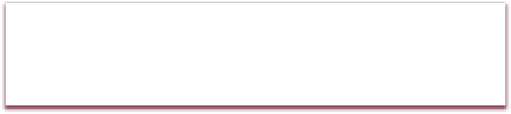

Questions:
What is mine and why is coal termed as mineral?
2. Write the precis of given passage & give a suitable title.

Slide 39
ANSWER
1.What is mine and why is coal termed as mineral?
When the layer of underground mineral is opened it is called a mine. Since coal is dug out from the mine , it is called mineral.

Slide 40
PRECIS OF THIS PASSAGE??

Slide 41




The coal-fields are underground tracts of land from which coal is obtained. They have underground layers of bed. They are called mine when they are opened.
Tracts of land from which coal is obtained are called coal-fields. These so-called fields are not on the surface of earth, but at some depths below it. They consist of layers of beds which run under the ground.
When a layer of this kind has been opened, the opening is called a mine and hence is classed as a mineral.

Slide 42
TITLE IDEAS??

Slide 43
POSSIBLE TITLE
Tracts of land from which coal is obtained are called coal-fields. These so-called fields are not on the surface of earth, but at some depths below it. They consist of layers of beds which run under the ground.
When a layer of this kind has been opened, the opening is called a mine and hence is classed as a mineral.
What are coal-fields?

Slide 44
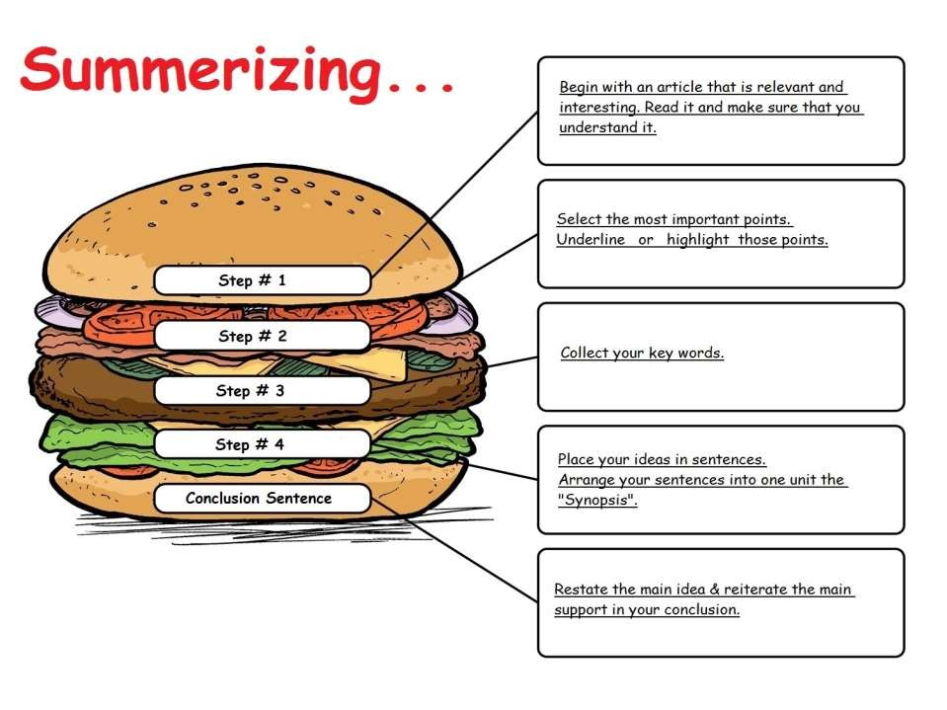

Slide 45
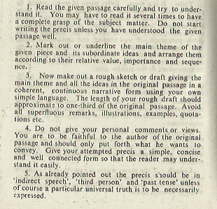

Slide 46
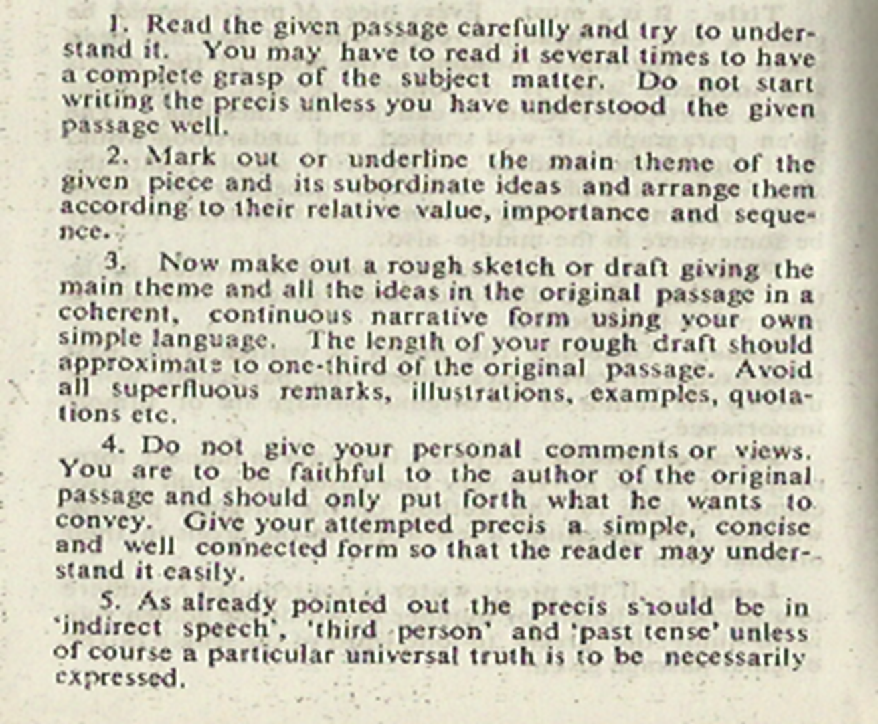


Slide 47
