Slide 1
WHAT IS TEXTUAL ANALYSIS?
Textual analysis is a methodology.
Textual analysis involves understanding language, symbols, and/or pictures present in texts to gain information.
Visual, written, or spoken messages provide cues to ways through which communication may be understood.

Slide 2
The messages are understood as influenced by and reflective of larger social structures.
For example, messages reflect and/or may challenge historical, cultural, political, ethical contexts for which they exist.
Therefore, the analyst must understand the broader social structures that influence the messages present in the text under investigation.

Slide 3
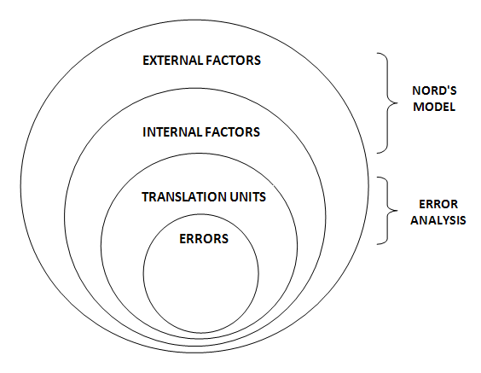
Analysis Methodology
The analysis itself is composed of four parts and it moves from surface to core.
The first two parts, are based on
Christiane Nord’s model of text
analysis in translation.
The other two parts then combine
several approaches to mistakes in
translation.

Slide 4
Firstly, the translation units of all the final TTs are being examined for language and translation errors and compared to the STs.
Secondly, the translation errors connected with the problem of equivalence are presented together with the solutions from all TTs.

Slide 6
Rhyme in Poetry

Slide 7
Rhyme
A rhyme is a repetition of similar sounding words, occurring at the end of lines in poems or songs.
A rhyme is a tool utilizing repeating patterns that bring rhythm or musicality to poems.

Slide 8
Various Types of Rhyme
Perfect Rhyme
A perfect rhyme is a case in which two words rhyme in such a way that their final stressed vowel, and all subsequent sounds, are identical. For instance, sight and light, right and might, and rose and dose.
Eye Rhyme
Eye rhymes, also called “sight rhymes,” or “spelling rhymes,” refers to words having the same spelling but different sounds. In such case, the final syllables have the same spellings, but are pronounced differently, such as cough and bough, and love and move.

Slide 9
General Rhyme
General Rhyme: The term general rhyme refers to a variety of phonetic likenesses between words.
Syllabic Rhyme– Bottle and fiddle, clever and silver, patter and pitter are examples of syllabic rhyme: words having a similar sounding last syllable, but without a stressed vowel.
Imperfect Rhyme – Wing and caring and reflect and subject are examples of imperfect rhyme. This is a rhyme between a stressed and an unstressed syllable.

Slide 10
General Rhyme
Assonance or Slant Rhyme exists in words having the same vowel sound. For instance, kill and bill and wall and hall.
Consonance exists in words having the same consonant sound, such as rabbit and robber, ship and sheep.
Alliteration or Head Rhyme refers to matching initial consonant sounds, such as sea and seal, and ship and shoes.

Slide 11
Types of Rhyme According to Position
Example #1: Twinkle, Twinkle Little Star (By Jane Taylor)
“Twinkle, twinkle little star --------→ /ɑː(r)/
How I wonder what you are” ------→ /ɑː(r)/
Classification: Tail Rhyme
This is the most common type of rhyme. It occurs in the final syllable of a verse or line.

Slide 12
Types of Rhyme According to Position
Example #2: Don’t Fence Me In (By Cole Porter and Robert Fletcher)
“Just turn me loose let me straddle my old saddle,
Underneath the western skies,
On my cayuse let me wander over yonder,
‘Til I see the mountains rise.”
Classification: Internal Rhyme
This is a type of rhyme in which a word at the end of a verse rhymes with another word in the same line.

Slide 13
Types of Rhyme According to Position
Example #4: At Lulworth Cove a Century Back (By Thomas Hardy)
“Had I but lived a hundred years ago ------------→ /əˈɡəʊ/ (A)
I might have gone, as I have gone this year, ----→ /jɪə(r)/ (B)
By Warmwell Cross on to a Cove I know, --------→ /nəʊ/ (A)
And Time have placed his finger on me there…”→ /ðeə(r)/ (B)
Classification: Cross rhyme
This refers to matching sounds at the ends of intervening lines.

Slide 14
Function of Rhyme
It gives poetry a typical symmetry that differentiates poetry from prose.
It makes recital of poetry a pleasurable experience for the readers, as the repetitive patterns render musicality and rhythm to it.

Slide 15
Orhan Ülkülü - İngilizcede Çok Ünlü Şiirler
The Tiger – Kaplan (by William Blake)
‘What immortal hand or eye / Could frame thy fearful symmetry?’
‘O korku veren düzgün vücudunu, senin / Hangi ölümsüz el, hangi gözdür yaratan?’

Slide 16
Orhan Ülkülü - İngilizcede Çok Ünlü Şiirler
Tiger - Kaplan
‘What immortal hand or eye / Could frame thy fearful symmetry?’
‘O korku veren düzgün vücudunu, senin / Hangi ölümsüz el, hangi gözdür yaratan?’
Symmetry = simetri, bakışım
Düzgün = decent, straight
Vücut = Kaynak metinde yok!
Frame = şekillendirmek, yaratmak = create
What x1 , hangi x2

Slide 17
‘What immortal hand or eye / Could frame thy fearful symmetry?’
‘Hangi ölümsüz el veya göz / Senin korkulu simetrini şekillendirebildi?’
‘O korku veren düzgün vücudunu, senin / Hangi ölümsüz el, hangi gözdür yaratan?’
Doğru çeviri ?
Güzel çeviri ?
Notes:
"Once upon a midnight dreary, while I pondered, weak and weary"❓❓
"I wandered lonely as a cloud, that floats on high o'er vales and crowd"❓❓
"Love is an endless mystery, for it has nothing else to explain"

Slide 18
TASK
Şiir Dizesi | Kafiye | Açıklama
"Once upon a midnight dreary, while I pondered, weak and weary"
‘’I wandered lonely as a cloud, that floats on high o'er vales and crowd"
"The ship has sailed through storm and hail, yet still she flies with tattered sail"

Slide 19
Şiir Dizesi | Kafiye | Açıklama
"Once upon a midnight dreary, while I pondered, weak and weary" | İç Kafiye (Internal Rhyme) | "dreary" ve "weary" aynı satır içinde kafiyeli olduğu için iç kafiye örneğidir
‘’I wandered lonely as a cloud, that floats on high o'er vales and crowd" | Mükemmel Kafiye (Perfect Rhyme) | "cloud" ve "crowd" tamamen aynı ses yapısına sahip olduğu için mükemmel kafiye örneğidir (
"The ship has sailed through storm and hail, yet still she flies with tattered sail" | Genel Kafiye - Assonance (Ünlü Uyumu) | Genel Kafiye - Assonance (Ünlü Uyumu)
Notes:
Çeviri, şiirin asıl mesajını koruyabiliyor mu?
Daha ritmik ve akıcı bir çeviri nasıl yapılabilirdi?
Şiirin biçimsel özelliklerini koruyarak çeviri yapmak mı, yoksa anlamı güçlü bir şekilde aktarmak mı daha önemli?

