Slide 1
Chapter Five
Money Markets

Slide 2
Money Markets
Money markets involve debt instruments with original maturities of one year or less
Money market debt
  Issued by high-quality (i.e., low default risk) economic units that require short-term funds
  Purchased by economic units that have excess short-term funds
  Little or no chance of principal loss
  Low rates of return
Most money market instruments have active secondary markets to provide liquidity

Slide 3
Money Market Yields
Money market securities use special rate quoting conventions:
  Discount yields (i_{d}): Interest rate is quoted on an annual basis assuming a 360 day year as a percent of redemption price or face value
  Single payment yields (i_{sp}): Interest rate is quoted on an annual basis assuming a 360 day year as a percent of purchase price
Both may be converted to a bond equivalent yield (i_{be}) for comparison with bonds
Notes:
Note that i_{bey} is an APR.

Slide 4
Discount Yields
Treasury bills and commercial paper rates are quoted as discount yields
Discount yields (i_{d}) use a 360-day year
  P_{f} = the face value of the security
  P₀ = the purchase price of the security
  n = the number of days until maturity
Notes:
Note the denominator is the face value rather than the purchase price P₀

Slide 5
Bond Equivalent Yields
Compare discount securities to bonds with bond equivalent yields (i_{be})
Convert bond equivalent yields into effective annual returns (EAR)
Notes:
Notice the two differences with the BEY – 1) the denominator is P0 rather than the face value and 2) the calculation uses 365 rather than 360 days.

Slide 6
Single-Payment Yields
Negotiable CDs and fed funds are money market securities that pay interest only at maturity. These use single-payment yields (i_{sp})
  to convert a single-payment yield to a bond equivalent yield:
  to directly convert a single payment yield to an EAR:

Slide 7
Sample Calculations of Money
Market Yields
A $1M investment in 90 day commercial paper has a 2% discount yield. An equivalent size and risk 90 day CD has a 2% single payment yield. Which security offers the better return? For the commercial paper:
The bond equivalent yield for the commercial paper is 2.038%

Slide 8
Sample Calculations of Money
Market Yields Continued
A $1M investment in 90 day commercial paper has a 2% discount yield. An equivalent size and risk 90 day CD has a 2% single payment yield. Which security offers the better return? For the CD:
The bond equivalent yield for the CD is 2.0278%
The commercial paper has the better return since its bond equivalent yield is 2.038%

Slide 9
Sample Calculations of Money
Market Yields Concluded
What is the commercial paper’s EAR?

Slide 10
Money Market Instruments
Treasury bills (T-bills)
Federal funds (fed funds)
Repurchase agreements (repos or RP)
Commercial paper (CP)
Negotiable certificates of deposit (CD)
Banker’s acceptances (BA)

Slide 11
Treasury Bills (T-Bills)
T-Bills are short-term debt obligations issued by the U.S. government
T-bills are virtually default risk free, are highly liquid, and have little interest rate risk
The Federal Reserve buys and sells T-bills to implement monetary policy
Strong international demand for T-bills as safe haven investment
Notes:
During the financial crisis, not only did the supply of T-bills increase, but demand for Treasuries as a safe haven investment soared. Demand increased so much that for the first time ever, yields on 3 month bills fell below zero. In essence, investors paid the U.S. government to take their money.

Slide 12
T-Bill Auctions
13- and 26-week T-bills are auctioned weekly, other maturities available
Bids are submitted by government securities dealers, financial and nonfinancial corporations, and individuals
Bids can be competitive or noncompetitive
  Competitive bids specify the amount of par value of bills desired and the discount yield, rather than the price
  Noncompetitive bidders get preferential allocation and agree to pay the lowest price of the winning competitive bids

Slide 13
T-Bill Auctions Continued
Noncompetitive Bids
Bid Price
1
S_{C}
S_{T}
2
3
4
5
6
Stop-out
price (P_{NC})
7
Quantity of
T-bills

Slide 14
The Secondary Market for T-Bills
The secondary market for T-bills is the largest of any U.S. money market instrument
23 primary dealers “make” a market in T-bills by buying the majority sold at auction and by creating an active secondary market
  Primary dealers trade for themselves and for customers
  T-bill purchases and sales are book-entry transactions conducted over Fedwire
T-Bills are sold on a discount basis

Slide 15
T-Bill Prices
T-Bill prices can be calculated from quotes (e.g., from The Wall Street Journal) by rearranging the discount yield equation
Or, by rearranging the bond equivalent yield equation

Slide 16
Federal Funds
The federal funds (fed funds) rate is the target rate in the conduct of monetary policy
Fed fund transactions are short-term (mostly overnight) unsecured loans
Banks with excess reserves lend fed funds, while banks with deficient reserves borrow fed funds
Multimillion dollar loans may be arranged in a matter of minutes
Fed funds are single-payment loans and thus use single-payment yields

Slide 17
Repurchase Agreement
A repurchase agreement (repo or RP) is the sale of a security with an agreement to buy the security back at a set price in the future
Repos are short-term collateralized loans (typical collateral is U.S. Treasury securities)
  Similar to a fed fund loan, but collateralized
  Funds may be transferred over FedWire system
  If collateralized by risky assets, the repo may involve a ‘haircut’
Notes:
The repo rate is typically lower than the Fed funds rate because repos are collateralized loans.
If risky securities are pledged as collateral, the fund’s lender may require a larger ‘haircut,’ i.e. repos normally have to be slightly overcollateralized. For instance, to borrow $100 the repo seller would have to sell securities currently worth $102, for a $2 haircut.
Bank of America (BofA) used repos to hide about $10.7 billion of debt from the public from 2007 to 2009. Under accounting rules if the value of the securities pledged on the repo are worth 105% of the cash received the borrowing firm (BofA) can book the transaction as an asset sale rather than as a loan. So for the term of the repo the borrower can report lower leverage ratios (i.e., it will have a higher equity to asset ratio). If these transactions occur a few days before a financial report date such as the end of a quarter, the firm can appear to be safer than it actually is. The strategy is called a ‘Repo 105’ strategy because of the 105% collateral requirement. It is actually not allowed under U.S. law but may be allowed for European subsidiaries under British laws. Lehman Brothers used a similar strategy to hide debt amounts of between $8 billion and $15 billion in 2007 and 2008.
Merced, M and J. Werdigier. The Origins of Lehmans Repo 105. Investment Banking, NY Times Dealbook, March 12, 2010.
Inability to roll over their repo financing of their extensive mortgage holdings was one factor that led to the collapse of Bear Stearns

Slide 18
Repurchase Agreement Continued
Typical denominations on repos of one week or less are $25 million and longer term repos usually have $10 million denominations
A reverse repurchase agreement is the purchase of a security with an agreement to sell it back in the future
Notes:
The repo rate is typically lower than the Fed funds rate because repos are collateralized loans.

Slide 19
Repurchase Agreement Yield
The yield on repurchase agreements (i_{RA}) uses a 360-day year, like the discount rate, but uses the current price in the denominator, like the bond equivalent yield
  P_{f} = the repurchase price of the security
  P₀ = the selling price of the security
  n = the number of days until the repo matures

Slide 20
Commercial Paper
Commercial Paper (CP) is unsecured short-term corporate debt issued to raise short-term funds (e.g., for working capital)
Generally sold in large denominations (e.g., $100,000 to $1 million) with maturities between 1 and 270 days
CP is usually sold to investors indirectly through brokers and dealers
CP is usually held by investors until maturity and has no active secondary market
Yields are quoted on a discount basis (like T-bills)

Slide 21
Asset-Backed Commercial Paper
A type of commercial paper that is backed by assets of the issuing firm
Grew very rapidly prior to the financial crisis peaking at $2.16 trillion, much of it was backed by mortgage investments
The market collapsed during the financial crisis

Slide 22
Negotiable Certificates of Deposit
A negotiable certificate of deposit (CD) is a bank-issued, fixed maturity, interest-bearing time deposit that specifies the interest rate and the maturity date
CDs are bearer instruments and thus are salable in the secondary market
Denominations range from $100,000 to $10 million; $1 million being the most common
Often purchased by money market mutual funds with pools of funds from individual investors

Slide 23
Banker’s Acceptances
A banker’s acceptance (BA) is a time draft payable to a seller of goods, with payment guaranteed by a bank
Used in international trade transactions to finance trade in goods that have yet to be shipped from a foreign exporter (seller) to a domestic importer (buyer)
Foreign exporters prefer that banks act as payment guarantors before sending goods to importers
Banker’s acceptances are bearer instruments and thus are salable in secondary markets

Slide 24
Money Market Participants
The U.S. Treasury
The Federal Reserve
Commercial banks
Money market mutual funds
Brokers and dealers
Corporations
Other financial institutions
Individuals

Slide 25
International Money Markets
U.S. dollars held outside the U.S. are tracked among multinational banks in the Eurodollar market
The rate offered for sale on Eurodollar funds is the London Interbank Offered Rate (LIBOR)
Eurodollar Certificates of Deposit are U.S. dollar-denominated CDs held in foreign banks
Eurocommercial paper (Euro-CP) is issued in Europe and can be in local currencies or U.S. dollars

Slide 26
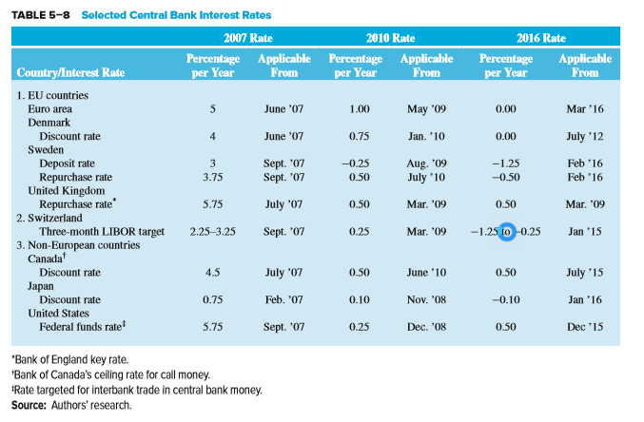
Central Bank Interest Rates

Slide 27
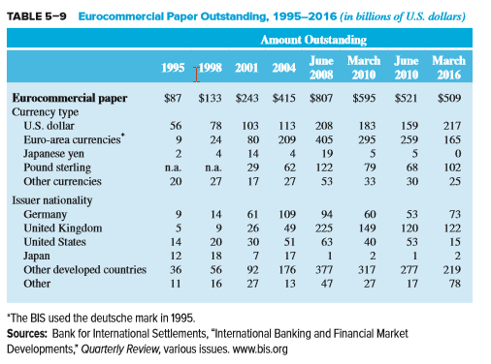
Eurocommercial Paper Outstanding, 1995 - 2016

Slide 28
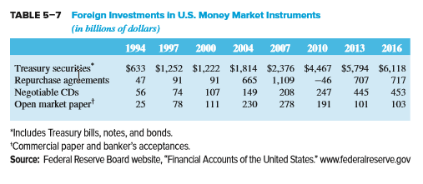
Foreign Investments in U.S. Money Market Instruments

Slide 29
International Money Markets Continued
The London Interbank Offer Rate (LIBOR) is the rate on interbank loans between British banks
LIBOR is the base rate on trillions of dollars of derivatives and is the base rate for many loans
Large banks manipulated LIBOR to profit on derivatives positions and/or to appear less risky during the crisis.
  Bank profits from misquoting LIBOR may have exceeded $75 billion
  Many banks fined, changed LIBOR reporting process
Notes:
Details of how the manipulation was accomplished to earn profits may be found in the Wall Street Journal Online article of 5/2/13: Clubby London Trading Scene Fostered Libor Rate-Fixing Scandal http://online.wsj.com/article/SB10001424127887323296504578396670651342096.html?mod=WSJ_hp_LEFTWhatsNewsCollection.
UBS was fined $1.52 billion, RBS $612 million and Barclays $450 million. J. P. Morgan and Deutsche-Bank are now facing fines from European Union regulators. As a result of the scandal the BBA is no longer allowed to publish LIBOR. ICE now publishes LIBOR. LIBOR is available in various maturities for the following currencies: USD, CHF (Swiss franc), GBP, JPY, CAD, Euro, AUD, DKK (Danish krone), NZD, and the SEK (Swedish krona). More disturbingly, The Federal Reserve Bank of New York and the Bank of England may have known of the manipulation as early as 2007 and a trader alleges that manipulation has occurred since 1991. This is one more instance of the need to emphasize ethics in business. LIBOR is the base rate on literally trillions of dollars of derivatives. LIBOR also is the base rate for many loans, including adjustable rate loans.

Slide 30
Single versus Discriminating Price Treasury Auctions
Single price auction
  Adopted by the U.S. Treasury in 1998
  All Treasury security bidders pay the same price for the Treasury security
Discriminating auctions
  Different successful bidders paid different prices (their bid prices)

Slide 31
Creation of a Banker’s Acceptance

