Slide 1
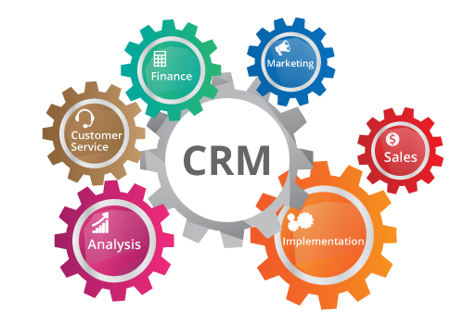
Chapter 8&9 Customer Empathy map & journey
https://results-software.com/tag/crm-for-small-business/

Slide 2
The customer proposition
In many markets, it is becoming increasingly difficult for an organization to distinguish itself from the competition solely on the basis of the products and services.
Customers can compose their own personalised proposition using a range of mass produced building blocks.
Customer’s needs are first!
Competitors are less important than individual customers.

Slide 3
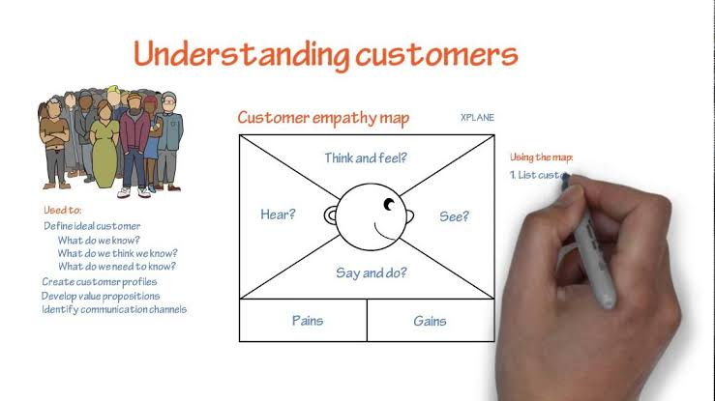
An empathy map is a collaborative tool teams can use to gain a deeper insight into their customers.
Much like a user persona, an empathy map can represent a group of users, such as a customer segment. The empathy map was originally created by Dave Gray and has been gaining popularity with the agile community

Slide 4
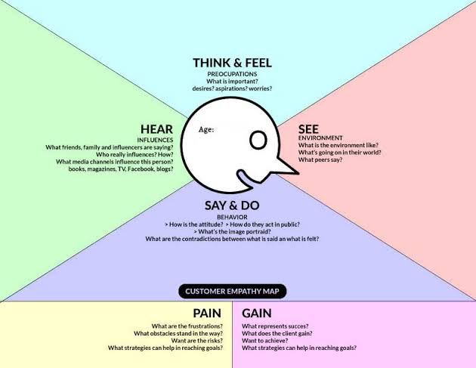
Customer Empathy Map

Slide 5
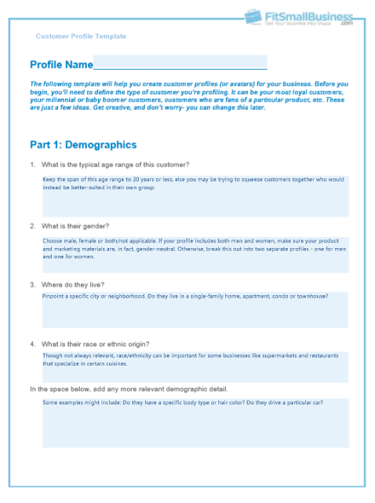
Create Customer profile

Slide 6
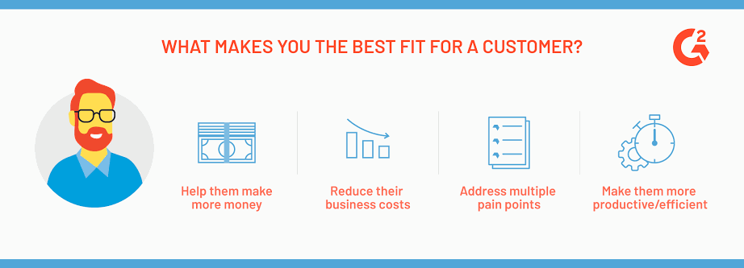
Creating value for your customers

Slide 7

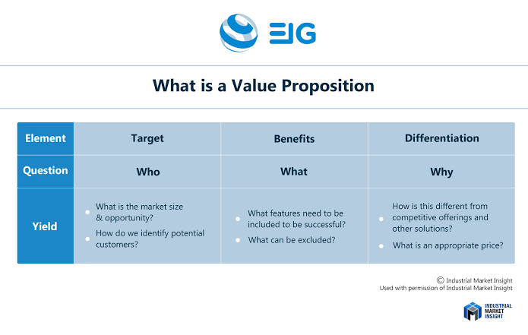
Create value proposition

Slide 8
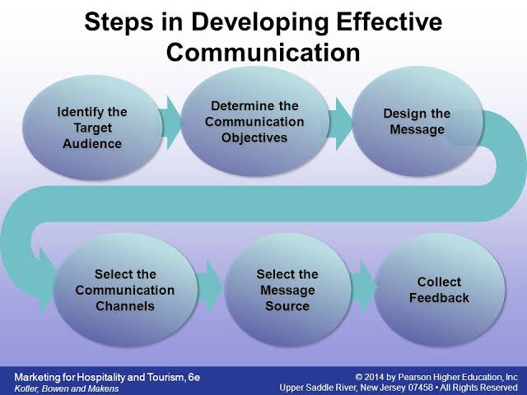

Slide 9
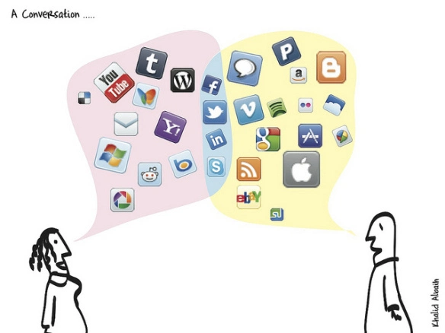
Multichannel communication

Slide 10
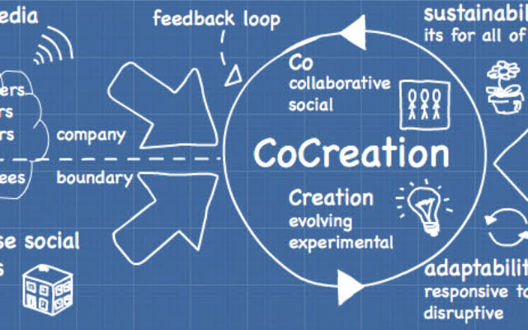
Co-creation,
is a form of open innovation.
In the context of a business, refers to a product or service design process in which input from consumers plays a central role from beginning to end.
Used more weakly, the term can also refer to any way in which a business allows consumers to submit ideas, designs or content.

Slide 11
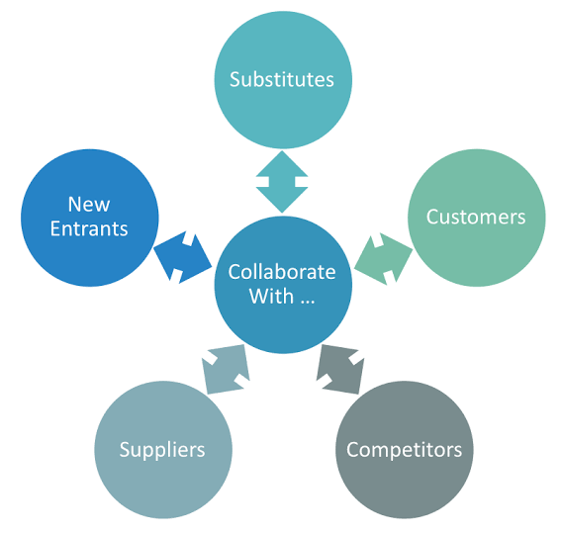
Co creation
The needs and desires of the end-user are the starting point ,not the technology.

Slide 12
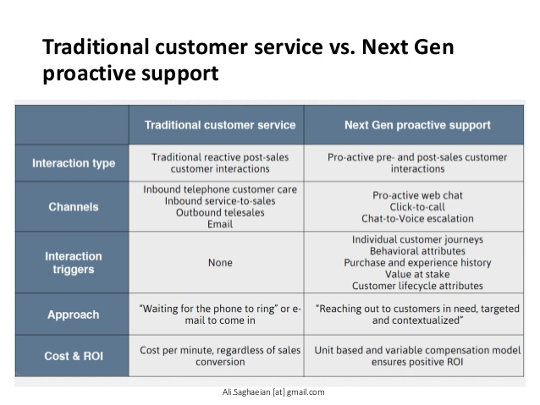

Slide 13
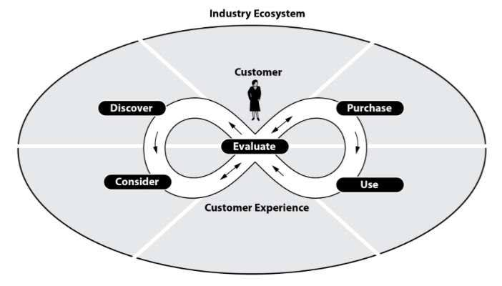
Customer experince is important!

Slide 14
Co-creation
58% of businesses are now piloting co-creation projects to help drive innovation.
İt is an excellent way to discover new market opportunities, push product branding in new directions, or establish a presence in a completely new area.
Customer co-creation refers to inviting stakeholders (usually customers) to participate in a design or problem-solving process to produce a mutually valued outcome.
the outcomes are: new product ideas,
ways to overcome delivery chain problems, or
even technical solutions to complex manufacturing questions.
Co-creation also includes plenty of fun, light exchanges, like musicians using Twitter to take fan suggestions regarding album titles, or football clubs asking for feedback on their rebranding efforts.

Slide 15
Digital co-creation of Fujitsu
https://www.youtube.com/watch?v=hLatzIEL_-I

Slide 16
co-creation examples
10 examples of successful co-creation initiatives
Unilever
IKEA
DeWalt
Lego
Heineken
DHL
Anheuser-Busch
BMW
General Mills
Coca-Cola

Slide 17
Unilever
is one of the world’s largest consumer goods companies, owning over 400 well-recognized brands, including Dove, Lipton, Best Foods, and many more.
With operations in 190 countries and products used by over 2.5 billion people on a daily basis, Unilever has a massive pool of customers from which to source ideas and solutions to product development questions.
To put this resource to use, Unilever actively looks to its customer base for product solutions, asking startups, academics, designers and customers for ideas and suggestions.

Slide 18

The global response to the Unilever platform has been strong, with the company receiving over 1,000 proposals in the first half of 2012 alone. This approach has also helped develop a more open culture: now, over 60% of Unilever’s research projects involve external collaboration.
Unilever’s approach to co-creation reflects the value of open innovation and shows the potential uses of crowdsourcing to solve problems – even complex problems requiring technical knowledge and expertise.

Slide 19
LEGO
Has always had a reputation for creativity.
However, the company’s commitment to innovation helped rescue the brand from a challenging financial situation in the early 2000s, the result of brand dilution, over-extended product lines, and excessive growth.
In 2004, a change in leadership resulted in a fresh approach to open-source product development and the creation of LEGO Ideas. Since then, the crowdsourcing platform has received suggestions from over 1 million people, with fans voting on the most popular ideas.
In return for contributing a winning idea, the creator can give final approval for the end product, be recognized on all packaging and marketing, and even earn a percentage of product sales. His innovative approach helped drive the launch of 23 dedicated LEGO Ideas sets, which have proven very popular with LEGO fans. Not only that, but the commitment to co-creation has helped lift revenue, saving this beloved company from dire straits.
LEGO’s embrace of customer co-creation shows how this kind of collaboration can help create new communities of fans around the world. The LEGO Ideas initiative has also driven a lot of media coverage and has strengthened customer loyalty.

Slide 20
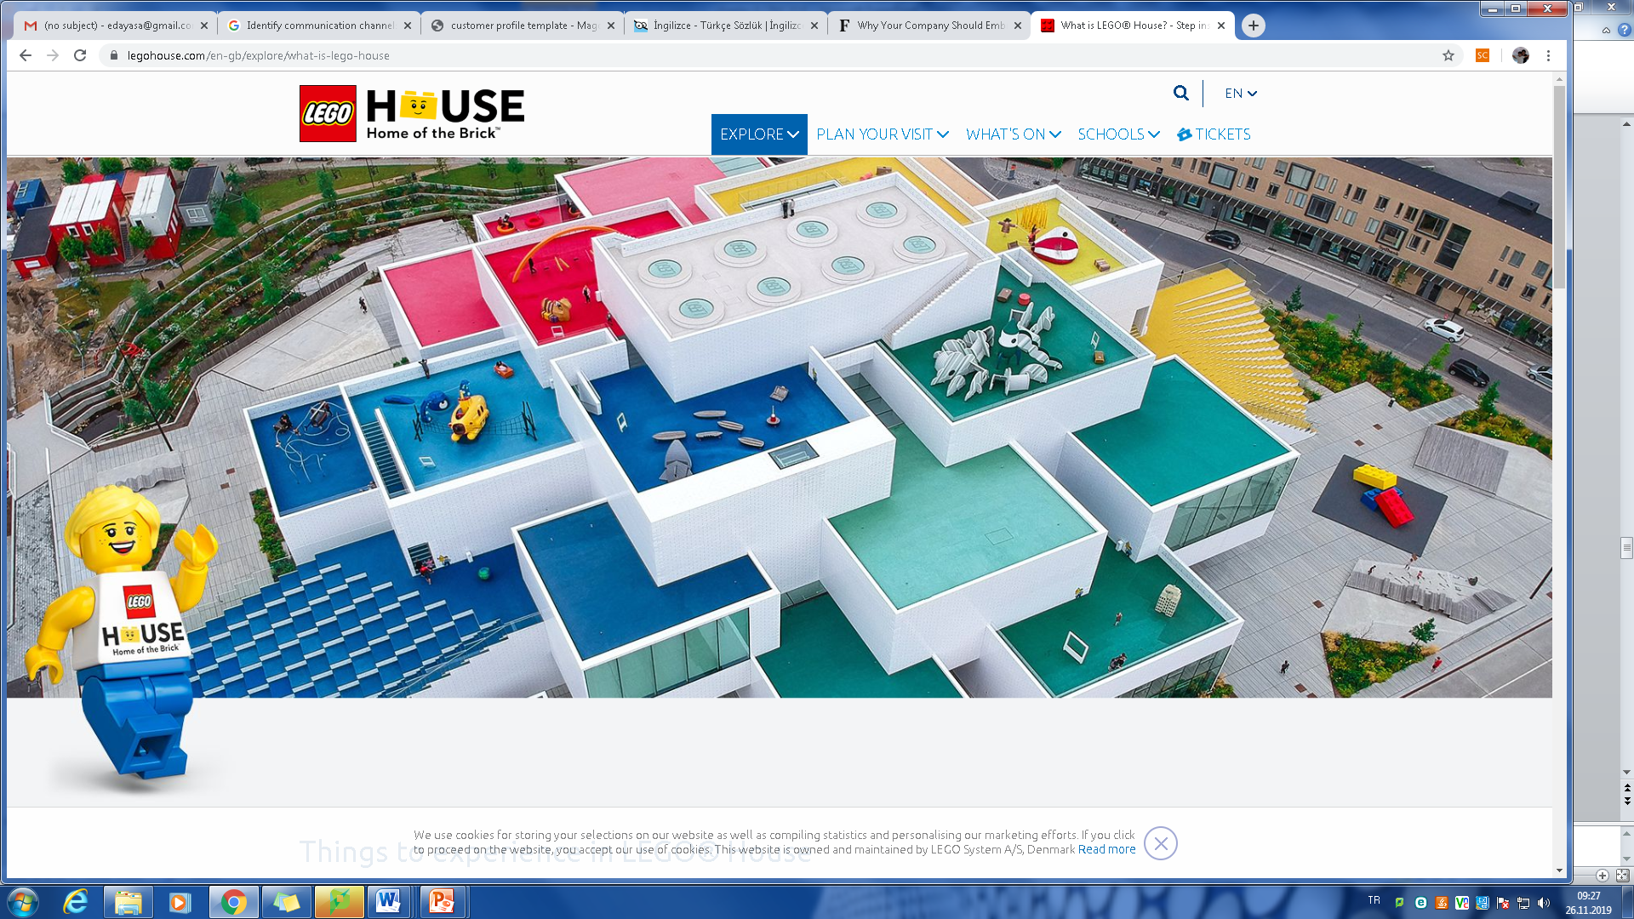

Slide 21
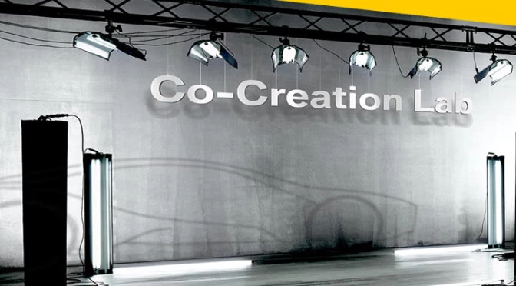
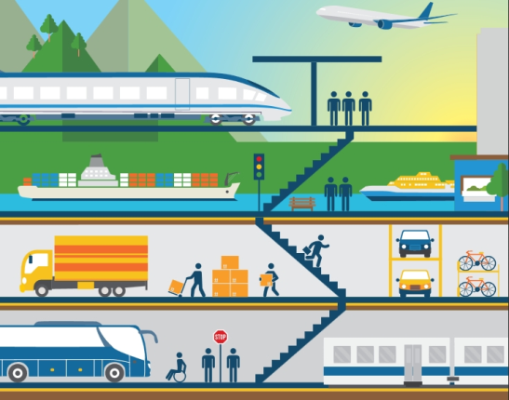
BMW
2010, BMW announced its first-ever open innovation contest: ‘Tomorrow’s Urban Mobility Services’. Launched within BMW’s Co-Creation Lab, the contest was an opportunity for fans and customers to share their product ideas and opinions with BMW.
This contest gave consumers the opportunity to get intimately involved in the design process from start to finish and created a real incentive for die-hard fans to contribute their ideas.
The contest resulted in
497 users
publishing over 300 distinct ideas,
which were then evaluated by over 1,000 judges and assessors around the world.
The winner of the contest was Venugopal Panicker, with his ‘Pick Me Up Please’ concept, a connected mobility system for pedestrians.
Following this initial contest, BMW has continued to host further innovation contests, helping to drive fan and industry interest in crowdsourced innovations for things like interior features of its compact class vehicles.
As this example shows, even luxury brands with huge levels of name recognition can embrace co-creation, inviting customer-driven solutions to complex problems.

Slide 22
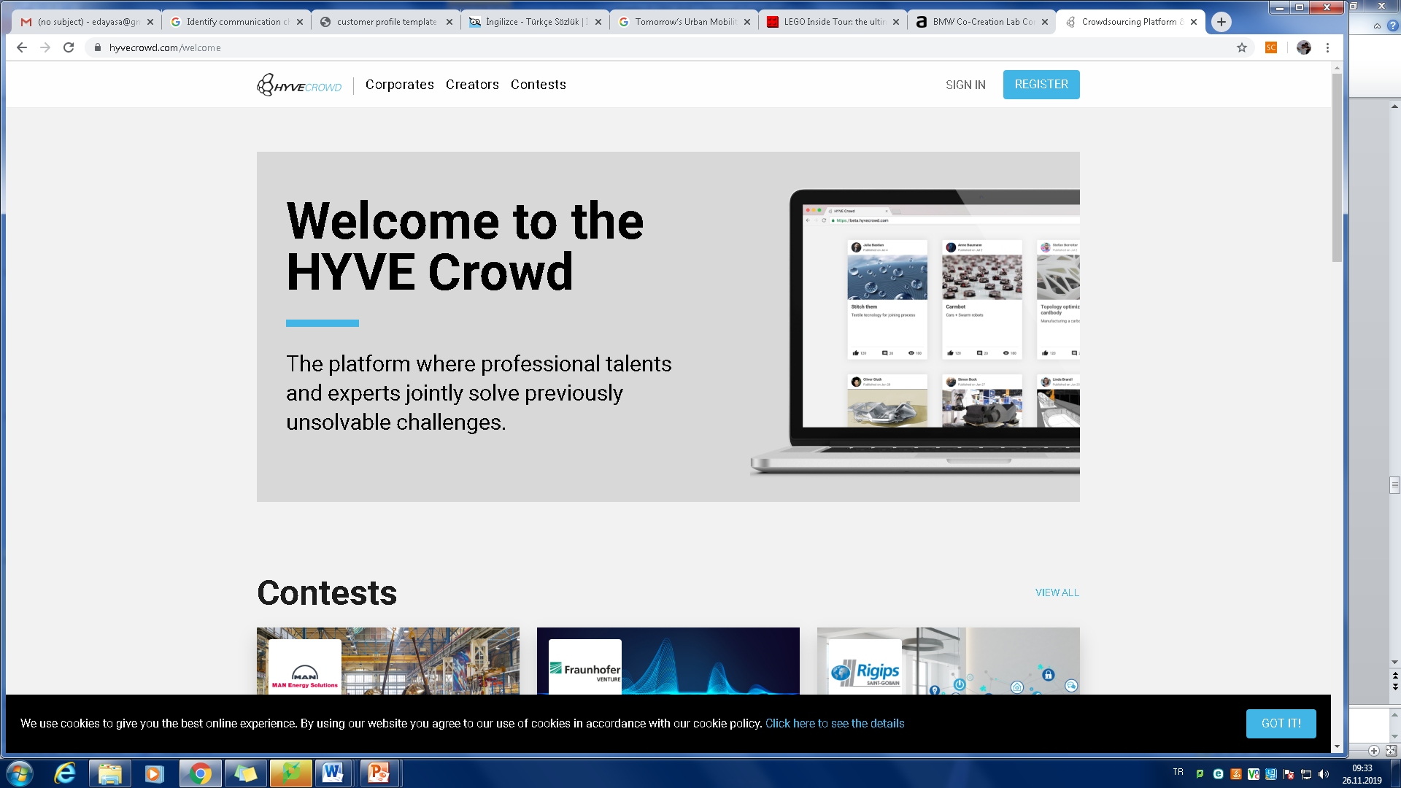
https://www.hyvecrowd.com/welcome

Slide 23
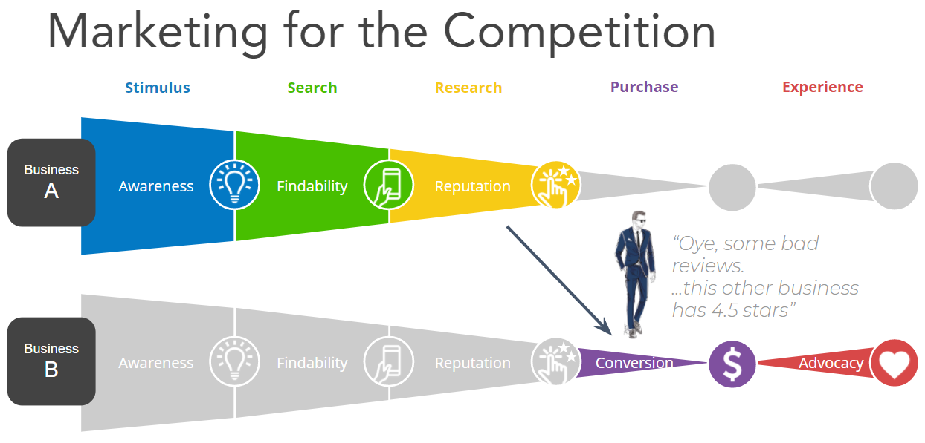
Customer journey

Slide 24
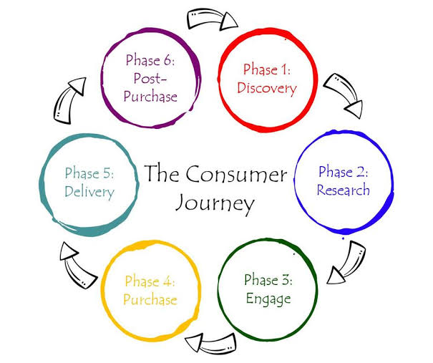

Slide 25
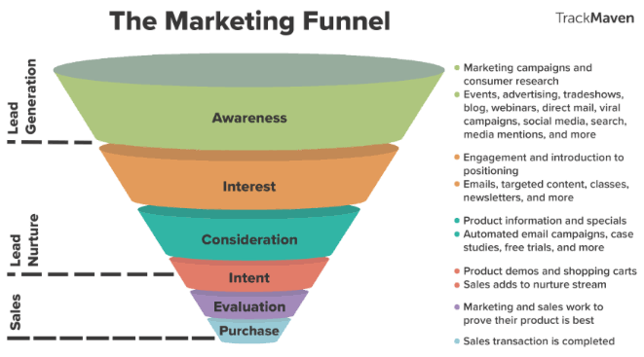
Funnel

Slide 26
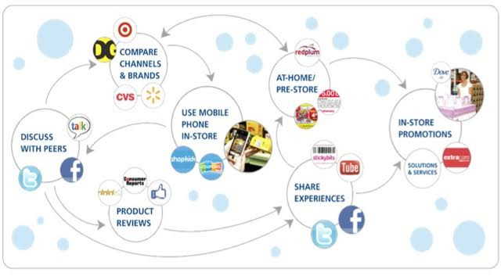
How Consumer Journeys have changed in the Digital Age

Slide 27
Questions?
How many people being reached?
How are customers and prospects experiencing the «touch points»?
What revenue and margins are achieved at what costs?

Slide 28
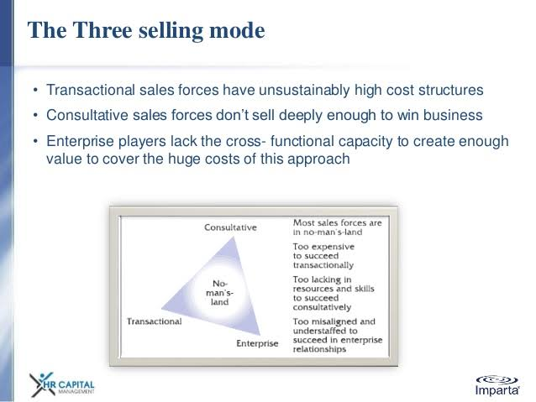

Slide 29
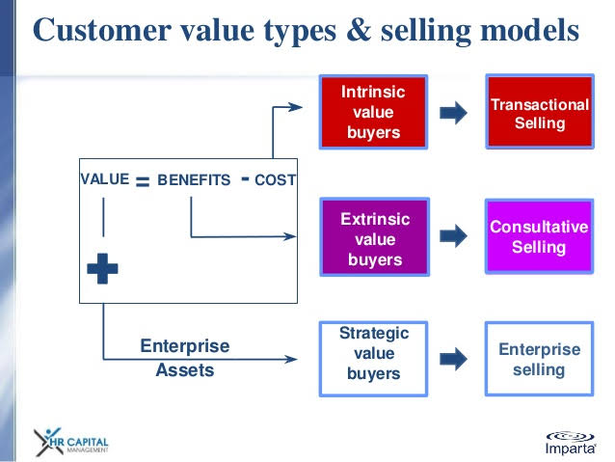

Slide 30
