Slide 1
Social Media: Living in the Connected World
Chapter 5

Slide 2
Learning Objectives
5.1 Describe the growth and use of social media.
5.2 Contrast the three major types of social media platforms.
5.3 Explain three ways consumers rely on social media to make buying decisions.
5.4 Identify the types of goals marketers use for social media campaigns.
5.5 Describe the various methods for measuring the effectiveness of social media marketing.
5.6 Outline the seven guidelines for creating effective social media content.
5.7 Summarize three ethical principles for social media marketers.
5.8 Given a goal for social media marketing, determine the most effective method of measurement.

Slide 3
Study in class

Slide 4
What is Social Media?
5-1

Slide 5
5-1 What is Social Media?
Social media: different forms of online communication through which users can create communities to exchange information, ideas, messages, and other content
Social media has grown to be an important tool for marketers by:
Building relationships with customers
Strengthening brands
Launching new products
Entering new markets
Boosting sales

Slide 6
Social Media Platforms
5-2

Slide 7
5-2 Social Media Platforms (Slide 1 of 4)
Social media platforms are the home base for an online community.
In order to access conversations, users must become members.
Each social media site may have their own rules.
Three basic types:
Social networking sites
Social bookmarking sites
Blogging sites and forums

Slide 8
5-2 Social Media Platforms (Slide 2 of 4)
Social networking sites are websites or apps that provide virtual communities for people to share daily activities, send messages, post opinions, increase their circle of online friends, and more.
They enable rapid dissemination of information and by using keywords, can bring users directly to a company website or promotion.
Some social networking sites include:
Facebook
Pinterest
Snapchat
LinkedIn

Slide 9
5-2 Social Media Platforms (Slide 3 of 4)
Bookmarking sites give users a place to save, organize, and manage links to websites and other resources on the Internet.
They offer a way to organically distribute messages to interested and influential users.
Some examples include:
StumbleUpon
Digg
Reddit
Pinterest, which combines social networking with bookmarking

Slide 10
5-2 Social Media Platforms (Slide 4 of 4)
Blogs are sites that regularly post articles and other content and are created and written by single authors about single subjects.
Blogs enable sharing of content and ongoing communication with audience via organization-controlled site and can be effective for generating traffic to organization website and e-commerce store.
Examples include:
WordPress
Tumblr
Twitter
Began as a microblog
Also has characteristics of a social network and bookmarking

Slide 11
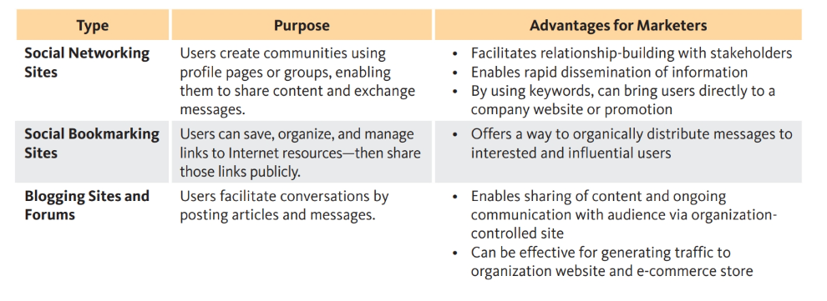

Slide 12
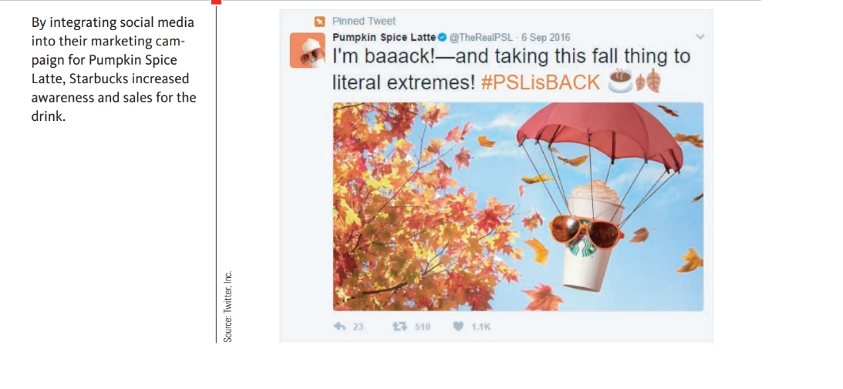

Slide 13
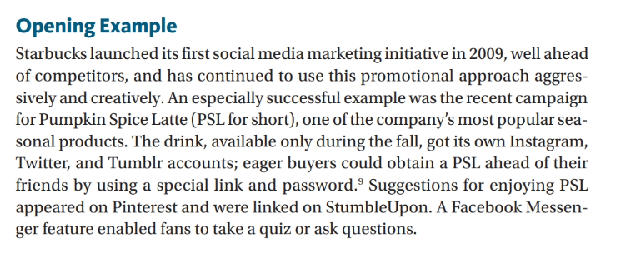

Slide 14
How Consumers Use Social Media
5-3

Slide 15
5-3 How Consumers Use Social Media (1 of 3)
Studies show an overall link between social media and trends in consumer behavior.
91% of consumers have visited a brick-and-mortar store because of an online experience.
Nearly 90% research a product using online search engines.
More than 67% of consumers make an in-store purchase after researching online.
In 2015, Facebook posts alone influenced over half of online and offline purchases.

Slide 16
5-3 How Consumers Use Social Media (2 of 3)
Roughly half of online consumers use a combination of search engines and social media in making purchase decisions.
58% start with search engines; 24% go straight to social media.
46% of consumers who start with social media then turn to search engines.

Slide 17
5-3 How Consumers Use Social Media (3 of 3)
The impact of social media on purchasing behavior varies by age.
47% of millennial shoppers are influenced by social media, compared to only 19% of other age groups.
Consumers rely on the communities created by social media for their buying decisions to:
Discover new goods and services: According to one recent report conducted by comScore and Group M Search, 28% of respondents said that sites like YouTube, Facebook, and Twitter helped steer them toward new brands and products.
Conduct research and share information: Reviews or rankings by fellow consumers, along with other shared information, can carry a lot of weight in certain purchase decisions
Make final purchase decisions: 72% of consum-ers regard online reviews as a primary driver of their decision to buy

Slide 18
If consumers learn about a product online, engaging with the company and other consumers via social media, they become part of the community the product’s marketers want to create. Consumers may purchase the product and share their response to it through social media, widening the circle even more.
Overall, it’s clear that social media are linked to trends in consumer behavior. As a result, marketers must take notice and develop strategies to address these trends.

Slide 19
Goals of a Social Media Marketing Campaign
5-4

Slide 20
PlayToday is an online service that sets up play dates for busy parents based on where they live and the ages of their children. When they founded the company, Marlene and Jim were confident that all they needed to succeed was a social media blitz. So they spent thousands of dollars publicizing their brand name and logo with “sponsored ads” on Facebook and “promoted pins” on Pinter-est.
They paid to boost their rankings on search engines Google and Bing. They even hired a movie production company to create a YouTube video called “The PlayToday Story.” But six months later, sales were flat. PlayToday’s revenues fell short of its social media costs.
Marlene and Jim couldn’t understand why other start-ups had boomed after social media campaigns—while their business, so far, was a bust. What had they missed?

Slide 21
5-4 Goals of a Social Media Marketing Campaign (1 of 6)
Social media marketing (SMM) is developing a conversation with current and potential customers on social media platforms.
However, this doesn’t always mean that social media posts will be used to promote a product or publicize a sale.
Any SMM plan must be built around specific goals.
Once goals are established, marketers are better able to develop strategies and choose the right platforms for their messages.

Slide 22
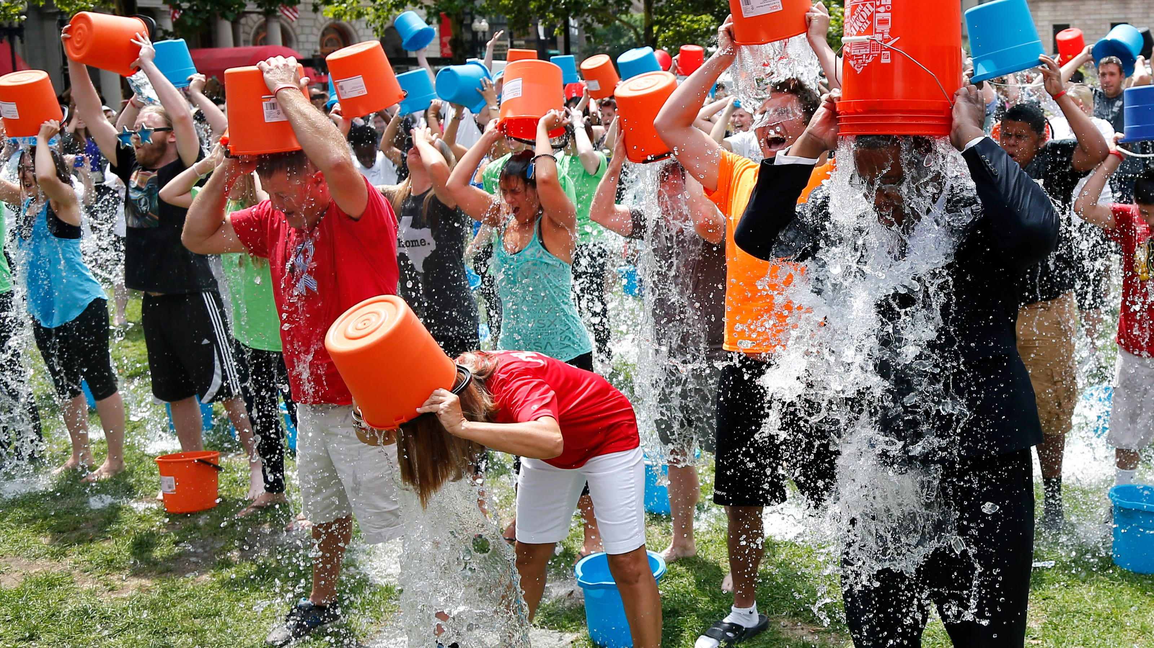
For example, organizations fighting amyotrophic lateral sclerosis (ALS) created the Ice Bucket Challenge, where people agreed to have a bucket of ice dumped on their heads to build aware-ness of the disease.
The campaign went viral, attracting famous participants like Justin Bieber, Selena Gomez, and Taylor Swift, and sparking over 2.4 million tagged videos on Facebook
https://youtu.be/a42OFezidFs

Slide 23
5-4 Goals of a Social Media Marketing Campaign (2 of 6)
Goal: Increase brand awareness and generate leads.
Purpose of this goal:
Increase the number of people who are aware of the company and its products.
Increase the positive perception of the brand.
Influencers are individuals with the capability of affecting the opinions and actions of others.
Examples:
Oprah Winfrey
Lady Gaga
Steven Spielberg

Slide 24
5-4 Goals of a Social Media Marketing Campaign (3 of 6)
Goal: Increase revenue.
Purpose of this goal: Increase sales.
‘Sponsored Ads’ on Facebook and Instagram, ‘Promoted Pin! On Intereset, ‘Snap Ads’ on Snapchat
Still, it’s important to remember that conversion rates can be quite low when advertising to new prospects. Create engagement!
Aligning social media promotions with traditional offline promotional campaigns can increase revenue.

Slide 25
5-4 Goals of a Social Media Marketing Campaign (4 of 6)
Goal: Improve customer service.
Purpose of this goal:
Communicate directly and easily with customers.
Detect and address any problems customers might be experiencing.
Example:
Delta Airlines has a full team dedicated to monitoring its Twitter handle and responding to customer inquiries.
@Delta Twitter handle and responding to customer inquiries—even about canceled flights or schedule changes. In addition, Delta can search mentions of their company across all of Twitter and directly contact unhappy customers to offer resolution.

Slide 26
5-4 Goals of a Social Media Marketing Campaign (5 of 6)
Goal: Manage a crisis.
Purpose of this goal: to better manage a public relations crisis
Respond more quickly.
Distribute message more directly.
Example:
In the aftermath of the BP oil spill off the Gulf Coast, the Louisiana Tourism Coastal Coalition had one major goal: to reduce losses resulting from the spill and rebuild tourism along the Louisiana coast.
Collaborating with an Internet consulting firm, the coalition launched a social media campaign that included postings on Facebook, Twitter, YouTube, and Flickr.

Slide 27
5-4 Goals of a Social Media Marketing Campaign (6 of 6)
Goal: market research and customer feedback
Purpose of this goal: to gather customer feedback for:
Guiding product development
Improving service
Planning expansion
Every strategy in an effective social media marketing campaign traces back to the campaign’s goals and ultimately links to a firm’s overall strategic goals. Collect e-mail addresses for further marketing (i.e., generate leads) 2. Sign up new members (i.e., increase revenue)

Slide 28
After their disappointing start, Marlene and Jim consulted a marketing professor at the local university. When he explained the importance of setting clear goals for a social media campaign, they knew what had gone wrong. “Our original approach was scattershot,” Jim admitted to investors. “But it didn’t take long to fix our mistake.”
The couple eliminated their sponsored ads and pins, recognizing that they needed to build brand awareness and engage with potential customers before trying to generate sales. Instead, they used Facebook and Twitter to introduce the company, post news about parenting, and invite viewers to share tips and stories.
Additionally, they hired a parenting expert to encourage and answer questions on a PlayToday parenting blog.
Within six months, Facebook likes had zoomed from fewer than 50 to over 500; Twitter retweets had quadrupled; and the blog was so successful that Marlene and Jim hired a second expert to respond to the steady stream of inquiries.
“We’ve achieved Goal #1, building awareness and engagement,” concluded Marlene. “Stay tuned for the next phase of our SMM plan: Goal #2 is to jumpstart revenue!”

Slide 29
Monitoring and Measuring Social Media Marketing
5-5

Slide 30
5-5 Monitoring and Measuring Social Media Marketing (1 of 4)
It’s one thing to launch a social media marketing campaign, but without tracking its effectiveness you won’t know whether the time and money invested is worth it.
The first step is to revisit the goals set at the beginning of the effort. Then, based on those goals, you can select the appropriate metric for measuring progress toward that goal.
Measurement methods fall into three categories:
Measures of activity
Measures of engagement
Measures of conversion

Slide 31
5-5 Monitoring and Measuring Social Media Marketing (2 of 4)
Measures of Activity: Understanding the overall reach of a social media campaign helps companies know whether they are reaching the right volume and type of customers.
Measurements of activity include:
Total likes/followers/subscribers to company social media profiles
New likes/followers/subscribers to company social media profiles
Impressions for social media content:Knowing the number of people who received your message is the foundation for most forms of promotion. Social media makes it easy to track how many people saw your blog post, watched your video, or read your tweet

Slide 32
5-5 Monitoring and Measuring Social Media Marketing (3 of 4)
Having lots of likes or impressions doesn’t mean that your social media activities are effective. That’s why digital marketers often focus more on measure of engagement for your social audience.
Measures of Engagement: A more engaged audience is more likely to purchase from a company and create good word-of-mouth.
Measurements of engagement include:
Likes/comments on social media content: When users engage with a piece of content, it makes that content visible to their own network of friends, which in turn makes it more likely that content will go viral.
Re-tweets/shares/re-pins: This type of engagement is even more powerful than likes and comments because the user is actively pushing the content to their network.
Click-through rate: Often social media content will include links to content on the company’s website, blog, or e-commerce store. This form of engagement is extremely valuable. First, it takes users off someone else’s social media platform and puts them on a platform you control, which allows you to control the messaging, branding, and user experience of the pages. Sec-ond, it facilitates collection of leads, such as e-mail addresses.

Slide 33
5-5 Monitoring and Measuring Social Media Marketing (4 of 4)
Measures of Conversion: The ultimate goal of many social media campaigns is to convert followers to customers (or repeat customers).
Even you can make e-commerce through Facebook when customers check out on company e-commerce sites, analytics tools allow the company to track where that traffic came from. (from engine query or a click-through a facebook post)
Companies can measure their conversion rate:
# of sales/# of visitors

Slide 34
Creating Effective Social Media Content
5-6

Slide 35
Opening Example Over the past several years, Weight Watchers’ revenues were flat and the com-pany was looking for ways to increase sales. Because of its “community-centric” approach, Weight Watchers focused its strategies on social networking to attract new members and retain existing ones. In 2015, the company partnered with Oprah Winfrey to launch its “Better Together” campaign, building on the star’s belief that “Life is better when you share it.”

Slide 36
5-6 Creating Effective Social Media Content (1 of 2)
Content marketing: creating and distributing relevant and targeted material to attract and engage an audience, with the goal of driving them to a desired action

Slide 37
5-6 Creating Effective Social Media Content (2 of 2)
Guidelines for creating effective social media content:
A strong brand focus
A focus on the audience rather than the organization: don’t promote the company only, share stories of customers, content generated by customers themselves.
Targeted keywords: use hashtag / target audience will search products through them.
Relevant information: not just product features, include problem-solving tips, answers to frequently asked questions, interviews, statistics, case studes, so forth.

Slide 38
Guidelines for creating effective social media content: (continue)
Shareworthy text and images: Marketers can turn customers into storytellers by encouraging them to post images related to the brand.
In one of the most successful promotions of 2016, fast-food chain Taco Bell ran a “sponsored lens” on Snapchat. Users could take funny, memorable selfies that transformed their heads into tacos, complete with the company’s Diablo sauce. In a single day, the promotion received 224 million views, more than any other sponsored lens since Snap invented this social media tool.
Invitations to generate content via posts, shares, discussions, reviews, or other forms of dialogue with the organization as well as with fellow customers
Promotions that offer discounts, gifts, or other special deals in exchange for participation

Slide 40
Ethics in Social Media
5-7

Slide 41
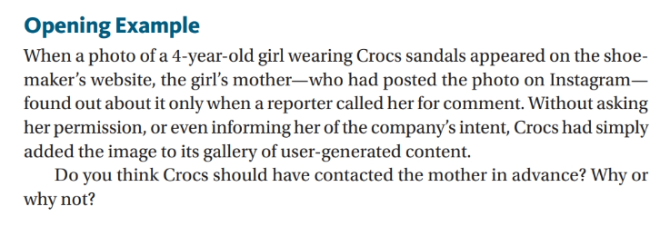

Slide 42
5-7 Ethics in Social Media (1 of 3)
Principle 1: Respect Privacy
Marketers must not distribute any personal information without consent.
Marketers must be vigilant about confidentiality and not let personal information or other data slip into unauthorized hands.
Violation of these practices and other privacy laws could destroy a company’s reputation and cost millions of dollars.

Slide 43
5-7 Ethics in Social Media (2 of 3)
Principle 2: Be Honest
Postings, ads, comments, and images must be checked for:
Accuracy
Fair and realistic claims
Balance and objectivity
Potential for misinterpretation

Slide 44
5-7 Ethics in Social Media (3 of 3)
Principle 3: Be Accountable
Social media marketers must take three actions to resolve mistakes.
Acknowledge a problem and take responsibility for it.
Communicate with the right people, via the most relevant channels, and promise to take steps necessary to correct the situation.
Implement the agreed-upon changes and evaluate ways to avoid similar problems in the future.

Slide 46
Launching and Measuring a Social Media Campaign
5-8

Slide 47
Exhibit 5.2 Measuring Social Media Marketing Results (1 of 2)
Goal | Type of Measurement | Examples | Why?
Increase brand awareness and generate leads | Measures of Activity | Total likes/followers/ subscribers to company social media profiles New likes/followers/ subscribers to company social media profiles Impressions for social media content | Measures how many users are seeing your content and indicating interest in your brand
Increase revenue | Measures of Conversion | Conversion rate | Measures how effective each source of social media traffic is at generating revenue

Slide 48
Exhibit 5.2 Measuring Social Media Marketing Results (2 of 2)
Goal | Type of Measurement | Examples | Why?
Increase customer service | Measures of Engagement | Likes/comments on social media content Retweets/shares/re-pins Click-through rate | Measures how many users are reacting to your content and/or sharing it with others
Manage a crisis | Measures of Engagement | Likes/comments on social media content Retweets/shares/re-pins Click-through rate | Measures how many users are reacting to your content and/or sharing it with others
Market research and customer feedback | Measures of Engagement | Likes/comments on social media content Retweets/shares/re-pins Click-through rate | Measures how many users are reacting to your content and/or sharing it with others

