Slide 1
«Introduction to Literature»
ING-404
Öğr. Gör. Merih Özbayrak

Slide 2
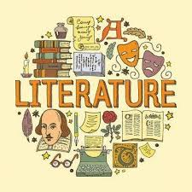
Literary Studies and Its Importance
Do you think Literature is important?

Slide 3
Literary Studies and Its Importance
Literary studies play a crucial role in understanding human culture, history, and emotions through written works. By analyzing literature, scholars gain insight into different societies, ideologies, and artistic expressions across time.
Literature not only reflects historical events and social structures but also explores universal themes such as love, conflict, identity, and morality.
Through literary studies, students develop critical thinking, analytical skills, and a deeper appreciation for language and storytelling.
Moreover, literature serves as a bridge between past and present, allowing us to connect with different perspectives and experiences, making it an essential field for cultural and intellectual growth.

Slide 4
«General Literary Terms»
What do you think these words mean?
Literature
Genre
Narrative
Plot
Theme
Character
Setting
Symbolism ,
Motif
Allegory
Metaphor
Simile
Hyperbole

Slide 5
Literature
Literature is written works like novels, stories, poems, or plays that express ideas and feelings.
"Kürk Mantolu Madonna" by Sabahattin Ali – A novel about love, loneliness, and personal struggles.
"Kaşağı is a well-known short story in Turkish literature is by Ömer Seyfettin. The story teaches a moral lesson about the consequences of lying.

Slide 6
Cemal Süreya called "Sevda Sözleri":
"Bir çiçek gibi açtım sana
Bir kuş gibi uçtum sana
Bir çiçek gibi solmuşsam
Bir kuş gibi düşmüşsem
Bunu sana anlatamam.«
In this poem, Cemal Süreya explores the theme of love. He uses metaphors like flowers and birds and beauty of love.
"Keşanlı Ali Destanı" is a well-known play in Turkish
literature by Haldun Taner. It mixes traditional Turkish storytelling with modern theatre techniques.

Slide 7
Genre
A genre is a type or category of literature or art that shares similar features.
Examples of genres in literature:
Poetry – Short, creative writing with rhythm and emotions. Example: A well-known poem in Turkish literature is "Sessiz Gemi" by Yahya Kemal Beyatlı.
Novel – A long story about characters and events. Example: "İnce Memed" by Yaşar Kemal.
Drama – A play meant to be performed. Example: "Ferhat ile Şirin" by Şahabettin Süleyman.
Short Story – A brief story focusing on one idea. Example: "Büyük İnsan" by Sait Faik Abasıyanık.

Slide 8
Narrative
A narrative is a story told from a certain point of view. It describes events, characters, and actions. The point of view is how the story is told—whether through the eyes of a character (first person), an outside observer (third person), or another perspective.
What is first person narrator and third person narrator?

Slide 9
"Küçük Prens" (The Little Prince) by Antoine de Saint-Exupér
This story is told from the point of view of a pilot who meets a young prince. The narrative shows the prince's adventures and lessons about life, told through the eyes of the pilot.
In this narrative, the point of view is first person because the pilot is telling the story from his perspective. Narrator uses "I" pronoun.
Example: "I asked the little prince, 'What is your story?'"

Slide 10
"Kürk Mantolu Madonna" by Sabahattin Ali.
In this novel, the story is told from the perspective of an outside narrator who observes the main character, Raif Efendi, and shares his experiences and emotions. The narrator describes Raif’s thoughts and actions using "he" or "she"
Example: "Raif Efendi was always quiet, lost in his thoughts."

Slide 11
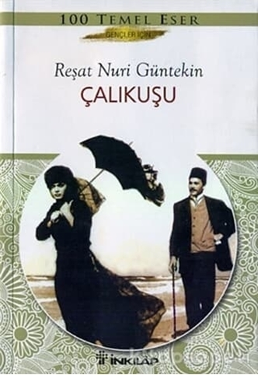
Plot
A plot is the series of events that happen in a story. It shows how the story begins, develops, and ends.
In "Çalıkuşu" by Reşat Nuri Güntekin, the plot follows Feride, a young teacher, as she faces challenges in her job and love life. The main events include her moving to a new town, her struggles with her students, and her love story. The plot shows her growth and the choices she makes.

Slide 12
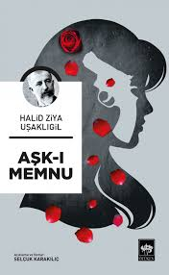
Theme
A theme is the main idea or message of a story.
In "Aşk-ı Memnu" by Halit Ziya Uşaklıgil, one of the central themes is forbidden love. The story explores the passionate and tragic relationship between Bihter and Behlül, which goes against societal and family expectations.

Slide 13
Character
A character is a person, animal, or being in a story who plays a role in the events. Characters can have different traits, personalities, and motivations that shape the story.
Who is the main character in the novel Çalıkuşu?
Feride is a young teacher who faces many challenges throughout her life. Her character is defined by her independence, her love for her students. Feride represents themes of love, and personal growth, as she navigates her role as a teacher and a woman in a changing society.

Slide 14
Setting
Setting is the time and place where a story happens. It helps create the atmosphere and background for the events.
In "Yaprak Dökümü" by Resat Nuri Güntekin, the setting is primarily in Istanbul.The story occurs in the 20th century, reflecting the changes in Turkish society during that time.

Slide 15
Symbolism
Symbolism is a literary device where a symbol—something that represents a deeper meaning or concept—appears in the story, poem, or text. It can be an object, color, or event that represents ideas beyond its literal meaning.
Here’s a stanza from "Büyük İnsan" by Sait Faik Abasıyanık,
"Denizin maviliği,
Her zaman olduğu gibi,
Bana huzur verir.
Birçok şeyin anlamını kaybettiği,
O sonsuz denizde."
In this stanza, the sea symbolizes a sense of peace and freedom for the character

Slide 16
"İstanbul'u dinliyorum, gözlerim kapalı.»
(“I am listening to Istanbul, my eyes closed.”)
In this line, Istanbul is symbolic of more than just a city—it represents a deep emotional connection
In the short story "The Gift of the Magi" by O. Henry, the hair
and the watch are symbols of love and sacrifice.
The wife, Della, sells her long hair to buy a chain for her husband's watch, while he sells his watch to buy a comb for her hair. The hair symbolizes Della's love, and the watch symbolizes Jim’s love. Both characters sacrifice something precious to show how much they care for each other.
Here’s a line from the story:
"She had beautiful hair. It reached below her knee and
made her look like a queen."The hair symbolizes Della's selflessness and the depth of her love for her husband.

Slide 17
Motif
A motif is a recurring idea, symbol, or image in a
story that helps to emphasize the main themes.
Example:
In "Harry Potter" by J.K. Rowling, the motif of light vs. darkness appears throughout the series. Light often symbolizes good, and darkness represents evil. For instance, the light from wands in battles against dark magic is a recurring image, emphasizing the ongoing fight between good and evil.
The light and darkness are motifs because they show up repeatedly and help develop the main idea of the struggle between good and bad.

Slide 18
Allegory
An allegory is a story in which characters, events, or settings symbolize something deeper, often representing abstract ideas or moral lessons.
In "Animal Farm" by George Orwell, the story is an allegory for the Russian Revolution and the rise of communism. The animals on the farm represent different groups in society (like the working class and political leaders). For example, Napoleon, the pig, represents Joseph Stalin, and Boxer, the horse, symbolizes the loyal working class. Through the story, Orwell critiques power, corruption, and inequality.
In this case, the story itself is a symbolic representation of real-world historical events and political ideas.

Slide 19
Allegory
Story: In this fable, the hare (a fast animal) boasts about how quickly he can run and challenges the tortoise (a slow animal) to a race. Confident that he will win easily, the hare takes a nap during the race. Meanwhile, the tortoise keeps moving steadily and eventually wins the race, showing that slow and steady effort can triumph over arrogance and laziness.
Moral/Allegory: The tortoise and hare are symbols of persistence and overconfidence. The story teaches that slow and steady effort is often more successful than rushing or being overly confident. The race represents the idea that hard work and consistent effort can lead to success, while arrogance and complacency can lead to failure.

Slide 20
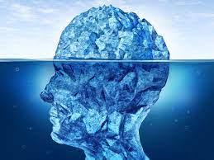
Metaphor
A metaphor is a literary device that directly compares two unrelated things to suggest they are alike in some way. It creates deeper meaning and imagery in writing.
"All the world's a stage, and all the men and women merely players."
📖 William Shakespeare – As You Like It
Meaning: Life is compared to a stage, and people are actors playing different roles throughout their lives.

Slide 21
Metaphor
"He has a heart of stone."
📖 (Common Literary Metaphor)
Meaning: This suggests that the person is emotionally cold and unfeeling, without literally having a stone for a heart.
"Hope is the thing with feathers."
📖 Emily Dickinson
Meaning: Hope is described as a bird, symbolizing its lightness, persistence, and ability to uplift people even in difficult times.

Slide 22
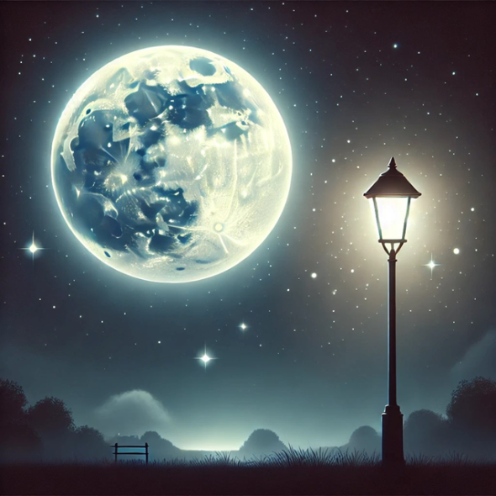
Simile
A simile is a literary device that compares two different things using the words "like" or "as"
"My love is like a red, red rose."
📖 Robert Burns – A Red, Red Rose
Meaning: Love is compared to a red rose, symbolizing beauty, passion, and deep emotions.
"She was as innocent as an angel."
📖 (Common Literary Simile)
Meaning: The person's innocence is directly compared to an angel, emphasizing purity and goodness.

Slide 23
Hyperbole
Hyperbole is a literary device that involves extreme exaggeration to emphasize a point or create a dramatic effect.
"I am so hungry I could eat a horse."
📖 (Common Hyperbole)
Meaning: The speaker isn't actually going to eat a horse, but this exaggeration emphasizes extreme hunger.
"She cried so long that she made a lake of tears."
📖 (Common Hyperbole)
Meaning: This exaggerates how much someone cried, making it more dramatic and emotional.

