Slide 1
Chapter 2.
generate ideas that will help in the choice of a suitable research topic;
identify the attributes of a good research topic;
turn research ideas into a research project that has clear research question(s) and objectives;
draft a research proposal.

Slide 2
How to decide...
clarfying. The research topic is the most exciting part.
it is important to choose something that will sustain your interest throughout the months that you will need to complete it.
You may even decide to do some research that is something that forms part of your leisure activities!

Slide 3
Before starting to your research
You need to have at least some idea of what you want to do.
This is probably
the most difficult
the most important, part of your research project.
This chapter is concerned with how to formulate and clarify your research topic and your research question.
Without being clear about what you are going to research it is difficult to plan how you are going to research it.

Slide 4
Alice’s Adventures in Wonderland
a favorite quote, is part of Alice’s conversation with the Cheshire Cat.
Alice asks the Cat (Carroll 1989:63–4):
‘Would you tell me, please, which way I ought to walk from here?’
‘That depends a good deal on where you want to get to’, said the Cat.
‘I don’t much care where’, said Alice.
‘Then it doesn’t matter which way you walk’, said the Cat.

Slide 5
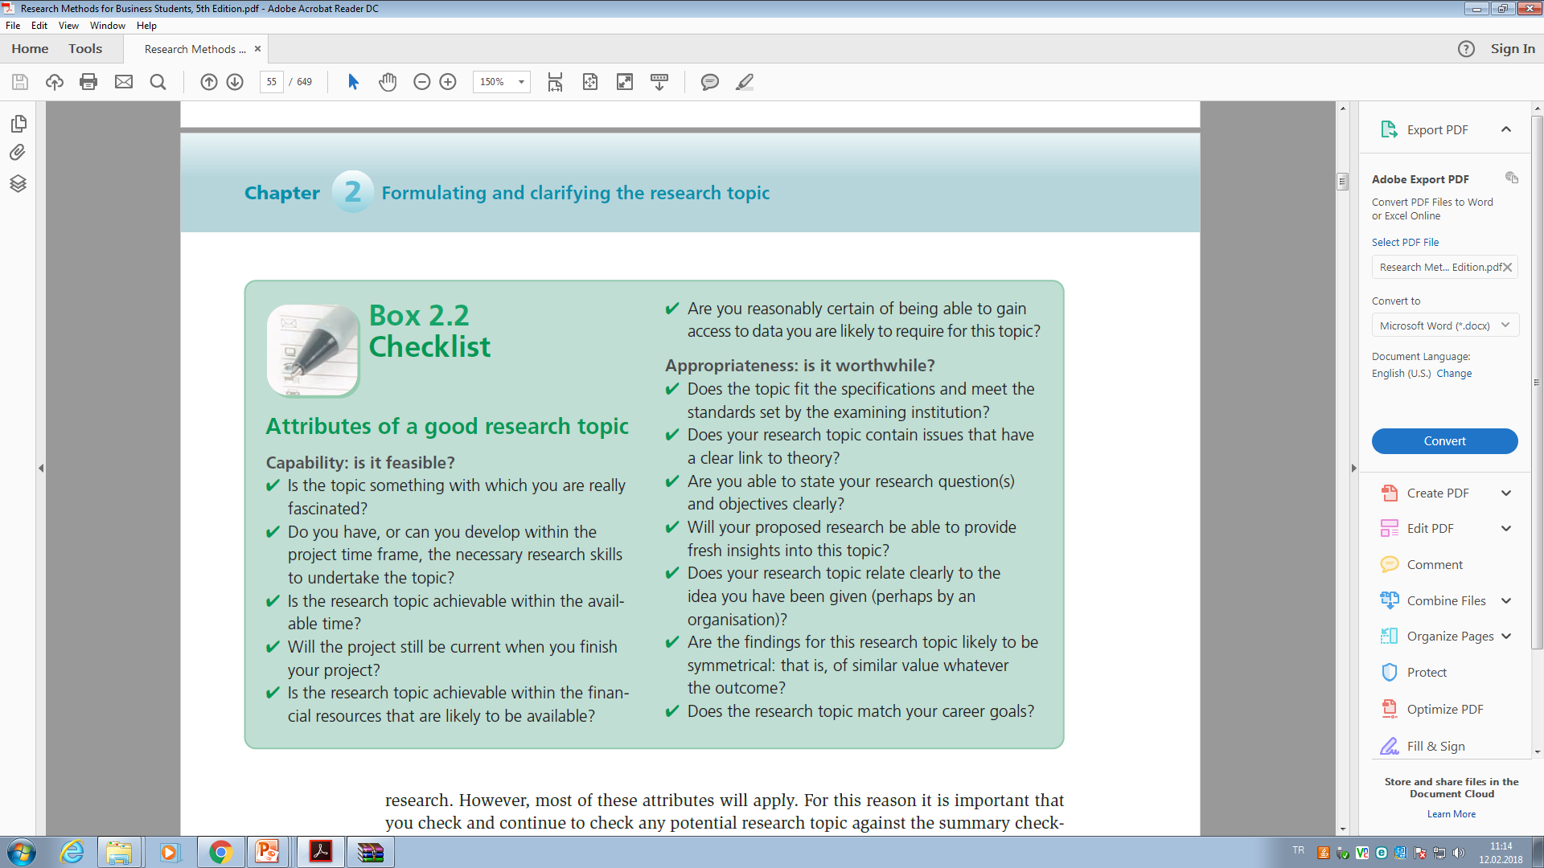
Attributes Of a Good Research…

Slide 6
Generating and refining research ideas

Slide 7

Generating research ideas..
Providing an initial research idea there are a lot of techniques
The unique technique that you choose to use and the order in which you should usethem are entirely up to you.
It is better to use a variety of techniques.

Slide 8
Rational thinking | Creative thinking
Examining your own strengths and interests | Keeping a notebook of your ideas
Examining staff research interests | Exploring personal preferences using past projects
Looking at past project titles | Exploring relevance to business using the literature
Discussion | Relevance trees
Searching existing literature | Brainstorming
Scanning the media
Table 2.1 More frequently used techniques for generating and refining research ideas

Slide 9
Rational thinking
Examining your own strengths and interests | Choose a topic you really like it, and already have some academic info about. For instance, if you would like to work in finance area, it is better to search a topic about financing and et al. Clear your dept. of knowledge & your enthusiasm.
Looking at past project titles | Dissertations, master thesis, et al. Scan your university’s and nation, or international databases to identify the titles. Based on your study, you may provide some fresh insights.
Discussion | Colloehues,friends,university academic staff,practioners, professionals,
Searching existing literature | Articles in academic journals,reports,books,
Scanning the media | Traditional or online media

Slide 10
Creative thinking
Keeping a notebook of your ideas | Anytime in a day you may keep an idea!
Exploring personal preferences using past projects | Evaluate the parameters based on your past experiences…
Relevance trees | Mind mapping. in which you start with a broad concept from which you generate further topics, more ideas are generated with the tree’s sub branches.
 | Exploring relevance to business using the literature
Brainstorming | A problem-solving technique, Brainstorming is a group creativity technique by which efforts are made to find a conclusion for a specific problem by gathering a list of ideas spontaneously contributed by its members. During brainstorming sessions, people should avoid criticizing or rewarding ideas. You're trying to open up possibilities and break down incorrect assumptions about the problem's limits.

Slide 11
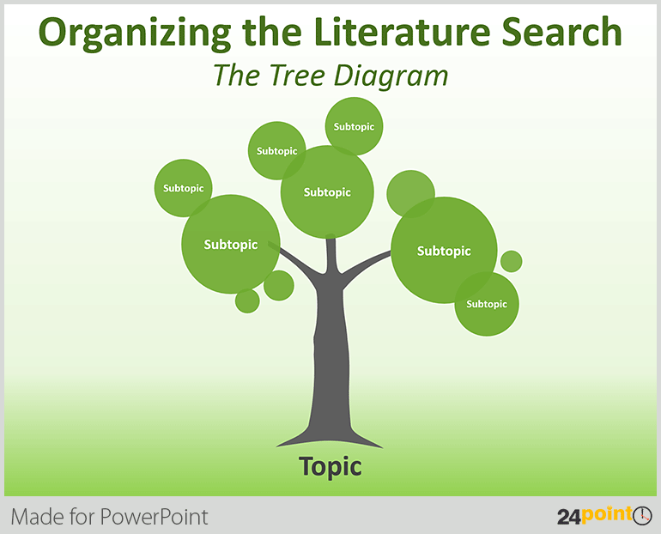

Slide 12
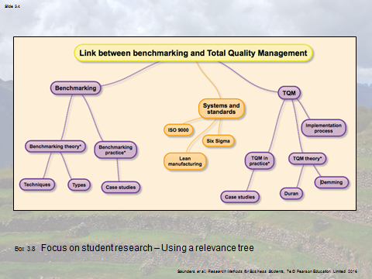

Slide 13
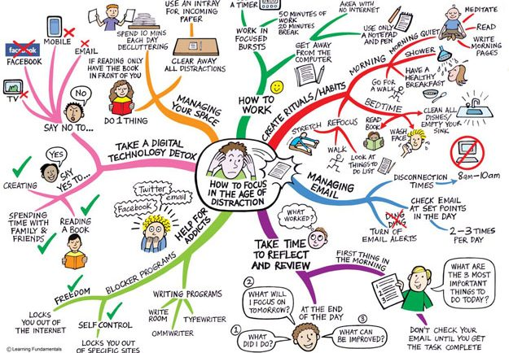
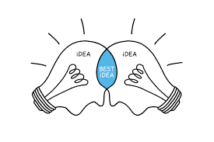

Slide 14
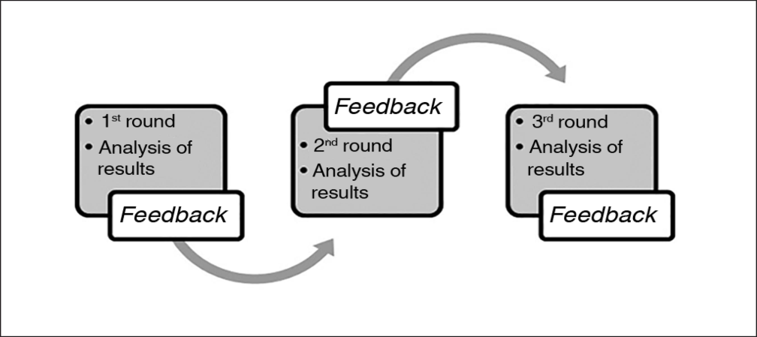
Refining research ideas…
The Delphi method is a structured communication technique or method, originally developed as a systematic, interactive forecasting method which relies on a panel of experts.
The experts answer questionnaires in two or more rounds.

Slide 15
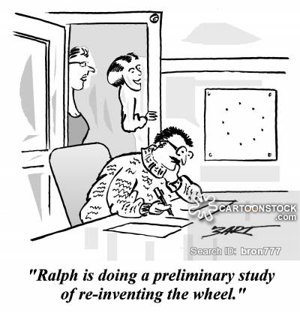
The preliminary study…
Preliminary study is an initial exploration of issues related to a proposed quality review or evaluation.
Preliminary studies do not happen in all systems but they may be used to identify key features to be addressed in a quality process.

Slide 16
Integrating ideas…
Working up and narrowing down…
Know that when the process of generating and refining ideas is complete as you will be able to say « ı would like to do some research on…» obviously still be a big gap between this and the point you start seriously on your work.

Slide 17
Turning research ideas into research projects…
Writing research questions
Writing research objectives

Slide 18
Research questions or hypotheses…
The specification of research questions or hypotheses (i.e., what is to be studied) and research strategy (i.e., how to conduct the study) is an extremely important part of any research project
Research questions or hypotheses influence the strategy that is employed in order to either provide answers to the questions or verify/falsify hypotheses.
What research strategy to use ought to depend on the nature of the problem domain (i.e., sociology, biology, physics, mathematics, etc.) and exact formulation of research questions.
Formulation of precise research questions requires deep insights into the domain of study:
Do the questions that are to be answered "fit" the research domain?
Are they the ones most worthy of investigation?
To which degree will answering the questions contribute to any progress within the research area? Do practitioners perceive the research questions to concern real problems?
Instead, studies of the problem area were expected to result in more sophisticated understanding of dominant concepts, so that the research questions could be adjusted accordingly.
Hence, the research questions presented in section are a result of iteration through problem formulation and actual research. They are not just "snatched out of thin air" -- they have evolved as a part of the research process.

Slide 19
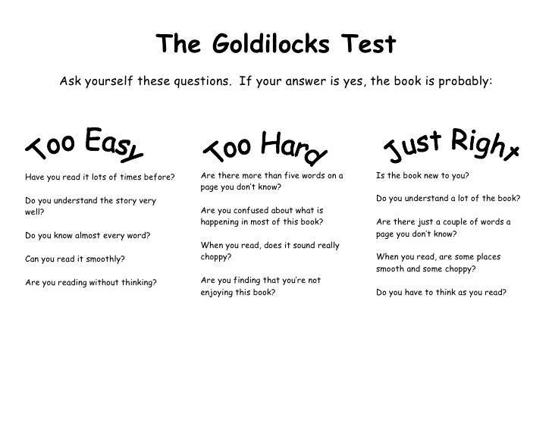
Sufficient questions are needed!!!
JUST RIGHT for investigation at this time,by this researcher in this setting….

Slide 20
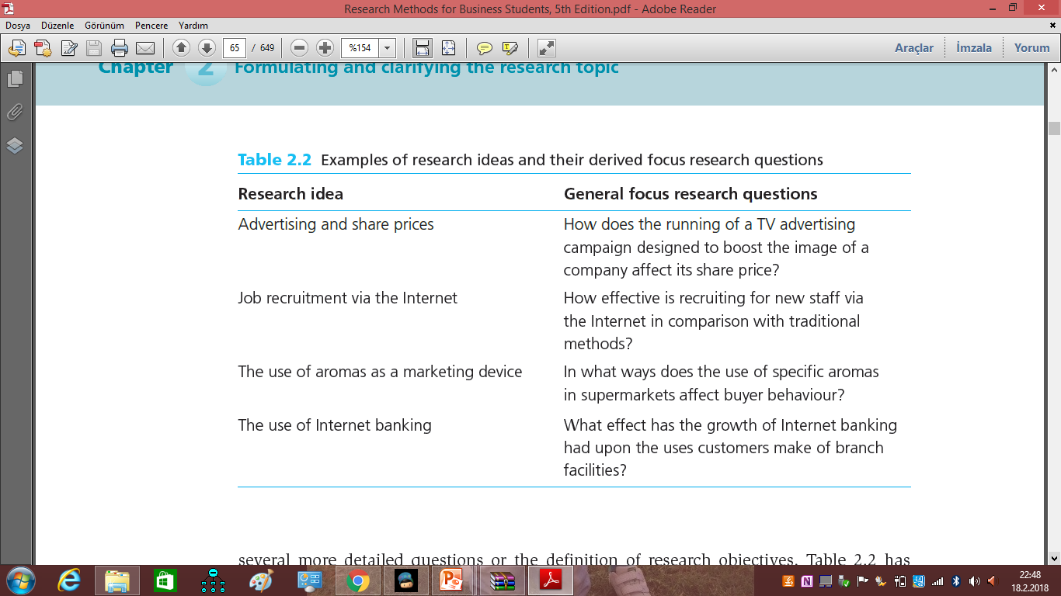

Slide 21
Research objectives.
Your research may begin with a general focus research question that then generates more detailed research questions, or you may use your general focus research question as a base from which you write a set of research objectives.
Objectives are more generally acceptable to the research community as evidence of the researcher’s clear sense of purpose and direction. It may be that either is satisfactory.
Do check whether your examining body has a preference.

Slide 22
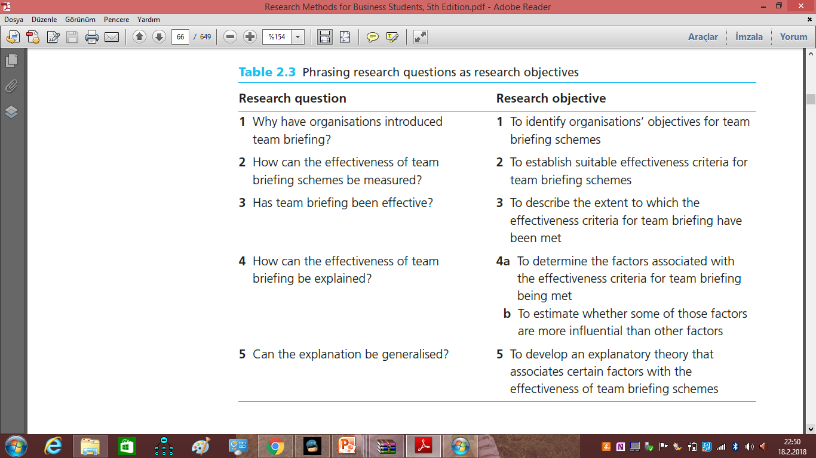

Slide 23
Maylor and Blackmon
SMART test.
Specific. What precisely do you hope to achieve from undertaking the research?
• Measurable. What measures will you use to determine whether you have achieved
your objectives? (e.g. secured a career-level first job in software design).
• Achievable. Are the targets you have set for yourself achievable given all the possible
constraints?
Realistic. Given all the other demands upon your time, will you have the time and
energy to complete the research on time?
• Timely. Will you have time to accomplish all your objectives in the time frame you
have set?

Slide 24

Theory
Theory is defined as «a formulation regarding the cause and effect relationships between two or more variables, which may or may not have been tested>>.
if the presence of theory is to be guaranteed, the researcher must ensure that what is passing as good theory includes a plausible, coherent explanation for why certain relationships should be expected in our data.

Slide 25
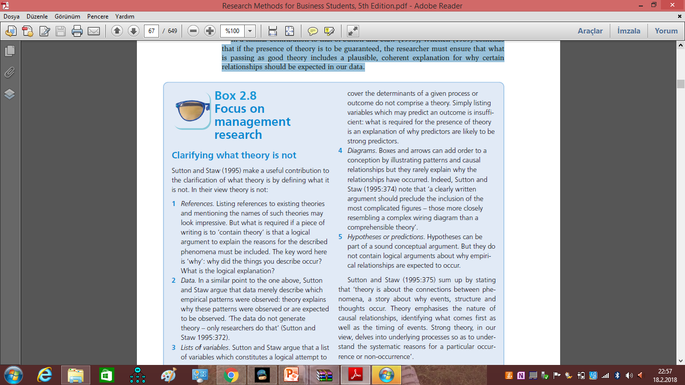

Slide 26
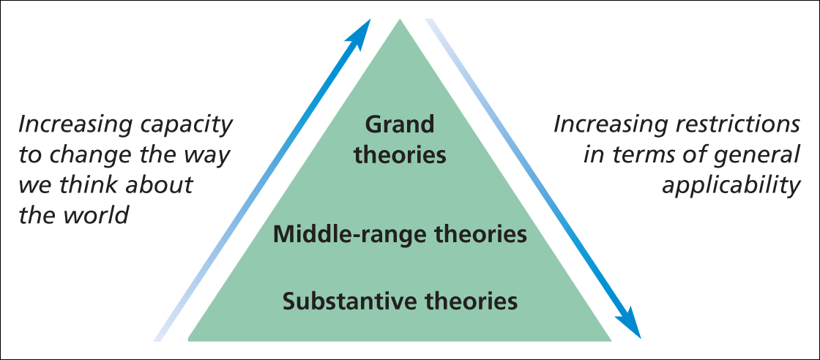
Figure 2.1 Grand, middle-range and substantive theories

Slide 27
Deductive/inductive
This discussion of theory does assume that a clear theoretical position is developed.
prior to the collection of data (the deductive approach).
It may be that your study is based on the principle of developing theory after the data
have been collected (the inductive approach).

Slide 28
Writing your research proposal
Organising your ideas
Convincing your audience
Contracting with your ‘client’

Slide 29
Finding a topic and
doing critical literature review (Chapter 3)
&
How to reach to the databases…

Slide 30
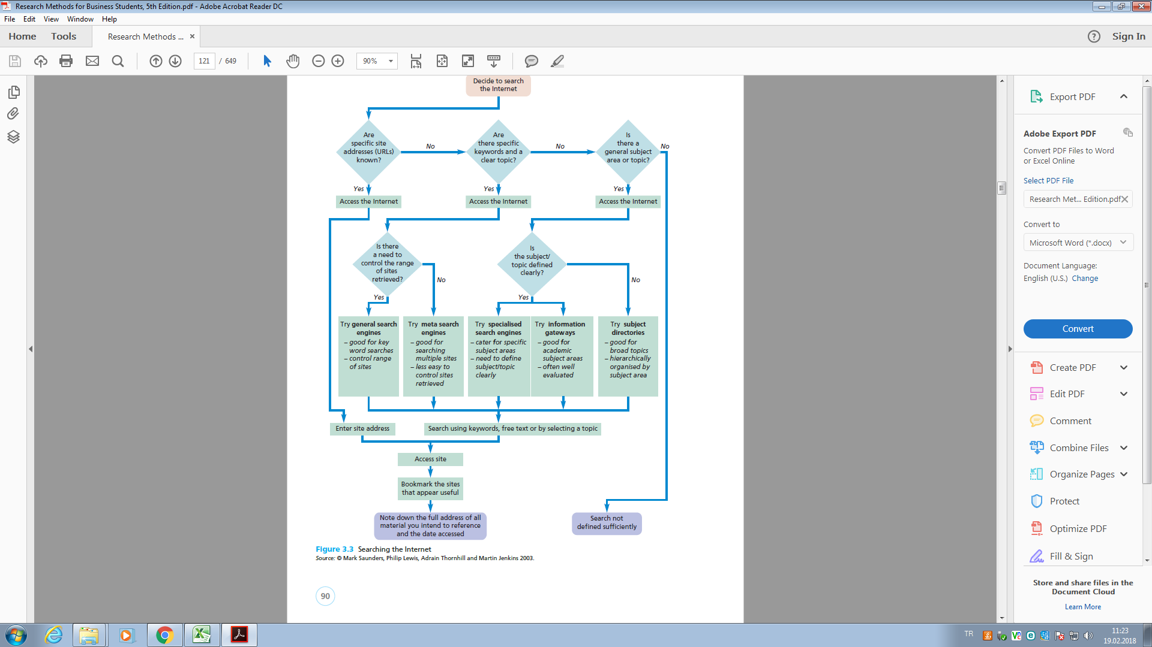

Slide 31
When planning your literature search you need to:
– have clearly defined research question(s) and objectives;
– define the parameters of your search;
– generate key words and search terms;
– discuss your ideas as widely as possible.

Slide 32
Bookmarking
Once you have found a useful Internet site, you can note its address electronically.
This process is termed ‘bookmarking’ or ‘add to favorites' depending on the Internet browser you use.
It uses the software to note the Internet address, and means that you will be able to access it again directly.

Slide 33
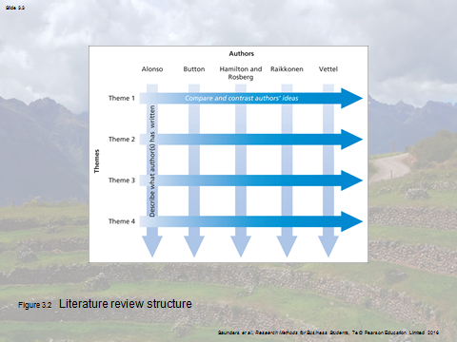

Slide 34
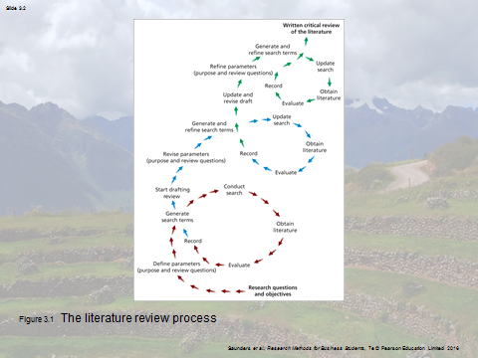

Slide 35
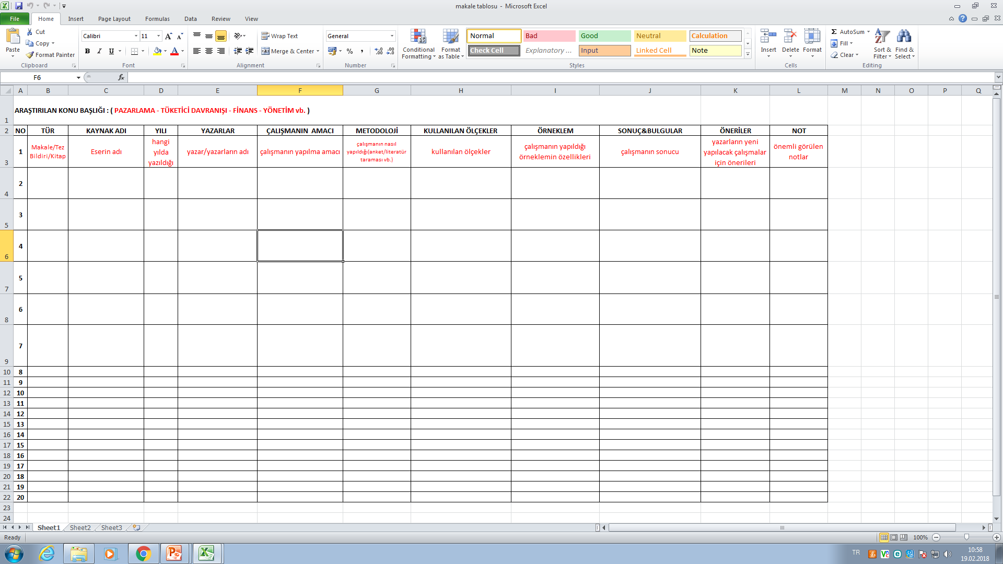

Slide 36
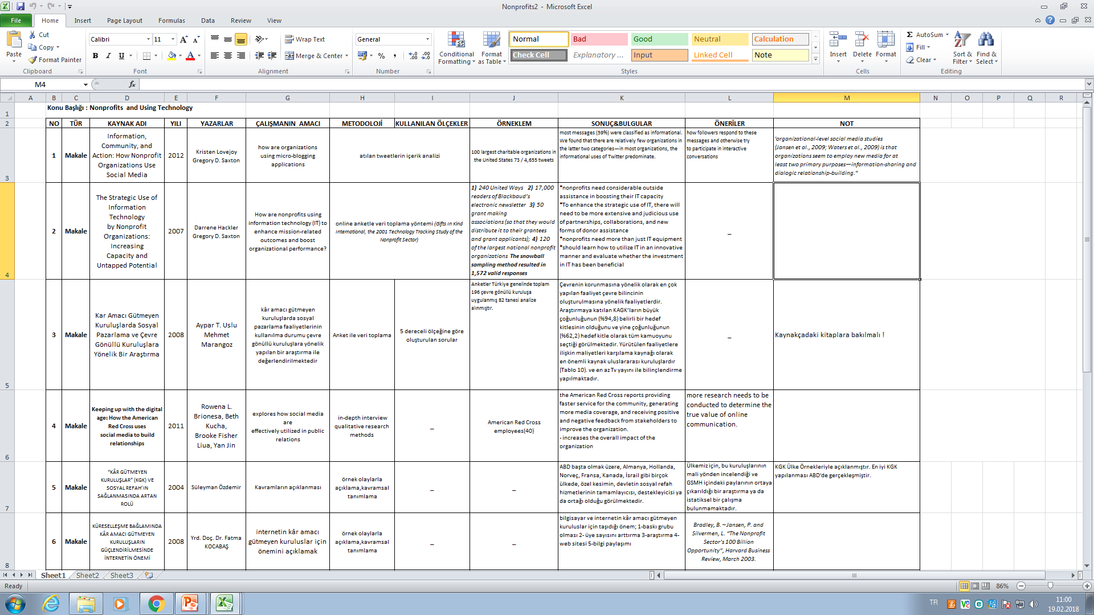

Slide 37
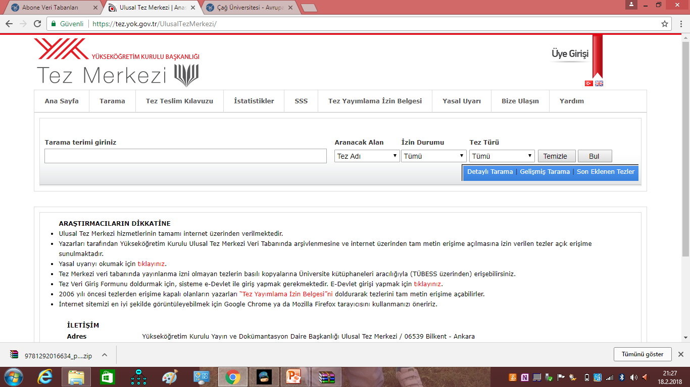

Slide 38
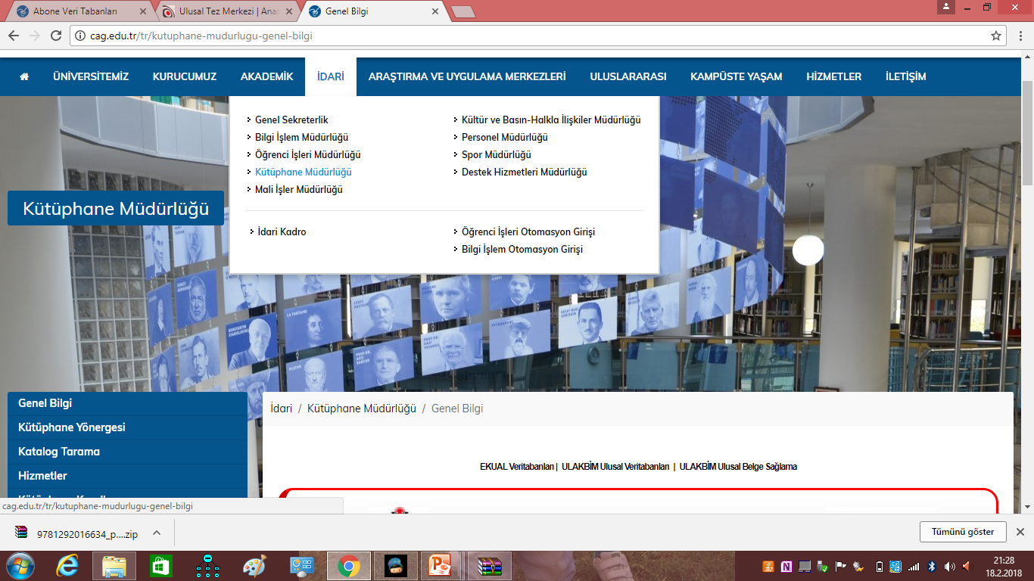

Slide 39
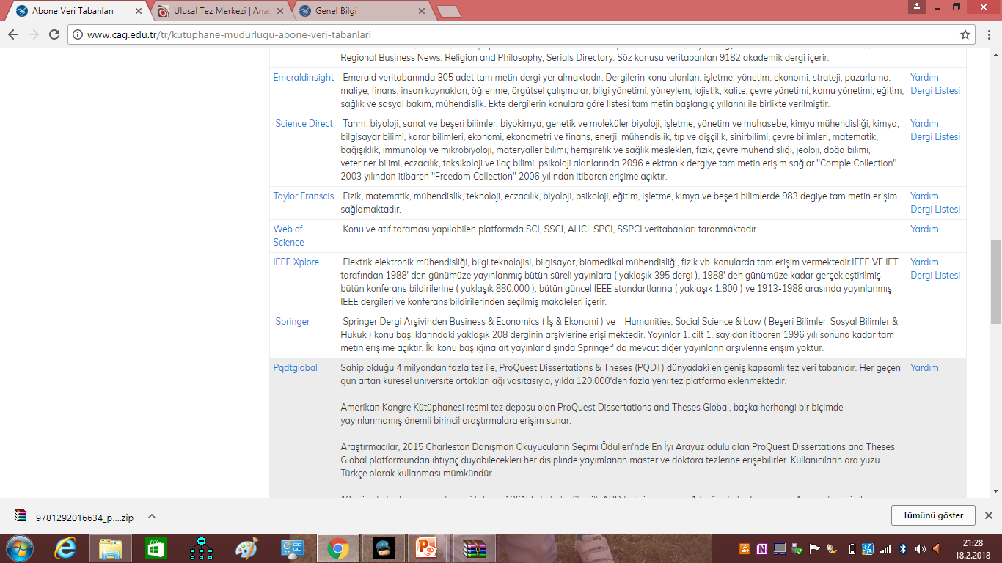

Slide 40
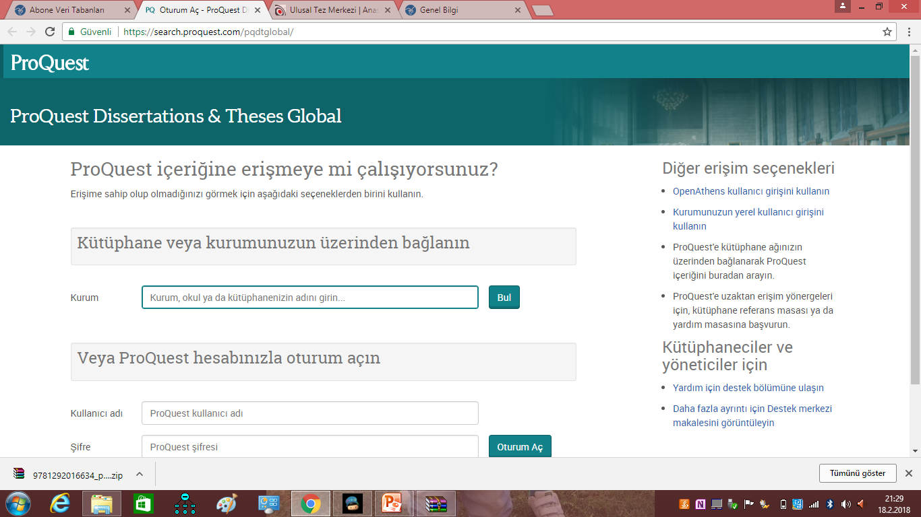

Slide 41
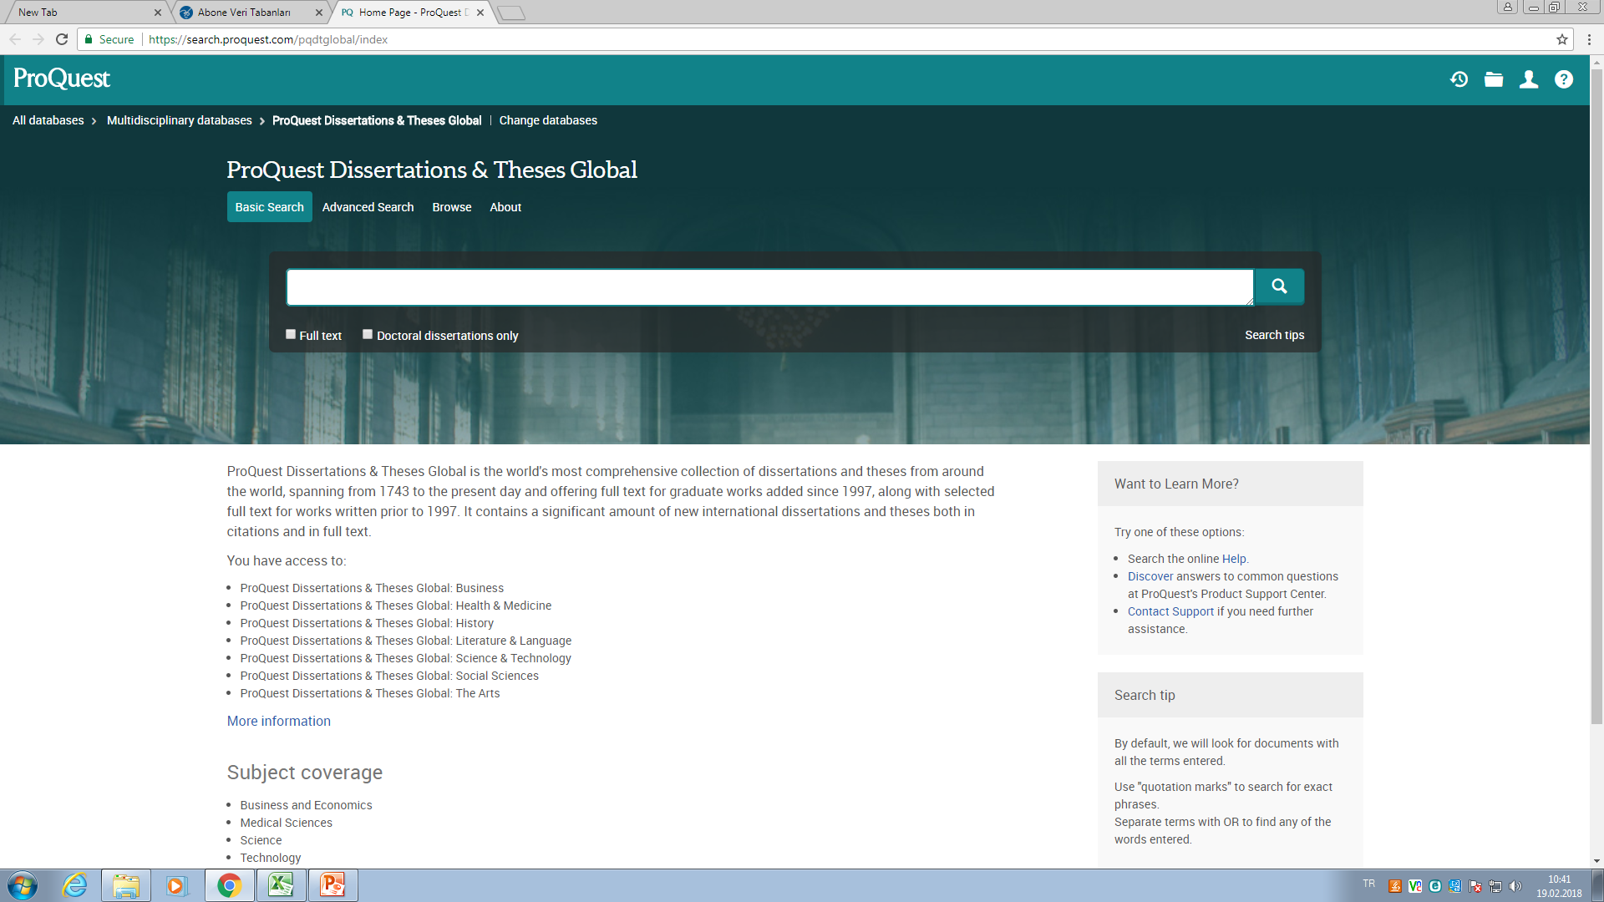

Slide 42

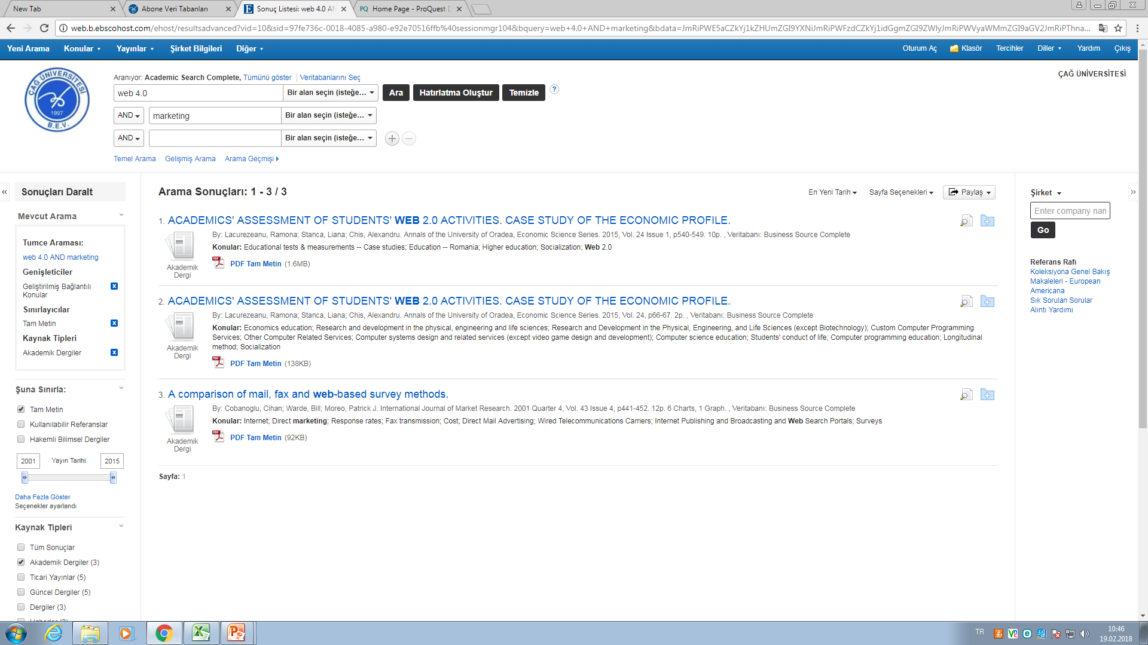
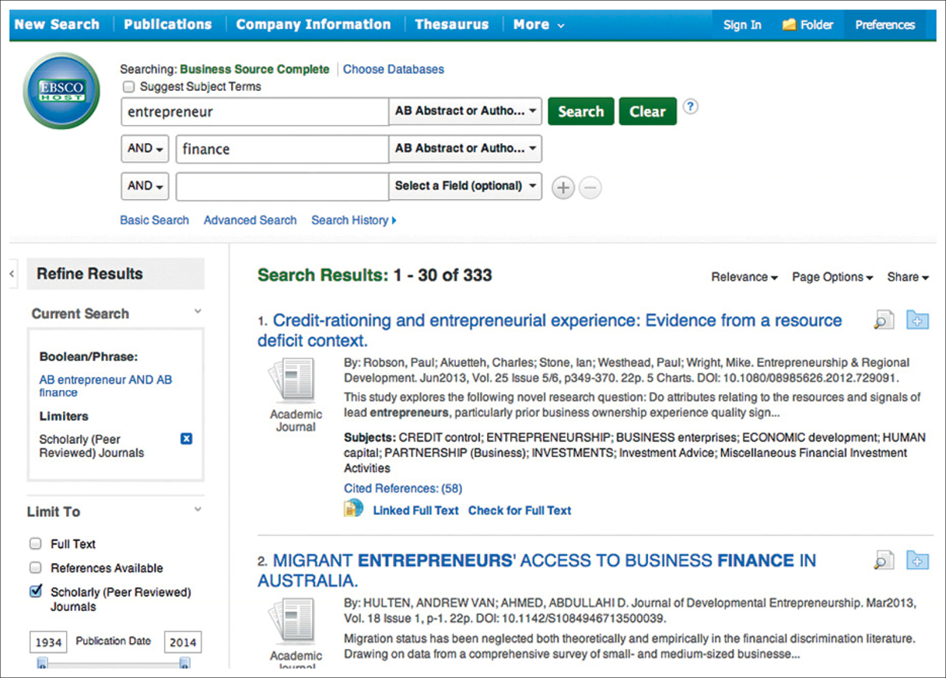

Slide 43
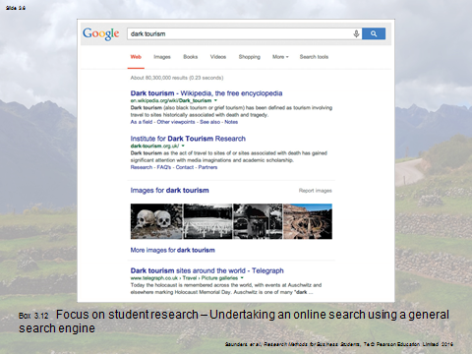
Google search...

Slide 44
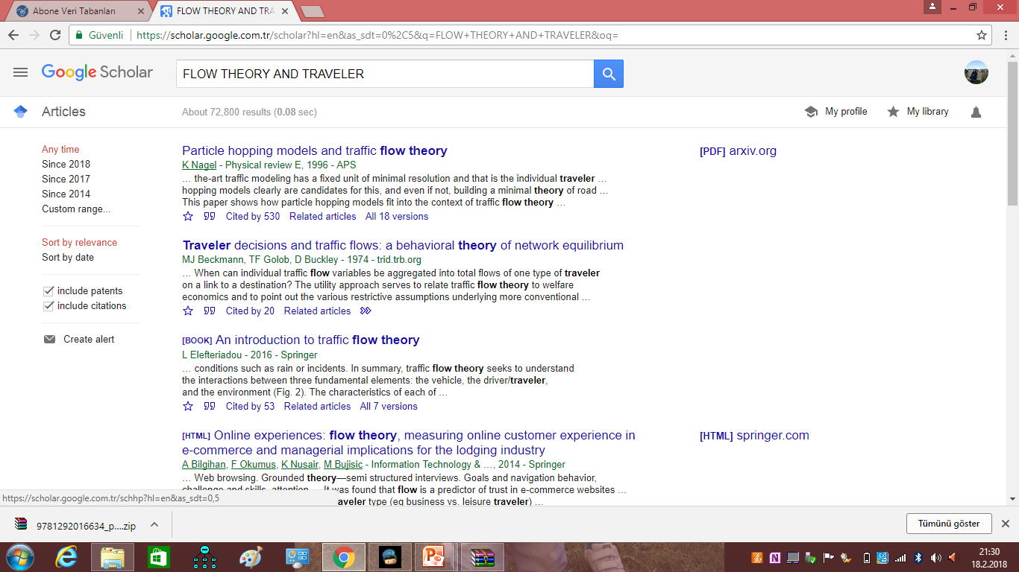
Google scholar…

Slide 45
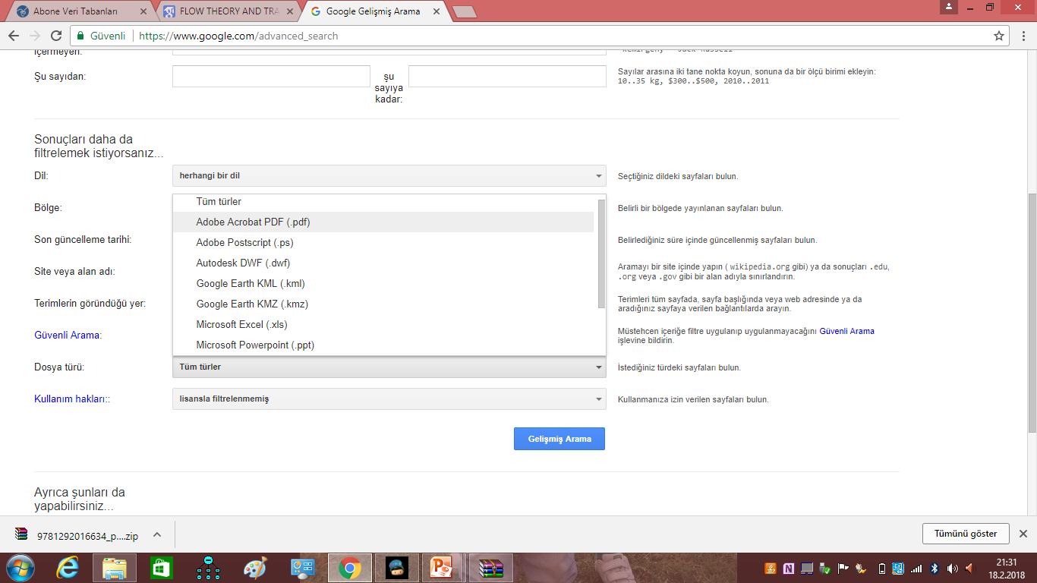

Slide 46
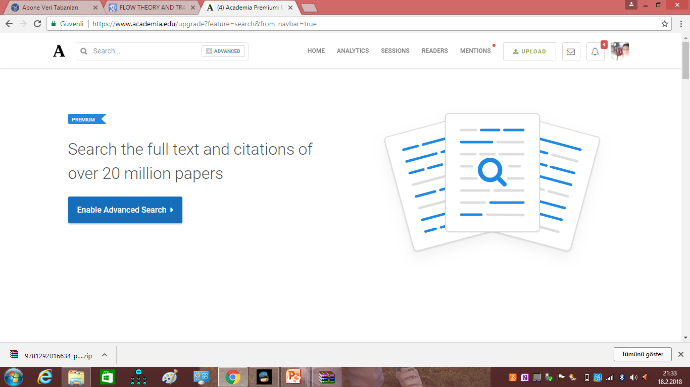

Slide 47
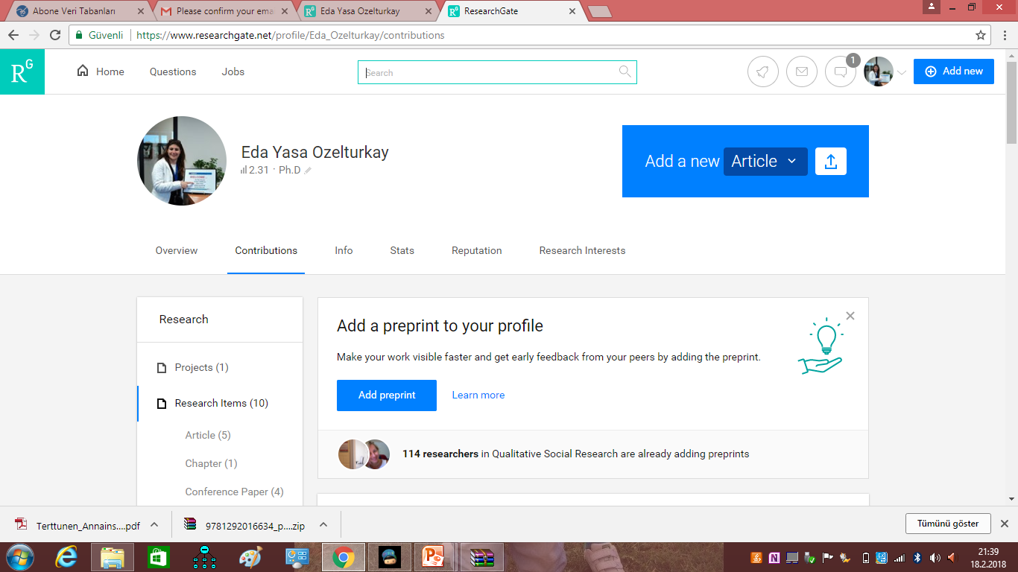

Slide 48
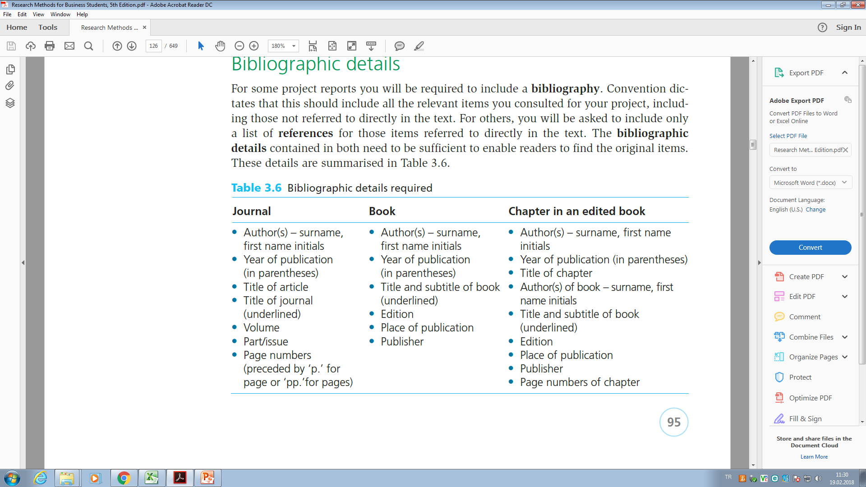

Slide 49
The content of the research proposal
Title
This may be your first attempt at the title. It may change as your work progresses. At this stage it should closely mirror the content of your proposal.
Background
It should tell the reader why you feel the research that you are planning is worth the effort. This may be expressed in the form of a problem that needs solving or something that you find exciting and has aroused your curiosity. It will just provide an overview of the key literature sources from which you intend to draw.
Research questions and objectives
The background section should lead smoothly into a statement of your research question(s) and objectives.

Slide 50
Method
Two aims may be met by dividing your method section into two parts: research design and data collection. In the part on research design you will explain where you intend to carry out the research. However, if your research topic is more generic you will wish to explain, for example, which sector(s) of the economy you have chosen to research and why you chose these sectors. You will also need to explain the identity of your research population (e.g. Managers or trade union officials) and why you chose this population. The research design section gives an overall view of the method chosen and the reason for that choice. ethical guidelines.
Timescale
This will help you and your reader to decide on the viability of your research proposal. It will be helpful if you divide your research plan into stages. This will give you a clear idea as to what is possible in the given timescale. Experience has shown that however well the researcher’s time is organised the whole process seems to take longer than anticipated

Slide 51
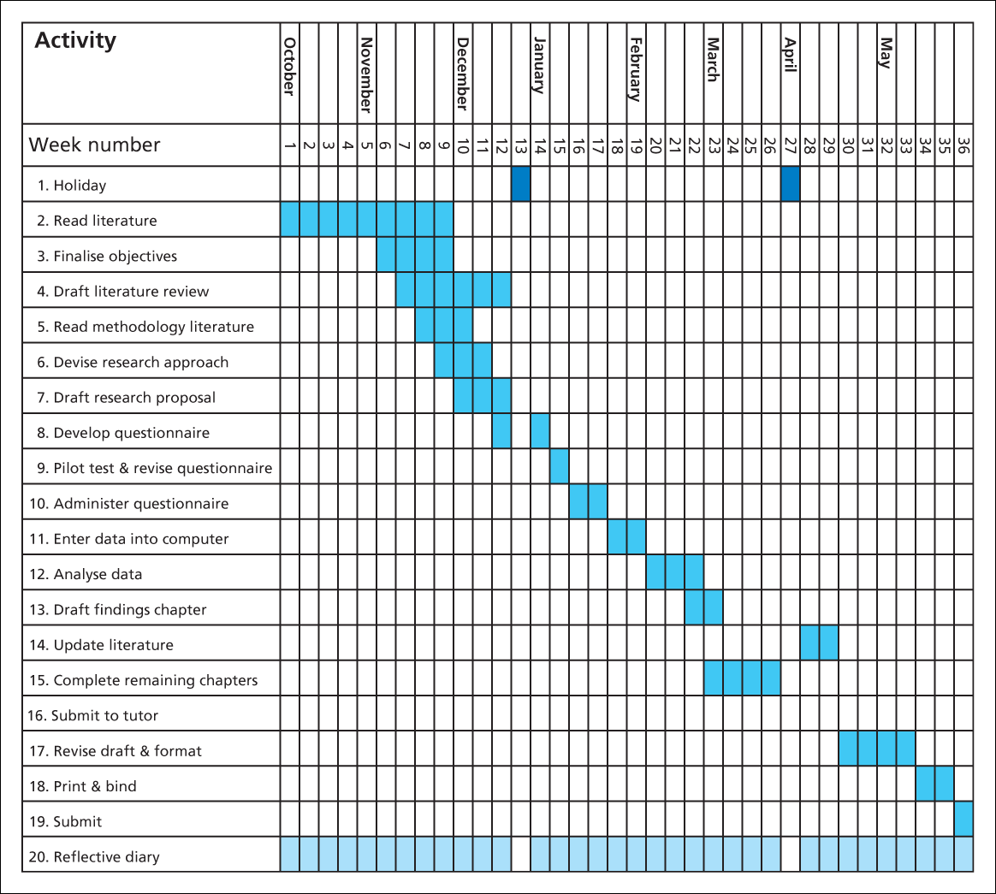
Case 2 Gantt chart

Slide 52
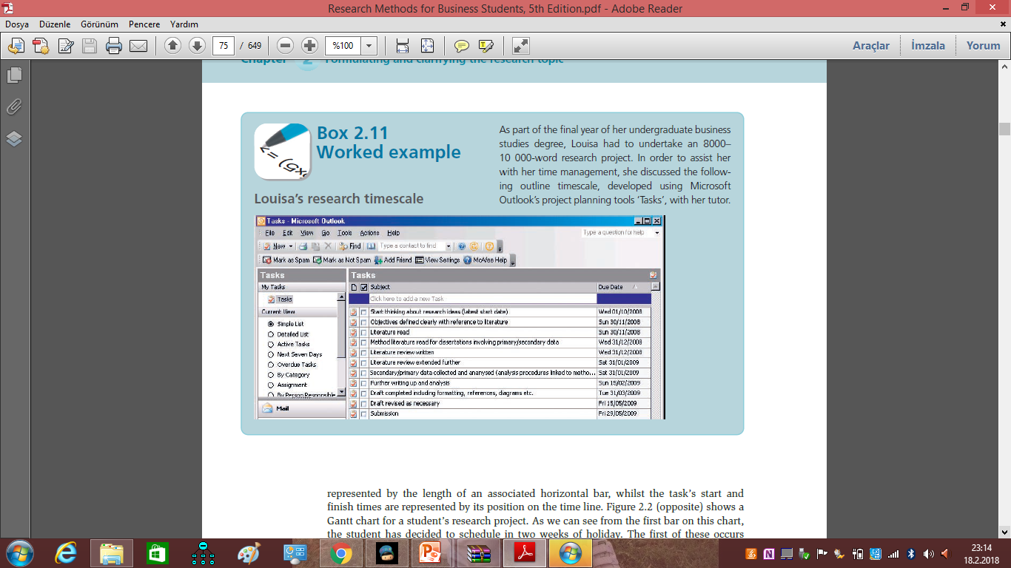

Slide 53
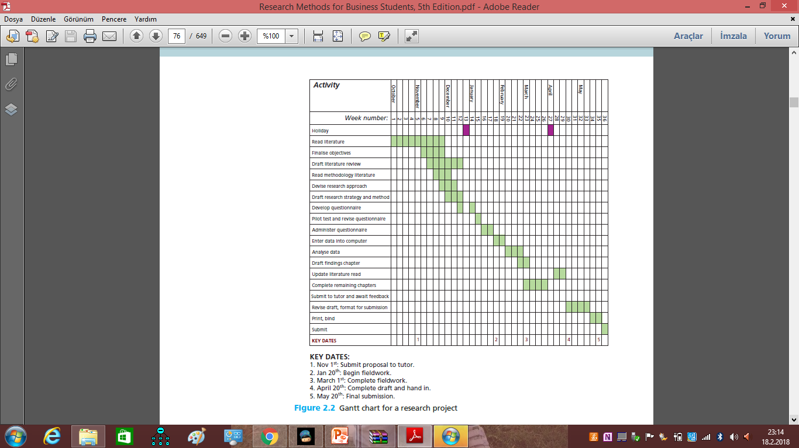

Slide 54
The viability of the proposal
This is the answer to the question:
‘Can this research be carried out satisfactorily within the timescale and with available resources?’

Slide 55

plagiarism?
Easterby-Smith et al. (2008 ) Presenting the work and ideas of other people and passing them off as your own, without acknowledging the original source of the ideas used, four common forms of plagiarism which are commonly found in universities
1. Stealing material from another source and passing it off as your own, for example: buying a paper from a research service, essay bank or term-paper mill (either specially written for the individual or pre-written); copying a whole paper from a source text without proper acknowledgement;
2. Submitting another student’s work with or without that student’s knowledge (e.g. by copying a computer disk);
3. Copying sections of material from one or more source texts, supplying proper documentation (including the full reference) but leaving out quotation marks, thus giving the impression that the material has been paraphrased rather than directly quoted;
4 . Paraphrasing material from one or more source texts without supplying appropriate documentation;
check their own work using plagiarism detection software

Slide 56
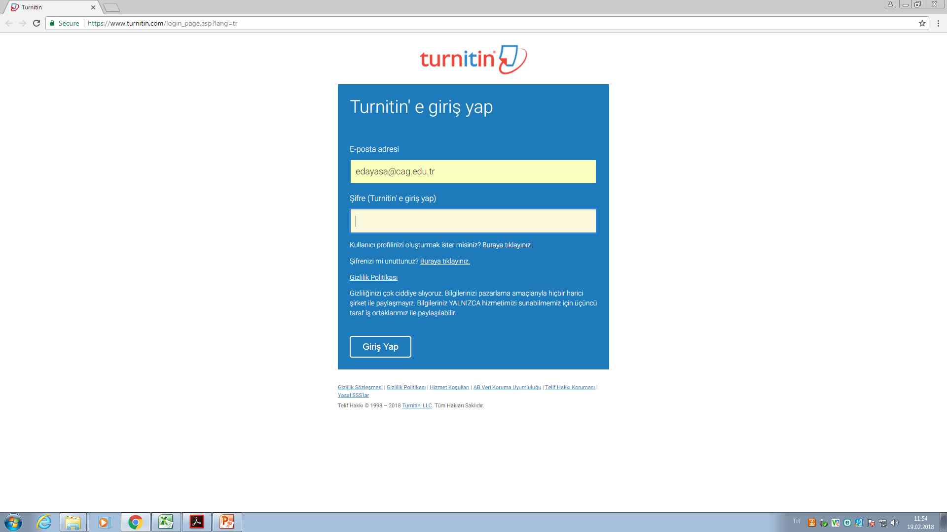

Slide 57
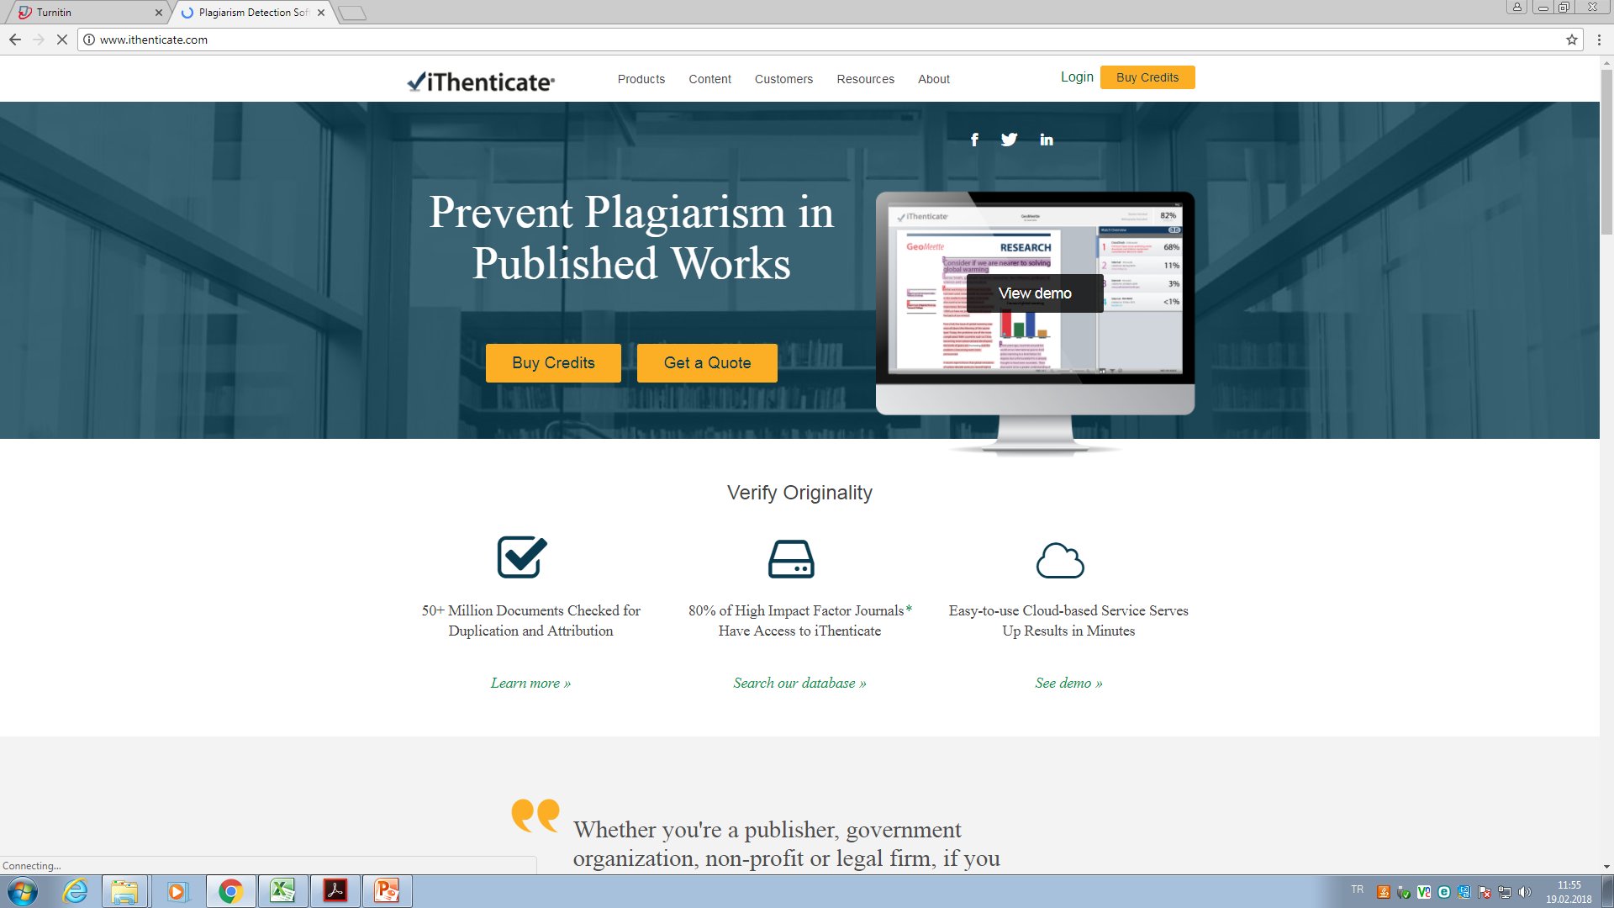

Slide 58
Understanding research philosophies and approaches
define the key terms ontology, epistemology and axiology and explain
their relevance to business research;
• explain the relevance for business research of philosophical perspectives
such as positivism, realism, pragmatism and interpretivism;
• understand the main research paradigms which are significant for
business research;
• distinguish between main research approaches: deductive and
inductive;
• state your own epistemological, ontological and axiological
positions.

Slide 59
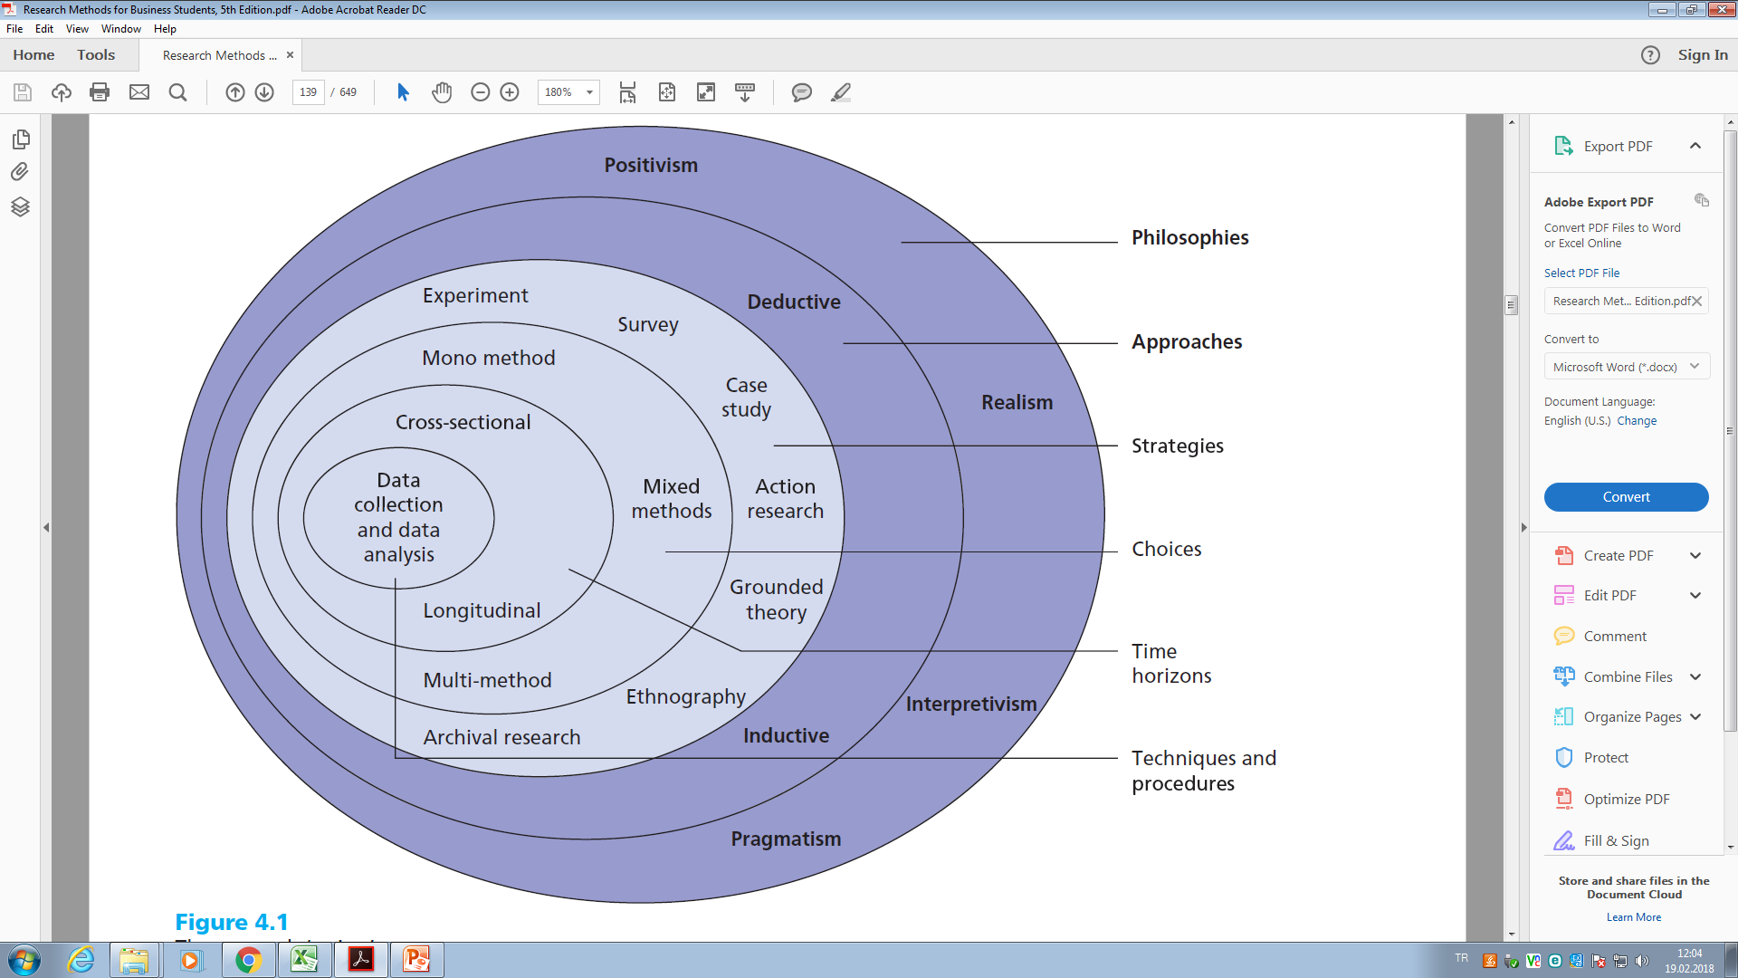

Slide 60
http://infolib.vnua.edu.vn/HUA/UpLoadFiles/Neville,%20Colin.%20The%20Complete%20Guide%20to%20Referencing%20&%20Avoiding%20Plagiarism.pdf

Slide 61
