Slide 1
Chapter Twenty
Types of Risks Incurred by Financial Institutions
©McGraw Hill LLC. All rights reserved. No reproduction or distribution without the prior written consent of McGraw Hill.

Slide 2
Risks at Financial Institutions
A major objective of FI management is to increase the FI’s returns for its owners, but increased returns typically come at the cost of increased risk:
  Credit risk
  Liquidity risk
  Interest rate risk
  Market risk
  Off-balance sheet risk
  Foreign exchange risk
  Country or sovereign risk
  Technology risk
  Operational risk
  Digital disruption and fintech risk
  Insolvency risk

Slide 3
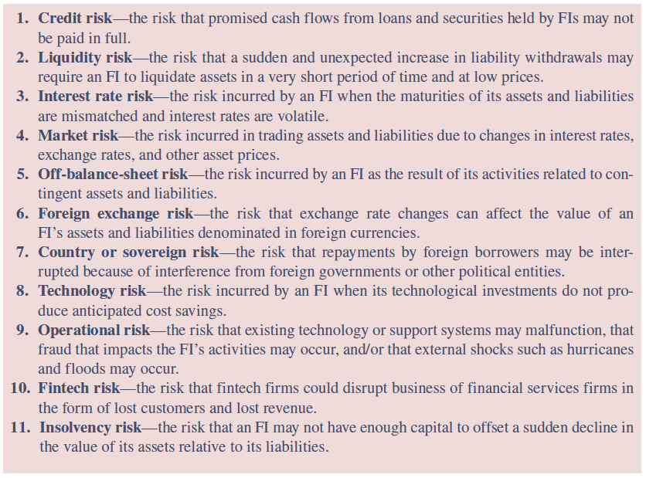
Risks Faced by Financial Institutions
Notes:
3
Table 20–1 presents a brief definition of each of the various risks facing FIs.

Slide 4
Credit Risk at FIs
Credit risk is the risk that the promised cash flows from loans and securities held by FIs may not be paid in full
  Virtually all types of FIs face this risk, but FIs that make loans or buy bonds with long maturities are more exposed than are FIs that make loans or buy bonds with short maturities
  Even as losses due to credit risk increase, FIs continue to willingly give loans because they charge a rate of interest on a loan that compensates for the risk of the loan
    Important element in the credit risk management process is pricing
  Managerial (monitoring) efficiency and credit risk management strategies directly affect the returns and risks of the loan portfolio
Notes:
4

Slide 5
Credit Risk at FIs (Continued)
Advantage that FIs have over individual investors is their ability to diversify credit risk exposures from a single asset by exploiting the law of large numbers in their asset investment portfolios
Diversification reduces firm-specific credit risk, the risk of default for the borrowing firm associated with the specific types of project risk taken by that firm
  E.g., risk specific to holding the bonds or loans of GM
Diversification does not reduce systemic credit risk, the risk of default associated with general economy-wide or macro-conditions affecting all borrowers
  E.g., an economic recession
Notes:
5

Slide 6
Charge-Off Rates for Commercial Bank Lending Activities
Notes:
6
The effects of credit risk are evident in Figure 20–1, which shows commercial bank charge-off (or write-off) rates (loans charged off as a percentage of total loans) for various types of loans between 1994 and 2022.
Notice, in particular, the high rate of charge-offs experienced on credit card loans throughout this period.
Credit card charge-offs by commercial banks increased persistently from the mid-1980s until late 1993 and again from 1995 through early 1998.
By 1999, credit card charge-offs leveled off, and they even declined after 1999.
With the downturn in the U.S. economy and an impending change in bankruptcy laws making it more difficult to declare bankruptcy, credit card charge-offs rose rapidly in 2001 and remained high through 2004.
Note particularly that in October 2005, the Bankruptcy Reform Act was signed into law. This act makes it more difficult for consumers to declare bankruptcy. As a result, there was a surge in bankruptcy filings in the summer and early fall of 2005 just before the new rules went into effect and a huge drop-off in bankruptcy filings just after the enactment of the new rules.
The financial crisis of 2008–2009 and the resulting economic recession produced a huge surge in credit card charge-off rates, which rose to an all-time high of 13.21 percent in March 2010. Despite these losses, credit card loans (including unused balances) extended by commercial banks continued to grow, from $160.8 billion in March 1994 to $421.5 billion in December 2022.
As of December 2022, credit card loans extended by commercial banks totaled $1,009.4 billion.

Slide 7
Credit Card Loss Rates and Personal Bankruptcy Filings
Notes:
7
The effects of credit risk are evident in Figure 20–2, which shows commercial bank charge-off (or write-off) rates (loans charged off as a percentage of total loans) for various types of loans between 1994 and 2022.

Slide 8
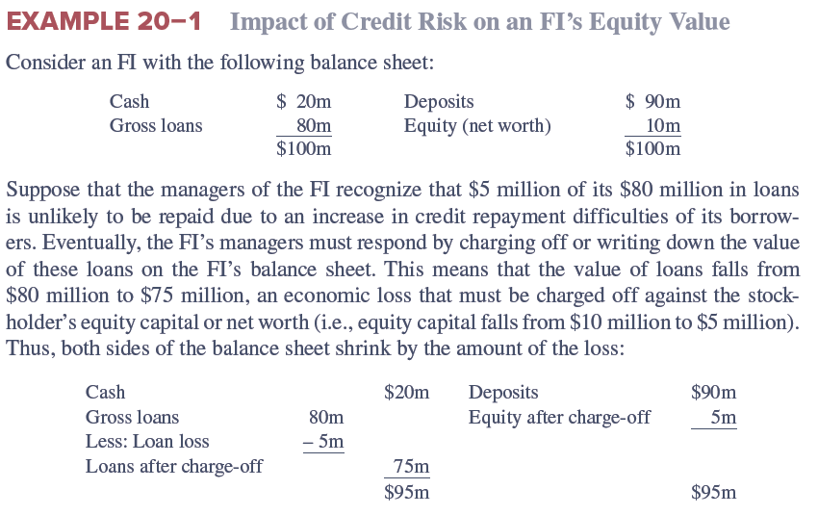
Impact of Credit Risk on an FI’s Equity Value
Notes:
8

Slide 9
Liquidity Risk
Liquidity risk is the risk that a sudden and unexpected increase in liability withdrawals may require an FI to liquidate assets in a very short period and at low prices
  On the asset side of the balance sheet, loan requests and the exercise by borrowers of their loan commitments and other credit lines causes liquidity risk
    Most liquid asset of all is cash
  To meet the demand for cash by liability holders, FIs must either liquidate assets or borrow additional funds
  When all, or many, FIs face abnormally large cash demands, the cost of purchased of borrowed funds rises and the supply of such funds becomes restricted
    FIs may have to sell some of their less liquid assets to meet the withdrawal demands, resulting in serious liquidity risk
Notes:
9

Slide 10
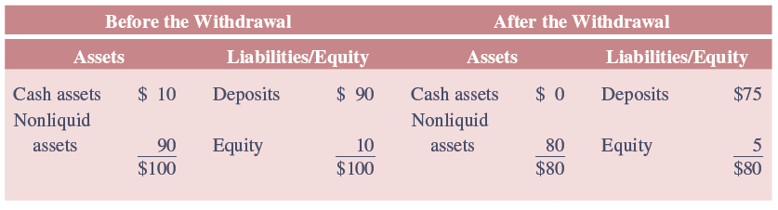
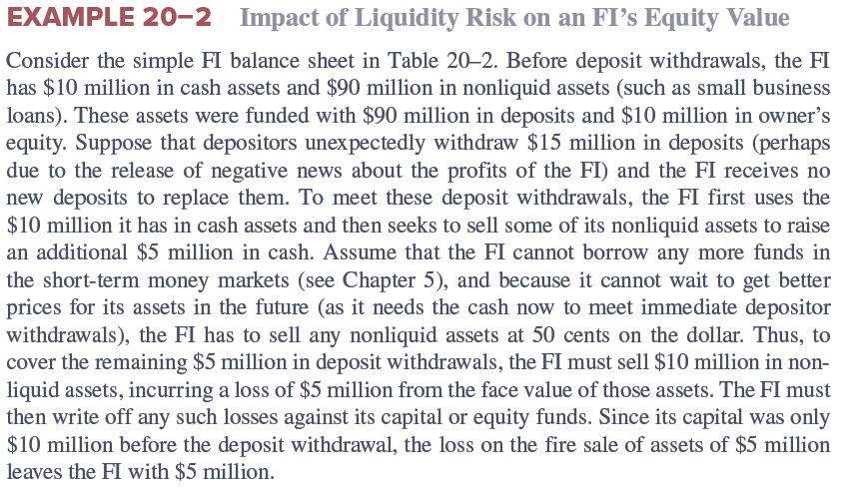
Impact of Liquidity Risk on Equity Value
Notes:
10

Slide 11
Interest Rate Risk
Interest rate risk is the risk incurred by an FI when the maturities of its assets and liabilities are mismatched and interest rates are volatile
  Asset transformation involves an FI buying primary securities/assets and issuing secondary securities/liabilities to fund the assets
    Primary securities that FIs purchase often have maturity characteristics different from the secondary securities that FIs sell
  Refinancing risk is the risk that the cost of rolling over or reborrowing funds will rise above the returns being earned on asset investments
    Type of interest rate risk that occurs when an FI holds longer-term assets relative to liabilities
  By holding shorter-term assets relative to its liabilities, an FI faces reinvestment risk, the risk that the returns on funds to be reinvested will fall below the cost of funds
Notes:
11

Slide 12
Interest Rate Risk
(Continued)
Price risk is the risk that the price of the security will change when interest rates change
  Rising (falling) interest rates increase (decrease) the discount rate on future asset or liability cash flows and reduce (increase) the market price or present value of that asset or liability
Mismatching maturities by holding longer-term assets than liabilities means that when interest rates rise, the economic or present value of the FI’s assets falls by a larger amount than its liabilities
FIs can seek to hedge or protect themselves against interest rate risk by matching the maturity of their asset and liabilities, but this strategy is not necessarily consistent with an active asset transformation function for FIs
  Matching maturities hedges interest rate risk only in a very approximate rather than complete fashion
Notes:
12

Slide 13
Market Risk
Market risk is the risk incurred in trading assets and liabilities due to changes in interest rates, exchange rates, and other asset prices
  Closely related to interest rate and foreign exchange risk
  Adds another dimension of risk: trading activity
    Market risk is the incremental risk incurred by an FI when interest rate and foreign exchange risks are combined with an active trading strategy, especially on that involves short trading horizons such as a day
  FI’s trading portfolio can be differentiated from its investment portfolio on the basis of time horizon and liquidity
    Trading portfolio contains assets, liabilities, and derivative contracts that can be quickly bought or sold on organized financial markets, whereas investment portfolio contains assets and liabilities that are relatively illiquid and held for longer periods
Notes:
13

Slide 14
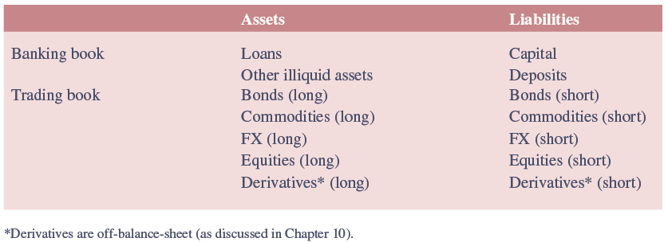
The Investment (Banking) Book and Trading Book of a Commercial Bank
Notes:
14
Table 20–3 shows a hypothetical breakdown between banking book and trading book assets and liabilities. Note that capital produces a cushion against losses on either the banking or trading books (see Chapter 23).
As can be seen, the banking book contains the majority of loans and deposits plus other illiquid assets. The trading book contains long and short positions in instruments such as bonds, commodities, foreign exchange, equities, and derivatives.

Slide 15
Market Risk
(Continued)
Traditional roles of many FIs have changed in recent years
  For large commercial banks such as money center banks, decline in income from traditional deposit taking and lending activities has been matched by an increased reliance on income from trading
  Decline in underwriting and brokerage income for large investment banks has also been met by more active and aggressive trading in securities, derivatives, and other assets
Mutual fund managers, who actively manage their asset portfolios, are also exposed to market risk
FIs are concerned about fluctuations in value, or value at risk (VAR) of their trading account assets and liabilities for periods as short as one day – so-called daily earnings at risk (DEAR) – especially if such fluctuations pose a threat to their solvency
Notes:
15

Slide 16
Off-Balance-Sheet Risk
Off-balance-sheet (OBS) risk is the risk incurred by an FI as the result of activities related to contingent assets and liabilities
  In 2022, commercial banks had $23.6 trillion in on-balance-sheet items, while the face or notional value of their off-balance-sheet derivative items was $191.0 trillion
    OBS activities do not appear on an FI’s current balance sheet since it does not involve holding a currency primary claim (asset) or the issuance of a current secondary claim (liability)
  OBS activities involve the creation of contingent assets and liabilities that give rise to their potential placement in the future on the balance sheet
    Contingent assets and liabilities are assets and liabilities off the balance sheet that potentially can produce positive or negative future cash flows for an FI
Notes:
16

Slide 17
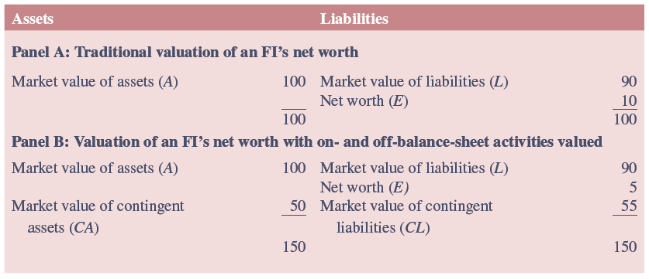
Valuation of an FI’s Net Worth with and without Consideration of OBS Activities
Notes:
17
Consider Table 20–4. In Panel A, the value of the FI’s net worth (E) is calculated in the traditional way as the difference between the market values of its on-balance-sheet assets (A) and liabilities (L). Under this calculation, the market value of the stockholders’ equity stake in the FI is 10 and the ratio of the FI’s capital to assets (or capital-to-assets ratio) is 10 percent.
A more accurate picture of the FI’s economic solvency should consider the market values of both its on-balance-sheet and OBS activities (Panel B of Table 20–4). Specifically, the FI manager should value contingent or future asset and liability claims as well as current assets and liabilities.
See Example 20-5 for additional details.

Slide 18
Off-Balance-Sheet Risk
(Continued)
More attention has been drawn to the OBS activities of banks, especially large ones, as opposed to small depository institutions or insurers
Issuing a letter of credit (LC) is an OBS activity
  LC is a credit guarantee issued by an FI for a fee on which payment is contingent on some future event occurring, most notably default of the agent that purchases the LC
  Other examples of OBS activities are collateralized mortgage obligations (CMOs), loan commitments by banks, mortgage servicing contracts by depository institutions, and positions in forwards, futures, swaps, and other derivative securities by almost all large FIs
Ability to earn fee income while not loading up or expanding the balance sheet has become an important motivation for FIs to pursue OBS business
Notes:
18
OBS activity is not risk free. Off-balance-sheet securities played a prominent role in the U.S. subprime mortgage crisis.

Slide 19
Foreign Exchange Risk
Foreign exchange (FX) risk is the risk that exchange rate changes can affect the value of an FI’s assets and liabilities denominated in foreign currencies
  U.S. pension funds that held approximately 5% of their assets in foreign securities in the early 1990s now hold close to 24% of their assets in foreign securities
  Returns on domestic and foreign direct investments and portfolio investments are not perfectly correlated for two reasons:
    Underlying technologies of various economies differ, as do the firms in those economies
    Exchange rate changes are not perfectly correlated across countries
  FIs expand globally through acquiring foreign firms or opening new branches in foreign countries, as well as investing in foreign financial assets
Notes:
19

Slide 20
Foreign Exchange Risk
(Continued)
A net long position in a foreign currency involves an FI holding more foreign assets than liabilities
  FI loses when foreign currency falls relative to the U.S. dollar
  FI gains when foreign currency appreciates relative to the U.S. dollar
A net short position in a foreign currency involves an FI holding fewer foreign assets than liabilities
  FI gains when foreign currency falls relative to the U.S. dollar
  FI loses when foreign currency appreciates relative to the U.S. dollar
FI is fully hedged only if we assume that it holds foreign assets and liabilities of exactly the same maturity
Notes:
20

Slide 21
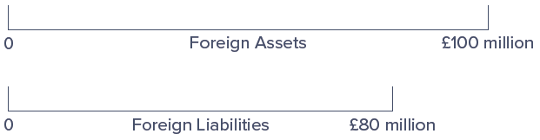
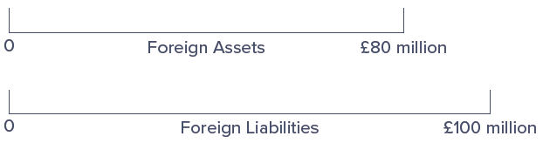
Foreign Asset and Liability Positions
Net Long Asset Position in Pounds
Net Short Asset Position in Pounds
Notes:
21
See Figure 20–3. In this case, the U.S. FI is net long £20 million in British assets. That is, it holds more foreign assets than liabilities.
Instead, the FI could have £20 million more foreign liabilities than assets. In this case, it would be holding a net short position in foreign assets, as shown in Figure 20–4. Under this circumstance, the FI is exposed to foreign exchange risk if the pound appreciates against the dollar over the investment period.

Slide 22
Sovereign Risk
Country, or sovereign, risk is the risk that repayments from foreign borrowers may be interrupted because of interference from foreign governments
  Differs from the type of credit risk that is faced by an FI that purchases domestic assets, such as the bonds and loans of domestic corporations
    With domestic defaults, FIs usually have some recourse through bankruptcy courts (i.e., FIs can recoup some of their losses when defaulted firms are liquidated or restructured)
  Foreign corporations may be unable to pay principal and interest even if they desire to do so
    Foreign governments may limit or prohibit debt repayment due to foreign currency shortages or adverse political events
Notes:
22

Slide 23
Sovereign Risk
(Continued)
In the event of restrictions or outright prohibitions on the payment of debt obligations by sovereign governments, the FI claimholder has little if any recourse to local bankruptcy courts or to an international civil claims court
Measuring sovereign risk includes an analysis of macroeconomic issues, such as the following:
  Trade policy;
  Fiscal stance (deficit or surplus) of the government;
  Government intervention in the economy;
  Its monetary policy;
  Capital flows and foreign investment;
  Inflation; and
  Structure of its financial system
Notes:
23
For example, in 2001 the government of Argentina, which had pegged its peso to the dollar on a one-to-one basis since the early 1990s, had to default on its government debt largely because of an overvalued peso and the adverse effect this had on its exports and foreign currency earnings. In December 2001 Argentina ended up defaulting on $130 billion in government-issued debt, and in 2002 it passed legislation that led to defaults on $30 billion of corporate debt owed to foreign creditors. Argentina’s economic problems continued into the 2000s and even the 2010s. In September 2003, it defaulted on a $3 billion loan to the IMF, and in early 2018 Argentina was still asking for debt payment adjustments.

Slide 24
Technology and Operational Risk
Technology risk is the risk incurred by an FI when its technological investments do not produce anticipated cost savings
  Major objectives of technological expansion are to lower operating costs, increase profits, and capture new markets for an FI
Operational risk is the risk that existing technology or support systems may malfunction or break down
  Not exclusively the result of technological failure
  Other sources of operational risk can result in direct costs, indirect costs, and opportunity costs that reduce an FI’s profitability and market value
Notes:
24
Technology and operational risks are closely related and in recent years have caused great concern to FI managers and regulators alike.

Slide 25
Digital Disruption and Fintech Risk
Digital Disruption and Fintech risk is the risk that fintech firms could disrupt business of financial services firms in the form of lost customers and lost revenue
  Broader and wider ranging than technology risk
  Fintech services such as cryptocurrencies (e.g., bitcoin) and blockchain provide a system that supports the exchange of value between two parties unknown to each other in a swift and effective way, without the need for financial intermediaries
  Largest fintech companies include the following:
    SoFi, an online personal finance company;
    Transferwise, an international money transfer provider; and
    Credit Karma, a platform that provides credit scores to users and also serves as a portal for people to search and apply for various financial services, like loans, credit cards, and insurance
Notes:
25

Slide 26
Insolvency Risk
Insolvency risk is the risk that an FI may not have enough capital to offset a sudden decline in the value of its assets relative to its liabilities
  Insolvency risk is a consequence or an outcome of one or more of the risks previously described:
    Interest rate, market, credit, OBS, technological, digital disruption and fintech, foreign exchange, sovereign, and liquidity risk
  Generally, the more equity capital to borrowed funds an FI has (i.e., the lower its leverage), the better able it is to withstand losses due to risk exposures such as adverse liquidity changes, unexpected credit losses, and so on
  Both regulators and managers focus on capital adequacy as a key measure of an FI’s ability to remain solvent and grow in the face of a multitude of risk exposures
Notes:
26

Slide 27
Other Risks and Interactions Among Risks
All of the previously defined risks are interdependent
  Each risk and its interaction with other risks ultimately affects solvency risk
Various other risks also impact FI’s profitability and risk exposure:
  Discrete, or event-type, risks:
    Sudden change in taxation
    Changes in regulatory policy, including lifting the regulatory barriers to lending or to entry or on products offered
    Sudden and unexpected changes in financial market conditions due to war, revolutions, or sudden market collapse
    Theft, malfeasance, and breach of fiduciary trust
  Macroeconomic risks:
    Increased inflation and inflation volatility
    Unemployment
Notes:
27

