Slide 1
Chapter 2
Money and the Payments System

Slide 2
Learning Objectives
Define money and describe its functions.
Discuss the different methods of payment and the future of money.
Explain how the money supply is measured and how it is linked to economic growth and inflation.

Slide 3
Money and How We Use It
Money is an asset that is generally accepted as payment for goods and services or repayment of debt.
Income is a flow of earnings over time
Wealth is the value of assets minus liabilities.
Money is one of those assets.

Slide 4
Money and How We Use It
Money has three characteristics:
It is a means of payment
It is a unit of account, and
It is a store of value.
The first of these characteristics is the most important

Slide 5
Money and How We Use It
Means of Payment
People insist on payment in money.
Barter requires a “double coincidence of wants”.
Money is easier and finalizes payments so there is no further claim on buyers and sellers.
The increase in the number of transactions and the numbers of buyers and sellers requires something like “money” to make transactions smoother.

Slide 6
Money and How We Use It
Unit of Account
Money is used to quote prices and record debts - it is a standard of value.
Prices provide the information needed to ensure resources are allocated to their best uses.
Using dollars makes relative price comparisons easier.

Slide 7
When you shop, should you use a debit card or a credit card?
A debit card works like a check only faster.
Funds are immediately removed from your account.
A credit card makes a deferred payment.
If not paid on time, there is a late fee.
If not paid fully, there is interest on the debt.
But if you do pay on time and fully, it is an interest free loan for a period of time.
Credit cards allow you to build a credit history.

Slide 8
Money and How We Use It
Store of Value
A means of payment has to be durable and capable of transferring purchasing power from one day to the next.
Other forms of wealth are also a store of value: stocks, bonds, houses, etc.

Slide 9
Money and How We Use It
Store of Value (cont.)
Although other stores of value are sometimes better than money, we hold money because it is liquid.
Liquidity is a measure of the ease with which an asset can be turned into a means of payment.
The more costly it is to convert an asset into money, the less liquid it is.

Slide 10
Money and How We Use It
Store of Value (cont.)
Financial institutions use:
Market liquidity - the ability to sell assets for money.
Funding liquidity - ability to borrow money to buy securities or make loans.

Slide 11
The Payments System
The payments system is a web of arrangements that allow for the exchange of goods and services, as well as assets.
The efficient operation of the economy depends on the payments system.
The possible methods of payment are:
Commodity and fiat Monies
Checks
Electronic Payments

Slide 12
Commodity and Fiat Monies
Commodity monies are things with intrinsic value.
Included items like silk and salt.
To be successful, a commodity money must be:
Usable by most people
Can be made into standardized quantities
Durable
Easily transportable
Divisible into smaller units

Slide 13
Commodity and Fiat Monies
Gold has been the most common commodity money as it meets these requirements.
In 1661, Stockholm Banco issued Europe's first paper money
King of Sweden printed too many to try to finance a war and the bank failed.
In 1775, the Continental Congress of the United States of America issued “continentals” to finance the Revolutionary War.
Both governments issued too much and the currency became worthless.

Slide 14
Commodity and Fiat Monies
Because of the failures, people became suspicious of government-issued paper money.
In 1862, the Confederate and the Union governments printed money with no explicit backing.
After the Civil War, the U.S. reverted to using gold as money.

Slide 15
Commodity and Fiat Monies
Gold coins and notes, backed by gold, were used into the 20th century.
Today’s paper money is called fiat money, because its value comes from government decree, or fiat.
We are willing to accept these bills as payment because the U.S. government stands behind its paper money.
In the end, money is about trust.

Slide 16
Commodity and Fiat Monies
Today, some critics claim the U.S. should return to the gold standard.
There is fear of governments issuing too much paper money.
A gold standard may not be time consistent.
In a crisis, a government can renege on the use of a gold standard to stabilize the economy.
Movement away from the gold standard was prompted by the Great Depression.
A fiat currency must be limited in volume of circulation to be credible.

Slide 17
Checks
A check is an instruction to the bank to take funds from your account and transfer them to another account.
A check is therefore not a final payment as currency is - it sets in motion a series of transactions.
The series of transactions put in motion can be seen in Figure 2.1: The Path of a Paper Check

Slide 18
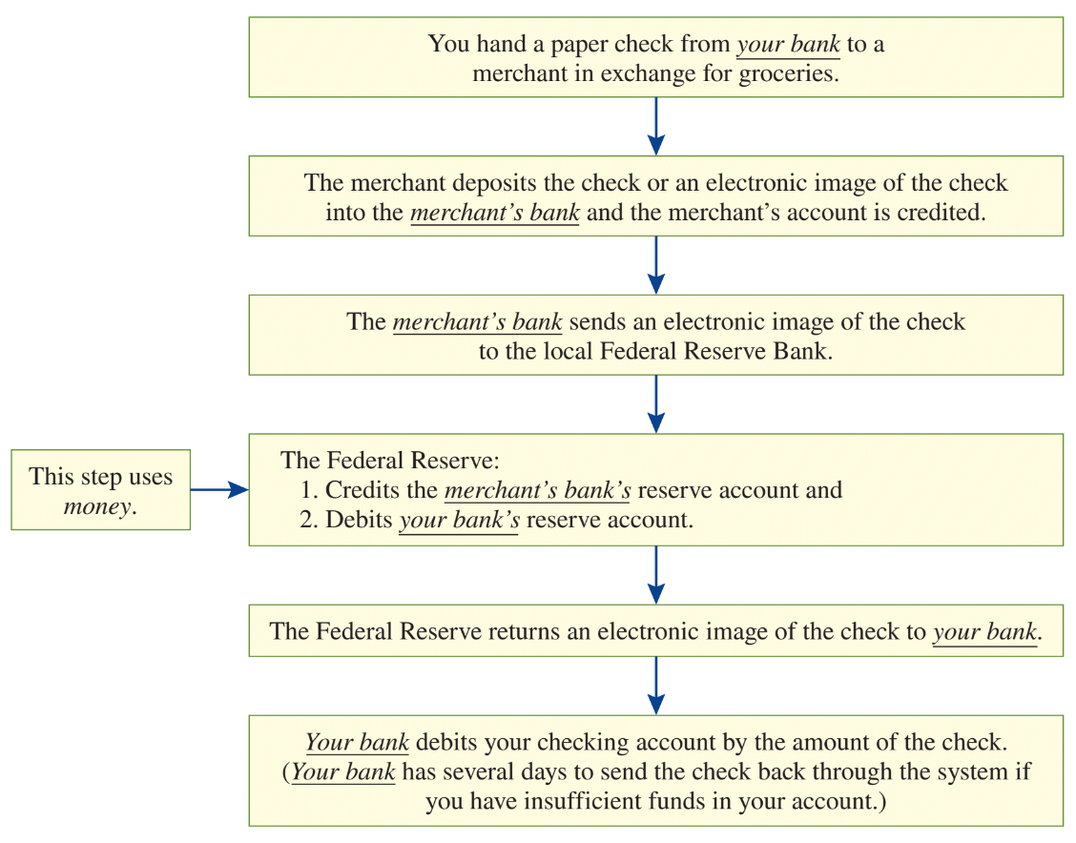
Figure 2.1: The Path of a Paper Check

Slide 19
For years, the U.S. financial system has lagged the efficiency in many advanced economies
In 2020 in the U.S., paper checks still accounted for 20 percent of U.S. noncash payments by value.
Today, the bulk of transactions in number are by credit or debit card, which are expensive.
The time and cost inefficiencies act like a sales tax that depresses economic activity.
As of mid-2023, with the launch of the Federal Reserve’s FedNow service, the U.S. has begun to catch up with technological advances enjoyed by other countries.
This new system will settle individual payments in seconds, 24 hours a day, 7 days a week, 365 days a year at a cost of $0.045 per transaction.
Drawback is that it currently supports only domestic payments between domestic banks and their customers.
While U.S. residents will all reap the benefits of FedNow, there remains substantial work to be done to improve the global payments system.

Slide 20
Electronic Payments
Electronic payments take the form of:
Credit and debit cards
Electronic funds transfers
E-money

Slide 21
Electronic Payments
Debit Cards
Works like a check - tells the bank to transfer funds from your account to another.
Credit Cards
A promise by a bank to lend the cardholder money to make a purchase.
They do not represent money.

Slide 22
Electronic Payments
Electronic funds transfers
Movements of funds directly from one account to another.
Most common form is the automated clearinghouse transaction (ACH).
Used for recurring payments like paychecks or utility bills.
Banks use electronic transfers for bank to bank transactions, sending money through Fedwire.

Slide 23
Electronic Payments
Electronic funds transfers (cont.)
Rapid innovation is reducing the cost and increasing the speed of payments and transfers.
There has been a proliferation of smartphone apps and infrastructure by Amazon Pay, Apple Pay, PayPal, Google Pay, Venmo, Zelle, and others.
In some cases, digital wallets are linked to a person’s bank account or credit card. In others, the service provider requires the transfer of funds prior to any purchase.
The goal of these digital systems is to improve reliability, ensure security, and prevent use for criminal purposes.

Slide 24
Market liquidity and funding liquidity are both needed to market financial markets function smoothly.
2007-2009 financial crisis led to a sudden loss of liquidity.
Before the crisis:
Financial institutions relied on short-term borrowing to hold long-term financial instruments.
They also believed markets would also be liquid.

Slide 25
In 2007, doubt led to a double “liquidity shock” increasing cash holdings.
This reduced loan supplied intensifying the decreasing liquidity.
One lesson: Liquidity is a highly valuable resource that can disappear when most needed.

Slide 26
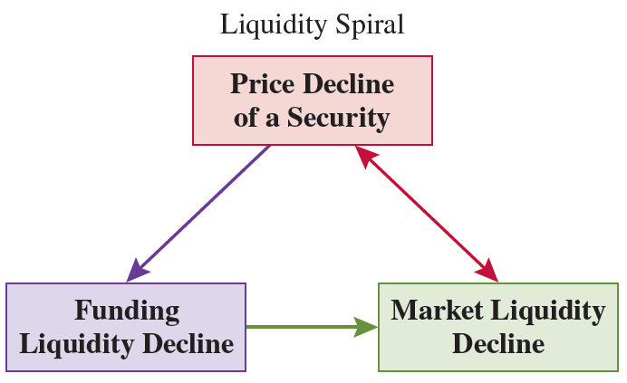

Slide 27
The Future of Money
The future of the three functions of money:
Means of payment: diminishing due to ease of electronic transactions.
Unit of account: likely to remain.
Will always be needed to quote values and prices because it is efficient.
Store of value: diminishing due to liquidity of many financial instruments.

Slide 28
The Future of Money
There are also crypto assets.
Bitcoin is the oldest and most prominent of the cryptocurrencies that have come into existence since 2008.
The technology used to record the ownership of Bitcoin and other crypto assets is an ever-growing, encrypted public ledger that is recorded on a network of computers known as a “distributed ledger.”
Bitcoin as a form of digital technology has two main advantages:
Its value cannot be undermined by government fiat.
Its users can remain anonymous while making payments electronically and efficiently.

Slide 29
The Future of Money
Digital tokens like Bitcoin and the second largest token of this type, Ether, are the rewards to the people maintaining the distributed ledger where transactions are recorded.
This means that these crypto assets derive their value from the fact that people want to own them and have their ownership recorded.
Stablecoins are different.
While they are part of the crypto asset universe, stablecoins are issued by entities with balance sheets that mimic those of a bank or a money market fund.

Slide 30
The Future of Money
Can private currencies, either digital tokens like Bitcoin or stablecoins like Tether, be mediums of payment, stores of value, and units of account?
Can they do the job better as money than what we currently have?
For now, the answer is no to both.
A dollar today is a dollar next week, next month, and next year.
The value of Bitcoin, Ether, and other digital tokens like them is extremely volatile.

Slide 31
Measuring Money
Changes in the quantity of money are related to
Interest Rates
Economic Growth
Inflation

Slide 32
Measuring Money
Inflation:
The process of prices rising.
Inflation rate:
The measurement of the process.
With inflation, you need more money to buy the same basket of goods.
The primary cause of inflation is too much money.

Slide 33
Measuring Money
The value of the means of payment depends on how much of it is circulating.
We therefore must be able to measure how much is circulating.
Defining money means defining liquidity (see Figure 2.2).

Slide 34
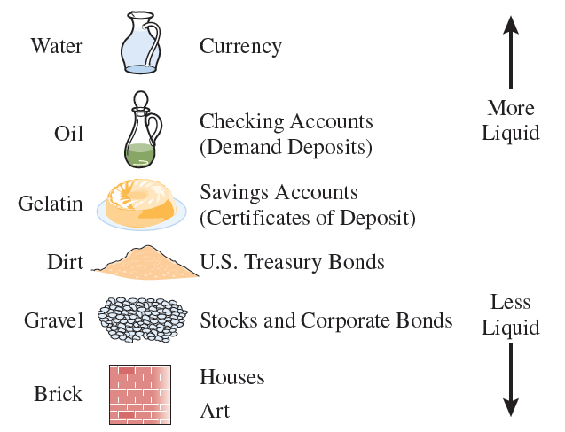
Figure 2.2 - The Liquidity Spectrum

Slide 35
Ensuring financial stability requires both resilient institutions and resilient markets.
A loss of liquidity in a key financial market can threaten the well-being of even the healthiest institutions.
U.S. Treasury Securities are the safest and most liquid instruments in the dollar world:
The Treasury market is the most active fixed-income market, exhibiting the highest trading volume and the lowest cost of trading.
Treasurys represent the highest quality collateral among dollar-denominated securities.
Treasurys account for the largest component of foreign exchange reserves.
Treasurys serve as the benchmark bond to which the yield on a risky dollar-denominated bond of similar maturity is compared.

Slide 36
The Federal Reserve, the U.S. central bank known as “the Fed”, has clear justification for acting to ensure that the U.S. Treasury market always functions smoothly.
To strengthen the system, the key is to make the Treasury market (and other critical financial markets) more resilient without relying on Fed intervention.

Slide 37
What happened in 2020 to threaten the strength of the system?
At the onset of the COVID pandemic, investors followed a familiar pattern: anticipating an economic downturn, they fled to safety.
On March 9, the 10-year Treasury yield hit a record low of 0.54%─a drop of 1.3 percentage points from the start of the year.
Then, the market turned. Over the next nine days, a widespread scramble ensued for the only asset thought to be more liquid than Treasury securities: cash.
The resulting avalanche of bond sales boosted the 10-year yield to 1.18% by March 18.

Slide 38
The problems that began on March 9 stemmed from the inability of Treasury market makers to satisfy huge, sudden, and unexpected demands to sell by foreign officials and speculators.
To calm the market, the Fed began massive purchases of Treasurys, with the rate of acquisition reaching a phenomenal $362 billion in the week ended April 1.
Over time, this experience and others like it taught Treasury market makers to expect emergency support from the central bank.
Perversely, that implicit insurance encourages market makers to rely on Fed intervention as a viable strategy for managing risk when demands for cash surge.

Slide 39
The solution may be partially in a central counterparty (CCP)—an entity that is the buyer to all sellers and the seller to all buyers.
Would expand the trading capacity of market makers by sharply reducing their need for cash.
CCP settlement can also provide important information, helping to expose market risks, such as concentrated positions of vulnerable traders or “crowded trades” in which the realization of a specific risk could suddenly undermine many market participants at the same time.

Slide 40
The existence of a CCP also concentrates risk.
Because there may be no substitutes in the short run to trading through a CCP, its failure could pose an existential threat to a market.
The question of whether a CCP would make the Treasury market more resilient requires understanding both the potential costs (CCP failure) and benefits (reduced liquidity needs) of switching from bilateral to CCP settlement.

Slide 41
Measuring Money
Different definitions of money are based upon degree of liquidity.
Drawing the line in a place that includes a range of liquid accounts. We call this broad money aggregates M2.
M2: Most commonly quoted monetary aggregate in the U.S.
People often compare its movements to interest rates and economic growth.
Includes currency in the hands of the public, demand deposits, other liquid deposits, small-denomination time deposits, and retail money-market mutual fund shares.

Slide 42
Table 2.1: The Monetary Aggregates

Slide 43
Measuring Money
What do the money aggregates mean?
As of the fourth quarter of 2022, nominal U.S. gross domestic product (GDP) was $26.145 trillion.
GDP was more than 20 percent larger than M2.

Slide 44
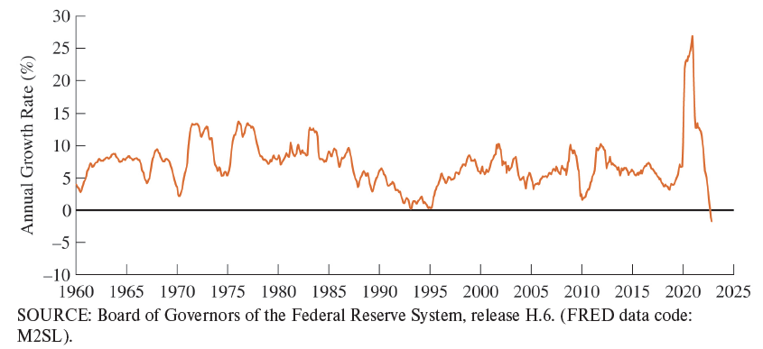
Figure 2.3: Growth Rates of the Money Aggregates, 1960-2022

Slide 45
Measuring Money
How useful is M2 in tracking inflation?
When the quantity of money grows quickly, it produces high inflation.
Figure 2.4 shows the inflation rate versus M2 two years earlier for the U.S.
Positive correlation up until 1980.
From 1990-2017 – virtually no correlation.
2018-2021 – relationship reemerged.

Slide 46
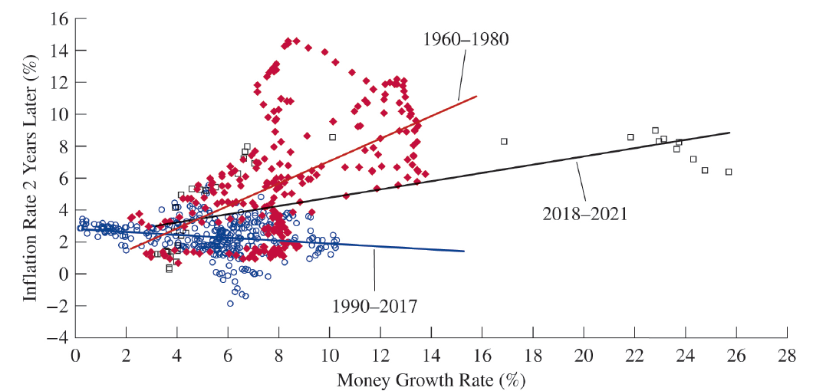
Figure 2.4: Money Growth and Inflation, Monthly 1960-2023

Slide 47
Measuring Money
Economists today remain cautious about using money growth to predict inflation in the short run because they know that the relationship can be unstable.
Maybe the relationship only applies at high levels of inflation.
Maybe it only shows up over longer periods of time.
Maybe we need a new measure of money.
We do know that at low levels of money growth, inflation is likely to stay low.

Slide 48
Computing CPI Inflation
Survey people to see what they bought.
Figure out what it would cost to buy the same basket of goods & services today.
Compute the percentage change in the cost of the basket of goods.

Slide 50
Today, there is nearly $2.3 trillion in paper U.S. currency in circulation, nearly 2.5 times the amount from a decade ago.
80 percent of this money was in $100 bills.
That is 53 $100 bills for each of the 334 million residents of the United States.
Large denomination paper currency facilitates illicit activity.
Printing these bills costs 17 cents, resulting in profit for the U.S. government.
Should we get rid of $100 bills?
All governments would have to agree to get rid of large-denomination paper money.
Paper money preserves freedom.

