Slide 1
DESCRIPTIVE RESEARCH DESIGN
Prof. Dr. Şehnaz Şahinkarakaş

Slide 2
Descriptive Designs
-used to summarize the current or past status of something.
-simply describes achievement, attitudes, behaviors, or other traits of a group of subjects.
-asks What is? or What was?
-reports things the way they are or were.
-There is no intervention.

Slide 3
Simple descriptive designs
provide very valuable data, especially at the beginning of research
  E.g. You want to learn the nature of classroom climate and its relationship to student attitudes and learning.
  You first describe what is meant by classroom climate (using some climate surveys—how students talk and act toward one another; how they feel about the teacher; etc.—to understand the atmosphere of the classroom)
  Your possible RQ= What are the classroom climate characteristics?
Later you can examine causal relationships.

Slide 4
Some descriptive RQ examples
How much do college students exercise?
What are the attitudes of students toward mainstreamed children?
How often do students cheat?
What do teachers think about merit pay?
How do students spend their time during independent study?
What are the components of the gifted program?

Slide 5
I- SURVEY RESEARCH
The most common in social sciences
Used to learn about people’s
  attitudes,
  beliefs,
  values,
  demographics,
  behavior,
  opinions,
  habits,
  desires,
  ideas, etc
Can be pen-and-paper or web-based forms

Slide 6
Popularity of Survey Research
Very popular in education for three reasons:
(a) versatility
  can be used to investigate almost any problem or question
(b) efficiency
  credible information and a variety of variables can be collected from a large populationat a relatively low cost (especially on internet)
(c) Generalizability
  small samples from larger populations permit generalizations to the population.

Slide 7
How to Conduct Survey Research
1. Define the purpose and objectives.
  Write a general statement and specific objectives that define in detail the information that needs to be collected.
  Before the data are collected, you need to know exactly how the results will be used.
2. Select resources and the target population.
  Make decisions about the questionnaire and the participants.
  Select a reliable and valid questionnaire (Developing a survey is a long process!)
3. Choose and develop techniques for gathering data.
  written questionnaire
  Telephone/personal interview
  Internet-based surveys

Slide 8
4. Instructions.
  Develop clear instructions for the respondent.
  Add demographic information questions
5. Sampling.
  Probability sampling to ensure adequate representation of the population.
  Stratified random sampling on some variables (e.g. sex, grade level, ability level, and socioeconomic status.
  When researching a relationship, be sure that the sample will provide variation in responses.
Use the largest possible numberof participants for probability sampling that resources will allow.

Slide 9
6. Pilot test.
  Pilot test both the instructions and the survey before distributing (with app. 10 participants similar to those in the sample)
7. Letter of transmittal & consent form.
  Important for mailed and Internet-based questionnaires
Include in the letter:
  the names and identifications of the investigators
  the purpose and intention of the study without complete details
  the importance of the study for the respondent and profession
  the importance of the respondent for the study
  the protection afforded the respondent by keeping the identities of the respondents confidential
  a time limit for returning a written survey that is neither too long nor too short (usually a week or less)
  a brief description of the questionnaire and procedure
  a request for cooperation and honesty
  thanks to the respondent.

Slide 10
Online Surveys
Can also be called
  electronic surveys, e-surveys, email surveys, or Internet surveys.
Mainly two types:
Email
  Asking the participants to complete an attached survey (e-mail)
Web-based
  Using a specific website for participants to access the survey

Slide 11
Effective Online Questionnaire Design
Use a few short items that are simple and direct.
Show one or just a few items per screen.
Avoid excessive scrolling.
Use simple graphics.
Limit the use of matrix questions.
Use specific error/warning messages.
Password protect Web surveys.
Indicate progress in completing the survey.
Use hypertext and color to enhance presentation and understanding.

Slide 12
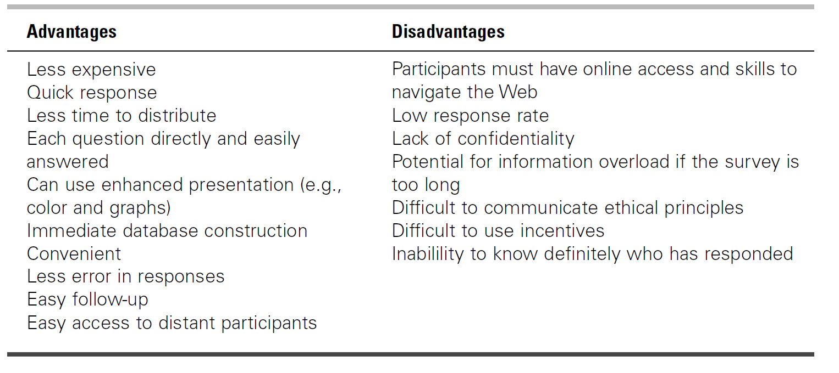
Advantages & Disadvantages of Online Surveys
(Millan & Schumacher, 2015, p.260)

Slide 13
II- SECONDARY DATA
Data that have already been collected.
E.g.
  examining trends in high-stakes testing from a state database,
  achievement test scores
Why secondary data?
  time efficiency
  cost effectiveness
  data quality
  increased sample size

Slide 14
III-LONGITUDINAL STUDIES
Investigate changes in participants over time:
  The same group or similar groups studied over some length of time on factors such as cognitive, social-emotional, or physical variables.
Cross-sectional analyses may not be enough to answer some questions
E.g.
  Are there fluctuations in students’ achievement over time?
Answer to this question requires longitudinal data.

Slide 15
Variations of Longitudinal Design
Trend study
  a general population is studied over time
  participants are sampled from the population each year or at other times of data collection.
E.g. Using a trend study to report high school students’ success in the University Entrance Exam over a period of time
Panel study
  the same individuals are surveyed each time data are collected

Slide 16
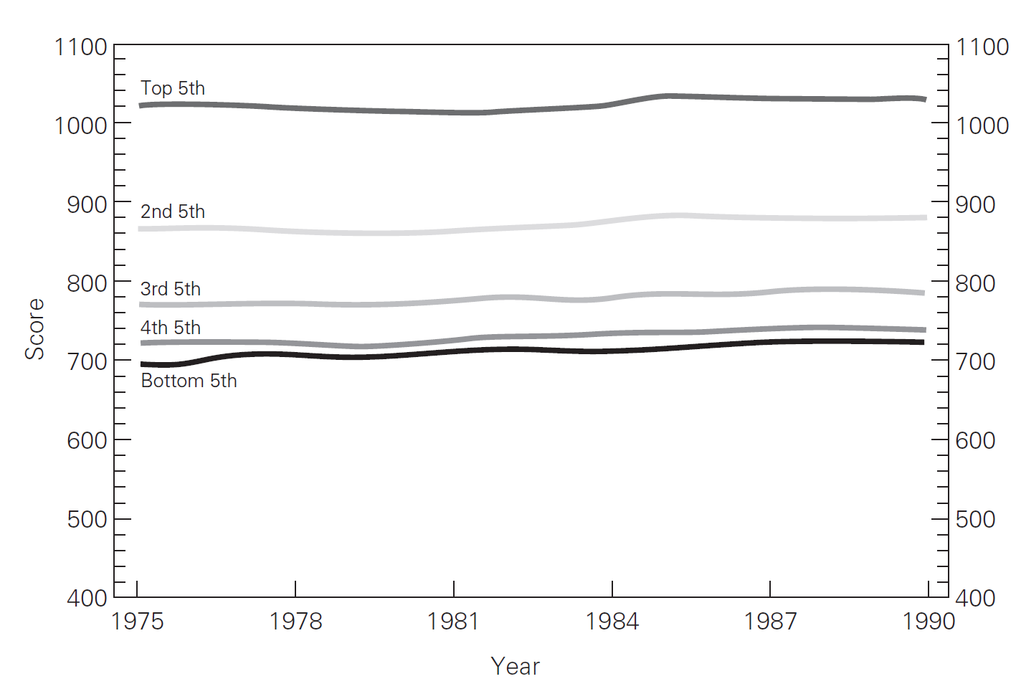
Trend Study
Average SAT by high school class rank (McMillan & Schumacher, 2015, p. 238)

Slide 17
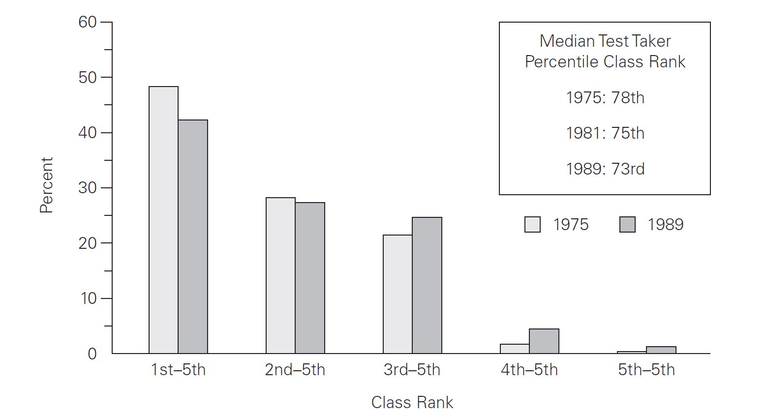
Trend Study
Percentage of SAT by high school class rank (McMillan & Schumacher, 2015, p. 238)

