Slide 1

CAG UNIVERSITY
2018 – 2019 FALL SEMESTER
MAN 429
HEALTH CARE MANAGEMENT

Slide 2
Chapter 3 Management and Motivation
Managers are continually challenged to motivate a workforce to do two things. The first is to motivate employees to work toward helping the organization achieve its goals.
The second is to motivate employees to work toward achieving their own personal goals.
Meeting the needs and achieving the goals of both the employer and the employee is often difficult for managers in all types of organizations.
In health care, however, this is often more difficult, in part as a result of the complexity of health care organizations, but also as a function of the wide array of employees who are employed by or work colaboratively with health care providers in delivering and paying for care.

Slide 3
Motivation – The Concept
According to Webster’s New Collegiate Dictionary, a motive is ‘‘something (a need or desire) that causes a person to act.’’
Motivate, in turn, means ‘‘to provide with a motive,’’ and motivation is defined as ‘‘the act or process of motivating.’’ Thus motivation is the act or process of providing a motive that causes a person to take some action.
Motivation comes from some need that leads to behavior which, in turn, results in some type of reward when the need is fulfilled. This definition raises a couple of basic questions.

Slide 4
What Are Rewards?
Rewards can take two forms,
Intrinsic rewards are derived from within the individual. For a health care employee, this could mean taking pride and feeling good about a job well done (e.g., providing excellent patient care).
Extrinsic rewards pertain to those reinforcements that are given by another person, such as a health care organization giving bonuses to teams of workers when quality and patient satisfaction are demonstrated to be exceptional.

Slide 5
Who Motivates Employees?
Managers do exert a significant amount of influence over employees, but they do not have the power to force a person to act. They can work to provide various types of incentives in an effort to influence an employee in any number of ways, such as by changing job descriptions, rearranging work schedules, improving working conditions, reconfiguring teams, and a host of other activities.
As managers, we often assume that employees are motivated or will respond to inducements from managers.

Slide 6
THEORIES OF MOTIVATION
Theories focus on motivation being a function of (1) employee needs of various types, (2) extrinsic factors, and (3) intrinsic factors. Each set of theories follows.

Slide 7
NEEDS-BASED THEORIES OF MOTIVATION
1. Maslow’s Hierarchy Of Needs
Physiological needs- food, water, sexual drive, etc.
Safety needs- shelter, employment, money, access to health care.
Belonging needs- desire for social contact and interaction.
Esteem needs- Status, recognition, positive regard
Self- actualization needs- desire for achievement, personal growth, development

Slide 8
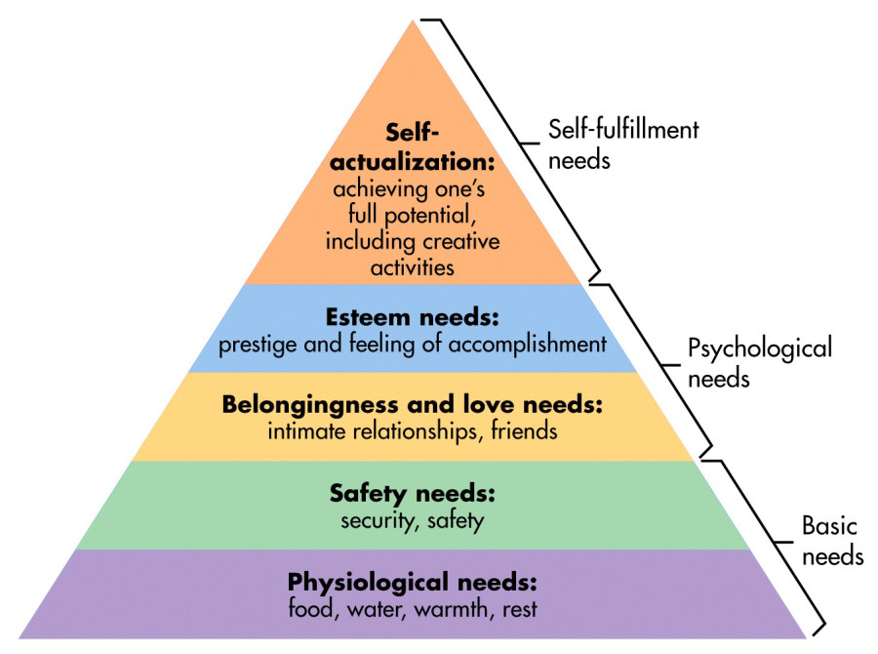
https://www.simplypsychology.org/maslow.html,20/10/2018

Slide 9
2. Alderfer’s ERG Theory
The three components identified by Alderfer (1972)
Existence- which related to Maslow’s first two needs, thus combining the physiological and safety needs into one level.
Relatedness-which addressed the belonging needs.
Growth- which pertained to the last two needs, thereby combining esteem and self-actualization.

Slide 10
3. Herzberg’s Two-Factor Theory
This theory consolidated it dowm to two areas of needs that motivated employees.
Hygienes which is characterized as lower-level motivators, such as supervision or working condition.
Motivators these are higher-level factors that impact aspects of work, such as achievement.

Slide 11
4. McClelland’s Acquired Needs Theory
Needs are acquired throughout life. That is, needs are not innate but are learned or developed as a result of one’s life experiencs. This theory focused on three types of needs :
Need for achievement- which emphasizes the desire for success, mastering tasks, and for attaining goals.
Need for affiliation- which focuses on the desire for relationships and association with other.
Need for power- which relates to the desire for responsibility for, control of, and authority over others.

Slide 12
EXTRINSIC FACTOR THEORIES OF MOTIVATION
Reinforcement Theory B.F. Skinner (1953)
Positive reinforcement- relates to taking action that rewards positive behaviors.
Avodiance learning- occurs when actions are taken to reward behavors that avoid undesirable or negative behaviors. This sometimes referred to as negative reinforcement.
Punishment- includes actions designed to reduce undesirable behaviors by creating negative consequences for the individual.
Extinction- represents the removal of positive rewards for undesirable behaviors. Likewise, if the rewards for desirable behaviors cease, those actions can be impacted as well.

Slide 13
INTRINSIC FACTOR THEORIES OF MOTIVATION
Adams’ Equity Theory- propose individuals are motivated when they perceive they treated equitably in comparison to others within the organization(Adams,1963).
Vroom’s Expectancy Theory- addresses the expectations of individuals and hypothesizes they are motivated by performance and the expected outcomes of their own behaviors (Vroom,1964).
Locke’s Goal-Setting Theory- hypothesizes establishing goals motivates individuals to take action to achieve those goals (Locke&Latham, 1990).

Slide 14
MANAGEMENT THEORIES OF MOTIVATION
Scientific Management Theory- Frederick Taylor’s ideas, put into practice by the Gilbreths in the film Cheaper by the Dozen, focused on studying job processes, determining the most efficient means of performing them, and in turn rewarding employees for their productivity and hard work. This theory assumes people are motivated and able to continually work harder and more efficiently and that employee pay should be based on the amount and quality of the work performed.

Slide 15
McGregors’s Theory X and Theory Y
Theory X managers view employees as unmotivated and disliking work. Under the Theory X approach, the manager’s role is to focus on the hygienes and to control and direct employees; it assumes employees are mainly concerned about safety.
Theory Y managers focus on Herzberg’s motivators and work to assist employees in achieving these higher levels. In assessing this theory, researchers have found approaching motivation from this either/or perspective is short-sighted.
Ouchi’s Theory Z managers providers rewards, such as long-term employment, promotion from within, participatory management, and other techniques to angage and motivate employees.

Slide 16
Extrinsic Rewards
There are a host of external things that managers can provide that may serve as incentives for employees to increase their productivity. These include tangible rewards such as:
Money—pay, bonuses, stock options, etc.
Benefits—also in many different forms, including health insurance, vacation, sick leave, retirement accounts, etc.
Flexible schedules.
Job responsibilities and duties.
Promotions.
Changes in status—conveyed either by changes in job titles or in new and different job responsibilities.
Supervision of others.
Praise and feedback.
A good boss.
A strong leader.
Other inspirational people.
A nurturing organizational culture.

Slide 17
Intrinsic Rewards
Five types of in­trinsic rewards that have been summarized by Manion (2005) include:
Healthy relationships
Meaningful
Competence
Choice
Progress
Intrinsic rewards, coupled with extrinsic ones, lead to high personal satisfaction and serve as motivators for most employees.

Slide 18
WHY MOTIVATION MATTERS
Employees who are motivated feel invested in the organization are happier, work harder, are more productive, and typically stay longer with an organization.
Managers play important roles in the engagement process particularly with respect to providing recognition
Managers who understand employees’ job-related needs experience a higher level of motivated behavior from their employees
All behavior is needs oriented. Even irrational behavior stems from a motivator of some sort. Once a need is satisfied, its impact as a motivator lessens. This basic foundational understanding of motivation is essential to succesful motivation and management of employees.

Slide 19
Managers need to draw upon different strategies in order to engage different types of workers, such as Baby Boomers, Millenials, women, etc.
Disengaged employees, as mentioned, have significant financial impacts on an organization’s bottom line. They can also act as ‘’Debby Downers’’ who pull other employees down, decrease morale, and increase turnover.
A motivated and engaged workforce experiences better outcomes and provides and organization with a competitive edge to succesfully compete and be viewed as a dominant force in the market.

Slide 20
Motivated vs. Engaged
In order to be motivated, employees must be engaged- and in order to be engaged, they must be motivated.
Rational- How well employees understand their roles and responsibilities
Emotional- How much passion they bring to their work and their organization
Motivational- How willing they are to invest discretionary effort to perform their roles well

Slide 21
Gallup studies show that engaged health care ‘’employees are more;
loyal to organization,
willing to put forth discretionary effort,
willing to trust and cooperate with others,
willing to work through challenges,
willing to speak out about problems and offer constructive suggestions for improvements.

Slide 22
MOTIVATIONAL and ENGAGEMENT STRATEGIES
Expect the best. People live up to the expectations they and others have of them. Henry Ford said it best: "Whether you think you can or you think you can't, you're right!'" (Manion, 2005).
Communicate and address the big picture. Employees are more engaged when their bosses communicate regularly, keep them apprised of what is happening, and what the collective purpose is of the organization.
Reward the desired behavior. Make sure that rewards are not given for undesirable behaviors and be sure to use many different types of re­wards to achieve the desired outcomes. Do something special to recognize desired behavior; examples suggested by Studer include sending a written than you note to an employee’s home or using a WOW card.

Slide 23
Create a "FUN (Focused, Unpredictable, and Novel) approach.
Celebration. Suggest using celebration to communicate the importance of completed projects or progress made.
Reward employees in ways that enhance performance and motivate them.
Tailor rewards.
Focus on revitalizing employees.
Find creative ways to obtain information and recognize excellence in employees.
Get subordinates to take responsibility for their own motivation.
Do unto others as you would have done unto you.
Focus on collaboration instead of competition.
Play to employees’ strengths, promote high performance, and focus on how they learn.
Give amployees three compliments for every criticism.
Acknowledge the importance of work-life balance and employee well-being.

Slide 24
MOTIVATING ACROSS GENERATION
Baby Boomers are only one of four generations that comprise today’s labor force. A generation is a group of individuals born and living contemporaneously who have common knowledge and experiences that affect their thoughts, attitudes, values, beliefs and behaviors.
Members of the four main generations include the traditionalists, the Baby Boomers, Generation X, and the Millennials (Generation Y). One consideration not previously, Generation Z, making five generatios working alongside each other in the workplace.
Table 3-1 illustrate an overview of generational differences among workplace characteristics and motivational preferences.

Slide 25
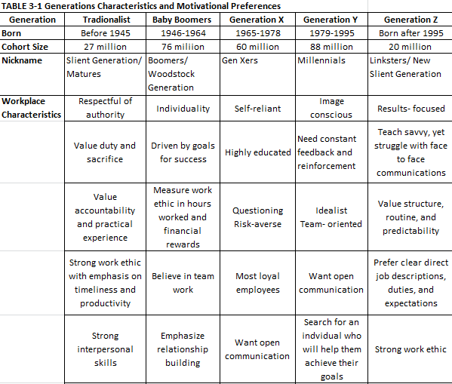

Slide 26
