Slide 1


Course Title
Investment Analysis
Course Coordinator
Assist.Prof.Dr. Gökhan Sökmen
Research Assistant
Gözde Elbir

Slide 2
Learning Objectives
After studying this chapter;
You will be able to know how to determine a firm’s cost of equity capital
You will be able to understand the impact of beta in determining the firm’s cost of equity capital
You will be able to know how to determine the firm’s overall cost of capital
You will be able to understand the impact of flotation costs on capital budgeting

Slide 3
The Cost of Capital
Whenever a firm has extra cash, it can take one of two actions:
1. It can pay out the cash directly to its investors
or
2. It can invest the extra cash in a project, paying out the future cash flows of the project.
Which action would the investors prefer?
If investors can reinvest the cash in a financial asset (a stock or bond) with the same risk as that of the project, the investors would desire the alternative with the higher expected return. The idea is illustrated in the Figure:

Slide 4
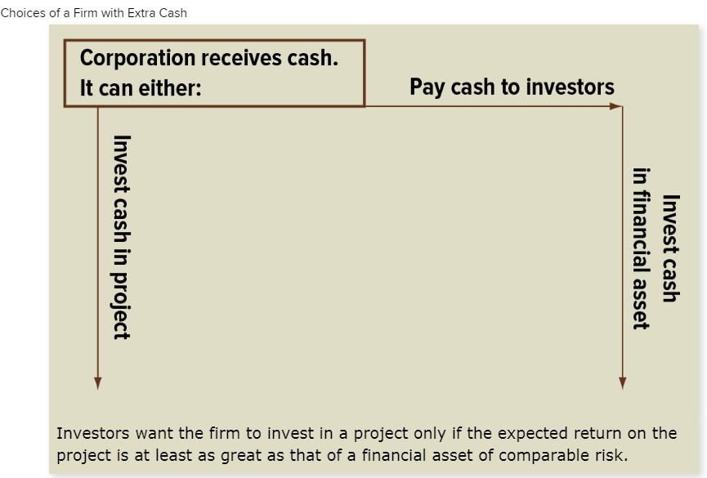
The Cost of Capital

Slide 5
What is the difference equity financing and debt financing?
DEBT FINANCING | EQUITY FINANCING
ADVANTAGES
Keep full ownership | Less risk than debt
No obligations after paying debt | No paying back funds
Interest is tax deductible | Gain credibility through investor networks
Short and long term options | Investors don’t expect immediate return on investment
More cash on hand | Fixed payments for better budgeting
DISADVANTAGES
Must pay back | Investor returns could be more than debt payments
Could cause cash flow issues | Investor gets some ownership
Usually need collateral | Must consult investor for decisions

Slide 6
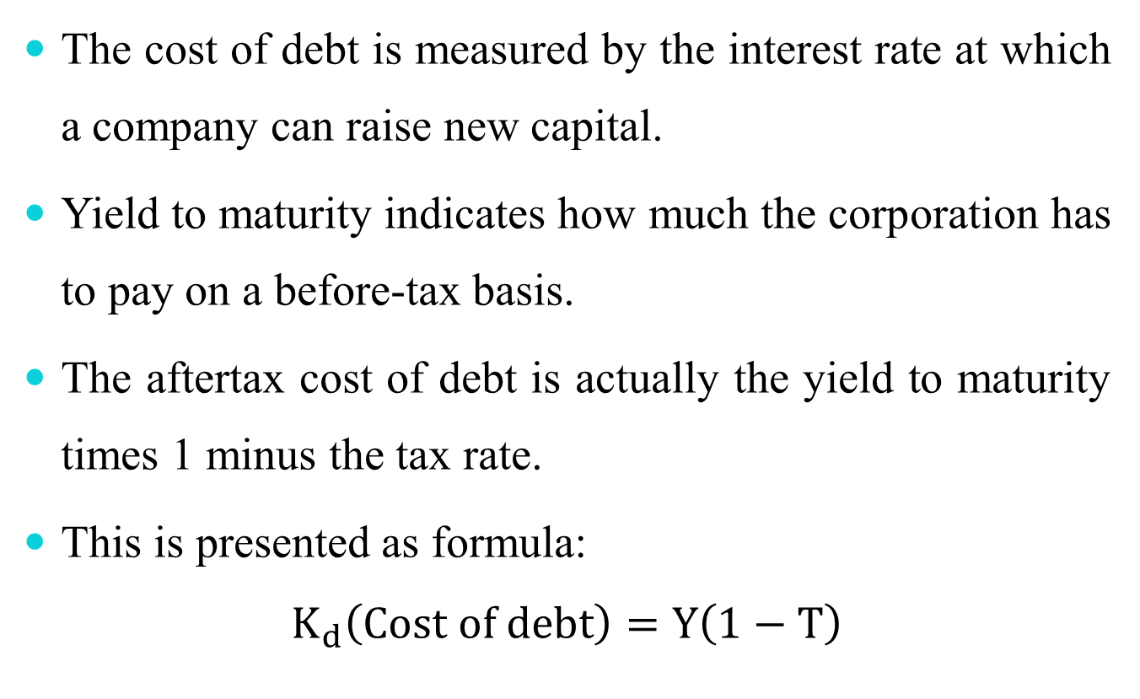
Cost of Debt
The cost of debt is measured by the interest rate at which a company can raise new capital.
Yield to maturity indicates how much the corporation has to pay on a before-tax basis.
The aftertax cost of debt is actually the yield to maturity times 1 minus the tax rate.
This is presented as formula:
$$K_{d}\left(Cost of debt\right)=Y\left(1−T\right)$$

Slide 7
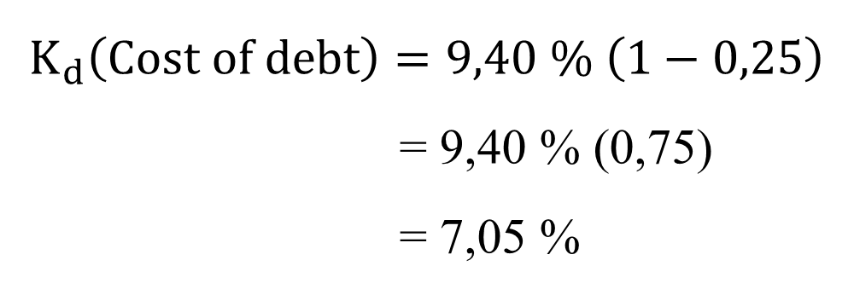
Example 1
The existing yield on the debt was 9,40 percent. We shall assume new debt can be issued at the same going market rate and that the firm is paying a 25 percent tax. What is the cost of debt?
$$K_{d}\left(Cost of debt\right)=9,40 \% \left(1−0,25\right)$$
= 9,40 % (0,75)
= 7,05 %

Slide 8
Example 2
The existing yield on the debt was 10.84% and tax rate is 40%.
What is the cost of debt?
Yield = 10.84%; Tax rate = 40%
K_{d} (Cost of debt) = Y(1 – T)
K_{d} (Cost of debt) = 10.84% (1 – 0.40)
= 10.84% × 0.65
= 6.5%

Slide 9
Cost of Equity Capital
Shareholder invests in financial asset
Firm with
excess cash
Pay cash dividend
A firm with excess cash can either pay a dividend or make a capital investment
Shareholder’s Terminal Value
Invest in project
Because stockholders can reinvest the dividend in risky financial assets, the expected return on a capital-budgeting project should be at least as great as the expected return on a financial asset of comparable risk.

Slide 10
Cost of Preferred Stock
Constant annual payment with no maturity date for principal payment
  Divide annual dividend by current price
  Represents rate of return to preferred stockholders and annual cost to corporation for preferred stock issue
Proceeds to firm are equal to selling price in market minus flotation cost

Slide 11

Cost of Preferred Stock
The cost of preferred stock is as follows
  K_{p} (Cost of preferred stock) = D_{p} / (P_{p} – F)
K_{p} = Cost of preferred stock
D_{p} = Annual dividend on preferred stock
P_{p} = Price of preferred stock
F = Flotation, or selling cost

Slide 12
Example 3
Assume annual dividend $10.50; preferred stock $100; flotation or selling cost $4
    K_{p} = D_{p} / (P_{p} – F) = $10.50 / ($100 – 4)
    = $10.50 / $96 = $10.94%

Slide 13
Cost of Common Equity
To determine cost of common stock, the firm must be sensitive to pricing and performance demands of current and future stockholders
Dividend valuation model:
P₀ = D₁ / (K_{e} – g)
P₀ = Price of the stock today
D₁ = Dividend at the end of the year (or period)
K_{e} = Required rate of return
g = Constant growth rate in dividends

Slide 14
Example 4
Assume that:
D₁ = $2,
P₀ = $40, and
g = 7%,
K_{e} = ?
K_{e} = (D₁ / P₀) + g
= ($2 / $40) + 7% = 5% +7% = 12%

Slide 15
Example 5
Your company is expected to pay a dividend of $4.40 per share next year (D₁). Dividends have grown at a steady rate of 5.1% per year and the market expects that to continue (g). The current stock price is $50 (P₀). What is the cost of equity?
K_{e} = (D₁ / P₀) + g
K_{e} = (4.40 / 50) + 0.051 = 0.139

Slide 16
Example 6
Suppose TB Pirates, Inc. is expected to pay a $2 dividend in one year. If the dividend is expected to grow at 5% per year and the required return is 20%, what is the price?
  D₁ = $2.00
  g = 5%
  K_{e} = 20%

Slide 17

Cost of Common Equity
One whose dividends are expected to grow forever at a constant rate, g.
D₁ = D₀(1+g)¹
D₂ = D₀(1+g)²
D_{t} = D_{t}(1+g)^{t}
D₀ = Dividend JUST PAID
D₁ – D_{t} = Expected dividends

Slide 18
Example 7
D₀ = $2.00 and constant g = 6%
D₃ = ?
D₁ | = D₀(1+g) | = 2(1.06) | = $2.12
D₂ | = D₁(1+g) | = 2.12(1.06) | = $2.2472
D₃ | = D₂(1+g) | = 2.2472(1.06) | = $2.3820

Slide 19
Gordon Growth Model
D₀(1+g)
D₁
P₀ =
=
K_{e} - g
K_{e} - g

Slide 20
Example 8
Suppose Big D, Inc. just paid a dividend of $0.50. It is expected to increase its dividend by 2% per year. If the market requires a return of 15% on assets of this risk, how much should the stock be selling for?
D₀= $0.50
g = 2%
K_{e} = 15%

Slide 21
Required Return on Common Stock Using the Capital Asset Pricing Model
Capital Asset Pricing Model (CAPM)
R_{i} = R_{f} + β_{i} (R_{m} − R_{f})
R_{i} = Required return on common stock
R_{f} = Risk-free rate of return, usually the current rate on Treasury bill securities
β_{i} = Beta coefficient (measures the historical volatility of an individual stock’s return relative to a stock market index)
R_{m} = Return expected in the market as measured by an approximate index
Market risk premium = R_{m} − R_{f}

Slide 22
Estimation of BETA
Market Portfolio – Portfolio of all assets in the economy. In practice, a broad stock market index, such as the S&P 500, is used to represent the market.
Beta – Sensitivity of a stock’s return to the return on the market portfolio.
    Betas may vary over time.
    The sample size may be inadequate.
    Betas are influenced by changing financial leverage and business risk.

Slide 23
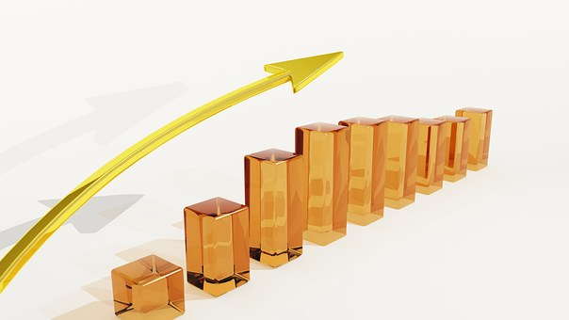
Stability of BETA
Most analysts argue that betas are generally stable for firms remaining in the same industry.
That is not to say that a firm’s beta cannot change.
  Changes in product line
  Changes in technology
  Deregulation
  Changes in financial leverage

Slide 24
Using an Industry BETA
It is frequently argued that one can better estimate a firm’s beta by involving the whole industry.
If you believe that the operations of the firm are similar to the operations of the rest of the industry, you should use the industry beta.
If you believe that the operations of the firm are fundamentally different from the operations of the rest of the industry, you should use the firm’s beta.
Do not forget about adjustments for financial leverage.

Slide 25
Example 9
Assume that:
R_{f} = 5.5%,
R_{m} = 12%, and
β_{i} = 1.0
R_{i} would be:
R_{i} = 5.5% + 1.0 (12% – 5.5%)
= 5.5% + 1.0 (6.5%)
R_{i} = 5.5% + 6.5% = 12%

Slide 26

Example 10
Suppose the stock of Stansfield Enterprises, a publisher of online presentations, has a beta of 1.5. The firm is 100% equity financed. Assume a risk-free rate of 3% and a market risk premium of 7%. What is the appropriate discount rate for an expansion of this firm?
R_{i} = R_{f} + β_{i} (R_{m} − R_{f})
R_{i} = 3% + (1.5 × 7%)
R_{i} = 13.5%

Slide 27
Example 11
Company’s equity beta = 1.2
Current risk-free rate = 7%
Expected market risk premium = 6%
What is the cost of equity capital?
R_{i} = R_{f} + β_{i} (R_{m} − R_{f})
R_{i} = 0.07+1.2 (0.06) = 14.2 %

Slide 28
Bond yield + risk premium
The bond yield plus risk premium approach is another method we can use to determine the value of an asset, specifically, a company’s publicly traded equity.
The method allows us to estimate the required return on an equity by adding the equity’s risk premium to the yield to maturity on company’s long-term debt.
Cost of equity = Bond yield + Risk premium
We can only utilize the approach if the entity has publicly traded debt, and it does not produce as accurate an estimate as the capital asset pricing model or discounted cash flow analysis.

Slide 29

Cost of Retained Earnings
Sources of capital for common stock equity
  Purchaser of new shares—external source
  Retained earnings—internal source
    Represent present and past earnings of firm minus previously distributed dividends
    Belong to current stockholders—paid as dividends or reinvested in firm
    Reinvestments represent source of equity capital supplied by current stockholders
    Opportunity cost involved

Slide 30
Cost of Retained Earnings
The cost of retained earnings is equivalent to the rate of return on the firm’s common cost, representing the opportunity cost
K_{e} represents both the required rate of return on common stock and the cost of equity in the form of retained earnings
K_{e} = (D₁ / P₀) + g
  K_{e} = Cost of common equity in the form of retained earnings
  D₁ = Dividend at the end of the first year, $2
  P₀ = Price of stock today, $40
  g = Constant growth rate in dividends, 7%
  K_{e} = (D₁ / P₀) + g = ($2 / $40) + 7% = 5% + 7% = 12%

Slide 31
Cost of New Common Stock
Slightly higher return than K_{e} expected
  Represents required rate of return of present stockholders
  Needed to cover distribution costs of new securities
Common Stock
New common stock
K_{e} = (D₁ / P₀) + g
K_{n} = [D₁ / (P₀ – F)] + g

Slide 32
Optimum Capital Structure—Weighting Costs
Desire to achieve minimum overall cost of capital
  Calculated decisions required on appropriate weights for
    Debt
    Preferred stock
    Common stock financing
  Capital mix determined by
    Considering present capital structure
    Ascertaining if current position optimal

Slide 33
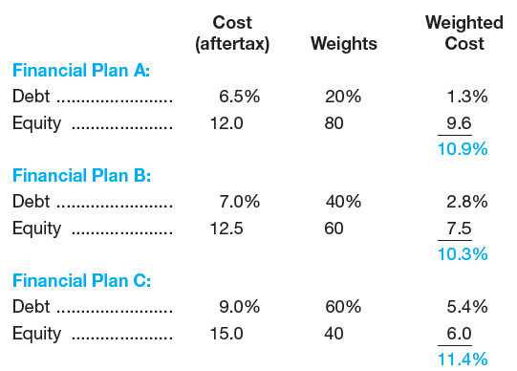
Optimum Capital Structure—Weighting Costs
Assessment of different plans:
  Firm able to initially reduce weighted average cost of capital with debt financing
  Beyond Plan B, continued use of debt becomes unattractive and greatly increases costs of sources of financing

Slide 34
Example 12
Assume the capital structure for the company:
The following facts are also provided:
Compute the weighted average cost of capital.
Debt | 35%
Preferred stock | 15%
Common equity | 50%
Bond yield to maturity | 9%
Corporate tax rate | 25%
Dividend, preferred stock | $ 8.50
Price, preferred stock | $ 100.00
Flotation cost, preferred stock | $ 2.00
Dividend, common stock | $ 1.20
Price, common stock | $ 30.00
Growth rate, common stock | 9%

Slide 35

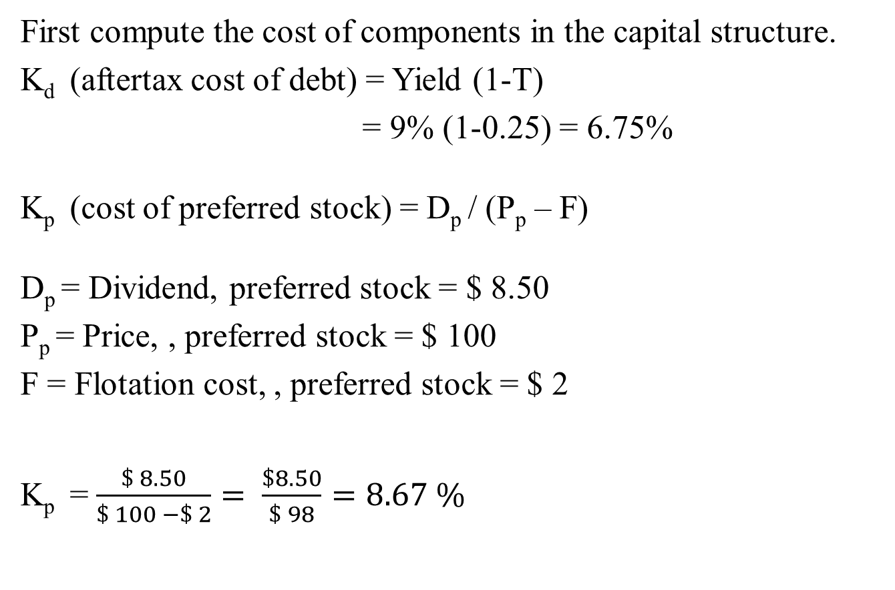
Example 13
First computethecost of components in thecapitalstructure.
K_{d} (aftertaxcost of debt) = Yield (1-T)
= 9% (1-0.25) = 6.75%
  K_{p} (costof preferredstock) = D_{p}/ (P_{p} – F)
D_{p}= Dividend, preferredstock = $ 8.50
P_{p}= Price, , preferredstock = $ 100
F = Flotationcost, , preferredstock = $ 2
  K_{p}= $\frac{\$ 8.50}{\$ 100 −\$ 2}= \frac{\$8.50}{\$ 98}=8.67 \%$

Slide 36
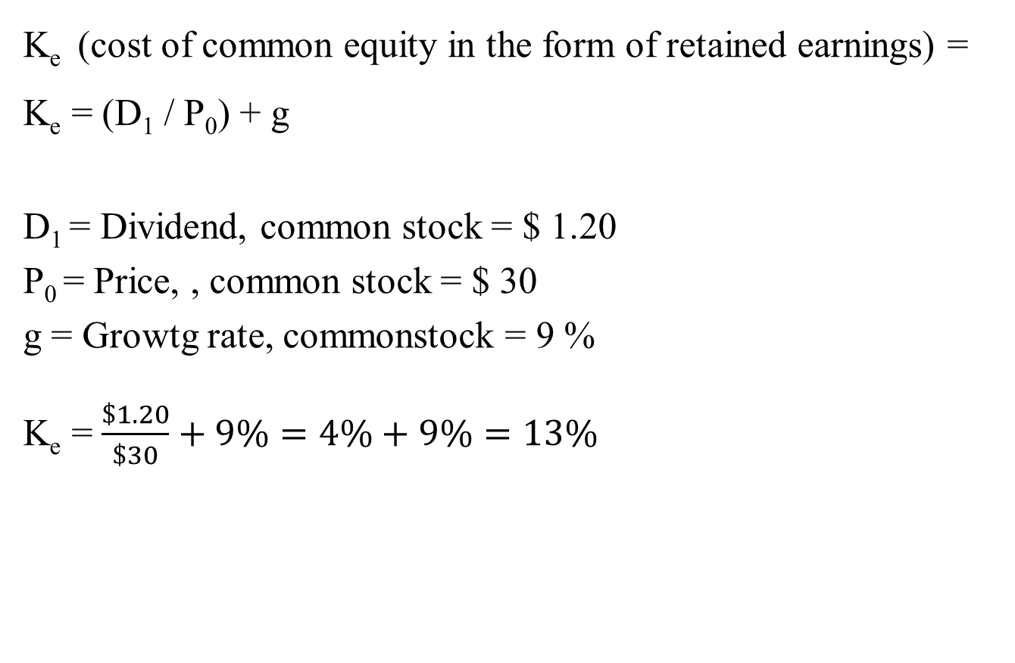
Example 14
K_{e} (cost of commonequity in the form of retainedearnings) =K_{e} = (D₁ / P₀) + g
D₁= Dividend, commonstock = $ 1.20
P₀= Price, , commonstock = $ 30
g = Growtg rate, commonstock= 9 %
K_{e} =$\frac{\$1.20}{\$30}+9\%=4\%+9\%=13\%$

Slide 37
Example 15
Now combine these with the weights in the capital structure to compute the weighted average cost of capital.
 |  | Cost | Weights | Weighted cost
Debt | K_{d} | 6.75% | 35% | 2.36%
Preferred stock | K_{p} | 8.67% | 15% | 1.30%
Common equity (retained earnings) | K_{e} | 13% | 50% | 6.50%
Weighted average cost of capital |  |  |  | 10.16%

Slide 38
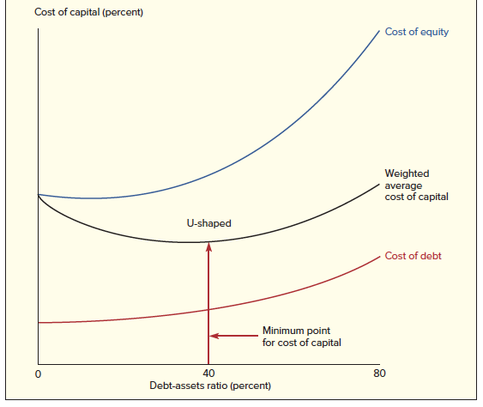
Cost of Capital Curve

Slide 39
Cost of Capital in the Capital Budgeting Decision
Current cost of capital for each source of funds important for capital budgeting decision
  Required rate of return, or discount rate, will be weighted average cost of capital
  Common stock value of firm will stay same or increase as long as firm earns cost of capital
    Stockholders’ expectations being met

Slide 40
The Marginal Cost of Capital
Market may demand higher cost of capital for each each amount of funds if large amount of financing required
  Equity (ownership) capital represented by retained earnings
    Retained earnings cannot grow indefinitely, as firm’s capital must expand
    Retained earnings limited to past and present earnings that can be redeployed into investments

Slide 41
The Marginal Cost of Capital
Assumptions:
  Firm has $23.40 million of retained earnings available for investment
  Since retained earnings are 60 percent of the capital structure, there are adequate retained earnings to support up to $39 million
Adequate retained earnings to support capital structure
X = Retained earnings / Percent of retained earnings in the capital structure
  Where X represents size of capital structure that retained earnings will support
  X = $23.40 million / 0.60 = $39 million

Slide 42
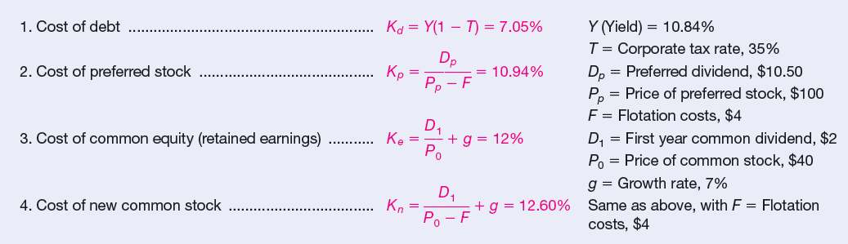
Cost of Components in the Capital Structure

