Slide 1

Business Research Methods
Thirteenth Edition
Pamela S. Schindler
Chapter 2
THE RESEARCH PROCESS: AN OVERVIEW
©2019 McGraw-Hill Education. All rights reserved. Authorized only for instructor use in the classroom. No reproduction or further distribution permitted without the prior written consent of McGraw-Hill Education.
Notes:
This chapter provides an overview of the research process and sets the stage for coming chapters.

Slide 2
Research Thought Leaders
“Today, individuals increasingly keep their emails and documents on remote servers in data centers—in short, in the cloud. But the transition to the cloud does not alter people’s expectations of privacy.”
Brad Smith,
president and chief legal officer,
Microsoft

Slide 3
Learning Objectives
Understand …
The standards of good research.
What is happening within each stage of the research process.
Research process pitfalls and their solutions.
Ethical issues at each stage in the process.

Slide 4

Actions that Deliver Effective Research
Clearly defined purpose
Detailed research process
Thoroughly planned design
High ethical standards
Adequate analysis
Limitations revealed
Unambiguous presentation
Insights justified
Conclusions justified
Notes:
Exhibit 2-1 presents the actions that deliver effective business research and also explains what managers should look for in research done by others.
You might wish to discuss the concepts here.
You can also use any Snapshot, or Making Research Decisions or From the Headlines discussion question to discuss these actions.
PHOTO CREDIT
© wdstock/Getty Images

Slide 5
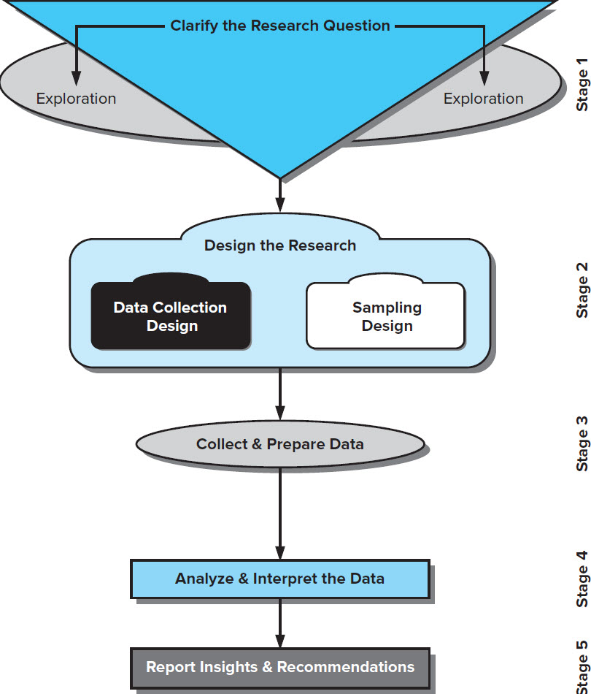
Research Process
Stage 1: Clarify the Research Question
Stage 2: Design the Research
Stage 3: Collect & Prepare the Data
Stage 4: Analyze & Interpret the Data
Stage 5: Report Insights & Recommendations
Jump to long description
Notes:
Exhibit 2-2 reveals the model for the research process that is followed in this text. Each stage is developed in subsequent chapters.

Slide 6
Research Process: Stage 1
Stage 1: Clarify the Research Question
Notes:
Exhibit 2-2 reveals the model for the research process that is followed in this text. Each stage is developed in subsequent chapters.
Exhibit 2-2 illustrates the research process. This slide focuses on the first stage of the process, clarifying the research question…which involves moving from the management dilemma to the research question using exploration.
The process begins at the most general level with the management dilemma. This is usually a symptom of an actual problem, such as rising costs, declining sales, or a large number of defects.
This portion of the research process is the focus of CHAPTER 3.
A management dilemma is an opportunity of problem that the manager has discovered because of one or more symptoms.
A research question is the hypothesis that best states the objective of the research; the question that focuses the researcher’s attention.

Slide 7

Curiosity Exploration
What role does curiosity
play in exploration?
Children are innately curious. As adults, we need to foster our curiosity and constantly strive for better and deeper understanding of the phenomena around us.
Notes:
Children are innately curious. As adults, we need to foster our curiosity and constantly strive for better and deeper understanding of the phenomena around us.
PHOTO CREDIT
©Blend / Image Source.

Slide 8
Research Process: Stage 2
Stage 2: Design the Research
Notes:
Exhibit 2-2 reveals the model for the research process that is followed in this text. Each stage is developed in subsequent chapters.

Slide 9
Stage 2: Design the Research (1 of 2)
Notes:
Stage 2 of Exhibit 2-2 encompasses the design of the research project. There are three components to this stage: research design, sampling design, and intrument development & pilot testing.
Research design is the blueprint for fulfilling objectives and providing the insight to answer the management dilemma. There are many methods, techniques, procedures, and protocols possible.
Chapters 6-9 identify various research designs
Another step in planning the research project is sampling design—to identify the target population and determine whether a sample or census is desired. A census is a count of all elements in a population. A sample is a group of cases, participants, events, or records that constitute a portion of the target population. The researcher must determine whether to choose a probability or nonprobability sample.
Types of samples, sample frames, how samples are drawn, and the determination of sample size are discussed in Chapters 5.
A pilot test is conducted to test weaknesses in the research design and the measurement instrument and protocols and to provide proxy data for selection of a probability sample.
Chapter 13 focuses on instrument development and pilot testing is discussed.

Slide 10
Stage 2: Design the Research (2 of 2)
The Research Project
Research Design
Sampling Design
Instrument Development & Pilot Testing
Notes:
Stage 3 encompasses the design of the research project. There are three components to this stage: research design, sampling design, and pilot testing.
Research design is the blueprint for fulfilling objectives and providing the insight to answer the management dilemma. There are many methods, techniques, procedures, and protocols possible.
Chapter 6 identifies various research designs and
Chapters 7-14 discuss specific methodologies.
Another step in planning the research project is to identify the target population and determine whether a sample or census is desired. A census is a count of all elements in a population. A sample is a group of cases, participants, events, or records that constitute a portion of the target population. The researcher must determine whether to choose a probability or nonprobability sample.
Types of samples, sample frames, how samples are drawn, and the determination of sample size are discussed in Chapters 15.
A pilot test is conducted to test weaknesses in the research methodology and the data collection instrument and to provide proxy data for selection of a probability sample.
Chapter 14 focuses on instrument development and pilot testing is discussed.

Slide 11
  Research design is the blueprint for fulfilling objectives and providing the insight to answer the management dilemma. There are many methods, techniques, procedures, and protocols possible.
    Chapter 6 identifies various research designs and
    Chapters 7-14 discuss specific methodologies.
  Another step in planning the research project is to identify the target population and determine whether a sample or census is desired. A census is a count of all elements in a population.
  A sample is a group of cases, participants, events, or records that constitute a portion of the target population. The researcher must determine whether to choose a probability or nonprobability sample.
    Types of samples, sample frames, how samples are drawn, and the determination of sample size are discussed in Chapters 15.
  A pilot test is conducted to test weaknesses in the research methodology and the data collection instrument and to provide proxy data for selection of a probability sample.
    Chapter 14 focuses on instrument development and pilot testing is discussed.

Slide 12
Research Process: Stage 3
Stage 3: Collect & Prepare the Data
Notes:
Exhibit 2-2 reveals the model for the research process that is followed in this text. Each stage is developed in subsequent chapters.

Slide 13
Stage 3: Data Collection, Preparation, Examination (1 of 2)
Collect and Prepare Data
Notes:
Stage 3 of Exhibit 2-2 focuses on data collection and data preparation and examination. This material is covered in detail in Chapter 13.

Slide 14

Stage 3: Data Collection, Preparation, Examination (2 of 2)
Collect the data
Deal with data errors/omissions
Reduce data to manageable size
Develop summaries
Notes:
PHOTO CREDIT
© Terry Vine/Blend Images LLC.

Slide 15

Data Characteristics
Abstractness
Verifiability
Elusiveness
Closeness
Data are collective units of information (e.g., production defects, purchases or returns, a person’s attitudes, behaviors, motivations, attributes, photos, recorded comments, etc.) from a subject or case (people, events, machines, personnel records, etc.) measured by a data collector (person or a sensing device or machine, digital or mechanical) following consistent procedures.
  Data are raw and unprocessed.
  Data are processed by our senses. When sensory experiences consistently produce the same result, our data are said to be trustworthy.
Notes:
Stage 3 deals with data collection and preparation.
Data are collective units of information (e.g., production defects, purchases or returns, a person’s attitudes, behaviors, motivations, attributes, photos, recorded comments, etc.) from a subject or case (people, events, machines, personnel records, etc.) measured by a data collector (person or a sensing device or machine, digital or mechanical) following consistent procedures.
Data are raw and unprocessed.
Data are processed by our senses. When sensory experiences consistently produce the same result, our data are said to be trustworthy.
PHOTO CREDIT
©BJI / Blue Jean Images/Getty Images.

Slide 16

Data Types
  Secondary data are originally collected to address a problem other than the one which require the manager’s attention at the moment.
  Primary data are data the research collects to address the specific problem at hand.
Notes:
Capturing data is elusive.
Data is characterized as of two main types.
Secondary data are originally collected to address a problem other than the one which require the manager’s attention at the moment.
Primary data are data the research collects to address the specific problem at hand.
Ask which students are seeing…
Expense reports are collected to reimburse people who have used personal resources to pay for a company expense (primary data), but if they are used in research to understand the cost of providing distribution to certain countries or geographic areas, they are seen as secondary data.
PHOTO CREDIT
murat sarica/Getty Images.

Slide 17
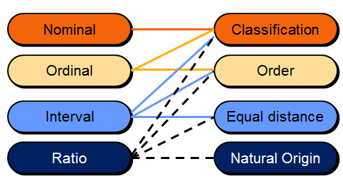
Data Levels & Characteristics
Notes:
This is an important slide not only for discussing the research process, but later when we discuss measurement, measurement questions, data preparation, and data analysis.

Slide 18
Research Process: Stage 4
Stage 4: Analyze & Interpret the Data
Notes:
Exhibit 2-2 reveals the model for the research process that is followed in this text. Each stage is developed in subsequent chapters.
Stage 4 of Exhibit 2-2 is covered in more detail in Chapters 14-15.

Slide 19

Steps in Data Analysis and Interpretation
Refine Preliminary Analysis Plan
Look for Patterns
Apply Statistical Techniques
Support or Refute Hypotheses
Develop Insights & Recommendations
Notes:
PHOTO CREDIT
Shutterstock / Andrey_Popov.

Slide 20
Research Process: Stage 5
Stage 5: Report Insights & Recommendations
Notes:
Exhibit 2-2 reveals the model for the research process that is followed in this text. Each stage is developed in subsequent chapters.
Stage 5 in Exhibit 2-2 is covered in Chapter 16.

Slide 21
Factors that Influence
Research Report:
Perspective
Method
Audience
Content
Notes:
In reporting the results, the researcher should strive to provide insightful information adapted to the managers needs and to choose words carefully when crafting interpretations, conclusions, and recommendations. The research report the perspective (management), the method (oral/wirtten), the audience (sponsoring audience or wider) and the content (findings, insights, recommendations?).
Chapter 16 deals with stage 5, Report the Research.

Slide 22
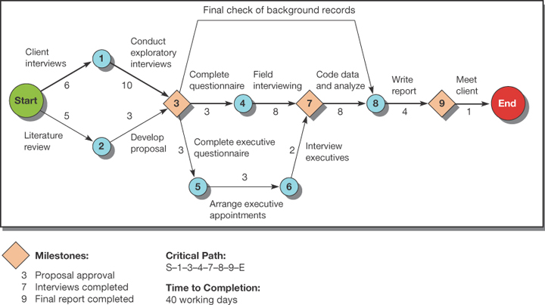
Research Project Time Frame (1 of 2)
Jump to long description
Notes:
Exhibit 2-3
Research is a time-based project. Project management tools, like CPM and Gantt, are useful.

Slide 23
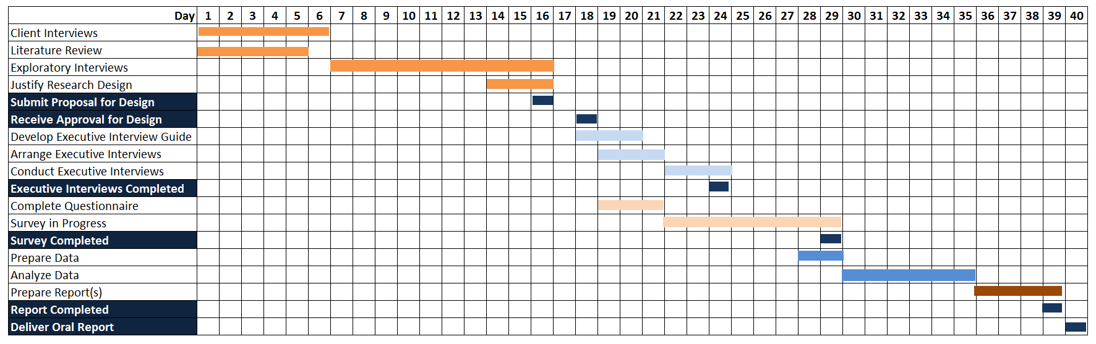
Research Project Time Frame (2 of 2)
Jump to long description
Notes:
Exhibit 2-4
Gantt chart of a research project.

Slide 24
Research Process Pitfalls to Avoid
Ill-defined Management Problem
Unresearchable questions: Not all management questions are researchable and not all research questions are answerable.
Manager’s Hidden Agendas: Sometimes a research study is intended to win approval for a pet idea or to protect a decision maker. In these cases, it may be more difficult to get support for the most appropriate research design.
Researcher Inexperience: can lead to an inappropriate research questions, poor research design, inadequate data collection protocols, in appropriate analytical techniques, and the insupportable conclusions and recommendations. Novice researchers should be supervised
Notes:
Researchers must remain objective. The slide presents common problems in the research process, especially in Stage 1 of Exhibit 2-2.
Unresearchable questions: Not all management questions are researchable and not all research questions are answerable.
An ill-defined problem is one that addresses complex issues and cannot be expressed easily or completely.
Manager’s Hidden Agendas: Sometimes a research study is intended to win approval for a pet idea or to protect a decision maker. In these cases, it may be more difficult to get support for the most appropriate research design.
Researcher Inexperience: can lead to an inappropriate research questions, poor research design, inadequate data collection protocols, in appropriate analytical techniques, and the insupportable conclusions and recommendations. Novice researchers should be supervised.

Slide 25
Research Process Problems to Avoid
Overembracing Data Analytics
Favored-Technique Syndrome
Researcher Inexperience
Notes:
Researchers must remain objective. The slide presents common problems in Stage 2 of the Research Process (Exhibit 2-2), the research design.
The favored-technique syndrome occurs when researchers are method-bound. They recast any management questions so that it is amenable to their favorite method.
Over-embracing Data Analytics means that managers may feel that they do not want to collect more data until they have thoroughly evaluated all existing data. While data mining can be a good starting point, it will rarely address all questions related to a specific management dilemma.
Researcher inexperience can lead to inappropriate designs for both data collection and sampling, and poor data collection protocols.
We discuss other problems to avoid in other stages in their respective chapters.

Slide 26
Ethical Issues in Research Process
Deception
Privacy
Notice
Choice
Access
Security
Respect
Bias
Notes:
The ethical issues of this chapter focus on deception, privacy, quality, notice, choice, access, security, respect, and bias.
Each of these leads to a right for a researcher, a sponsor, or a participant…to quality research, to confidentiality, to privacy, to absence of coercion. etc.
If you prefer, the next slide contains Exhibit 2-2, currently hidden.

Slide 27
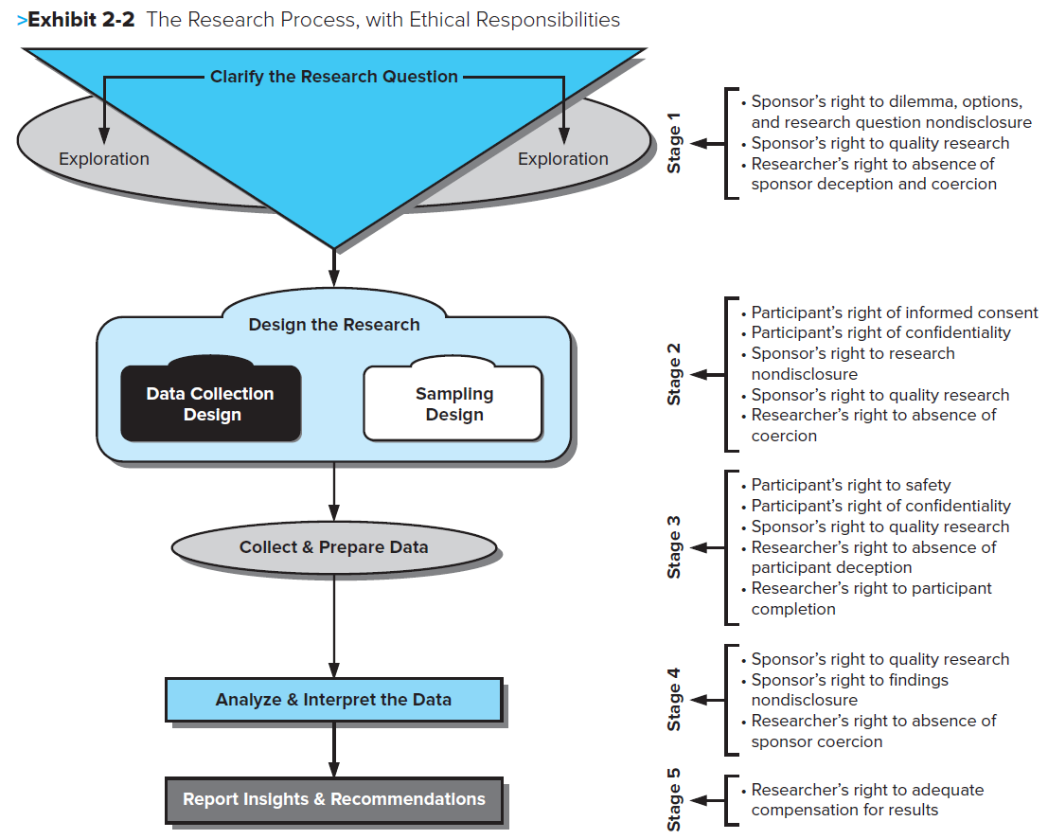
Research Process with Ethical Responsibilities
Jump to long description
Notes:
Exhibit 2-2 reveals the model for the research process that is followed in this text. Each stage is developed in subsequent chapters.

Slide 28
Key Terms
Case
Census
Dashboard
Data
Data analysis
Findings
Insights
Interval data
Key Performance Indicator
Management dilemma
Nominal data
Ordinal data
Primary data
Ratio data
Recommendations
Research design
Research process
Research question(s)
Sample
Secondary Data
Target population

Slide 29

Chapter 2
THE RESEARCH PROCESS, AN OVERVIEW
DISCUSSION OPPORTUNITIES
©2019 McGraw-Hill Education. All rights reserved. Authorized only for instructor use in the classroom. No reproduction or further distribution permitted without the prior written consent of McGraw-Hill Education.

Slide 30
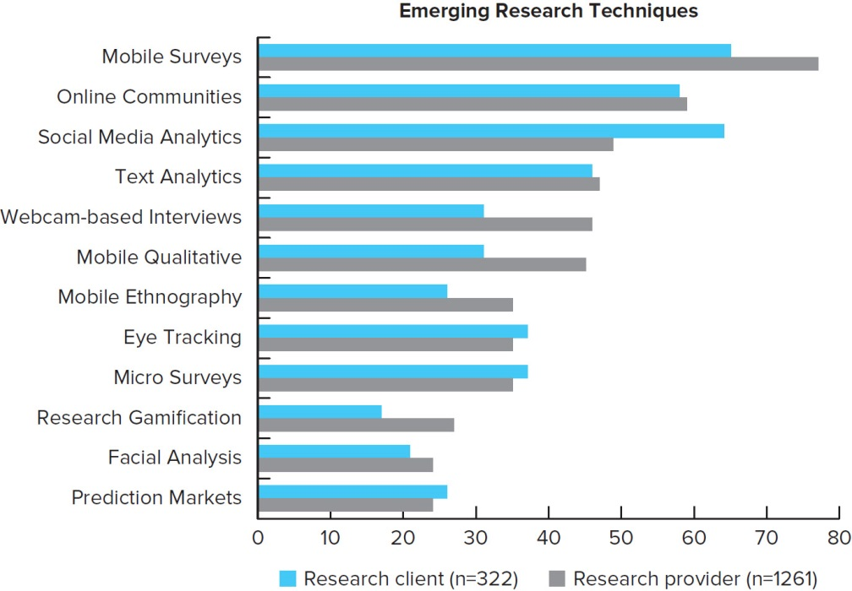
PicProfile: Emerging Research Techniques
Jump to long description

Slide 31

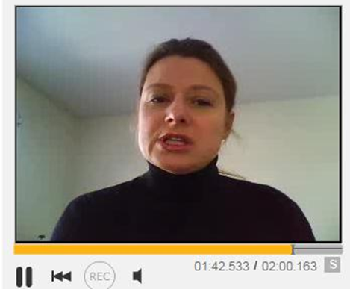
Snapshot: Moms Video Insights
Notes:
Use the snapshot: New Moms and Moms to Be offer Video Insights, the project from Marcus Thomas LLC and Qualvu to disucss Step 3: Designing the Research.
Photo Credit
Left
©Hero/Corbis/Glow Images
Right
Courtesy of Marcus Thomas LLC.

Slide 32

Snapshot: Research & Programmatic Algorithms (1 of 2)
Today’s digital ads are bought via computer programmatically through an “astonishing range of complex calculations” that no human could do in the time available.
Notes:
Use the snapshot Research and Programmatic Algorithms to discuss Step 3: Designing the Research.
PHOTO CREDIT
Robert Daly/Caia Image/Glow Images.

Slide 33
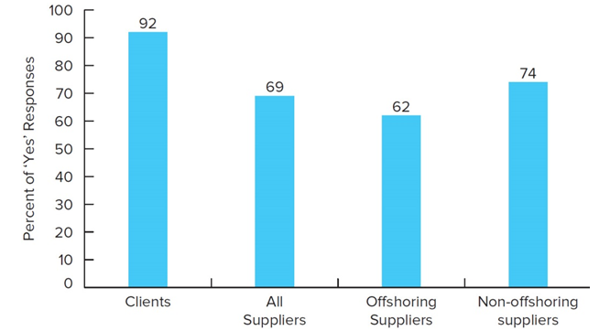
Snapshot: Research Leaving Country (1 of 2)
Q. Regardless of what your stance is on offshoring, do you believe research suppliers have an obligation to tell their clients that they offshore? (n = 850)
Jump to long description
Notes:
This snapshot is one that can be used to discuss ethical issues, as well as research process pitfalls.
A bar graph is shown.

Slide 34
Appendix of Image Long Descriptions

Slide 35
Research Process Long Description
Stage 1 is "clarify the research question," pointing to "exploration." Stage 2 is "design the research," with "data collection design" and "sampling design" as substeps. Stage 3 is "Collect and Prepare Data. “Stage 4 is "analyze and interpret the data." Stage 5 is "Report Insights and Recommendations.
Jump to image

Slide 36
Research Project Time Frame (1 of 2) Long Description
The process starts and splits into client interviews (6 days) and literature reviews (5 days). From client interviews (step 1), conduct exploratory interviews (10 days), and from lit review (step 2), develop proposal (3 days), with the two coming together as step 3. From step 3 is complete questionnaire (3 days, step 4), leading to step 7 field interviewing (8 days), and complete executive questionnaire (step 5, 3 days), leading to arrange executive appointments (step 6, 3 days), meeting at step 7. Step 8 is code data and analyze (8 days), at which time the final check of background records from step 3 is completed. Step 9 is write report (4 days), finalizing with meet client (1 day).
Jump to image

Slide 37
Research Project Time Frame (2 of 2) Long Description
Client interviews: days 1-6. Literature review: days 1-5. Exploratory interviews: days 7-16. Justify research design: days 14-16. Submit proposal for design: day 16. Receive approval for design: day 18. Develop executive interview guide: days 18-20. Arrange executive interviews: days 19-21. Conduct executive interviews: days 22-24. Executive interviews completed: day 24. Complete questionnaire: days 19-21. Survey in progress: days 22-29. Survey completed: day 29. Prepare data: days 28-29. Analyze data: days 30-35. Prepare report(s): days 36-39. Report completed: day 39. Deliver oral report: day 40.
Jump to image

Slide 38
Research Process with Ethical Responsibilities Long Description
Stage 1 is "clarify the research question," pointing to "exploration." Ethical responsiblities for Stage 1 are: Sponsor's right to dilemma, options, and research question nondisclosure, sponsor's right to quality research, researcher's right to absence of sponsor deception and coercion. Stage 2 is "design the research," with "data collection design" and "sampling design" as substeps. Ethical responsibilities for Stage 2 are: Participant's right of informed consent, participant's right of confidentiality, sponsor's right to research nondisclosure, sponsor's right to quality research, researcher's right to absence of coercion. Stage 3 is "Collect and Prepare Data." Ethical responsibilities for Stage 3 are: Participant's right to safety, participant's right of confidentiality, sponsor's right to quality research, researcher's right to absence of participant deception, researcher's right to participant completion. Stage 4 is "analyze and interpret the data." Ethical responsibilities for Stage 4 are: Sponsor's right to quality research, sponsor's right to findings nondisclosure, researcher's right to absence of sponsor coercion. Stage 5 is "Report Insights and Recommendations. Ethical responsibility for Stage 5 is Researcher's right to adequate compensation for results.
Jump to image

Slide 39
PicProfile: Emerging Research Techniques Long Description
Data are (approximately) as follows, in ordered pairs as (client, provider): Mobile surveys (65, 78), Online communities (58, 59), social media analytics (64, 49), text analytics (45, 46), webcam-based interviews (30, 45), mobile qualitative (30, 44), mobile ethnography (26, 35), eye tracking (37, 35), Micro surveys (37, 35), research gamification (17, 27), facial analysis (21, 24), prediction markets (26, 24).
Jump to image

Slide 40
Snapshot: Research Leaving Country (1 of 2) Long Description
A bar graph reporting 850 people in one of four groups' "yes" responses to the question: Regardless of what your stance is on offshoring, do you believe research suppliers have an obligation to tell their clients that they offshore? Clients: 92%; All suppliers: 69%; Offshoring suppliers 62%; Non-offshoring suppliers: 74%
Jump to image

