Slide 1
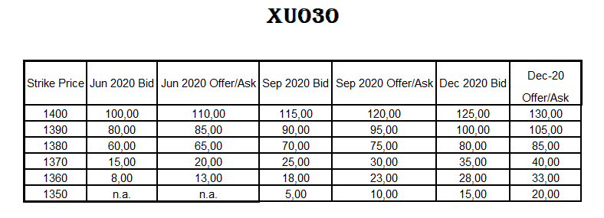
call PRICES
Q5: Today is 25 Dec 2019 Spot: 1.375, Short (write) one call contract from 1.380 maturity: Dec 20 ;
(1 contract is 100 share)
What is the payoff and profit as of Dec 20? Dec’20 Price of XU030 is 1.160 Draw the Graph.

Slide 2
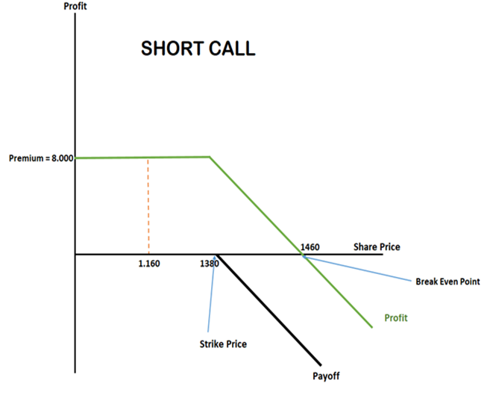
Answer q5:
Bid Cost (1.380) : 80
1 option contract : 100 share
Total Cost (Premium) : 80 x 100 = 8.000 TL
Breakeven = 1.380 + 80 = 1.460 TL
*** Constant Payoff occurs below 1.380
Is the price below 1.380?
Yes it is 1.160 TL
Constant payoff = 8.000 TL

Slide 3
call PRICES
Q6: Today is 25 Dec 2019 Spot: 1.375, Short (write) three call contracts from 1.370 maturity: Jun 20 ;
(1 contract is 100 share)
What is the payoff and profit as of Jun 20? Jun’20 Price of XU030 is 1.365. Draw the Graph

Slide 4
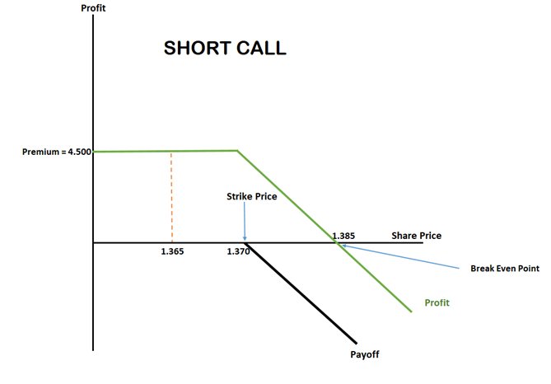
Answer q6:
Bid Cost (1.370 ) = 15,00 TL
3 option contracts: 300 share
Total Cost (Premium) = 15 x 300 = 4.500 TL
Breakeven = 1.370 + 15 = 1.385
*** Constant Payoff occurs below 1.370
Is the price below 1.370?
Yes it is 1.365
So constant payoff : 4.500 TL

Slide 5
call PRICES
Q7: Today is 25 Dec 2019 Spot: 1.375, Short (write) two call contracts from 1.400 maturity: Sep 20 ;
(1 contract is 100 share)
What is the payoff and profit as of Sep 20? Sep’20 Price of XU030 is 1.410. Draw the Graph.

Slide 6
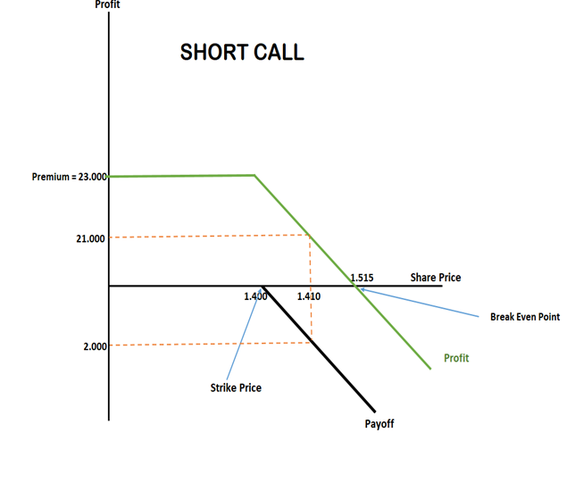
Answer q7:
Bid Cost (1.400) : 115,00 TL
2 contracts: 200 shares
Total Cost (Premium) : 115 x 200 = 23.000 TL
Breakeven = 1.400+115=1.515 TL
*** Constant payoff occurs below 1.400
Is it below 1.400? No, there is no constant payoff.
Payoff: 1.410 – 1.400 = 10 TL
Total Payoff: 10 x 200 = 2.000 TL
Profit = 23.000 – 2.000 = 21.000 TL

Slide 7
call PRICES
Q8: Today is 25 Dec 2019 Spot: 1.375, Short (write) four call contracts from 1.360 maturity: Jun 20 ;
(1 contract is 100 share)
What is the payoff and profit as of Jun 20? Jun’20 Price of XU030 is 1.500. Draw the Graph.

Slide 8
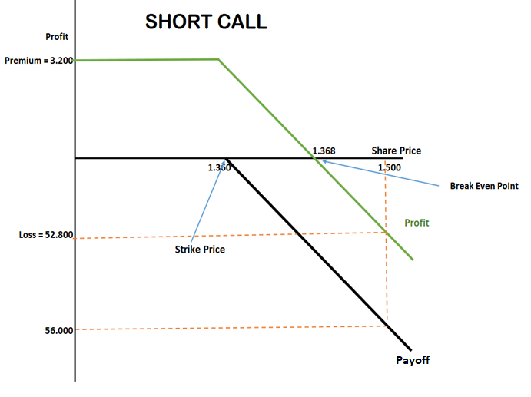
Answer q8:
BID Cost (1.360) : 8,00 TL
4 option contract: 400 share
Total Cost (Premium) : 8 x 400 = 3.200 TL
Breakeven= 1.360 + 8 = 1.368 TL
*** Constant payoff occurs below 1.360
Is the price below 1.360? No , it is 1.500
Payoff = 1.500 – 1.360 = 140 TL
Total payoff = 400 x 140 = 56.000 TL
Profit : 3.200 – 56.000 = -52.800
Loss : 52.800 TL

