Slide 1
CAG UNIVERSITY 2019 – 2020 FALL SEMESTER MAN 429 HEALTH CARE MANAGEMENT

Slide 2
Chapter 6: Healthcare Marketing
Learning Objectives
Assess marketing and the progression of becoming a market-oriented organization
Critique the critical link between strategic management and health care marketing
Differentiate among the major components that are part of the marketing management process
Compare and contrast several important marketing terms, including market segmentation, target markets, marketing mix, and positioning
Analyze how health care managers can integrate ethics and social responsibility into marketing strategy
Create marketing tactics such as using social media related to the strategic goals of a health care organization

Slide 3
The extent of marketing in the health care industry is enormous.
Health care marketing consists of the kinds of activities a firm uses to satisfy customer needs; the approaches managers pursue to create, communicate, and deliver value in selected markets; and the means of capturing value in return.
A customer is the purchaser of products, services, and ideas. All marketing activities should focus on the customer. In this sense, the role of health care marketing must be understood as the process of creating long-term, mutually beneficial relationships between the organization and well-defined target customers.

Slide 4
What is marketing?
Many people mistakenly equate marketing with advertising, promotion, or selling.
The American Marketing Assoc. (2013) defines marketing as «the activity, set of institutions, and processes for creating, communicating, delivering, and exchanging offerings that have value for customers, clients, partners, and societ at large».
From this definition; first it places marketing in the central role of satisfying customer needs.
Second, all marketing activities center on building a sustainable value-driven system for customers, stakeholders, and society. These customers can include individual health care consumers, physicians, insurers, or other organizations.
Third, health care organizations and managers with a relentless focus on creating long-term customer relationships will generally achieve superior performance over those who only focus on short-term results.

Slide 5
Key components of the Marketing Concept
According to the marketing concept, an organization must create, communicate, and deliver customer value to selected target markets more effectively than its competition to achieve goals and objectives.
Customer value is the difference between the benefits a consumer perceives from the purchase of a product, service, or idea and the cost to acquire those benefits.
Through a coordinated set of well-defined activities, the marketing manager must do the right things at the right time to orchestrate individual strategies into a wholly integrated system.
In general, an organization can be characterized as production oriented, sales oriented, or marketing oriented.

Slide 6
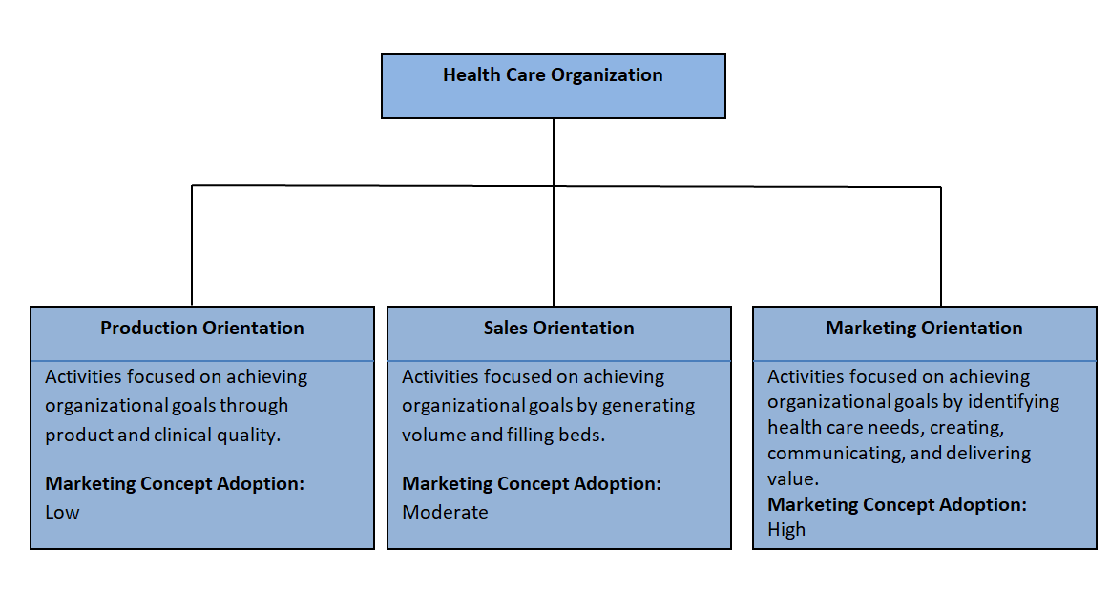
Organizational Orientations

Slide 7
The Strategic Marketing Process
The emergence of a market where sustainable distinctive advantage is based on the ability of an organization to create, communicate, and deliver customer lifetime value more effectively than its competitors is creating profound changes in the practice of health care marketing.
NorthShore University Health System commissioned a market research study to understand consumer motivation. By listening to patients, they learned consumers were interested in talking about their medical conditions- not hospital services. They also learned patients identify with physicians and nurses-not hospitals.

Slide 8
The Strategic Marketing Process
Although external uncontrollable (marketplace) and internal controllable (organizational) complexities present marketing issues, agile health care organizations can achieve extraordinary results by keeping the customer front and center as the focal point in all marketing activities. The Figure with the Pie represents the essential components of strategic marketing.
Organizations can formulate an effective marketing strategy within the context of the organization’s strategic plan and in concert with other functional areas (finance, HR, etc.).
Marketing relies on the strategic plan to deliver a sound and reasonable fit between the external environment and internal organizational capabilities.

Slide 9
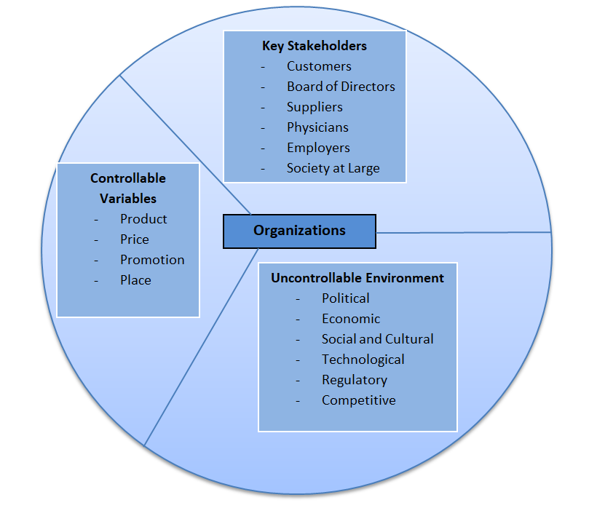
Components of Strategic Marketing

Slide 10
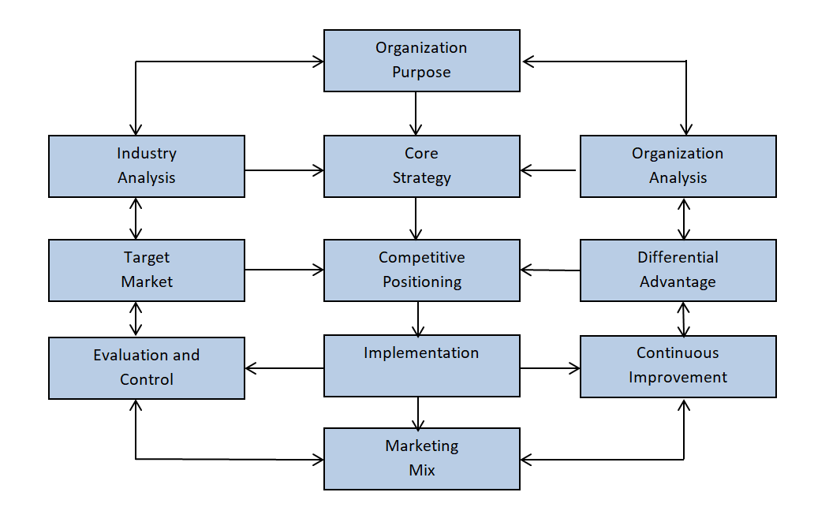
Strategic Marketing Process Framework

Slide 11
The development of a marketing strategy can be viewed at three main levels:
Establishment of a core strategy
Creation of the company’s competitive positioning
Implementation of the strategy

Slide 12
Understanding Marketing Management
Health care marketers must continually scan the external environment and conduct a situation assessment to determine the strengths, weaknesses, opportunities, and threats (SWOT Analysis) for a given offering, set of offerings, or an entire portfolio of products and services.
As such, health care marketing management is the art and science of selecting target markets and creating, and delivering values to selected customers in a manner that is both sustainable and differentiated from the competition.

Slide 13
Segmentation, Targeting, and Positioning
A market is a diverse group of organizations or individuals who have disparate needs for products and services.
Market segmentation is the process of dividing the total market into groups or segments that have relatively similar needs for products and services.
Segmentation is most useful when buyers in target segments have the budget, authority, need, and time with a propensity to purchase products and services. In other words, attractive healt care market segments must also be measureable and actionable.
A target market consists of a more narrowly defined group of individuals or organizations with relatively similar wants and needs.

Slide 14
Target Market Segment Selection
The combination of target market needs and characteristics, the offering portfolio, and the organization’s objectives and resources must be taken into consideration.
Berkowitz(2011) distinguishes between the two categories of strategies as follows:

Slide 15
1. Concentration strategy:
This approach targets a single market in order to specialize with the objective of gaining a large share of the market. An orthodontic practice choosing to focus solely on children and adolescents as a niche market is an example.
An advantageof this strategy is that specialization enable the health care provider to focus all marketing activities on creating, delivering, and sustaining long-term value to a distinct set of customers.
The disadvantage is that specialization may preclude the organization from entering other attractive markets, such as treating adults in the orthodontic practice.
2. Multisegment strategy:
This approach targets several segments with differentiation among the selected group of customers.
For example, a general dental practice might choose to serve both children and adults, but might also offer orthodontic services.

Slide 16
Positioning
The positioning aspect of the strategic marketing process brings health care marketing closer to tactical implementation. Once an organization determines which portion of the larger market serve, it then positions itself in the face of competition.
Hence, health care organizations and providers must deliberately position the brand image and offerings in the mind of the target market.
To position products or services apart from the competition, managers must determine what makes them or differentiates them and focus on these features in the marketing strategy.

Slide 17
Health Care Buyer Behavior
Organizational Buying Behavior:
The business market has been defined as all organizations that acquşre goods and services.
Business-to-business (B2B) marketing concentrates on organizational buyers. Consider the following examples:
- Employers purchase health insurance coverage for employees.
- Local, state, and national governments hire health policy consultants.
- Physician practices contract with vendors of electronic health record software.
- Medical devices, pharmaceuticals, and medical surgical supplies comprise a large share of virtually every hospital’s total expenditures.
- Group purchasing organizations facilitate the complex task of sourcing and contracting products and services for health care system.

Slide 18
Health Care Buyer Behavior
Consumer Buying Behavior:
Consumer behavior refers to the totality of consumers’ decisions with respect to the acquisition, consumption, and disposition of goods, services, time, and ideas by humans over time.
The study of consumer behavior seeks to understand how people select, secure, use, and dispose of products, services, experiences, or ideas to satisfy their needs.
To understand consumer behavior, health care managers must draw heavily from the field of psycology. A number of psychological theories have been used to explain the consumer decision-making process.

Slide 19
Consumer Decision-Making Process

Slide 20
Marketing Mix
Putting the marketing strategy into practice requires attending to the controllable variables for the organization. The marketing mix consists of these four controllable P’s:
(1) Product: goods, services, or ideas
(2) Price: value placed on the product
(3) Promotion: marketing activities used to communicate to the target market, including public relations, advertising, personal selling, and integrated marketing campaigns
(4) Place: the offering delivery route (e.g., a pediatric optometrist office)

Slide 21
Marketing Plan
The marketing plan is a written document that serves to guide marketing initiatives across the organization.
Promotion via Social Media
One of the most common Internet activities is looking for health information.
Types of Marketing
Social marketing is;
1. the application of commercial marketing principles and techniques
2. used to influence behavioral change
3. focused on a specific target audience
4. used in order to promote public health
5. intended to benefit society as a whole

Slide 22
Marketing Plan
Cause-related marketing links a for-profit company and its offeirngs to a societal issue, such as breast cancer, with the goal of building brand equity and increasing profits.
Ribbon used for social and cause-related marketing

Slide 23
Ethics and Social Responsibility
The marketing discipline must take into consideration the impact that marketing activities have on individual, group, organizational, and societal outcomes.
There can be a dark side of marketing such as firms that market unhealthy products such as cigarettes or encourage behaviors such as alcohol consumption and video game addiction.
In addition, there are ethical issues associated with advertising to children and vulnerable populations.
Social responsibility and ethical approaches need to be learned and applied to marketing
Health care leaders and their respective organizations should model ethically responsible marketing practices.

