Slide 1
Chapter Twenty-Three
Managing Interest Rate Risk and Insolvency Risk on the Balance Sheet
©McGraw Hill LLC. All rights reserved. No reproduction or distribution without the prior written consent of McGraw Hill.

Slide 2
Interest Rate Risk
Asset-transformation function performed by financial institutions (FIs) often exposes them to interest rate risk via the mismatching of asset and liability maturities
FIs use two main methods to measure interest rate exposure:
  Repricing gap (i.e., funding gap) model examines the impact of interest rate changes on an FI’s net interest income (NII)
  Duration gap model incorporates the impact of interest rate changes on the overall market value of an FI’s balance sheet and ultimately on its owners’ equity or net worth
Insolvency risk is the result, a consequence, or an outcome of excessive amounts of one or more of the risks taken by an FI (e.g., liquidity risk, credit risk, and interest rate risk)
Notes:
NII is the difference between an FI’s interest income and interest expense.

Slide 3
Interest Rate Risk Measurement and Management
Federal Reserve’s monetary policy strategy is the most direct influence on the level and movement of interest rates
  If the Fed wants to slow down the economy, it will tighten monetary policy by taking actions that raise interest rates
    Results in a decrease in business and household spending
  If the Fed wants to stimulate the economy (i.e., expansionary monetary policy), it allows interest rates to fall
    Promotes borrowing and spending
Until recently, bank regulators based evaluations of bank interest rate risk on the repricing gap model alone
  While the repricing gap model is still used to measure interest rate risk in most FIs, it is increasingly being used in conjunction with the duration gap model
©McGraw Hill LLC. All rights reserved. No reproduction or distribution without the prior written consent of McGraw Hill.
Notes:
3

Slide 4
Repricing Model
Repricing or funding gap is the difference between those assets whose interest rates will be repriced or changed over some future period (RSAs) and liabilities whose interest rates will be repriced or changed over some future period (RSLs)
  Simple model used by small FIs in the U.S.
  Model is essentially a book value accounting cash flow analysis of the interest income earned on an FI’s assets and the interest expense paid on its liabilities (or its net interest income) over some particular period
  Using this approach, DIs report quarterly on their Call Reports, interest-rate sensitivity reports which show the repricing gaps for assets and liabilities with various maturities
©McGraw Hill LLC. All rights reserved. No reproduction or distribution without the prior written consent of McGraw Hill.
Notes:
4

Slide 5
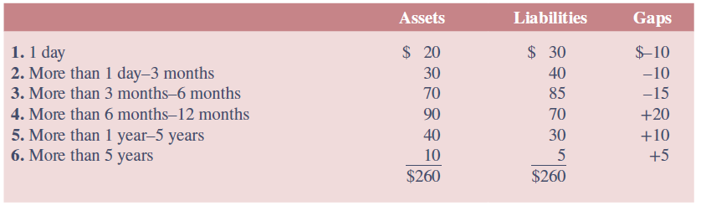
Repricing Gaps for an FI
©McGraw Hill LLC. All rights reserved. No reproduction or distribution without the prior written consent of McGraw Hill.
Notes:
5
Table 23–1 shows the assets and liabilities of an FI categorized into six maturity buckets. For simplicity, we assume equity is equal to zero.

Slide 6
Repricing Model (Continued)
Gap in each maturity bucket (or bin) is calculated by estimated the difference between the rate-sensitive assets (RSAs) and the rate-sensitive liabilities (RSLs)
  Rate sensitivity is the time to repricing of an asset or liability
Repricing model measures the change in an FI’s net interest income exposure (or profit exposure) to interest rate changes in each different maturity bucket
  Negative gap (where RSA < RSL) exposes the FI to refinancing risk, the risk that the cost of rolling over or reborrowing funds will rise above the returns being earned on asset investments
  A positive gap (where RSA > RSL) exposes the FI to reinvestment risk, the risk that the returns on funds to be reinvested will fall below the cost of the funds
©McGraw Hill LLC. All rights reserved. No reproduction or distribution without the prior written consent of McGraw Hill.
Notes:
6
Note that repricing could be the result of a rollover of an asset or liability, or it can occur if the asset of liability is a variable-rate instrument.

Slide 7

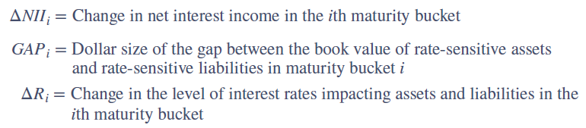
Change in Net Interest Income
Change in net interest income in the ith maturity bucked is calculated as follows:
©McGraw Hill LLC. All rights reserved. No reproduction or distribution without the prior written consent of McGraw Hill.
Notes:
7

Slide 8
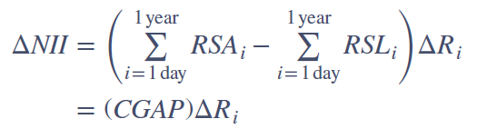
Cumulative Gaps (CGAP)
FI manager can also estimate cumulative gaps (CGAP) over various repricing categories or buckets
  Common CGAP of interest is the one-year repricing gap
Cumulative effect on a bank’s net interest income may be estimated using:
CGAP effect is the relation between changes in interest rates and changes in net interest income
©McGraw Hill LLC. All rights reserved. No reproduction or distribution without the prior written consent of McGraw Hill.
Notes:
8

Slide 9
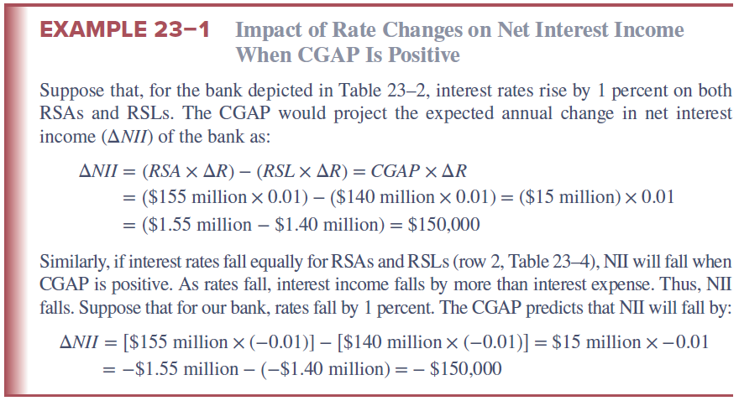
Impact of Rate Changes on Net Interest Income When CGAP is Positive
©McGraw Hill LLC. All rights reserved. No reproduction or distribution without the prior written consent of McGraw Hill.
Notes:
9

Slide 10
Spread Effect
Spread effect is the effect that a change in the spread between rates on RSAs and RSLs has on net interest income (NII) as interest rates change
In general, the spread effect is such that, regardless of the direction of the change in interest rates, a positive relation exists between changes in the spread (between rates on RSAs and RSLs) and changes in NII
When the spread increases (decreases), NII increases (decreases)
©McGraw Hill LLC. All rights reserved. No reproduction or distribution without the prior written consent of McGraw Hill.
Notes:
10

Slide 11
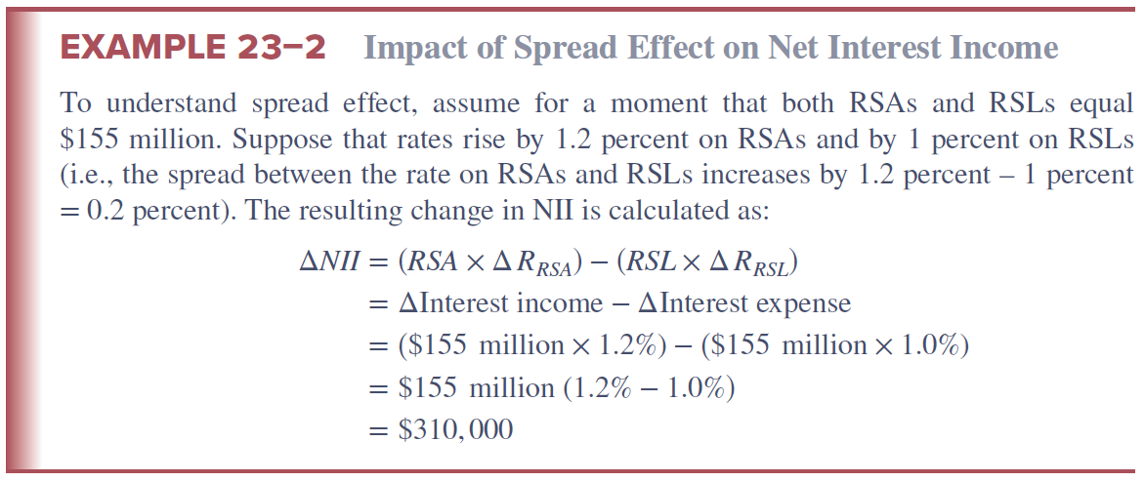
Impact of Spread Effect on Net Interest Income
©McGraw Hill LLC. All rights reserved. No reproduction or distribution without the prior written consent of McGraw Hill.
Notes:
11

Slide 12
Weaknesses of the Repricing Model
Repricing model has four major weaknesses
  It ignores market value effects of interest rate changes
    Repricing gap is only a partial and short-term measure of overall interest rate exposure
  It ignores cash flow patterns within a maturity bucket
    On average, liabilities may be repriced toward the end of the bucket’s range and assets may be repriced toward the beginning
  It fails to deal with the problem of rate-insensitive asset and liability cash flow runoffs and prepayments
    FI receives runoff from its rate-insensitive portfolio that can be reinvested at current market rates
  It ignores cash flows from off-balance-sheet (OBS) activities
    Changes in interest rates will affect the cash flows on many OBS instruments, as well as those listed on the balance sheet
©McGraw Hill LLC. All rights reserved. No reproduction or distribution without the prior written consent of McGraw Hill.
Notes:
12

Slide 13

Duration Gap Model
Duration measures the interest rate sensitivity of an asset or liability’s value to small changes in interest rates
Duration gap is a measure of overall interest rate risk exposure for an FI
To estimate the overall duration gap of an FI:
  Determine the duration of an FI’s asset portfolio (A) and the duration of its liability portfolio (L)
  Calculate the market value weighted average of the duration of the assets (or liabilities) in the portfolio
©McGraw Hill LLC. All rights reserved. No reproduction or distribution without the prior written consent of McGraw Hill.
Notes:
13

Slide 14



Duration Gap Model (Continued)
The dollar change in the market value of the asset portfolio for a change in interest rates is:
Similarly, the dollar change in the market value of the liability portfolio for a change in interest rates is:
Rearranging and combining these equations results in a measure of the change in the market value of equity:
©McGraw Hill LLC. All rights reserved. No reproduction or distribution without the prior written consent of McGraw Hill.
Notes:
14

Slide 15
Duration Gap Model (Concluded)
Effect of interest rate changes on the market value of an FI’s equity or net worth (∆E) breaks down into three effects:
  Leverage-adjusted duration gap = D_{A} – kD_{L}
    Measured in years and reflects degree of duration mismatch in an FI’s balance sheet
    The larger this gap in absolute terms, the more exposed the FI is to interest rate risk
  Size of the FI
    A measures the size of the FI’s assets; the larger the asset size, the larger the dollar size of the potential net worth exposure from any given interest rate shock
  Size of the interest rate shock = ∆R/(1 + R)
    The larger the shock, the greater the FI’s exposure
©McGraw Hill LLC. All rights reserved. No reproduction or distribution without the prior written consent of McGraw Hill.
Notes:
15

Slide 16
Fannie Mae Duration Gap
©McGraw Hill LLC. All rights reserved. No reproduction or distribution without the prior written consent of McGraw Hill.
Notes:
16
Table 23–6 shows the duration gap and the market value impact on Fannie Mae’s net portfolio for interest rate shocks for the three months ended December 31, 2022, and the three months ended December 31, 2021. For both periods, the effective duration gap was approximately zero months.

Slide 17
Difficulties in Applying the the Duration Model to Real-World FI Balance Sheets
Duration matching can be costly
  Critics claim that restructuring the balance sheet can be time-consuming and costly
  Note that this argument isn’t as true today as is has been in the past, given the growth of purchased funds, asset securitization, and loan sales markets have eased the speed and lowered the transaction costs of major balance sheet restructurings
Immunization is a dynamic problem
  The duration of assets and liabilities changes as they approach maturity, and the rate at which their durations change through time may not be the same on the asset and liability sides of the balance sheet
Large interest rate changes and convexity
  Convexity is the degree of curvature of the price-yield curve around some interest rate level
©McGraw Hill LLC. All rights reserved. No reproduction or distribution without the prior written consent of McGraw Hill.
Notes:
17

Slide 18
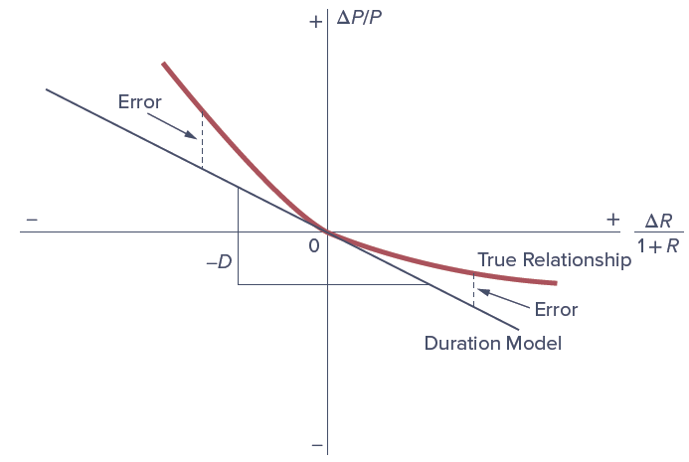
Duration Estimated versus True Bond Price
©McGraw Hill LLC. All rights reserved. No reproduction or distribution without the prior written consent of McGraw Hill.
Notes:
18
As Figure 23–2 shows, in actuality, the capital loss effect of rate increases tends to be smaller than the capital gain effect of rate decreases. This is the result of the bond’s price–yield relationship exhibiting a property called convexity rather than linearity, as assumed by the basic duration model (see the more detailed discussion in Chapter 3).

Slide 19
Insolvency Risk Management
To ensure survival, an FI manager must protect against the institution against the risk of insolvency
The primary means of protection against the risk of insolvency and failure is an FI’s equity capital
  Capital is also a source of funds
  Capital is a necessary requirement for growth under existing minimum capital-to-asset ratios set by regulators
FI managers often prefer low levels of capital in order to generate a higher return on equity (ROE) for stockholders
  The moral hazard problem of deposit insurance exacerbates this tendency
  Strategy results in a greater chance of insolvency
©McGraw Hill LLC. All rights reserved. No reproduction or distribution without the prior written consent of McGraw Hill.
Notes:
19

Slide 20
Insolvency Risk Management (Continued)
Capital Purchase Program, part of the Troubled Asset Relief Program (TARP) of 2008-2009, was designed to encourage U.S. FIs to build capital to increase the flow of financing to U.S. businesses and consumers and to support the U.S. economy
  Under the program, the Treasury purchased over $205 billion in senior preferred stock issued by FIs
  In addition to capital injections received as part of the CPP, TARP provided additional emergency funding to Citigroup ($25 billion) and Bank of America ($20 billion)
  Through December 2019, $245 billion of TARP capital injections had been allocated to DIs, of which $239.8 billion had been paid back, along with a return of $35.8 billion in dividends and assessments
©McGraw Hill LLC. All rights reserved. No reproduction or distribution without the prior written consent of McGraw Hill.
Notes:
20

Slide 21
Capital
The economic meaning of capital is net worth, the difference between the market value of an FI’s assets and the market value of its liabilities
  Essentially a market value accounting concept
  The market value or mark-to-market value basis uses balance sheet values that reflect current rather than historical prices
Regulatory- and accounting-defined capital and required leverage ratios are based in whole or in part on historical or book values (BV) accounting concepts
  Book value is the value of assets and liabilities based on their historical costs
©McGraw Hill LLC. All rights reserved. No reproduction or distribution without the prior written consent of McGraw Hill.
Notes:
21
Equity capital has many definitions: an economist’s definition of capital may differ from an accountant’s definition, which in turn may differ from a regulator’s definition.

Slide 22
Market Value of Capital
The market value of capital and credit risk
  Declines in current and expected future cash flows on assets lowers the market value of the FI’s asset portfolio
  Decreases in the MVs of assets are charged directly against the equity owners’ capital or net worth
  Liability holders are only hurt when losses on the asset portfolio exceed FI’s net worth
  Capital acts as “insurance”, protecting liability holders against insolvency risk
The market value of capital and interest rate risk
  Rising interest rates reduce the market value of the FI’s long-term securities and loans, while floating-rate instruments find their market values largely unaffected if interest rates on such securities are instantaneously reset
©McGraw Hill LLC. All rights reserved. No reproduction or distribution without the prior written consent of McGraw Hill.
Notes:
22

Slide 23
The Book Value of Capital
Book value (BV) of capital is the difference between the BV of assets and the BV of liabilities
BV of capital usually comprises the following three components in banking:
  Par value of shares – the face value of the common shares issued by the FI times the number of shares outstanding
  Surplus value of shares – the difference between the price the public paid for common shares when originally offered and their par values, times the number of shares outstanding
  Retained earnings – the accumulated value of past profits not yet paid in dividends to shareholders
    Since these earnings could be paid in dividends, they are part of the equity owners’ stake in the FI
©McGraw Hill LLC. All rights reserved. No reproduction or distribution without the prior written consent of McGraw Hill.
Notes:
23

Slide 24
The Book Value of Capital (Continued)
Book value of capital and credit risk
  Managers of FIs may resist writing down the values of bad assets as long as possible to try to present a more favorable picture to depositors, shareholders, and regulators
  FI managers can selectively sell assets to inflate their reported capital
  Only pressure from auditors and regulators may force loss recognition and write-downs of the values of problem assets
Book value of capital and interest rate risk
  Failure of BV accounting systems to recognize the impact of interest rate risk is extreme relative to their partial and lagged recognition of credit risk problems
©McGraw Hill LLC. All rights reserved. No reproduction or distribution without the prior written consent of McGraw Hill.
Notes:
24

Slide 25
Discrepancy between the Market and Book Values of Equity
Degree to which the BV of an FI’s capital deviates from its true economic market value depends on a number of factors, especially:
  Interest rate volatility – the higher the interest rate volatility, the greater the discrepancy
  Examination and enforcement – the more frequent are on-site and off-site examinations and the stiffer the examiner/regulator standards regarding charging off problem loans, the small the discrepancy
  Asset trading – the more assets that are traded, the easier it is to assess the true MV of the asset portfolio
Market-to-book ratio shows the discrepancy between the stock market value of an FI’s equity and the book value of its equity
©McGraw Hill LLC. All rights reserved. No reproduction or distribution without the prior written consent of McGraw Hill.
Notes:
25
The higher the market-to-book ratio, the more the book value of capital understates an FI’s true equity or economic net worth position as perceived by investors in the capital market. If the market-to-book value is less than 1, the FI’s equity is perceived by investors in the stock market to be worth less than the book value of its capital.

Slide 26
Market-to-Book Value Ratios for U.S. DIs
©McGraw Hill LLC. All rights reserved. No reproduction or distribution without the prior written consent of McGraw Hill.
Notes:
26
Table 23–14 lists the market-to-book ratios for selected U.S. depository institutions as of December 31, 2022. The values range from a low of 0.53 times for Citigroup to 20.28 times for Charles Schwab.

Slide 27
Arguments Against Market Value Accounting
Arguments against market value accounting include the following:
  Difficult to implement
    Especially true for small commercial banks and thrifts with large amounts of nontraded assets, such as small loans, in their balance sheets
    When market prices or values for assets cannot be determined accurately, marking to market may be done only with error
  Introduces unnecessary degree of variability into FI’s reported earnings – and thus net worth – because paper capital gains and losses on assets are passed through the income statement
  FIs are less willing to accept longer-term asset exposures if these assets must be continually marked-to-market to reflect changing credit quality and interest rates
©McGraw Hill LLC. All rights reserved. No reproduction or distribution without the prior written consent of McGraw Hill.
Notes:
27

