Slide 1
MAT 304 Data Analysis & Reporting
Chapter 1 -What is Business Research?
Assist.Prof. Dr. Duygu GÜR

Slide 2
Objectives of the unit- What is business research?
Understand the meaning of research.
Distinguish between different kinds of researches.
Understand the importance, need and significance of the research.
Define the importance of ethics in business research.
Understand research design and the process of research design.
Formulate a research problem and state it as a hypothesis.

Slide 3
What is Research ?
Research is a process to discover new knowledge to find answers to a question.
The word research has two parts RE (AGAIN) and SEARCH (FIND)
which denote that we are taking up an activity to look into an aspect once again or we want to look for some new information about something
The process of finding solutions to a problem after a thorough study and analysis of the situational factors.
The research comprises defining and redefining problems, formulation of hypothesis; collection, organizing and evaluation of data; and reaching conclusions !
Research is a process of systematic inquiry that entails collection of data; documentation of critical information; and analysis and interpretation of that data/information, in accordance with suitable methodologies set by specific professional fields and academic disciplines.

Slide 4
Research is conducted to...
Evaluate the validity of a hypothesis or an interpretive framework.
To gather a body of fundamental information and conclusions for sharing in appropriate formats.
To help generate questions for further inquiries.

Slide 5
Criterias of research
is undertaken by making a framework within certain philosophies;
Philosophy here means approach e.g. qualitative, quantitative and the academic discipline in which you have been trained.
makes use of procedures, methods and techniques that have been tested for their validity and reliability;
Validity means that correct procedures have been applied to find answers to a question.
Reliability refers to the quality of a measurement procedure that provides repeatability and accuracy.
has been planned to be unbiased and objective :
you have taken each step in an unbiased manner and drawn each conclusion to the best of your ability and without introducing your own vested interest. The researcher does not change / attempt to change the procedure as per his/ her understanding of facts and information.

Slide 6
What is Business Research?
How managers use research?
Managers in organizations constantly engage themselves in studying and analyzing issues and hence are involved in some form of research activity as they make decisions at the workplace.
To be successful manager it is important for you to know how to go about making the right decisions by being knowledgeable about the various steps involved in finding solutions to problematic issues.

Slide 7
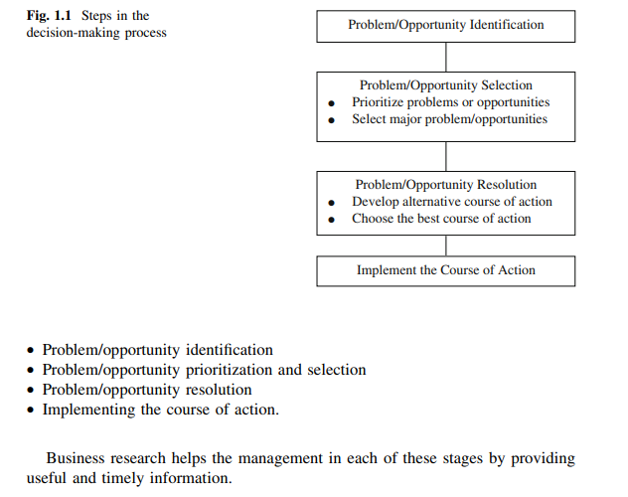
Role of Business Research in Decision Making

Slide 8
Some Commonly Researched Areas in Business
1. Employee behaviors such as performance, absenteeism, and turnover.
2. Employee attitudes such as job satisfaction, loyalty, and organizational commitment.
3. Supervisory performance, managerial leadership style, and performance appraisal systems.
4. Employee selection, recruitment, training, and retention.
5. Validation of performance appraisal systems.
6. Human resource management choices and organizational strategy.
7. Evaluation of assessment centers.
8. The dynamics of rating and rating errors in the judgment of human performance.
9. Strategy formulation and implementation.
10. Just-in-time systems, continuous-improvement strategies, and production efficiencies.
11. Updating policies and procedures in keeping with latest government regulations and organizational changes.
12. Organizational outcomes such as increased sales, market share, profits, growth, and effectiveness.
13. Brand loyalty, product life cycle, and product innovation.
14. Consumer complaints.
15. Impression management, logos, and image building.
16. Product positioning, product modification, and new product
development.
17. Cost of capital, valuation of firms, dividend policies, and investment decisions.
18. Keeping ahead of the competition in the new millennium.

Slide 9
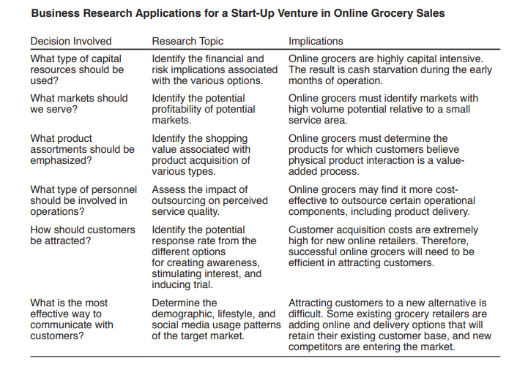

Slide 10
TYPES OF BUSINESS RESEARCH: APPLIED AND BASIC
Basic / Pure / Fundamental Research
Applied Research

Slide 11
1. Basic Research
It is more focused on creating scientific knowledge and predictions for further studies
The aim is to generate a body of knowledge by trying to comprehend how certain problems that occur in organizations can be solved
It enhances the understanding of certain problems that commonly occur in organizational settings and seek methods of solving them.
The findings of such research contribute to the building of knowledge in the various functional areas of business. Such knowledge generated is usually later applied in organizational settings for problem solving.
For example, Coca-Cola may want to know why Pepsi is gaining market share in Paris.

Slide 12
Examples of basic research
A study looking at how alcohol consumption impacts the brain
A study to discover the components making up human DNA
A study accessing whether stress levels make people more aggressive
A study looking to see if gender stereotypes lead to depression
A study searching for the causative factors of cancer
A study on the growth process of oak trees
A study seeing what areas of the United States have the most rain
A study examining whether a vegetarian diet is healthier than one with meat
A study on the various types of kiwis grown in Chile

Slide 13
2. Applied Research
Applied research is a type of examination looking to find practical solutions for existing problems
to solve a current problem faced by the manager in the work setting, demanding a timely solution.
For example, a particular product may not be selling well and the manager might want to find the reasons for this in order to take corrective action.
Research done with the intention of applying the results of the findings to solve specific problems currently being experienced in the organization is called applied research.
For example, why are people drinking more bottled water and less cola?

Slide 14
Examples of applied research
A study on how to improve illiteracy in teenagers
A study looking for ways to market products for millennials
A study trying to decrease fraud on social media platforms
A study searching for ways to encourage high school graduates to attend college
A study to find ways to make car tires last longer
A study exploring ways to cook gluten-free meals with a limited budget
A study on how to treat patients with insomnia
A study looking for ways to improve patient retention at a dentist's office
A study providing solutions for how to train dogs to stay in their yard

Slide 15
Key Differences between Basic and Applied Research
a) Basic Research can be explained as research that tries to expand the already existing scientific knowledge base. On the contrary, applied research is used to mean the scientific study that is helpful in solving real-life problems.
b) While basic research is purely theoretical, applied research has a practical approach.
c) The applicability of basic research is greater than the applied research, in the sense that the former is universally applicable whereas the latter can be applied only to the specific problem, for which it was carried out.
d) The primary concern of the basic research is to develop scientific knowledge and predictions. On the other hand, applied research stresses on the development of technology and technique with the help of basic science.
e) The fundamental goal of the basic research is to add some knowledge to the already existing one. Conversely, applied research is directed towards finding a solution to the problem under consideration.

Slide 16
Basic or Applied Research?
General Electric Company generates knowledge concerning the different applications of electrical energy, their motto being “We bring good things to life.” Computer companies in the Silicon Valley are constantly engaged in generating the know-how to increase the usefulness of microcomputers in industry, which benefits managers and technicians in all organizations. This, ultimately, results in increased sales of computers for them.

Slide 17
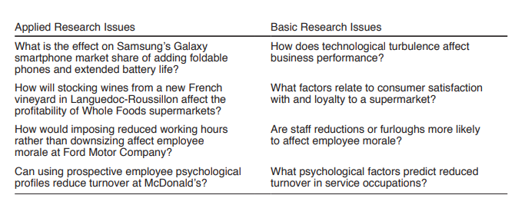

Slide 18
Basic or Applied Research?
How does the human memory work?
A study to improve classroom interaction between teachers and students.
An investigation to determine the side effects of alcohol consumption.
An investigation into the symptoms of diarrhea.
How do panic attacks happen?
What are the ways to improve employees’ productivity in the workplace?

Slide 19
Basic or Applied Research?
Reasons for Absenteeism
A university professor wanted to analyze in depth the reasons for absenteeism of employees in organizations. Fortunately, a company within 20 miles of the campus employed her as a consultant to study that very issue.
Effects of Nasal Spray on Flu
A research scientist surveys 1,000 employees in different organizational settings to study the efficacy of several types of nasal sprays in controlling the flu virus. He subsequently publishes his findings in a highly respected medical journal.

Slide 20
Basic or applied research?
A team of researchers is conducting a study on the effectiveness of a new drug in treating a rare disease. The study involves administering the drug to a group of patients with the disease and comparing their outcomes to a control group that receives a placebo. The researchers collect data on the patients' symptoms, as well as any side effects of the drug
.

Slide 21
In sum, being knowledgeable about research and research methods helps Professional managers to:
1. Identify and effectively solve minor problems in the work setting.
2. Know how to discriminate good from bad research.
3. Appreciate and be constantly aware of the multiple influences and multiple
effects of factors impinging on a situation.
4. Take calculated risks in decision making, knowing full well the probabilities
associated with the different possible outcomes.
5. Prevent possible vested interests from exercising their influence in a situation.
6. Relate to hired researchers and consultants more effectively.
7. Combine experience with scientific knowledge while making decisions

Slide 22
Careers that use basic research and applied research
Researcher: A researcher may use basic research to analyze trends and, depending on the industry they work in, they may work to find a solution to a problem through the use of applied research.
Psychologists: Basic research helps psychologists understand different types of mental health conditions, while applied research can help them find possible solutions to help their patients cope with these conditions.
Market research analysts: Market research analysts use basic research to help predict sales trends and use applied research to come up with new ways to collect data from customers to use for market strategies.
Research assistant: Like researchers, a research assistant may use basic research when looking to expand knowledge in an area of study and applied research when looking to find a resolution to a problem.
Sociologists: A sociologist often uses basic research when trying to learn more about a particular group of people, such as middle schoolers, in their settings and may also use applied research to find solutions to problems a group faces.

Slide 23
Ethics in Business Research
Ethics refers to the moral principles that govern a person’s behavior or the conduct of an activity.
In business research, ethics are essential to ensure that research is conducted in a fair and just manner that protects the rights of all participants.

Slide 24
Why Ethics in Business Research is Important:
Protecting Participants: ensuring that participants are not subjected to any harm or discomfort during the research process. Researchers have a responsibility to obtain informed consent from participants, protect their privacy, and maintain confidentiality.
Ensuring Validity of Results: using appropriate research methods, avoiding bias, and ensuring that the research design is free from errors.
Maintaining Credibility: being transparent about the research process, acknowledging any potential conflicts of interest, and reporting the findings accurately.
Compliance with Regulations: obtaining ethical clearance from institutional review boards and complying with legal requirements related to data protection, privacy, and confidentiality.
Social Responsibility: conducting research in a way that is socially responsible and considering the impact of the research on society.

Slide 25
A case study on ethics in business research
Company Background:
Company X is a global corporation that specializes in the production and distribution of personal care and beauty products. As part of its research and development efforts, the company conducts various studies to identify consumer preferences and market trends. One of these studies was recently conducted to identify the consumer demand for eco-friendly packaging.

Slide 26
Ethical Standards of Company X’ s business research
Informed Consent: The research team obtained informed consent from the participants before conducting the study. The participants were informed of the purpose of the study, how their data would be used, and their right to withdraw from the study at any time.
Confidentiality: The research team ensured that the data collected from the participants was kept confidential. The data was only accessible to the research team members and was not shared with any third parties.
Data Protection: The research team complied with legal requirements related to data protection, privacy, and confidentiality. The team ensured that the data collected from the participants was stored securely and was only accessible to authorized personnel.
Avoiding Bias: The research team took measures to avoid bias in the study. For example, the survey questions were designed to be neutral, and the participants were selected randomly to ensure a representative sample.
Compliance with Regulations: The research team obtained ethical clearance from institutional review boards and complied with legal requirements related to research.

Slide 27
Analysis of the case
Company X's business research was conducted with a high level of ethical standards. The research team obtained informed consent from the participants and ensured that their data was kept confidential and protected. The team also took measures to avoid bias in the study and complied with legal requirements related to research.
However, there are a few areas where the research could have been improved with stronger ethical practices:
For example, the research team could have been more transparent about the purpose of the study and how the results would be used. Additionally, the team could have informed the participants of any potential conflicts of interest related to the study.

