Slide 1
Retailers, Wholesalers, and Direct Marketers

Slide 2
Objectives
Explain the wheel of retailing (a hypothesis explaining the development cycle in retail industry introduced by McNair from Harvard University).
Describe the five key strategies for selecting target markets.
Describe how the four elements of the marketing mix apply/refer to retailing strategy.
Explain the concepts of retail convergence and scrambled merchandising**.
*Retail Convergence is the ability of a marketer to establish a relationship with their consumers and persuade them to purchase their products/service by creating engaging omni-channel experiences (An omnichannel customer experience is made up of individual customer touch points, over a variety of channels that seamlessly connect, allowing customers to pick up where they left off on one channel and continue the experience on another, i.e. Starbucks is widely recognized as the leading champion in omni-channel experiences. Their app provides a seamless user experience where customers can pay with a Starbucks card, physical card, or through the mobile app. They've earned their place at the top with so many touch points available to their customer.).
**Scrambled Merchandising refers to a retail tactic in which a retailer broadens their assortment to include items that are generally outside their focus or are usually sold in a different retail format.

Slide 3
Objectives
Describe the three functions performed by wholesaling intermediaries.
Describe the two major types of independent wholesaling intermediaries and the appropriate situations for using each.
Describe the six basic types of direct marketing and non-store retailing.
Explain how the Internet has altered/changed the retailing, wholesaling, and direct marketing environments.

Slide 4
Retailing
Activities involved in selling merchandise to ultimate/final consumers
Large and small retailers perform the major channel activities:
  Creating time, place, and ownership utilities
Retailers act as both customers and marketers in their channels

Slide 5
Evolution/Progress of Retailing
The general store (a retail store located usually in a small or rural community that carries a wide variety of goods including groceries but is not divided into departments) – First type of retail institution
Rise of supermarkets in the early 1930s
Discount stores in the 1950s
Convenience stores in the 1960s
Off-price retailers in the 1980s and 1990s

Slide 6
Evolution of Retailing
Wheel of retailing - Hypothesis that each new type of retailer gains a competitive foothold/bridgehead by offering lower prices than current suppliers charge, the result of reducing or eliminating services (cost).

Slide 7
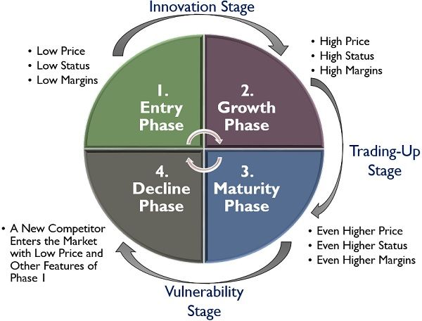
Wheel of Retailing Theory
The wheel of retailing theory explains the life cycle of a retail organization and the different levels through which it passes. The life of a business is divided into four quadrilaterals

Slide 8
Quad 1: Entry
The initial phase of the wheel of retailing is when the organization enters the market with limited products at a very reasonable price, keeping a low margin.
Since the business entity still needs to build its reputation at this stage, and the consumers are not very much aware of the organization.
Moreover, the organization provides minimal services and the infrastructure used is usually low cost and temporary. Thus, at this level, the company tries to penetrate the market with a low-price strategy.
Quad 2: Growth
With the low-price strategy, the organization can build its reputation in the market. At this level, the retailer can adopt growth strategies like slightly hiking the price of the products, widening the product category, upgrading the store and providing additional services.
This is the phase where the organization can keep a better margin since more and more consumers prefer to buy the products. Now, the retailer concentrates on the other aspects of competitiveness, rather than price.

Slide 9
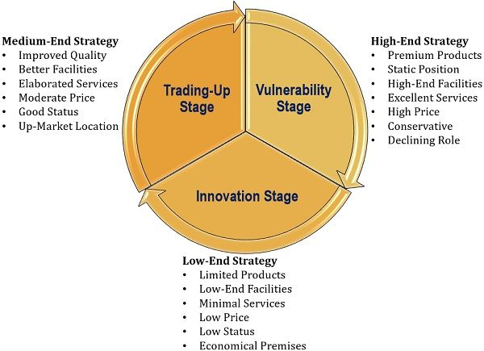
Wheel of Retailing Strategies
Quad 3: Maturity
At this phase, the organization has gained a high reputation and established itself as a well-known business entity. Now, the business is unable to acquire more new consumers, also the customer turnover increases.
Therefore, the retailer’s main area of concern at the maturity level is customer loyalty and retention by enhancing their satisfaction level.
Quad 4: Decline
This is the level where the business starts going down. The other firms enter the market with their low-priced competitive products, to drag customer’s attention. In no time, the competitor’s products take over the market, and the organization tend to lose its customers.
Thus, the organization now plans to revive the business through divestment, merger, acquisition and other strategic alliance (https://theinvestorsbook.com/wheel-of-retailing.html , Accessed 12/11/2020).

Slide 10
Retailing Strategy
Retailers base key decisions on two fundamental steps in the marketing strategy process
  Selecting a target market
  Developing a retailing mix to satisfy the chosen market

Slide 11
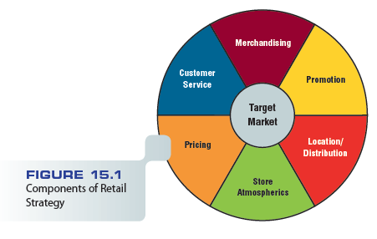
Figure 15.1 – Components of Retail Strategy

Slide 12
Selecting a Target Market
Size of the market
Profit potential of the market
Level of competition

Slide 13
Merchandising Strategy
Guides/leads retailer’s decisions on the items it will offer
While developing the merchandise mix, retailers should consider:
  Needs and preferences of its target market
  The competitive environment
  Overall profitability of each product line and category

Slide 14
Category Management
Seeks to improve retailer’s product performance through coordinated buying, merchandising, and pricing
Evaluates performance according to each product category
Categories that underperform (to fail to do as well as expected) may be dropped/eliminated even if they are strong brands

Slide 15
The Battle for Shelf Space
Proliferation/accrual of new products and variations on existing ones has increased the competition for shelf space
Stock-keeping unit (SKU) - Offering within a product line

Slide 16
The Battle for Shelf Space
Major retailers increasingly make demands from manufacturers in return for shelf space
  Slotting allowances (a fee paid by a manufacturer to a supermarket chain for shelf space for a new product; also referred to as the Stocking Allowance, Introductory Allowance, Shelf Fee or Street Money) - Nonrefundable fees grocery retailers receive from manufacturers to secure shelf space for new products

Slide 17
Customer Service Strategy
Heightened/improved customer service is one possible retailing strategy
The goal is to attract and retain target customers to increase sales and profits
Some services that retailers could provide:
  Enhanced comfort through lounges/waiting areas, complimentary/free coffee, convenient/favorable restrooms
  Child-care services for customers
  Virtual assistance programs (An intelligent virtual assistant (IVA) or intelligent personal assistant (IPA) is a software agent that can perform tasks or services for an individual based on commands or questions).

Slide 18
Pricing Strategy
Prices reflect a retailer’s marketing objectives and policies
They affect consumer perceptions (of quality)

Slide 19
Markups and Markdowns
Markup - Amount a retailer adds to the cost of a product to determine its selling price
Markup is influenced by two factors:
  Services performed by the retailer (cost)
  Inventory turnover rate (Inventory turnover is a ratio that measures the number of times inventory is sold or consumed in each time period. Also known as inventory turns, stock turn, and stock turnover, the inventory turnover formula is calculated by dividing the cost of goods sold (COGS) by average inventory).
Markdown - Amount by which a retailer reduces the original selling (the list) price of a product

Slide 20
Location/Distribution Strategy
Location depends on many factors
  Type of merchandise
  The retailer’s financial resources
  Characteristics of the target market
  Site/location availability

Slide 21
Locations in Planned Shopping Centers
Planned shopping center - Group of retail stores planned, coordinated, and marketed as a unit
  Includes five main types:
    Neighborhood shopping center
    Community shopping center
    Regional shopping center
    Power center
    Lifestyle center

Slide 22
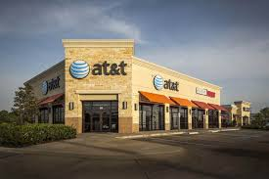
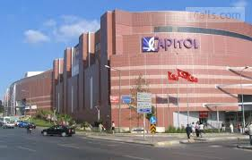
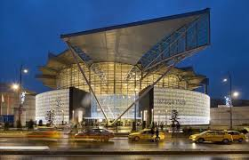
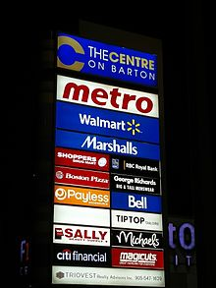
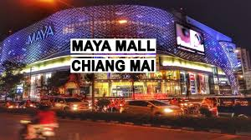

Slide 23
Promotional Strategy
Promotion informs customers about locations, merchandise selections, hours of operation, and prices
Helps retailers attract shoppers and build customer loyalty
National chains purchase advertising in print and broadcast media

Slide 24
Promotional Strategy
Salespeople play an important promotional role
  Selling up (selling -the debtor’s- property to cover debts or
  to sell your house or company in order to go somewhere else or do something else.
  Suggestion/suggestive selling (also known as add-on selling or upselling) is a sales technique where an employee asks a customer if they would like to include an additional purchase or recommends a product which might suit the client).
Poor service can influence customers’ attitudes about a retailer

Slide 25
Store Atmospherics
Atmospherics - Combination of physical characteristics and amenities/means that contribute to a store’s image
Includes exterior and interior décor

Slide 26
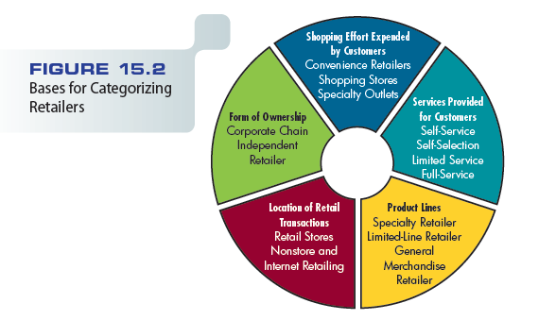
Figure 15.2 – Bases for Categorizing Retailers

Slide 27
Classification of Retailers by Form of Ownership
Chain stores
  Groups of retail outlets that operate under central ownership and management and handle the same product lines
  Volume purchases allow chains to pay lower prices than their independent rivals must pay (Migros, CarrefourSa)

Slide 28
Classification of Retailers by Form of Ownership
Independent retailers
  Generate about $4.7 trillion in retail sales in a recent year
  Traditional advantage is friendly, personalized service (Grocery stores, greengrocers etc.)

Slide 29
Classification by Shopping Effort
Convenience (neighborhood) retailer - Focuses marketing appeals on:
  Accessible locations
  Extended store hours
  Rapid checkout services
  Adequate parking facilities
Shopping stores - Offer potential customers the chance to compare pricing, assortment, and quality levels

Slide 30
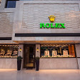
Classification by Shopping Effort
Specialty retailer - Store that combines carefully defined product lines, services, and reputation to:
  Persuade shoppers to spend considerable shopping effort there (authorized dealers for Rolex watch

Slide 31
Classification by Services Provided
Classification system consists of three retail types:
  Self-service
  Self-selection
  Full-service retailers

Slide 32
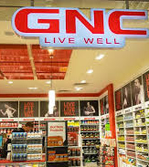
Classification by Product Lines
Specialty stores - Handles only part of a single product line
Label specialty - The practice of handling a specific, narrow line of merchandise

Slide 33
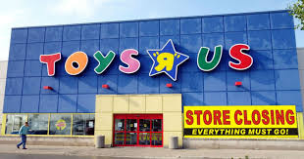
Classification by Product Lines
Limited-line retailers
  Offer a large assortment of products within one product line or a few related lines
  Category killer - Offers huge selections and low prices in single product lines

Slide 34
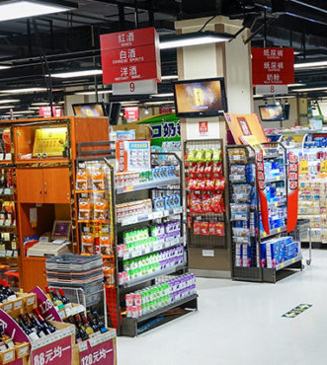
General Merchandise Retailers
General merchandise retailer - Store that carries a wide variety of product lines, stocking all of them in some depth
Variety stores
  Offer an extensive range and assortment of low-price merchandise
  Declining in popularity

Slide 35
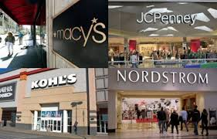
General Merchandise Retailers
Department stores
  A series of limited-line and specialty stores under one roof
  Faced intense competition from discount stores, Internet retailers, and hypermarkets
  Fought back by:
    Eliminating poorly performing lines
    Opening in new locations
    Modernizing their stores

Slide 36
Mass Merchandiser
Store that stocks a wider line of goods than a department store, usually without the same depth of assortment within each line

Slide 37
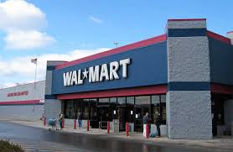
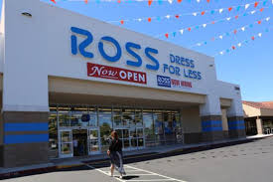
Mass Merchandisers
Four types
  Discount houses - Charge low prices and offer fewer services
  Off-price retailers - Stock only designer labels at prices equal to or below regular wholesale prices and then passes the cost savings along to buyers

Slide 38
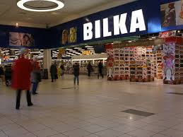
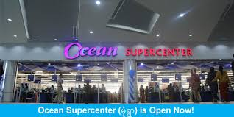
Mass Merchandisers
  Hypermarkets - Giant one-stop shopping facilities that offer wide selections of grocery and general merchandise products at discount prices
  Supercenter - Large store, usually smaller than a hypermarket, that combines groceries with discount store merchandise
  Showroom and warehouse retailers - Send direct mail to their customers and sell the advertised goods from showrooms that display samples

Slide 39
Classification of Retail Transactions by Location
Most retail transactions occur in stores
Nonstore retailing is used for generating orders for both consumer and B2B marketers

Slide 40
Retail Convergence and Scrambled Merchandising
Retail convergence - Situation in which similar merchandise is available from multiple retail outlets
  Resulting in the blurring (not clear) of distinctions between type of retailer and merchandise offered
Scrambled merchandising - Retailing practice of combining dissimilar/unlike product lines to boost sales volume

Slide 41
Wholesaling Intermediaries
Wholesaler - Channel intermediary that takes title to goods it handles and distributes these goods to retailers, other distributors, or B2B customers
Wholesaling intermediary – Comprehensive/broad term that describes wholesalers as well as agents and brokers

Slide 42
Functions of Wholesaling Intermediaries
Creating utility/benefit
  Time utility - Making products available for sale when consumers want to purchase them
  Place utility - Helping deliver goods and services for purchase at convenient locations
  Ownership utility - Smooth exchange of title to the products from producers or intermediaries to final purchasers

Slide 43
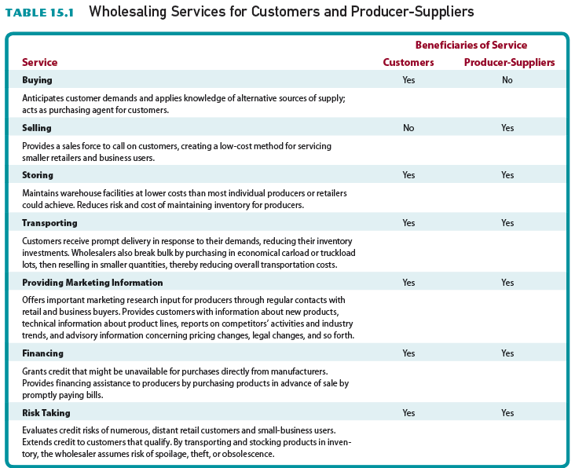
Table 15.1 – Wholesaling Services for Customers and Producer-Suppliers

Slide 44
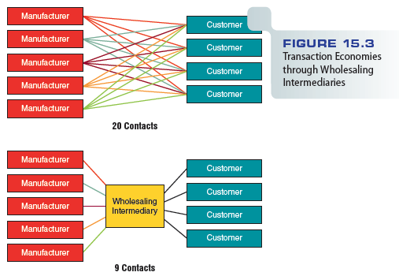
Figure 15.3 – Transaction Economies through Wholesaling Intermediaries

Slide 45
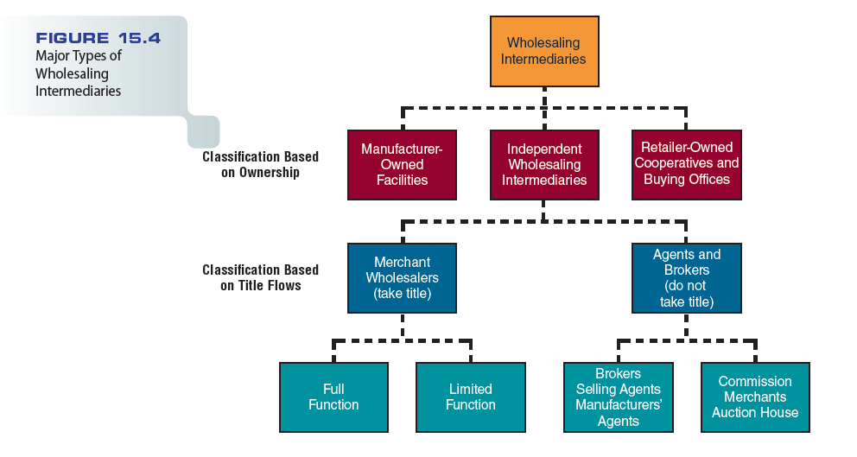
Figure 15.4 - Major Types of Wholesaling Intermediaries

Slide 46
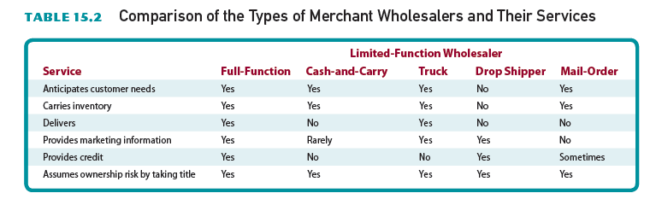
Table 15.2 - Comparison of the Types of Merchant Wholesalers and Their Services

Slide 47
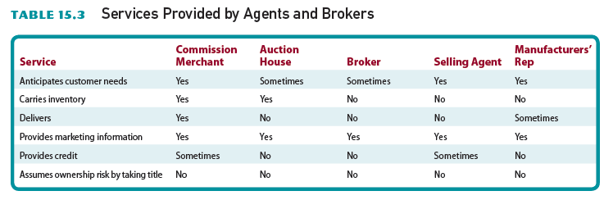
Table 15.3 - Services Provided by Agents and Brokers

Slide 48
Direct Marketing and Other
Nonstore Retailing
Direct marketing - Direct communications, other than personal sales contacts, between buyer and seller, designed to:
  Generate sales, information requests, or store or website visits

Slide 49
Direct Mail
Comes in a variety of forms, including postcards, letters, and catalogs
Can narrowly target a market, achieve good coverage, send messages quickly, and personalize mailing pieces
Relatively high response rates

Slide 50
Direct Mail
High per-reader cost
Effectiveness depends on quality
Considered “junk mail” by some consumers
Relies on database technology
Includes catalog marketing

Slide 51
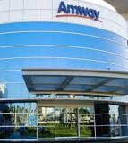
Direct Selling
Manufacturers sell directly to consumers

Slide 52

Direct-Response Retailing
Customers order merchandise by mail or telephone, by visiting a mail-order desk in a retail store, or by computer or fax machine
Increasingly reaching buyers through the Internet and through unique catalogs
Includes home shopping aided by television promotion, such as infomercials

Slide 53

Telemarketing
Direct marketing conducted by telephone
Most frequently used form of direct marketing

Slide 54
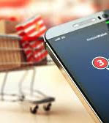
Internet Retailing
Selling directly to consumers via virtual storefronts (virtual showcase)
Internet-based retailers keep little or no inventory
  Fill customer orders directly from vendors
Some traditional brick-and-mortar stores (refers to a traditional street-side business that offers products and services to its customers face-to-face in an office or store that the business owns or rents. The local grocery store and the corner bank are examples of brick-and-mortar) companies have successfully extended their presence to the Web.

Slide 55
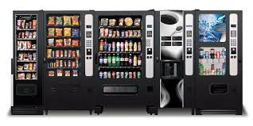
Automatic Merchandising
Uses vending machines to offer a wider variety of goods
As technology advances, high-end products are being sold in vending machines

Slide 56
GaGa SherBetter Video
http://www.cengage.com/marketing/book_content/boone_9781133628460/videos/ch15.html
Scripps Networks Interactive & Food Network Video
http://www.cengage.com/marketing/book_content/boone_9781133628460/videos/part5.html

