Slide 1
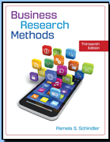
Business Research Methods Thirteenth Edition Pamela S. Schindler
Chapter 4
Stage 2: RESearcH DesigN: AN Overview
introduces the major descriptors and types of research design
©2019 McGraw-Hill Education. All rights reserved. Authorized only for instructor use in the classroom. No reproduction or further distribution permitted without the prior written consent of McGraw-Hill Education.
Notes:
This chapter introduces the major descriptors and types of research design.

Slide 2
Research Thought Leaders
“Good research is about using the right platform for each piece of a study, for each activity or interaction.”
Nick Drew VP Insights and Strategy,
Fresh Intelligence

Slide 3
Learning Objectives
Understand . . .
The tasks that comprise research design.
The types of variable relationships.
The major descriptors of research designs.

Slide 4
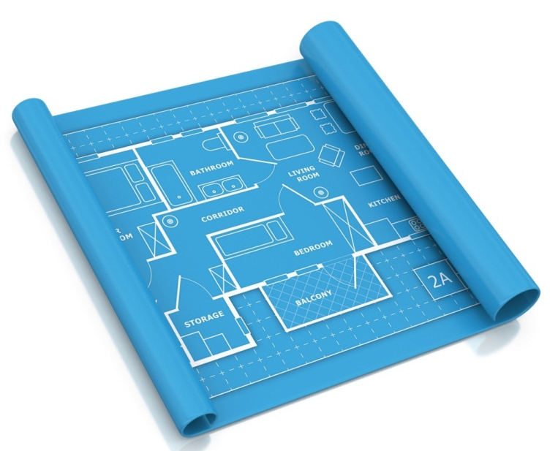
What Is Research Design?
Research design is the blueprint for fulfilling research objectives and answering investigative questions.
Its essentials include
1) an activity and time-based plan= Blueprint
2) a plan based on the research questions= Plan ,
3) a guide for selecting sources and types of information= Guide ,
4) a framework for specifying the relationships among the study’s variables, & 5) a procedural outline for every research activity. = Framework
Notes:
There are many definitions of research design. This slide uses a blueprint for a house to make the connection between planning for space use, plumbing, electrical, etc., to the research design
Photo CREDIT
©Getty Images.

Slide 5
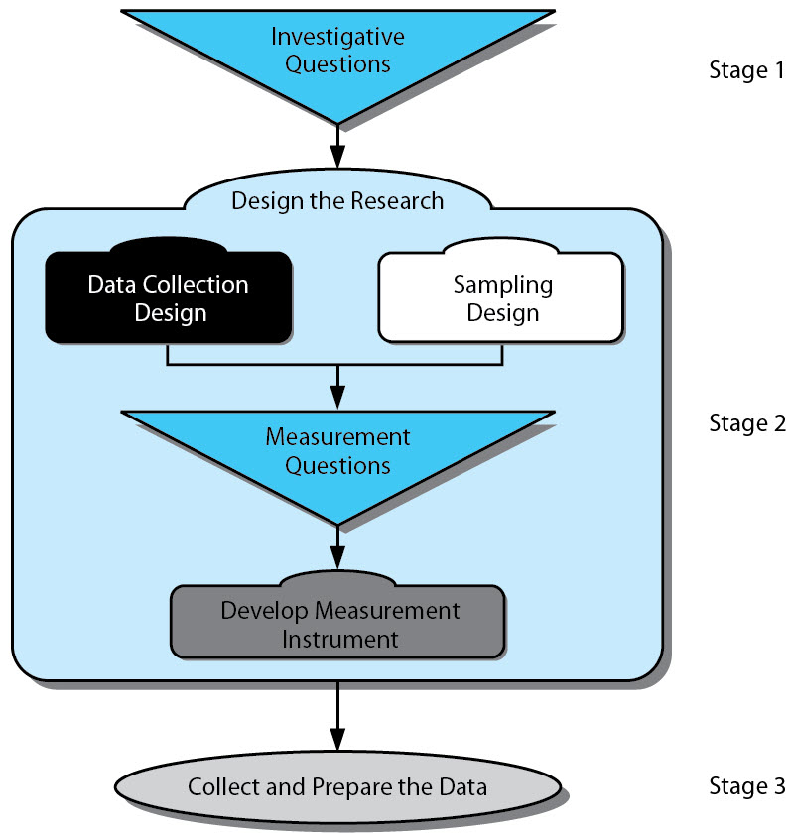
Design the Research
Notes:
Exhibit 4-1 illustrates design in the research process and highlights the topics covered by the term research design. Subsequent chapters will provide more detailed coverage of the research design topics.

Slide 6
Exploratory Study
Exploratory studies are used when the research question is still fluid or undetermined. The goal of exploration is to develop hypotheses or questions for future research.
Formal studies are used when the research question is fully developed and there are hypotheses to be examined.
Qualitative studies, like having participants take pictures and upload them, is an exploratory technique.
Notes:
The degree to which the research question has been crystallized or structured defines two classifications of research.
Exploratory studies are used when the research question is still fluid or undetermined. The goal of exploration is to develop hypotheses or questions for future research. We discussed exploration and exploratory studies extensively in Chapter 3
Formal studies are used when the research question is fully developed and there are hypotheses to be examined.
You may choose to unhide this slide and the next if you believe a review is necessary (right click the slide in the slide panel on the left, click HIDE SLIDE option).
Qualitative studies, like having participants take pictures and upload them, is an exploratory technique.
Photo Credit
mindof/123RF

Slide 7
Some Exploratory Study Methods
Participant observation
Film, photographs
Projective techniques
Case studies
Ethnography
Expert interviews
Document analysis
Notes:
The objectives of exploration may be accomplished with qualitative and quantitative techniques, but exploration relies more heavily on qualitative techniques. Qualitative techniques are non-quantitative data collection used to increase understanding of a topic. Qualitative refers to the meaning, definition, analogy, model, or metaphor characterizing something, while quantitative assumes the meaning and refers to a measure of it.
There are many approaches useful for exploratory investigations of management questions. Several such approaches are listed in the slide. Some techniques were discussed in Chapter 3 and more are introduced in Chapter 7 and Chapter 8.
PHOTO CREDIT
©mindof/123RF
You may choose to unhide this slide and the next if you believe a review is necessary (right click the slide in the slide panel on the left, click HIDE SLIDE option).

Slide 8
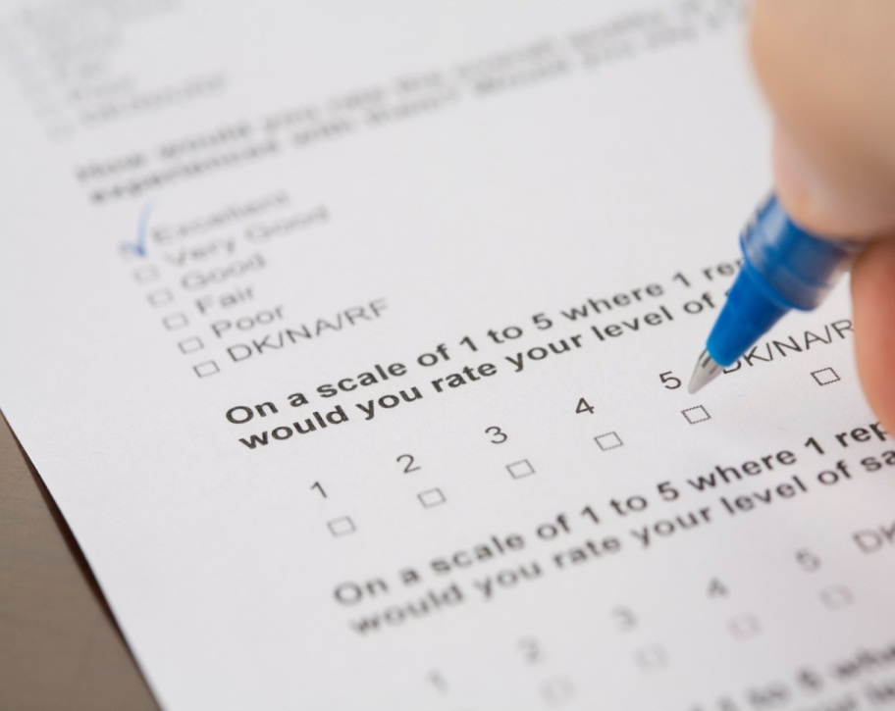
Formal Study
Formal Study
Begins with hypotheses/research questions
Precise procedures for data collection & analysis
Notes:
The degree to which the research question has been crystallized or structured defines two classifications of research.
Exploratory studies are used when the research question is still fluid or undetermined. The goal of exploration is to develop hypotheses or questions for future research. We discussed exploration extensively in Chapter 3
Formal studies are used when the research question is fully developed and there are hypotheses to be examined.
You may choose to unhide this slide and the next if you believe a review is necessary (right click the slide in the slide panel on the left, click HIDE SLIDE option).
PHOTO CREDIT
©enis izgi/Getty Images

Slide 9
Some Formal Study Methods
Self administered surveys
Survey via personal interview
Telephone surveys
True experiments
Pre-experiments
Quasi-experiments
Notes:
The degree to which the research question has been crystallized or structured defines two classifications of research.
Exploratory studies are used when the research question is still fluid or undetermined. The goal of exploration is to develop hypotheses or questions for future research. We discussed exploration extensively in Chapter 3
Formal studies are used when the research question is fully developed and there are hypotheses to be examined.
You may choose to unhide this slide and the next if you believe a review is necessary (right click the slide in the slide panel on the left, click HIDE SLIDE option).
PHOTO CREDIT
©enis izgi/Getty Images.

Slide 10
Sampling Design
A census requires that you take information from all elements of the target population (e.g., drain the blood from a body).
A sample requires that you take only some elements from the target population (e.g., use a drop of blood from a body
Notes:
A census requires that you take information from all elements of the target population (e.g., drain the blood from a body).
A sample requires that you take only some elements from the target population (e.g., use a drop of blood from a body).
PHOTO CREDIT
WLADIMIR BULGAR/Getty Images

Slide 11
Data Collection Design: The Method
Monitoring: collections information by observation from a unit of the target population, either electronic or in person.
Communication: collects information by talking with a member of the target population
Notes:
The dimension of data collection design that most students think cover all aspects is the data collection method. The slides that follow are designed to focus their attention on the other dimensions.
Monitoring collections information by observation from a unit of the target population, either electronic or in person.
Communication collects information by talking with a member of the target population.
Photo credits
LEFT: Shutterstock / Monika Wisniewska
RIGHT: ©Jetta Productions/Blend Images LLC

Slide 12
Objective of the study (highlighted in this slide and the next four slides)
Reporting (who, what, when, where, how—in the past)
Descriptive (who, what, when, where, how—now)
Causal-Explanatory (why, how—now)
Causal-Predictive (what, why, in future)
Researcher’s ability to manipulate variables being studied
• Experimental (ability to manipulate)
• Ex post facto (no ability to manipulate)
The topical scope of the study
• Statistical study (significant breadth, some depth)
• Case study (little breadth, significant depth)
The measurement emphasis of research techniques
• Qualitative (emphasis on measures of meaning)
• Quantitative (emphasis on measures of frequency)
Complexity of design
• Single-methodology study
• Multiple-methodology study
The method of data collection
• Monitoring
• Communication study
The research environment
• Field setting
• Laboratory setting
• Simulation
The time dimension
• Cross-sectional (one measurement at one point in time)
• Longitudinal (many measurements in specified period of time)
The participants’ research awareness of the research activity
Actual routine
Modified routine

Slide 13
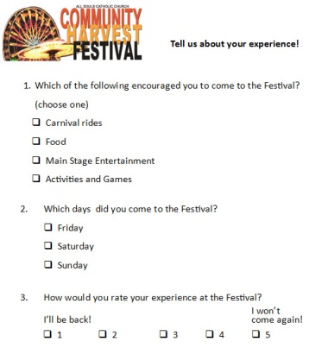
Descriptive Studies
Descriptions of population characteristics
Estimates of frequency of characteristics
Discovery of associations among variables
Notes:
Objective of the study
Reporting (who, what, when, where, how—in the past)
Descriptive (who, what, when, where, how—now)
Causal-Explanatory (why, how—now)
Causal-Predictive (what, why, in future)
PHOTO CREDIT
©Pamela Schindler

Slide 14
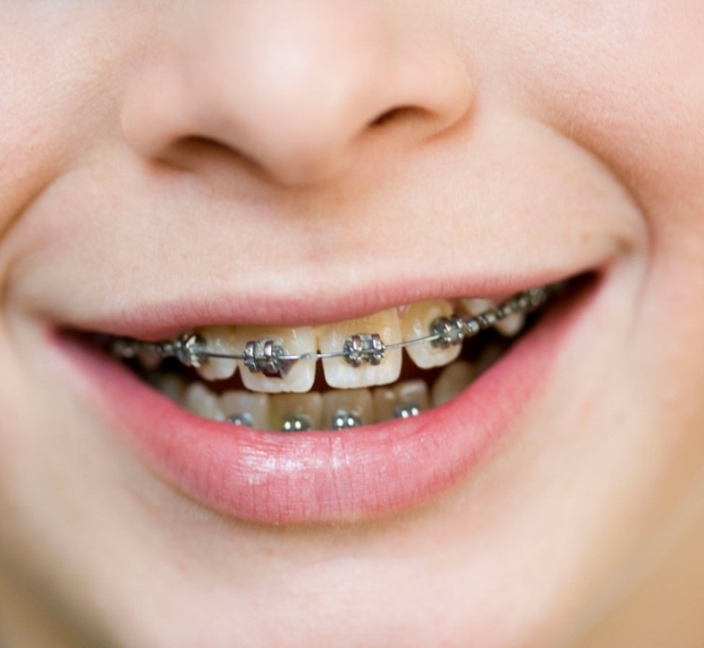
Topical Scope (1 of 2)
Statistical Study
Case Study
Notes:
A statistical study is designed for breadth rather than depth. It attempts to capture a population’s characteristics by making inferences from a sample’s characteristics and then testing resulting hypotheses.
A case study places more emphasis on full contextual analysis of a few events or conditions and their interrelations. Case studies rely on qualitative data and emphasize the use of results for insight into problem-solving, evaluation, and strategy.
PHOTO CREDIT
Left: ©iStockphoto.com/teekid
Right: © Christine Schneider/Brigitte Sporrer / Alamy Stock Photo

Slide 15
Measurement Emphasis (1 of 2)
Qualitative (emphasis on measures of meaning)
On school bullying, this would be to understand the phenomenon.
Quantitative (emphasis on measures of frequency)
On school bullying, this would be to quantify or count incidents, types, etc.
Notes:
Qualitative (emphasis on measures of meaning)
On school bullying, this would be to understand the phenomenon.
Quantitative (emphasis on measures of frequency)
On school bullying, this would be to quantify or count incidents, types, etc.
Photo credit
©Beau Lark/Glow Images.

Slide 16
Measurement Emphasis (2 of 2)
Complexity of design
• Single-methodology study
To study advertising effectiveness in Times Square, a single methodology might do an intercept study of ad recall
• Multiple-methodology study
To study advertising effectiveness in Times Square, a multiple methodology might do an intercept study of ad recall and ad messaging, but also track mobile visits to a website following ad exposure pinging off NYC cell towers.
Notes:
Complexity of design
• Single-methodology study
To study advertising effectiveness in Times Square, a single methodology might do an intercept study of ad recall
• Multiple-methodology study
To study advertising effectiveness in Times Square, a multiple methodology might do an intercept study of ad recall and ad messaging, but also track mobile visits to a website following ad exposure pinging off NYC cell towers.
Photo Credit
©Francisco Diez Photography/Getty Images

Slide 17
Time Dimension
Cross-sectional
Longitudinal
This photo, like a single survey, catches an attitude at a given moment. That’s what a cross-sectional study does.
A study that captures behavior, attitudes, etc. at several moments over time is longitudinal.
Notes:
This photo, like a single survey, catches an attitude at a given moment. That’s what a cross-sectional study does. A study that captures behavior, attitudes, etc. at several moments over time is longitudinal.
PHOTO CREDIT
©Horizon Images/Motion / Alamy Stock Photo.

Slide 18
Measurement Instrument
Tasks:
Determine Measurement Approach
Determine Measurement Questions/ Elements
Order questions or elements
Determine Non-question Elements
Craft measurement Instrument
Determine need for Data Collector Training
Craft training guides or activities
Notes:
A measurement instrument is a tool for collecting data on a study’s variables. There are many different types: survey questionnaires, interview guides, group discussion guides, and observation checklists, to name a few.
The measurement instrument flows from the investigative questions related to the research question/hypothesis.
The measurement Instrument completes research design.

Slide 19
Key Terms
Case study
Causal-explanatory study
Causal-predictive study
Communication study
Cross-sectional study
Descriptive study
Experiment
Longitudinal study
Monitoring study
Multiple-methodology design
Qualitative research
Quantitative research
Reporting study
Research design
Sampling design
Single-methodology design
Statistical study

Slide 20
Snapshot: How Agile Research helped Prove the Value in a Packaging Redesign
“Are consumers more or less likely to buy the new packaging versus the current one?”
Phase 1:
Online qualitative
Phase 2:
Online Survey
Notes:
PHOTO CREDIT
Courtesy of Gut Check and Suja Juice Co.

Slide 21
Snapshot: AIG & Research Design
AIG had an urgent need to demonstrate to shareholders that it could differentiate employee performance.
Virtual Focus Groups by ThinkTank.net
Expert interview with Danny Kahneman
IDIs with HR professionals
Pilot test of new performance management system
Survey after pilot test
Notes:
PHOTO
©John Lund/Drew Kelly/Blend Ima.ges LLCCREDIT

