Slide 2
Topics Covered
19.1 Links Between Long-Term and Short-Term Financing
19.2 Tracing Changes in Cash
19.3 Cash Budgeting
19.5 Dynamic’s Short-Term Financial Plan
Notes:
2

Slide 3
Firm’s Cumulative Capital Requirement
Dollars
A
B
C
Cumulative
capital requirement
Year 1
Year 2
Time
Lines A, B, and C show alternative amounts of long-term finance
Strategy A: A permanent cash surplus
Strategy B: Short-term lender for part of year and borrower for remainder
Strategy C: A permanent short-term borrower

Slide 4
Working Capital
Factors in establishing working capital levels
  Matching maturities
  Permanent working capital requirement
  Maintaining liquidity

Slide 5
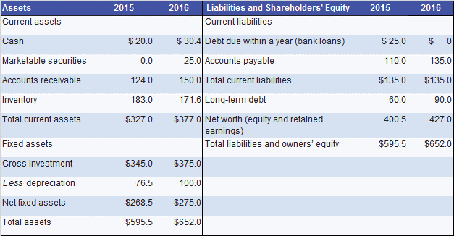
Changes in Cash and W.C. (1 of 5)
Example — Dynamic Mattress Company
Notes:
21

Slide 6
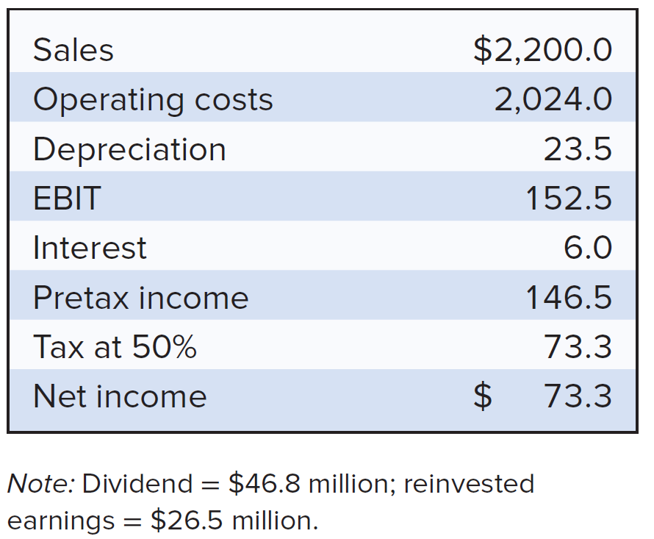
Changes in Cash and W.C. (2 of 5)
Example (continued)
Notes:
22

Slide 7
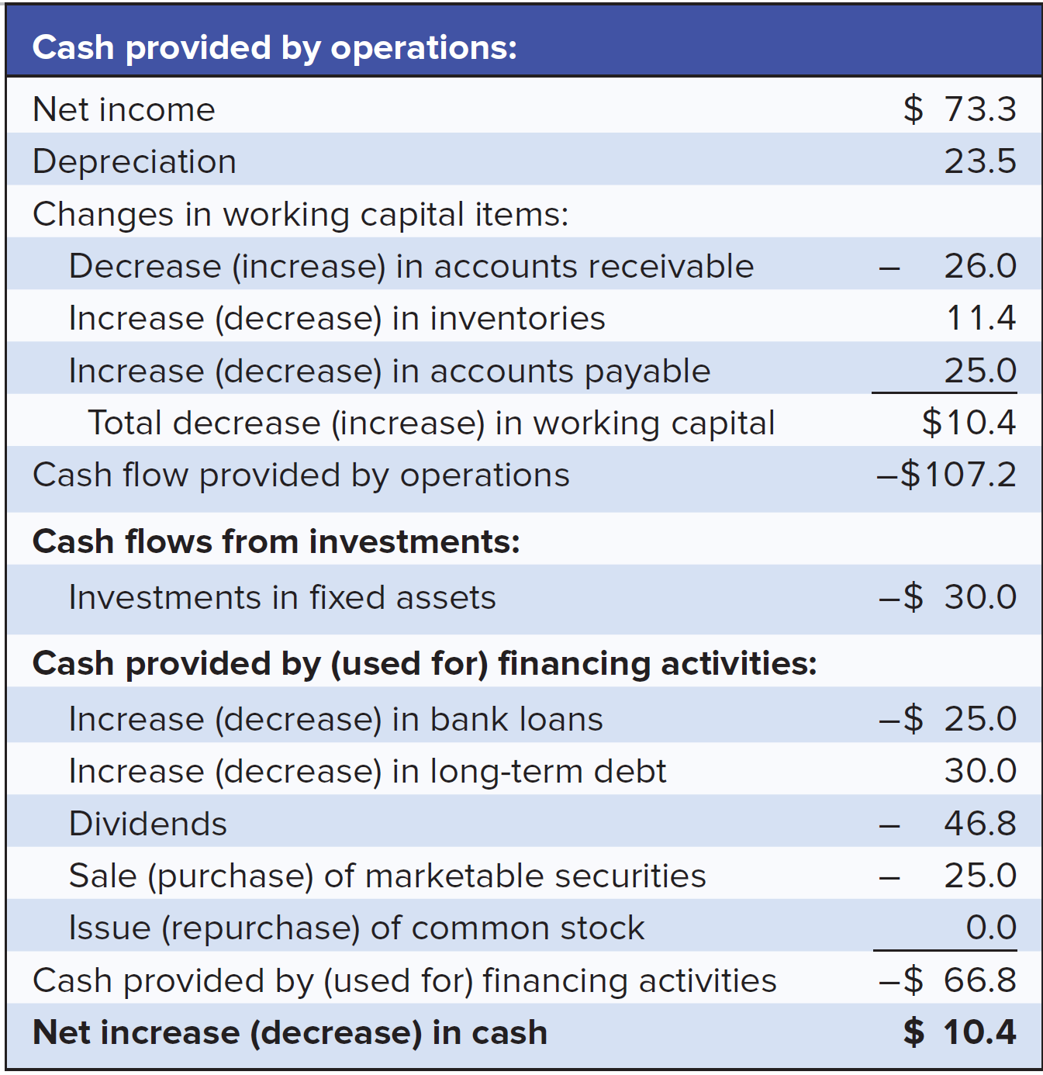
Changes in Cash and W.C. (3 of 5)
Example (continued)
Statement of Cash Flows
Notes:
23

Slide 8
Changes in Cash and W.C. (4 of 5)
Example (continued)
  Dynamic generated cash as follows:
  Net income was $73.3 million
  With $23.5 million depreciation
  Reduced inventory by $ 11.4 million
  Increased accounts payable by $25 million
  Issued $30 million of long-term debt
Notes:
24

Slide 9
Changes in Cash and W.C. (5 of 5)
Example (continued)
  Dynamic used cash as follows:
  Accounts receivable expanded by $26 million
  Invested $30 million in fixed assets
  Paid $46.8 million dividend
  Purchased $25 million of marketable securities
  Repaid $25 million short-term bank loans
Notes:
24

Slide 10
Cash Budgeting (1 of 7)
Steps to preparing a cash budget
  Step 1 — Forecast the sources of cash
  Step 2 — Forecast uses of cash
  Step 3 — Calculate whether the firm is facing a cash shortage or surplus
Notes:
25

Slide 11
Cash Budgeting (2 of 7)
Example — Dynamic Mattress Company
  Dynamic forecasted sources of cash
Quarter | 1st | 2nd | 3rd | 4th
Sales, $ millions | $560 | $502 | $742 | $836
AR ending balance = AR beginning balance + sales - collections
Notes:
26

Slide 12
Cash Budgeting (3 of 7)
Example (continued)
  Dynamic collections on AR
Quarter: | First | Second | Third | Fourth
Receivables (beginning of period) | 150.1 | 199.0 | 181.6 | 253.6
Sales | 560.0 | 502.0 | 742.0 | 836.0
Collections
On sales in current period (70%) | 392.0 | 351.4 | 519.4 | 585.2
On sales in previous period (30%) | 119.1 | 168.0 | 150.6 | 222.6
Total collections | 511.1 | 519.4 | 670.0 | 807.8
Receivables (end of period) | 199.0 | 181.6 | 253.6 | 281.8
Notes:
27

Slide 13
Cash Budgeting (4 of 7)
Example (continued)
  Dynamic forecasted uses of cash
    Payments of accounts payable
    Labor, administrative, and other expenses
    Capital expenditures
    Taxes, interest, and dividend payments
    Increase in inventory
Notes:
28

Slide 14
Cash Budgeting (5 of 7)
Example (continued)
  Dynamic cash budget
Quarter: | First | Second | Third | Fourth
Sources of cash
Collections of acct receivable | 511.1 | 519.4 | 670.0 | 807.8
Other | 0.0 | 0.0 | 77.0 | 0.0
Total sources | 511.1 | 519.4 | 747.0 | 807.8
Uses of cash
Payments of accounts payable | 250.0 | 250.0 | 267.0 | 261.0
Increase in inventory | 150.0 | 150.0 | 170.0 | 180.0
Labor & other expenses | 136.0 | 136.0 | 136.0 | 136.0
Capital expenses | 70.0 | 10.0 | 8.0 | 14.5
Taxes, interest, and dividends | 46.0 | 46.0 | 46.0 | 46.0
Total uses | 652.0 | 592.0 | 627.0 | 637.5
Net cash inflow = sources - uses | -140.9 | -72.6 | 120.0 | 170.3
Notes:
29

Slide 15
Cash Budgeting (6 of 7)
Example (continued)
  Dynamic short term financing requirements
Quarter: | First | Second | Third | Fourth
Cash at start of period | 30.4 | -110.5 | -183.1 | -63.1
+ Net cash inflow | -140.9 | -72.6 | 120.0 | 170.3
= Cash at end of period | -110.5 | -183.1 | -63.1 | 107.2
Minimum operating balance | 25.0 | 25.0 | 25.0 | 25.0
Cumulative financing required | 135.5 | 208.1 | 88.1 | -82.2
Notes:
30

Slide 16
Cash Budgeting (7 of 7)
Forecast uses of cash
  Payments of accounts payable
  Labor, administrative, and other expenses
  Capital expenditures
  Taxes, interest, and dividend payments
  Increase in inventory

Slide 17
A Short-Term Financing Plan
Example (continued)
  Dynamic’s Financing Plan
Quarter: | First | Second | Third | Fourth
A. Cash requirements
Cash required for operationsª | 135.50 | 72.60 | -120.00 | -170.30
Interest on bank loan^{b} | 0.00 | 2.50 | 2.50 | 1.85
Interest on stretched payables^{c} | 0.00 | 0.53 | 4.33 | 0.00
Repayments of last quarter's stretched payables | 0.00 | 10.50 | 86.63 | 0.00
Lost interest on sold securities | 0.00 | 0.50 | 0.50 | 0.50
Total cash required | 135.50 | 86.63 | -26.04 | -167.95
B. Cash raised in quarter
Bank loan | 100.00 | 0.00 | 0.00 | 0.00
Stretched payables | 10.50 | 86.63 | 0.00 | 0.00
Securities sold | 25.00 | 0.00 | 0.00 | 0.00
Total cash raised | 135.50 | 86.63 | 0.00 | 0.00
C. Repayments
Of bank loan | 0.00 | 0.00 | 26.04 | 73.96
D. Addition to cash balances or security holdings | 0.00 | 0.00 | 0.00 | 93.99
E. Bank loan
Beginning of quarter | 0.00 | 100.00 | 100.00 | 73.96
End of quarter | 100.00 | 100.00 | 73.96 | 0.00
Notes:
32

