Slide 1
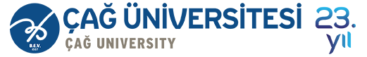

Course Title
Financial Literacy
Course Coordinator
Assist.Prof.Dr. Ayşegül Kurtulgan

Slide 2
Learning Objectives
After studying this chapter;
You will be able to analyze the process for making personal financial decisions.
You will be able to identify personal financial process.
You will be able to explain types of budgeting systems
You will be able to create and implement a budget.
You will be able to create personal budget via excel.

Slide 3
Personal Financial Planning
Personal financial planning is the process of managing your money to achieve personal economic satisfaction.
This planning process allows you to control your financial situation.
Since every person, family or household has a unique financial position, every financial activity must be carefully planned to meet specific needs and goals.

Slide 4
The Financial Planning Process
The advantages of personal financial planning include:
    Increased effectiveness in obtaining, using and protecting your financial resources throughout your life.
    Increased control of your financial activities by avoiding excessive debt
    Improved personal relationships resulting from well-planed and effectively communicated financial decisions.
    Enhanced freedom from financial worries.

Slide 5
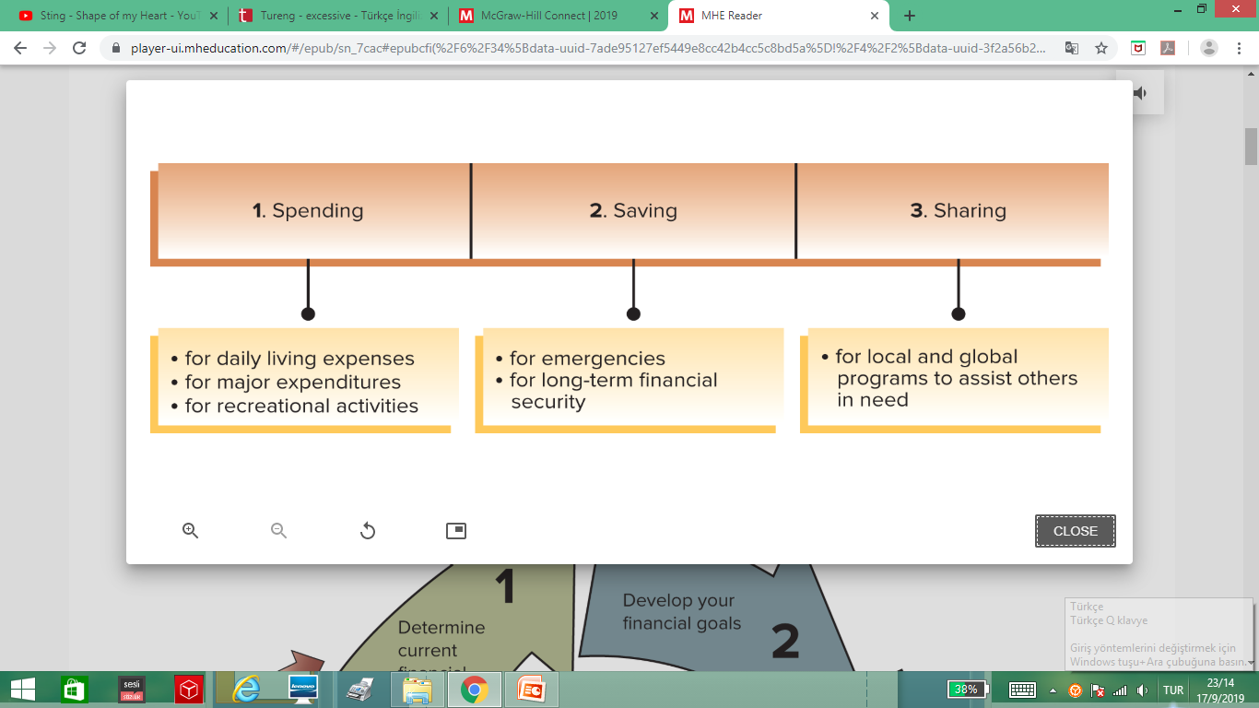
The Financial Planning Process
We all make hunderds of decisions each day. Many of these choices are quite simple. However, some are complex and have long-term effects on our personal and financial situations.
Personal financial activities involve three main decisions areas:

Slide 6
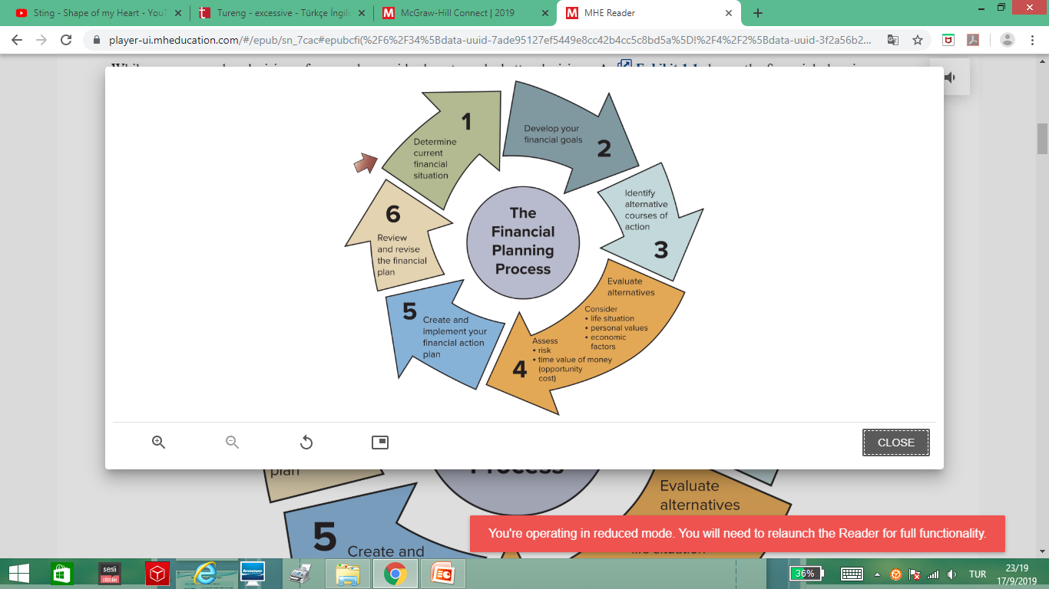
The Financial Planning Process
While everyone makes decisions, few people consider how to make better decisions. The financial planning process is a logical, six-step procedure that can be adapted to any life situation.

Slide 7
The Financial Planning Process
Step1: Determine your current financial situation: First, determine your current financial situation regarding income, savings, living expenses and debts.
Step 2: Develop financial goals: How will economic conditions affect your goals and priorities? The purpose of this analysis is to differentiate your needs from your wants.
Step 3: Identify alternative courses of action: Creative decision-making is vital for effective choices. For instance, most people believe they must own a car to get to work or school. However, they should consider other alternatives such as public transportation, capooling, renting a car, shared-car ownership or use a ride-sharing program.

Slide 8
The Financial Planning Process
Step 4: Evaluate your alternatives: Evaluate possible courses of action, taking into consideration your life situation, personal values and current economic conditions.
Step 5: Create and implement your financial action plan: This step involves developing an action plan to identify methods to achieve your goals.
Step 6: Review and revise your plan: You need to regularly assess your financial decisions.

Slide 9
BUDGETING
Create and implement a budget.
A budget is a spending plan
The main purposes of a budget are to help you:
  Live within your income
  Spend your money wisely
  Reach your financial goals
  Prepare for financial emergencies
  Develop wise financial management habits

Slide 10
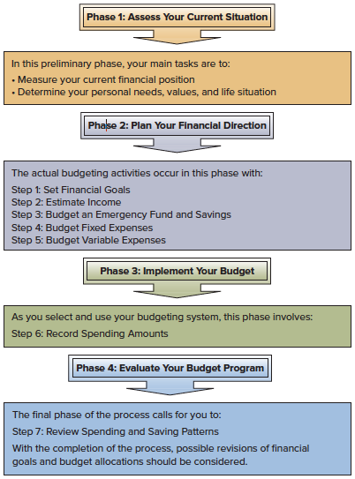
Creating and Implementing a Budget

Slide 11
The Budgeting Process
Step 1: Set Financial Goals
Step 2: Estimate Income
Step 3: Budget An Emergency Fund and Savings
Step 4: Budget Fixed Expenses
Step 5: Budget Variable Expenses
Step 6: Record Spending Amounts
Step 7: Review Spending and Saving Patterns
Review Your Financial Progress
Revise Your Goals and Budget Allocations

Slide 12
The Budgeting Process
Determine Income | Calculate your income. Identify all income sources: Wages/salaries Gifts or allowance Interest Scholarships, grants, and student aid
Determining Your Expenses | Consider all examples Determine which are fixed and which are variable expenses
Expense Considerations | Know what you owe. Consider your ongoing needs. Plan other expenditures. Identify how much money you need to cover expenses. Expect the unexpected.

Slide 13
Characteristics of Successful Budgeting
A budget will work only if you follow it.
Experts advise that a successful budget should be:
  Well planned
  Realistic
  Flexible
  Clearly communicated

Slide 14
Types of Budgeting Systems
Mental budget:
exists only in your head
Physical budget:
use envelopes for your expenses such as food, rent, etc.
Written budget:
detailed plan for spending in a spreadsheet or notebook
Computerized budgeting system:
use Excel or software such as Quicken
Online budget:
Budgeting app:
use bank or financial institution website
use cell phone or tablet

Slide 15
Realistic Budget Building
Budget: Itemized summary of estimated income and expected expenditures during a given period
Observe spending habits via a spending journal.
Record your income and when you receive it.
List all your fixed expenses and when they are due. Be careful with fixed expenses.

Slide 16
Realistic Budget Building
List your variable monthly expenses. Variable expenses can be controlled and changed.
After 1 month, project spending and earnings for the next 12 months.
Project when extraordinary expenses and income will change to maintain a positive cash flow. This is where the Emergency Fund comes into play.

Slide 17
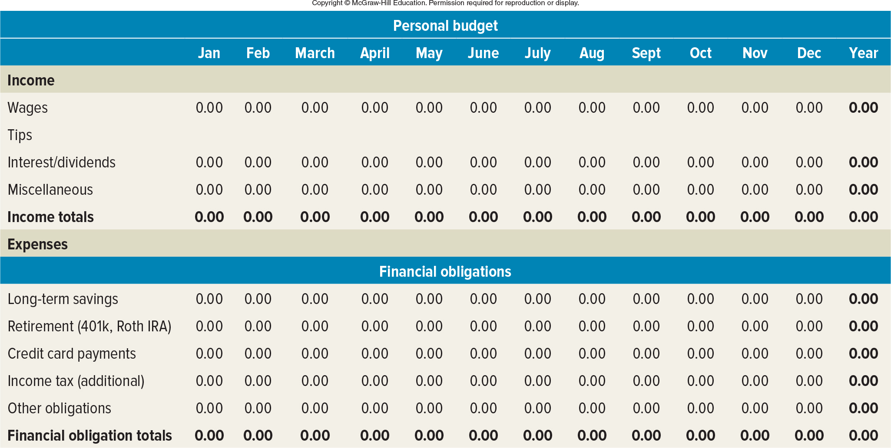
Example: Annual Personal Cash Budget
Annual Personal Cash Budget showing monthly inflows and outflows.

Slide 18
https://www.viddler.com/embed/23371889/?f=1&player=arpeggio&secret=37455950&make_responsive=0

Slide 19
Create a Budget
How much money do you get each month?
Income $2,000
What expenses do you have each month?
Fixed Expenses
Rent $ 600
Cell Phone $ 40
Car insurance ($300/quarter) $ 100
Variable Expenses
Food (estimate) $ 500
Utility bills (estimate) $ 50
Gas $ 50
Total Expenses $1,540
Income
Fixed Expenses
Variable Expenses

Slide 20
Create a Budget
Excel practice

Slide 21
Questions
What are the advantages of personal financial planning?
What are the main decisions areas in personal financial activities?
Explain the steps of the financial planning process.
What is a budget and what are the main purposes of a budget?
When making a budget, which items do you need?

