Slide 1
Marketing: The Art and Science of Satisfying Customers

Slide 2
Objectives
Define marketing and how it creates utility/use/benefit.
Contrast/differ/vary marketing activities during the five eras in the history of marketing.
Explain the importance of avoiding/preventing marketing myopia.
Describe the characteristics of not-for-profit marketing.

Slide 3
Objectives
Explain each of the five types of nontraditional marketing.
Explain the shift from transaction-based marketing to relationship and social marketing.
Identify the eight universal functions of marketing.
Demonstrate the relationship between ethical business practices/methods, social responsibility, and marketplace success.

Slide 4
What Is Marketing?
Production and marketing together create utility
Utility - The want-satisfying power of a good or service
Needs: States of felt deprivation
Physical—food, clothing, warmth, safety
Social—belonging and affection
Individual—knowledge and self-expression
Wants: Form that needs take as they are shaped by culture and individual personality
Demands: Wants backed by buying power

Slide 5
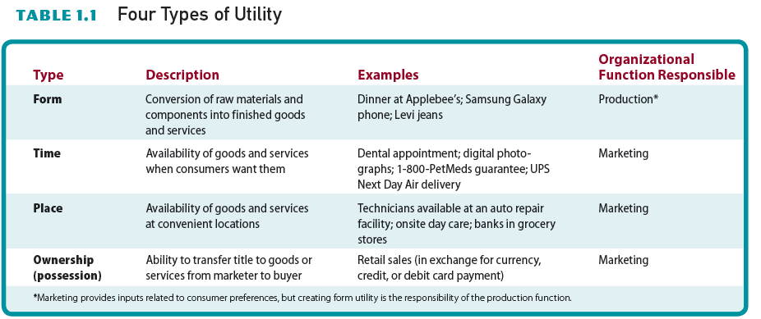
Four Types of Utility
TABLE 1.1

Slide 6
What Is Marketing?
All organizations must create utility to survive
  Foundation for the creation of utility— designing, marketing want-satisfying goods, services, and ideas
Activities marketers perform to create customers:
  Identifying needs in the marketplace

Slide 7
What Is Marketing?
  Finding out/discovering which needs the organization can profitably serve
  Developing goods and services to convert/turn into potential buyers into customers
Marketing specialists are responsible for the activities necessary to create the customers
  Identifying customer needs
  Designing products that meet those needs

Slide 8
What Is Marketing?
  Communicating information about those goods and services to prospective buyers
  Making the products available when and where customers want them
  Pricing merchandise and services
  Providing after-sales service and following-up

Slide 9
A Definition of Marketing
Marketing – Activity, set of institutions, and processes for:
  Creating, communicating, delivering, and exchanging offerings
  Managing customer relationships in ways that have value for customers (customer value), clients, partners, and society at large

Slide 10
Today’s Global Marketplace
Factors that have extended economic views beyond national borders
  International trade agreements to expand trade among nations
  Growth of electronic business
  Interdependence of the world’s economies
Companies seek the most efficient manufacturing sites and most lucrative/profitable markets worldwide

Slide 11
Today’s Global Marketplace
Companies are tailoring/customize/adapt their marketing efforts to the needs and preferences of local markets

Slide 12
Five Eras in the History of Marketing (Maketing Management Orientations)
Essence/nature of marketing includes managing customer relationships and the exchange process
Exchange/trade off process - Activity in which two or more parties give something of value to each other to satisfy perceived need.
Some dominant stances…

Slide 13
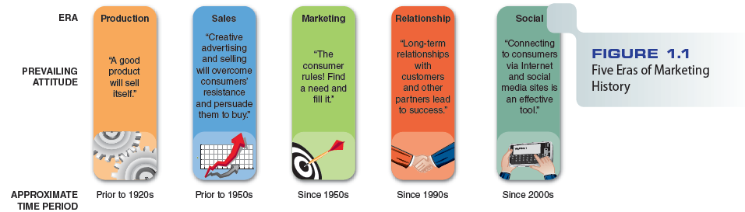
Five Eras of Marketing History
FIGURE 1.1

Slide 14
The Production Era
Period before 1925
Production orientation - Stressing efficiency in producing a quality product, with the attitude toward marketing that “a good product will sell itself”
Business success was defined solely in terms of production successes
Characterized by production shortages and intense consumer demand

Slide 15
The Sales Era
Sales orientation - Customers will resist purchasing nonessential items
  Only personal selling and creative advertising would persuade them to buy
With the sophistication/complication of production techniques, output grew from the 1920s into the early 1950s
  Manufacturers began to increase their emphasis/ interest on effective sales forces

Slide 16
The Marketing Era
Emergence/occurence of the marketing concept
  Shift from a seller’s market to a buyer’s market
  A strong buyer’s market created the need for consumer orientation/focus
  Marketing concept - A companywide consumer orientation/focus/cooperation to achieve long-run success
  A strong market orientation improves market success and overall performance

Slide 17
The Relationship Era
Emerged during the 1990s and continues to grow in importance
Relationship marketing - Developing long-term, value-added relationships over time with customers and suppliers
Strategic alliances and partnerships benefit everyone

Slide 18
The Social Era
Characterized by the accessibility to the Internet and the creation of social media sites
Routine use of the Web and social networking sites by companies to connect to consumers

Slide 19
Converting Needs to Wants
Consumers acquire goods and services on a continuing basis to fill certain needs
To convert needs into wants, marketers:
  Focus on the benefits of goods and services

Slide 20
Avoiding Marketing Myopia
Marketing myopia - Management’s failure to recognize the scope of its business
Overcoming marketing myopia
  Developing broader marketing-oriented business ideas focusing on customer need (product) satisfaction

Slide 21
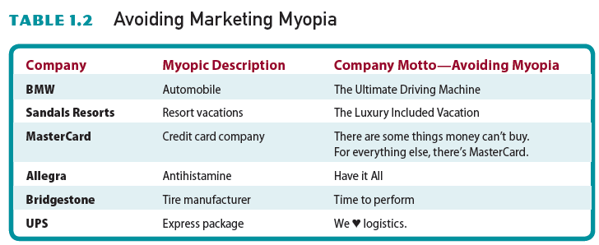
Avoiding Marketing Myopia
TABLE 1.2

Slide 22
Not-for-Profit Marketing
Marketing in not-for-profit organizations
  Operate in both the public and private sector
  Adopt marketing strategies to meet service objectives
  Communicate their messages through advertisements relating to their goals
  Form alliances with for-profit firms to promote/ publicise each other’s causes

Slide 23
Characteristics of Not-for-Profit Marketing
Focus is to generate revenue to support their causes and not on the bottom line
May market tangible goods and services
Markets to multiple audiences
Often possess some degree of monopoly power in a specific geographic region
Service users have less control over the firm’s future

Slide 24
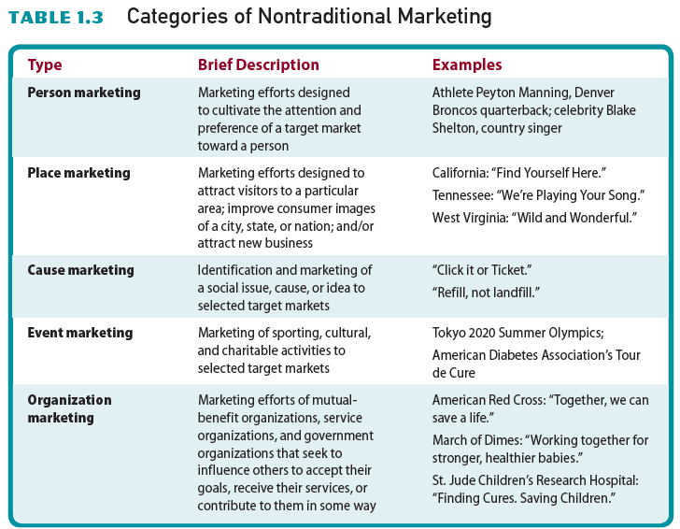
Categories of Nontraditional Marketing
TABLE 1.3

Slide 25
Nontraditional Marketing
Person marketing – Efforts to cultivate/develop the attention, interest, and preferences of a target market toward a person (Trump vs Biden)
  Celebrity endorsements/backing/approval
Place marketing - Efforts to attract people and organizations to a particular geographic area
  Tourism enhancements/breakthroughs/improvements

Slide 26
Nontraditional Marketing
Cause marketing - Identification and marketing of a social issue, cause or idea to selected target markets
Many profit-seeking firms link their products to social causes
Strong support among customers and employees for cause-related marketing

Slide 27
Nontraditional Marketing
Event marketing - Marketing of sporting, cultural, and charitable activities to selected target markets
  Also, includes sponsorship of such events by firms (remote education in primary education – VESTEL Tablet PC)
Event/affair sponsorships have gained effectiveness in increasing brand recognition, enhancing image, boosting/raise/increase purchase volume

Slide 28
Nontraditional Marketing
Organization marketing - Intended to persuade others to:
  Accept the organization’s goals
  Receive its services
  Contribute to the organization in some way
Adopted by mutual-benefit organizations (ICC), service organizations(Lions Club), and government organizations (YOK)

Slide 29
From Transaction -Based Marketing to Relationship Marketing
Transaction-based marketing - Buyer and seller exchanges characterized by limited communications and little or no ongoing relationships between the parties
Marketers realize that consumers are becoming more and more sophisticated
Sale/deal – based Marketing.

Slide 30
From Transaction-Based Marketing to Relationship Marketing
Relationship marketing gives a company new opportunities to gain a competitive edge/advantage by moving customers up a loyalty ladder
  It starts with determining what customers need and want, then developing high-quality products to meet those needs

Slide 31
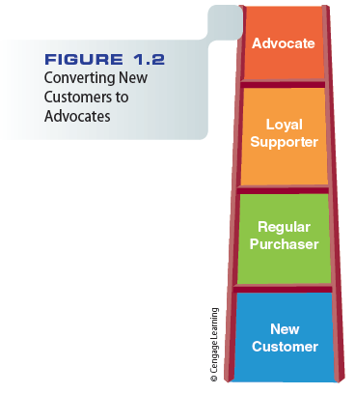
Converting New Customers to Advocates/friends/supporter
FIGURE 1.2

Slide 32
Using Social Marketing to
Build Relationships
Mobile marketing - Marketing messages transmitted/conveyed via wireless technology
Interactive marketing - Buyer–seller communications in which the customer controls the amount and type of information received from a marketer

Slide 33
Using Social Marketing to
Build Relationships
Social marketing - The use of online social media as a communications channel for marketing messages
  Electronic conversations can establish innovative relationships between users and the business
By converting indifferent/uninterested customers into loyal ones, companies generate repeat sales

Slide 34
Using Social Marketing to
Build Relationships
Some of the best repeat customers* are those who are also willing to spread the word
Buzz marketing is the word of mouth messages that bridge the gap between a company and its products
*Someone who buys again from a company that they have used before.
Patron/frequnter

Slide 35
Developing Partnerships and Strategic Alliances
Relationship marketing extends to /outstretchs business-to-business relationships with suppliers, distributors, and other partners
Strategic alliances - Partnerships in which two or more companies combine resources and capital to create competitive advantages in a new market

Slide 36
Developing Partnerships and Strategic Alliances
Forms of alliances
  Product development partnerships
  Vertical alliances*
Not-for-profit organizations often use strategic alliances to raise awareness and funds for their causes
*Vertical strategic alliances, which describe the collaboration between a company and its upstream and downstream partners in the Supply Chain, that means a partnership between a company its suppliers and distributors.

Slide 37
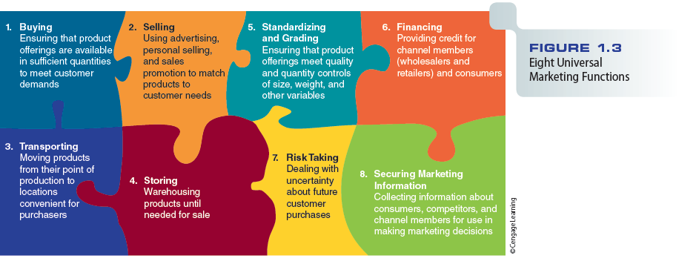
Eight Universal Marketing Functions
FIGURE 1.3

Slide 38
Ethics and Social Responsibility
Ethics - Moral standards of behavior expected in a society
Most businesses follow ethical practices, although there have been breaches/ noncompliance at times
Social responsibility - Marketing philosophies, policies, procedures, and actions that have the enhancement of society’s welfare/good as a primary objective

Slide 39
Ethics and Social Responsibility
Socially responsible efforts produce such benefits as:
  Improved customer relationships
  Increased employee loyalty
  Marketplace success
  Improved financial performance
Sustainable products - Products that can be produced, used, and disposed of with minimal impact on the environment

Slide 40
Ethics and Social Responsibility
Firms stand to gain needed credibility from their efforts to protect the environment
Research reveals that customers are willing to pay a premium for environmentally friendly goods and services

Slide 41
Strategic Implications/suggestions of Marketing in the 21st Century
Advances and innovations in electronic commerce and computer technologies have allowed organizations to:
  Reach new markets
  Reduce selling and marketing costs
  Enhance their relationships with customers and suppliers

Slide 42
Geoffrey B. Small Video
http://www.cengage.com/marketing/book_content/boone_9781133628460/videos/ch01.html

