Slide 3
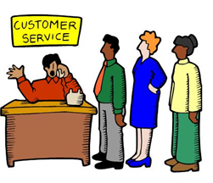
Customer
A customer is a person or company that receives, consumes or buys a product or service and can choose between different goods and suppliers.
The main goal of all commercial enterprises is to attract customers or clients, and make them purchase what they have on sale.
They also try to encourage them to keep coming back.

Slide 4
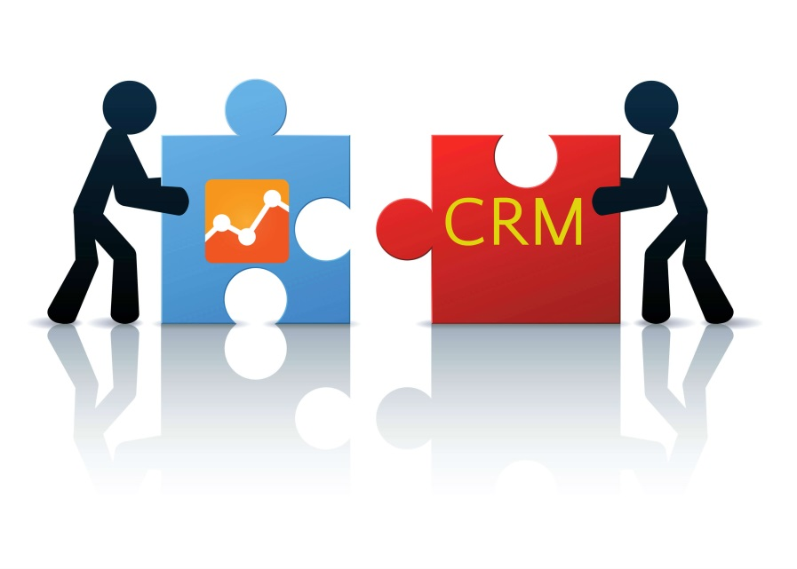
Relationship
Thoughts of the feelings that two people have for one another:
mutual attraction and respect,
consideration,
dependency and the like.
Interactions must take place between at least two parties; characteristic of interactions can influence one another.
Relationships will also have to extend over a longer period of time.

Slide 5
Crm for banking
Banks offer a wide range of banking products and financial services to corporate and retail customers.
CRM activities helped them making customers loyal.
Banks believe that a true customer-centric relationship can only be accomplished by considering the unique perspectives of every single customer of the organization.

Slide 6
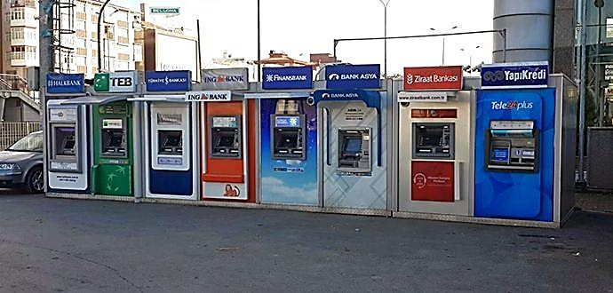
Why crm- the changing enviroment
Increased competition : 47 banks and 10422 branches

Slide 7
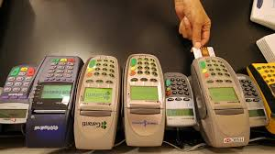
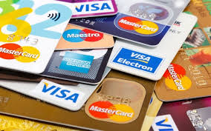
Why crm- the changing enviroment
Growth of product: Increase in banking product diversity

Slide 8
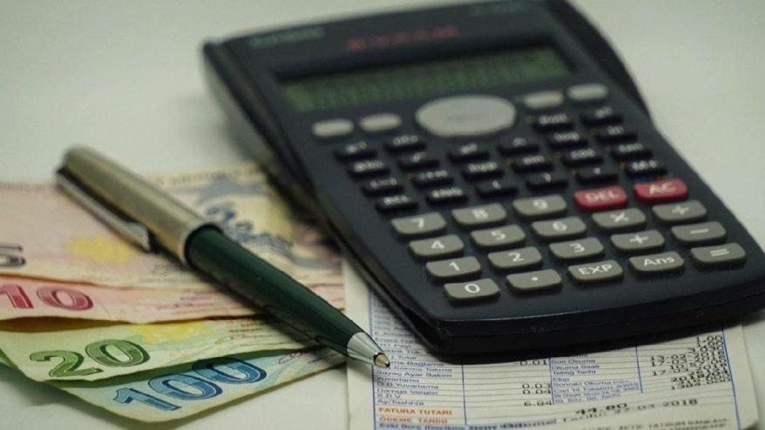
Why crm- the changing enviroment
Diminishing margins :Decrease in profitability

Slide 9
Services marketing mix – 7 P’s
Product
Price
Place
Promotion
People
Physical evidence
Process

Slide 12
The first P: Service Product or Service Package
Services are benefits which are offered to the target market.
Banking: Debit cards, credit cards, different types of loans and current and saving accounts.
Insurance: Life Insurance and Non-life Insurance.

Slide 13
Product
Financial Services that Need Marketing
Banking Services
Credit Cards
Debit Cards
Saving account and Different type of Loans
Mutual Funds
Insurance Products
Life
Non-Life
Pension Funds
Stock Brocking Services
Other Financial Services

Slide 14
This refers to the interest rates,bank charges,commissions for services.

Slide 16
Modern Thinking in Distribution of
Services
If customers can’t reach you,
reach your customers.

Slide 17
https://www.youtube.com/watch?v=nSY36XO9qWg#action=share

Slide 18
It is concerned with advertising,direct sales,tele-marketing,internet,personel visits to the customer

Slide 19
The fifth P: People
(People are) … All human actors who
play a part in service delivery and thus
influence the buyers’ perceptions;
namely, the firm’s personnel, the
customer, and other customers in the
service environment.
People are an extremely important
element of the marketing mix in services
marketing

Slide 20
Because of heavy competition, banks expect their staff to take a pro-active selling or customer service role
In fact bankers are more sales persons these days than two decade ago.

Slide 21
The Sixth P: Process
(Process is) … The actual procedures,
mechanisms, and flow of activities by
which the service is delivered – the
Service delivery and operating systems.

Slide 22
PROCESS
-Service Delivery
-Policies
-Procedures
-Customer Involvement
-Direction
-Workflow
-Complaints
-Response Time

Slide 23
The Seventh P: Physical evidence
(Physical evidence is) … The
environment in which the service is
delivered, and where the firm and
customer interact, and any tangible
components that facilitate performance
or communication of the service.

Slide 24
Designing
Facilities
Signposts
Equipments
Interiors
Exteriors
Displays
Lighting
Ventilation
Drinking water
Waiting Lounge
Scent
Music
Reports
Brochures
Parking
Dresses and Uniforms
Color Combinations
Logos
Physical Evidence
and Attractions

Slide 25
4Ps to 4Cs

Slide 26
Bank Marketing
Provides services
Aimed to satisfy customer’s needs and wants
Needs and wants may be non financial in nature
Competitive element, efficiency and effectiveness
Organizational objectives are still the driving force
Commercial objective to make profit
Social Objectives

Slide 27
Essentials for a Bank Success
Can not exist without customer
Create, win and keep customers
Organizational design should be oriented to the customer
Deliver total satisfaction to the customer
Customer satisfaction is affected by the performance of all the personnel of the bank.

Slide 28
Benefits of CRM :
Reduced costs, because the right things are being done (ie., effective ad efficient operation)
Increased customer satisfaction, because they are getting exactly what they want (ie. Meeting and exceeding expectations)
Ensuring that the focus of the organisation is external
Growth in numbers of costumers
Maximisation of opportunities (eg. İncreased services, referrals, etc.)
Increased access to a source of market and competitor information
Highlighting poor operational processes
Long term profitability and sustainability

Slide 29
Components of Crm Cycle
Understand and Differentiate.
Develop and Customise.
Interact and Deliver.
Acquire and Retain

