Slide 1
Economics
Chap 2 – Demand and Supply
Dr. Cansu Unver-Erbas
cnsunvr@gmail.com
c.unver-erbas@lboro.ac.uk

Slide 2
AIM OF THIS LECTURE
In this lecture, we will learn about: MARKET FORCES OF SUPPLY AND DEMAND
Following the lecture, you should be able to
What a competitive market is
What determines the demand for a good in a competitive market
What determines the supply of a good in a competitive market

Slide 3
READING MATERIAL
Mankiw, G. and Taylor, M. (2017). Microeconomics. Cengage Learning.
Chapter 3: The Market Forces of Supply and Demand

Slide 4

EXAMPLES OF THE WORKINGS OF SUPPLY AND DEMAND

Slide 5
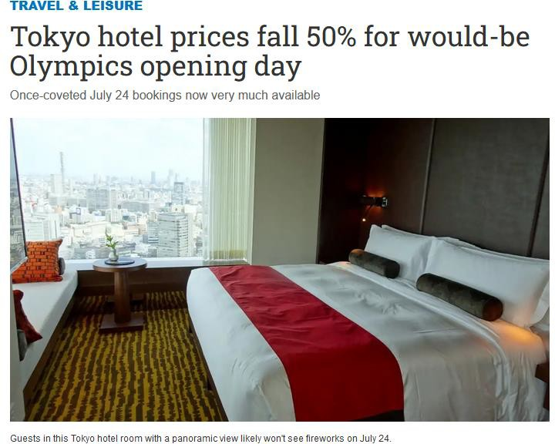
EXAMPLES OF THE WORKINGS OF SUPPLY AND DEMAND

Slide 6
INTRODUCTION
Supply and Demand:
Two words that economists use most often
Forces that make market economies work
Determine the quantity of each good produced and the price at which it is sold
If you want to know how an event or policy will affect the economy, you must first think about how it will affect supply and demand

Slide 7

INTRODUCTION
Supply and demand refer to behavior of people as they interact with one
another in markets.
Market: group of buyers and sellers of a particular good or service.
Buyers determine the demand.
Sellers determine the supply.

Slide 8
INTRODUCTION
Competitive market: a market in which there are many buyers and many sellers
so that each has a negligible impact on the market price.
E.g., competitive market: market for milk.
Each producer of milk has limited control over the price because other sellers are offering almost identical milk.
E.g., non competitive market: Netflix, Hulu, and Amazon for online
streaming.
Small number of providers → each provider is big enough to affect market price.

Slide 9
INTRODUCTION
Perfectly competitive markets have 2 characteristics:
Goods being offered for sale are identical for all sellers.
Buyers or sellers are so numerous that no single buyer or seller can influence the market price (they are “price takers”).
Perfectly competitive markets are easiest to analyse.
  In most of this course, we will assume that the market is competitive, i.e.,
study how buyers and sellers interact in perfectly competitive markets.
  We will study how buyers and sellers interact in other types of markets (e.g.,
(monopolistically competitive, oligopolistic, monopolistic) in Chap 8.

Slide 10
INTRODUCTION
Assume you are planning to go to the cinema next Friday.
What is the maximum price you would be willing to pay for a ticket?
Find 2 other elements besides the price that determine how often you go to
the cinema every month.

Slide 11
DEMAND

Slide 12
DEMAND
Individual Demand / Market Demand
People have unlimited needs/wishes for goods and services. Demand reflects a decision about which needs/wishes to satisfy.
Individual demand is the amount of a good that an individual is willing and able to purchase within a given time period.
Market demand is the amount of a good that all buyers are willing and able to
purchase within a given time period.

Slide 13
DEMAND
Individual Demand
Consider your own demand for pizzas. What factors affect how many pizzas you buy each month?

Slide 14
DEMAND
Individual Demand
Consider your own demand for pizzas. What factors affect how many pizzas you buy each month?
Factors affecting individual demand:
Price of the good
Income
Price of related goods
Tastes
Expectations
Advertising
b, c, d, e, f: Non price determinants of demand.

Slide 15







DEMAND
Individual Demand
How does price affect individual demand?
  If price of pizza increases, you will buy less pizza.
  If price of pizza decreases, you will buy more pizza.
Law of demand: Other things being equal, the quantity demanded of a good
falls when the price of the good rises.
( = Quantity demanded is negatively related to the price.)

Slide 16


DEMAND
Individual Demand
How does income affect individual demand?
  If your income increases, you will buy more pizza.
  If your income decreases, you will buy less pizza.
If the demand for a good increases when income increases, the good is called a
normal good.
Example: pizza.
If the demand for a good falls when income increases, the good is called an
inferior good.
Example: frozen pizza

Slide 17





DEMAND
Individual Demand
How does the price of related goods affect individual demand?
Related goods: those consumed with pizza or instead of pizza
  If price of pasta increases, you will buy more pizza.
  If price of beer (or something that you usually consume with pizza) increases, you will buy less pizza.
Substitutes: two goods for which an increase in the price for one good leads to an increase in the demand for the other good.
Example: pizza and pasta
Complements: two goods for which an increase in the price for one good leads to a decrease in the demand for the other good.
Example: pizza and beer, petrol and cars, bacon and eggs
17

Slide 18



DEMAND
Individual Demand
d) How do tastes affect individual demand?
If you like pizza, you buy more of it.
Economists do not try to explain people’s tastes, but they examine what happens when tastes change.

Slide 19

DEMAND
Individual Demand
How do expectations affect individual demand?
  If you expect to earn a higher income next month, you may save less this
month and buy more pizza.
  If you expect the price of pizza to be lower next week, you may be less willing to buy a pizza at today’s price.

Slide 20


DEMAND
Individual Demand
f) How does advertising affect individual demand?
If a firm is having an advertising campaign, the demand for the product will rise.

Slide 21
DEMAND
Individual Demand
Many variables determine quantity of pizza a person demands. Imagine all these variables except price are held constant.
Demand schedule: table that shows the relationship between the price of a good and the quantity demanded, when all other variables affecting demand are held constant.
Demand curve: graph of the relationship between the price of a good and the quantity demanded, when all other variables affecting demand are held constant.
Example : Sabine’s ice cream demand schedule/curve.

Slide 22
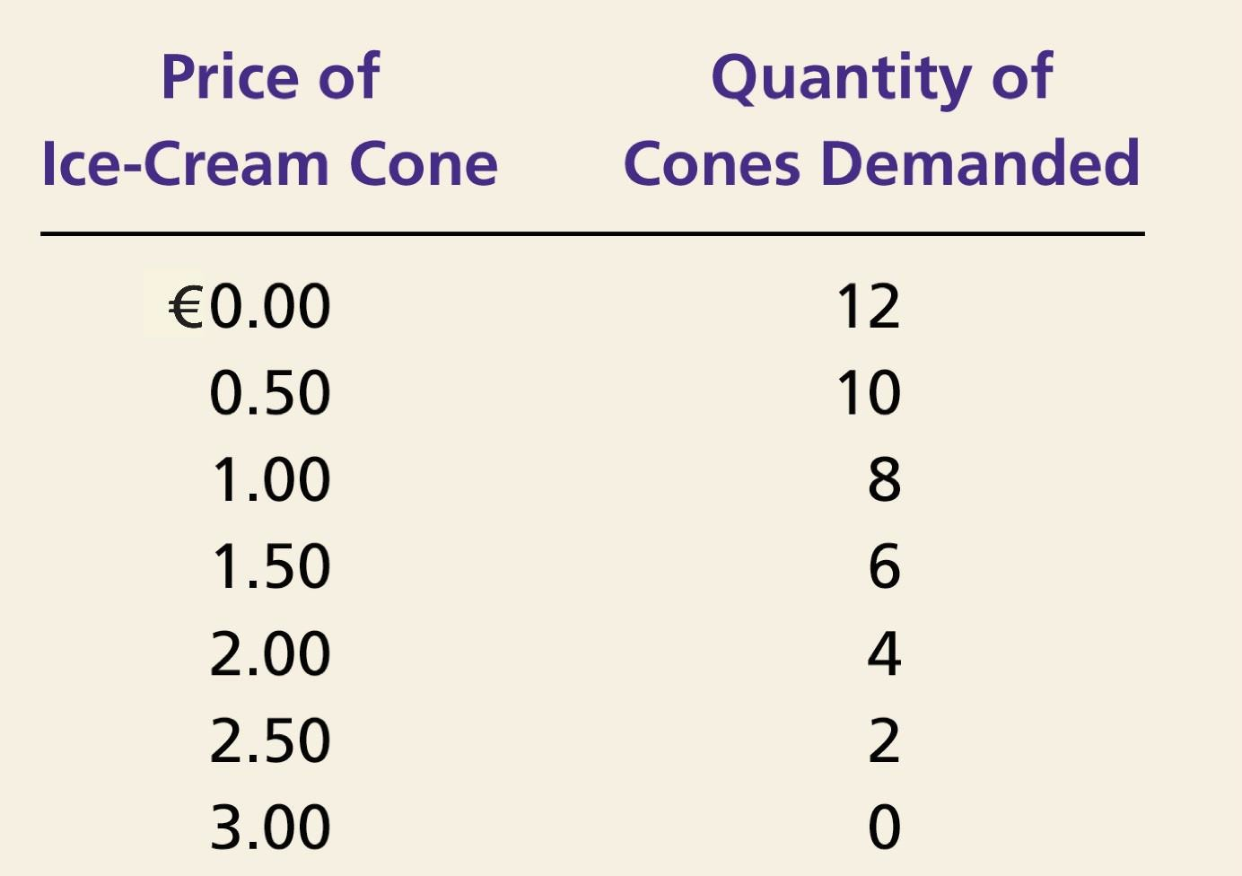

DEMAND
Individual Demand
Ex: Sabine’s demand schedule (ice-cream cones per month).

Slide 23
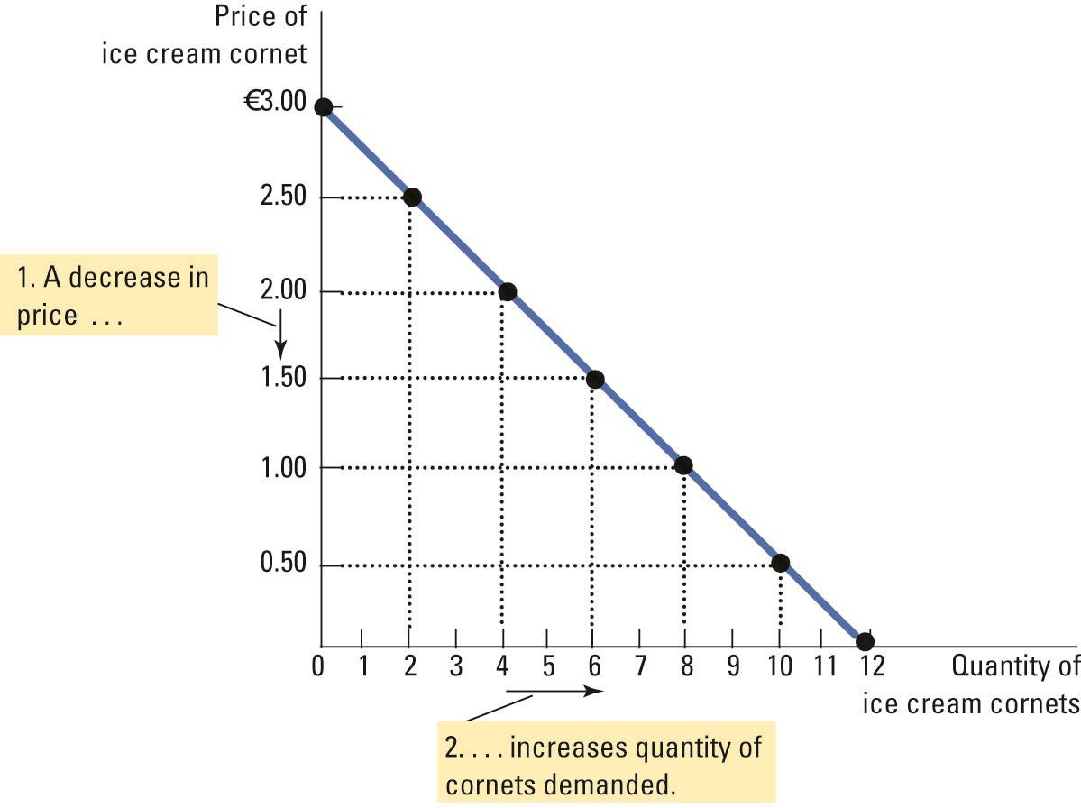
DEMAND
Individual Demand
Sabine’s demand curve

Slide 24
DEMAND
Market Demand
Market demand is the sum of all the individual demands for a particular good or service.
Factors which determine market demand:
factors which determine individual demand
number of buyers
The market demand is found by adding horizontally the individual demand curves.

Slide 25
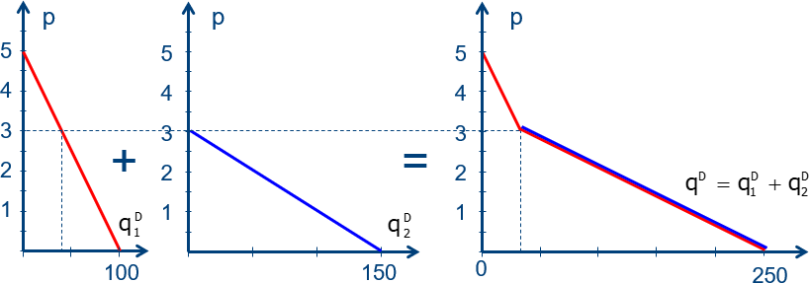
DEMAND
Market Demand

Slide 26
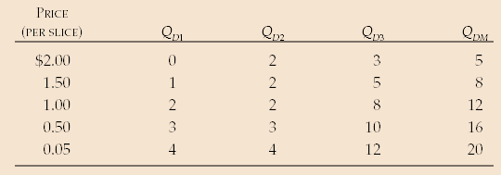

DEMAND
Market Demand
Example: market demand 𝑄_{𝐷𝑀} for pizza when there are 3 consumers:
𝑝=£2.0 → 𝑄_{𝐷𝑀} =0+2+3=5
𝑝=£1.5 → 𝑄_{𝐷𝑀} =1+2+5=8
… for all prices

Slide 27
DEMAND
Demand Changes
Important:
When the price changes, the quantity demanded changes. This is a movement
along the demand curve.
When a non price determinant changes, the demand schedule/curve change. This is a shift of the demand curve.

Slide 28
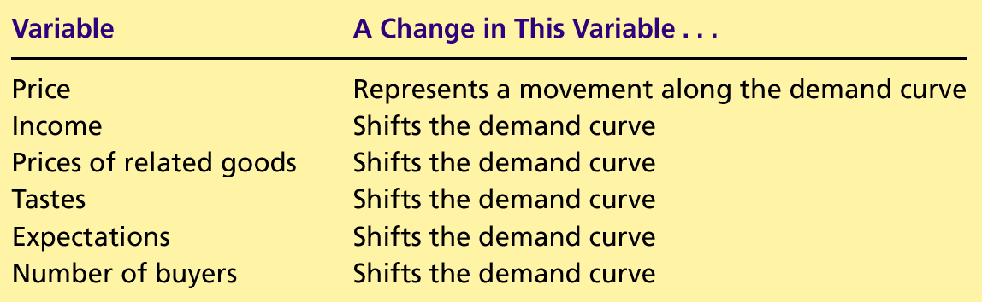
DEMAND
Demand Changes
Variables that influence buyers:

Slide 29
DEMAND
Demand Changes
Example 1: changes in demand for ice cream cones.
Example 2: changes in demand for pizza.

Slide 30
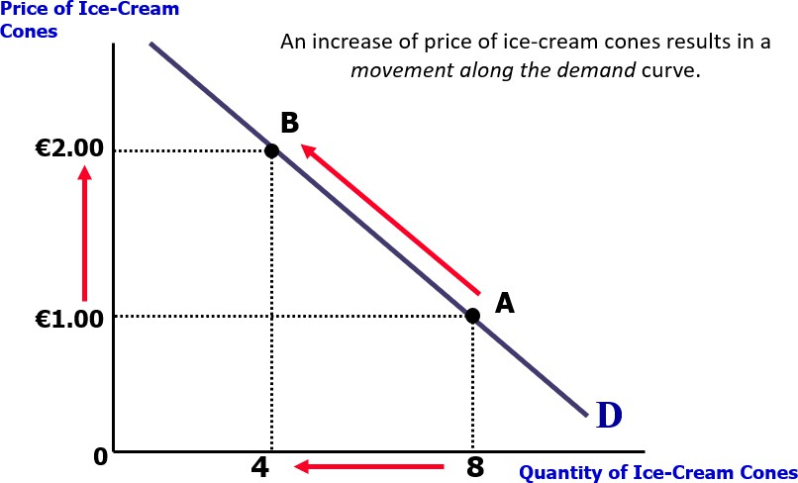
DEMAND
Demand Changes: Example 1

Slide 31
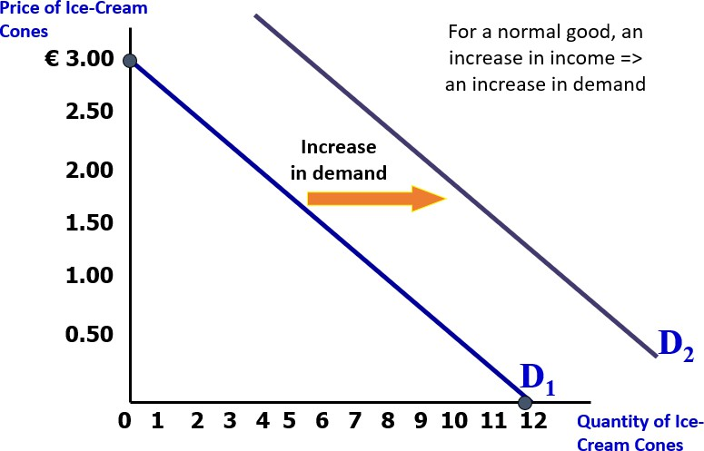
DEMAND
Demand Changes: Example 1

Slide 32
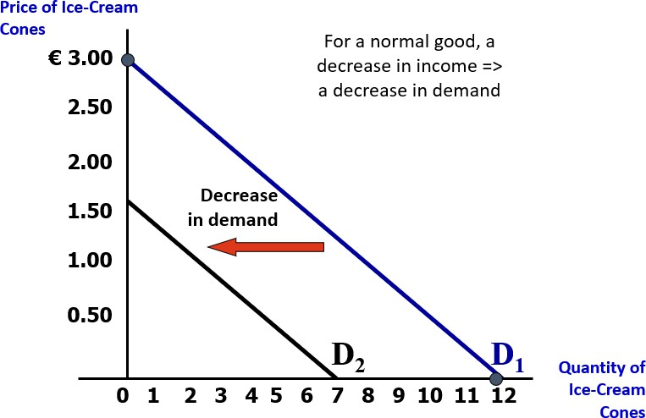
DEMAND
Demand Changes: Example 1

Slide 33
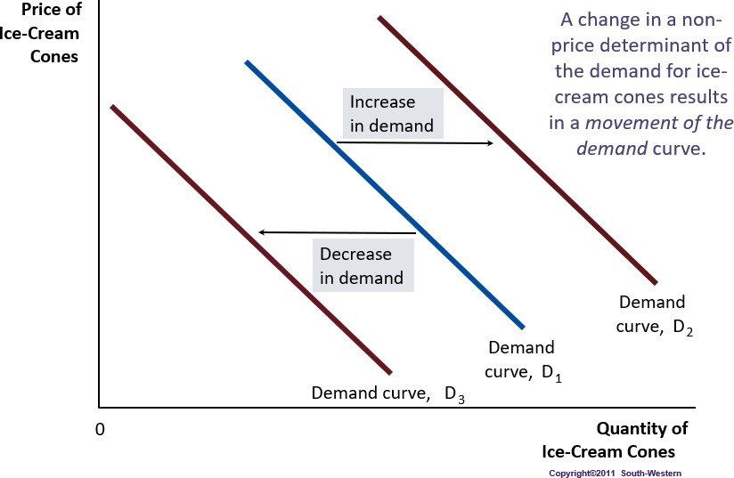
DEMAND
Demand Changes: Example 1

Slide 34
DEMAND
Demand Changes: Example 2 (changes in demand for pizza).
Suppose that the European Medical Association announces a new discovery: people who regularly eat pizzas live shorter and less healthy lives.
How does this discovery affect market for pizza?
Which determinant of demand is affected by this discovery?

Slide 35
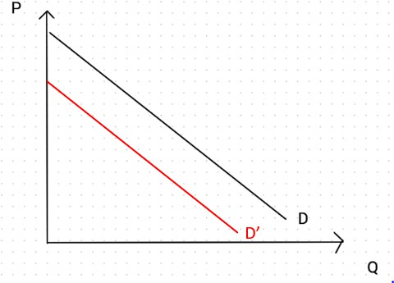
DEMAND
Demand Changes: Example 2

Slide 36
DEMAND
Finding price and quantity using algebra
Linear equation for a demand curve:
Qd = 1800 – 30p
What will the quantity demanded be if
  the price is £5: Q = 1800 – 30*5 = 1650
  the price is £ 20: Q = 1800 – 30*20 = 1200
If we know the quantity demanded is 1500 how much will the price then be? 1500 = 1800 – 30*P => -300 = -30P => P= 10

Slide 37
DEMAND
Finding price and quantity using algebra
Exercise: Qd = -80P + 1600
Calculate Qd when the price is €10 and €15. Plot the demand curve.

Slide 38
DEMAND
Finding price and quantity using algebra
Exercise: Qd = -80P + 1600
Calculate Qd when the price is €10 and €15. Plot the demand curve.
P=10: P=15:
Q = -80*10 + 1600 = 800 Q = -80*15 + 1600 = 400

Slide 39
DEMAND
Finding price and quantity using algebra
Exercise: Qd = -80P + 1600
Calculate Qd when the price is €10 and €15. Plot the demand curve.
P=10: P=15:
Q = -80*10 + 1600 = 800 Q = -80*15 + 1600 = 400
Intercept vertical axis:
0 = -80P + 1600 => 80P = 1600 => P = 20
Intercept horizontal axis:
Q = -80*0 + 1600 => Q = 1600

Slide 40
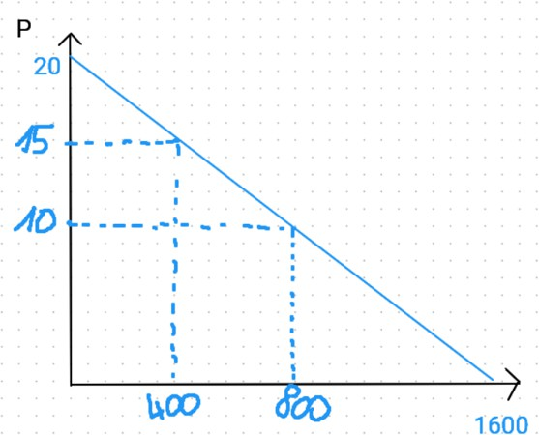
DEMAND
Finding price and quantity using algebra
P=10: P=15:
Q = -80*10 + 1600 = 800 Q = -80*15 + 1600 = 400
Intercept vertical axis: 0 = -80P + 1600 => 80P = 1600 => P = 20 Intercept horizontal axis: Q = -80*0 + 1600 => Q = 1600

Slide 41
SUPPLY

Slide 42
SUPPLY
Individual Supply
The quantity supplied of any good or service is the amount that sellers are willing and able to sell.
Individual supply: the amount that one particular firm is willing and able to sell.

Slide 43
SUPPLY
Individual Supply
What determines the supply of pizza?

Slide 44
SUPPLY
Individual Supply
What determines the supply of pizza? Factors affecting individual supply:
Price of the good
Input Prices
Technology
Expectations
Natural/social factors
Profitability of other goods in production and prices of goods in joint supply
b, c, d, e, f: Non price determinants of supply.

Slide 45




SUPPLY
Individual Supply
How does price affect individual supply of a firm?
  If the price of pizza is high, producing pizzas is profitable, so the firm
should produce and sell many pizzas.
  If the price of pizza is low, producing pizzas is not that profitable, so the firm should produce and sell few pizzas.
Law of supply: Other things being equal, the quantity supplied of a good rises when the price of the good rises.

Slide 46



SUPPLY
Individual Supply
b) How do input prices affect individual supply?
Input prices for producing pizza: price of tomatoes, ham, mozzarella, oven, etc.
When the price of one or more inputs rises, producing pizza becomes less profitable so the firm should produce less pizzas.
The quantity supplied of a good is negatively related to the price of inputs used to make that good.

Slide 47

SUPPLY
Individual Supply
c) How does technology affect individual supply?
An advancement in technology that reduces firms’ cost (e.g., less workers needed to produce same number of pizzas) will make producing pizzas more profitable and thus raise the quantity of pizza supplied.

Slide 48
SUPPLY
Individual Supply
d) How do expectations affect individual supply?
If the firm expects the price of pizza to increase in the future, it will put some of
its current production into storage and supply less to the market today.

Slide 49



SUPPLY
Individual Supply
How do natural/social factors affect individual supply?
Examples:
  flood or drought reduces agricultural production.
  Impact Covid-crisis on cinemas

Slide 50












SUPPLY
Individual Supply
e) How do the profitability of other goods in production and prices of goods in joint supply affect individual supply?
Firms have some flexibility in their supply and can sometimes switch production
to other goods that might be more profitable.
Sometimes goods are in joint supply – e.g. lamb and wool
An increase in the supply of lamb will also lead to an increase in the supply of wool

Slide 51
SUPPLY
Individual Supply
Many variables determine quantity of pizza a firm supplies.
Imagine all these variables except price are held constant.
The supply schedule is a table that shows the relationship between the price of the good and the quantity supplied when all other variables affecting supply are held constant
Supply curve: graph of the relationship between the price of a good and the quantity supplied when all other variables affecting supply are held constant.

Slide 52
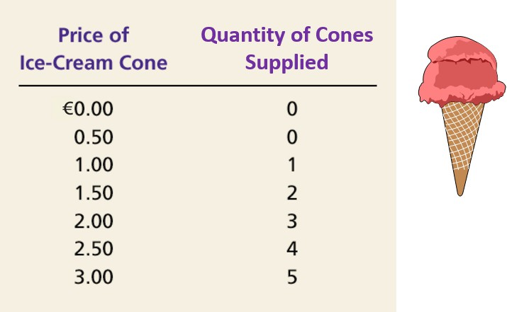
SUPPLY
Individual Supply
Ex: Häagen’s Supply Schedule

Slide 53
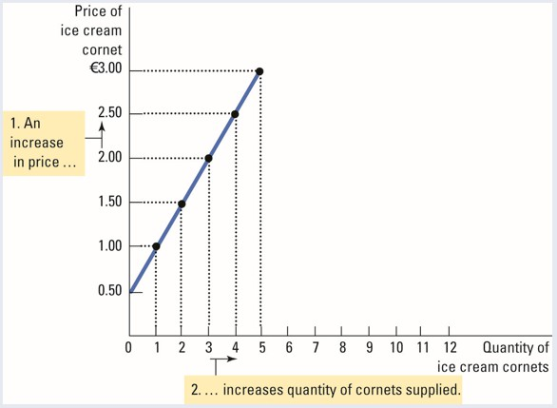
SUPPLY
Individual Supply
Häagen’s Supply curve

Slide 54
SUPPLY
Market Supply
Market Supply is the sum of all the individual supplies for a particular good or service.
The market supply is found by adding horizontally the individual supply curves.
It shows how the total quantity supplied of a good varies as the price of the good varies.
Market supply depends on:
factors that determine individual supply
number of sellers

Slide 55
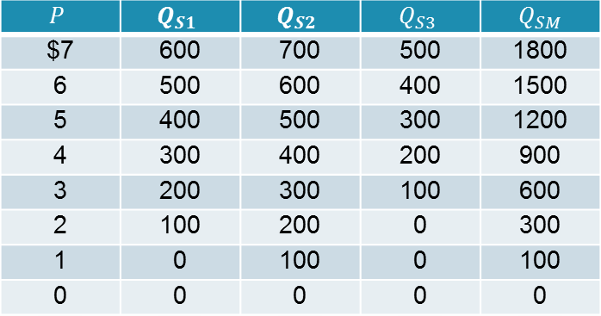
SUPPLY
Market Supply
Example: market supply schedule of pizzas when there are 3 suppliers

Slide 56
SUPPLY
Supply Changes
Important:
When the price changes, the quantity supplied changes. This is a movement
along the supply curve.
When a non price determinant changes, supply changes. This is a shift of the supply curve.

Slide 57
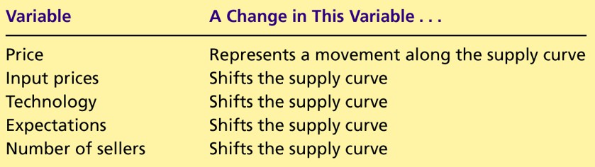
SUPPLY
Supply Changes
Variables that influence supply:

Slide 58
SUPPLY
Supply Changes
Example 1: changes in supply for ice-cream cones.
Example 2: changes in supply for pizza.

Slide 59
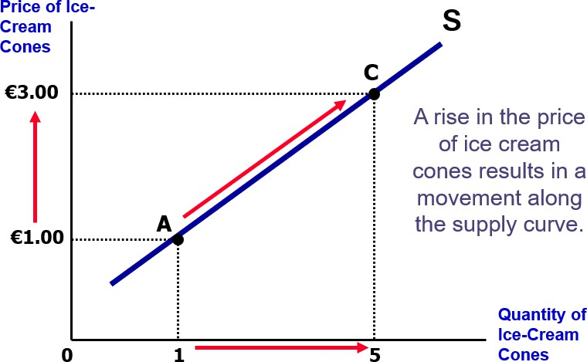
SUPPLY
Supply Changes: Example 1

Slide 60
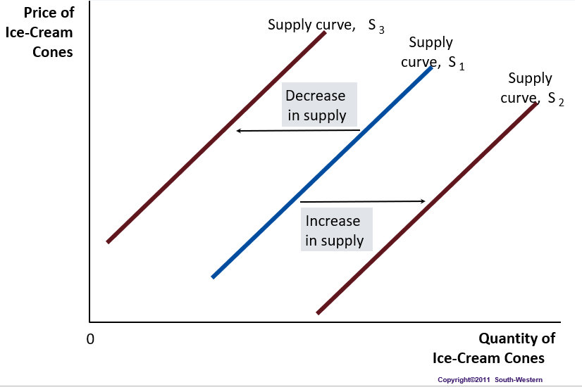
SUPPLY
Supply Changes: Example 1

Slide 61
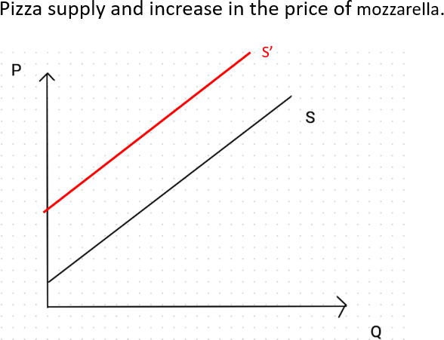
SUPPLY
Supply Changes: Example 2

Slide 62
SUPPLY
The algebra of Supply
Linear equation for a supply curve:
Qs = -150 + 50P
How much is the supplied quantity if the price is
  the price is £10:
  the price is £15:
Intercept horizontal axis:
Intercept vertical axis:

Slide 63
SUPPLY
The algebra of Supply
Linear equation for a supply curve:
Qs = -150 + 50P
How much is the supplied quantity if the price is
  the price is £10: Q = -150 + 50*10 = 350
  the price is £15: Q = -150 + 50*15 = 600
Intercept horizontal axis: Q = -150 + 50*0 = -150
Intercept vertical axis: 0 = -150 + 50P => P = 3

Slide 64
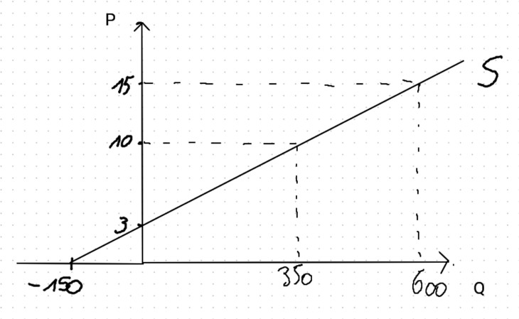
SUPPLY
Intercept horizontal axis:
Q = -150 + 50*0 = -150
Intercept vertical axis: 0 = -150 + 50P => P = 3

Slide 65
SUMMARY
The demand curve shows how the quantity of a good depends on the price.
  According to the law of demand, as the price of a good falls, the quantity demanded rises. Therefore, the demand curve slopes downward.
  In addition to price, other determinants of how much consumers want to buy include income, the prices of complements and substitutes, tastes, expectations, advertising and the number of buyers. If one of these factors changes, the demand curve shifts.
The supply curve shows how the quantity of a good supplied depends on the price.
  According to the law of supply, as the price of a good rises, the quantity
supplied rises. Therefore, the supply curve slopes upward.
  In addition to price, other determinants of how much producers want to sell include input prices, technology, expectations, … and the number of sellers. If one of these factors changes, the supply curve shifts.

