Slide 1
Chapter Nine
Foreign Exchange Markets
©McGraw Hill LLC. All rights reserved. No reproduction or distribution without the prior written consent of McGraw Hill.

Slide 2
Overview of Foreign Exchange Markets
Cash flows from the sale of products, services, or assets denominated in a foreign currency are transacted in foreign exchange (FX) markets
  A foreign exchange rate is the price at which one currency (e.g., the U.S. dollar) can be exchanged for another currency (e.g., the Swiss franc) in the foreign exchange markets
  These transactions expose U.S. corporations and investors to foreign exchange risk as the cash flows are converted into and out of U.S. dollars
Currency depreciation (appreciation) occurs when a country’s currency falls (rises) in value relative to other currencies

Slide 3
Background and History of Foreign Exchange Markets
During most of the 1800s, FX markets operated under a gold system, where currency issuers guaranteed to redeem notes, upon demand, in an equivalent amount of gold
From 1944-1971, the Bretton Woods Agreement called for the exchange rate of one currency for another to be fixed within narrow bands around a specified rate with the help of government intervention
  Smithsonian Agreement of 1971 allowed the dollar to be devalued and the boundaries between which exchange rates could fluctuate were increased from 1% to 2.25%
  In 1973, under Smithsonian Agreement II, exchange rate boundaries were eliminated, creating a free-floating system that is still partially in place

Slide 4
Background and History of Foreign Exchange Markets (Continued)
Though the free-floating FX rate system is still partially in place, central governments may still intervene in the FX markets
  In 1992, 12 major European countries and Vatican City pegged their exchange rates together to create a single currency, called the euro
Until 1972, the interbank FX market was the only channel through which spot and forward FX transactions took place
  Since 1972, organized markets such as the International Money Market (IMM) or the Chicago Mercantile Exchange (CME) have developed derivatives trading in FX currency futures and options

Slide 5
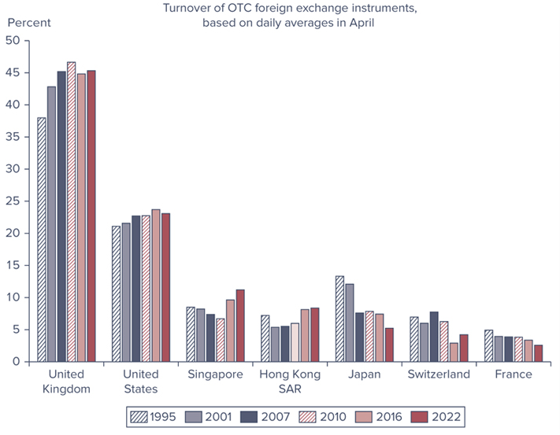
Largest Global FX Markets
Notes:
The foreign exchange markets have become among the largest of all financial markets, with turnover exceeding $9.8 trillion per day in 2022. Figure 9–1 shows the percentage share of the major foreign exchange trading centers worldwide from 1995 through 2022.

Slide 6
The Introduction of the Euro
Euro is the European Union’s single currency
  Started trading on January 1, 1999
  Creation of the euro had its origins in the creation of the European Community (EC) a consolidation of three European communities in 1967:
    European Coal and Steel Community, the European Economic Market, and the European Atomic Energy Community
  Significant effect throughout Europe, as well as the global financial system
  Dollar remains the unparalleled medium of exchange because it is the world’s easiest currency to buy or sell
    In 2022, 88% of all FX transactions were denominated in dollars, while 31% were denominated in euros
Notes:
With respect to the statistic about FX transactions, two currencies are involved in each FX transaction. As such, the sum of the percentage shares of individual currencies totals 200 percent instead of 100 percent.

Slide 7
Dollarization
Dollarization is the use of a foreign currency in parallel to, or instead of, the local currency
  After the gold standard and the Bretton Woods Agreement were abandoned, many countries achieved currency stabilization by pegging the local currency to a major convertible currency
  Other countries abandoned their local currency in favor of exclusive use of the U.S. dollar (or another major international currency, such as the euro)
Dollarization may occur unofficially or officially
Major advantage is the promotion of fiscal discipline and thus greater financial stability and lower inflation
  Panama, Ecuador, and El Salvador are the biggest economies to have officially dollarized
Notes:
The U.S. dollar, the euro, the New Zealand dollar, the Swiss franc, the Indian rupee, and the Australian dollar are the only currencies used by other countries for official dollarization.

Slide 8
Free-Floating Yuan
In 2005, China shifted away from its currency’s (the yuan) peg to the U.S. dollar
  China stated the value of the yuan would be determined using a “managed” floating system with reference to an unspecified basket of foreign currencies
  Partial free-floating of the yuan was in part the result of pressure from Western countries whose politicians argued that China’s currency regime gave it an unfair advantage in global markets
In 2009, China began a pilot program of internationalizing its currency by allowing Hong Kong banks to trade the yuan
  In 2011, China began to allow Americans to trade in the currency
In 2015, the IMF designated the Chines yuan an IMF-accepted reserve currency

Slide 9
Foreign Exchange Rates
Recall, a FX rate is the price at which one currency (e.g., the U.S. dollar) can be exchanged for another currency (e.g., the Swiss franc)
FX rates are listed in two ways:
  U.S. dollars received for one unit of the foreign currency exchanged (IN US$ or USD, also referred to as the direct quote)
  Foreign currency received for each U.S. dollar exchanged (PER US$, also referred to as the indirect quote)

Slide 10
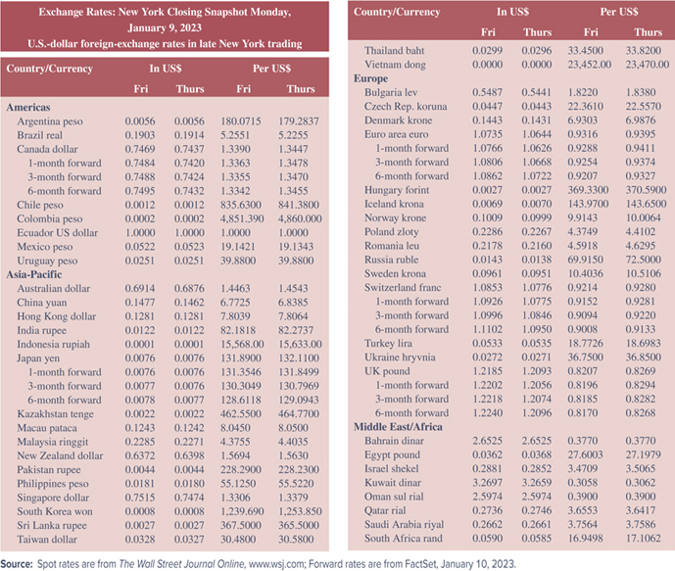
Foreign Currency Exchange Rates
Notes:
Table 9–1 lists the exchange rates between the U.S. dollar and other currencies as of 4:00 p.m. eastern standard time on January 9, 2023.
For example, the exchange rate of U.S. dollars for Canadian dollars (CAD) on January 9, 2023, was $0.7469 (US$/C$ or CAD/ USD), or U.S. $0.7469 could be received for each Canadian dollar exchanged. Conversely, the exchange rate of Canadian dollars for U.S. dollars was 1.3390 (C$/US$ or USD/CAD), or 1.3390 Canadian dollars could be received for each U.S. dollar exchanged.

Slide 11
Foreign Exchange Transactions
Two types of FX rates and FX transactions:
  Spot FX transactions involve the immediate exchange of currencies at the current (or spot) exchange rate
  Forward FX transaction is the exchange of currencies at a specified exchange rate (or forward exchange rate) at some specified date in the future
    Example is an agreement today (at time 0) to exchange dollars for pounds at a given (forward) exchange rate in three months
    Typically written for one-, three-, or six-month periods
Of the $7.51 trillion in average daily trading volume in the FX markets in 2022(on a net-net basis), 28% involved spot transactions while 72% involved forward and other transactions

Slide 12
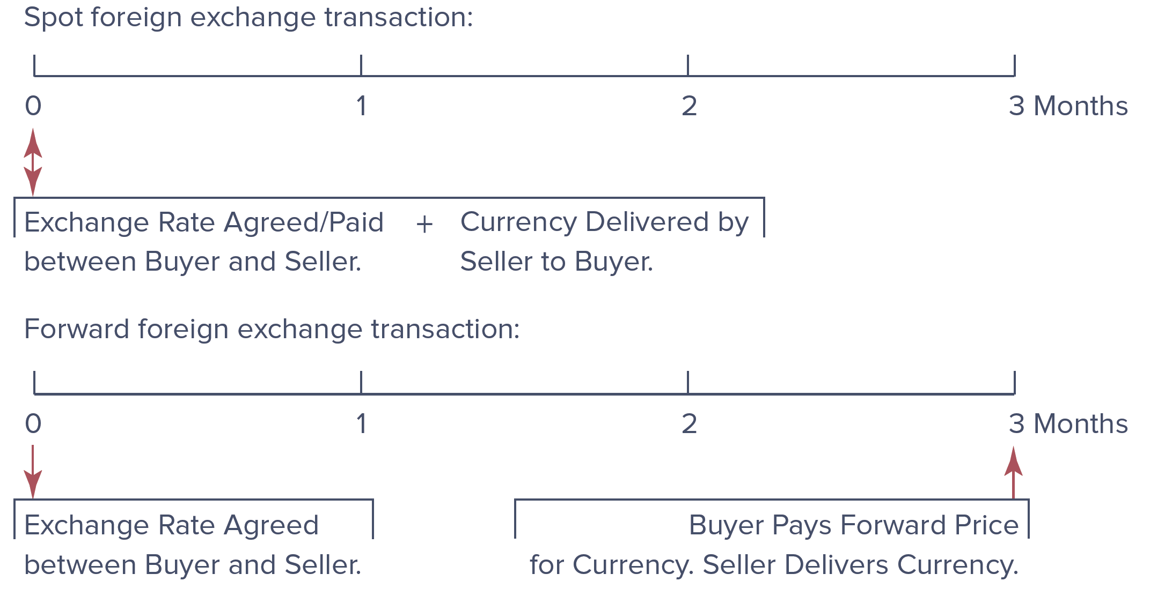
Spot versus Forward Foreign Exchange Transaction

Slide 13
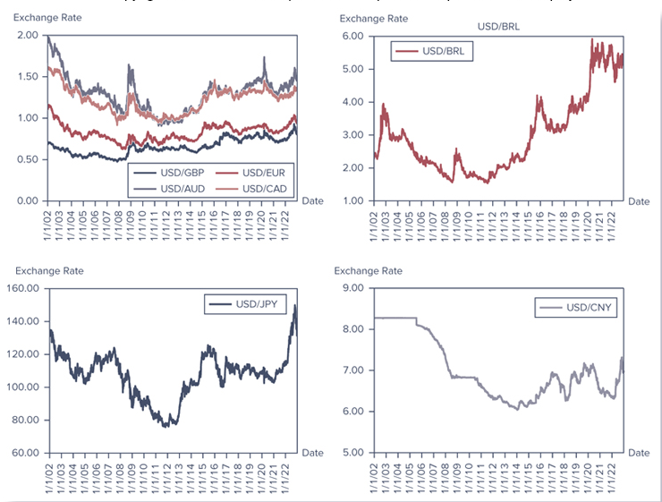
Exchange Rate of the U.S. Dollar with Various Foreign Currencies
Notes:
Figure 9–3 shows the pattern of spot exchange rates between the U.S. dollar and several foreign currencies from 2002 through 2022.

Slide 14
Measuring Risk and Return on FX Transactions
Risk involved with a spot FX transaction is that the value of the foreign currency may change relative to the U.S. dollar over a holding period
  FX risk is also introduced by adding foreign currency assets and liabilities to a firm’s balance sheet
FIs, and particularly commercial banks, are the main participants in the FX markets

Slide 15
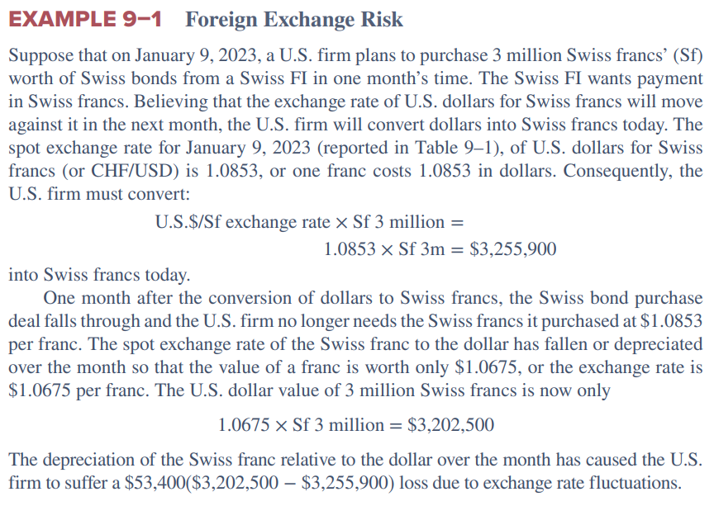
FX Risk: Example

Slide 16
FX Risk: Example (Continued)
To hedge, the U.S. firm could have entered into a forward:
  If the U.S. firm had entered into a one-month forward contract selling the Swiss franc on January 9, 2023, at the same time it purchase the spot francs, the U.S. firm would have been guaranteed an exchange rate of 1.0926 U.S. dollars per Swiss franc, or 0.9152 Swiss francs per U.S. dollar, on delivering the francs to the buyer in one month’s time
  If the U.S. firm had sold francs one month forward at 1.0926 on January 9, 2023, it would have largely avoided the $53,400 loss
  By selling 3 million francs forward, it would have received 1.0926 x Sf 3 million = $3,277,800 at the end of the month, suggesting a gain of $3,277,800 - $3,255,900 = $21,900.00 on the combined spot and forward transactions
Notes:
This discussion is directly tied to the example provided on the previous slide.

Slide 17
Hedging Foreign Exchange Risk
Managers hedge to manage their exposure to currency risks, not to eliminate it
  While it reduces possible losses, it also reduces possible gains
An FI can better control the scale of its FX exposure in either of two major ways:
  On-balance-sheet hedging involves making changes in the on-balance-sheet assets and liabilities to protect the FI’s profits from FX risk
  Off-balance-sheet hedging involves no on-balance-sheet changes, but rather involves taking a position in forward or other derivative securities to hedge FX risk

Slide 18
On-Balance-Sheet Hedging
By directly matching its foreign asset and liability book, an FI can lock in a positive return or profit spread whichever direction exchange rates change over the investment period
Sources of FX risk exposure include the following:
  International differentials in real prices
  Cross-country differences in the real rate of interest
  Regulatory and government intervention
  Restrictions on capital movements
  Trade barriers
  Tariffs
Notes:
Example 9-3 provides an example of hedging on the balance sheet.

Slide 19
Hedging with Forwards
Securities that may be used to hedge foreign exchange risk includes the following:
  Forwards
  Futures and options foreign exchange contracts
  Foreign exchange swaps
Notes:
Example 9-4 provides an example of hedging with forwards.

Slide 20
Role of Financial Institutions in FX Transactions
FX market transactions are conducted among dealers mainly OTC using telecommunication and computer networks
  A major structural change in FX trading has been the growing share of electronic brokerage in the interbank markets at the expense of direct dealing (and telecommunication)
Since 1982, when Singapore opened its FX market, FX markets have operated 24 hours a day

Slide 21
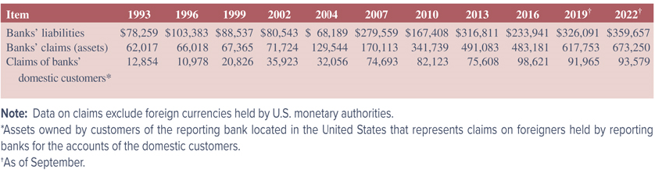
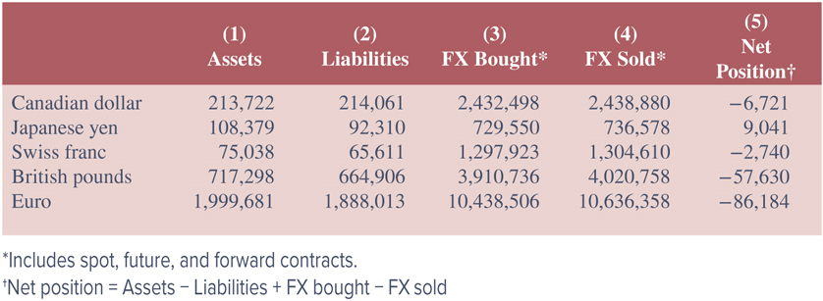
Financial Institutions in FX Transactions
Notes:
Table 9–4 lists the outstanding dollar value of U.S. banks’ foreign assets and liabilities for the period 1993 to September 2022.
Table 9–5 gives the categories of foreign currency positions (or investments) of all U.S. banks in five major currencies in September 2022. Columns 1 and 2 of Table 9–5 refer to the assets and liabilities denominated in foreign currencies that are held in the portfolios of U.S. banks. Columns 3 and 4 refer to foreign currency trading activities (the spot and forward foreign exchange contracts bought—a long position—and sold—a short position—in each major currency). A financial institution’s overall net foreign exchange (FX) exposure in any given currency can be measured by its net book or position exposure, which is measured in column 5.

Slide 22
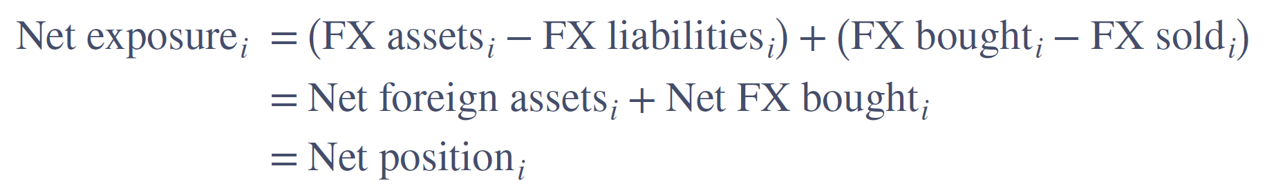
Role of Financial Institutions in FX Transactions (Continued)
An FI’s net exposure is the overall FX exposure in any given currency, measured by its net book or position exposure, where i = i^{th} country’s currency:
A positive net exposure position implies an FI is overall net long in a currency (i.e., the FI has purchased more foreign currency than it has sold)
A negative net exposure position implies the FI is net short (i.e., the FI has sold more foreign currency than it has purchased) in a foreign currency

Slide 23
Role of Financial Institutions in FX Transactions (Concluded)
A financial institution’s position in the FX markets generally reflects four trading activities:
  Purchase and sale of foreign currencies to allow customers to partake in and complete international commercial trade transactions
  Purchase and sale of foreign currencies to allow customers (or the FI itself) to take positions in foreign real and financial investments
  Purchase and sale of foreign currencies for hedging purposes to offset customer (or FI) exposure in any given currency
  Purchase and sale of foreign currencies for speculative purposes through forecasting or anticipating future movements in FX rates
Notes:
In the first two activities, the financial institution normally acts as an agent on behalf of its customers for a fee but does not assume the foreign exchange risk itself. In the third activity, the financial institution acts defensively as a hedger to reduce foreign exchange exposure. In the fourth, the FI acts as a speculator.

Slide 24
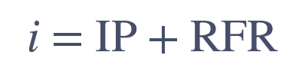
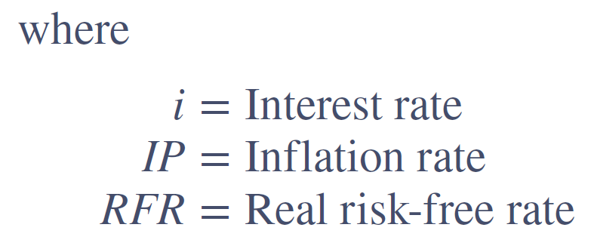
Interaction of Interest Rates, Inflation, and Exchange Rates
Recall the relationship among nominal interest rates, real interest rates, and expected inflation is the Fisher effect
Notes:
As global financial markets and financial institutions and their customers have become increasingly interlinked, so have interest rates, inflation, and foreign exchange rates.

Slide 25
Interaction of Interest Rates, Inflation, and Exchange Rates (Continued)
The international Fisher effect incorporated FX rates into the relationship; the expected spot rate is the current spot rate multiplied by the ratio of the foreign nominal interest rate to the domestic nominal interest rate:
Suppose the spot exchange rate of U.S. dollars for Canadian dollars is 0.7709, the current nominal interest rate in the U.S. is 4%, and the nominal interest rate in Canada is 5%. The international Fisher effect predicts:
Notes:
The international Fisher effect assumes the appreciation or depreciation of exchange rates is proportional to differences in nominal interest rates across countries.

Slide 26
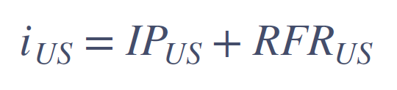
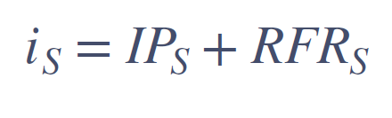
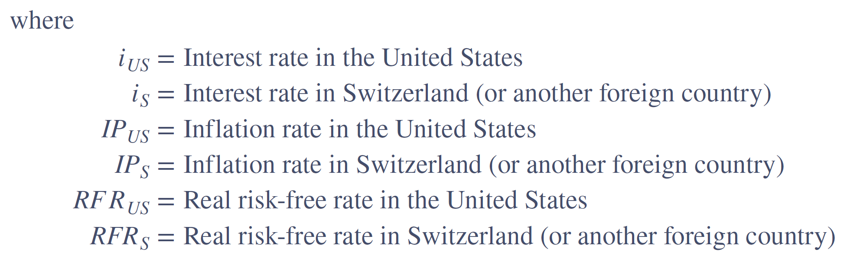
Purchasing Power Parity (PPP)
Purchasing power parity (PPP) is the theory explaining the change in foreign currency exchange rates as inflation rates in the countries change
Notes:
One factor affecting a country’s foreign currency exchange rate with another country is the relative inflation rate in each country. From Chapter 2, recall relative inflation rates are directly related to relative interest rates.

Slide 27
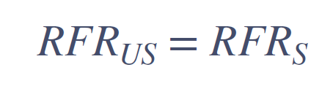
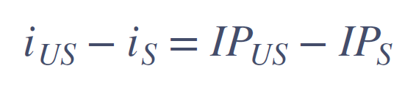
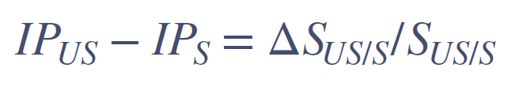
Purchasing Power Parity (PPP) (Continued)
Assuming real rates of interest (or rates of time preference) are equal across countries:
Then, the following is true:
PPP theorem states the change in the exchange rate between two countries’ currencies is proportional to the difference in their inflation rates:

Slide 28
Purchasing Power Parity (PPP) (Concluded)
The law of one price is an economic rule which states that, in an efficient market, identical goods and services produced in different countries should have a single price
  This is the theory behind purchasing power parity
An example of this line of thinking is demonstrated in The Economist’s “Big Mac” index

Slide 29
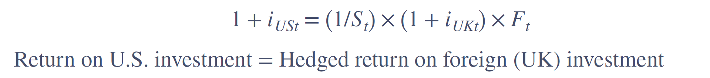
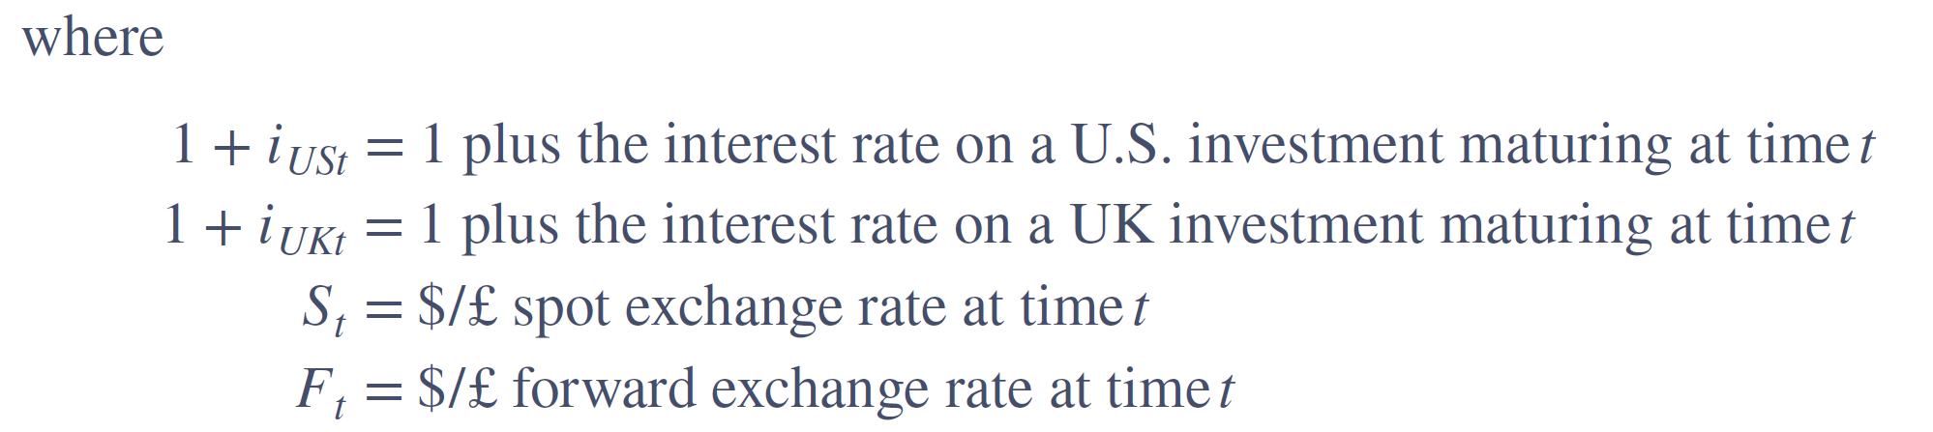
Interest Rate Parity
Interest rate parity theorem (IRPT) is the theory that the domestic interest rate should equal the foreign interest rate minus the expected appreciation of the domestic currency
IRPT can be expressed as the following:
Notes:
The relationship that links spot exchange rates, interest rates, and forward exchange rates is described as the interest rate parity theorem (IRPT).

Slide 30
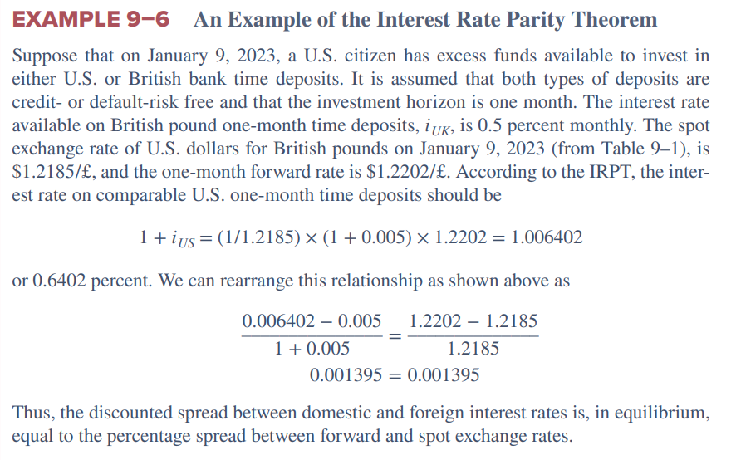
Interest Rate Parity: Example

