Slide 1
E-commerce 2023: business. technology. society.
Seventeenth Edition
Chapter 10
Online Content and Media
Copyright © 2024, 2020, 2022 Pearson Education, Inc. All Rights Reserved
Notes:
If this PowerPoint presentation contains mathematical equations, you may need to check that your computer has the following installed:
1) MathType Plugin
2) Math Player (free versions available)
3) NVDA Reader (free versions available)

Slide 2
Learning Objectives
10.1 Understand the major trends in the consumption of media and online content, the major revenue models for digital content delivery, digital rights management, and the concept of media convergence.
10.2 Understand the key factors affecting the online publishing industry.
10.3 Understand the key factors affecting the online entertainment industry.
10.4 Understand how creators are attempting to monetize user-generated content.

Slide 3
Streaming Wars: Who Will Win?
Class Discussion
Do you subscribe to any online video streaming services? If so, which ones? Is there a limit to how many services you would be willing to subscribe to, or a monthly cap on what you would be willing to pay?
What services have given you the best overall viewing or entertainment experience, and why?
Are you willing to pay a higher price in order to watch streaming video without ads?
Who do you think will win the “streaming wars” and why?

Slide 4
Trends in Online Content
Streaming wars: slowing growth; shift to advertising-supported model.
Mobile platform accelerates the transition to digital content
Tech companies become significant players in content production business
Book publishing stable as e-book sales growth slows
Podcasting becoming increasingly popular
Mobile platform and apps morph into content distribution platform
Time spent with digital media vastly exceeds time spent with TV

Slide 5
Content Audience (1 of 2)
Average American adult spends more than 4,800 hours/year consuming various media
Time spent with digital media accounts for more than 60% of total media time spent.
Desktop and mobile use: 8 and a quarter hours per day

Slide 6
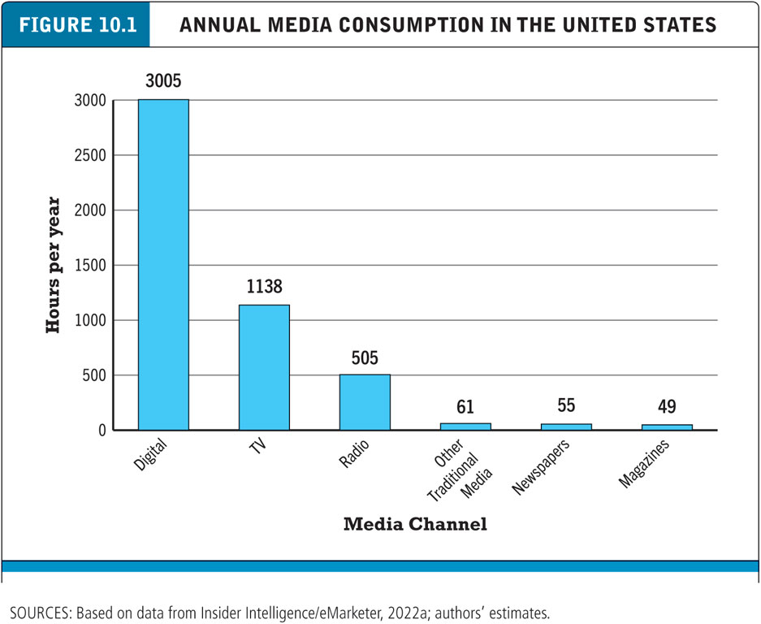
Figure 10.1 Annual Media Consumption in the United States
Notes:
Figure 10.1, Page 608.
In 2022, U.S. adults are expected to spend more than 4,800 hours consuming various types of media, with the majority of those hours spent with various forms of digital media.
SOURCES: Based on data from eMarketer, Inc., 2022a; authors’ estimates.
Alt Text
Long description: The media channels and their consumption data are as follows. (Digital, 3005), (tv, 1138), (radio, 505), (other traditional media, 61), (newspapers, 55), (magazines, 49).

Slide 7
Content Audience (2 of 2)
Cannibalization versus complementary
Does time on Internet reduce time spent with other media?
Massive shift of audience to Web, tablets, smartphones
Television viewing, music consumption remains strong, reading has increased
Impact of Internet:
Increase in total demand for media, including traditional products like books
Physical products replaced by digital

Slide 8
Insight on Society: Is Gen Z Really All That Different?
Class discussion:
What are some of the defining socioeconomic and behavioral patterns of Gen Z?
How does Gen Z differ from previous generations?
In what ways does evidence contradict stereotypes about Gen-Z’s behavior patterns?
Do you self-identify as a member of Gen Z? Why or why not?

Slide 9
Content Market: Entertainment and Media Industry Revenues
Total U.S. entertainment and media industry revenues estimated to be about $360 billion in 2021
Entertainment industry comprises almost 80% of total
Television and movie account for majority of entertainment industry revenue
Video game industry: rising in importance
Music and radio: less than 10% each
Podcasting: less than 1% but growing
Print media: about 20% of total
Book publishing, magazines, newspapers

Slide 10
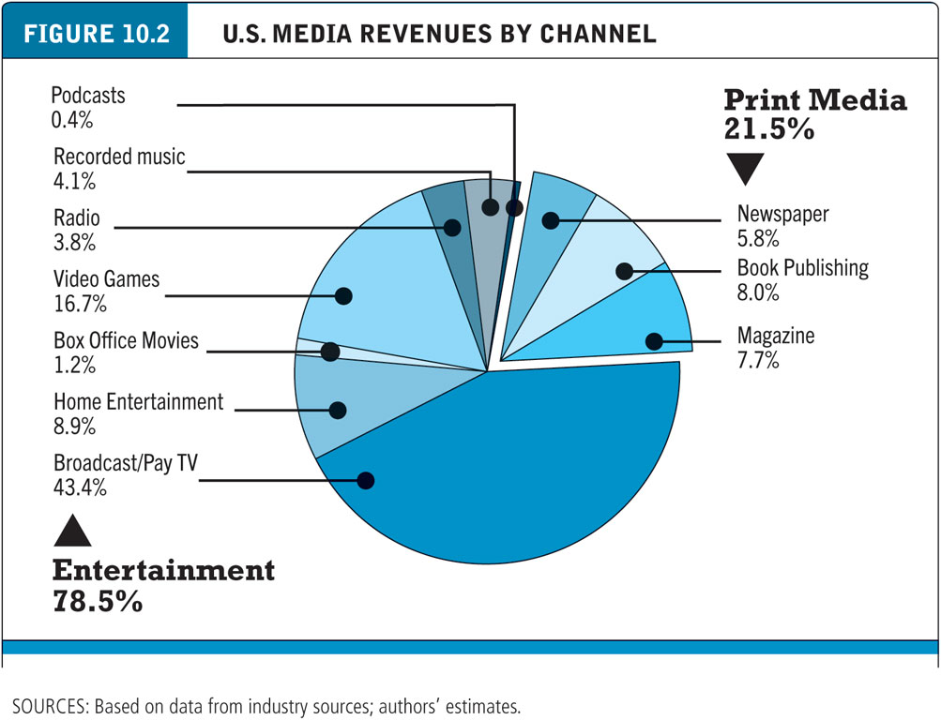
Figure 10.2 U.S. Media Revenues by Channel
Notes:
Figure 10.2, Page 675.
The various entertainment industries generate over three-quarters of U.S. media revenues.
SOURCES: Based on data from industry sources; authors’ estimates.
Alt Text
Long description: The channel types are entertainment with 78.5 percent of the total revenue and print media with 21.5 percent of it. The channels under entertainment are as follows. Podcasts, 0.4 percent; recorded music, 4.1 percent; radio, 3.8 percent; video games, 16.7 percent; box office movies, 1.2 percent; home entertainment, 8.9 percent; broadcast or pay tv, 43.4 percent. The channels under print media are as follows. Newspaper, 5.8 percent; book publishing, 8.0 percent; magazine, 7.7 percent

Slide 11
Online Content: Consumption, Revenue Models, and Revenue (1 of 2)
Online content delivery revenue models
Subscription
A la carte (pay for what you use)
Advertising supported (free/freemium)
Free content can drive users to paid content
Users increasingly paying for high-quality, unique content

Slide 12
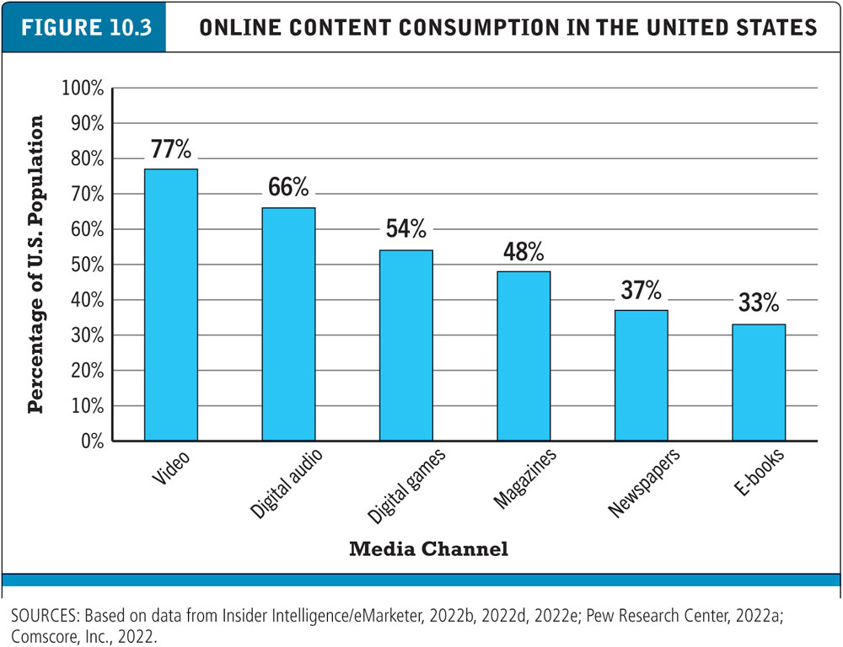
Figure 10.3 Online Content Consumption in the United States
Notes:
Figure 10.3, Page 612.
SOURCES: Based on data from Insider Intelligence/eMarketer, 2022b, 2022d, 2022e, 2020f; Pew Research Center, 2022a; Comscore, Inc., 2022.
Alt Text
Long description: The media channels and the consumer percentage values of the graph are as follows. (Video, 77 percent); (digital audio, 66 percent); (digital games, 54 percent); (magazines, 48 percent); (newspapers, 37 percent); (e-books, 33 percent).

Slide 13
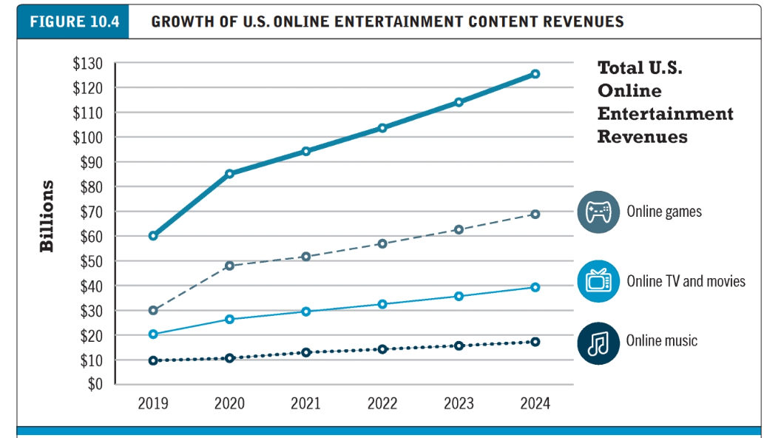

Slide 14
Online Content: Consumption, Revenue Models, and Revenue (2 of 2)
Early years: Internet audience expected free content but willing to accept advertising
Early content was low quality
With advent of high-quality content, fee models successful
iTunes
Millions of users buy from legal music sites
YouTube cooperating with Hollywood and New York film production studios

Slide 15
Digital Rights Management (D R M)
Technical and legal means to protect digital content from unlimited reproduction and distribution
D R M hardware and software encrypts content so that it cannot be used without some form of authorization, typically based on a payment.
DRM can prevent users from purchasing and making copies for widespread distribution over the Internet without compensating the content own-ers. Although music tracks in the iTunes Store were originally protected by DRM, Apple eventually abandoned the practice because of user objections and because Amazon had opened an online music store without any DRM protections, with the support of music industry firms, who had come to realize that DRM was preventing the music industry from exploiting the opportunities of the Internet and perhaps even encourag-ing an illegal market.
Streaming content
Difficult to copy
Walled garden:For instance, e-books purchased from Amazon can be read only on a Kindle device or with the Kindle app, and Kindle books cannot be converted to other formats

Slide 16
Media Industry Structure
Three separate segments
Print
Movies
Music
Each dominated by few key players with little crossover
Delivery platform firms tried to become content producers
Comcast's acquisition of majority interest in N B C Universal
A T&T’s merger with Time Warner: did not succeed
Verizon’s purchase of A O L and Yahoo: did not succeed

Slide 17
Media Convergence
Has 3 dimensions. For the consumer, convergence means being able to get any con-tent you want, when you want it, on whatever platform you want it—from an iPad to an Android phone or an iPhone and to a desktop/laptop computer PC
Technological convergence: development of hybrid devices that can enable the delivery of various types of media via a single device
Hybrid devices
Content convergence:
Three aspects: Design, production, distribution
New tools for digital editing and processing
Industry convergence
merger of media enterprises into powerful, synergistic combinations. This convergence can take place either through acquisitions or through strategic alliances.

Slide 18
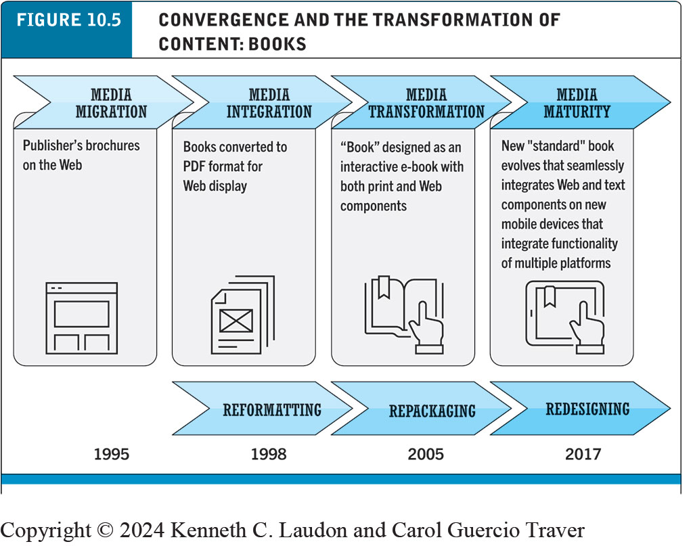
Figure 10.5 Convergence and the Transformation of Content: Books
Notes:
Figure 10.5, Page 616.
The Internet is making it possible for publishers and writers to transform the standard “book” into a new form that integrates features of both text and the Internet, and also transforms the content of the book itself.
Alt Text
Long description: In the first phase, media migration in 19 95, the publisher’s brochures move to the web. The second phase, media integration in 19 98, involves reformatting books and converting them to P D F format for web display. The third phase, media transformation in 2005, involves repackaging of books by designing them as interactive e-books with both print and web components. The final phase, media maturity in 20 17, involved redesigning books, as a new standard book that seamlessly integrates web and text components on new mobile devices which also integrates the functionality of multiple platforms.

Slide 19
Online Publishing Industry
Three segments
Online newspapers
E-books
Online magazines

Slide 20
Online Newspapers
Most troubled segment of publishing industry
Revenues shrunk from $60 billion in 2002 to an estimated $20 billion in 2021
Four factors in decline
Growth of Web, mobile devices as alternative medium
Alternative digital sources for news
Failure of to develop suitable new business models
Rise of social media and role of directing traffic to newspaper content

Slide 21
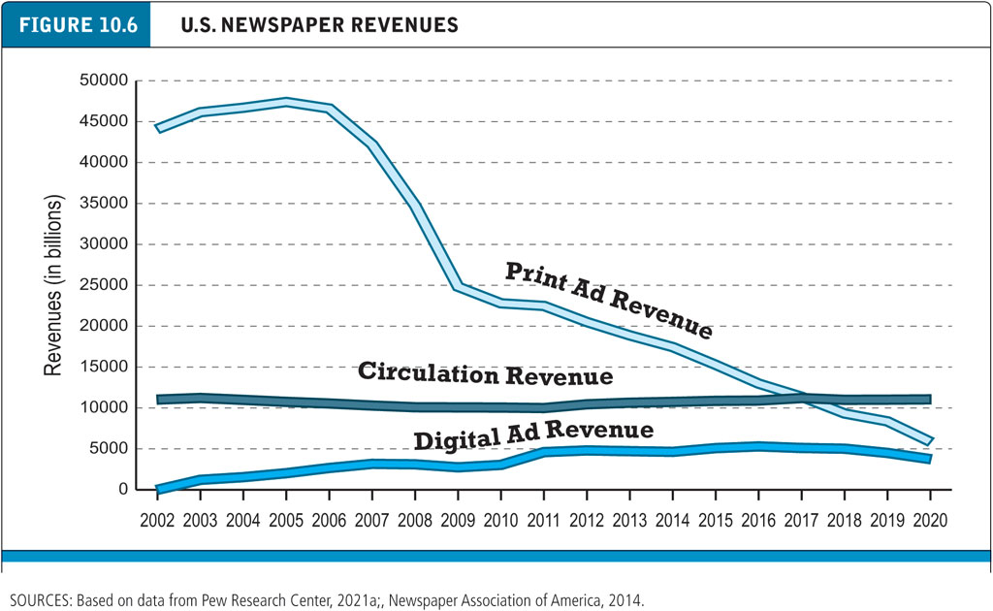
Figure 10.6 Newspaper Revenues
Notes:
Figure 10.6, Page 616.
U.S. newspaper ad revenues have declined precipitously since 2006. As a percentage of total revenues, circulation subscription revenues have become more important. Digital advertising revenue has also become an important source of revenue.
SOURCES: Based on data from Pew Research Center, 2021a; Newspaper Association of America, 2014.
Alt Text
Long description: There are three plotted lines in the graph. They are as follows. Print ad revenue starts at approximately 44000, in the year 2002 and decreases to approximately 6000 by the year 20 20. The circulation revenue starts at approximately 12000, in the year 2002 and remains the same by the year 20 20. The digital ad revenue starts at 0, in the year 2002 and increases to approximately 4000 by 20 20.

Slide 22
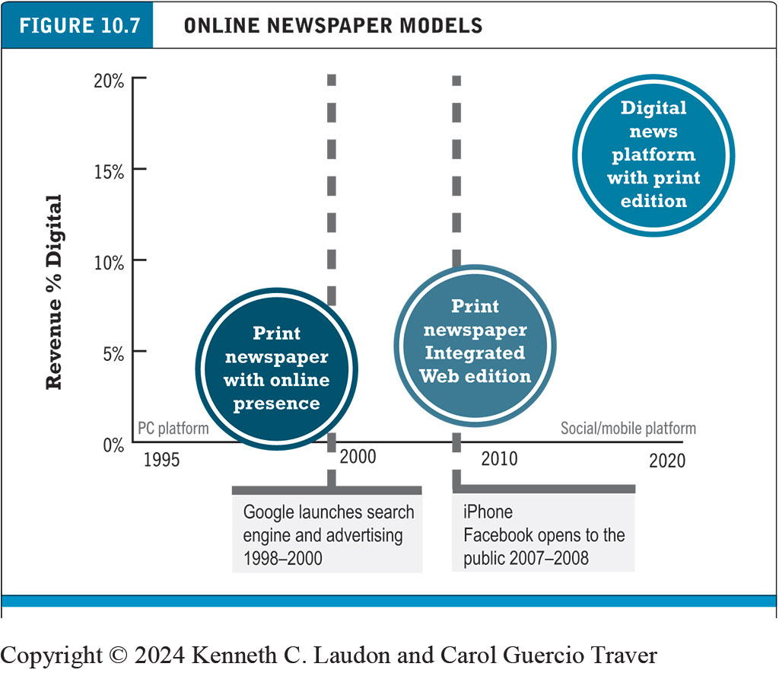
Figure 10.7 Online Newspaper Models
Notes:
Figure 10.7, Page 620.
Newspapers have gone through three different business models as they adapt to the Internet.
Alt Text
Long description: From 19 95 to 2000, on the pc platform, the print newspaper with an online presence business model generated digital revenues of up to about 7 percent. From 2000 to 20 10, the print newspaper with an integrated web edition business model generated digital revenues of less than 10 percent. From 2010 to 20 20, the digital news platform with a print edition on the social and mobile platforms generated digital revenues of up to 20 percent. There are two notes below the x-axis, they are as follows. Google launches a search engine and advertising between 1998 to 2000; the iPhone and Facebook were made open to the public between 2007 to 2008.

Slide 23
Online Newspaper Industry: Strengths and Challenges
Strength: Newspaper audience size and growth
Challenge: Digital ad revenue
Strength: Content is king
Challenge: Finding a revenue model
Challenge: Growth of digital-only digital competitors
Challenge: Surviving digital disruption

Slide 24
Insight on Business: Vox: Native Digital News
Class discussion:
How do you read news online? Which sites do you prefer, and why? Have you visited any Vox sites?
How are native digital news sites changing journalism?
Is Vox Media the future of digital news publishing? Why or why not?

Slide 25
Magazines Rebound on the Digital Platform
Physical magazine circulation falls after 2001
Exception is special interest magazines
Digital magazines
Ad revenue growing
Total audience size increasing
Popular websites drive traffic to online magazines
The New Yorker Today app
Magazine aggregators: Apple News+

Slide 26
E-books and Online Book Publishing
After several years of explosive growth, e-book sales have flattened in recent years
New channel for self-publishing authors
Major publishers still dominant source of book content
While some large bookstore chains have disappeared, the number of small independent bookstores had been growing prior to the Covid-19 pandemic

Slide 27
Amazon and Apple: The Digital Media Ecosystems
E-book hardware, software, combined with online megastores
Amazon Kindle: Linked to Amazon store and cloud storage
Apple iPad: Multipurpose tablet, linked to Apple stores
Authors able to bypass traditional agent, publisher channels

Slide 28
E-book Business Models
E-book industry composition
Intermediary retailers (booksellers), traditional publishers, technology developers, device makers (e-readers), vanity presses
Wholesale model
Retailers pay wholesale price and establish retail price
Agency model
Distributor as agent must charge publisher’s retail price
Apple and book publisher price-fixing

Slide 29
Online Entertainment Industry
Major players: Television and movies, music, games
Internet has transformed industry:
Mobile devices
Social networks featuring video streaming
Download and streaming services
Growth in broadband access
Closed streaming platforms reduce need for D R M
Emergence of very large-scale, integrated technology media companies
Amazon, Google, Apple, and Netflix.

Slide 30
Home Entertainment: Television and Movies (1 of 2)
Transition to Internet delivery platforms
Streaming and downloading services
O T T: Over-the-top (Internet) delivery
Mobile platform
Binge watching versus linear T V
Social network influences
Uncertain future for cable T V

Slide 31
Home Entertainment: Television and Movies (2 of 2)
Hollywood maintaining control of content creation, delivery and revenue
D V Ds, rental D V Ds
Electronic Sell Through (E S T) - downloading movies
Subscription streaming
Video On Demand (V O D)
Challenges
Digital formats produce less revenue than physical
Pressure to change release windows
Growing strength of online movie distributors like Netflix
Pirated content

Slide 32
Audio Entertainment: Music and Podcasts (1 of 2)
Most disrupted of content industries
Move from physical to digital product
Took 20 years until revenue in 2021 finally topped previous high in 1999
Digital revenues: 87% of all revenues in 2021
Two types of digital music services
Streaming subscription services (Internet radio)
Digital download (download to own)

Slide 33
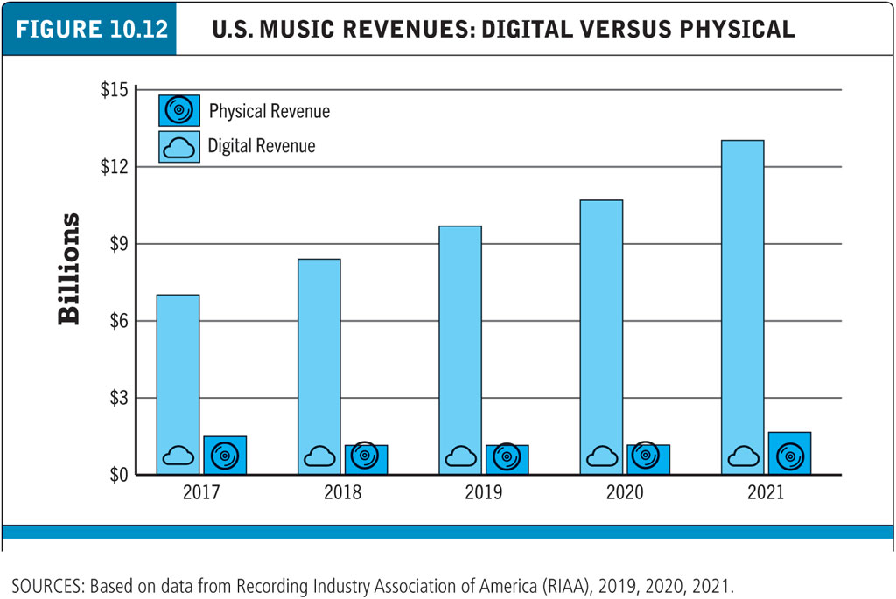
Figure 10.12 U.S. Music Revenues: Digital versus Physical
Notes:
Figure 10.12, Page 641.
Music industry revenues fell drastically between 19 99 and 20 15. However, revenues began to grow again because of the rise of streaming services. Revenue from digital sources now more than 85% of all U.S. music revenues.
SOURCES: Based on data from Recording Industry Association of America (RIAA), 2019, 2020, 2021.
Alt Text
Long description: The yearly music revenues in billions of dollars from physical and digital means are as follows. 20 17: digital revenue, 7 billion; physical revenue, 1.5 billion. 20 18: digital revenue, 8 billion; physical revenue, 1 billion. 20 19: digital revenue, 10 billion; physical revenue, 1 billion. 20 20: digital revenue, 11 billion; physical revenue, 1 billion. 20 21: digital revenue, 13 billion; physical revenue, 1.5 billion.

Slide 34
Audio Entertainment: Music and Podcasts (2 of 2)
Podcasts
Digital audio presentation that can be downloaded from Internet, stored on desktop or laptop computer or mobile device, and listened to at listener’s convenience
Becoming a professional talk content-distribution industry
Supported primarily by advertising

Slide 35
Games
Online gaming has had explosive growth
Pokémon Go; mobile platform
Types of digital gamers
Casual
Social
Mobile-fastest growing market
Massively multiplayer online (M M O)
Console
Business models in flux
E-sports, Twitch

Slide 36
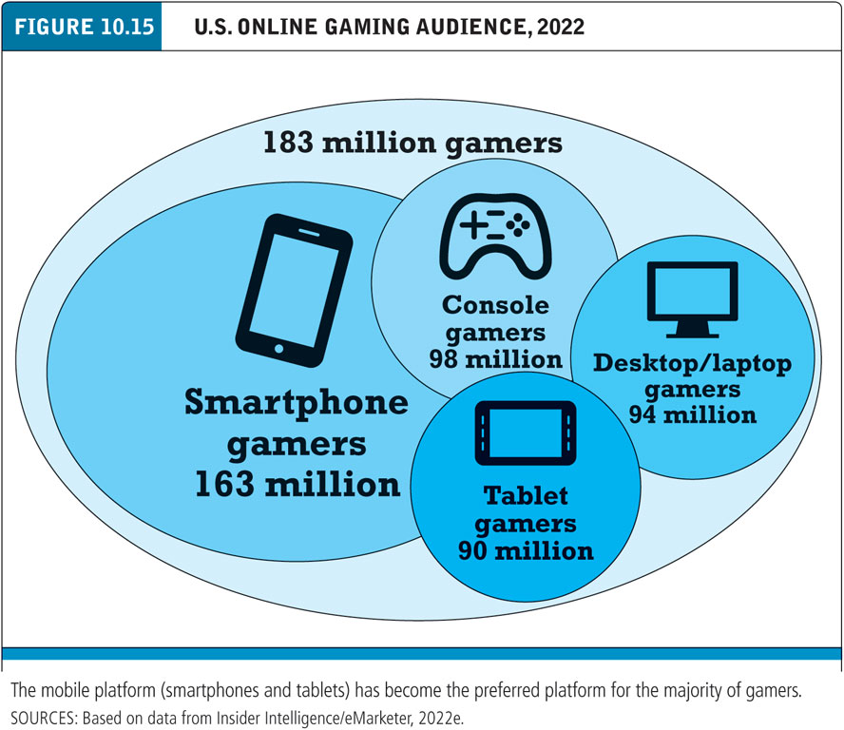
Figure 10.15 U.S. Online Gaming Audience, 2022
Notes:
Figure 10.15, Page 646.
The mobile platform (smartphone and tablets) has become the preferred platform for the majority of gamers.
SOURCES: Based on data from eMarketer, 2022e.
Alt Text
Long description: Four smaller oval shapes are inside it and are marked as follows. Smartphone gamers, 163 million; console gamer, 98 million; desktop or laptop gamers, 94 million; and tablet gamers, 90 million.

Slide 37
Insight on Technology: Twitch: Game On
Class Discussion
Have you ever viewed a live-streamed game or other content on Twitch? How about other live-streaming platforms?
Who are Twitch’s primary competitors?
What are some of the major issues facing Twitch?

Slide 38
Creators and User-Generated Content (1 of 2)
Types of user-generated content
Print, video, digital audio, games, art, photography
Revenue models
Advertising
Sales of digital content (subscription or on a per-piece basis)
NFTs
“Tips” from fans
Events

Slide 39
Creators and User-Generated Content (2 of 2)
Platforms
YouTube
Best known
Patreon
Membership platform
Roblox
Online game platform
Social networks
Creator funds
Only small percentage of creators have received more than $5000 from a creator fund

Slide 40
Careers in E-commerce
Position: Digital Audience Development Specialist
Qualification/Skills
Preparing for the Interview
Possible Interview Questions

Slide 41
Copyright
This work is protected by United States copyright laws and is provided solely for the use of instructors in teaching their courses and assessing student learning. Dissemination or sale of any part of this work (including on the World Wide Web) will destroy the integrity of the work and is not permitted. The work and materials from it should never be made available to students except by instructors using the accompanying text in their classes. All recipients of this work are expected to abide by these restrictions and to honor the intended pedagogical purposes and the needs of other instructors who rely on these materials.

