Slide 1
INTERNATIONAL LEGAL ENGLISH
Öğretim Görevlisi: Özen TEKİN

Slide 2
UNIT 11: INTELLECTUAL PROPERTY
Intellectual property (IP) refers to creations of the mind that are legally protected from unauthorized use by others. It includes intangible assets such as inventions, literary and artistic works, designs, symbols, names, and images used in commerce. Intellectual property laws grant creators certain exclusive rights to their works for a specified period, enabling them to benefit from their ideas and creations.
Key categories of intellectual property include:
Patents: Protect inventions and technological advancements.
Copyrights: Protect literary, artistic, and musical works.
Trademarks: Protect brand names, logos, and slogans.
Trade Secrets: Protect confidential business information that gives a competitive edge.
The goal of intellectual property law is to encourage innovation and creativity while balancing the rights of creators with public access to knowledge and cultural works.

Slide 3
Reading A: Background Information
Intellectual property rights divided as:
Patents
Trade Marks
Copyrights
Monopoly right
Exclusive right
Prohibit unauthorised use

Slide 4
Intangible property rights refer to legal rights associated with property that does not have a physical form but holds value. These rights allow the owner to control, use, and benefit from intangible assets, which are often intellectual or digital in nature.
Examples of intangible property rights include:
Intellectual Property Rights: Rights over creations of the mind, such as patents, copyrights, trademarks, and trade secrets.
Goodwill: The reputation or customer loyalty associated with a business, which can add value beyond its physical assets.
Licenses: Rights to use software, intellectual property, or other intangible assets under agreed terms.
Digital Assets: Rights over domain names, digital content, or crypto currency.
Franchising Rights: Rights to operate a business under a recognized brand or system.
These rights are enforceable by law and often involve contracts, licenses, or other legal instruments to ensure proper use and protection.

Slide 5
2.2.
Intangible rights: Refers to intellectual property rights or rights to assets which lack physical existence
Right of fair use: It’s privilege which is afforded to third parties to use copyrighted work without the consent of the copyright holder
Infringement of rights: Use of an intellectual property right without authorisation from the holder of the right

Slide 6
Reading B: Case Brief
State Street Bank & Trust Co. v. Signature Financial Group, Inc. is an important court case from 1998 about patents for business methods and software.
Background:
Signature Financial Group created a system called the "Hub and Spoke" model. This system helped manage mutual funds by combining their money (the "Hub") and dividing it among smaller funds (the "Spokes"). They got a patent for this system. State Street Bank wanted to use a similar system and argued that Signature’s patent was not valid because it wasn’t something that could be patented.
Court's Decision:
The court decided that the patent was valid. It said that business methods could be patented if they had a clear and useful result. The court found that Signature’s system met this rule because it helped manage mutual funds in a useful way.
Impact:
This decision made it easier to get patents for business methods and software. Later, in other cases, the rules for what can be patented were reviewed and made stricter.
This case is important because it changed how patents for ideas and systems are handled.

Slide 7
Writing: Example
Facts of the case: State Street Bank & Trust Co. Vs Signature Financial Group (1998) involved the patentability of a data-processing system for managing mutual funds.
Legal issue in question: The legal issue was whether a patented data-processing system fell within two exceptions to patentability – mathmetical algorithms and mehods of doing business- and the issued patent was thus invalid.

Slide 8
Holdings and reasoning of the courts: The lower court held that the software patent involved was invalid on the grounds that it entailed two exceptions to patentability. However,, the US Court of Appeals for the Federal Circuit affirmed the patentability of business method-related software and rejected both exceptions to patentability. The court held that since the claims of the patent-at-issue were directed to a machine programmed with software, and such a machine produced a useful, concrete and tangible result, the software constituted patentable subject matter.
General legal significance of the case: As a result of the ruling, business-method software may now be patented.

Slide 9
Writing
Now it’s your turn!
Check my personal page and submit a momerandum on Diamond v. Chakrabarty, 447 U.S. 303 (1980)

Slide 10
Facts of the Case: Ananda Mohan Chakrabarty, a genetic engineer working for General Electric, developed a bacterium capable of breaking down crude oil, intended for use in treating oil spills. General Electric filed a patent application listing Chakrabarty as the inventor. The patent examiner rejected the application, stating that living organisms are not patentable under 35 U.S.C. § 101. The Board of Patent Appeals and Interferences upheld this decision. However, the United States Court of Customs and Patent Appeals reversed it, leading the Patent Office, represented by Commissioner Sidney A. Diamond, to appeal to the Supreme Court.
Legal Issue in Question: The central issue was whether a living, human-made microorganism constitutes patentable subject matter under 35 U.S.C. § 101, which permits patents for any new and useful "manufacture" or "composition of matter."

Slide 11
Holdings and Reasoning of the Court: The Supreme Court, in a 5-4 decision, held that a live, human-made microorganism is patentable under § 101. Chief Justice Warren E. Burger, writing for the majority, reasoned that Congress intended patentable subject matter to "include anything under the sun that is made by man." The Court emphasized that Chakrabarty's bacterium was not a product of nature but a result of human ingenuity, thereby fitting within the statutory language of patentable subject matter.
General Legal Significance of the Case: This decision was pivotal in expanding the scope of patentable subject matter to include genetically modified organisms, thereby fostering growth in the biotechnology industry. It established that living organisms could be patented if they are a product of human invention, influencing subsequent legal interpretations and the development of patent law concerning biotechnology.

Slide 12
Reading C: Business Method Patent
Read to text to find;
What does the letter of advice concern?
Who is it adressed to?
What does it recommend?
It concerns the general question of whether business methods can be patented and the specific question of whether Ms Costa’s Express Lane is a patentable business method.
It is adressed to Ms Costa, whose company, Libris, has developed the Express Lane Internet ordering solution.
It recommends a more detailed investigation of whether Express Lane meets the patentability requirements of novelty and non-obviousness.

Slide 13
Writing: Paraphrasing in Plain Language
9.1. What kinds of change have been made?
Paraphrase paragrapghs 3-4 in plain language on page 157. One example is done for you:
P2: The Office will tell the owner of the Community trademark and anyone who has a registered right in it, when the registration will run out, in good time before it runs out. I the office doen’t give this information, it will not be the fault of the Office.
-The long sentence has been broken down into shorter sentences
-Passive sentences have been made into active ones
-«Shall» has been replaced with other vers
-Formal vocabulary has been replaced with more common, everyday words

Slide 14
P3: The owner has to send in the request for renewal within a peiod of 6 months ending on the last day of the month in which protection ends. He also has to pay the fees within this period. If this has not been done, he can submit the request and pay the fees within a further period of 6 months following the day reffered to in the first sentence, as long as he pays additional fees within this further period.

Slide 15
P4: If the owner submits the request or pays the fees in respect of only some of the goods or services for which the Community trade mark is registered, the Office will only renew registration for those goods or services.

Slide 16
9.4. Write a response to Ms Fox’s email
Dear Ms Fox,
In response to your request of 18 December for information concerning the renewal of registration of a Community trade mark, allow me to answer the three questions you posed.
First of all, the Office for Harmonization in the Internal Market (OHIM) informs the owner of the Community trade mark when the registration will expire in good time before it expires. However, even if you don’t get notice of expiry, you still have to renew your registration, so you should be aware of the date of expiry.

Slide 17
Secondly, as the owner of the trade mark, you can renew the registration of the trade mark yourself. Alternatively, another person can renew the registration if you, the owner, have authorised this person to do so. Naturally, this means that I can do it for you if you wish.
Finally, in response to your question, you must submit the request for renewal 6 months bedore the last day of the month in which protection ends. Furthermore, you must pay the renewal fees within this 6 months peiod. If you don’ pay the fees within this period, you can submit the request and pay the fees within a further period of 6 months, but you would then have to pay additional fees.

Slide 18
I hope that the information I have provided is useful to you. If you would like further assistance in this matter, please do not hesitate to contact me.
Yours sincerely,
Estella Walters

Slide 19
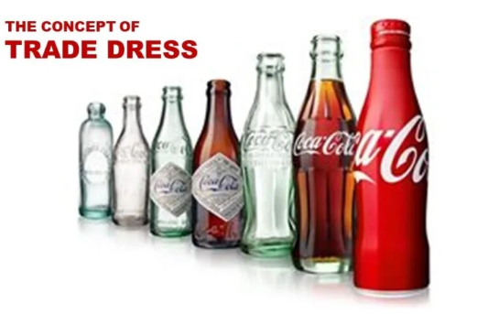
WHAT IS TRADE DRESS?
Trade dress refers to the visual appearance of a product or its packaging that signifies its origin.
It includes elements such as color, shape, design, texture, and overall presentation.
Trade dress can be a powerful tool in distinguishing products in the marketplace and protecting brand identity.

Slide 20
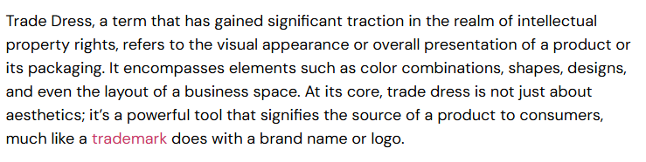
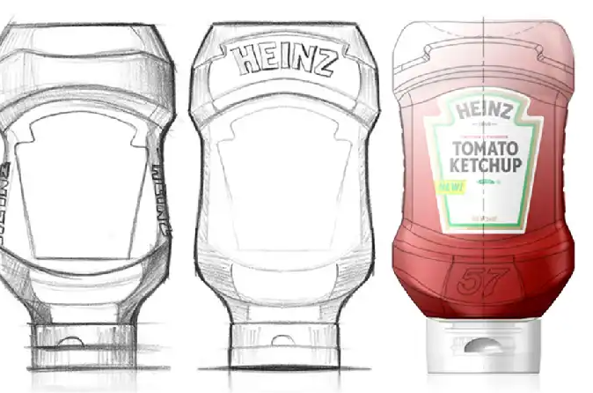

Slide 21
By definition, it is exactly what it implies. It refers to how brand owners choose to ‘dress’ their final product before it hits the market, by controlling design elements like their products’ size, shape, and color. A lot of thought goes into conceptualizing these elements because brands have realized that it helps consumers distinguish and recognize their favorite brands between an endless selection of almost identical products. Imagine skimming through the shampoo aisle for your favorite brand. Most of the time, you’d be able to visually identify what you’re looking for by its shape, size, and color.
The Basics: Trade Dress Vs. Design Patent
Trade dress rights are often confused with design patents. We’ve often encountered brand owners seeking to ‘trademark’ their products in its entire physical form or ‘patent’ a sneaker collection. To understand how to lawfully protect your trade dress rights, we must first touch upon a few key guidelines regarding its elements. This is to ensure that in actuality, your product requires trade dress enforcement, rather than a design patent:
Trade dress is strictly limited to the promotional and visual aspects of a product i.e. packaging.
It must never serve as a functional part of the product i.e. the buttons on your ‘smart remote control’ will not be protected, while the smart- remote’s unique design, shape, and color would be eligible for trade dress protection.
Good to know: Functional elements of a product can be protected but by design patents, under patent law.

Slide 22
Trade Dress Done Right
It comes with more benefits than what meets the eye. Not only does it serve as overall protection for your IP, but it also plays a very effective role in your overall brand protection strategy. But it is not as easy as it sounds. Transforming simple elements of your product such as color or size into a globally recognized trade dress requires endless research, development, and time. In other words, it is expensive.
But not too expensive for the below list of brands (trade dress example) who were visibly able to harness the power of trade dress.

Slide 23

Christian Louboutin’s Iconic Red Sole
We refer to the ‘red sole’ as iconic not only because it crowned Louboutin as the first shoe-designer in history to transform a visual element into global fashion culture but also due to the infinite debates it has sparked within the global IP community. It all started in the early nineties when equally renowned fashion house Yves Saint-Laurent released a shoe line with notable similarities to Louboutin’s design. It is now safe to say that YSL’s shoe line left the boutique’s display shelves sooner than the period they were intended to stay for.

Slide 24
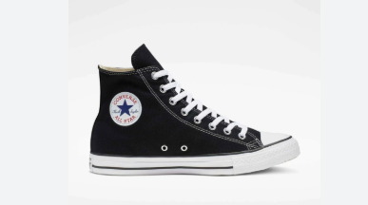
Converse’s Timeless Chucks
To date, Chuck Taylors remain the highest-selling basketball shoes in history. It would be a rare sighting to catch a basketball player wearing them on the courts, but Chuck’s have undeniably played a huge impact on the sneaker industry as a whole. Despite its shaky ability to maintain a solid fanbase over the years, chuck’s have always been around and are probably here to stay. The signature ‘toe cap’ combined with striped rubber sole trade dress has successfully opposed younger brands, trying to monetize on converse’s ageless popularity.

Slide 25
Heinz And The Ketchup Revolution
Heinz was ingeniously able to take their customers’ frustration at the difficulty of getting ketchup out of a bottle and turned it into instant success through a well-engineered bottle shape that was inherently distinctive. Protecting this shape as a trade dress is the main reason why rival attempts to copy the Heinz bottle design have been unsuccessful, to date.

Slide 26
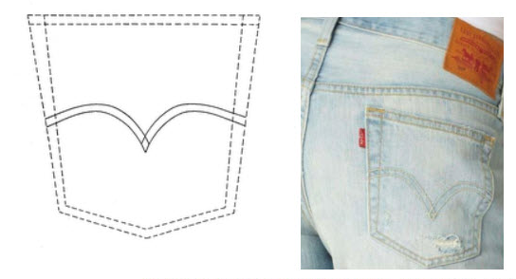
Levi Strauss & Co. have at least two design features that are in the middle of trademark infringement litigation. The first is with the red Levi’s tab that’s located on the back pocket of their denim jeans. In April of this year, they filed an infringement lawsuit against French fashion brand Kenzo in regards to the latter’s new collection that bears a similar tab on their clothes. They also were involved in a lawsuit filed against two Chinese companies that centered around the curved stitching design on the back pocket of jeans last year.

Slide 27
Proving acquired distinctiveness is not easy – the more common a design, the more difficult it will be to prove acquired distinctiveness. However, some items that help show acquired distinctiveness are:
Length of use – the longer you use it, the more likely consumers are to associate the design element with one company
Sales information – extensive sales are important to showing the penetration of the brand in the marketplace
Advertising – Extensive advertising is essential for protecting clothing trade dress
Consumer recognition surveys – some of the most valuable evidence is a survey of likely consumers to see if the mark is distinctive. Survey evidence is powerful, but extremely expensive (>$40,000 in most cases)
Unsolicited media – Reviews, check-ins, news articles mentioning or showing the design element.
Anything else that ties the design to a single company

Slide 28
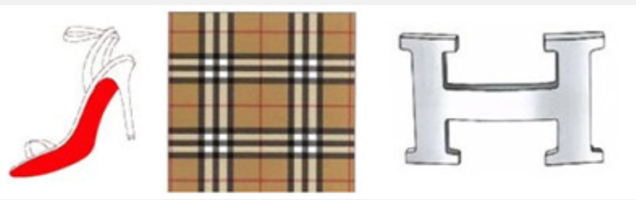
Trade dress is particularly important because it is one of the few mechanisms to protect overall appearance of designs and packaging. It protects unique design elements, such as color, shape and patterns, including Louboutin’s red-soled heels, Burberry’s plaid and Hermés’ H-shaped fixtures.

Slide 29
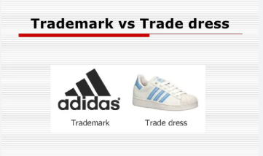
Trade Mark vs. Trade Dress
Trade Dress: Refers to the overall look and feel of a product, including packaging and design.
Trademark: Protects distinctive words, logos, or symbols that represent a brand.
Both serve to distinguish products in the marketplace, but trade dress protects the visual appearance, while a trademark protects brand names and logos.

Slide 30
Trade dress can be protected under trademark law if it meets the following criteria:
1. Distinctiveness: There are two types of distinctiveness under trademark law: inherent distinctiveness and acquired distinctiveness. So, the trade dress must either be inherently unique or have gained distinctiveness through widespread use in the marketplace. It should be able to serve as an indicator of the origin of the product or service.
2. Non-functionality: The trade dress must not be mainly functional, meaning it should not serve a practical purpose beyond its aesthetic value so that it can not be essential to the product’s use or purpose. Elements of a product or packaging that are primarily functional are typically not eligible for trade dress protection. For example, the shape or packaging of a product cannot be protected if it serves a practical function, such as a bottle design that facilitates pouring or storing the product. The rationale for this rule is that functional features are seen as part of the product's utility and should be accessible for competitors to use.
3. Likelihood of confusion: Trade dress must avoid confusing consumers about the origin of the product. In other terms, the trade dress must be unique enough to stop consumers from incorrectly assuming that a product from one company originates from another.

Slide 31
While trade dress can be protected without formal registration, registering the trade dress before the relevant intellectual property office is also possible. The registration process typically involves a search and analysis process, submitting an application, along with supporting evidence -if the relevant intellectual property office requires it- and a description and visual representations of the trade dress.
Registering the trade dress offers several advantages, including the presumption of the validity of the trade dress and its exclusive rights. A registered trade dress also allows the businesses to more easily enforce its rights in court and take legal action against infringing competitors. Remedies for trade dress violations may involve court orders to stop the infringement, financial compensation, and the removal or destruction of the infringing materials. Additionally, companies can take legal action under unfair competition laws if the trade dress is used in a manner that deceives consumers.

Slide 32
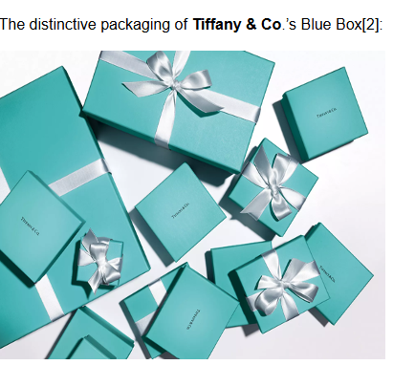
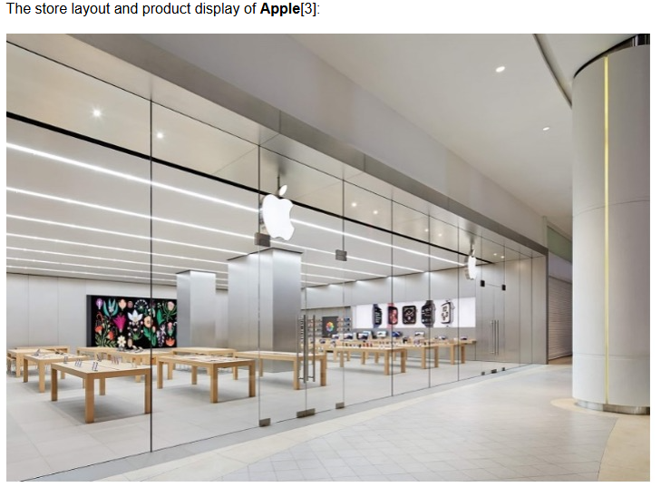
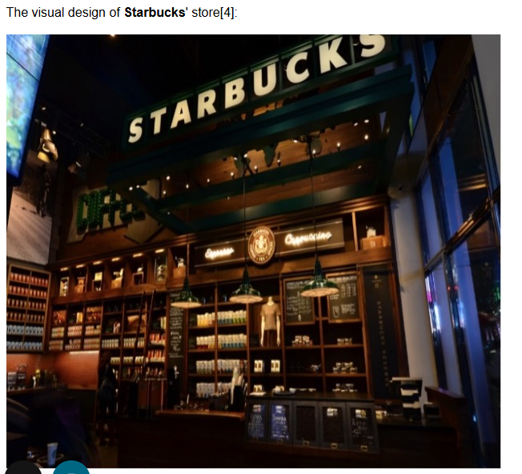

Slide 33
Trade Dress Infringement
A claim of trade dress infringement involves proving that the defendant’s use of a trade dress is likely to cause confusion among consumers. Courts typically assess several factors to determine if confusion exists:
Similarity of the trade dress: How similar the allegedly infringing trade dress is to the protected trade dress.
Strength of the trade dress: How well-known or distinctive the trade dress is in the market.
Evidence of actual confusion: Whether there is evidence that consumers have been confused by the trade dress.
Defendant’s intent: Whether the defendant intentionally adopted trade dress to imitate the plaintiff's dress.
If trade dress infringement is found, the defendant may be required to stop using the confusing trade dress and pay damages to the plaintiff.

Slide 34
Challenges in Protecting Trade Dress:
  Proving Distinctiveness: Proving that a trade dress is inherently distinctive or has acquired distinctiveness through consumer recognition can be difficult. Factors such as the duration of use, consumer surveys, and the degree of consumer recognition are typically considered in court.
  Non-functionality Requirement: Companies may face challenges when trying to protect trade dress that has functional elements. If the elements are primarily functional (e.g., a product's shape designed for optimal use), they may be excluded from protection.

Slide 35
Trade dress protection helps businesses safeguard the unique visual identity that makes their products or services stand out in the market. While it shares similarities with trademarks, trade dress is specifically concerned with the appearance of products or services. However, the protection is subject to the condition that the design is non-functional and distinctive, and it does not infringe on the rights of others.
This protection is a vital tool for businesses that have established a strong visual identity and want to prevent competitors from copying their distinctive look and potentially confusing consumers.

Slide 36
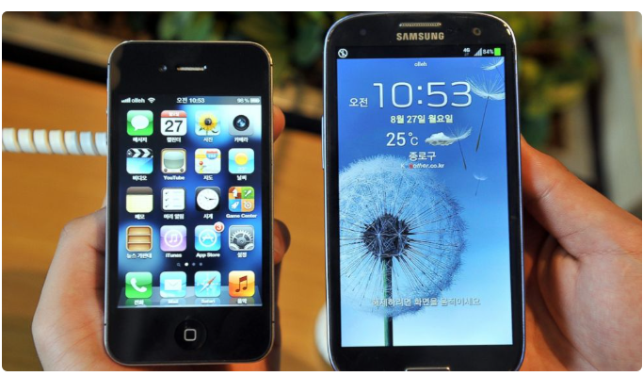
Analyze it according to trade dress concept

Slide 37
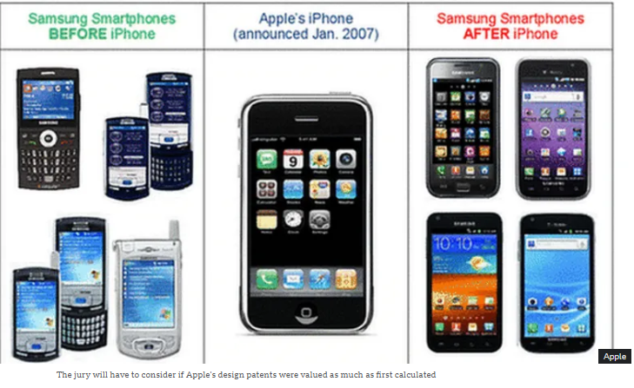

Slide 38
https://www.youtube.com/watch?v=cJjc2KsTrGQ

Slide 39
Apple VS Samsung (2011)
Background:
In 2011, Apple filed a lawsuit against Samsung, accusing the company of copying the design of the iPhone and iPad. Apple claimed that Samsung’s Galaxy smartphone and tablet looked too similar to their products, particularly in terms of trade dress, design, and overall appearance.
Key issues:
Apple argued that Samsung’s products imitated the trade dress of the iPhone and iPad.
Samsung, in turn, argued that Apple’s design patents were overly broad and that it wasn’t infringing on Apple’s intellectual property.

Slide 40
Discussion Points
Trade Dress in the Samsung vs. Apple Case:
  Apple argued that Samsung's smartphones and tablets copied the distinctive look of the iPhone and iPad, including features such as the rectangular shape with rounded corners, the grid of icons, and the overall design of the user interface.
  This raised the issue of whether trade dress could be applied to the shape and appearance of electronic devices like phones and tablets.
Design Patents and Functionality:
  Apple also had design patents that covered specific design elements like the shape of the iPhone and the user interface.
  The court had to decide whether the design patents Apple held were valid and if Samsung had infringed on them.
  Additionally, Samsung raised the defense that some of the design features were functional and not eligible for trade dress protection.

Slide 41
Outcome of the Case
In 2012, a U.S. jury found that Samsung had infringed on several of Apple’s patents and awarded Apple over $1 billion in damages.
However, the case continued for several years with appeals, and in 2018, the U.S. Supreme Court ruled that the damages should be reconsidered. In the end, Samsung paid $539 million in damages, but the case remains one of the most significant in the realm of intellectual property law.

Slide 42
Article
You are ready to read the article on my personal page
«The conflict between Apple and Samsung over patents and copyrights»

Slide 43
Significance for Trade Dress Protection
Trade dress refers to the overall visual appearance of a product or its packaging that signifies the source of the product to consumers. It can include the shape, color, and design elements that distinguish a product.
In the Samsung vs. Apple case, Apple argued that Samsung’s Galaxy smartphones and tablets infringed upon Apple’s trade dress, specifically in relation to the iPhone's distinctive look, which included:
  The rectangular shape with rounded corners.
  The grid of colorful icons on the screen.
  The general design of the iPhone and iPad user interfaces.
The case helped to define the boundaries of trade dress protection for technology products like smartphones and tablets, which are often viewed as functional products.

Slide 44
Why is it important
It clarified the scope of what can be protected as trade dress, particularly in consumer electronics.
It raised important questions about the distinction between functional elements (those that are necessary for the function of a device) versus distinctive visual elements (which can be protected as trade dress).
The case demonstrated that even highly functional designs could be protected under trade dress if the design had acquired secondary meaning—meaning that consumers could associate the design with a particular brand.

Slide 45
The Role of Design Patents
Design patents protect the ornamental design of a functional item (the way a product looks). Apple held design patents on specific aspects of the iPhone's appearance, including the shape and the icon layout of the interface.
Apple argued that Samsung’s Galaxy phones and tablets copied not only the design features but also the specific trade dress associated with the iPhone.
Why this is important:
The case raised the question of how broad design patents can be. Can a design patent be used to protect a simple rectangular shape with rounded corners?
The decision impacted the way courts view the validity and enforceability of design patents and how functional elements (such as the shape of a phone) are treated under the law.
It also emphasized the importance of design patents in protecting products that rely heavily on aesthetics (such as consumer electronics).

Slide 46
High-Stakes Economic Impact
The financial implications of the case were massive. Apple initially sought $2.5 billion in damages, and the jury awarded them $1.05 billion. Later, after appeals and adjustments, the final settlement was about $539 million.
Why this is important:
The case underscored the economic power of intellectual property, particularly in the technology sector.
The case showed how IP disputes can influence not only company finances but also broader market competition and innovation.
Large damage awards (such as the $1 billion initial verdict) served as a strong deterrent to companies considering copying the designs or trade dress of competitors.

Slide 47
Legal Precedent for Future Cases
The Samsung vs. Apple case set important legal precedents for future trade dress and design patent cases. In particular, it addressed:
The definition of trade dress in the tech industry.
The relationship between functionality and aesthetics in design patent claims.
The scope of protection for iconic product designs in the modern world, especially for companies operating in highly competitive industries like consumer electronics.
Why this is important:
It provided clarity on the boundaries of intellectual property protection in an increasingly digital world.
It gave future plaintiffs and defendants guidelines on how courts might rule in cases involving the design and trade dress of products.
Companies may be more cautious about imitating designs and may invest more heavily in IP protection after seeing how seriously the courts take these issues.

Slide 48
Consumer Perception and Branding
Consumer perception was at the core of Apple’s argument. Apple’s legal team emphasized that consumers identified the iPhone’s look and feel as something distinctively Apple. They argued that the look of the iPhone had acquired secondary meaning, making it more than just a product design, but a symbol of the brand.
Why this is important:
  The case highlighted the importance of brand identity in consumer electronics, where companies are trying to stand out in a crowded market.
  The ruling reinforced the idea that companies should protect their trade dress and designs in order to maintain brand recognition and prevent consumer confusion.
  This case raised awareness about the value of aesthetic features in creating a strong brand and showed how legal protections can extend beyond logos and names to include product appearance.

Slide 49
The Role of Jury Trials in IP Cases
The trial included a jury decision on many aspects of the case, including the determination of damages.
Why this is important:
The case illustrated the challenges of using a jury to decide complex IP disputes, particularly in the technology sector.
Jury members are often not experts in intellectual property law, which can complicate the process of determining damages and assessing patent infringement.
Some argued that these cases should be decided by judges with expertise in IP law, rather than juries, to ensure fairer and more accurate outcomes.

Slide 50
Conclusion: The Legacy of Samsung vs. Apple
The Samsung vs. Apple case is important because it set important precedents for the protection of design elements, clarified the scope of trade dress and design patent protections, and showed the economic and branding stakes of intellectual property disputes. It also reinforced the idea that product design—including shape, color, and functionality—is a critical part of a company’s overall intellectual property strategy.
This case is a critical reference point for any business involved in consumer product design and a landmark in the realm of intellectual property law, influencing both legal practice and corporate strategy moving forward.

