Slide 1
Chapter 3
Financial Instruments, Financial Markets, and Financial Institutions

Slide 2
Learning Objectives
Explain what financial instruments are, how they are used, and how they are valued.
Discuss the role and structure of financial markets and identity the characteristics of a well-run financial market.
Describe the role of financial institutions and structure of the financial industry.

Slide 3
Introduction
Indirect Finance: An institution stands between lender and borrower.
  We get a loan from a bank or finance company to buy a car.
Direct Finance: Borrowers sell securities directly to lenders in the financial markets.
  Direct finance provides financing for governments and corporations.
Asset: Something of value that you own.
Liability: Something you owe.

Slide 4
Introduction
Financial development is linked to economic growth.
The role of the financial system is to facilitate production, employment, and consumption.
Resources are funneled through the system so resources flow to their most efficient uses.

Slide 5
Introduction
We will survey the financial system in three steps:
Financial instruments or securities
  Stocks, bonds, loans and insurance.
  What is their role in our economy?
Financial Markets
  New York Stock Exchange, Nasdaq.
  Where investors trade financial instruments.
Financial institutions
  What they are and what they do.

Slide 6
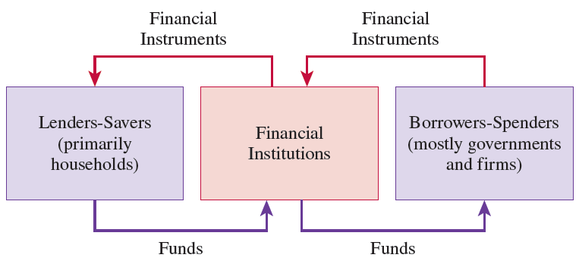
Figure 3.1: Funds Flowing through the Financial System

Slide 7
Financial Instruments
Financial Instruments: The written legal obligation of one party to transfer something of value, usually money, to another party at some future date, under specified conditions.
  The enforceability of the obligation is important.
  Financial instruments obligate one party (person, company, or government) to transfer something to another party.
  Financial instruments specify payment will be made at some future date.
  Financial instruments specify conditions under which a payment will be made.

Slide 8
Uses of Financial Instruments
Three functions:
  Financial instruments act as a means of payment (like money).
    Employees take stock options as payment for working.
  Financial instruments act as stores of value (like money).
    Financial instruments can be used to transfer purchasing power into the future.
  Financial instruments allow for the transfer of risk (unlike money).
    Futures and insurance contracts allows one person to transfer risk to another.

Slide 9
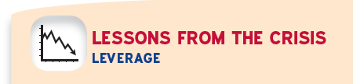
The use of borrowing to finance part of an investment is called leverage.
  Leverage played a key role in the financial crisis of 2007-2009.
The more leverage, the greater the risk that an adverse surprise will lead to bankruptcy.
    During the crisis, some financial firms leveraged more than 30 times their net worth.
    For those important firms, small declines in assets made these firms vulnerable.

Slide 10
When losses are experienced, firms try to deleverage to raise net worth.
    As many institutions deleveraged, prices fell, losses increased, and net worth fell.
  This is called the “paradox of leverage”.
    Reinforces the leverage spiral
    Both spirals fed the cycle of falling prices and widespread deleveraging - the hallmark of the financial crisis of 2007-2009.

Slide 11
Characteristics of Financial Instruments
These contracts are very complex.
This complexity is costly, and people do not want to bear these costs.
Standardization of financial instruments overcomes potential costs of complexity.
Financial instruments also communicate information, summarizing certain details about the issuer.

Slide 12
Characteristics of Financial Instruments
Mechanisms exist to reduce the cost of monitoring the behavior of counterparties.
  A counterparty is the person or institution on the other side of the contract.
The solution to the high cost of obtaining information is to standardize both the instrument and the information about the issuer.
Financial instruments are designed to handle the problem of asymmetric information.
  Borrowers have some information they don’t disclose to lenders.

Slide 13
Underlying Versus Derivative Instruments
  Underlying instruments are used by savers/lenders to transfer resources directly to investors/borrowers.
  This improves the efficient allocation of resources.
    Examples: stocks and bonds
Derivative instruments are those where their value and payoffs are “derived” from the behavior of the underlying instruments.
  Examples are futures, options, and swaps.
  The primary use is to shift risk among investors.

Slide 14
A Primer for Valuing Financial Instruments
Four fundamental characteristics influence the value of a financial instrument:
Size of the payment:
  Larger payment - more valuable.
Timing of payment:
  Payment is sooner - more valuable.
Likelihood payment is made:
  More likely to be made - more valuable.
Conditions under with payment is made:
  Made when we need them - more valuable.

Slide 15
A Primer for Valuing Financial Instruments
We organize financial instruments by how they are used:
Primarily used as stores of value
Bank loans
  Borrower obtains resources from a lender to be repaid in the future.
Bonds
  A form of a loan issued by a corporation or government.
  Can be bought and sold in financial markets.

Slide 16
A Primer for Valuing Financial Instruments
Home mortgages
  Home buyers usually need to borrow using the home as collateral for the loan.
    A specific asset the borrower pledges to protect the lender’s interests.
Stocks
  The holder owns a small piece of the firm and entitled to part of its profits.
  Firms sell stocks to raise money.
  Primarily used as a stores of wealth.

Slide 17
A Primer for Valuing Financial Instruments
Asset-backed securities
  Shares in the returns or payments arising from specific assets, such as home mortgages and student loans.
  Mortgage backed securities bundle a large number of mortgages together into a pool in which shares are sold.
    Securities backed by sub-prime mortgages played an important role in the financial crisis of 2007-2009.

Slide 18

The biggest risk we all face is becoming disabled and losing our earning capacity.
  Insuring against this should be one of our highest priorities.
It is important to assess to make sure you have enough insurance.
Disability insurance is one way to transfer that risk to someone else.

Slide 19
Financial Instruments Used Primarily to Transfer Risk
Insurance contracts.
  Primary purpose is to assure that payments will be made under particular, and often rare, circumstances.
Futures contracts.
  An agreement between two parties to exchange a fixed quantity of a commodity or an asset at a fixed price on a set future date.
  A price is always specified.
  This is a type of derivative instrument.

Slide 20
Financial Instruments Used Primarily to Transfer Risk
Options
  Derivative instruments whose prices are based on the value of an underlying asset.
  Give the holder the right, not obligation, to buy or sell a fixed quantity of the asset at a pre-determined price on either a specific date or at any time during a specified period.

Slide 21
Financial Instruments Used Primarily to Transfer Risk
Swaps
  Agreements to exchange two specific cash flows at certain times in the future.
  Come in many varieties reflecting differences in maturity, payment frequency, and underlying cash flows

Slide 22
Financial Markets
Financial markets are places where financial instruments are bought and sold.
These markets are the economy’s central nervous system.
These markets enable both firms and individuals to find financing for their activities.
These markets promote economic efficiency

Slide 23
The Role of Financial Markets
Market liquidity:
  Ensure owners can buy and sell financial instruments cheaply.
  Keeps transactions costs low.
Information:
  Pool and communication information about issuers of financial instruments.
Risk sharing:
  Provide individuals a place to buy and sell risk.

Slide 24
The Structure of Financial Markets
Distinguish between primary or secondary markets
Categorize by the way they trade
Group based on the type of instrument they trade

Slide 25
Primary versus Secondary Markets
A primary market is one in which a borrower obtains funds from a lender by selling newly issued securities.
Secondary financial markets are those where people can buy and sell existing securities.

Slide 26

Trading is what makes financial markets work.
You can place a market order.
You can place a limit order
Executing a trade requires someone on the other side.
  Can seek help of a broker who can facilitate access to an electronic trading system known as an Electronic Communication network (ECN).

Slide 27
For a well known stock, the NYSE is another place from which to order.
  Liquidity may be supplemented by designated market makers (DMMs).
The system combines the buy (sell) orders of different customers at each price.
  We can see the aggregate supply (demand) of the stock at that price.

Slide 28
Centralized Exchanges, OTCs, and ECNs
Historically there were:
  Centralized exchanges - buyers and sellers meet in a central, physical location.
  Over-the-counter markets (OTS’s) - decentralized markets where dealers stand ready to buy and sell securities electronically.
More recently, there are electronic communication networks (ECN’s):
  Electronic system bringing buyers and sellers together without the use of a broker or dealer.

Slide 29
Centralized Exchanges, OTCs, and ECNs
Pace of structural change has accelerated dramatically
  Ongoing technological advances in computing and communications
    Physical location of exchange less important
  Increased globalization
    Encouraged more cross border mergers of exchanges.

Slide 30
Centralized Exchanges, OTCs, and ECNs
Decentralized electronic exchanges has benefits
  Customers can see their orders
  Orders happen quickly
  Can trade 24 hours a day
  Low cost
  Reduces operational risk, like when the NYSE was inaccessible for days after 9-11.

Slide 31
Centralized Exchanges, OTCs, and ECNs
But it also has risks
  The system has proven prone to errors
    Trading algorithm a rule based program for automatically executing hundreds or thousands of trades.
    High frequency traders (HFTs) can purchase or sell thousands of stocks in seconds.
We also see that efforts to speed up electronic trading drain resources from other uses.
  Could diminish the willingness of market makers to provide liquidity.

Slide 32
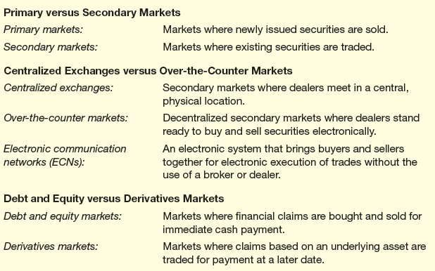
Table 3.4: The Structure of Financial Markets

Slide 33

High-frequency trading (HFT) poses at least five problems
It amplifies the risks of electronic operations
The complex real-time interaction of HFT algorithms can overwhelm trading platforms and disrupt the markets
The prevalence of HFT weakens the position of market makers, who provide liquidity to traditional investors
Creates a temptation for front-running customer orders, which damages investor confidence
It can trigger a socially unproductive arms race

Slide 34
Debt and Equity versus Derivative Markets
Used to distinguish between markets where debt and equity are traded and those where derivative instruments are traded.
Dept markets are markets for loans, mortgages, and bonds.
Equity markets are the markets for stocks.
Derivative markets are the markets where investors trade instruments like futures, options, and swaps.

Slide 35
Debt and Equity versus Derivative Markets
In debt and equity markets, actual claims are bought and sold for immediate cash payments.
In derivative markets, investors make agreements that are settled later.
Debt instruments categorized by the loan’s maturity
  Repaid in less than a year - traded in money markets.
  Maturity of more than a year - traded in bond markets.

Slide 36
Characteristics of a Well-Run Financial Market
Essential characteristics of a well-run financial market:
  Must be designed to keep transaction costs low.
  Information the market pools and communicates must be accurate and widely available.
  Borrowers promises to pay lenders much be credible.
  Lenders must be able to enforce their right of repayment quickly and at low cost.

Slide 37
Financial Institutions
Firms that provide access to the financial markets, both
  to savers who wish to purchase financial instruments directly and
  to borrowers who want to issue them.
Also known as financial intermediaries.
  Examples: banks, insurance companies, securities firms, and pension funds.

Slide 38
The Role of Financial Institutions
To reduce transaction costs by specializing in the issuance of standardized securities.
To reduce the information costs of screening and monitoring borrowers.
  They curb asymmetries, helping resources flow to most productive uses.
To give savers ready access to their funds.

Slide 39
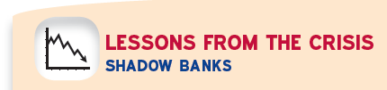
Financial intermediation and leverage in the U.S. have shifted away from traditional banks and toward other financial institutions less subject to government regulations.
  Brokerages, insurers, hedge funds, etc.
These have become known as shadow banks.
  Provide services that compete with banks but do not accept deposits.
  Take on more risk than traditional banks and are less transparent.

Slide 40
The rise of highly leveraged shadow banks, combined with government relaxation of rules for traditional banks, permitted a rise of leverage in the financial system as a whole.
Rapid growth in some financial instruments made it easier to conceal leverage and risk-taking.
The financial crisis of 2007-2009 transformed shadow banking.
  Scrutinize any financial institution that could, by risk taking, pose a threat to the financial system.

Slide 41
The Structure of the Financial Industry
We can divide intermediaries into two broad categories:
  Depository institutions,
    Take deposits and make loans
    What most people think of as banks
  Non-depository institutions.
    Include insurance companies, securities firms, mutual fund companies, hedge funds, private equity or venture capital firms, finance compnaies, and pension funds.

Slide 42
The Structure of the Financial Industry
Depository institutions take deposits and make loans.
Insurance companies accept premiums, which they invest, in return for promising compensation to policy holders under certain events.
Pension funds invest individual and company contributions in stocks, bonds, and real estate in order to provide payments to retired workers.

Slide 43
The Structure of the Financial Industry
Securities firms include brokers, investment banks, underwriters, mutual fund companies private equity firms, and venture capital firms.
  Brokers and investment banks issue stocks and bonds to corporate customers, trade them, and advise customers.
  Mutual-fund companies pool the resources of individuals and companies and invest them in portfolios - passive investing.
  Hedge funds do the same for small groups of wealthy investors.
  Private equity and venture capital firms also serve wealthy investors by acquiring controlling stakes in a few firms and manage them actively.

Slide 44
The Structure of the Financial Industry
Finance companies raise funds directly in the financial markets in order to make loans to individuals and firms.
Government-sponsored enterprises (GSEs) are federal credit agencies that provide loans directly for farmers and home mortgagors.

Slide 45
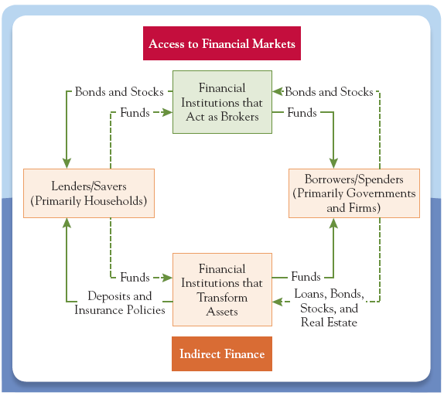
Figure 3.2: Flow of Funds through Financial Institutions

Slide 46

Financial access promotes both economic equality and economic growth
Finance allows countries to mobilize domestic savings effectively, lowering transaction costs
  Efficient means of payment broadens the markets for goods and services and facilitates a greater division of labor

