Slide 1
Chapter Twenty-Two
Managing Liquidity Risk on the Balance Sheet
©McGraw Hill LLC. All rights reserved. No reproduction or distribution without the prior written consent of McGraw Hill.

Slide 2
Liquidity Risk Management
Unlike other risks, liquidity risk is a normal aspect of the everyday management of an FI
  Banks must manage liquidity so they can pay out cash as deposit holders request withdrawals of their funds
At the extreme, liquidity risk can lead to insolvency
Some FIs are more exposed to liquidity risk than others
  Depository institutions (DIs) are highly exposed
  Mutual funds, hedge funds, pension funds, and property-casualty insurers have relatively low liquidity risk exposure
Financial crisis of 2008-2009 was, in part, due to liquidity risk
  Central banks around the world had to pump short-term cash into strained markets to stem the post-2007 liquidity crisis

Slide 3
Causes of Liquidity Risk
Liquidity risk arises for two reasons:
  Liability-side reason occurs when FI’s liability holders, such as depositors or insurance policyholders, seek to cash in their financial claims immediately
    FIs must meet withdrawals by borrowing additional funds or liquidating assets
    Some assets may be liquidated only at fire-sale prices
  Asset-side reason arises when FI needs to fund loans immediately
    Loan commitment allows a customer to borrow funds from an FI on demand, and when a borrower draws on its loan commitment, the FI must fund the loan on the balance sheet immediately
    FIs may meet this need by running down cash assets, selling off other liquid assets, or borrowing additional funds
Notes:
3

Slide 4
Liquidity Risk and
Depository Institutions (DIs)
DIs’ balance sheets typically have large amounts of short-term liabilities, such as demand deposits and other transaction accounts, that fund relatively long-term, illiquid assets (e.g., commercial loans and mortgages)
Demand deposit accounts and other transaction accounts are contracts that give holders the right to put their financial claims back to the DI on any given day and demand immediate repayment of the face value in cash
DIs know that normally only a small portion of demand deposits will be withdrawn on any given day
  Most demand deposits act as core deposits—i.e., they are a stable and long-term funding source
Deposit withdrawals are normally, in part, offset by the inflow of new deposits
Notes:
4

Slide 5
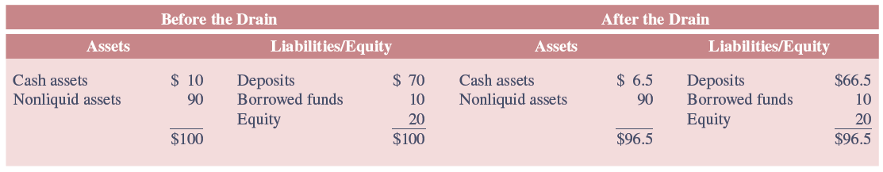
Effect of Net Deposit Drains on the Balance Sheet
Notes:
5
Table 22–2 illustrates a 5 percent, equal to $3.5 million, net deposit drain.

Slide 6
Liquidity Risk and
Depository Institutions (DIs) (Continued)
DI managers monitor net deposit drains, the amount by which cash withdrawals exceed additions; a net cash outflow
FIs manage a drain on deposits in two major ways:
  Purchased liquidity management is an adjustment to a deposit drain that occurs on the liability side of the balance sheet
    DI manager utilizes the markets for purchased funds, which are interbank markets for short-term loans
    Can be expensive, since DI must pay market rates to offset drains
    Availability may be limited should the DI incur insolvency difficulties
  Stored liquidity management is an adjustment to a deposit drain that occurs on the asset side of the balance sheet
    FI liquidates some of its assets, utilizing stored liquidity
Notes:
6
Traditionally, DI managers relied on stored liquidity as the primary mechanism of liquidity management. Today, many DIs— especially the largest banks with access to the money market and other nondeposit markets for funds—rely on purchased liquidity. Smaller DIs—such as community banks—more often look to stored liquidity.
Although stored liquidity management and purchased liquidity management are alternative strategies for meeting deposit drains, a DI can combine the two methods by using some purchased liquidity management and some stored liquidity management to meet liquidity needs.

Slide 7
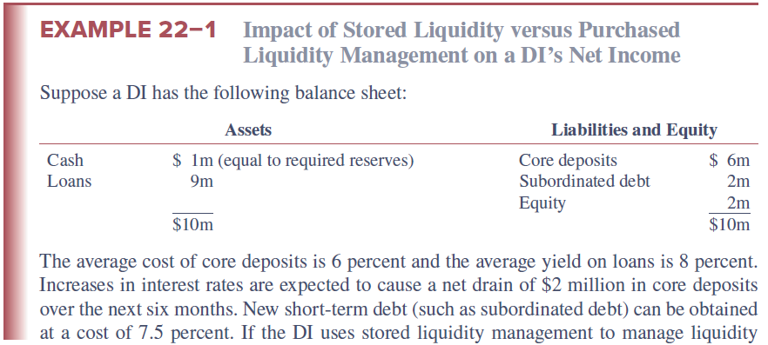
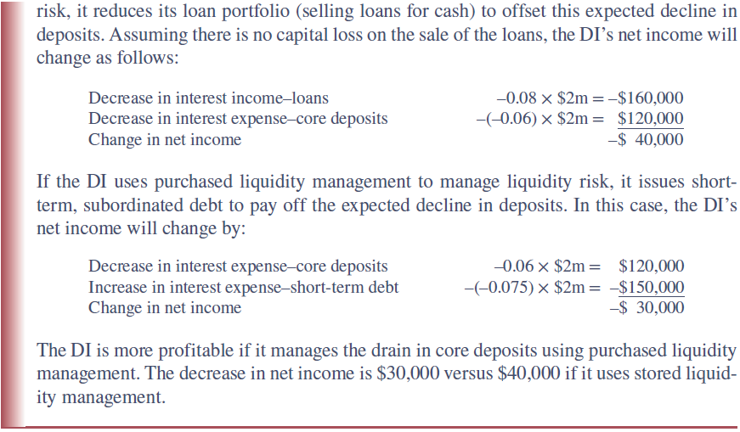
Stored Liquidity vs Purchased Liquidity Management on DI’s Net Income
Notes:
7

Slide 8
Liquidity Risk and
Depository Institutions (DIs) (Concluded)
Just as deposit drains can cause a DI liquidity problems, so can loan requests, resulting form the exercise, by borrowers, of loan commitments and other credit lines
DIs increased their loan commitments tremendously in recent years, with the belief they would not be exercised
  Unused loan commitments to cash grew from 529.4% in 1994 to 1,014.6% in October 2008 (before falling back to 608.6% during the financial crisis)
Notes:
8

Slide 9
Financing Gap and the Financing Requirement
One way to measure liquidity risk exposure is to determine the DI’s financing gap, the difference between a DI’s average loans and average (core) deposits
  If financing gap is positive, DI must find liquidity to fund gap
    Funding may come from via either purchase liquidity management (i.e., borrowing funds) or stored liquidity management (i.e., liquidating assets)
  Relationship may be written as follows:
Notes:
9
Having discussed the sources of liquidity risk for a DI, we next look at several methods currently used to measure the extent of a DI’s liquidity risk exposure.

Slide 10
Financing Gap and the Financing Requirement (Continued)
Financing requirement is the financing gap plus a DI’s liquid assets
  Larger financing gap and liquid asset holdings, the higher the amount of funds it needs to borrow in the money market and the greater is its exposure to liquidity problems
  Financing Requirement (or Borrowed Funds) =
  Financing Gap + Liquid Assets
Widening financing gap can warn of future liquidity problems since it may indicate increased deposit withdrawals and increasing loans due to more exercise of loan commitments
Notes:
10

Slide 11
Sources and Uses of Liquidity
Net liquidity statement lists sources and uses of liquidity, and, thus, provides a measure of a DI’s net liquidity position
  Used by DI managers to measure DI’s daily liquidity position, serving as the second method by which to measure liquidity risk exposure
DI can obtain liquid funds in three ways:
  Sell its liquid assets, such as T-bills, immediately with little price risk and low transaction costs
  Borrow funds in the money/purchased funds market up to a maximum amount
  Use any excess cash reserves over and above the amount held to meet regulatory imposed reserve requirements
All DIs report historical sources and uses of liquidity in annual and quarterly reports
Notes:
11

Slide 12
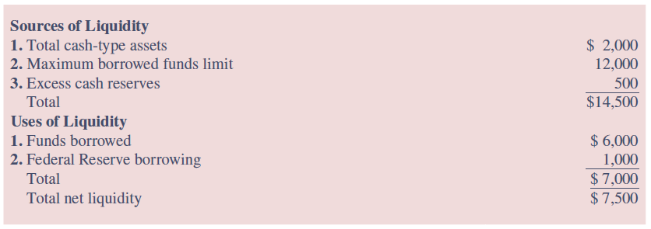
Net Liquidity Position
Notes:
12
A net liquidity statement for a hypothetical U.S. bank is presented in Table 22–9.
In Table 22–9, the DI’s sources of liquidity total $14,500 million. Compare this to the DI’s uses of liquidity—in particular, the amount of borrowed or purchased funds it has already utilized (e.g., fed funds, RPs borrowed) and the amount of cash it has already borrowed from the Federal Reserve through discount window loans. These total $7,000 million. As a result, the DI has a positive net liquidity position of $7,500 million.

Slide 13
Peer Group Ratio Comparisons
Third way to measure a DI’s liquidity exposure is to compare certain of its key ratios and balance sheet features with those for DIs of a similar size and geographic location
As shown below, BOA was exposed to substantially greater liquidity risk from unexpected takedowns of these commitments
Notes:
13
Table 22–10 lists the September 22 values of these ratios for the banks we reviewed in Chapter 12: Heartland Bank and Trust Company (HBT) and Bank of America Corporation (BOA).

Slide 14

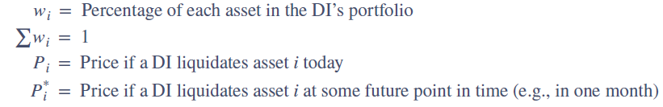
Liquidity Index
Final way to measure liquidity risk is to use a liquidity index, which measures potential losses a DI could suffer as a result of a sudden (or fire-sale) disposal of assets
  Larger the differences between fire-sale asset prices and fair market prices, the less liquid the DI’s asset portfolio
  Liquidity index will always lie between 0 and 1
  Liquidity index for particular DI could also be compared with indexes calculated for a peer group of similar DIs
Notes:
14

Slide 15
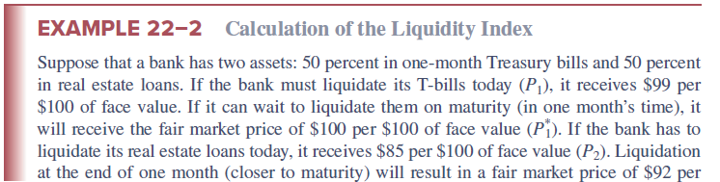
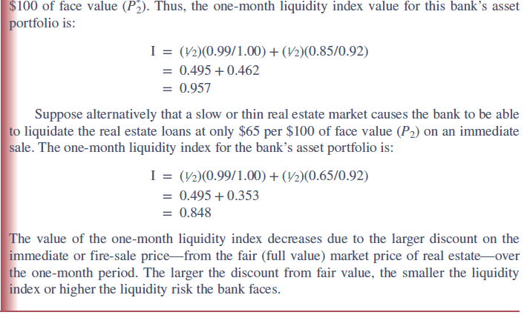
Calculation of the Liquidity Index
Notes:
15

Slide 16
New Liquidity Risk Measures Implemented by BIS
Two regulatory standards were developed by BIS for liquidity risk supervision:
  Liquidity coverage ratio (LCR) aims to ensure a DI maintains an adequate level of high-quality liquid assets (HQLA) that can be converted into cash to meet liquidity needs for a 30-day time horizon under an “acute liquidity stress scenario” specified by supervisors
  Net stable funds ratio (NSFR) takes a longer-term look at liquidity on a DI’s balance sheet
Notes:
16
The rule applies to large, internationally active banking organizations with $250 billion or more in total consolidated assets or $10 billion or more in total on-balance-sheet foreign exposure, and to consolidated subsidiary depository institutions of these banking organizations with $10 billion or more in total assets.

Slide 17
Liquidity Planning
Liquidity planning allows managers to make important borrowing priority decisions before liquidity problems arise
  Lowers costs of funds by determining an optimal funding mix
  Minimizes amount of excess reserves a DI needs to hold
Liquidity plans have a number of components:
    Delineation of managerial details and responsibilities
    Detailed list of fund providers most likely to withdraw funds and a pattern of fund withdrawals
    Identification of the size of potential deposit and fund withdrawals over various time horizons in the future
    Internal limits on separate subsidiaries’ and branches’ borrowings as well as acceptable risk premiums to pay in each market (fed funds, RPs, CDs, etc.)
Notes:
17

Slide 18
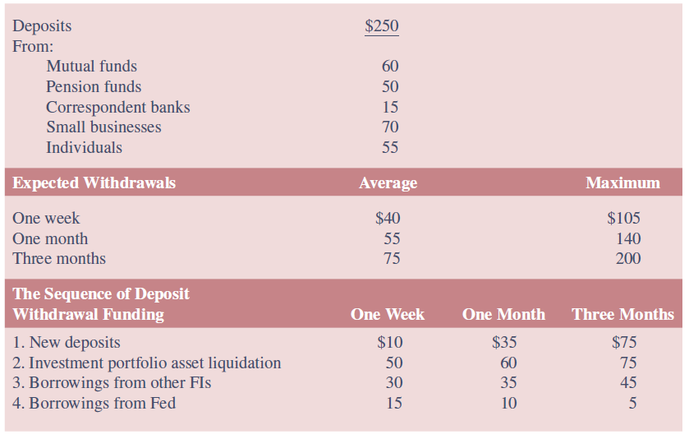
Deposit Distribution and Possible Withdrawals Involved in DI’s Liquidity Plan
Notes:
18
Consider, for example, Table 22–11.
The data are for a DI that holds $250 million in deposits from mutual funds, pension funds, correspondent banks, small businesses, and individuals. The table includes the average and maximum expected withdrawals over the next one-week, one-month, and one-quarter periods. The liquidity plan for the DI outlines how to cover expected deposit withdrawals should they materialize. In this case, the DI will seek to cover expected deposit withdrawals over the next three months first with new deposits, then with the liquidation of marketable securities in its investment portfolio, then with borrowings from other FIs, and finally, if necessary, with borrowings from the Federal Reserve.

Slide 19
Liquidity Risk, Unexpected Deposit Drains, and Bank Runs
Major liquidity problems arise if deposit drains are abnormally large and unexpected
Abnormal deposit drains can occur for a number of reasons, including the following:
  Concerns about a DI’s solvency relative to that of other DIs
  Failure of a related DI, leading to heightened depositor concerns about the solvency of surviving DIs (i.e., a contagion effect)
  Sudden changes in investor preferences regarding holding nonbank financial assets (e.g., T-bills or mutual funds shares) relative to DI deposits
A bank run is a sudden and unexpected increase in deposit withdrawals from a DI
Notes:
19

Slide 20
Deposit Drains and Bank Run Liquidity Risk
Demand deposits are first-come, first-served contracts in the sense that a depositor’s place in line determines the amount he or she will be able to withdraw from a DI
Incentives for depositors to withdraw their funds at the first sign of trouble creates a fundamental instability in the banking system
  A bank panic is a systemic or contagious run on the deposits of the banking industry as a whole
Regulatory mechanisms are in place to ease banks’ liquidity problems and to deter bank runs and panics
  Deposit insurance
  Discount window
Notes:
20

Slide 21
Deposit Insurance
FDIC was created in 1933 in the wake of the banking panics of 1930-1933, when some 10,000 commercial banks failed
Deposit insurance was first introduced in the U.S. in 1934 with coverage up to $2,500
  Coverage was increased to $100,000 in 1980 and to $250,000 in October 2008
Individuals can achieve many times the $250,000 coverage cap on deposits by structuring their deposits in a particular fashion
Primary intention of deposit insurance is to deter DI runs and panics, but a secondary and related objective has been to protect the smaller, less informed saver against the reduction in wealth that would occur if that person were last in line were the DI to fail
Notes:
21

Slide 22
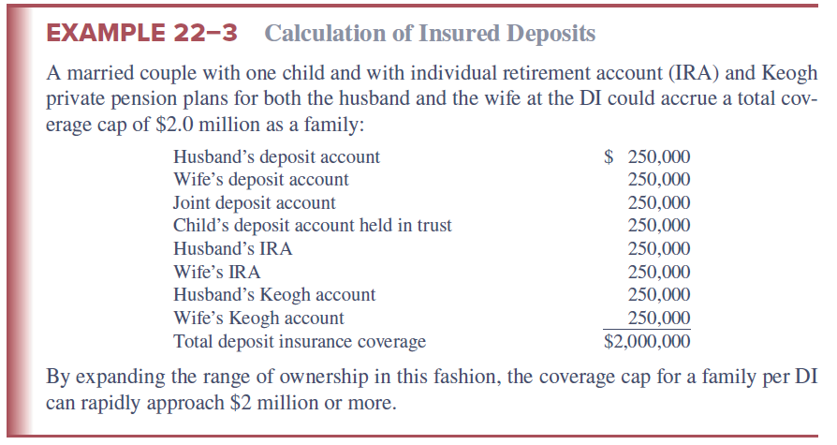
Calculation of Insured Deposits
Notes:
22

Slide 23
The Discount Window
Federal Reserve also provides a “discount window” lending facility, serving as a lender of last resort
Interest rate at which securities are discounted is called the discount rate and is set by the central bank
While the discount window has traditionally been available to DIs, in the spring of 2008 investment banks gained access to the discount window through the Primary Dealer Credit Facility (PDCF)
After March 2008, several new broad-based lending programs were implemented, providing funding to a wide array of new parties, including U.S. money market mutual funds, commercial paper issuers, insurance companies, and others
Notes:
23

Slide 24
Liquidity Risk and Insurance Companies
Life insurance companies hold cash reserves and other liquid assets for the following reasons:
  Meet policy payments
  Meet cancellation (surrender) payments
    Surrender value of a life insurance policy is amount that insurance policyholder receives when cashing in a policy early
  Other working capital needs
Property-casualty (P&C) insurance companies
  Claims against P&C insurers are relatively short-term and unpredictable
  P&C insurance companies have a greater need for liquidity than life insurance companies
Notes:
24
The most severe liquidity stress scenario faced by life insurers is a mass surrender of policies that arise due to a loss in the confidence of the financial strength of a firm.
P&C claims (such as the estimated $35 billion in insurance losses associated with Hurricane Sandy in 2012) are virtually impossible to predict.

Slide 25
Guarantee Programs
Both life insurance and property-casualty insurance companies are regulated at the state level
  Unlike banks and thrifts, neither life nor P&C insurers have a federal guarantee fund
Beginning in the 1960s, most states began to sponsor state guarantee funds for firms selling insurance in that state
  Differ from deposit insurance in several important ways:
    Programs are run and administered by the private insurance companies themselves
    No permanent guarantee fund exists for the insurance industry, with the sole exception of the state of New York
    Size of required contributions that surviving insurers make vary widely from state to state
    Delay usually occurs before cash surrender values or other payment obligations are received from the guarantee fund
Notes:
25

Slide 26
Liquidity Risk and Investment Funds
Investment funds, such as mutual funds and hedge funds, sell shares as liabilities to investors and invest the proceeds in assets such as bonds and equities
Face similar liquidity problems as DIs when the number of withdrawals rises to abnormally high or unexpected levels
  Fundamental difference in the way investment fund contracts are valued compared to the valuation of DI deposit contracts, thereby reducing the incentives for investment fund shareholders to engage in deposit-like runs
Notes:
26

