Slide 1
CRM
Trust, satisfaction, commitment and loyalty
Leacky Bucket Theory/ Customer Lifetime Value
Market oriented strategies (Treacy & Wiersame, 1996)

Slide 2
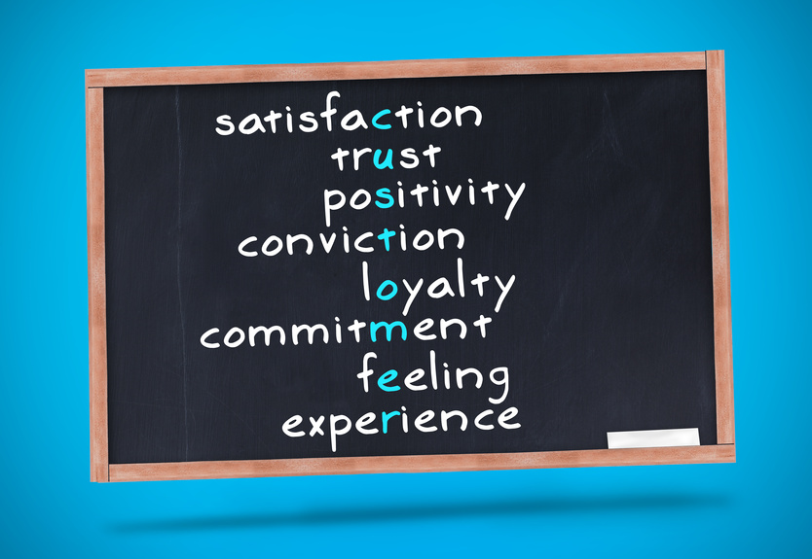
İt is important...

Slide 3
Trust & Commitment
Trust - the belief in the reliability, truth, or ability of someone or something.
Confidence in exchange partner’s reliability and integrity. Trust is an underlying condition that results from certain activities.
It is an essential ingredient as a foundation for interpersonal relationships, cooperation, and basis for stability in social institutions and market.

Slide 4

Trust can:
Reduce conflict
Decrease transactional costs (no constant checks/verification)
Promotes adaptive organizational forms (network relationships)
Promote effective response to crisis

Slide 5
Words that describes trusting situations:
  Probity – the reputation of the individual/organization following previous transactions. It focuses on honesty and integrity realized in business terms as professional understanding and reputation.
  Equity - the quality of being fair-minded and impartial.
  Reliability - the quality of having the required expertise to perform its business effectively and reliably.
  Satisfaction - the overall evaluation, feeling, or attitude about the other party in a relationship.

Slide 6

Commitment
Commitment is central to relationship marketing. It is the quality or state of being committed to a cause or activity.
Affective commitment - emotional bonding (qualitative)
Calculative commitment - balance sheet of costs and benefits (quantitative)

Slide 7
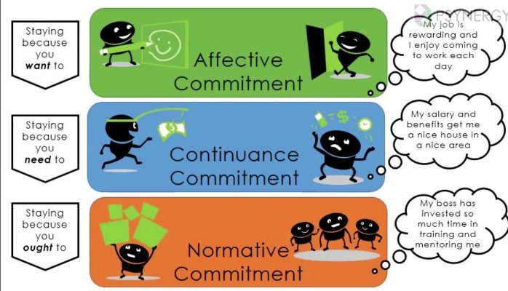
Commitment types

Slide 8

Trust and Commitment
are inseparable in relationship marketing.
They are a prerequisite to sale.

Slide 9

Customer Satisfaction
Profitability is enhanced when customer retention is high.
Retention in competitive markets is a product of customer satisfaction.
Customers are satisfied when expectations of values are positively confirmed, while the greater gap between the level of expectation and results equates dissatisfaction.

Slide 10
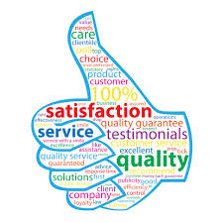
Satisfaction Drivers:
  Confirmed standards lead to moderate satisfaction;
  Positively disconfirmed standards lead to high satisfaction (better than expected);
  Negatively disconfirmed standards lead to dissatisfaction;

Slide 11
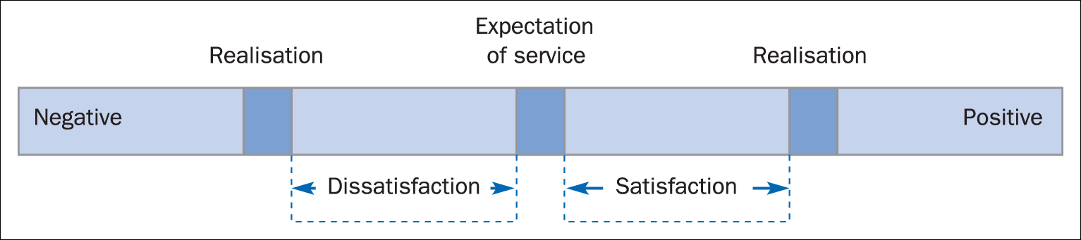
Figure 6.1 Expectation and realisation of service

Slide 12
Customer Satisfaction Terms...
Customer satisfaction indices - satisfied customers do not necessarily mean retention. Any customer satisfaction survey results do not predict loyalty.
Feedback - are comments, complaints, and questions. Is the most effective means to establish customer satisfaction.
Market research - defines non-customer satisfies and expectations. This is used to establish drivers to understand what caused them to move elsewhere.

Slide 13
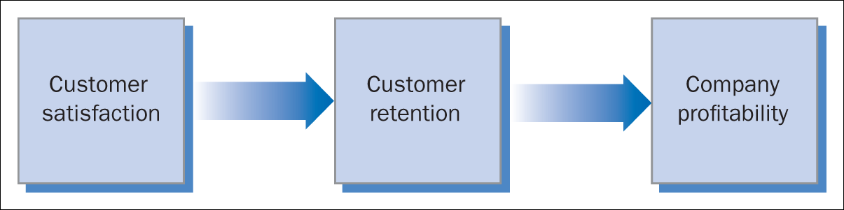
Benefits of Customer Satisfaction
Figure 6.2 Simple ‘return on relationship (ROR)’ model
Customer satisfaction is the key to :
securing& increasing customer loyalty,
generation superior long-term financial performance,
improving the firm’s repuatation in the marketplace,
Reducing price elasticity,
Lowers transaction costs,
Reducing the failure rates and the costs of attracting new customers ,et al.

Slide 14
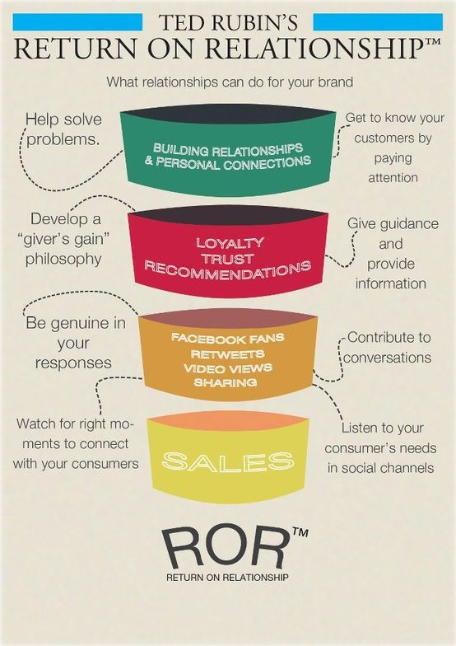
ROR
Gummesson (1999) has coined the phrase ‘return on relationships’ (ROR) to describe the expectation that there would be a return on this investment. ROR as
‘the long-term net financial outcome caused by the establishment and maintenance of an organization's network of relationships’.

Slide 15
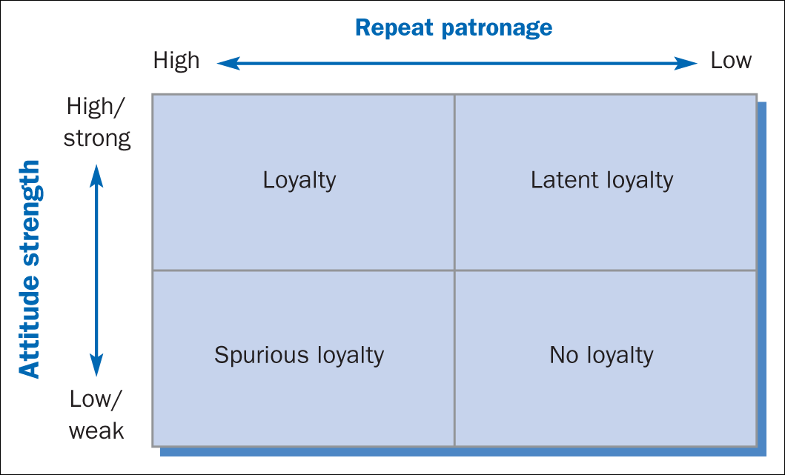
Figure 6.3 Relative attitude–behaviour relationship
Source: Adapted from Dick and Basu, 1994.
  positive attitude but no repeat buying behavior due to reasons
  as there could be no other alternatives or options

Slide 16
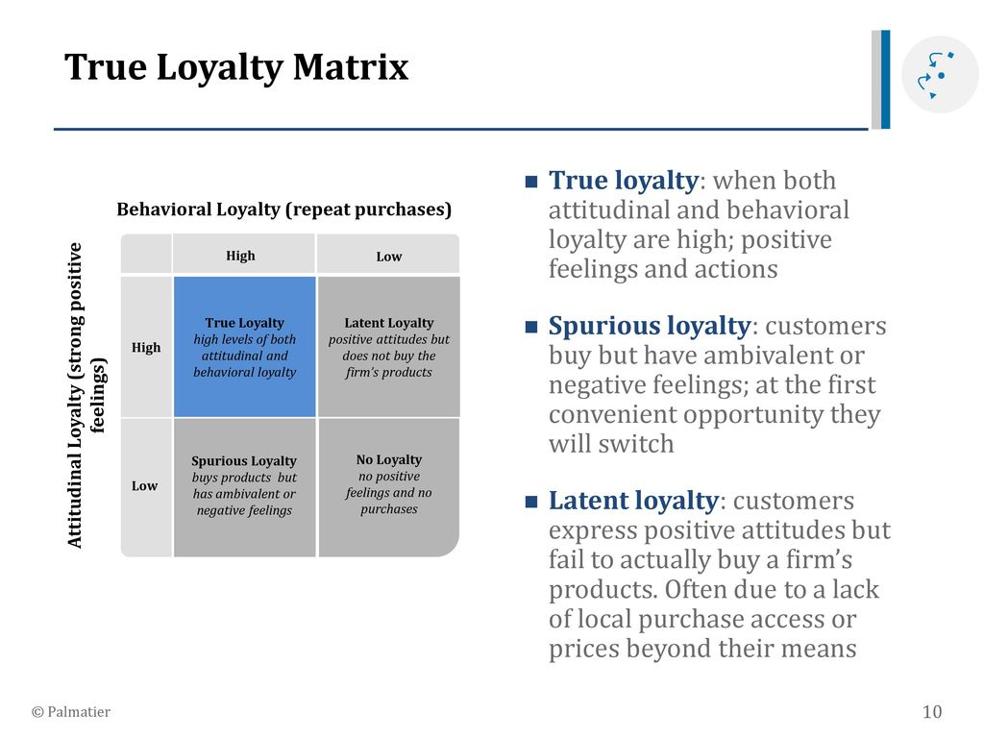

Slide 17
Leacky Bucket Theory
The focus of traditional marketing has been on creating new customers.
Although the acquisition of the customers is important, it is an intermediate step in the process.
The first line of defence for any company is maintaning its existing customers.
To succeed a company, must both have a flow of new customers and restrict customer exist.
To achieve profitability, the dual strategies of (offensive and defensive) acquisition and retention must work in tandem.

Slide 18
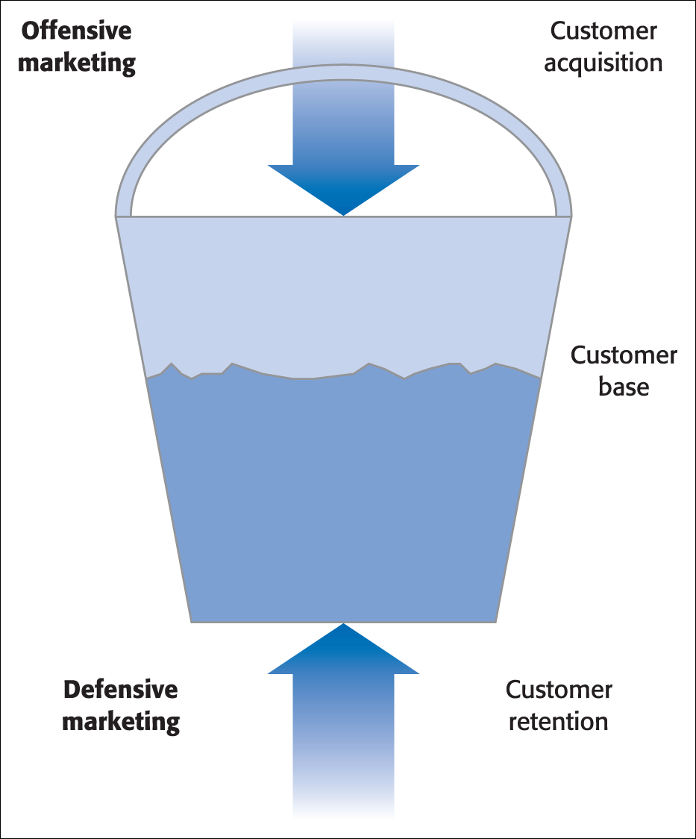
This emphasizes the importance of keeping customers while recognizing that acquiring customers is, of course, the basis for having any customers to keep.
Figure 4.1 Leaky bucket theory

Slide 19
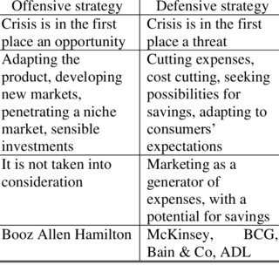

Slide 20
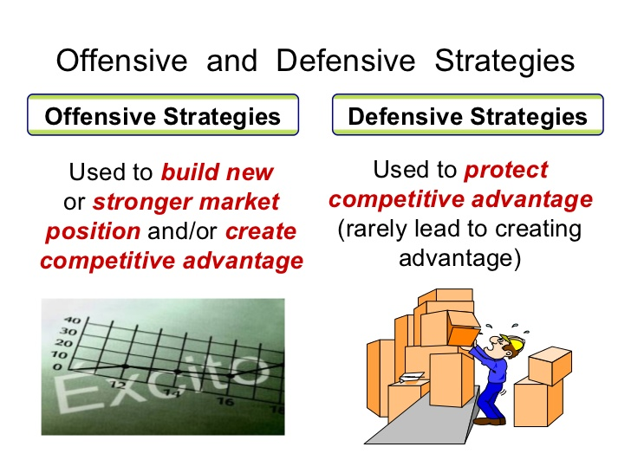
in addition to acquiring wholly new customers, attempting to attract dissatisfied customers away from competitors, particularly in periods of heavy competition (Storbacka et al., 1994, pp. 22–3).
highlights the proposition that, in addition to ‘offensive strategies’, companies need ‘defensive strategies’ which minimize customer turnover (Storbacka et al., 1994, pp. 22–3

Slide 21
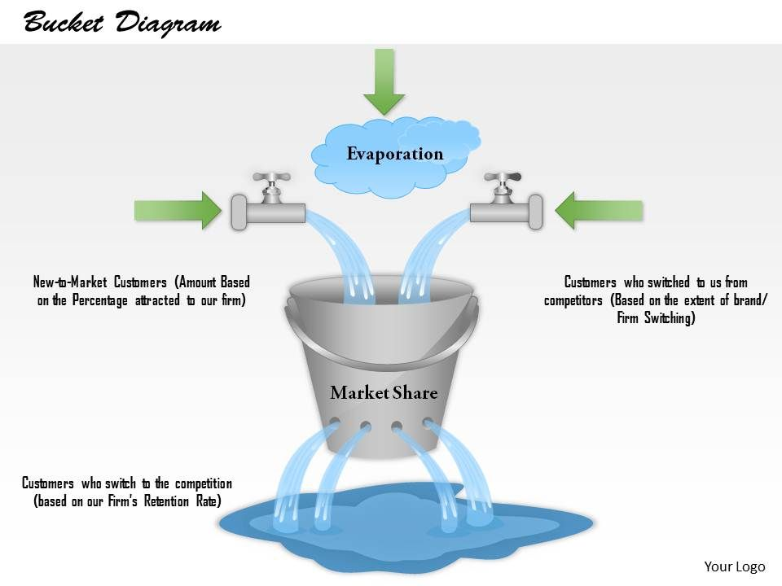

Slide 22
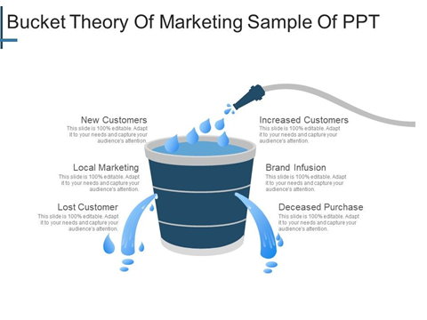

Slide 23
Customer Retention
It has become one of the underpinning convictions of RM that it encourages retention marketing first and acquisition marketing second (Gummesson, 1999, p. 9).
This bias exists because customer retention is perceived as offering significant advantages, particularly in saturated markets (Dawes and Swailes, 1999, p. 36).
Reichheld (1996, p. 65), for example, suggests that the benefits are cumulative and that the longer the cycle continues the ‘greater the company’s financial strength’. The dual benefits of customer retention can be summarized, therefore, as:
■ existing customers are less expensive to retain than to recruit;
■ securing a customer’s loyalty over time produces superior profits.

Slide 24
Relationship Ladders or Stages
Various models exist that illustrate this concept (Figure 4.3) and that may be seen to approximately equate to both consumer and business-to-business relationships.

Slide 25
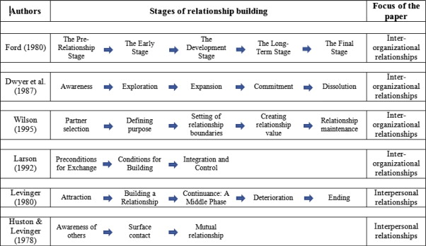
Stages of relationship

Slide 26
Dwyer et al. (1987, p. 15) suggest a five-stage model
where each phase represents a major transition in how parties in a relationship regard each other. These are:
■ awareness;
■ exploration;
■ expansion;
■ commitment;
■ dissolution.

Slide 27
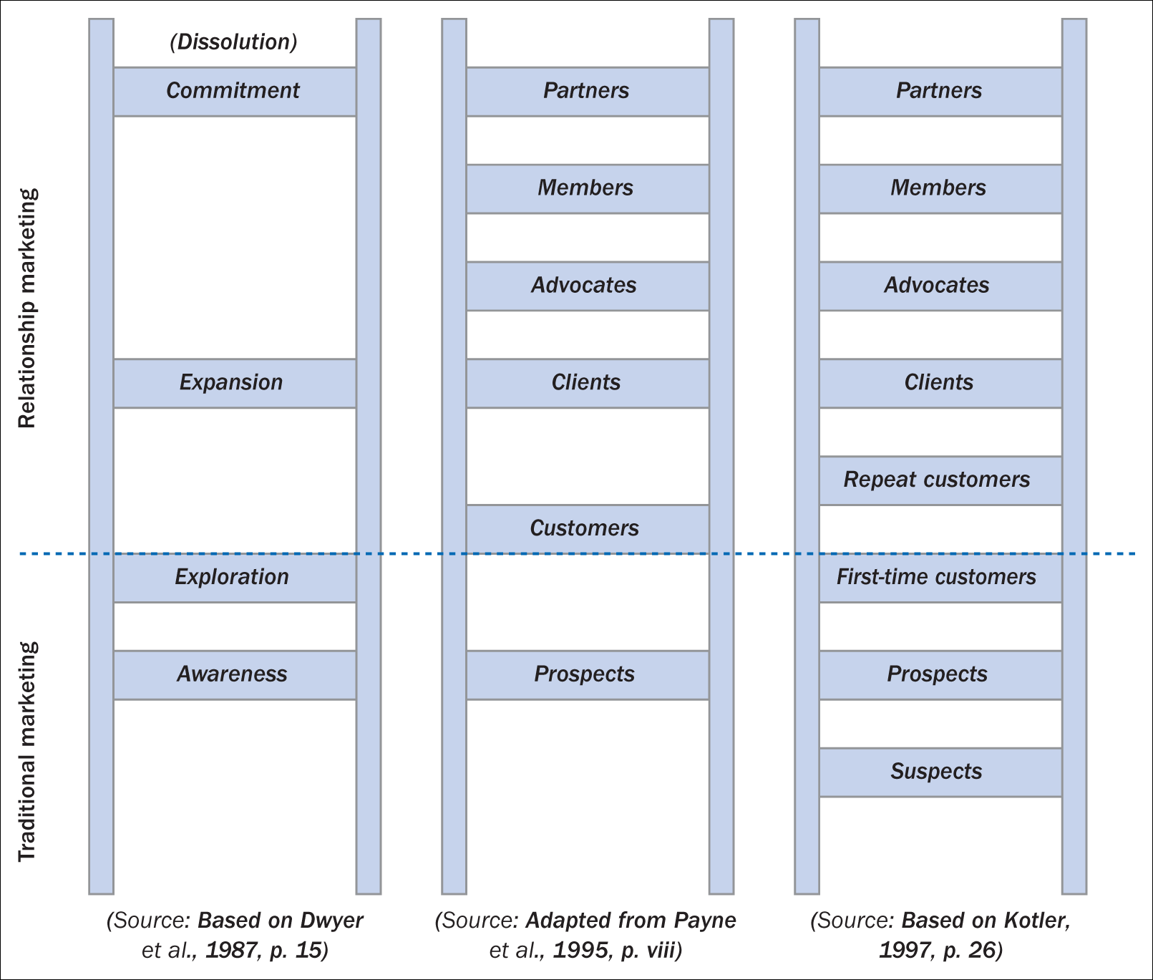
Figure 4.3 Relationship ladders or stages
Source: Based on Dwyer et al., 1987, p. 15, Adapted from Payne et al., 1995, p. viii, Based on Kotler et al., 1997, p. 26.

Slide 28
Awareness
Awareness is where one party recognizes that the other party is a ‘feasible exchange partner’. Interaction has not yet taken place although there may be ‘positioning’ and ‘posturing’ by the parties to enhance their attractiveness.
Exploration
Exploration refers to the ‘research and trial stage’ in the exchange. At this level potential partners consider obligations, benefits and burdens of the exchange. This may well include the psychological and actual costs involved.
Dwyer et al. suggest that this stage includes sub-phases such as attraction, communication and bargaining, development and exercise of power, norm development (e.g. Contractual arrangements) and expectation development (e.g. trust and commitment).

Slide 29
Expansion
Expansion refers to the period where there is a continual increase in benefits obtained by exchange partners and where they become increasingly interdependent.
Commitment
Commitment relates to the implicit or explicit pledge of relational continuity between the parties.
Dissolution
The inclusion in the model of a dissolution stage reminds us that disengagement always remains a possibility in any relationship.

Slide 30
Lifetime value
Recognition of the importance of RM was driven, in part, by the realization that people trade over lifetimes (Ambler and Styles, 2000, p. 503).
The ‘lifetime value’ concept suggests that a company should avoid taking a short-term view of the profit (or indeed loss) of any individual but rather should consider the income derived from that company’s lifetime association with the customer.
As part of a successful customer retention strategy, organizations should project the value of individual customers over time rather than focus on customer numbers (Dawes and Swailes, 1999, p. 36).

Slide 31
Switching Costs
These are costs (monetary and non-monetary) that buyers encounter when switching from one supplier to another.
The psychological ‘costs’ (which are not mutually exclusive), may be summarised as:
Search Costs
Learning Costs
Emotional Costs
İnertial Costs
Risk
Social Costs
Financial Costs
Legal Barriers.

Slide 32
Knowing Your Customer!
Not all customers are the same. Recognise that not all customers contribute equally to the firm’s profit.
Although a crude measure, it allows them to differentiate between potentially profitable and less-profitable customers. In most organizations, the difficulty of calculating ‘relationship profitability’ stems from the problem in allocating costs to specific customer relationships and promotes the need to identify the cost drivers of those relationships.

Slide 33
Apply the 80/20 rule – a Pareto Analysis
According to Living Life the 80/20 Way by Richard Koch, the following are true:
80% of your profits come from 20% of your customers
80% of your profits come from 20% of the time you spend
80% of your sales come from 20% of your products
80% of your sales are made by 20% of your sales staff
80% of your complaints come from 20% of your customers
Many businesses can increase profitability dramatically by focusing on their most effective areas, and eliminating, or ignoring the less effective areas as appropriate. Profitability is a function of how much was expended to achieve profit, not just the revenue itself.

Slide 34
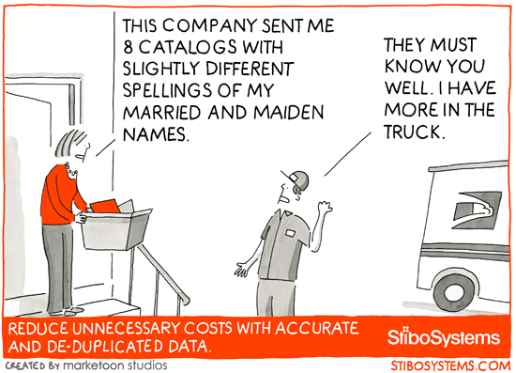
Duplication occurs: when there are several sources of customer data are recorded independently without being properly matched to current data.

Slide 35
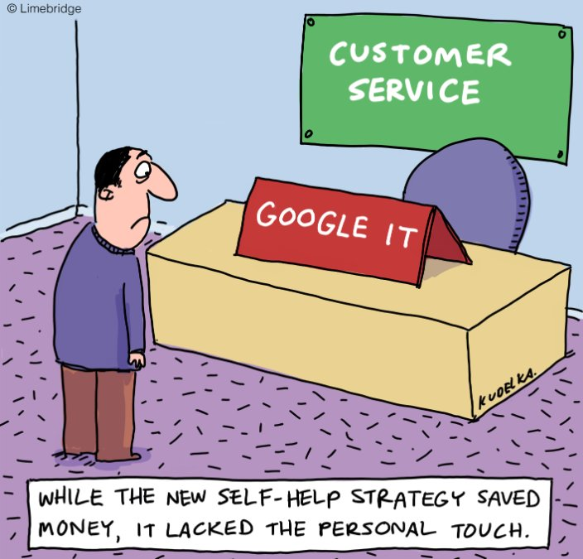

Slide 36
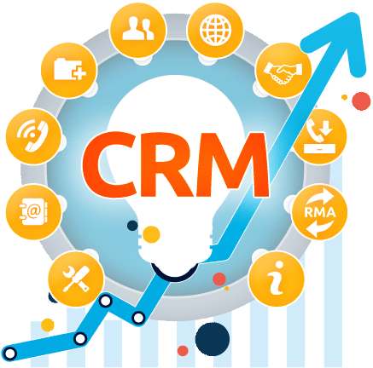
Why CRM?
It costs six times more to sell to new customer than to sell to an existing one.
A typical dissatisfied customer will tell 8-10 people
By increasing the customer retention rate by 5%, profits could increase by 85%
70% of the complaining customers will remain loyal if problem is solved.

Slide 37
With CRM
Better knowledge of customers. ...
Better segmentation. ...
Better customer retention. ...
Better anticipation of needs. ...
Better and speedier communication. ...
Better protection of data privacy.

Slide 38
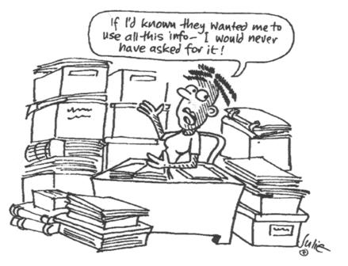

Slide 39
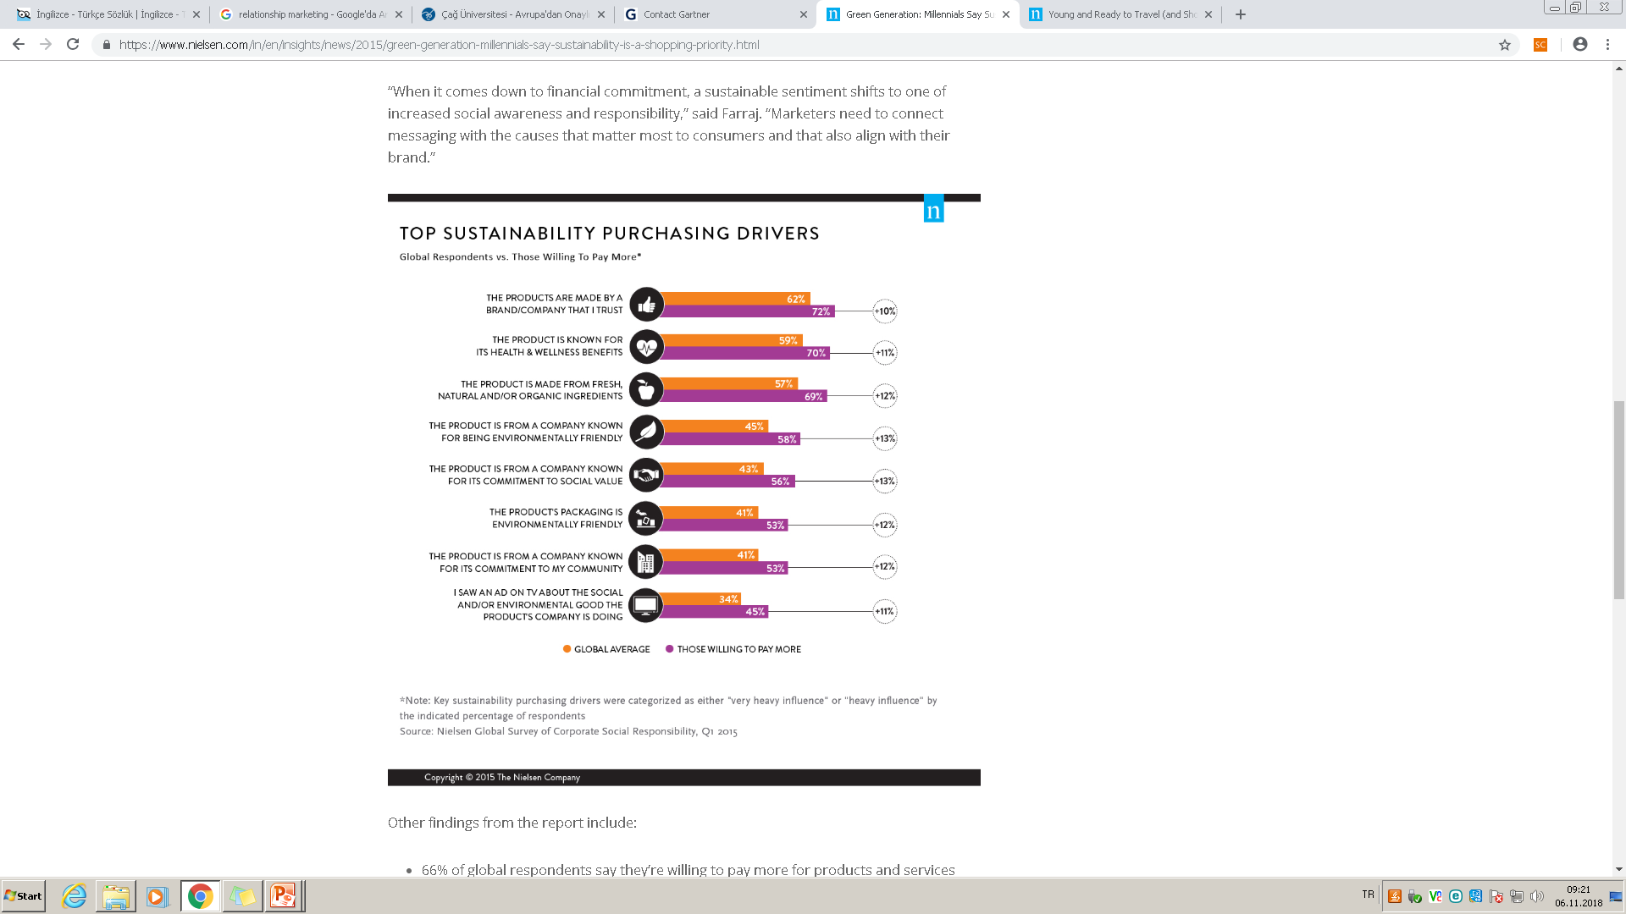

Slide 40
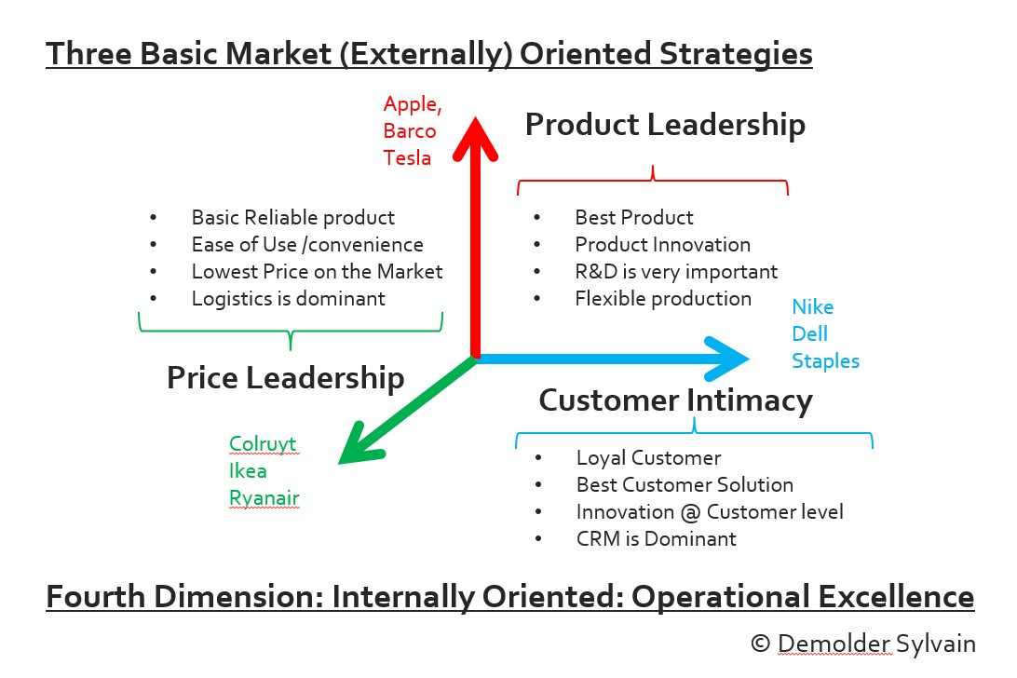
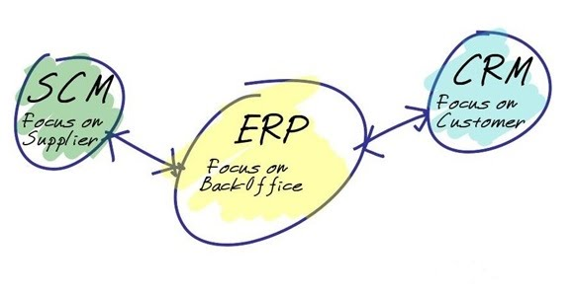
Treacy AND Wiersema (1996)
Company want to amaze its customers!, push the limits

