Slide 1
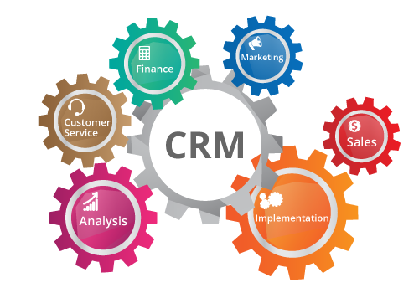
RELATIONSHIP MARKETING John EGAN - Fourth Edition PEARSON
https://results-software.com/tag/crm-for-small-business/

Slide 2
Chapter 9
Supplier Partnerships

Slide 3
An organization's external relationships can be seen to have a vertical and horizontal dimension (Palmer, 2000, p. 689). These can be described as:
■ vertical relationships representing those that integrate all or part of the supply chain through component suppliers, manufacturers and intermediaries;
■ horizontal relationships represented by organizations that are at the same point in the channel of distribution (including competitors) who seek to cooperate and collaborate for mutual benefit.

Slide 4
Supplier partnerships
Partnerships between customers and suppliers come in many forms and under many different guises: for example, Christopher et al. (1991, p. 24) note that electrical and healthcare company Phillips called them in the past ‘vendor partnerships’ and AT&T labeled them ‘co-makerships’. Although ‘supplier partnerships’ is the term used here for these vertical relationships, it refers, more broadly, to any two-way relationship within the vertical chain and is sometimes more simply known as ‘partnering’.

Slide 5
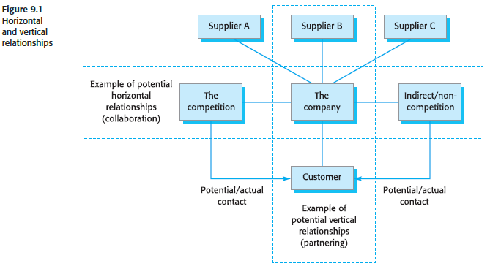

Slide 6
This chapter will concentrate on relationships further back in the supply chain. The most common way of describing this is as ‘business-to-business’ (B2B) relationships, this term having largely replaced the term ‘industrial goods and services marketing’.
Business-to-business relationship
Industrial Marketing and Purchasing Group (IMP) researchers also suggested that a two-level approach was evident, the first ‘including short-term episodes . . . exchange of goods and services, information, financial and social aspects’ and the second, and longer-term, ‘processes leading to adaptation and institutionalization of roles and responsibilities’ (Grönroos, 2000,p. 7).

Slide 7
Håkansson and Snehota (2000, p. 75), meanwhile, saw the four cornerstones of the IMP research into B2B markets as:
■ relationships that exist between buyers and sellers;
■ business relationships that are connected (by networks);
■ a relationship being a combination that includes elements of both market and hierarchy;
■ relationships that are confrontational (and therefore innovative).
The cooperation between buyers and sellers may include the establishment of long-term contractual commitments, the divulging of personal information and the adaptation of the production, delivery and buying processes to meet the requirements and needs of both the buyer and the seller (Palmer, 2000, p. 693).

Slide 8
In the retail field, such replenishment strategies are often referred to as supplier/retailer collaboration (SRC). The GEA Consulting Group (1994), in a study for Coca-Cola, defined SRC as where:
‘‘both retailers and suppliers share proprietary internal and external data and/or share policies and processes used in decision-making with the clear objective of sharing the benefits.’’

Slide 9
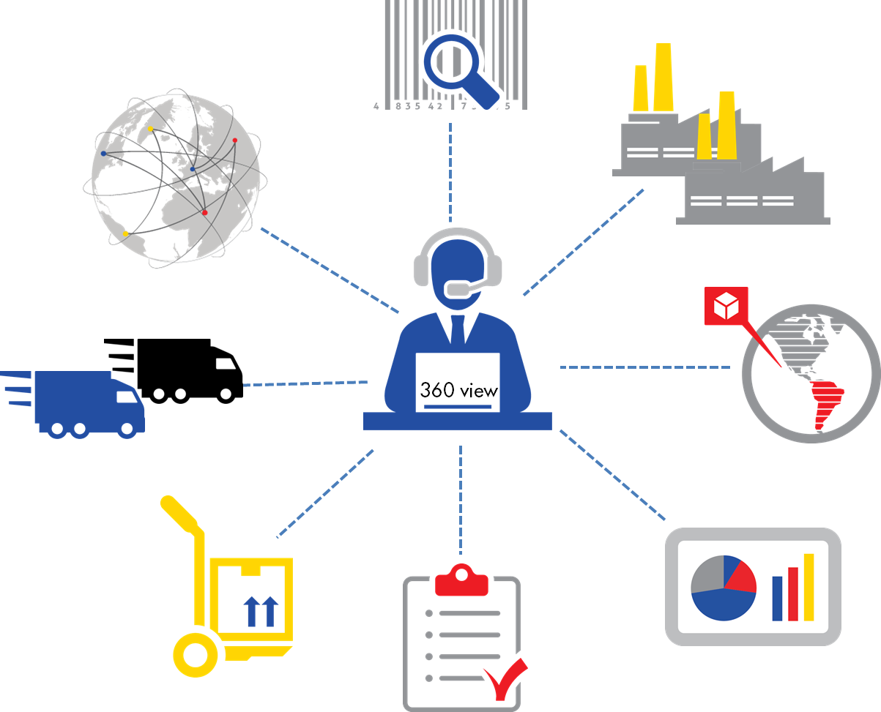

Slide 10
Technology
Rapid technological development has increased the cost of research and development (R&D) and the ‘window of opportunity’ for getting products and services to market has shortened, forcing companies to work together in joint research projects and joint product development programmes (Sheth and Parvatiyar, 1995, p. 410).
As a result of changing markets and available technology, suppliers and retailers appear to be changing the habits of a lifetime. Whereas before they regarded each other with suspicion many now see each other as allies in the distributive chain.

Slide 11
Partnering
Partnering can take many forms, so a rather generalized definition must suffice:
Partnering is a relationship between customer and supplier organizations, recognized as such by the parties involved, whose principal objective is a shared increase in the effectiveness and efficiency of joint responsibilities within the remit of their relationship.
The raison d’être of a partnership approach is, therefore, to improve the efficiency and effectiveness with which a value-adding system functions. Sheth and Sisodia (1999, p. 82) suggest that, through partnering, buyers and sellers can gain many of the advantages of vertical integration without the drawbacks associated with acquisition. These advantages include:
■ lower transaction costs;
■ assurance of supply;
■ improved coordination;
■ higher entry barriers.

Slide 12
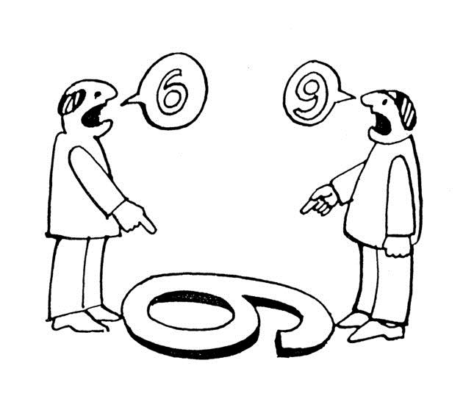
Culture Gap
Critical to partnering is a good understanding between partner firms. In particular, a knowledge and acceptance of each other’s organisational cultures would appear crucial to successful business relationships (Phan et al., 1999, p. 8; Arnett et al., 2002, p. 87). Kanter (1994, pp. 99–100) talks about the need for ‘chemistry’ and ‘compatibility’ when selecting partners and that success will have more to do with peoplecentred factors than financial or strategic ones.

Slide 14
Partnership costs and benefits
According to Brennan (1997, p. 770), the purpose of a partnership approach must be to improve the efficiency with which a value-adding system functions. He candidly notes:
If there is no improvement in overall systematic efficiency, then the only way one party can gain is at the expense of another, in which case the firms are playing a ‘zero-sum game’ and are back to old-style adversarial relations. Partnering can only flourish in a ‘positive-sum game’ where there are real economic advantages associated with this approach to doing business.

Slide 15
From his research in the automobile industry, Brennan notes that the primary benefits for the supplier and the customer of the partnership approach are that:
■ The supplier gains an in-depth understanding of the customer’s requirements and can be proactive in suggesting product improvements.
■ The supplier’s personnel become familiar with the customer’s ‘way of doing things’, potentially reducing misunderstandings and improving the speed of response.
■ Greater supplier involvement (as a ‘member of the team’) at an early stage in new projects and new product development can increase the ‘speed to market’.
■ There is a reduction or elimination of the ‘cost of sales’ (or marketing costs) for the customer.

Slide 16
■ The supplier is not exposed to the hazards of the marketplace, implying greater certainty about future revenues.
■ The ‘partner–supplier’ usually gains privileged access to information about long term customer plans, enabling a proactive stance to be taken and subsequent reinforcement of its ‘preferred supplier’ position.
■ There is an increased information flow and greater information trustworthiness.
■ The ability of both partners to focus on those aspects of the value-added chain that are their ‘core competencies’ is increased, enabling them to leave other aspects to their trusted partner.

Slide 17
Power
Power and dependency in a relationship are very much a function of the relative importance of the relationship to both parties (Storbacka et al., 1994, p. 29). Imbalance of power, where one partner is seen as dominant and the other dependent, creates opportunities for individual parties to pursue short-term advantage, whereas ‘balanced or symmetrical dependence represents a mutual safeguard and a collective incentive to maintain a relationship’ (Palmer, 1996, pp. 20–1).
According to Weitz and Jap (2000, p. 235), partners in a relationship are more likely to engage in constructive conflict resolution when they are power-equals. If the power is imbalanced, then the more powerful party has little incentive to engage in joint problem-solving. It will come as no surprise to many small and medium-sized enterprises (SMEs), therefore, that relationship power imbalances are most evident when larger companies are involved.

Slide 18
Chapter 10 External Partnership

