Slide 1
Foreign Direct Investment and Cross-Border Acquisitions
Chapter Sixteen
Notes:
This chapter discusses various issues associated with foreign direct investments by MNCs, which play a key role in shaping the nature of the emerging global economy.

Slide 2
Chapter Outline
Global Trends in FDI
Why Do Firms Invest Overseas?
Trade Barriers
Imperfect Labor Markets
Intangible Assets
Vertical Integration
Product Life Cycle
Shareholder Diversification
Cross-Border Mergers and Acquisitions
Political Risk and FDI
Summary
16-2

Slide 3
Global Trends in FDI
Foreign direct investment often involves the establishment of production facilities abroad.
Greenfield investment involves building new facilities from the ground up.
Cross-border acquisition involves the purchase of an existing business.
16-3

Slide 4
Global Trends in FDI (continued)
Several developed nations are the sources of FDI outflows.
Most world-wide FDI comes from the developed world.
This implies that MNCs domiciled in these countries should have certain comparative advantages in undertaking overseas investment projects.
Both developing and developed nations are the recipient of inflows of FDI.
Some developing countries, like China and Mexico, have begun to undertake FDI, albeit on a modest scale.
16-4

Slide 5
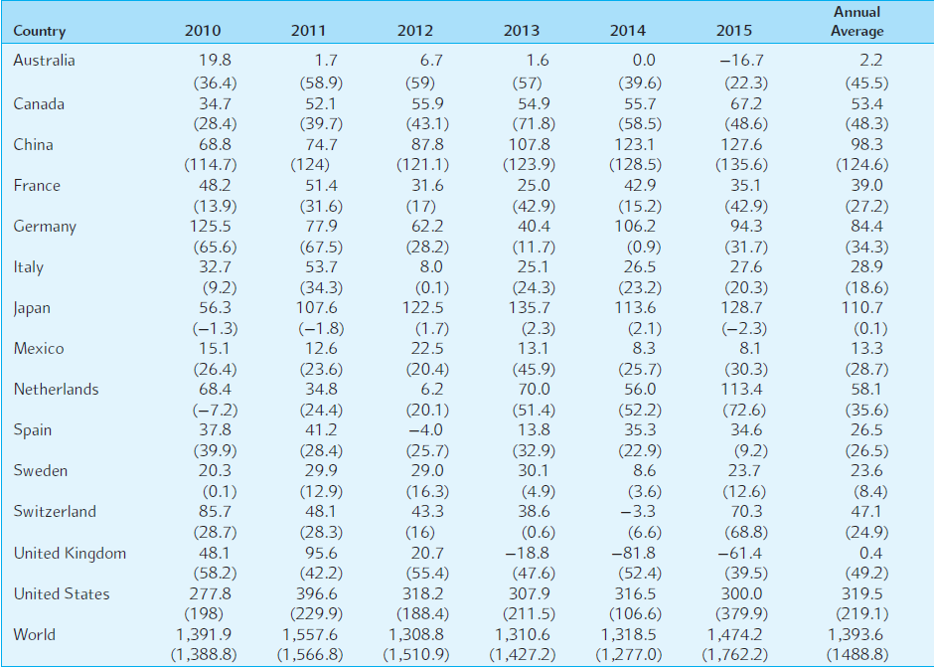
EXHIBIT 16.1 Foreign Direct Investment–Outflows (Inflows) in Billions of Dollars
16-5
Notes:
Note: FDI flows with a negative sign indicate that at least one of the three components of FDI (equity
capital, reinvested earnings, or intra-company loans) is negative and is not offset by positive amounts
of the other components. There are instances of reverse investment or disinvestment.

Slide 6
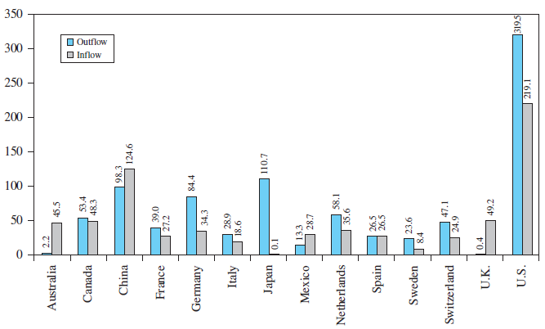
EXHIBIT 16.2 Average Foreign Direct Investment per Year 2010–2015 ($ billions)
16-6

Slide 7
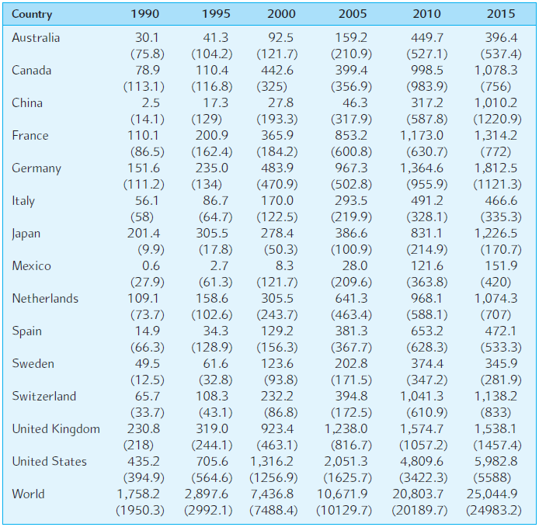
EXHIBIT 16.3 Foreign Direct Investment Outward (Inward) Stocks in Billions of Dollars
16-7

Slide 8
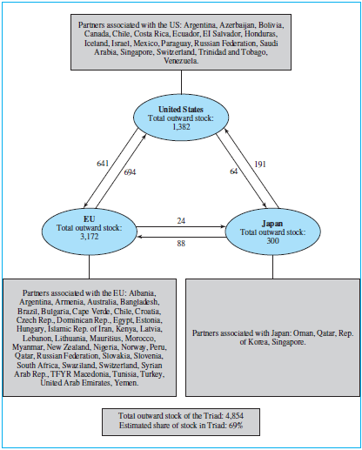
EXHIBIT 16.4 FDI Stocks among the Triad and Economies in Which FDI from the Triad Dominates, 2001 (billions of dollars)
16-8

Slide 9
Why Do Firms Invest Overseas?
Trade barriers
Labor market imperfections
Intangible assets
Vertical integration
Product life cycle
Shareholder diversification
16-9

Slide 10
Trade Barriers
Government action leads to market imperfections.
Tariffs, quotas, and other restrictions on the free flow of goods, services, and people.
Trade barriers can also arise naturally due to high transportation costs, particularly for low value-to-weight goods.
16-10

Slide 11
Labor Market Imperfections
Among all factor markets, the labor market is the least perfect.
Recall that the factors of production are land, labor, capital, and entrepreneurial ability.
If there exist restrictions on the flow of workers across borders, then labor services can be underpriced relative to productivity.
The restrictions may be immigration barriers or simply social preferences.
16-11

Slide 12
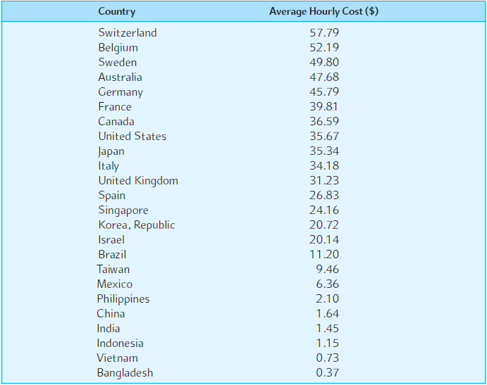
EXHIBIT 16.5 Labor Costs around the Globe (2012)
16-12
Notes:
Source: U.S. Department of Labor, Bureau of Labor Statistics and Japan External Trade Organization.

Slide 13
Intangible Assets
Coca-Cola has a very valuable asset in its closely guarded “secret formula.”
To protect that proprietary information, Coca-Cola has chosen FDI over licensing.
Since intangible assets are difficult to package and sell to foreigners, MNCs often enjoy a comparative advantage with FDI.
16-13

Slide 14
Vertical Integration
MNCs may undertake FDI in countries where inputs are available in order to secure the supply of inputs at a stable accounting price.
Vertical integration may be backward or forward:
Backward: e.g., a furniture maker buying a logging company.
Forward: e.g., a U.S. auto maker buying a Japanese auto dealership.
16-14

Slide 15
Product Life Cycle
U.S. firms develop new products in the developed world for the domestic market, and then markets expand overseas.
FDI takes place when product maturity hits and cost becomes an increasingly important consideration for the MNC.
16-15

Slide 16
Product Life Cycle
The U.S.
production
Quantity
exports
imports
consumption
New product Maturing product Standardized product
Less advanced countries
Quantity
consumption
exports
imports
production
New product Maturing product Standardized product
16-16

Slide 17
Product Life Cycle (continued)
It should be noted that the product life cycle theory was developed in the 1960s when the U.S. was the unquestioned leader in R&D and product innovation.
Increasingly, product innovations are taking place outside the United States as well, and new products are being introduced simultaneously in many advanced countries.
Production facilities may be located in multiple countries from product inception.
16-17

Slide 18
Shareholder Diversification
Firms may be able to provide indirect diversification to their shareholders if there exists significant barriers to the cross-border flow of capital.
Capital market imperfections are of decreasing importance, however.
Managers, therefore, probably cannot add value by diversifying for their shareholders, as the shareholders can do so themselves at lower cost.
16-18

Slide 19
Cross-Border Mergers & Acquisitions
Greenfield investment
Building new facilities from the ground up.
Cross-border acquisition
Purchase of existing business.
Represents 40-50% of FDI flows.
Cross-border acquisitions are a politically sensitive issue:
Greenfield investment is usually welcome.
Cross-border acquisition is often unwelcome.
16-19

Slide 20
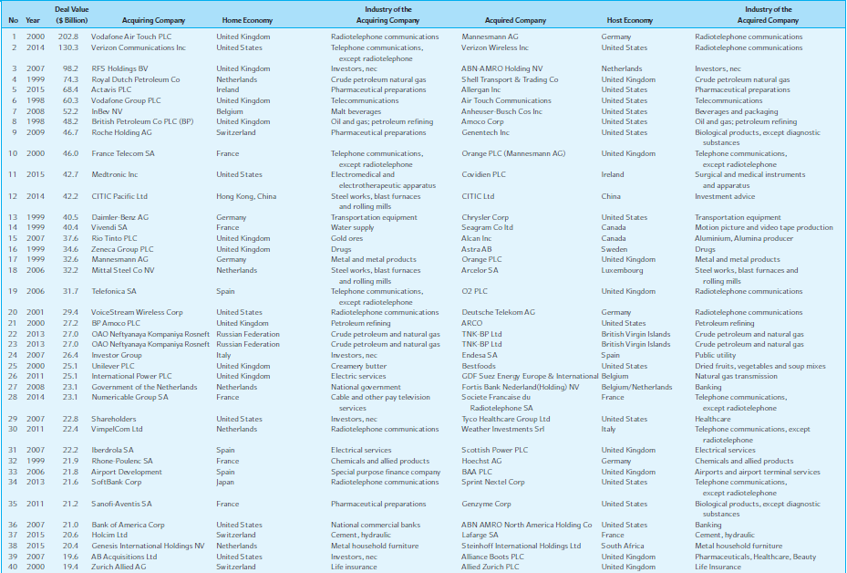
EXHIBIT 16.7 Top 40 Cross-Border M&A Deals Completed during 1998–2015
16-20

Slide 21
EXHIBIT 16.8 Average Wealth Gains from Cross-Border Acquisitions: Foreign Acquisitions of U.S. Firms
16-21
Notes:
Source: Reprinted from Journal of Banking and Finance 20, C. Eun, R. Kolodny, and C. Scheraga, “Cross-Border Acquisitions and Shareholder Wealth: Tests of the Synergy and Internalization Hypotheses,” pp. 1559–82, © 1996 with kind permission from Elsevier Science-NL, Sara Burgerhartstreet 25, 1055 KV Amsterdam, The Netherlands.

Slide 22
Political Risk and FDI
Unquestionably this is the biggest risk when investing abroad.
A more important question than normative judgments about the appropriateness of the foreign government’s existing legislation is, “Does the foreign government uphold the rule of law?”
A big source of risk is the non-enforcement of contracts.
16-22

Slide 23
Political Risk and FDI (continued)
Macro risk
All foreign operations are put at risk due to adverse political developments.
Micro risk
Selected foreign operations are put at risk due to adverse political developments.
16-23

Slide 24
Political Risk (concluded)
Transfer risk
Uncertainty regarding cross-border flows of capital.
Operational risk
Uncertainty regarding the host country’s policies on a firm’s operations.
Control risk
Uncertainty regarding expropriation.
16-24

Slide 25
Measuring Political Risk
The host country’s political and government system
A country with too many political parties and frequent changes of government is risky.
The track records of political parties and their relative strength
If the socialist party is likely to win the next election, watch out.
16-25

Slide 26
Measuring Political Risk (continued)
Integration into the world system
North Korea and Iran are examples of isolationist countries unlikely to observe the “rules of the game.”
Ethnic and religious stability
Look at recent genocides around the world.
Regional security
Kuwait is a nice enough country, but it’s in a rough neighborhood.
16-26

Slide 27
Measuring Political Risk: Key Indicators
Key economic indicators
Political risk is not entirely independent of economic risk.
Severe income inequality and deteriorating living standards can cause major political disruptions.
In 2002, Argentina’s protracted economic recession led to the freezing of bank deposits, street riots, and three changes of the country’s presidency in as many months.
16-27

Slide 28
Political Risk Analysis: Vietnam
Sovereign Rating: Moody’s: B2, Outlook: Stable; S&P: BB-, Outlook: Negative
Political Strengths | Economic Strengths
Political Stability with Communist Party in government since end of the country’s civil war in 1975 Widespread support for the CPV (Vietnam Communist Party) reflects its success in raising living standards and creating and maintaining security | Transformation to market oriented economy since late 1980s High GDP growth facilitated by foreign investment Well educated and cheap labor force Sizeable natural resources and advantageous location
Political Weaknesses | Economic Weaknesses
Inconsistent and evolving regulations Unreliable legal system and corruption A lack of financial transparency, insufficient protection for minority owners, and poor corporate governance | Large fiscal and trade deficits and weak banking system Plethora of state-owned enterprises and less diversification Industry and credit policies favor state-owned enterprises
Political & Governance Indicators | Economic Indicators
World Bank Ranking- Ease of doing business 78th/183 Freedom House - Political rights and civil liberties Not Free Transparency International Ranking – Corruption Perception Index 116th/180 OECD country risk rating 5 (Scale: 0-7, 0 is least risk, 7 is highest risk) | GDP ($US bn) 104 GDP per capita ($US) 1,174 Real GDP growth (15 year average, %) 7.3 Fiscal balance (% of GDP) -6.4 Public debt (% of GDP) 53.0 Foreign direct investment (% of GDP) 6.6 Current account (% of GDP) -3.8 External debt (% of GDP) 42.1 Foreign reserves (% of GDP) 11.6
Source: http://www.efic.gov.au ; 2011 figures
16-28

Slide 29
Political Risk Analysis: Turkey
Sovereign Rating: Moody’s: Ba1; Outlook: Positive; S&P: BB, Outlook: Positive
Political Strengths | Economic Strengths
Transition to democracy at the end of 1970s Significant liberalization and stabilization by a drive to join European Union | Key dimensions of economic performance on par with central and eastern European countries Was able to weather the recent global economic crisis Debt is highly sought after by foreign investors Healthy growth forecast
Political Weaknesses | Economic Weaknesses
Instability fuelled by conflict between the army and the civilian government Strained relations between religious conservatives and secular modernists | Mounting macroeconomic imbalances and major reliance on foreign financing Widening current account deficit, surging credit growth and building inflation pressures High business cycle and currency risk Lira is a volatile emerging market currency
Political & Governance Indicators | Economic Indicators
World Bank Ranking - Ease of doing business 65th/183 Freedom House - Political rights and civil liberties Partly Free Transparency International Raking- Corruption Perception Index 56th/180 OECD country risk rating 4 (Scale: 0-7, 0 is least risk, 7 is highest risk) | GDP ($US bn) 742 GDP per capita ($US) 10,399 Real GDP growth (15 year average, %) 4.0 Fiscal balance (% of GDP) -3.6 Public debt (% of GDP) 42.3 Foreign direct investment (% of GDP) 1.2 Current account (% of GDP) -6.5 External debt (% of GDP) 42.5 Foreign reserves (% of GDP) 14.3
Source: http://www.efic.gov.au ; 2011 figures
16-29

Slide 30
Hedging Political Risk
Geographic diversification
Simply put, don’t put all your eggs in one basket.
Minimize exposure
Form joint ventures with local companies.
Local government may be less inclined to expropriate assets from their own citizens.
Join a consortium of international companies to undertake FDI.
Local government may be less inclined to expropriate assets from a variety of countries all at once.
Finance projects with local borrowing.
16-30

Slide 31
Hedging Political Risk: Insurance
Insurance
The Overseas Private Investment Corporation (OPIC), a U.S. government federally-owned organization, offers insurance against:
The inconvertibility of foreign currencies.
Expropriation of U.S.-owned assets.
Destruction of U.S.-owned physical properties due to war, revolution, and other violent political events in foreign countries.
Loss of business income due to political violence.
16-31

Slide 32
EXHIBIT 16.9 Frequency of Expropriations of Foreign-Owned Assets
16-32

Slide 33
EXHIBIT 16.12 Corruption Perceptions Index 2015—Transparency International (Excerpt)
16-33

Slide 34
Summary
Firms become multinational when they undertake FDI.
FDI may involve either the establishment of new production facilities in foreign countries or acquisitions of existing foreign businesses.
During the six-year period 2010–2015, total annual worldwide FDI out-flows amounted to about $1,394 billion on average.
The United States is the largest recipient, as well as initiator, of FDI.
Besides the United States, Japan, China, and Germany are the leading sources of FDI outflows, whereas the United States, United Kingdom, China, Canada, and Australia are the major destinations for FDI in recent years.
16-34

Slide 35
Summary (continuing)
The internalization theory of FDI holds that firms that have intangible assets with a public good property tend to invest directly in foreign countries in order to use these assets on a larger scale and, at the same time, avoid the misappropriations that may occur while transacting in foreign markets through a market mechanism.
According to the product life-cycle theory, when firms first introduce new products, they choose to produce at home, close to their customers. Once the product becomes standardized and mature, it becomes important to cut production costs to stay competitive. At this stage, firms may set up production facilities in low-cost foreign countries.
16-35

Slide 36
Summary (continued)
In recent years, a growing portion of FDI has taken the form of cross-border acquisitions of existing businesses.
Synergistic gains may arise if the acquirer is motivated to take advantage of various market imperfections.
Imperfections in the market for intangible assets, such as R&D capabilities, may play a key role in motivating cross-border acquisitions. The internalization may proceed forward to internalize the acquirer’s intangible assets or backward to internalize the target’s intangible assets.
16-36

Slide 37
Summary (concluded)
In evaluating political risk, experts focus their attention on a set of key factors such as the host country’s political/government system, historical records of political parties and their relative strengths, integration of the host country into the world political/economic system, the host country’s ethnic and religious stability, regional security, and key economic indicators.
In evaluating a foreign investment project, it is important for the MNC to consider the effect of political risk, as a sovereign country can change the rules of the game.
The MNC may adjust the cost of capital upward or lower the expected cash flows from the foreign project. Or, the MNC may purchase insurance policies against the hazard of political risks.
16-37

