Slide 1
Economics
Introduction
Dr.Cansu Unver-Erbas
cnsunvr@gmail.com
cansu.u.e@cag.edu.tr

Slide 2
Part I: About the module

Slide 3
(PROVISIONAL) TEACHING SCHEDULE
Week | Slot 1 | Slot 2
1 | Chap 1: Introduction
2 | Chap 2: Demand and Supply
3 | Chap 3: Market Equilibrium | Practice session 1: Quiz
4 | Chap 4: Elasticity
5 | Chap 5: Background to Supply
6 | Chap 5: Background to Supply | Practice session 2: Quiz
7 | Chap 6: Market Efficiency | Chap 7: Externalities
8 | Chap 8: Public Goods
9 | Chap 9: Market Power
10 | Practice session 3: Quiz | Q&A session

Slide 4
TEACHING
Lectures: there will be 9 chapters to cover
  Slides and handouts:
    PowerPoint slides will be used
    Handouts will be emailed before lectures
  Activities:
    You may be asked to partake in “quick exercises” & quick discussions
    Please take with you a paper and pencil at every lecture

Slide 5
TEACHING
Practice sessions:
  Multiple choice questions:
    You will have some time to answer the questions during the session
    I will then go through the answers with you
  We will be using Socrative:
    https://b.socrative.com/login/student/
    The “room” number is CANSU7488
    Official app is available on Android, iOS, iPadOS and the webpage
shown above

Slide 6
TEACHING
Practice sessions:
  Multiple choice questions:
    You will have some time to answer the questions during the session
    I will then go through the answers with you
  We will be using Socrative:
    https://b.socrative.com/login/student/
    The “room” number is CANSU7488
    Official app is available on Android, iOS, iPadOS and the webpage
shown above
Workshops (week 3, 5, 7 & 9):
  Problem solving exercises relating to the lecture material
  Have to be prepared before the session (exercises given in advance)

Slide 7
ASSESSMENT & FEEDBACK
Assessment:
  The module is 100% by exam
  1h in-person exam: Multiple Choice Exam (30%)+ 3 Quizzes (5% each) + Final Exam (55%)
Feedback:
  Practices sessions & workshops
  Q&A session
  Before session: Students send questions by email to the lecturer (at least 48
hours before the start of the session).
    During session: Discussion of students’ questions.
This means that the content of the Q&A sessions is determined by the students.
  Generic written feedback on examinations
  Quick exercises & questions during lectures
  Dialogue between students & lecturer during lectures and workshops

Slide 8
AIM OF THIS MODULE
The aim of this module is to practically demonstrate the concepts of economics
with applications to the different sectors.
Content:
the allocation of resources (Chap1 – Part 2)
the role of demand and supply in markets (Chap 2 and 3)
the sensitivity of demand to price and income (Chap 4)
the supply & role of costs (Chap 5)
understanding why markets might at times fail to work to the benefit of
society in practice (Chap 6, 7, 8 and 9)

Slide 9
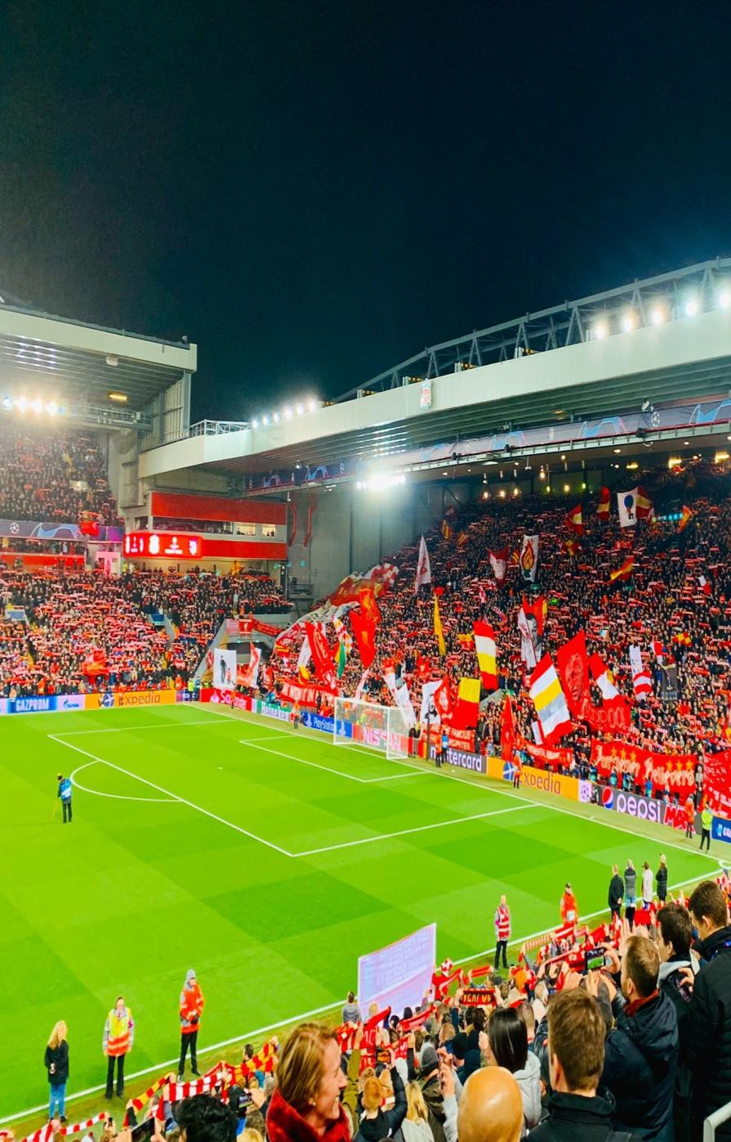
Example of economics in action in the leisure sector
Suppose Liverpool football club raise the price of their season tickets by 20%, how will individual fans behave?
The 2019/20 prices range from £685 to £869* so a 20% increase will imply prices increase to £822 to £1043.
Season Ticket Prices (liverpoolfc.com)
Anfield – home of Liverpool FC

Slide 10
What will be the impact of this price rise?
Demand is likely to fall – but by how much? How sensitive is demand in
relation to price?
How does the impact of a price rise compare to, say, demand for swimming pool facilities?
Will individual fans switch to alternative leisure activities?
Will Liverpool increase revenue from the price rise?
Economics provides an understanding of the above.

Slide 11
READING LIST
Prerequisites:
No pre-requisites in economics.
Basic maths (e.g.: draw simple graphs, calculate %).
Recommended books:
Sloman, J., Wride, A. and Garratt, D. (2018), Economics, 10th Edition, Pearson
Lipsey, R. and Chrystal, A. (2020), Economics, 14th Edition, Oxford.
Mankiw, G. and Taylor, M. (2020), Economics, 5th Edition, Cengage
Learning.
These are designed as introductory economics texts, so will contain material that is not applicable to this module. But they are good at defining key economic concepts. Other editions of these books are also available and would be equally as good.

Slide 12
Part II: Economics

Slide 13
AIM OF THIS PART
In this lecture, we will learn about: ECONOMICS
Following the lecture, you should be able to
understand what Economics is about
understand some basic economic principles

Slide 14
READING MATERIAL
Mankiw, G. and Taylor, M. (2017). Microeconomics. Cengage Learning.
→ Chapter 1: Ten principles of economics (only p. 1-8)

Slide 15
ECONOMICS
The word economy comes from the Greek word “oikos nomos” which means
“one who manages a household.”
Economies are similar to households.
  Households must make decisions:
    who cooks dinner
    who chooses the TV program
    how much to spend on leisure
  Societies must make decisions:
    how many farmers /engineers do we need
    who should become a farmer/engineer
    How much resources to allocate to the sports and leisure sectors

Slide 16
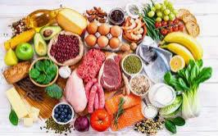

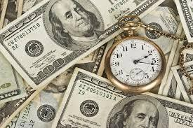
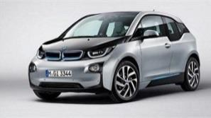

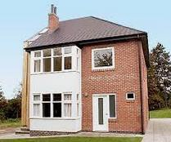

ECONOMICS
Unlimited needs/desires
Scarce resources
Unlimited needs/desi
choose

Slide 17
ECONOMICS
Like households, societies need to manage their scarce resources:
Examples of resources: land, labour (e.g., employees such as the
players and accountants), capital (e.g., provision of a stadium and facilities).
Resources are used to produce goods and services, consumed by people.
But there is a tension between:
  People’s / societies’ desire for goods and services which is unlimited
  The available resources (land, labour, capital) which are limited
Society will never have enough resources to produce the goods and services that will satisfy the needs of all its citizens. (= Scarcity)
Given the scarcity of the resources, it is important to manage them well and make the right decisions.

Slide 18
ECONOMICS
Economics = the study of how society manages its scarce resources
to fulfil the unlimited needs
Resources
Needs
Choices have to be made

Slide 19
ECONOMICS
Two main subfields:
  Microeconomics: the study of how consumers and firms make decisions and how they interact in specific markets (+ impact of governments on their choices and interaction).
  Macroeconomics: the study of the effect on the aggregate economy of
choices made by individuals, firms and government.
Examples of Microeconomics:
  How consumers decide on the quantity of video games to buy, depending on the price of the video games, the price of substitute goods, and their income.
  What will be the effect of a rise of rugby season tickets on consumption by fans?

Slide 20
SOME IMPORTANT PRINCIPLES OF ECONOMICS
How people make decisions:
People face trade-offs.
The cost of something is what you give up to get it.
Rational people think at the margin.
People respond to incentives.
How people interact with each other:
Trade can make everyone better off.
Markets are usually a good way to organize economic activity.
Governments can sometimes improve economic outcomes.

Slide 21
HOW PEOPLE MAKE DECISIONS

Slide 22
PRINCIPLE #1: PEOPLE FACE TRADE-OFFS
To get one thing we like, we usually have to give up another thing that we like,
or:
“There is no such thing as a free lunch”
Examples:
Time spent studying Leisure Market versus watching a movie
Buying board games versus food

Slide 23
PRINCIPLE #2: THE COST OF SOMETHING IS WHAT YOU GIVE UP TO GET IT
Because people face trade-offs and make choices, they must compare the costs and benefits of each action. Sometimes the cost of an action is not as obvious as it might appear.
Opportunity cost: the highest-valued alternative that must be given up to
obtain something.
Note:
Good decision when value of the choice > opportunity cost
Opportunity cost = explicit cost + implicit cost
Example 1: decide between going to the cinema or not.
Benefits: relax, spend time with friends …
Costs: price of the tickets, time not spent on studying Leisure Market …

Slide 24
PRINCIPLE #2: THE COST OF SOMETHING IS WHAT YOU GIVE UP TO GET IT
Example 2: societies have to decide how to spent their resources.
They can employed them to make a variety of goods and services, including leisure market goods and services. They can also used them to produce education, healthcare, housing ….
However, resources are scarce/limited and so producing more leisure goods
& services means we have to sacrifice non-leisure goods.
We can depict this trade-off on a production possibility frontier (PPF)
  It shows us the maximum level of output we can produce of both goods
when we employ all our labour resources in different combinations.
  It tells us the trade-offs involved: if we wish to produce more leisure goods, we must move labour from the non-Leisure sector and therefore less non-Leisure goods are produced
  It shows us that societies have choices to make on how to use scarce resources

Slide 25
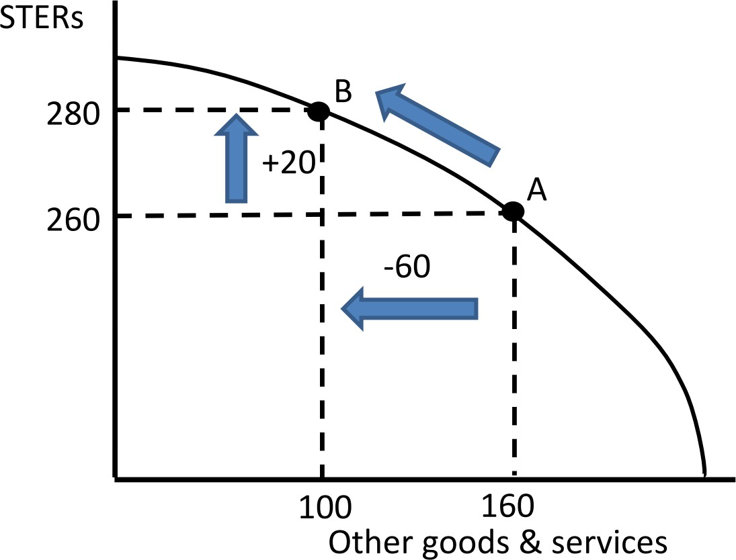
PRINCIPLE #2: THE COST OF SOMETHING IS WHAT YOU GIVE UP TO GET IT
You decide you want to increase leisure output from 260 to 280 units, an increase of 20. This means the output of other goods must fall from 160 to 100. The economy/society shifts from point A to point B
Leisure
goods
&
services
Production possibility frontier (PPF)

Slide 26
PRINCIPLE #3: RATIONAL PEOPLE THINK AT THE MARGIN
Rationality:
In economics, we study the behaviour of consumers and producers.
We usually assume that consumers and producers behave rationally.
Rational behaviour refers to a decision-making process that is based on making choices that produce the best outcomes for themselves.
Note: Rationality has its boundaries.

Slide 27
PRINCIPLE #3: RATIONAL PEOPLE THINK AT THE MARGIN
Thinking at the margin:
Marginal changes: small incremental adjustments to a plan of action.
In many situations, decision makers will make the best decision by thinking
at the margin (= “edge”).
A rational decision maker takes an action if the marginal benefit of the action exceeds its marginal cost.
Examples:
buy another pint of beer
watching a TV show for another hour
airlines and standby passengers

Slide 28
PRINCIPLE #3: RATIONAL PEOPLE THINK AT THE MARGIN
Thinking at the margin:
Example: Airlines and standby passengers 200 seat plan: flight cost = €100 000
So average cost (AC) = €500
1 empty seat
Someone is willing to pay €300
Should the airline company accept this?

Slide 29
PRINCIPLE #3: RATIONAL PEOPLE THINK AT THE MARGIN
Thinking at the margin:
Example: Airlines and standby passengers 200 seat plan: flight cost = €100 000
So average cost (AC) = €500
1 empty seat
Someone is willing to pay €300
Should the airline company accept this?
YES! Don’t look at AC but at marginal cost (MC) = extra cost to take 1 extra passenger and compare it with marginal revenue (MR) = extra benefit from taking this extra passenger = €300
MC < MR !

Slide 30
PRINCIPLE #4: PEOPLE RESPOND TO INCENTIVES
People make decisions by comparing costs and benefits → behaviour may
change when costs and/or benefits change.
Example 1: change in price → change in buying behaviour
Example 2: changing in grading scheme → change in class attendance Example 3: change in seat belts regulation → change in driving behaviour.

Slide 31
HOW PEOPLE INTERACT WITH EACH OTHER

Slide 32
PRINCIPLE #5: TRADE CAN MAKE EVERYONE BETTER-OFF
Trade is not like a sports competition where 1 side wins and the other side
looses
Trade allows each person to specialize in the activities he/she does best.
By trading with others, we can buy a greater variety of goods and services at
lower costs.
What would be my standard of living if I had to produce everything I
consume?
Countries that trade with other countries enjoy higher standards of living.

Slide 33
PRINCIPLE #6: MARKETS ARE USUALLY A GOOD WAY TO ORGANIZE ECONOMIC ACTIVITY
A market economy is an economy that allocates resources through the decentralized decisions of many firms and households as they interact in markets for goods and services:
Households decide what to buy and who to work for.
Firms decide who to hire and what to produce.

Slide 34
PRINCIPLE #6: MARKETS ARE USUALLY A GOOD WAY TO ORGANIZE ECONOMIC ACTIVITY
Adam Smith made the observation that households and firms interacting in markets act as if guided by an “invisible hand.”
Because households and firms look at prices when deciding what to buy and
sell, they (unknowingly) take into account the social costs of their actions.
As a result, prices guide decision makers to reach outcomes that tend to maximize the welfare of society as a whole.

Slide 35
PRINCIPLE #7: GOVERNMENTS CAN SOMETIMES IMPROVE MARKET OUTCOMES
…But markets do not always lead to an optimal allocation of resources.
Two important reasons for the government to interfere with the economy:
→ the promotion of efficiency and equity.
Efficiency means society gets the most that it can from its scarce resources.
Equity means the benefits of those resources are distributed fairly among the members of society.

Slide 36
PRINCIPLE #7: GOVERNMENTS CAN SOMETIMES IMPROVE MARKET OUTCOMES
Efficiency
Market failure occurs when the market fails to allocate resources efficiently - it may be caused by:
an externality, which is the impact of one person or firm’s actions on the well-being of a bystander
market power, what is the ability of a single person or firm to unduly
influence market prices

Slide 37
PRINCIPLE #7: GOVERNMENTS CAN SOMETIMES IMPROVE MARKET OUTCOMES
Equity
The invisible hand is even less able to ensure a fair distribution of economic
prosperity
A goal of many government interventions is to achieve a more equitable distribution of economic well-being
E.g., income tax

Slide 38
SUMMARY
When individuals make decisions, they face trade-offs among alternative
goals.
The cost of any action is measured in terms of foregone opportunities.
Rational people make decisions by comparing marginal costs and marginal
benefits.
People change their behaviour in response to the incentives they face.
Trade can be mutually beneficial.
Markets are usually a good way of coordinating trade among people.
Government can potentially improve market outcomes if there is some
market failure or if the market outcome is inequitable.

