Slide 2
Topics Covered
18.1 What is Financial Planning?
18.2 Financial Planning Models
18.3 A Long-Term Financial Planning Model for Dynamic Mattress
18.4 External Financing and Growth
Notes:
2

Slide 3
Financial Planning (1 of 3)
The Financial Planning Process
Analyzing the investment and financing choices open to the firm
Projecting the future consequences of current decisions
Deciding which alternatives to undertake
Measuring subsequent performance against the goals set forth in the financial plan
Notes:
3

Slide 4
Financial Planning (2 of 3)
Planning Horizon
Time horizon for a financial plan
Managers are often asked to model different possible outcomes
Optimistic case
Expected case
Pessimistic case
Financial plans help managers ensure that their financial strategies are consistent with their capital budgets. They highlight the financial decisions necessary to support the firm’s production and investment goals.
Notes:
8

Slide 5
Financial Planning (3 of 3)
Why Build Financial Plans?
Contingency planning
Considering options
Forcing consistency
Notes:
9

Slide 6
Financial Planning Models (1 of 3)
Inputs
Planning Model
Outputs
Inputs — Current financial statements. Forecasts of key variables (such as sales or interest rates).
Planning Model — Equations specifying key relationships.
Outputs — Projected financial statements (pro forma). Financial ratios. Sources and uses of funds.
Notes:
12

Slide 7
Financial Planning Models (2 of 3)
Pro Formas
Projected or forecasted financial statements
Percentage of Sales Model
Planning model in which sales forecasts are the driving variable and most other variables are proportional to sales
Balancing Item
Variable that adjusts to maintain the consistency of a financial plan
Also called a plug
Notes:
13

Slide 8
Financial Planning Models (3 of 3)
Net Income
Retained Earnings
Dividends
New Assets
Retained Earnings
External Financing
New Equity
New Debt
External Financing
By entering data provided for each variable, the remaining variable is the “plug”
Data is determined by “policy” or “rules” established by the company
Notes:
13

Slide 9
Dynamic Mattress (1 of 7)
2016 Financial Statements

Slide 10
Dynamic Mattress (2 of 7)
2016 Financial Statements

Slide 11
Dynamic Mattress (3 of 7)
2017 Pro Forma Statements

Slide 12
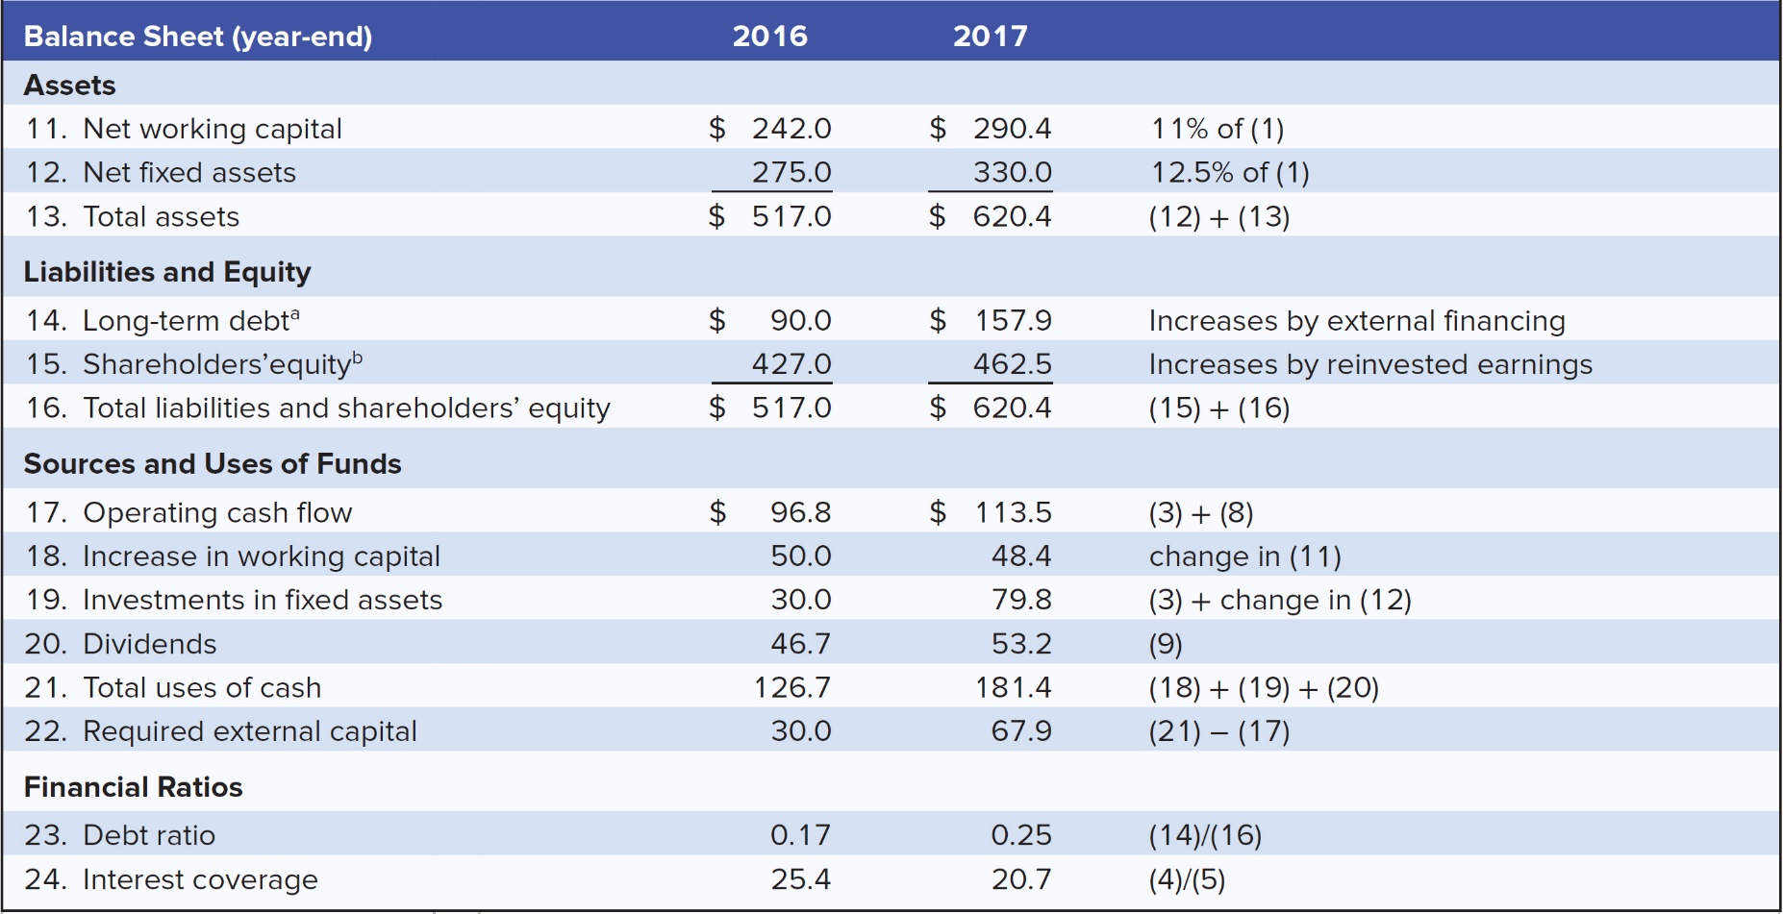
Dynamic Mattress (4 of 7)
2017 Pro Forma Statements

Slide 13
Dynamic Mattress (5 of 7)
A Long-term planning model for Dynamic Mattress
Income Statement | 2015 | 2016 | 2017 | 2018 | 2019 | 2020
Revenue |  | 2200.0 | 2,640.0 | 3,168.0 | 3,801.6 | 4,561.9
Cost of goods sold |  | 2024.0 | 2,428.8 | 2,914.6 | 3,497.5 | 4,197.0
Depreciation |  | 23.5 | 24.8 | 29.7 | 35.6 | 42.8
EBIT |  | 152.5 | 186.5 | 223.7 | 268.5 | 322.2
Interest expense |  | 6.0 | 9.0 | 15.8 | 24.0 | 34.0
Earnings before taxes |  | 146.5 | 177.5 | 207.9 | 244.4 | 288.1
Taxes at 50% |  | 73.3 | 88.7 | 104.0 | 122.2 | 144.1
Net income |  | 73.3 | 88.7 | 104.0 | 122.2 | 144.1
Dividends |  | 46.7 | 53.2 | 62.4 | 73.3 | 86.4
Reinvested earnings |  | 26.6 | 35.5 | 41.6 | 48.9 | 57.6
Balance Sheet (year-end)
Assets
Net working capital | 192.0 | 242.0 | 290.4 | 348.5 | 418.2 | 501.8
Net fixed assets | 268.5 | 275.0 | 330.0 | 396.0 | 475.2 | 570.2
Total assets | 460.5 | 517.0 | 620.4 | 744.5 | 893.4 | 1072.1
Liabilities and equity
Long-term debt (note a) | 60.0 | 90.0 | 157.9 | 240.4 | 340.4 | 461.5
Shareholders' equity (note b) | 400.5 | 427.0 | 462.5 | 504.1 | 553.0 | 610.6
Total liab. & share. equity | 460.5 | 517.0 | 620.4 | 744.5 | 893.4 | 1072.1

Slide 14
Dynamic Mattress (6 of 7)
Sources and Uses of Funds | 2015 | 2016 | 2017 | 2018 | 2019 | 2020
Operating cash flow (3 + 8) |  | 96.8 | 113.5 | 133.7 | 157.9 | 186.8
Increase in working capital |  | 50.0 | 48.4 | 58.1 | 69.7 | 83.6
Investments in fixed assets |  | 30.0 | 79.8 | 95.7 | 114.8 | 137.8
Dividends |  | 46.7 | 53.2 | 62.4 | 73.3 | 86.4
Total uses of cash |  | 126.7 | 181.4 | 216.2 | 257.9 | 307.9
Required external financing |  | 30.0 | 67.9 | 82.5 | 100.0 | 121.0
Financial ratios
Debt ratio |  | 0.17 | 0.25 | 0.32 | 0.38 | 0.43
Interest coverage |  | 25.4 | 20.7 | 14.2 | 11.2 | 9.5

Slide 15
Dynamic Mattress (7 of 7)
Required external financing
= (net assets/sales) × increase in sales - retained earnings

Slide 16
Pitfalls
Many models ignore realities such as depreciation, taxes, etc.
Percent of sales methods are not realistic because fixed costs exist
Most models generate accounting numbers not financial cash flows
Adjustments must be made to consider these and other factors
If factories are operating below full capacity, sales can increase without investment in fixed assets
Beyond some sales level, new capacity must be added
Notes:
17

Slide 17
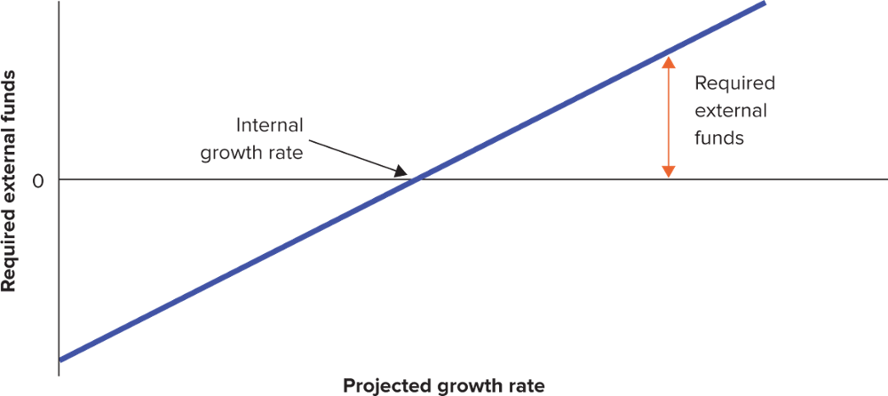
External Financing and Growth (1 of 2)
Where the sloping line crosses the horizontal axis, external financing is zero
The firm is growing as fast as possible without resorting to new security issues
Called the internal growth rate

Slide 18
External Financing and Growth (2 of 2)
Sustainable growth rate — Steady rate at which a firm can grow without changing leverage
Sustainable growth rate = plowback ratio × return on equity
$$Internal growth rate= \frac{retained earnings}{assets}$$
$$=\frac{retained earnings}{net income}×\frac{net income}{equity}×\frac{equity}{assets}$$
$$Required external financing=\frac{new assets}{sales}×\begin{matrix}\begin{aligned}increase \\ in sales\end{aligned} & − & \begin{aligned}reinvested \\ earnings\end{aligned}\end{matrix}$$
Notes:
20

