Slide 1
Past Simple with Other Verbs
Positive- Negative - Question

Slide 2
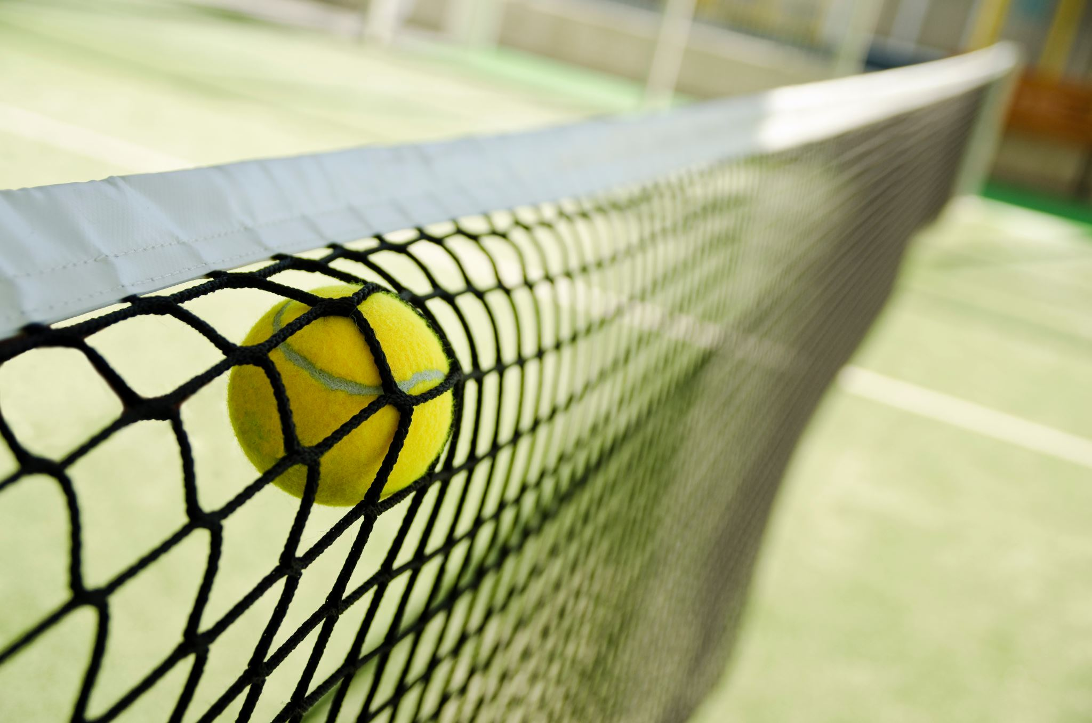
Past simple expresses a completed action in the past.
When I was 17, I was a tennis player. My family and my friends were so proud because I was the best in the game.
One day, I did my best! I won an award in my last competition and I felt great.

Slide 3
Positive Form:
We wanted to go to Italy last year.
I had a meeting yesterday evening.
My mother made a birthday cake for her friend.
In the lesson, our teacher gave lots of examples.
She called me when I was busy.
When I left home, I saw my friend.

Slide 4
Positive Form:
For regular verbs, use the –ed form of the verb in a positive sentence.
When I was a child, I played piano.
Donna lived in Paris when she was 5.
For irregular verbs, use the correct past tense form in positive sentence.
I sent you an e-mail yesterday.
The student gave a speech in English. They did a great job!

Slide 5
Some Irregular Verbs:
eat | ate
come | came
have | had
buy | bought
forget | forgot
do | did
go | went
feel | felt
understand | understood
know | knew
send | sent
write | wrote
For more irregular verbs, please go to page 176.

Slide 6
Negative Forms:
I didn’t go to Spain last summer.
We didn’t arrive home early.
She didn’t stay at a hotel in Ankara.
Verb always should be infinitive. Verb doesn’t change.
I didn’t went to Spain last summer.
go

Slide 7
See more examples!
They didn’t cook at the weekend.
Lucy didn’t meet her friends last week.
It didn’t rain yesterday.
We didn’t go on holiday last year.
We didn’t go to the party.
David and I didn’t dance at the party.

Slide 8
Question Forms:
Did you watch TV last night?
Yes, I did. / No, I didn’t.
Did your friends play football yesterday?
Yes, they did. No, they didn’t.
Did your mum bake a cake last weekend?
Yes, she did. No, she didn’t.

Slide 10
Let’s practice!
I ………. (study) French yesterday.
I studied French yesterday.
We …………….(watch) an interesting programme last night.
We watched an interesting programme last night.
Mark …………… (stop) the car in front of the post-office.
Mark stopped the car in front of the post-office.
My parents ……………….. (not arrive) at half past six.
My parents didn’t arrive at half past six.
Alison ………….. (walk) to school.
Alison walked to school.
Charles and Wendy ………………(not dance) at the party.
Charles and Wendy didn’t dance at the party.

Slide 11
Let’s make questions!
Did it snow a lot last winter?
Yes, it snowed a lot last winter.
Did you tell your kid a story last night?
Yes, I told my kid a story last night.
Did she join the game yesterday?
Yes, she joined the game yesterday.

Slide 12
Let’s practice more!
Go to join.quizizz.com
Enter the code 1288 5169

