Slide 1
Why university students should take this course
Just about every university course includes an element of research that students must carry out independently, in the form of projects, dissertations and theses, and
The more advanced the degree, the greater the research content.
In the workplace there is frequently a need to do research in order to develop or improve the business or service,
While some types of businesses rely on doing research projects for their very existence.

Slide 2
Term Projects (2)
ASSESSMENT METHODS
Activities | Number |  | Effect | Notes
Homeworks | 2-3 |  | 15%
Midterm Exam | 1 |  | 35%
Project & presentation | 1 |  | 50% | 1 Project will be assigned
Effect of The Activities |  |  | 50%
Effect of The Final Exam | 1 |  | 50%
ECTS TABLE
Contents |  | Number | Hours |  | Total
Hours in Classroom |  | 14 | 3 |  | 42
Hours out Classroom |  | 12 | 3 |  | 42
Home works |  | 3 | 6 |  | 18
Projects |  | 1 | 32 |  | 32
Midterm Exam |  | 1 | 12 |  | 12
Final Exam |  | 1 | 18 |  | 18
Total Total / 30 ECTS Credit |  |  |  |  | 164
 |  |  |  |  | 164/ 30 = 5.4
 |  |  |  |  | 6.00

Slide 3
Term project
Decide on a topic to make a Research Project
search with engines the topics.
do alone or with a group of at most 3 friends
Financial literacy level of students
Digital literacy level of students
Food Quality and Preferences
Sustainability
Or other topics.
Sustainable development goals.

Slide 5
BUSINESS RESEARCH METHODS CHAPTER 1 & 2

Slide 6
What is Research?
Research is a very general term for an activity that involves finding out, in a more or less systematic way, things you did not know. A more academic interpretation is that research involves finding out about things that no-one else knew either.
Therefore the basic characteristics:
Data are collected systematically.
Data are interpreted systematically.
There is a clear purpose: to find things out.

Slide 7
Types of Business Research: Applied And Basic
Figure 1.1 Basic and applied research
Source: Authors’ experience; Easterby-Smith et al. (2012); Hedrick et al. (1993).

Slide 8
Methods vs Methodology
Methods to refer to techniques and procedures used to obtain and analyse data. This, includes questionnaires, observation and interviews as well as both quantitative (statistical) and qualitative (nonstatistical) analysis techniques and, as you have probably gathered from the title.
In contrast, the term methodology refers to the theory of how research should be undertaken. We believe that it is important that you have some understanding of this so that you can make an informed choice about your research.

Slide 10
Research Methods
Research methods are the techniques you use to do research.
They represent and provide you with ways to collect, sort and analyse information so that you can come to some conclusions.
If you use the right sort of methods for your particular type of research, then you should be able to convince other people that your conclusions have some validity, and that the new knowledge you have created is soundly based.

Slide 11
Generating research ideas..
Providing an initial research idea there are a lot of techniques.
The unique technique that you choose to use and the order in which you should use them are entirely up to you.
It is better to use a variety of techniques.

Slide 12
Before starting to your research
You need to have at least some idea of what you want to do.
This is probably
The most difficult
The most important, part of your research project.
Without being clear about what you are going to research it is difficult to plan how you are going to research it.

Slide 13
Rational thinking | Creative thinking
Examining your own strengths and interests | Keeping a notebook of your ideas
Examining staff research interests | Exploring personal preferences using past projects
Looking at past project titles | Exploring relevance to business using the literature
Discussion | Relevance trees
Searching existing literature | Brainstorming
Scanning the media
Table 2.1 More frequently used techniques for generating and refining research ideas

Slide 14
WHAT YOU CAN DO WITH RESEARCH
Categorise | This involves forming a typology of objects, events or concepts, i.e. a set of names or ‘boxes’ into which these can be sorted.
Describe | Descriptive research relies on observation as a means of collecting data. It attempts to examine situations in order to establish what is the norm, i.e. what can be predicted to happen again under the same circumstances.
Explain | This is a descriptive type of research specifically designed to deal with complex issues. It aims to in order to make sense of the myriad other elements involved, such as human, political, social, cultural and contextual.
Evaluate | This involves making judgements about the quality of objects or events. Quality can be measured either in an absolute sense or on a comparative basis.
Compare | Two or more contrasting cases can be examined to highlight differences and similarities between them, leading to a better understanding of phenomena.
Correlate | The relationships between two phenomena are investigated to see whether and how they influence each other.
Predict | Predictions of possible future behaviour or events are made on the basis that if there has been a strong relationship between two or more characteristics or events in the past, then these should exist in similar circumstances in the future, leading to predictable outcomes.
Control | Once you understand an event or situation, you may be able to find ways to control it. For this you need to know what the cause and effect relationships are and that you are capable of exerting control over the vital ingredients.

Slide 15
RESEARCH DESIGNS
There are numerous types of research design that are appropriate for the different types of research projects.
The choice of which design to apply depends on the nature of the problems posed by the research aims.
Each type of research design has a range of research methods that are commonly used to collect and analyze the type of data that is generated by the investigations.
Types of research
Historical
Descriptive
Correlation
Comparative
Experiemental
Ethnological
Cultural

Slide 16
HISTORICAL
This aims at a systematic and objective evaluation and synthesis of evidence in order to establish facts and draw conclusions about past events.
It uses primary historical data and documentary sources of the past

Slide 17
DESCRIPTIVE
This design relies on observation as a means of collecting data. ‘Observation’ can take many forms.
Depending on the type of information sought, people can be interviewed, questionnaires distributed, visual records made, even sounds and smells recorded.
Important is that the observations are written down or recorded in some way, in order that they can be subsequently analysed.

Slide 18
COMPARATIVE
This design is used to compare past and present or different parallel situations, particularly when the researcher has no control over events. It can look at situations at different scales, macro (international, national) or micro (community, individual)

Slide 19
EXPERIMENTAL
Experimental research attempts to isolate and control every relevant condition which determines the events investigated and then observes the effects when the conditions are manipulated.
They usually require a hypothesis (prediction) to be formulated first in order to determine what variables are to be tested and how they can be controlled and measured.

Slide 20
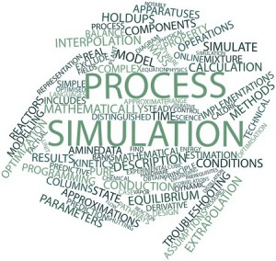
SIMULATION
Simulation involves devising a representation in a small and simplified form (model) of a system, which can be manipulated to gauge effects. It is similar to experimental design in the respect of this manipulation, but it provides a more artificial environment in that it does work with original materials at the same scale.

Slide 21
ETHNOLOGICAL
Ethnological research focuses on people. In this approach, the researcher is interested in how the subjects of the research interpret their own behaviour rather than imposing a theory from outside. It takes place in the undisturbed natural settings of the subjects’ environment.

Slide 23
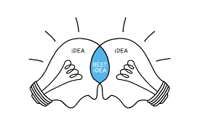
Deciding on The Research Type
It is your research interest that decides the nature of your research problem, and this will indicate the appropriate type of research to follow.
Once the objectives of a research project have been established, the issue of how these objectives can be met leads to a consideration of which research design should be chosen.

Slide 24
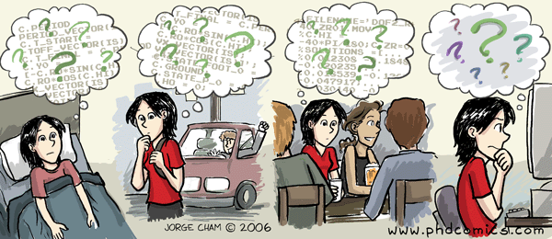
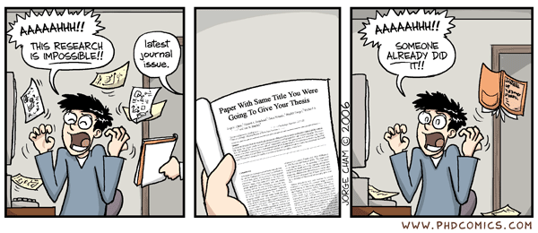
Deciding on Your Type of Research

Slide 25
INDUCTIVE REASONING – THE EMPIRICIST’S APPROACH
Inductive reasoning starts from specific observations or sensory experiences and then develops a general conclusion from them. This simple example gives and indication of the line of reasoning:
All the giraffes that I have seen have very long necks.(Repeated observations)
Therefore I conclude that all giraffes have long necks.(Conclusion)

Slide 26
? ? ?
There are problems with induction:
1- How many observations must be made before we can reasonably draw a conclusion that is reliable enough to generalize from?
2- How many situations and under which conditions should the observations be made so that true conclusions can be reached?

Slide 27
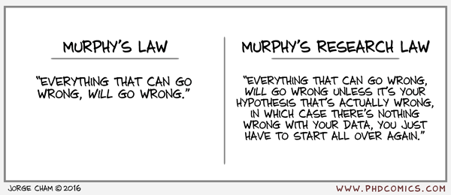
Therefore, in order to be able to rely on the conclusions we come to by using inductive reasoning, we should ensure that we make a large number of observations, we repeat them under a large range of circumstances and conditions and that no observations contradict the generalization we have made from the repeated observations.

Slide 28
DEDUCTIVE REASONING – THE RATIONALIST’S APPROACH
Deductive reasoning begins with general statements (premises) and, through logical argument, comes to a specific conclusion. Again, a simple example will provide a guide to how this works:
All living things will eventually die.(General statement – first premise)
Animals is a living things. (Inference – second premise)
Therefore, animals will eventually die.(Conclusion)

Slide 29
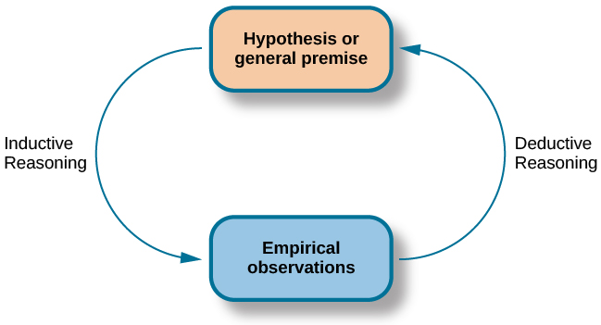

Slide 30
RESEARCH THEORY
All philosophical positions and their attendant methodologies, explicitly or implicitly, hold a view about reality. This view, in turn, will determine what can be regarded as legitimate knowledge. Philosophy works by making arguments explicit.
You need to develop sensitivity towards philosophical issues so that you can evaluate research critically. It will help you to discern the underlying, and perhaps contentious.

Slide 31
Theories
are speculative answers to perceived problems, and are tested by observation and experiment. Science is seen to proceed by trial and error: when one theory is rejected, another is proposed and tested, and thus the fittest theory survives.
In order for a theory to be tested, it must be expressed as a statement called a hypothesis. The essential nature of a hypothesis is that it must be falsifiable.

Slide 32
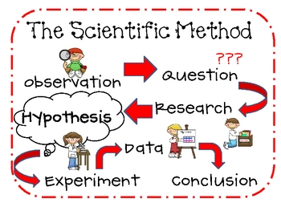
SCIENTIFIC METHOD
identification or clarification of a problem;
developing a hypothesis (testable theory) inductively from observations;
charting their implications by deduction;
practical or theoretical testing of the hypothesis;
rejecting or refining it in the light of the results.
It is this combination of experience with deductive and inductive reasoning which is the foundation of modern scientific research, and is commonly referred to as scientific method.

Slide 33
Aspects of philosophy
Positivism - the stance of the natural scientist
Realism - direct and critical realism
Interpretivism - researchers as ‘social actors’
Axiology - studies judgements about value

Slide 34
The research ‘onion’
Saunders et al, (2008)

Slide 35
Aspects of approaches
The two main research approaches are
Deduction;
Theory and hypothesis are developed and tested
Induction;
Data are collected and a theory developed from the data analysis

Slide 36
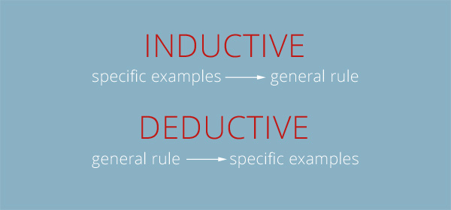

Slide 37
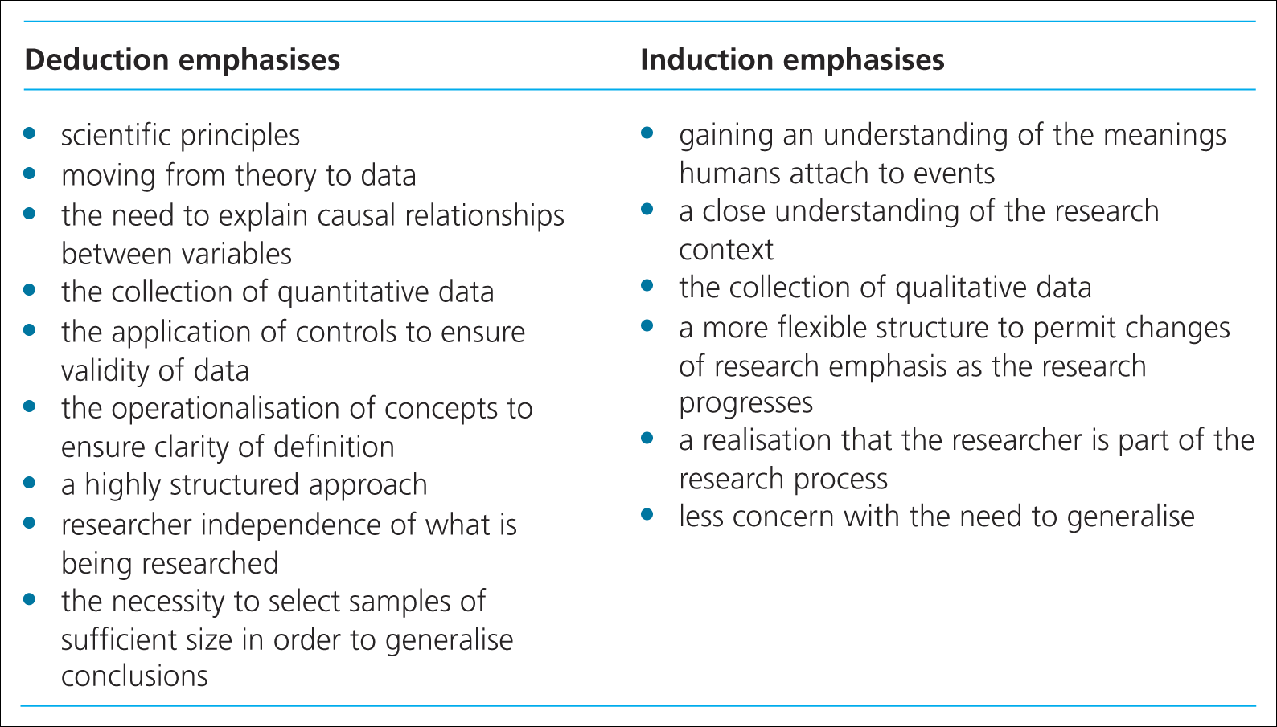
Major differences between these approaches
Saunders et al, (2009)
Table 4.2 Major differences between deductive and

Slide 38
Research Paradigms
Paradigsm: is a term frequently used in the soical sciences, but one can lead to confusion because it tends to have multiple meanings.
Is a way of examining social phenomena from which particular understandings of these phenomena can be gained and explanations attemped.

Slide 40
Structuring the Research Project
What information you collect and how you analyse it depends on the nature of the research problem, the central generating point of a research project.

Slide 41
THE RESEARCH PROCESS
The problem will generate the subject of the research, its aims and objectives,
and will indicate what sort of data need to be collected in order to investigate the issues raised,
and what kind of analysis is suitable to enable you to come to conclusions that provide answers to the questions raised in the problem.

Slide 42
The answers to four important questions underpin the framework of any research project:
What are you going to do?
The subject of your research.
Why are you going to do it?
The reason for this research being necessary or interesting.
How are you going to do it?
The research methods that you will use to carry out the project.
When are you going to do it?
The programme of the work.

Slide 43
THE RESEARCH PROBLEM
There is no shortage of problems throughout the world, but for a problem to be researchable, it needs to have several crucial features. It must be:
stated clearly and concisely;
significant i.e. not trivial or a repeat of previous work;
delineated, in order to limit its scope to practical investigation;
possible to obtain the information required to explore the problem;
possible to draw conclusions related to the problem, as the point of research is to find some answers.

Slide 44
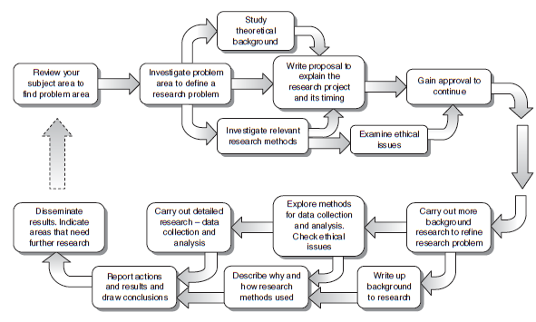
Structure of a typical research project, Walliman, 2011

Slide 45
A research problem
can be based on a question, an unresolved controversy, a gap in knowledge or an unrequited need within the chosen subject.

Slide 46
The different things you can do to split up the main question are to:
Split it down into different aspects that can be investigated separately, e.g. political, economic, cultural, technical.
Explore different personal or group perspectives, e.g. employers, employees.
Investigate different concepts used, e.g. health, wealth, confidence, sustainability.
Consider the question at different scales, e.g. The individual, group, organization.
Compare the outcomes of different aspects from the above ways of splitting down.

Slide 47
DEFINING THE RESEARCH PROBLEM
Question or Questions: Probably the simplest way to set up a research problem is to ask a question.
For example:
Main question: Are school exam results a true test of a student’s intelligence?

Slide 48
In this case the sub-questions could concentrate on:
What constitutes intelligence? (Investigating a concept, i.e. ‘intelligence’.)
What ways of testing intelligence are there? (Exploring different perspectives – i.e. other intelligence tests, and thus investigating the concept ‘test’.)
What sort of school exams are there and how are they marked? Investigating another concept – i.e. ‘exams’.)
How do school exam criteria match those of the criteria of other intelligence tests? (Split into aspects – in this case, criteria of exams and other intelligence tests.)

Slide 49
Note how all the sub-questions relate directly to the main question and break down the rather abstract question into practical questions that can be investigated individually and build up to an answer to the main question.

Slide 50
An example of this form of research definition is:
This study examines the problem of career development of women engineers in the automotive industry in Britain. It focuses on the identification of specific barriers (established conventions, prejudices, procedures, career paths) and explores the effectiveness of specific initiatives that have been aimed at breaking down these barriers.

Slide 51
HYPOTHESES
The research problem in research projects that use the hypothetico-deductive method is expressed in terms of the testing of a particular hypothesis.
Hypotheses are nothing unusual.
Reasonable guesses can be expressed in the form of statement. This is a hypothesis.
A good hypothesis is a very useful aid to organizing the research effort, but it must have certain qualities.
It must be a statement that can be put to the test.
It must specifically limit the enquiry to the interaction of certain factors.

Slide 52
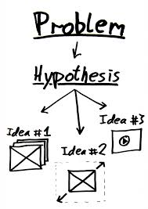
So, to express the above example of a research question in the form of a hypothesis it would need to be written simply like this as a statement:
School exam results are a true test of a student’s intelligence.

Slide 53
Operationalization
One of the fundamental criteria of a hypothesis that it is testable but formulated on a conceptual level cannot be directly tested; it is too abstract.
It is therefore necessary to convert it to an operational level. This is called operationalization.

Slide 55
RESEARCH ETHICS
Working with human participants in your research always raises ethical issues about how you treat them.
People should be treated with respect, which has many implications for how exactly how you deal with them before, during and after the research.

Slide 56
Even if you are not using human participants in your research, there is still the question of honesty in the way you collect, analyse and interpret data.

Slide 57
There are two aspects of ethical issues in research:
1- The individual values of the researcher relating to honesty and frankness and personal integrity.
2- The researcher’s treatment of other people involved in the research, relating to informed consent, confidentiality, anonymity and courtesy.

Slide 58
Organizations And Ethics Committees
The role of ethics committees is to oversee the research carried out in their organizations in relation to ethical issues. Applying for ethics approval inevitably involves filling in forms.

Slide 59
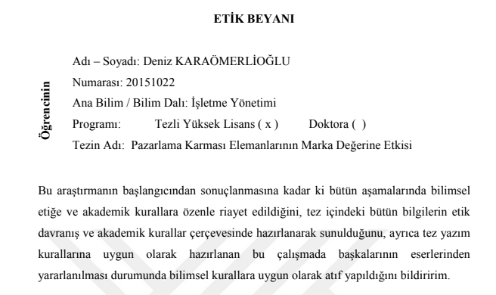

Slide 60
HONESTY IN YOUR WORK
Plagiarism
Citation
Data and Interpretations

Slide 61
Plagiarism
Presenting the work and ideas of other people and passing them off as your own, without acknowledging the original source of the ideas used, four common forms of plagiarism which are commonly found in universities

Slide 62
Plagiarism
Directly copying someone else’s work into your report, thesis etc. and letting it be assumed that it is your own.
Using the thoughts, ideas and works of others without acknowledging their source, even if you paraphrased into your own words, is unethical.

Slide 63
Stealing material from another source and passing it off as your own.
For example: buying a paper from a research service, essay bank or term-paper mill (either specially written for the individual or pre-written); copying a whole paper from a source text without proper acknowledgement.
2. Submitting another student’s work with or without that student’s knowledge
For example: by copying a computer disk

Slide 64
3. Copying sections of material from one or more source texts, supplying proper documentation (including the full reference) but leaving out quotation marks, thus giving the impression that the material has been paraphrased rather than directly quoted.
4 . Paraphrasing material from one or more source texts without supplying appropriate documentation

Slide 67
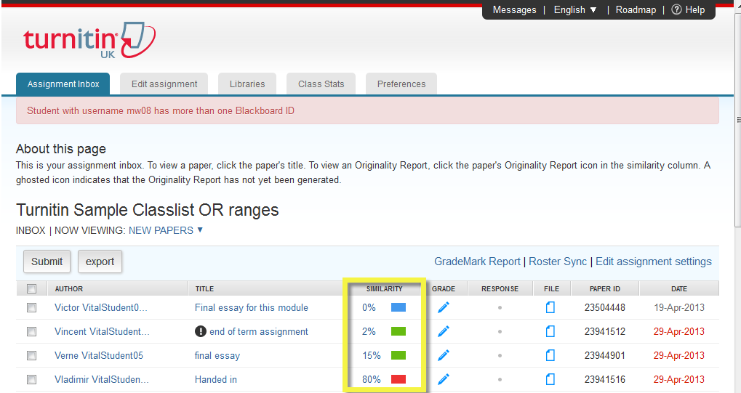

Slide 69
CITATION
You can avoid accusations of plagiarism by acknowledging the sources of these features and their originators within your own text. This is called citation.
Although there are several well established citation methods, they all consist of brief annotations or numbers placed within the text that identify the cited material,
and a list of references at the end of the text that give the full publication details of the source material.

Slide 70
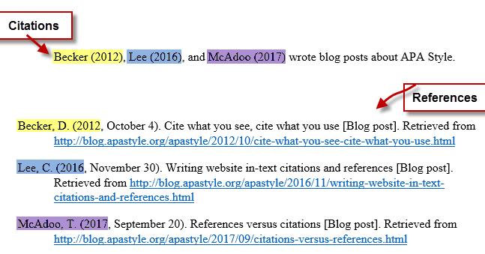

Slide 71
DATA AND INTERPRETATIONS
If you can see any reason for a possibility of bias in any aspect of the research, it should be acknowledged and explained.
If the study involves personal judgements and assessments, the basis for these should be given.
The sources of financial support for the research activities should be mentioned, and pressure and sponsorship from sources which might influence the impartiality of the research outcomes should be avoided.

