Slide 1
Majority Influence: Conformity
Week

Slide 2


Conformity
• Airplane crash example (‘The Wrong Stuff’, BBC 2, February 1986)
• 1 Captain and 2 Co-pilots
• Technical staff, flight engineers

Slide 3
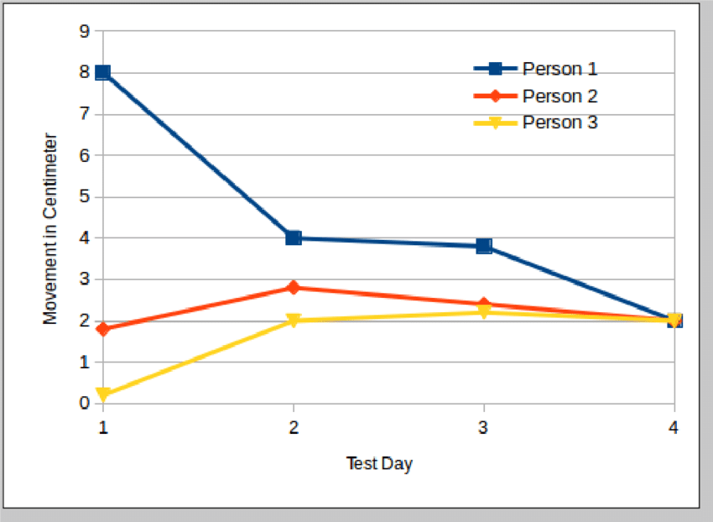
Classic Experiments: Sherif (1936)
• Autokinetic effect experiments
• Norm formation and conformity
• Testing time:
- 1st person
- 2nd person
- 3rd person

Slide 4
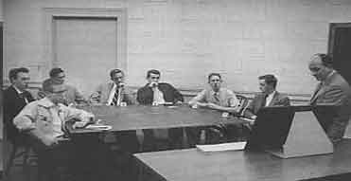
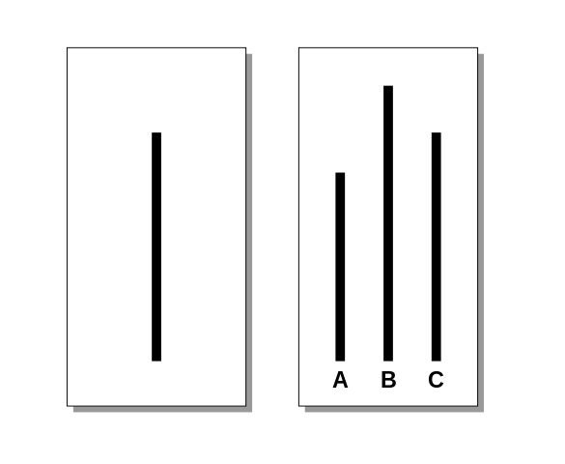
Classic Experiments: Asch (1956)
• Conformity experiments
• 36% of responses were either wrong (same as the majority) or in that direction
• Effect of the number of confederates
• Effect of the number of real subjects
Video: https://www.youtube.com/watch?v=2qXxhBafevY
Cevapların %36'sı ya yanlış (çoğunluk ile aynı) ya da onun yönündeydi)
Sahte denek sayısının etkisi
Gerçek denek sayısının etkisi

Slide 5


Conformity: Cultural Differences
Berry (1967) – levels of conformity and economic characteristics of different societies
It has been observed that the Temne people in Sierra Leone, who depend on a single crop every year, show significantly higher levels of conformity than indigenous groups in the Arctic whose economies are based on hunting and fishing trips.

Slide 6
Conformity: Cultural Differences
Berry's theory is more applicable to non-industrialized societies
Smith et al. (2013) – emphasize the importance of dominant types of values in societies:
  In Individualistic cultures, a strong emphasis is placed on values such as individual achievement, separation from other group members, competition with them, self-determination, and independence.
  In Collectivist cultures, collective achievements, closeness and cooperation with the in-group, and the desire for consensus are valued.
It has emerged that the dimension of individualism-collectivism is related to the levels of conformity shown in the Asch paradigm (Bond and Smith 1996).
People in collectivist cultures (e.g., Brazil, Japan) tend to show higher rates of conformity compared to those in more individualistic cultures (e.g., UK, USA).

Slide 7
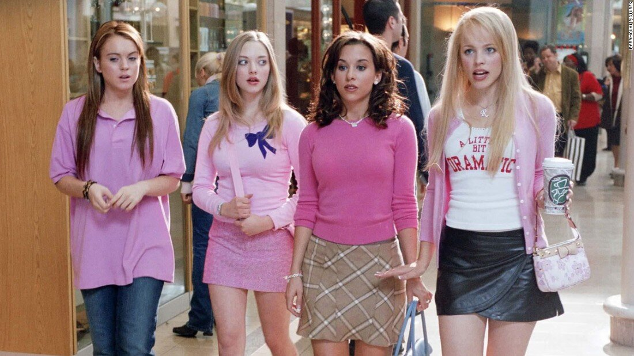


Conformity
Conformity is not limited to judgments regarding experimentally designed environments (such as line lengths or distance perception).
We have a very general tendency to change our attitudes and behaviors in a way that aligns them with the people around us.
This applies to relatively minor issues like clothing fashion and music taste, as well as more fundamental moral values and socio-political actions...

Slide 8
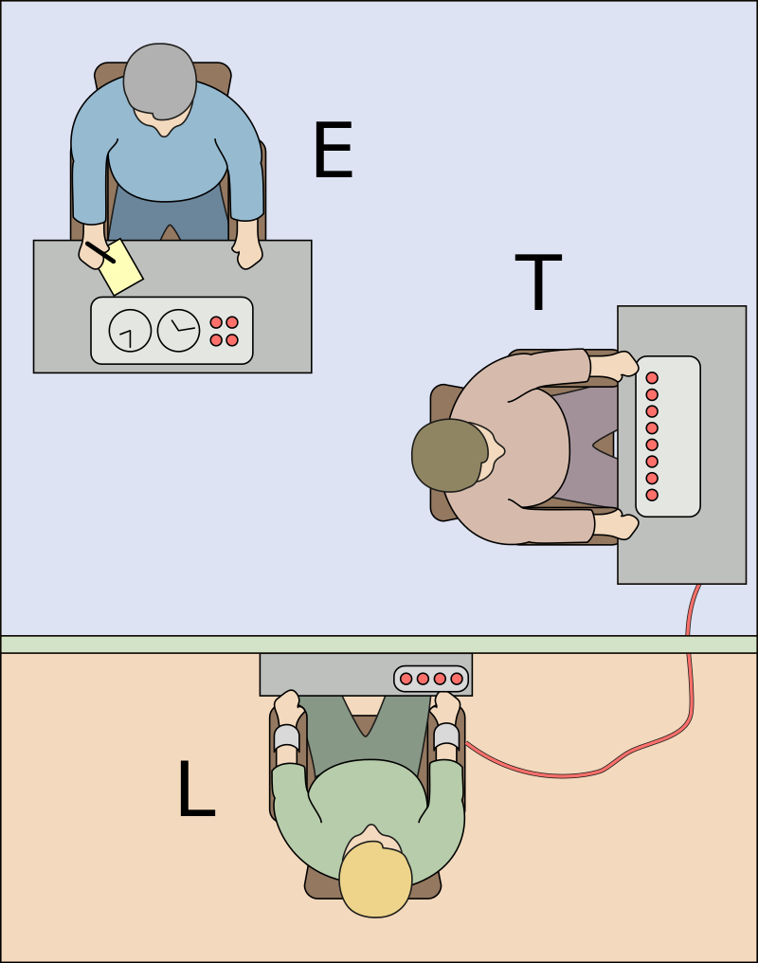
Milgram’ın (1963) deneylerini hatırlayalım!
İnsanların acı verici ve potansiyel olarak tehlikeli olduğuna inandıkları cezaları araştırma katılımcılarına uygulayabildiklerini gösteren çalışmalar
Çok sayıda katılımcı, araştırmacıya itaat etmeye ve 400V veya daha fazla şok vermeye hazırdı (itaat oranları % 30 ile% 65 arasında değişmektedir).

Slide 9
Conformity – Milgram’s later experiments
In two subsequent experiments, Milgram demonstrated the power of group influence on the same antisocial behavior (Milgram 1964, 1965).
In the first version, there were two additional confederates helping the real participant in the learning experiment.
These two pseudo-participants constantly suggested higher voltages (The experimenter explained that the "lowest voltage" specified by everyone should be applied. Thus, the participant was also given the chance to suggest a lower voltage).
Result: Parallel to Asch's (1955) study, more than half of the participants consistently showed conformity to the implicit pressure applied by their two fellow 'teachers' who administered more than 210V of 'shock'.
However, as Milgram (1965) later showed, this group pressure can also be used to limit (reduce) anti-social behaviors!

Slide 10
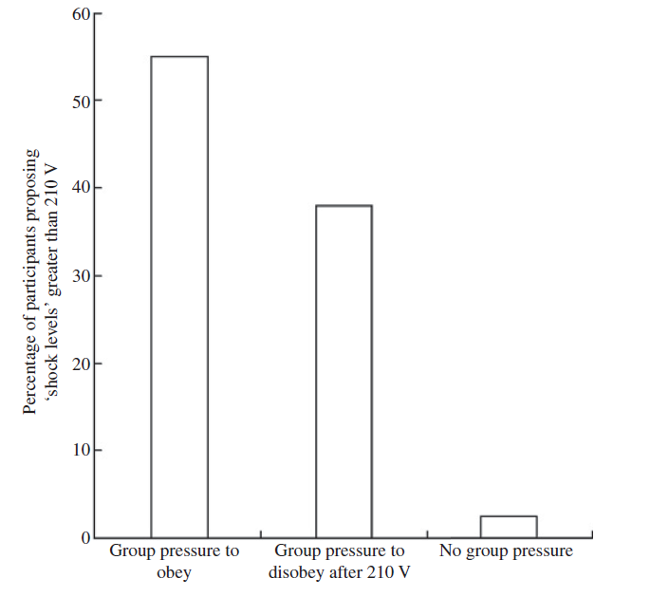
Conformity – Milgram’s later experiments
Bir diğer versiyon: 2 araştırmacı – şok seviyesi '150V'ye ulaştığında birinin deneye devam etmeyi reddetmesi ve diğerinin '210V'de geri çekilmesi
210 V’ dan fazla şok verenlerin yüzdesi
İtaat için grup baskısı
İtaat etmemeye yönelik grup baskısı
grup baskısı yok

Slide 11
“What are the underlying reasons for conformity?”
Two important processes that cause individuals to be influenced by the majority in a group (Festinger, 1950):
1. Social construction of reality: We all have a set of beliefs about the world.
For us, these are mini-theories that guide our actions and help us interpret social events. Therefore, we want to validate or test these theories. However, unlike scientific theories, we generally do not have any objective tools or agreed-upon procedures to do this.
  Pressures toward "uniformity/unity" are likely to increase in new or ambiguous situations, as there are fewer 'objective' cues to guide our judgments—(recall Sherif's (1936) autokinetic effect experiment).
  Furthermore, the importance of conformity increases in situations where the consequences of our decisions are significant.
  Asch (1955) – eyewitness adaptation: The highest conformity (approximately 51%) was observed under conditions of high difficulty and high importance

Slide 12
“What are the underlying reasons for conformity?”
Two important processes that cause individuals to be influenced by the majority in a group (Festinger, 1950):
2. The presence of group goals: When a group has a clearly defined goal, this in itself leads to uniformity of action among group members, especially in situations where achieving the goal depends on the sum of their efforts.
For example, the effectiveness of a tug-of-war team critically depends on their success in maximizing and coordinating their pulling of the rope. However, in more complex group tasks, it is also vital that group members agree not only on the goal itself but also on the means of achieving that goal. Without this consensus (i.e., conformity), the efforts of group members are likely to become fragmented, making it less likely that the goal will be achieved.

Slide 13
“What are the underlying reasons for Conformity?”
3. A third explanation, which is the opposite of the social reality function proposed by Festinger (Deutsch & Gerard, 1955):
People may conform not because they rely on the judgments of confederates to define reality, but rather to avoid social ridicule or the possibility of being seen as “odd.”
We are attracted to others who hold attitudes similar to our own—or perhaps we are excluded by those who hold different attitudes—this relates to social approval (or disapproval).
If we dislike others who disagree with us, we may assume that others will also dislike us if we express views that differ greatly from theirs.
Assuming that most people prefer being liked to being disliked, concern about being liked and accepted may explain this motivation to conform.

Slide 14
“What are the underlying reasons for Conformity?”
Experiments by Deutsch and Gerard (1955):
Several modifications were made to Asch’s procedure.
Condition 1 (closest to Asch’s experiment): a face-to-face situation in which a majority of three people gave incorrect answers. In half of the trials, responses were given while the stimuli were still visible; in the remaining trials, the stimuli were removed before decisions were made (“ambiguity of the situation”).
Condition 2: the same as the first, except that participants could not see each other and gave their responses anonymously.
Condition 3: conformity pressures were increased by informing participants that they formed one of twenty groups and that the five groups making the fewest errors would receive an attractive reward (group goals made salient).
Across these three conditions, there were also trials in which participants were asked to write down their responses before hearing others’ answers and before giving their own responses.

Slide 15
“What are the underlying reasons for Conformity?”
Experiments by Deutsch and Gerard (1955):
The results supported the idea that all three motivations have significant effects on conformity.
As the group became psychologically more important by providing a collective goal, levels of conformity increased—even though the group’s goal was to “make the fewest errors.”
This supports Festinger’s group goal hypothesis.
Festinger’s reality-testing hypothesis—the need for information in ambiguous situations—was also supported: greater conformity was found in the more ambiguous trials where the stimuli were removed before responses were given.
The need to be liked was also influential: there was less conformity in anonymous responses compared to face-to-face situations.
Conformity decreased even further when participants wrote down their decisions first.

Slide 16
Any Questions??

