Slide 1


Course Title
Investment Analysis
Course Coordinator
Assist.Prof.Dr. Gökhan Sökmen
Research Assistant
Gözde Elbir

Slide 2
Capital Budgeting and Risk
Risk defined in terms of variability of possible outcomes from given investment
Risk is measured in terms of losses and uncertainty
New projects involve risk. Capital budgeting decisions require that managers analyze the following factors for each project they consider:
    Future cash flows
    The degree of uncertainty of these future cash flows
    The value of these future cash flows considering their uncertainty
13-2

Slide 3
RISK AND CASH FLOWS
When managers estimate what it costs to invest in a given project and what its benefits will be in the future, they are coping with uncertainty.
The uncertainty arises from different sources, depending on the type of investment being considered, as well as the circumstances and the industry in which it is operating.
Uncertainty may result from:
    Economic conditions. Will consumers be spending or saving? Will the economy be in a recession? Will the government stimulate spending? Will there be inflation?
13-3

Slide 4
RISK AND CASH FLOWS
Market conditions. Is the market competitive? How long does it take competitors to enter into the market? Are there any barriers, such as patents or trademarks, that will keep competitors away? Is there a sufficient supply of raw materials and labor? How much will raw materials and labor cost in the future?
Taxes. What will tax rates be? Will Congress alter the tax system?
Interest rates. What will be the cost of raising capital in future years?
International conditions. Will the exchange rate between different countries’ currencies change? Are the governments of the countries in which the firm does business stable?
13-4

Slide 5
RISK AND CASH FLOWS
These sources of uncertainty influence future cash flows. To choose projects that will maximize owners’ wealth, we need to assess the uncertainty associated with a project’s cash flows. In evaluating a capital project, we are concerned with measuring its risk.
13-5

Slide 6

Variability and Risk
Three investment proposals illustrated in following slide
  Each with different risk characteristics
All investments in illustration have same expected value of $20,000
Investment C is most risky of the three due to variability
13-6

Slide 7
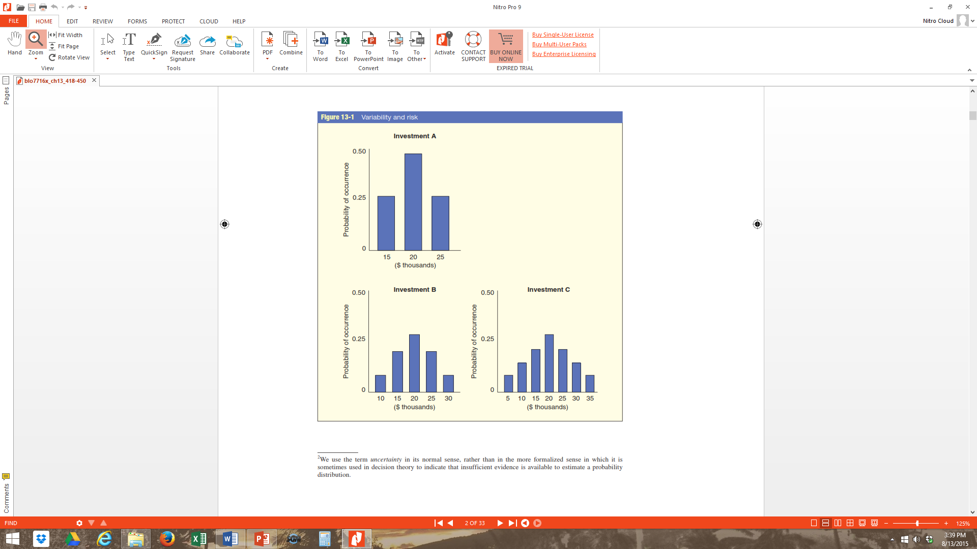
Variability and Risk Continued
The variability (risk) increases from Investment A to Investment C. Because you may gain or lose the most in Investment C, it is clearly the riskiest of the three.
13-7

Slide 8

The Concept of Risk-Averse
Most investors and managers are risk-averse
  Prefer relative certainty as opposed to uncertainty
Investors require a higher expected value or return for risky investments
  Figure Risk-Return Trade-Off
13-8

Slide 9
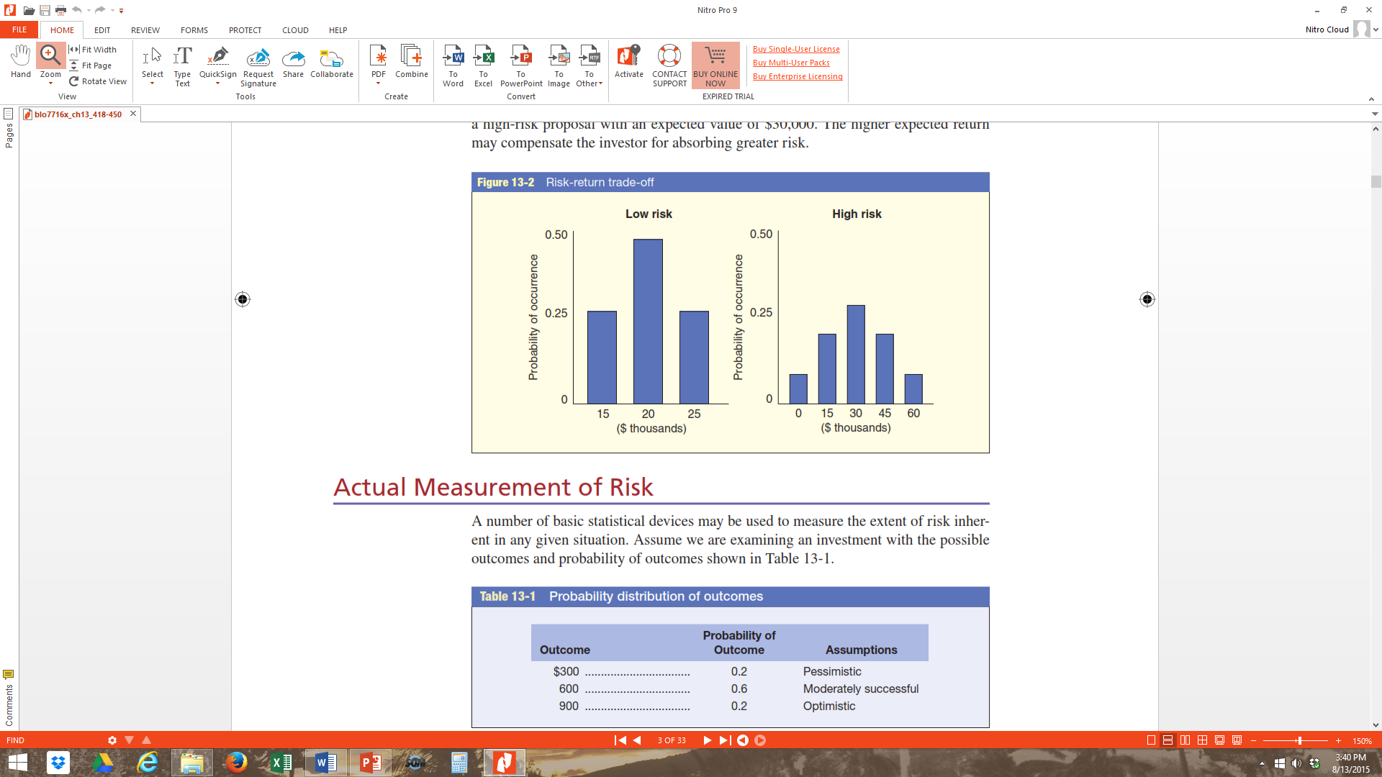
Risk-Return Trade-Off
13-9

Slide 10

Actual Measurement of Risk
Basic statistical devices used to measure the extent of risk in any given situation
  Expected value:
  Standard deviation:
  Coefficient of variation:
= Expected value or expected return
R = a weighted average of outcomes or the nth possible return
P = The probability of the nth return occuring
σ = Standard deviation
13-10

Slide 11
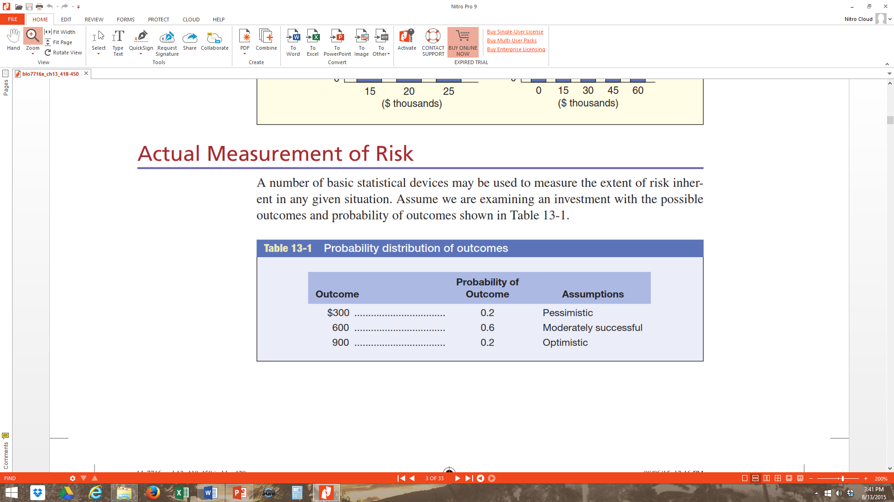
Probability Distribution of Outcomes
Example 1: Based on the data in the table, compute the expected value and the standard deviation.
13-11

Slide 12

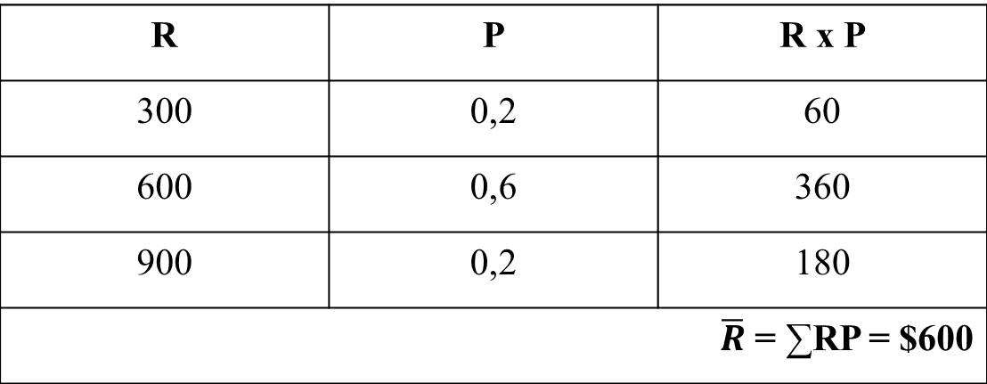
Example 1: The expected value ($\overline{R}$) is a weighted average of outcomes (R) times their probabilities (P):
  Expected value:
R | P | R x P
300 | 0,2 | 60
600 | 0,6 | 360
900 | 0,2 | 180
$\overline{R}$ = ∑RP = $600
13-12

Slide 13
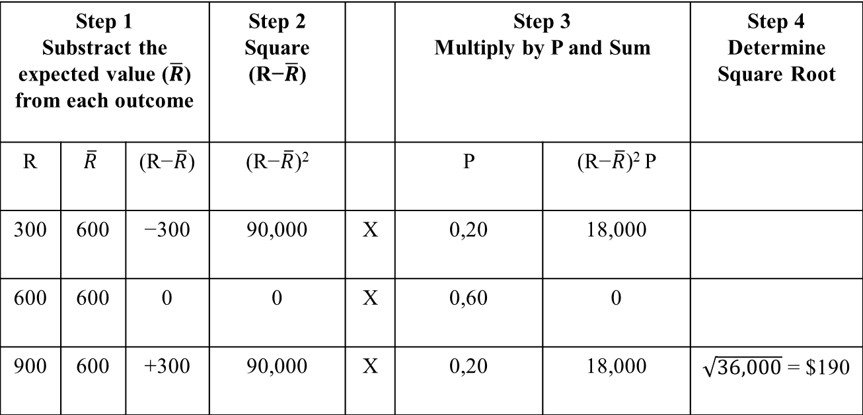
Example 1: The expected value is $600. Compute the standard deviation:
  Standard deviation:
Step 1 Substract the expected value ($\overline{R}$) from each outcome |  |  | Step 2 Square (R−$\overline{R}$) |  | Step 3 Multiply by P and Sum |  | Step 4 Determine Square Root
R | $$\overline{R}$$ | (R−$\overline{R}$) | (R−$\overline{R}$)² |  | P | (R−$\overline{R}$)² P
300 | 600 | −300 | 90,000 | X | 0,20 | 18,000
600 | 600 | 0 | 0 | X | 0,60 | 0
900 | 600 | +300 | 90,000 | X | 0,20 | 18,000 | $\sqrt{36,000}$ = $190
13-13

Slide 14
Example 2: Investment A: The investment amount is 1000$ and the economic life is 1 year.
Based on the data in the table, compute the variance and the standard deviation.
Cash Flow | Probability
2000 | 0,30
1500 | 0,50
1200 | 0,20
13-14

Slide 15
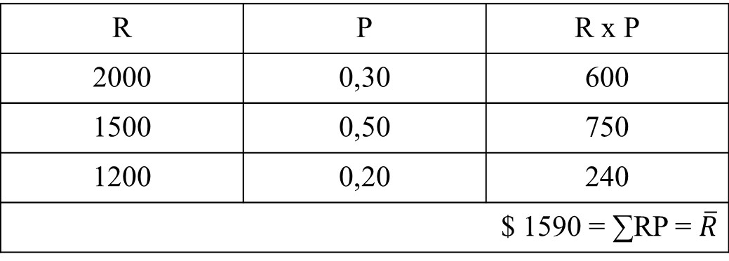
Example 2:
Expected value:
R | P | R x P
2000 | 0,30 | 600
1500 | 0,50 | 750
1200 | 0,20 | 240
$ 1590 = ∑RP = $\overline{R}$
13-15

Slide 16
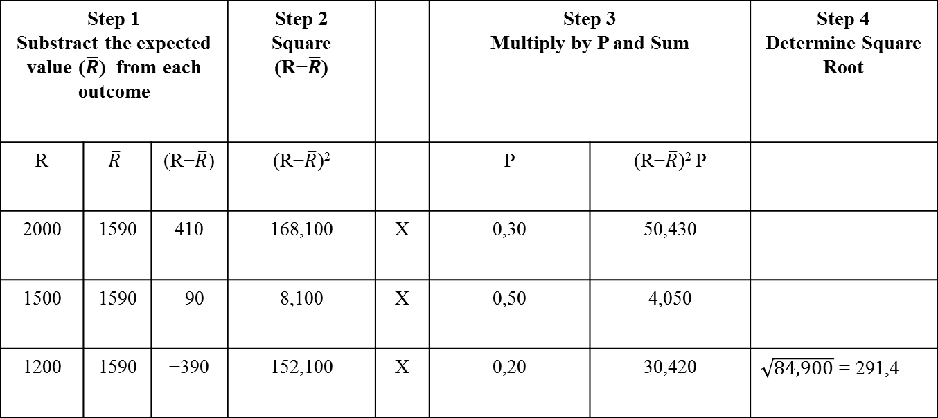
Example 2: Standard deviation:
Expected return = 1,590
Variance = 84,900
Standard deviation = 291,4
Coefficient of variation = 0,18
Step 1 Substract the expected value ($\overline{R}$) from each outcome |  |  | Step 2 Square (R−$\overline{R}$) |  | Step 3 Multiply by P and Sum |  | Step 4 Determine Square Root
R | $$\overline{R}$$ | (R−$\overline{R}$) | (R−$\overline{R}$)² |  | P | (R−$\overline{R}$)² P
2000 | 1590 | 410 | 168,100 | X | 0,30 | 50,430
1500 | 1590 | −90 | 8,100 | X | 0,50 | 4,050
1200 | 1590 | −390 | 152,100 | X | 0,20 | 30,420 | $\sqrt{84,900}$ = 291,4
13-16

Slide 17
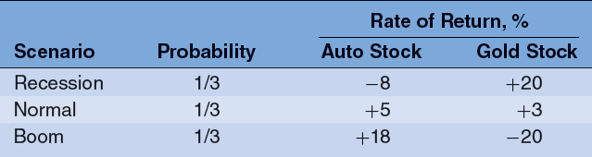
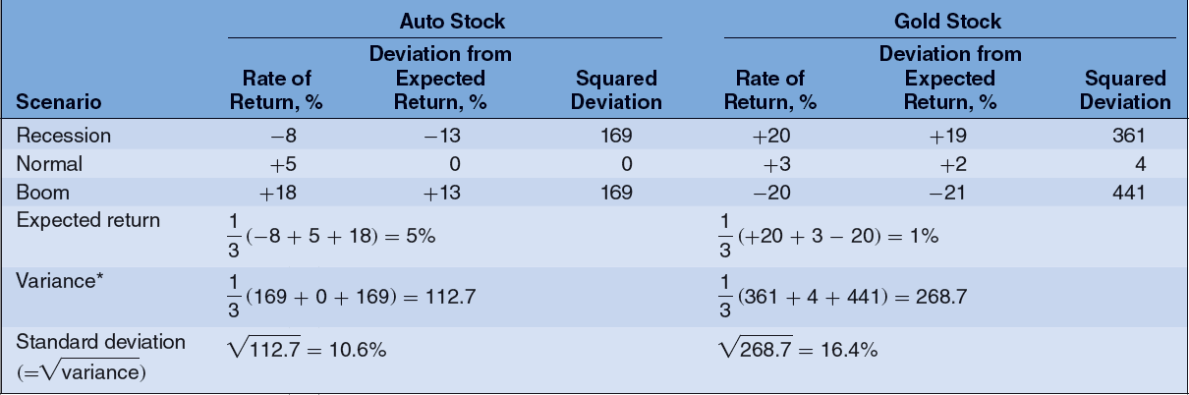
Risk and Diversification
Two Asset Example: Gold and Auto stocks

Slide 18
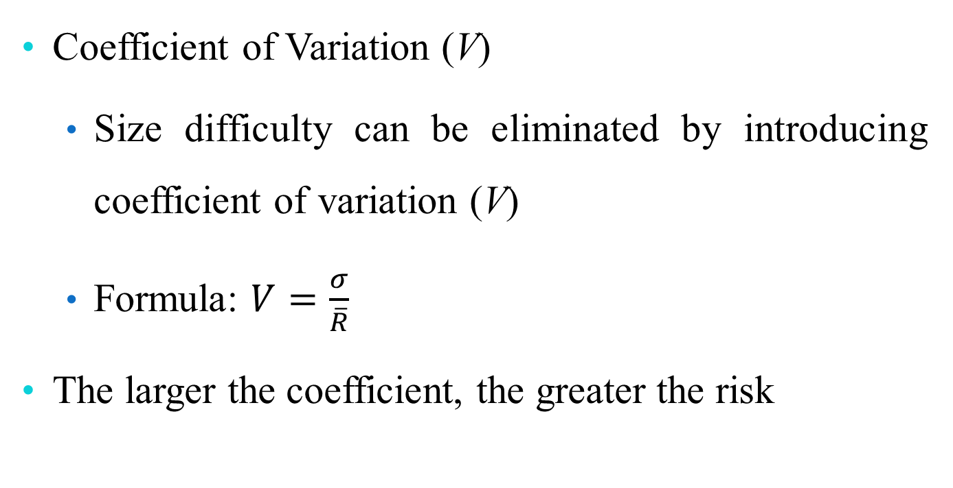
Actual Measurement of Risk
Coefficient of Variation (V)
  Size difficulty can be eliminated by introducing coefficient of variation (V)
  Formula: $V=\frac{σ}{\overline{R}}$
The larger the coefficient, the greater the risk
13-18

Slide 19

Actual Measurement of Risk Continued
Risk Measure—Beta (β)
  Widely used with portfolios of common stock
  Measures volatility of returns on individual stock relative to returns on stock market index
    A common stock with a beta of 1.0 is said to be of equal risk with the market
13-19

Slide 20
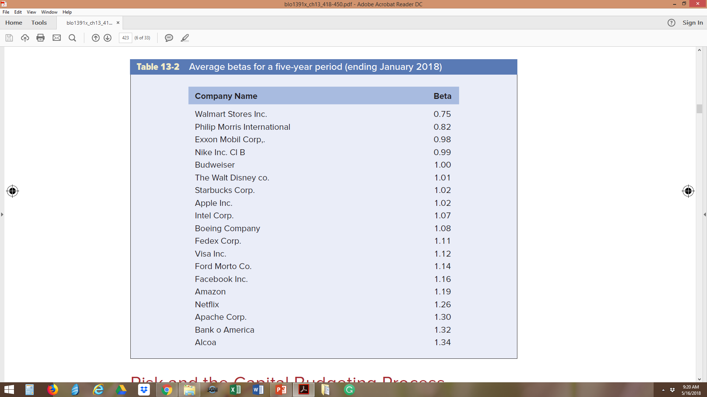
Table 13-2 Average Betas for a Five-Year Period (Ending January 2018)
A common stock with a beta of 1.0 is said to be of equal risk with the market. Stocks with betas greater than 1.0 are risker than the market, while stocks with betas of less than 1.0 are less risky than the market.
13-20

Slide 21

Risk and the Capital Budgeting Process
Informed investor or manager differentiates between
  Investments that produce “certain” returns
  Investments that produce expected value of return, but have high coefficient of variation
13-21

Slide 22

Risk-Adjusted Discount Rate
Different capital-expenditure proposals with different risk levels require different discount rates
  Project with normal amount of risk should be discounted at cost of capital
  Project with greater than normal risk should be discounted at higher rate
Risk assumed to be measured by coefficient of variation (V)
13-22

Slide 23
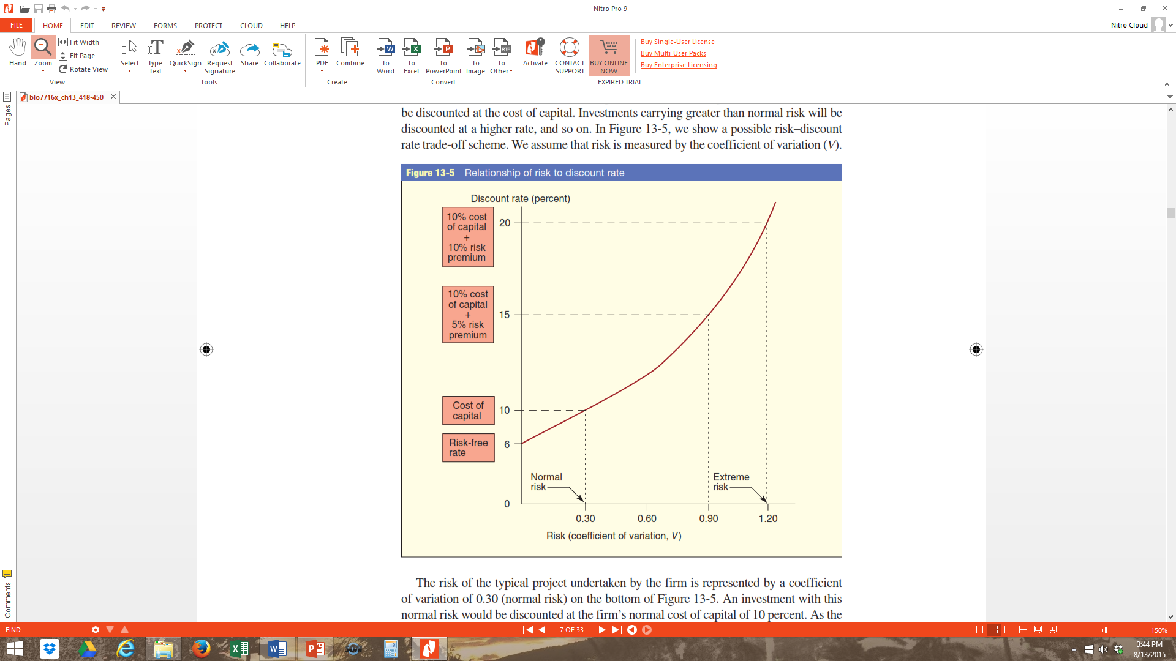
Relationship of Risk to Discount Rate
Example of increasing risk-aversion at higher levels of risk and potential return
13-23

Slide 24
Increasing Risk over Time
Accurate forecasting becomes more difficult farther out in time
Unexpected events
  Create higher standard deviation in cash flows
  Increase risk associated with long-lived projects
13-24

Slide 25
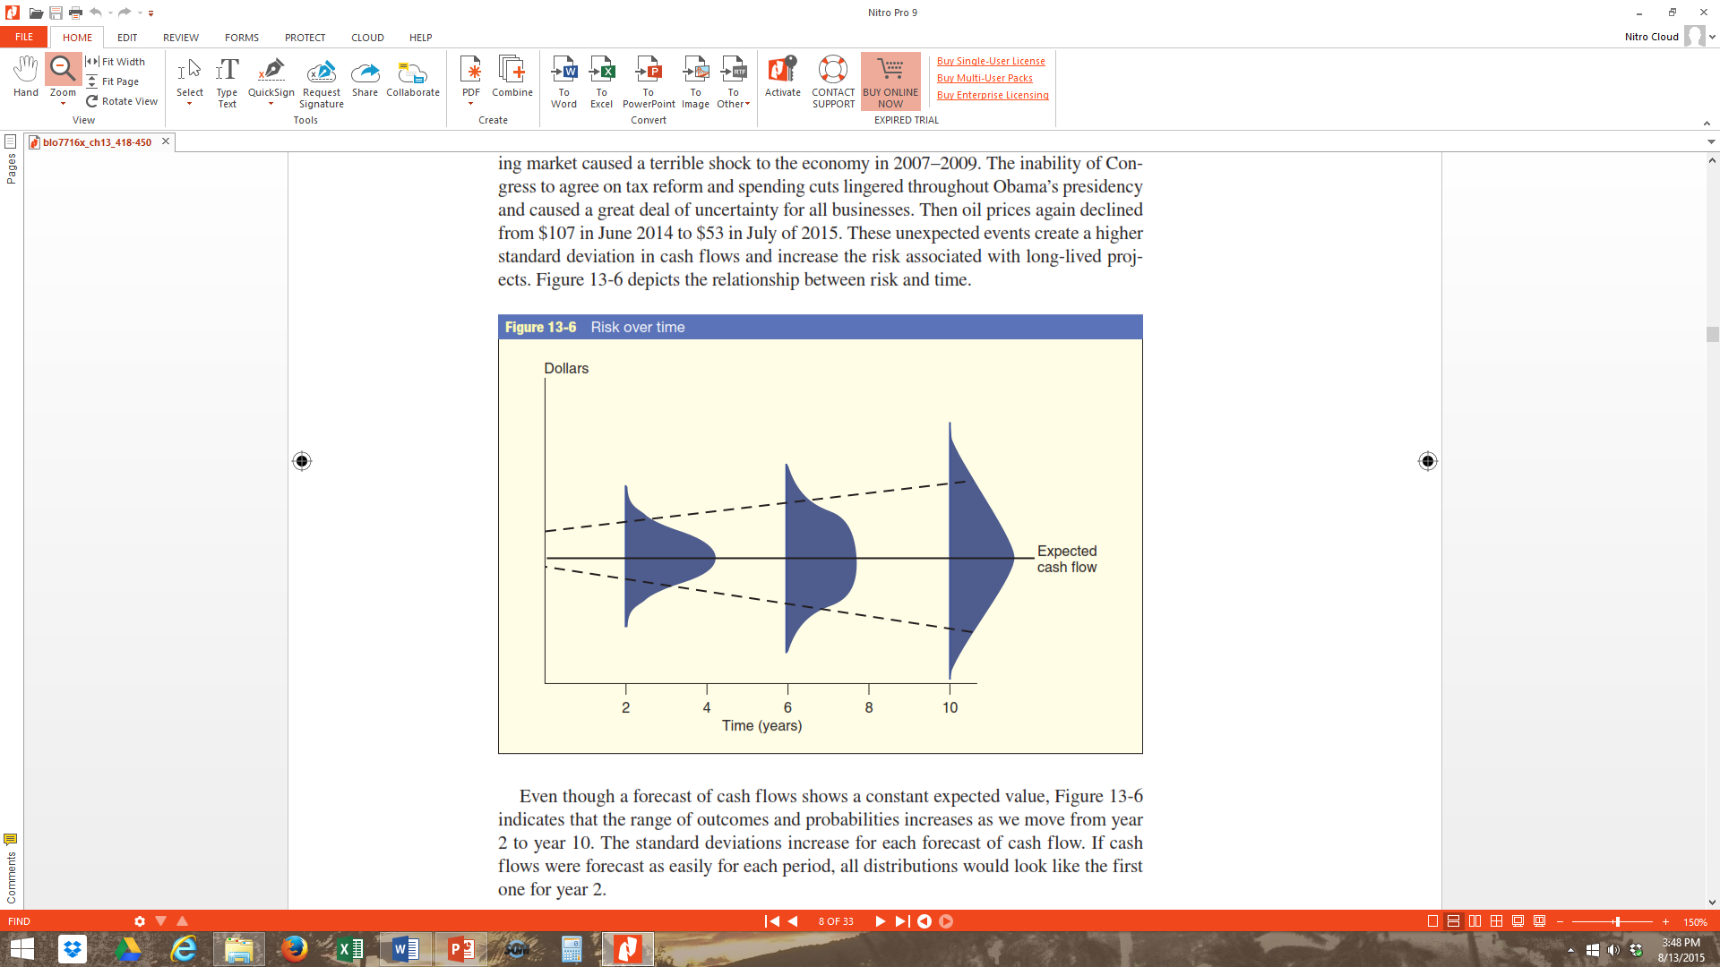
Risk over Time
Depicts the relationship between risk and time
Unexpected events create a higher standard deviation in cash flows and increase the risk associated with long-lived projects.
Even though a forecast of cash flows shows a constant expected value, the figure indicates that the range of outcomes and probabilities increases as we move from year 2 to year 10.
13-25

Slide 26
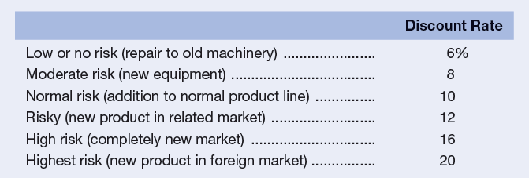
Qualitative Measures and Table
Setting up risk classes based on qualitative considerations
Raising discount rate to reflect perceived risk
The table Risk Categories and Associated Discount Rates
13-26

Slide 27
Capital Budgeting Analysis
Example: Investment B preferred based on NPV calculation without considering risk factor
13-27

Slide 28
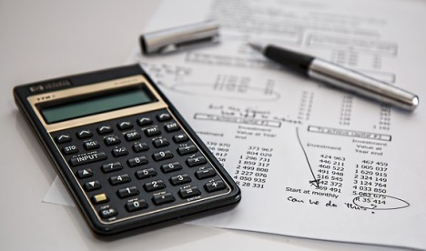
Capital Budgeting Decision Adjusted for Risk Example
Assume:
  Investment A calls for addition to normal product line, assigned 10 percent discount rate
  Investment B represents new product in foreign market, must carry 20 percent discount rate to adjust for large risk component
13-28

Slide 29
Capital Budgeting Decision Adjusted for Risk
  Investment A is only acceptable alternative after adjusting for risk factor
13-29

Slide 30
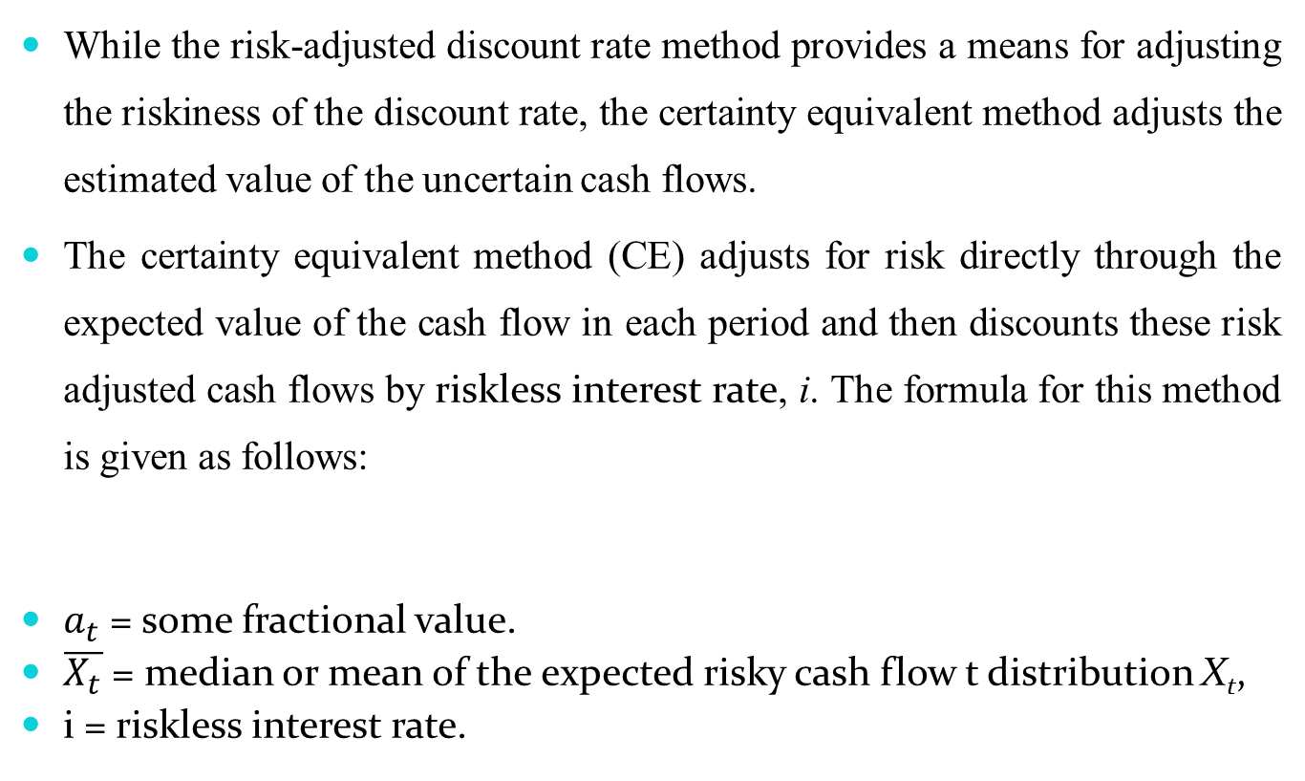
Certainty Equivalent Method
While the risk-adjusted discount rate method provides a means for adjusting the riskiness of the discount rate, the certainty equivalent method adjusts the estimated value of the uncertain cash flows.
The certainty equivalent method (CE) adjusts for risk directly through the expected value of the cash flow in each period and then discounts these risk adjusted cash flows by riskless interest rate, i. The formula for this method is given as follows:
$a_{t}$ = some fractional value.
$\overline{X_{t}}$ = median or mean of the expected risky cash flow t distribution X_{t},
i = riskless interest rate.
13-30

Slide 31
Certainty Equivalent Method
Example:
13-31

Slide 32
Sensitivity Analysis
Estimates of cash flows are based on assumptions about the economy, competitors, consumer tastes and preferences, construction costs, and taxes, among a host of other possible assumptions.
One of the first things managers must consider about these estimates is how sensitive they are to these assumptions.
For example, if we only sell 2 million units instead of 3 million units in the first year, is the project still profitable? Or, if Congress increases the tax rates, will the project still be attractive?
13-32

Slide 33
Sensitivity Analysis
Sensitivity analysis illustrates the effects of changes in assumptions.
But because sensitivity analysis focuses only on one change at a time, it is not very realistic.
We know that not one, but many factors can change throughout the life of a project.
13-33

Slide 34
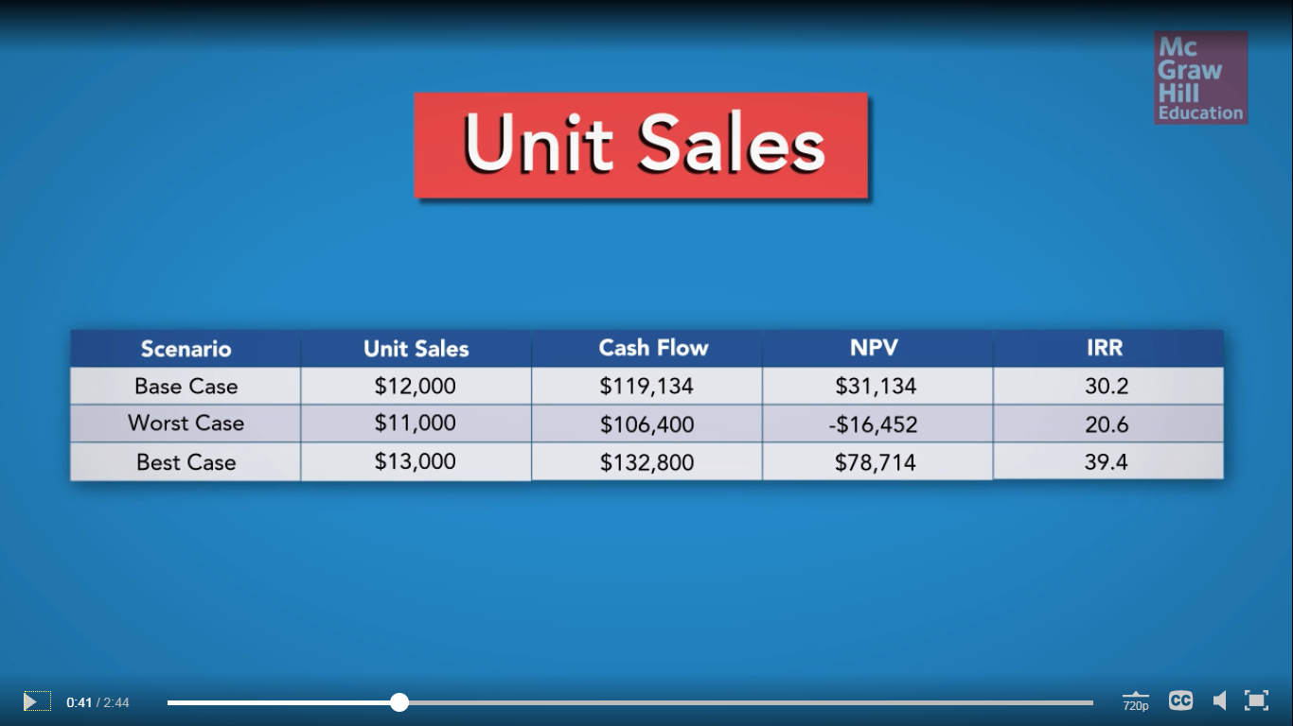
Sensitivity Analysis
Unit Sales:
Notice that with the base case, the NPV is $31,134 with unit sales of $12,000.
If unit sales go down to $11,000 and keeping all other items constant, the NPV becomes a negative $16,452.
Whereas, if sales go up to $13,000, the NPV would rise to $ 78,714.
13-34

Slide 35
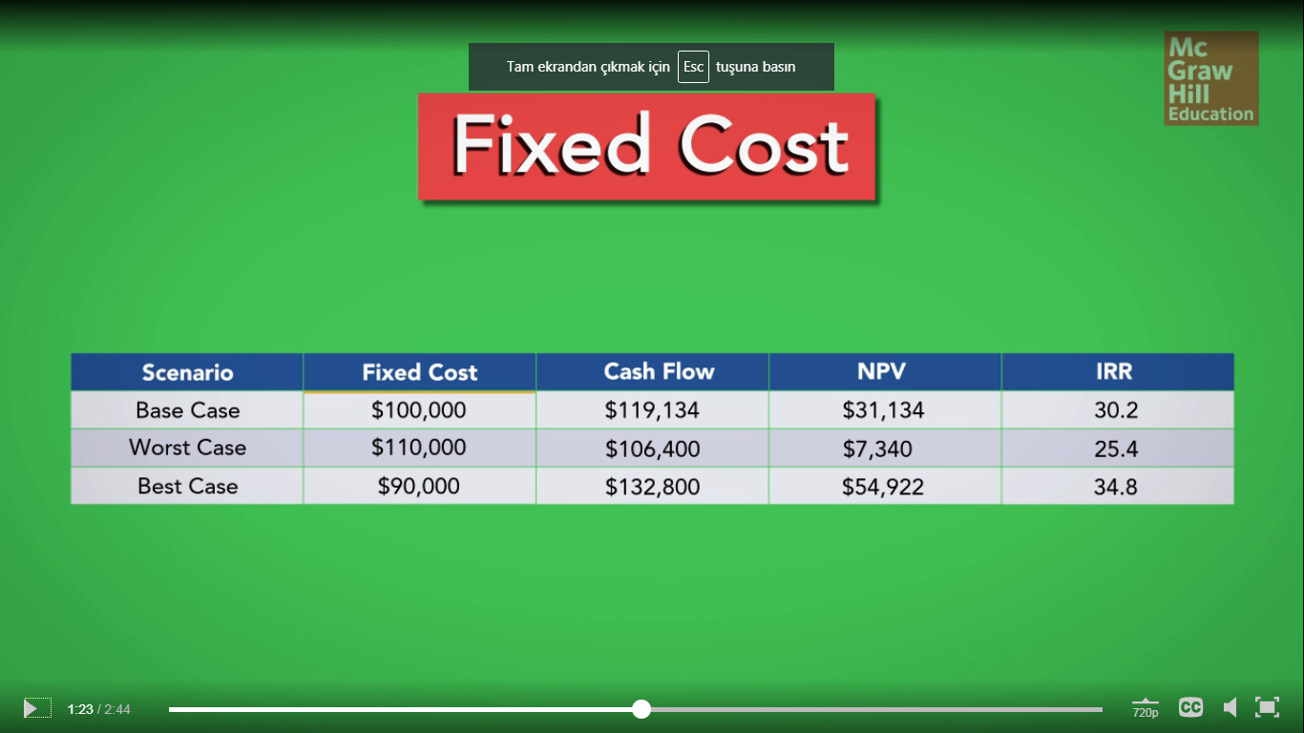
Sensitivity Analysis
Fixed Cost:
Continuing with the same project, we now freeze everything except fixed costs and repeat the analysis.
Under the worst case for fixed costs, the NPV is still positive.
The estimated NPV of this project is more sensitive to change in projected unit sales than it is to change in projected fixed costs.
13-35

Slide 36
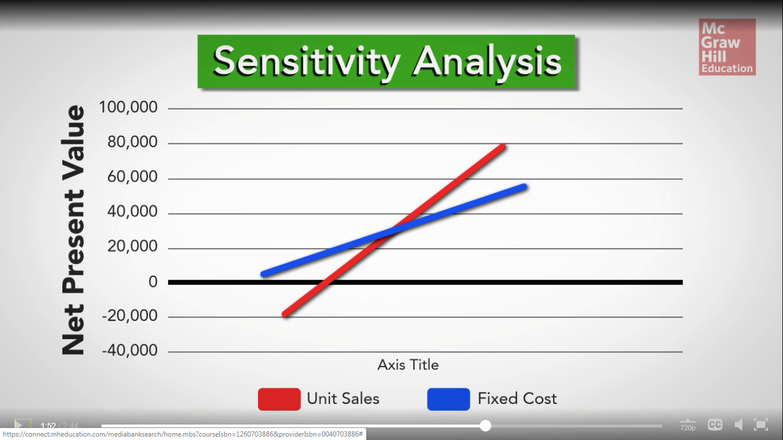
Sensitivity Analysis
The graph:
Remember, the fixed costs did have an effect on the NPV but the NPV was always positive, even in the worst-case scenario.
The NPV was negative in the worst-case scenario.
13-36

Slide 37
Sensitivity Analysis
Example: The effect of variable costs on expected returns
Assumed | Mean ($) | E(R) ($)
Deviation Ratio (%) | Variable Costs | Expected Return
−10 | 100.000 | 3.000.000
−5 | 120.000 | 2.500.000
0 | 140.000 | 2.000.000
+5 | 160.000 | 1.500.000
+10 | 180.000 | 1.000.000
13-37

Slide 38
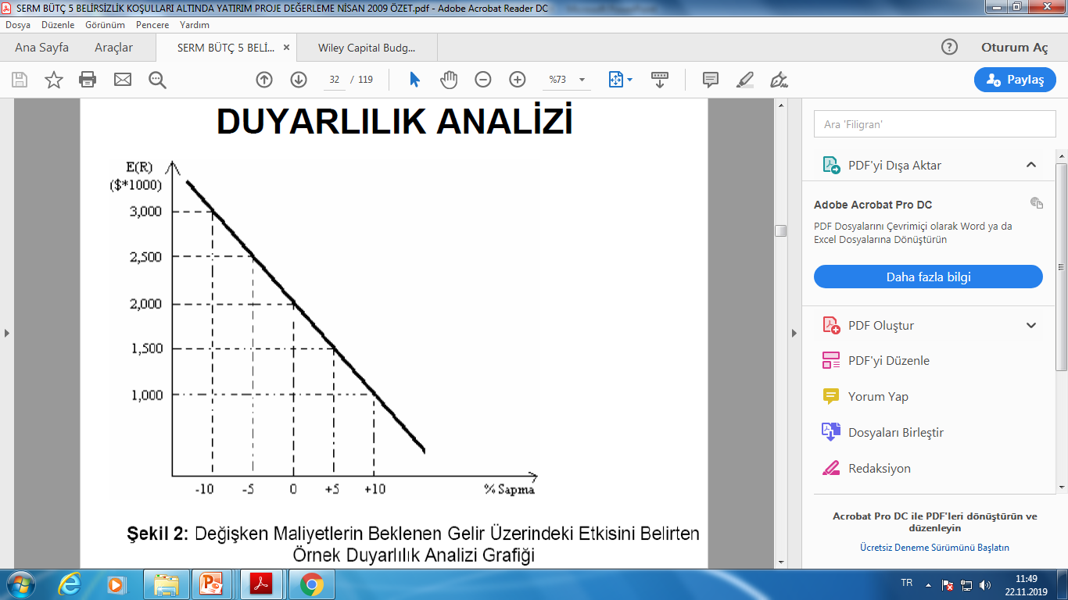
Sensitivity Analysis
Example: The effect of variable costs on expected returns
Deviation %
13-38

Slide 39
SCENARIO ANALYSIS
What if’s
Scenario Analysis

Slide 40
SCENARIO ANALYSIS
Process of analyzing decisions by considering alternative possible outcomes.
Three scenarios:
    Base case/Normal or Expected scenario
    Worst case/Pessimistic scenario
    Best case/Optimistic scenario
Utilized for the evaluation of combined effect of different variable.

Slide 41
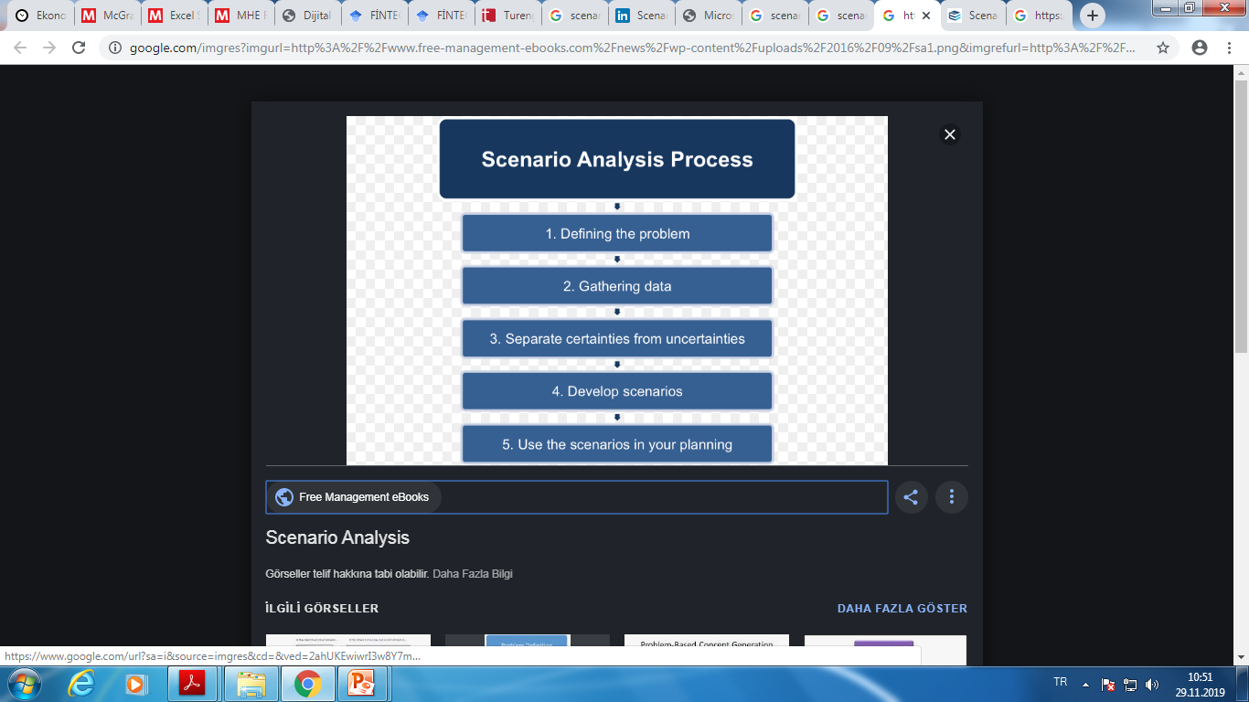
SCENARIO ANALYSIS

Slide 42
SCENARIO ANALYSIS
Example: A firm might use scenario analysis to determine the NPV of a potential investment under low, medium and high inflation scenarios.
Scenario | NPV | Prob. | NPV (Prob.)
Best | 33,796.89 | 15% | 5,069.5335
Base | 27,357.56 | 60% | 16,414.536
Worst | 21,890.20 | 25% | 5,472.55

Slide 43
SCENARIO ANALYSIS
Example: Assume a 5-year project has a base-case NPV of $213,000, a tax rate of 21%, and a cost of capital of 14%. What will be the worst-case NPV if the annual after-tax cash flows are reduced in that scenario by $35,000 for each of the 5 years?
NPV = $213,000 + (−$35,000 {(1 / 0.14) − [1 / 0.14(1.145)]})
= $92,842.17

Slide 44
Break-Even Analysis
Common tool for analyzing the relationship between sales volume and profitability
There are three common break-even measures
  Accounting break-even: sales volume at which net income = 0
  Cash break-even: sales volume at which operating cash flow = 0
  Financial break-even: sales volume at which net present value = 0

Slide 45
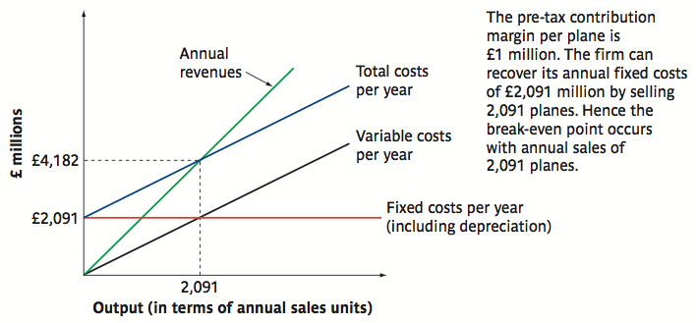
Accounting Break-even Analysis
Notes:
Hiller

Slide 46
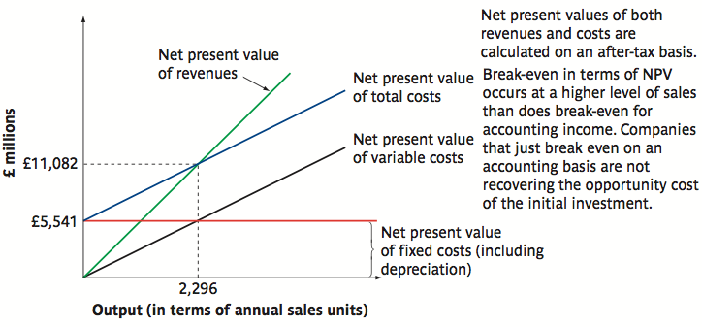
Financial Break-even Analysis
Notes:
Hiller

Slide 47
Break-even Analysis: Overview
Accounting
Financial
Investments shouldn’t make a loss
Investments should have a positive NPV

Slide 48
Simulation Models
Deal with uncertainties involved in forecasting outcome of capital budgeting projects or other decisions
  Computers enable simulation of various economic and financial outcomes using number of variables
    Monte Carlo model uses random variables for inputs
  Rely on repetition of same random process as many as several hundred times
13-48

Slide 49
Simulation Models
Have ability to test various combinations of events
Used to test possible changes in variable conditions included in process (real world)
Allow planner to ask “what if” questions
Driven by sales forecasts, with assumptions to derive income statements and balance sheets
Generate probability acceptance curves for capital budgeting decisions
13-49

Slide 50
Simulation Models
Simulation analysis is more realistic than sensitivity analysis because it introduces uncertainty for many variables in the analysis.
But if you use your imagination, this analysis may become complex since there are interdependencies among many variables in a given year and interdependencies among the variables in different time periods.
13-50

Slide 51
How to undertake a Monte Carlo Simulation
Step 1
Specify the Basic Model
Step 2
Specify a Distribution for Each Variable
Step 3
The Computer Draws One Outcome
Step 4
Repeat the Procedure
Step 5
Calculate the NPV

Slide 52
Real Options
One of the fundamental insights of modern finance theory is that options have value.
The phrase “We are out of options” is surely a sign of trouble.
Because corporations make decisions in a dynamic environment, they have options that should be considered in project valuation.

Slide 53
Real Options
The Option to Expand
  Has value if demand turns out to be higher than expected
The Option to Abandon
  Has value if demand turns out to be lower than expected
The Option to Delay
  Has value if the underlying variables are changing with a favorable trend

Slide 54
Discounted CF and Options
We can calculate the market value of a project as the sum of the NPV of the project without options and the value of the managerial options implicit in the project.
M = NPV + Opt
A good example would be comparing the desirability of a specialized machine versus a more versatile machine. If they both cost about the same and last the same amount of time, the more versatile machine is more valuable because it comes with options.

Slide 55
The Option to Abandon: Example
Suppose we are drilling an oil well. The drilling rig costs $300 today, and in one year the well is either a success or a failure.
The outcomes are equally likely. The discount rate is 10%.
The PV of the successful payoff at time one is $575.
The PV of the unsuccessful payoff at time one is $0.

Slide 56
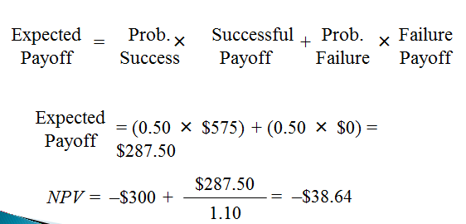
The Option to Abandon: Example
Traditional NPV analysis would indicate rejection of the project.

Slide 57
The Option to Abandon: Example
However, traditional NPV analysis overlooks the option to abandon.
Success: PV = $500
Drill
Sit on rig; stare at empty hole: PV = $0.
Failure
Sell the rig; salvage value = $250
Do not drill
The firm has two decisions to make: drill or not, abandon or stay.

Slide 58
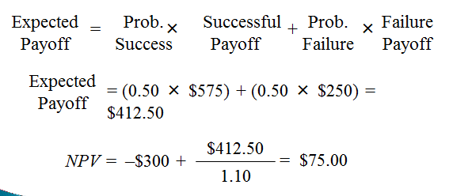
The Option to Abandon: Example
When we include the value of the option to abandon, the drilling project should proceed:

Slide 59
Valuing the Option to Abandon
Recall that we can calculate the market value of a project as the sum of the NPV of the project without options and the value of the managerial options implicit in the project.
M = NPV + Opt
$75.00 = –$38.64 + Opt
$75.00 + $38.64 = Opt
Opt = $113.64

Slide 60
Decision Trees
Help lay out sequence of possible decisions
  Present tabular or graphical comparison between investment choices
  Branches of tree highlights the differences between investment choices
  Provide important analytical process
13-60

Slide 61
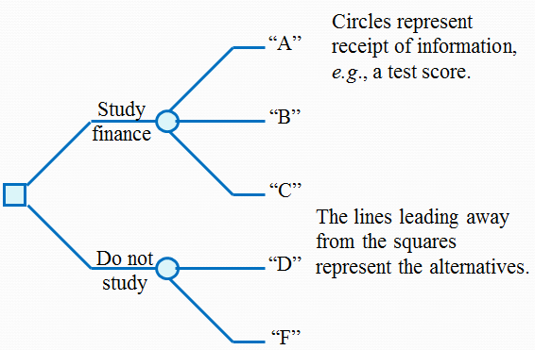
Decision Trees
This graphical representation helps to identify the best course of action.

Slide 62
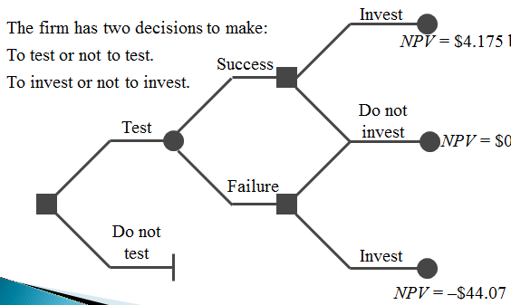
Decision Trees
Example:
Notes:
If you don’t invest, the NPV = 0, even if you test first, because the cost of testing becomes a sunk cost.
If you are so unwise as to invest in the face of a failed test, you incur lots of additional costs, but not much in the way of revenue, so you have a negative NPV as of date 1.

Slide 63
Decision Trees
Example: A pro football team has a NPV of $200 million. There is a 70% chance the team will get a new stadium within 1 year and the value of the team will increase to $350 million. To keep the team from moving, a rich local benefactor has offered to buy the team for $200 million today. Given a 12% discount rate what is the most the current owner should be willing to offer the benefactor to keep the offer on the table until the end of the year?
Value of team with offer = (0.70 × $350 + $200 × 0.30) / (1.12) = $272 million
Value of team without offer = $200 million
Value of offer to buy the team = $272 − 200 = $72 million

Slide 64
Decision Trees
Example:
Assume a firm is considering two choices
  Project A—opening additional physical stores in a new geographic region but using a format that has already proven successful elsewhere
  Project B—developing a new online-only retail venture
  Both projects cost $60 million, with different net present value (NPV) and risk
    Project A—High likelihood of modest positive rate of return, reasonable expectation of long-term growth
    Project B—Stiff competition may result in loss of more money or higher profit if sales high
13-64

Slide 65
Decision Trees
13-65

Slide 66
Decision Trees
Example: A project offers a 30% probability of a payoff after one year of $2 million and a 70% chance of a payoff of $1 million. What is the maximum you would invest in this project today if the discount rate is 10%?
NPV = 0 = −Inv + [(0.30 × $2m) + (0.70 × $1m)] / 1.1; Inv
= $1,181,818.18

Slide 67
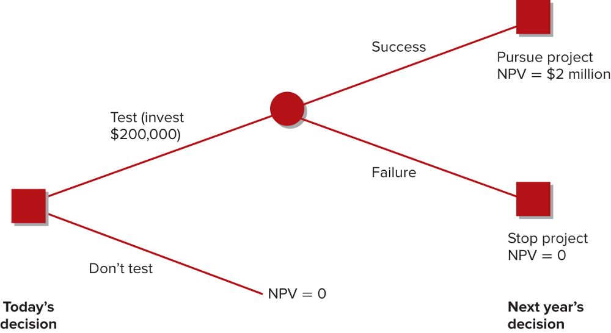
Decision Trees
Example:

Slide 68
Coefficient of Correlation
Represents extent of correlation among various projects and investments
  May take on values anywhere from –1 to +1
  Real world will produce a more likely measure, between –0.2 negative correlation and +0.3 positive correlation
Risk can be reduced
  Combining risky assets with low-risk or negatively correlated assets
13-68

Slide 69
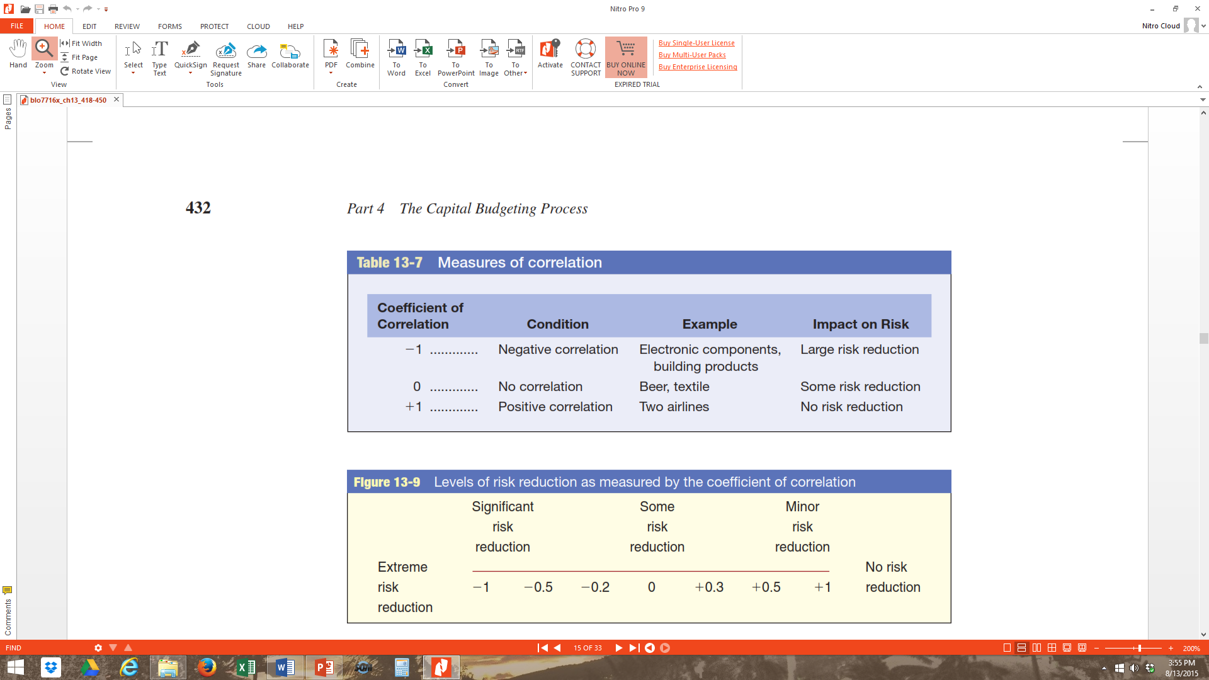
Measures of Correlation
13-69

Slide 70
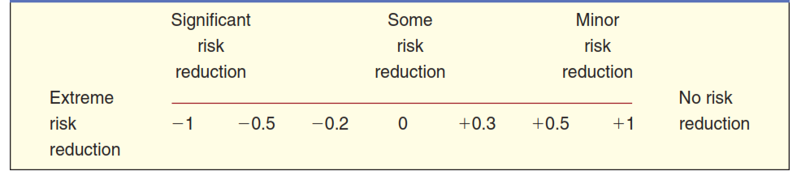
Levels of Risk Reduction as Measured by the Coefficient of Correlation
  In the real world, few investment combinations take on values as extreme as -1 or +1. The more likely case is a point somewhere between, such as -0,2 negative correlation or +0,3 positive correlation, as indicated along the continuum in the Figure.
13-70

Slide 71
Evaluation of Combinations
Two primary objectives in choosing between various points or combinations
  Achieve highest possible return at given risk level
  Provide lowest possible risk at given return level
Determining position of firm on efficient frontier
  Where on the line the firm should be
  Willingness to take larger risks for superior returns
  Make conservative selection
13-71

Slide 72
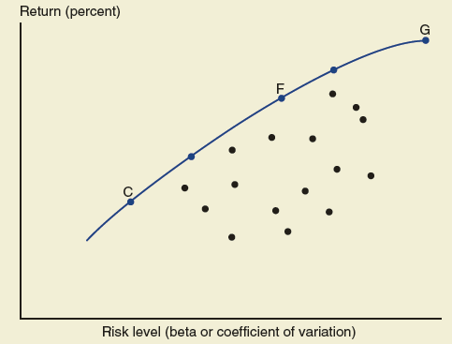
Risk-Return Trade-Offs
Best opportunities fall along leftmost sector (line C–F–G)
Points to right less desirable
13-72

Slide 73
The Share Price Effect
Firm must be sensitive to wishes and demands of shareholders
When taking unnecessary or undesirable risks
  Higher discount rate and lower valuation may be assigned to stock in market
Higher profits from risky ventures could have a result opposite from what intended
  Raising the firm’s risk could lower the overall valuation of the firm
13-73

